Slide 1
Machine Learning Foundations
Capstone-Project
Teaching-Assistant-Performance-Evaluation
K M L Karunanayake
DSA_0308
2022-07-31

Slide 2
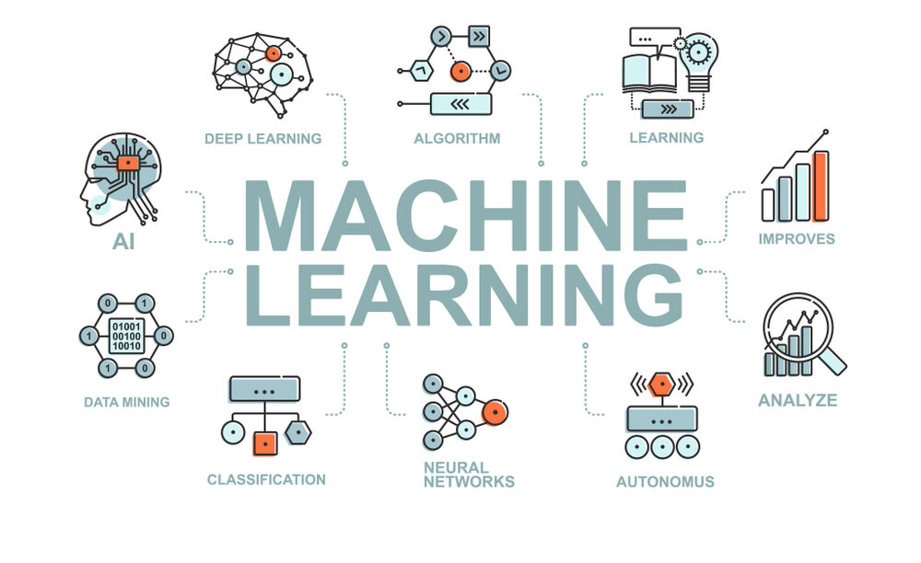
Content
Use Case
Data
Solution
Model
Results
Implementation
Capstone-Project - Teaching-Assistant-Performance-Evaluation – K M L Karunanayake

Slide 3
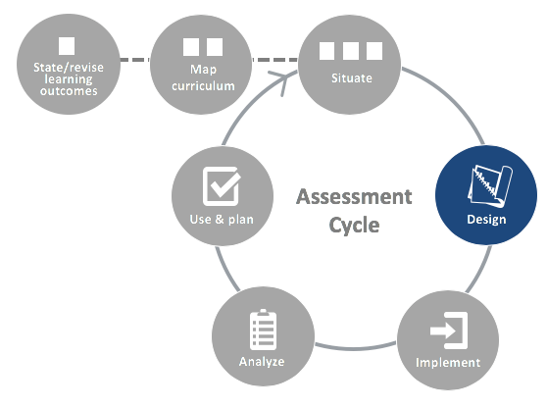
USE CASE
Teaching Assistant Evaluation
Capstone-Project - Teaching-Assistant-Performance-Evaluation – K M L Karunanayake

Slide 4
DATA
Teaching Assistant Evaluation Data Set
Data Source – UCI Machine Learning Repository
Data Format– CSV file format
Number of Attributes – 5
Number of Instances – 151
Capstone-Project - Teaching-Assistant-Performance-Evaluation – K M L Karunanayake

Slide 5
Solution
LOW
TRAINING DATA SET
ML ALGORITHM
ML Model
MEDIUM
HIGH
INPUT EVALUATION DATA SET
Capstone-Project - Teaching-Assistant-Performance-Evaluation – K M L Karunanayake

Slide 6








Tools
Capstone-Project - Teaching-Assistant-Performance-Evaluation – K M L Karunanayake

Slide 7
Model Building
Pre-process Data for Training
Predict on a Sample Data
Data Pre-processing
Score Function
Train Test Split
Post-processing
Model Training Function
Inference Pipeline
Saving Best Model
Get Prediction
Capstone-Project - Teaching-Assistant-Performance-Evaluation – K M L Karunanayake

Slide 8
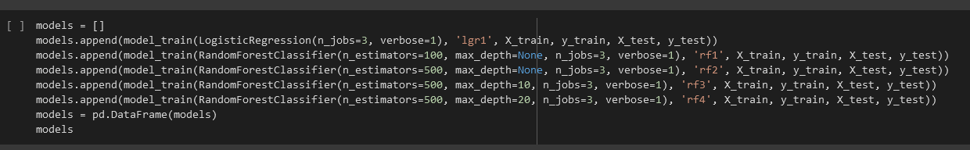
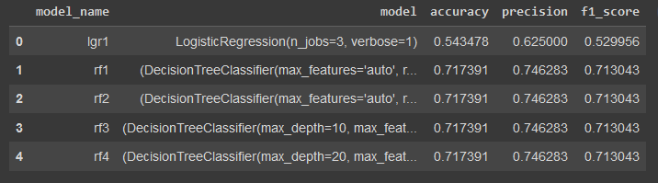

Selecting Best Model
Models parameters
Models
Best model
Capstone-Project - Teaching-Assistant-Performance-Evaluation – K M L Karunanayake

Slide 9
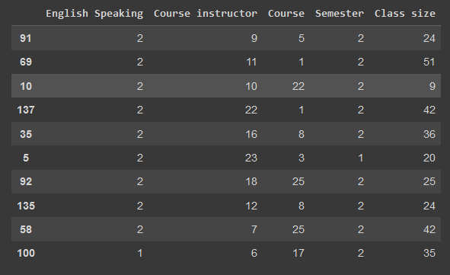
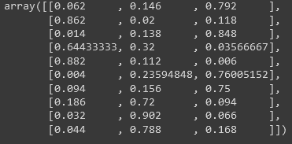

Results
Sample Data
Predictions
Capstone-Project - Teaching-Assistant-Performance-Evaluation – K M L Karunanayake

Slide 10
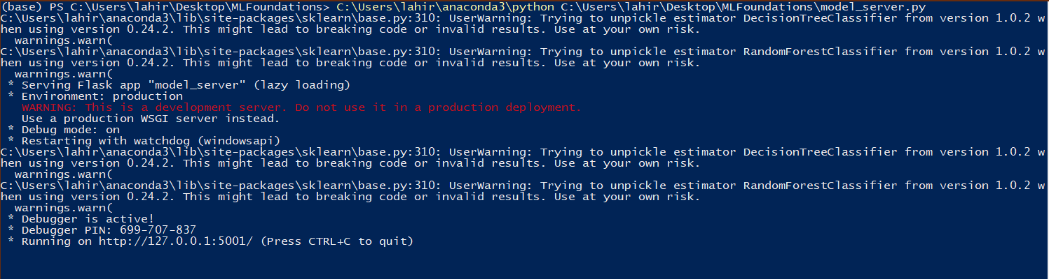
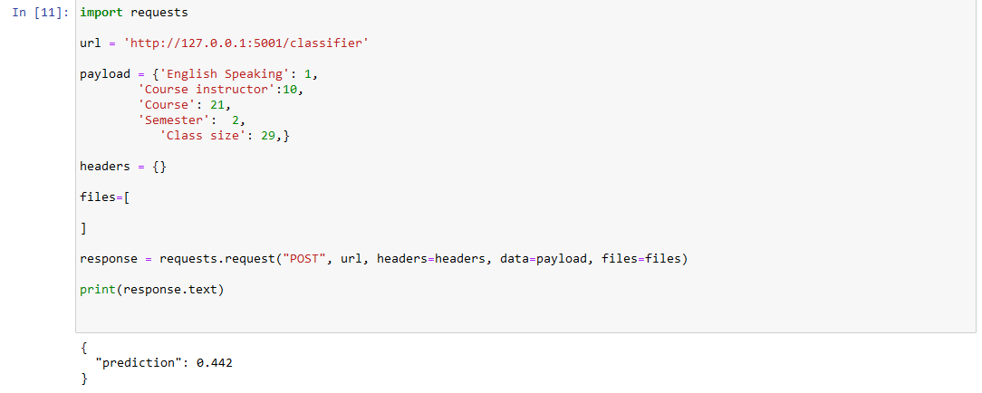
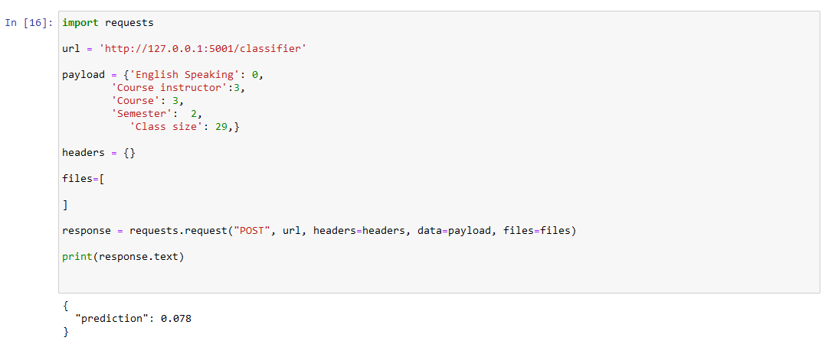
Model server API and Test
Model Server API
Test 1 and Result
Test 2 and Result
Capstone-Project - Teaching-Assistant-Performance-Evaluation – K M L Karunanayake

