Slide 1
The Hit Factor
DSA3101 GROUP 13
Lim Xi Chen Terry Loke Kay Chi
Nigel Issac Chua Kiat Fang Tan Jie Yi
Wong Zea Teng Yang Zhuolin
Zhong Zhaoping
Notes:
Good evening everyone, I’m qiting from group 13 and today, we will be presenting on our project, the hit factor.

Slide 2
TABLE OF CONTENTS
1
2
3
4
Introduction
Methodology
Findings from Model
Business Insights
Description of project and EDA
Data modelling process
Important features in predicting
Potential usage of our model
Notes:
I will first introduce our project and the exploratory data analysis of our dataset. Then, Terry will take over to talk about the data modelling process.
Lastly, Zhuolin will present on the findings from our model and the potential usage of our model to generate valuable business insights.

Slide 3
1
Introduction
Our dataset

Slide 4
QUICK QUESTION
What makes a song popular?
Notes:
Before I start, here is a question for everyone: What do YOU think makes a song popular?

Slide 5
INTRODUCTION
Tune
Danceability
Lyrics
Liveliness
Popularity of Artist
Notes:
Is it the tune? <CLICK>
Danceability? <CLICK>
Or something else? <CLICK>
There is business value in this question and our group tries to develop machine learning models to predict the popularity score of a song based on some attributes. <CLICK>

Slide 6
DATASET
SPOTIFY MUSIC
Duration
Acousticness
Energy
Instrumentalness
Loudness
FEATURES
Manual scraping
21 attributes
13,500 songs
Notes:
Instead of obtaining well-prepared datasets from platforms like Kaggle, we decided to make our analysis more interesting by scraping our own data from Spotify’s database using<CLICK>
their open API, that consists of 21 attributes such as <CLICK>
duration and many more. We managed to scrap more than 10 thousand songs. <CLICK>

Slide 7
DATASET
SPOTIFY MUSIC
FEATURES
LIMITATIONS
Manual scraping
21 attributes
13,500 songs
1000 songs scrapable each time
Structure of data
Notes:
The limitations of scraping data from API is that <CLICK>
Spotify only allowed us to scrape 1000 songs each time, <CLICK>
and the data gathered was not structured in an orderly manner, thus we have to clean and manipulate the data into a tidy DataFrame.<CLICK>

Slide 8
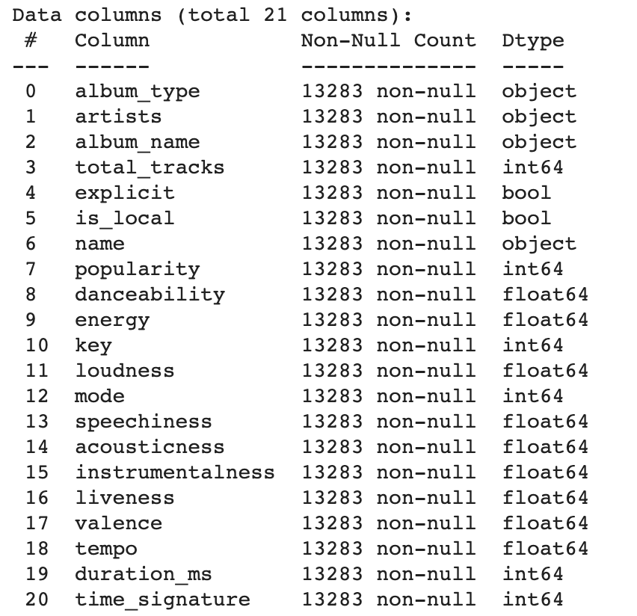
Exploratory Data Analysis
Check for missing/null values
Check data types
Notes:
Let’s move on to talk about the exploratory data analysis. <CLICK>
First, we checked for missing or null values <CLICK>
and see if there is any column with non-matching data type.<CLICK>

Slide 9
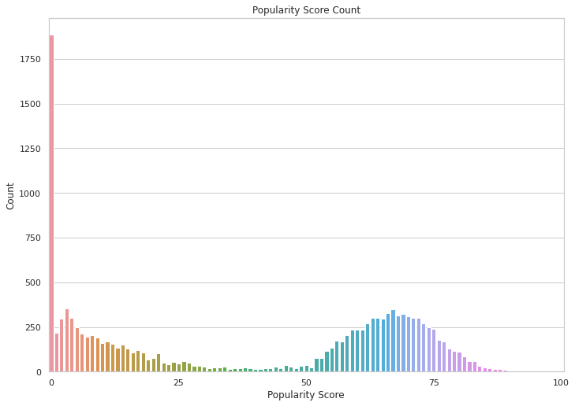
Exploratory Data Analysis
14% with 0 popularity
Notes:
Next, we will look at some distributions of attributes. Popularity score distribution is very important to our project as it is what we want to predict. Under or over representation will induce bias to the model. Looking at the popularity score,<CLICK>
there are unusually large number of songs with zero popularity that occupies 14% of the data.<CLICK>

Slide 10
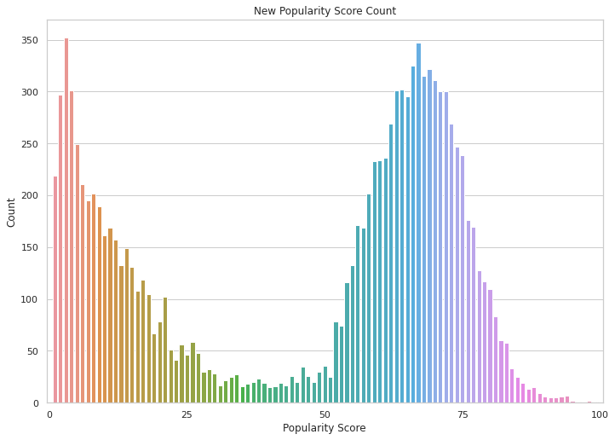
Exploratory Data Analysis
14% with 0 popularity
Mean: 45.9/ 100
Notes:
Upon further research,we found out that songs with 0 popularity score either have 0 score or have not been graded yet <CLICK>
And we cannot determine which are true 0 and which are not graded. <CLICK>
To get rid of the ambiguity, we decided to remove songs with 0 popularity.<CLICK>

Slide 11
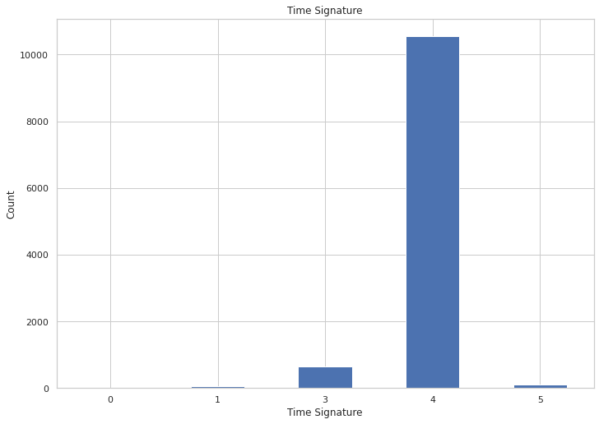
Exploratory Data Analysis
93% with time signature of 4
Notes:
Next, 93% of our dataset has time signature of 4.

Slide 12
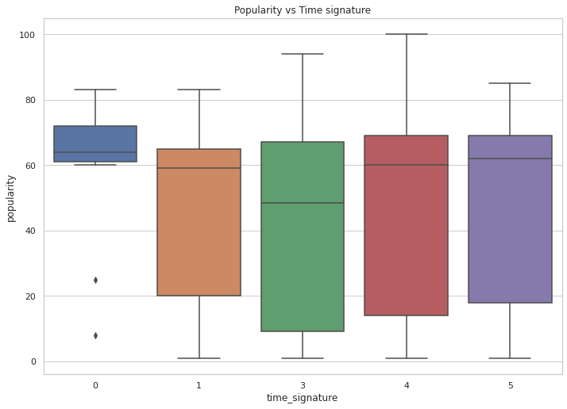
Exploratory Data Analysis
93% with time signature of 4
Notes:
However, the popularity mean score of diff time signature dont vary too much and hence this attribute might not be so useful in modelling.

Slide 13
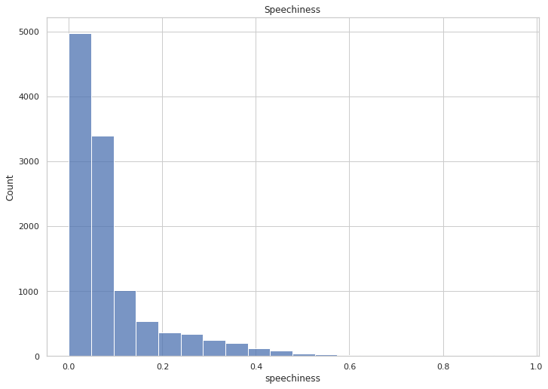
Exploratory Data Analysis
Right skewed
Notes:
Due to time constraints, i will skip all other attributes as they are either right skewed and left skewed like this graph shown. These attributes need to be transform or balance later.

Slide 14
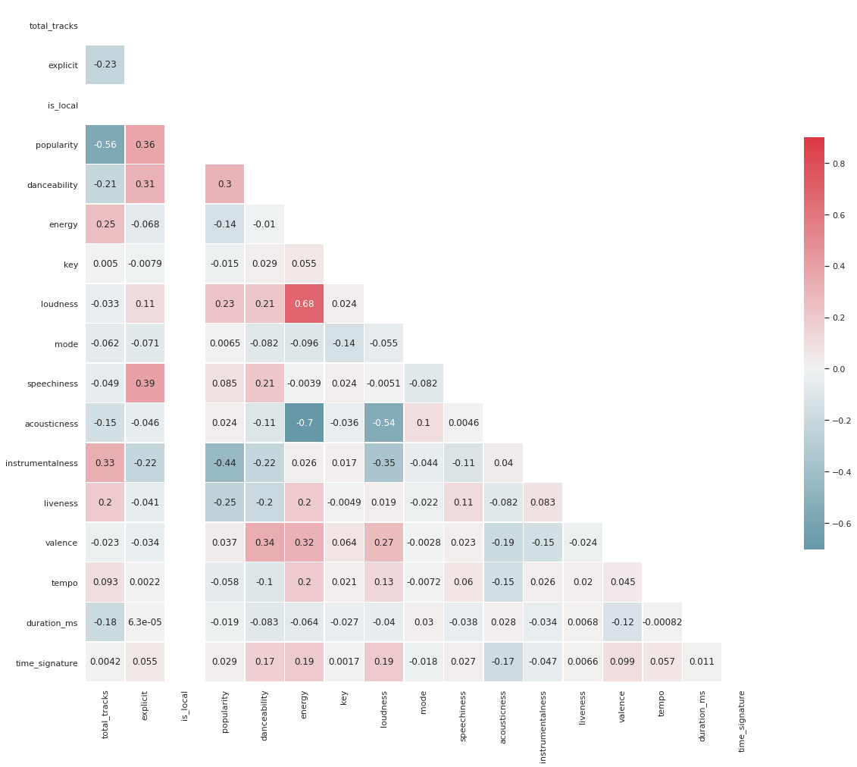
Exploratory Data Analysis
Checking correlation
between attributes
Notes:
Through the correlation matrix, we see that most of the attributes are lightly correlated with 0.68 as the largest one between loudness and energy, suggesting that principal component analysis might not be applicable.

Slide 15

Exploratory Data Analysis
Not necessary for modelling
Unimportant attributes
Notes:
We then move on to drop columns that are <CLICK>
Unimportant <CLICK>
And Not necessary for modelling like artists name and album_name. I will now pass the time to terry to share with you more about our modelling process.<CLICK>

Slide 16
2
Methodology
All about modelling
Notes:
Thank you Qi Ting! <CLICK>

Slide 17
Factor Analysis
p-value of 0.00
0.655
Bartlett’s Sphericity test
Kaiser-Mayer-Olkin (KMO) test
Notes:
Firstly, we started with a Factor Analysis to find out whether we can form meaningful clusters with our dataset. Using the Bartlett’s Sphericity Test and KMO, our p-value of 0 was less than 0.05 and the KMO score of 0.655 was more than 0.5, indicating that factor analysis may be useful for our data. The KMO score is decent but not ideal. <CLICK>

Slide 18
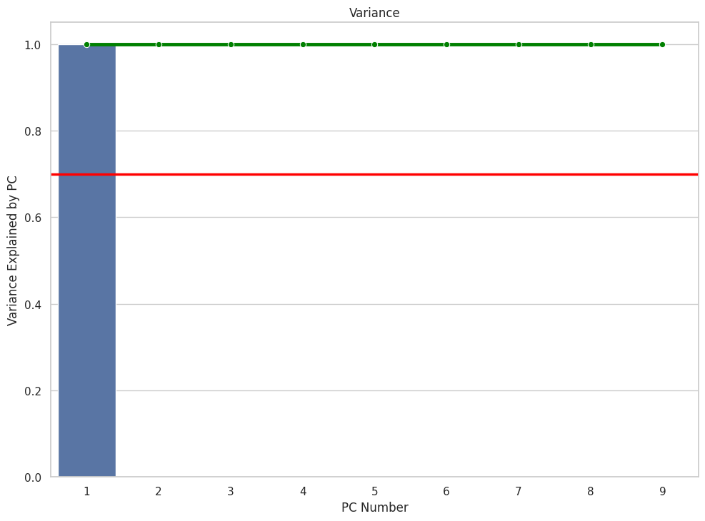
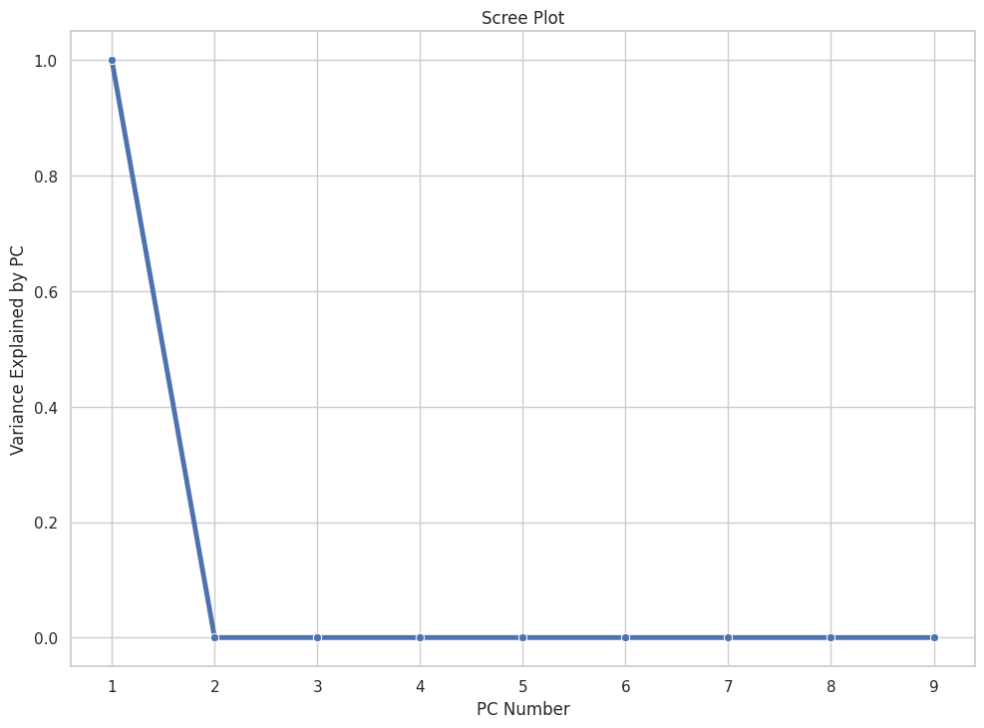
Factor Analysis
Notes:
However, upon conducting factor analysis, we realised that the number of principal components has no effect on the proportion of variance explained by it, as the horizontal line remains at 1.0. Next, from the graph on the right, it also suggests that we can try using 2 clusters for the factor analysis. <CLICK>

Slide 19
Factor Analysis
p-value of 0.00
0.655
2 PCs
<0.7
Decision Tree instead!
Bartlett’s Sphericity test
Kaiser-Mayer-Olkin (KMO) test
Elbow
CronbachAlpha
Notes:
We realised that our CronbachAlpha value doesn’t hit the minimum requirement of 0.7 and there might not be much meaning to cluster the variables together, as they are quite different from each other in terms of nature. <CLICK> Hence, we have decided to investigate the problem as a regression problem instead, using Decision Trees!<CLICK>

Slide 20
Classification Tree
Regression Tree
Find the split that has the highest information gain
Leaf nodes: binary
Find the split that reduce the squared error
Leaf node: Average response of all observations at that node
ALBUM TYPE = COMPILATION
ALBUM TYPE = COMPILATION
NOT POPULAR
TOTAL TRACK ≤ 20
AVERAGE POPULARITY
TOTAL TRACK ≤ 20
POPULAR
TOTAL TRACK ≤ 30
AVERAGE POPULARITY
TOTAL TRACK ≤ 30
NOT POPULAR
POPULAR
AVERAGE POPULARITY
AVERAGE POPULARITY
Notes:
Now I will talk about what's the main difference between a classification tree and a regression tree. As the outputs of a Regression Tree is all real numbers, it is not possible to represent every value as a leaf node. Thus, it is the mean response of all observations at that node instead. Also, instead of finding the split with the highest information gain, we now prioritise finding the split that reduces the largest root mean squared error. <CLICK>

Slide 21
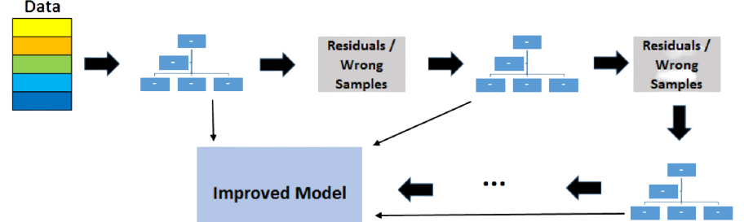
XGBRegressor
Gradient-boosted Ensemble of Decision Trees for Regression
Slow to Learn, but Better Model Performance
Notes:
Instead of using a normal Regression Tree from Scikit Learn, we had utilised XGBRegressor. It is a gradient-boosted ensemble of decision trees for regression. As seen in the diagram below, all the trees are connected in series and each tree tries to minimise the error of the previous tree. Due to this sequential connection, boosted trees are usually slower to learn, but have better model performance. <CLICK>

Slide 22
Evaluation of Models (1)
Can we do better ?!
Model | R² |  | RMSE |  | MAE |  | MAPE
 | Train | Test | Train | Test | Train | Test | Train | Test
XGBRegressor | 0.689 | 0.628 | 15.690 | 17.236 | 11.005 | 12.010 | 1.274 | 1.484
GridSearchCV + XGBRegressor | 0.971 | 0.681 | 4.834 | 15.972 | 3.206 | 10.724 | 0.262 | 1.211
Notes:
This is the result for our models. The 4 metrics we used here are R^2, RMSE, MAE and MAPE. For this presentation, we would only focus on the Test RMSE values. We tried to improve the model by running GridSearchCV to find the best hyperparameters. Here, we can see that there is an improvement in Test RMSE score. <CLICK> Question: Can we do better? Of course we can! <CLICK>

Slide 23
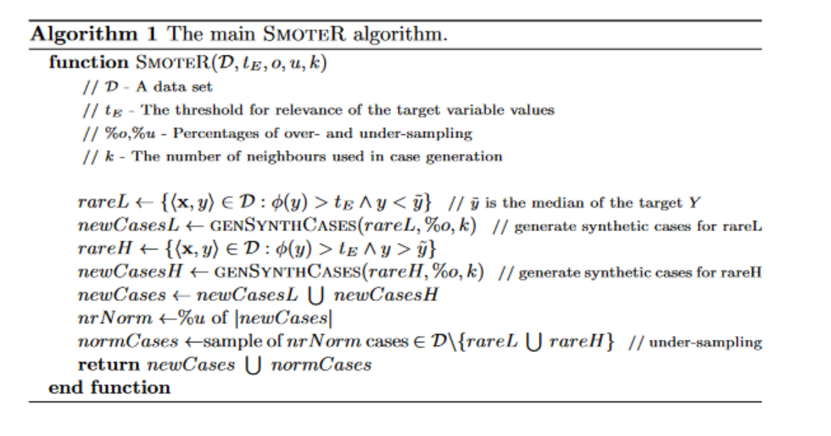
SmoteR
Synthetic
Minority
Oversampling
TEchnique
for
Regression
Similar, but different from SMOTE
Used to address imbalance of dataset for Regression problems
Data
11398 rows
Threshold
Extreme Values
Generate Synthetic Cases
New Data
23237 rows
Relevance Function
Notes:
We tried to improve our dataset by using the SMOTER algorithm (which is Synthetic Minority Oversampling Technique for Regression) to oversample rare values. It is similar to the SMOTE algorithm covered in class, but different in formulating these synthentic cases. As the number of classes are distinct and limited in classification problems, it is easy to tell which class value is the minority class. However, for regression, there is a potentially infinite number of values of the target variable.
What SMOTER does is to use a relevance function and a user-defined threshold to find the extreme values in our dataset, then generate synthetic cases and append them to the dataset, resulting in a more balanced distribution of the values. As you can see, our dataset has grown from 11 000+ rows to 23 000+ rows. <CLICK>

Slide 24
Evaluation of Models (2)
Can we do EVEN better ?!
Model | R² |  | RMSE |  | MAE |  | MAPE
 | Train | Test | Train | Test | Train | Test | Train | Test
XGBRegressor | 0.689 | 0.628 | 15.690 | 17.236 | 11.005 | 12.010 | 1.274 | 1.484
GridSearchCV + XGBRegressor | 0.971 | 0.681 | 4.834 | 15.972 | 3.206 | 10.724 | 0.262 | 1.211
GridSearchCV + smoteR + XGBRegressor | 0.923 | 0.753 | 6.422 | 11.449 | 3.920 | 7.249 | 0.316 | 0.649
Notes:
With SMOTER, our test RMSE score had decreased significantly from 15.972 to 11.449. <CLICK> Again, can we do even better? Yes we can! <CLICK>

Slide 25
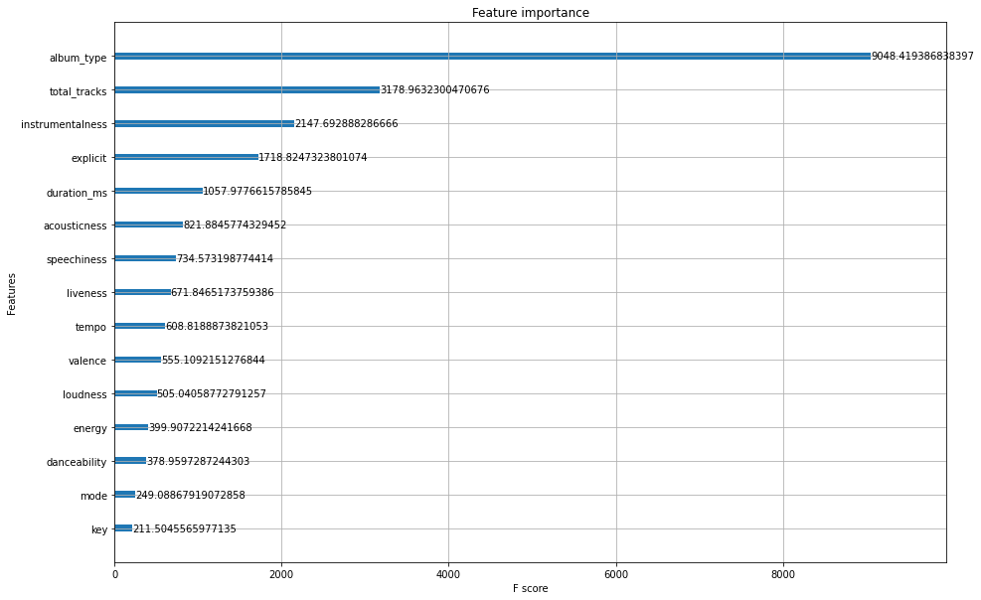
Feature Importance
Notes:
Looking at the feature importance of each variables in our fitted tree, our proposed method is to prune the tree by removing the unimportant features. This attempts to decrease the likelihood of overfitting the tree and allow lesser features to express the tree. <CLICK> In this case, we can remove key as it is the least important feature. <CLICK>

Slide 26
Pruning
Find least important feature and Remove it
Repeat
Refit Model
Evaluate Model
Notes:
We repeat the process of removing the least important feature, refitting the model then evaluating it until 2 variables are left. This process is similar to Backward Stepwise Selection in Linear Regression. <CLICK>

Slide 27
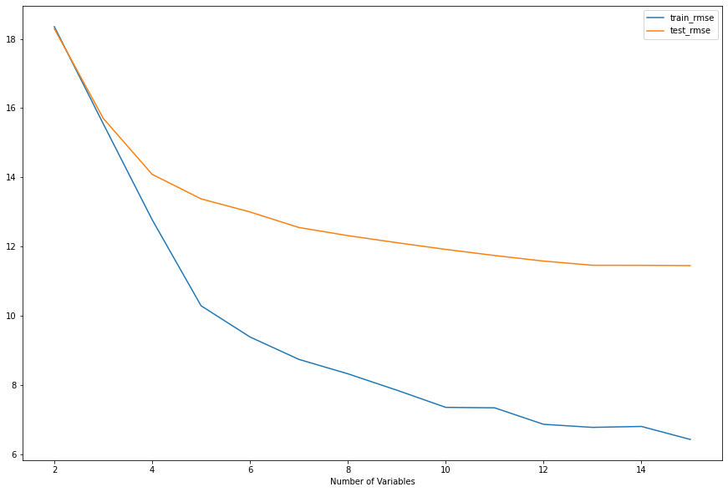
Pruning Result
Notes:
The graph here illustrates how the train and test rmse changes during the pruning process. Using more variables would always result in a lower test rmse score, and the model would be more accurate. However, we have decided to retain 12 variables of the original 15, as we wanted a simpler model. <CLICK>

Slide 28
Evaluation of Models (3)
Model | R² |  | RMSE |  | MAE |  | MAPE
 | Train | Test | Train | Test | Train | Test | Train | Test
XGBRegressor | 0.689 | 0.628 | 15.690 | 17.236 | 11.005 | 12.010 | 1.274 | 1.484
GridSearchCV + XGBRegressor | 0.971 | 0.681 | 4.834 | 15.972 | 3.206 | 10.724 | 0.262 | 1.211
GridSearchCV + smoteR + XGBRegressor | 0.923 | 0.753 | 6.422 | 11.449 | 3.920 | 7.249 | 0.316 | 0.649
Final Model | 0.909 | 0.747 | 7.002 | 11.595 | 4.272 | 7.334 | 0.343 | 0.652
Notes:
The final model has a slightly higher test rmse value than the previous best model, but it uses lesser variables. Also, the difference between train rmse and test rmse is lower. Now I will pass the time over to Zhuolin who will share more about the findings from the model.. <CLICK>

Slide 29
3
Findings from Model
Which features affect popularity score?
Notes:
Thank you Terry. Next I will be talking about the findings from our model. From its performance, some features are observed to have a high feature importance (click)

Slide 30
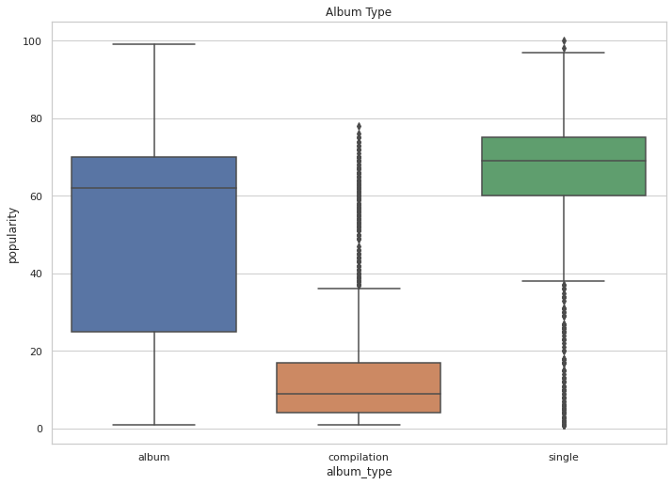
High Feature Importance
Album Type
Album → High
Compilation → Low
Single → High
Notes:
Firstly, “Album Type” seem to hold the highest feature importance.
It’s a categorical variable contains album, compilation and single. From the figure, (click)compilation has a lower popularity compared to others. This might because some of them consists previously released songs, which dilute its popularity. (Click)

Slide 31
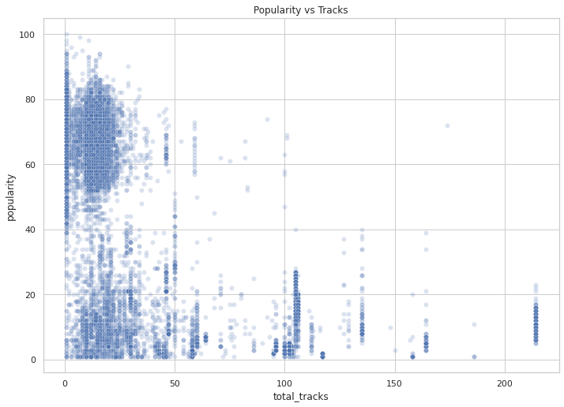
High Feature Importance
Total Tracks
Album Type
Increase total number of tracks
Album → High
Compilation → Low
Single → High
Decrease highest possible popularity
Notes:
Next, we have the Total Tracks. From the scatterplot, there is no clear trend on how total tracks will impact song popularity, especially since the album has a low number of tracks.(Click)
However, as the track numbers increase, (click) the highest possible popularity generally decreases. (Click)

Slide 32
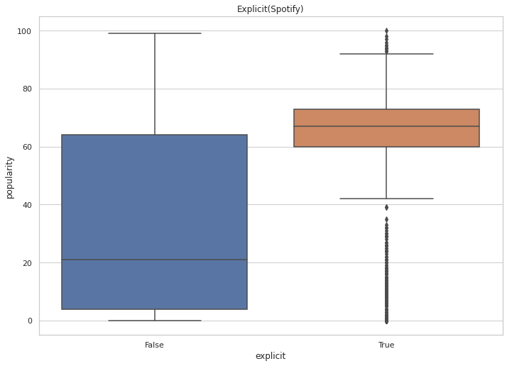
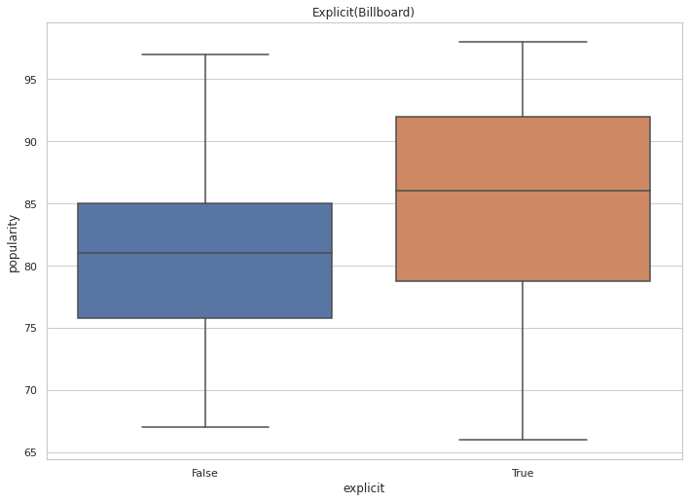

High Feature Importance
Explicit
Total Tracks
Album Type
Explicit → Higher
Increase total number of tracks
Appeal to the young generation
Album → High
Compilation → Low
Single → High
Decrease highest possible popularity
Notes:
Next, we have the Explicit feature
From this figure, (click) explicit songs on average have a higher popularity than non-explicit ones.
However, we were aware that explicit songs were the minority in our dataset. To further validate our finding, (click) we scraped additional data from the Weekly Billboard Top 100 songs.
From the figure, the mean popularity of explicit songs are higher than the non-explicit ones, matches with our prediction. (Click) This might because explicit songs seem to appeal more to the younger generation. (Click)

Slide 33
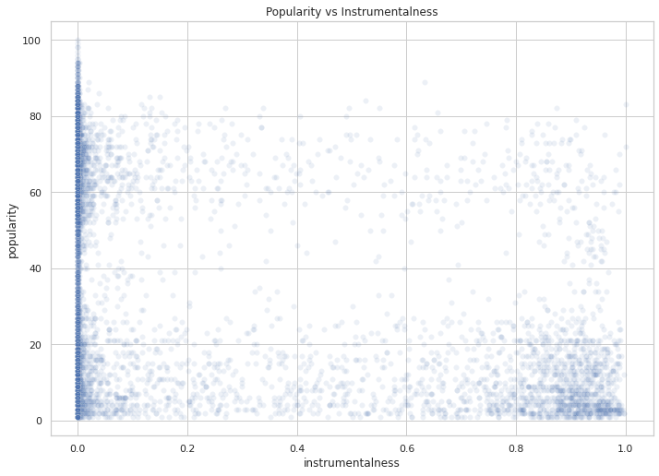
High Feature Importance
Explicit
Total Tracks
Album Type
Instrumentalness
Explicit → Higher
Increase total number of tracks
High instrumental- ness
Appeal to the young generation
Album → High
Compilation → Low
Single → High
Decrease highest possible popularity
Low popularity
Notes:
Lastly we have the instrumentalness feature. It can be seen that songs with (click) high instrumentalness are more likely to achieve (click) low popularity. Hence, songs with high vocal content are preferred over songs that consists mainly of instrumental sounds. (Click)

Slide 34
4
Business Insights
What our model can do?
Notes:
After getting all these high importance features, what can we do to generate business insights? (Click)

Slide 35
Business Insights
Time & Effort
Thousands of songs released
Money
≠
Popularity
Notes:
Every piece of music not only takes time and effort (click) but also involves lots of money (click) to produce them. Each year (click) thousands of songs are being released but not all songs are popular. (Click)

Slide 36

Conclusion
Album type
Total tracks
Explicit
Instrumentalness
$4,000
Popularity
Notes:
Hence, to achieve a higher popularity, we suggest artists to have an album or single, instead of compilation.
Moreover, they should not include too many tracks inside.
And since explicit songs seem to be more attractive, artists could take this genre into consideration.
Lastly, artists should try to reduce the instrumental component inside their songs.
Through these insights, we hope to provide strategies on the kind of music artists should produce for their songs to be successful. (Click) As popular songs can eventually generate revenue and fame for the artists.
As we have known, on Spotify, (click) the pay out range is average out to $4,000 per million spins. Also, knowing if a piece of music would be popular, production companies can make a more informed decision on how much to spend on a particular music. (Click)

Slide 37
Future Work
Lyrics
Relevant Dataset
Artist popularity
Natural Language Processing
To show relationships between popularity, revenue & investment
Do popular artists → popular songs?
Notes:
Due to time constraints, there are many more models that we can try (click)
such as using nlp to examine the relationship between lyrics and popularity of songs.
Secondly, (click) we can also try to analyse different datasets that contain attributes on popularity, revenue gain, or investment, to explore the relationship between these attributes, thus validate our business insights.
Alternatively, (click) we can also include artist popularity score to see the artists’ popularity could imply that his or her songs will be popular.
With these, (click) we concluded our presentation, thank you.

Slide 38
THANK YOU
Credits: SlidesGo

