Slide 2


Open Source & CMS:
Making A Bigger Impact
Andrea Fletcher
Remy DeCausemaker
Jen Belman
Aaron Pava
Chief Digital Strategy Officer and Director
Digital Service at CMS
Open Source Program Office Lead
Digital Service at CMS
Director, Division of Web Experience
Office of Communications at CMS
Co-Founder & Chief Experience Officer
CivicActions
https://github.com/DSACMS/decks/blob/main/cfa2025.pdf

Slide 3
OSS & CMS at CFA Summit
What is CMS?
What is the Digital Service at CMS?
What is Open Source?
What is the Office of Communications at CMS?
What are some of our Open Source Success Stories?
What is the impact?
What are your questions?

Slide 4
What are the Centers for Medicare and Medicaid Services? (CMS)
“CMS is the federal agency that provides health coverage to more than 160 million through Medicare, Medicaid, the Children's Health Insurance Program, and the Health Insurance Marketplace. CMS works in partnership with the entire health care community to improve quality, equity and outcomes in the health care system.”
https://www.cms.gov/about-cms

Slide 5
Who we serve: The American People
67.8
82.3
21.1
M
M
M
Medicare Beneficiaries
(2023)
Medicaid Beneficiaries
(2023)
Healthcare.gov
(2023)
https://data.cms.gov/fact-sheet/cms-fast-facts
https://www.cms.gov/files/document/health-insurance-exchanges-2024-open-enrollment-report-final.pdf

Slide 6
Who we serve: Taxpayers
1.76
1.05
846
$
$
$
T
T
B
Total Medicare Payments
(FY 2024)
Total Medicaid Payments
(FY 2024)
CMS Budget
22% of the
federal budget
(FY 2024)
https://data.cms.gov/fact-sheet/cms-fast-facts
https://www.govinfo.gov/content/pkg/BUDGET-2025-BUD/pdf/BUDGET-2025-BUD.pdf
https://www.cms.gov/files/document/cms-financial-report-fiscal-year-2024.pdf

Slide 7
Who we serve: The Healthcare System
6,613
1.5
22
M
%
CMS Employees
(FY 2024)
Health Care Providers
(2024)
National Health Care Spending is Medicare
(2024)
https://data.cms.gov/sites/default/files/2025-04/CMSFastFacts2025_508.pdf
https://www.cms.gov/oact/tr/2024
https://www.cms.gov/files/document/cms-financial-report-fiscal-year-2024.pdf

Slide 8




What does the Digital Service at CMS do?
We transform the US Healthcare System by
Improving design and user experiences
Delivering value to government, providers, and patients
Modernizing systems
Participating in Policy Development

Slide 9






How do we do it?
We deploy small groups of designers, engineers, and product managers on a "tour of duty" to work alongside dedicated civil servants.
These multidisciplinary teams bring best practices and new approaches to support government modernization efforts.

Slide 10
What is Open Source Software?
Source code that anyone can inspect, modify, enhance, and share.
96% of all commercial software contains open source code, representing $8.8T of value if it had to be rewritten from scratch.
https://www.blackduck.com/blog/open-source-trends-ossra-report.html
https://library.hbs.edu/working-knowledge/open-source-software-the-nine-trillion-resource-companies-take-for-granted
Notes:
An icon of merging a branch
An icon of 5 networked dots that are being modified to 4
An icon of a puzzle piece in a folder
An icon of information being shared between two individuals

Slide 11
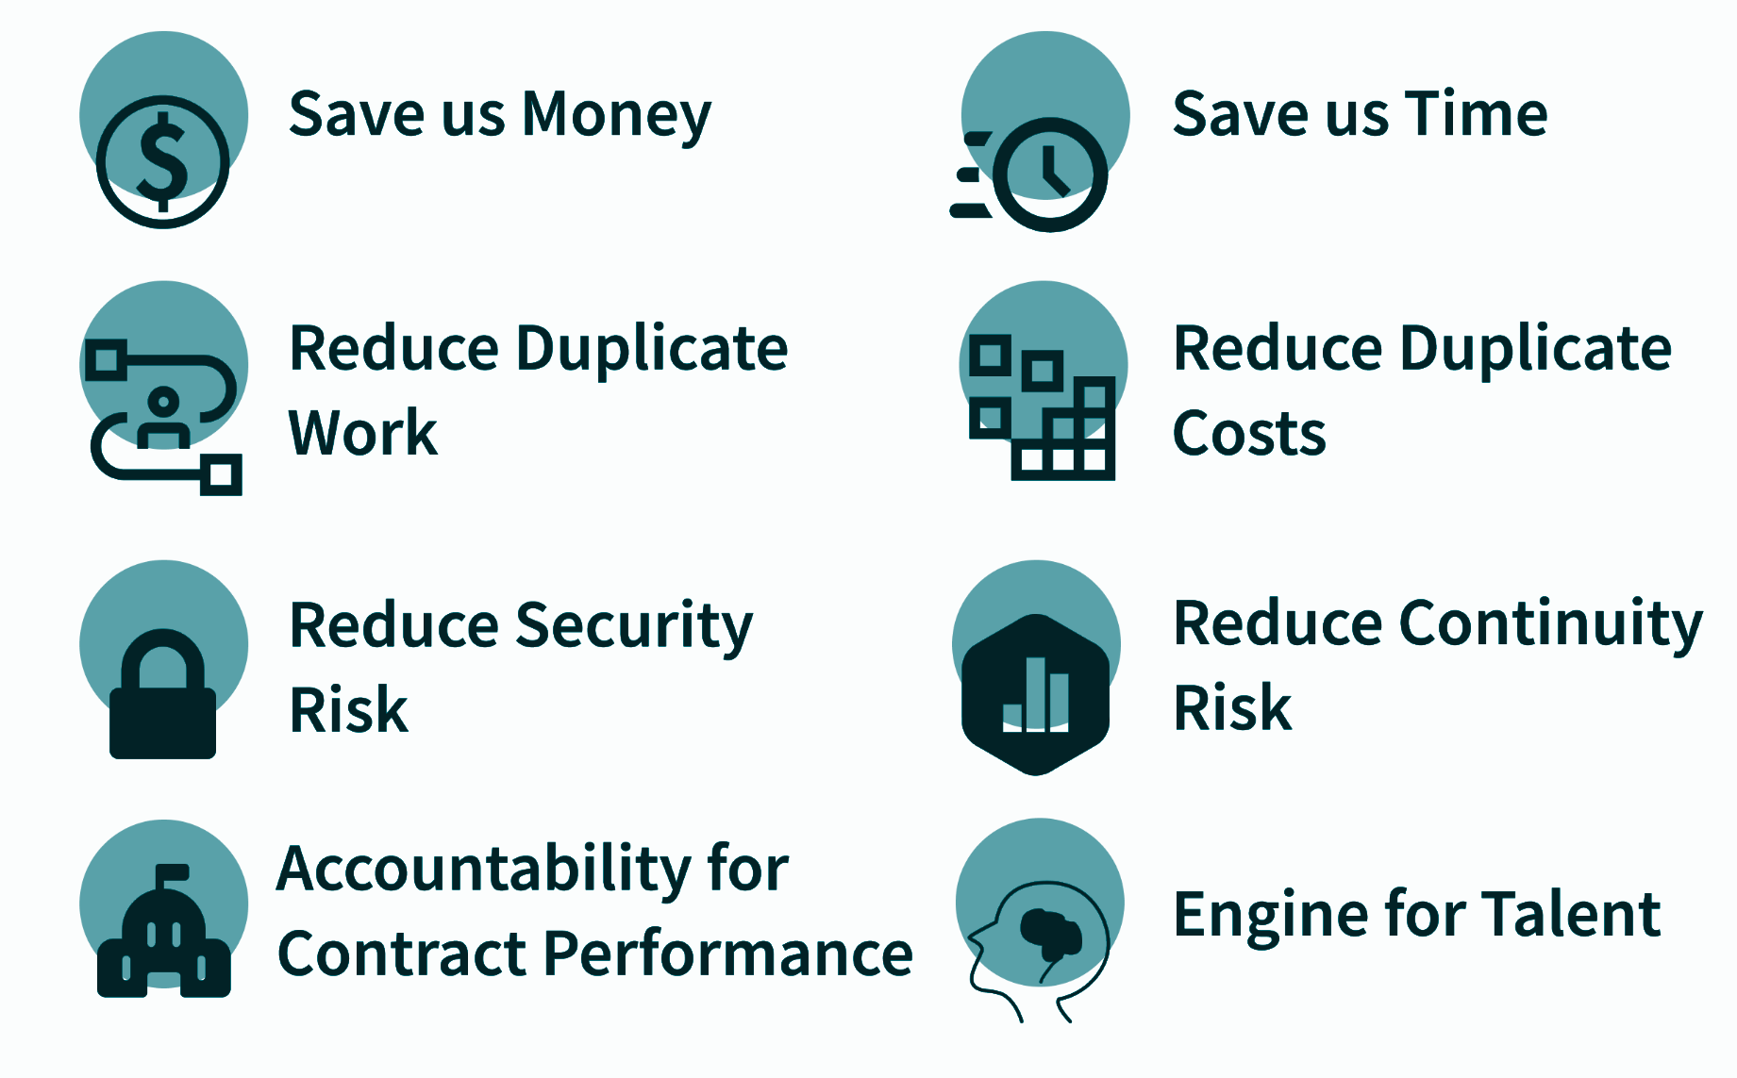
What does an Open Source Program Office (OSPO) do?
An Open Source Program Office (OSPO) serves as the center of competency for an organization's open source operations, strategy, and structure.
An OSPO is responsible for defining and implementing programs, policies, and projects to guide these efforts.
30% of Fortune 100 companies have implemented an OSPO, with 84% of OSPOs developing or managing GenAI infrastructure.
CMS is the first United States Federal Agency to implement this private-sector styled approach to an Open Source Strategy.
https://github.blog/open-source/maintainers/why-companies-are-starting-ospos/
https://www.linuxfoundation.org/hubfs/LF%20Research/lfr_ospo24_infogfx_111824.png?hsLang=en

Slide 12




What are the “Risks” (aka Myths) of Open Source?
Open Source is less more secure
Open Source means that ALL data MUST be public.
Open Source means that SOME data CAN be public
“Given enough eyeballs, all bugs are shallow.” - Linus’s Law
The more people who look,
the faster we find bugs, and
the faster we fix them.
Open Source is not a monolith, it is a stack, and it has layers. Being explicit about what cannot be shared for privacy or security reasons helps open information silos and unlock shared value.
Open Source is bad good for business
Open by Default is not what Federal Government does
By lowering acquisition costs, businesses gain world-class tools and infrastructure built and maintained by the largest enterprises. By preventing vendor lock-in, businesses can invest strategically, promote competition, and reduce technical debt.
Title 17 U.S. Code § 101 and 105: “Copyright protection under this title is not available for a Work of the United States Government” Work meaning “prepared by an officer or employee of the United States Government as part of that person's official duties”
See Also: Federal Source Code Policy M-16-21 and starting on 07/22/25 The SHARE IT Act
https://www.law.cornell.edu/uscode/text/17
https://www.law.cornell.edu/uscode/text/17/105
https://obamawhitehouse.archives.gov/sites/default/files/omb/memoranda/2016/m_16_21.pdf
https://dsacms.github.io/share-it-act-lp

Slide 13



What are the actual Risks in Open Source?
Overdifferentiation Unnecessarily duplicating work Unnecessarily dividing your resources | Examples “Not Invented Here Syndrome” From Scratch v.s. Commodity Roll your own Crypto™
Proliferation Unnecessarily duplicating communities and projects Unnecessarily dividing your addressable market | Examples “Decision Fatigue” Framework Proliferation Event / Conference Proliferation
Fragmentation Unnecessarily duplicating your code base Unnecessarily dividing your community of contributors | Examples “Hostile Forks” License Forks Internal Forks

Slide 14
What is our answer? The OSPO Model!
Open Source Repository Maturity Models
Q: Where is our project on our Open Source Journey?
A: a framework to evaluate and categorize open source repositories based on their composition and goals can be found here: https://dsacms.github.io/repo-scaffolder/#maturity-model-framework
Repository Templates
Q: What files are required/recommended for healthy repository hygiene?
A: a foundation for building well-documented, clean, repositories that adhere hygiene standards and best practices is available here: https://dsacms.github.io/repo-scaffolder/#repository-templates
Outbound Checklists
Q: What steps should our project take to share our repository safely?
A: a review process to reduce risk and improve quality when releasing open source projects can be found here: https://dsacms.github.io/repo-scaffolder/#outbound-checklists
Repository Metadata Inventory
Q: How do we keep our repositories healthy at scale?
A: Workflows to automate code scanning, secret detection, metrics gathering, and documentation generation are available here: https://github.com/DSACMS/repo-scaffolder/blob/main/docs/.github-directory.md#workflows

Slide 15
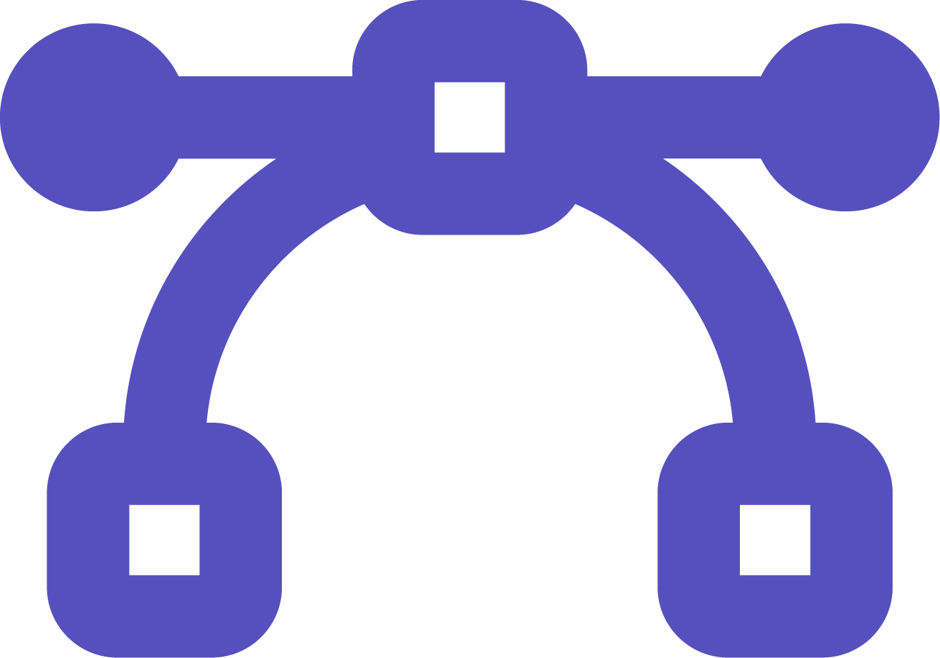




What does the Office of Communications at CMS do?
We manage customer service for Medicare and the Health Insurance Marketplace, including managing CMS’ consumer facing websites and open data sites, among numerous other functions.
Web Development
Front-end design & user experience
DevOps, Security and Systems Testing & Monitoring
Notes:
Jen

Slide 16
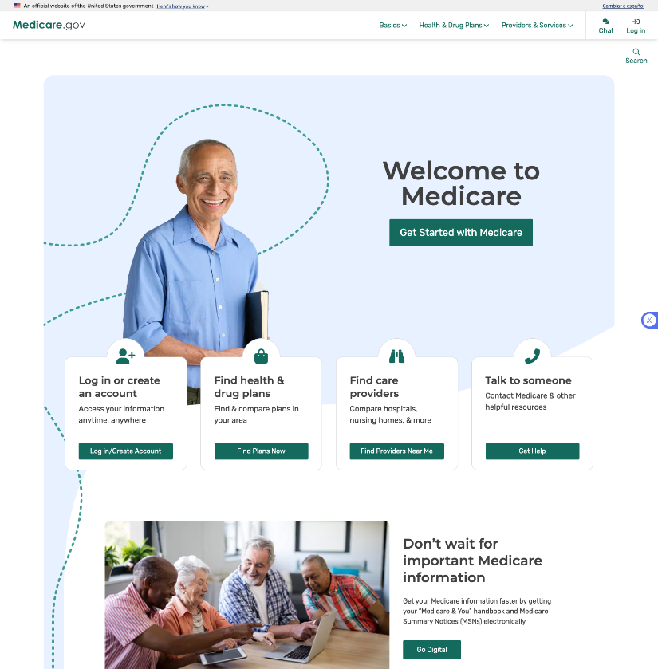
Medicare.gov The official website for people with Medicare
Key Metrics (CY 2024)
Unique Users: 68 million
Sessions: 129 million
Pageviews: 886 million
Notes:
Jen

Slide 17
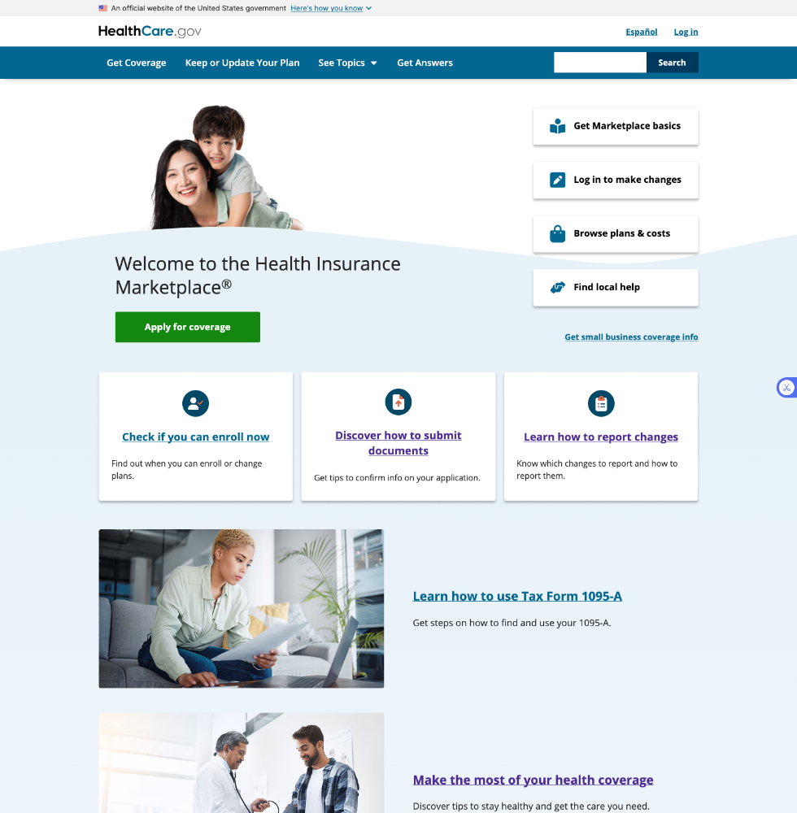
HealthCare.gov
The official website of the
Federal Health Insurance Marketplace
Key Metrics (CY 2024)
Unique Users: 83 million
Sessions: 126 million
Pageviews: 1400 million
Notes:
Jen

Slide 18
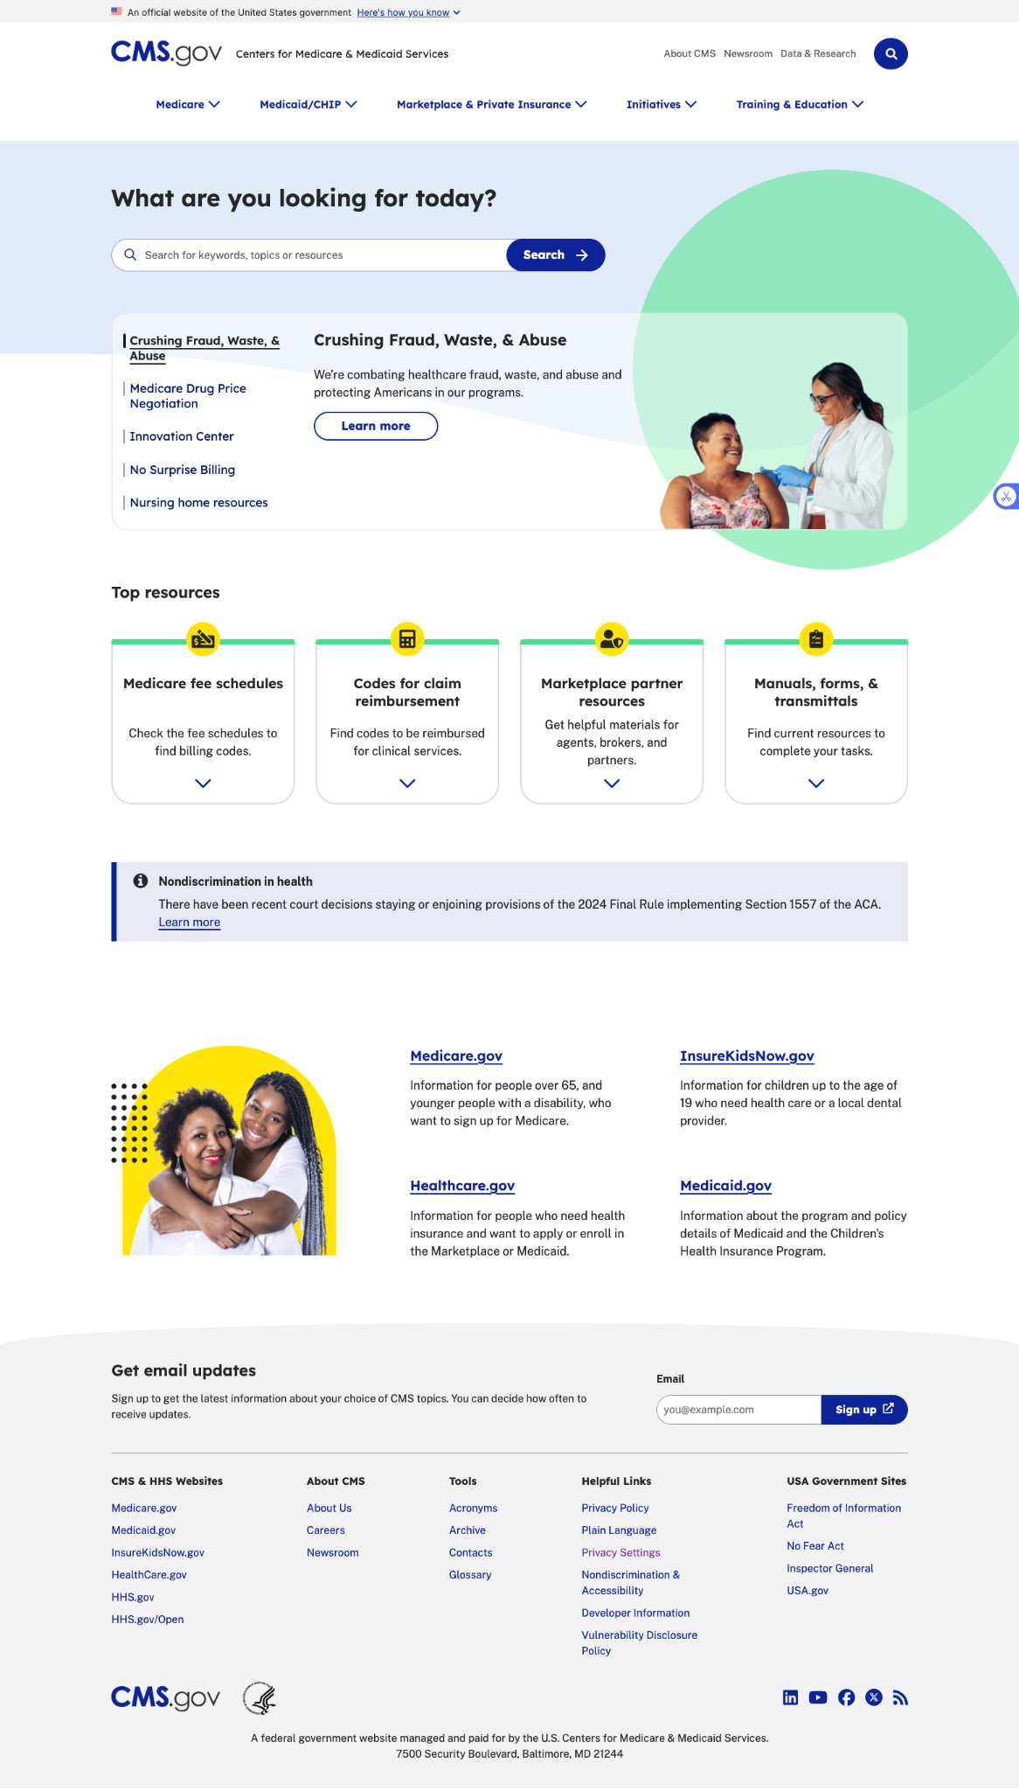
CMS.gov The official Agency website of the
Centers for Medicare & Medicaid Services
Key Metrics (CY 2024)
Unique Users: 35 million
Sessions: 58 million
Pageviews: 126 million
Notes:
Jen

Slide 19
Drupal success stories:
Content Quality
Challenge
Solution
Outcome
Arachno Analysis - A custom Drupal module that shows the relationship between content items.
Broken links and orphaned content and media items.
Prevents content editors from accidentally editing someone else’s content
Notes:
Jen

Slide 20
Drupal success stories: Complex Content Workflows
Challenge
Solution
Outcome
Healthcare.gov is a complex, multi-product platform spanning several lower environments. A traditional architecture limits operational efficiency and agility for releasing the content.
Drupal Headless/Decoupled Architecture
Content authors can publish content from a single production Drupal instance to various lower environments
Improves page load speed and publishing times and optimizes rendering for different devices and platforms.
Notes:
Jen

Slide 21
Drupal success stories: Author Experience and Visual Consistency
Challenge
Solution
Outcome
CMS.gov is a highly complex website that has 650 Drupal users. We needed a way to allow CMS Centers and Offices to edit their own content.
CMS Groups - An Access Scheme in Drupal that defines distinct CMS groups for different Centers and Offices. Every piece of content and media in Drupal is assigned to one of these groups. When a user is granted access to Drupal, they must be assigned to one of these groups.
Prevents content editors from accidentally editing someone else’s content.
Notes:
Jen

Slide 22
Drupal success stories: Content Ownership in a Large Organization
Challenge
Solution
Outcome
Gives content creators to the ability to make visually appealing content, within an area that we have defined and in a way that they can do it themselves.
Does not require contractor support to build custom coded sections of the website.
CMS.gov uses a distributed model for content management, in which each Center/Office is responsible for posting and maintaining the content that is relevant to their expertise. These content editors often do not have a design, user experience, or tech background, but desire visually appealing pages that are consistent with the look and feel of the rest of the website.
Layout Builder
Notes:
Jen

Slide 23
Drupal success stories: Review and Approvals
Challenge
Solution
Outcome
Often times before content editors publish content, they want to preview the webpage to see if everything looks correct. There wasn’t a great way to show what the page would look like without the content editing interface in the way.
Draft Preview Link
Content editors can share out a preview of a page they have created with a tokenized link.
Content editors can take this link and send it to others, like their approvers, to review.
Editors can select how long they want the link to work, from 24 hours to 2 weeks.
Notes:
Jen

Slide 24
Drupal success stories: Visual Consistency & Accessibility
Challenge
Solution
Outcome
CMS needed to provide web product teams with a single source of truth design system that supports the visual design pattern libraries that include CMS program branding.
CMS Design System & “child” Design Systems
A single open source global design system with themed child design systems (CDS) to support CMS’s three major program websites.
Each themed CDS is built on top of the based “core” design system.
Notes:
Jen

Slide 25
CivicActions Contributions
12
302
147
Months
Drupal Contributions
DKAN Contributions
Notes:
Speaker: Aaron
Contrub first

Slide 26

Drupal
Community of over 100,000 active contributors
Free, open source content management system (CMS)
Modular design is easily customizable
Powerful content authoring tools, for creating, managing and organizing content
Extensive API for seamless integration with other systems and services
Notes:
Speaker: Aaron

Slide 27
Vertex AI Search
Admins can now create and configure custom search pages
Additional settings include autocomplete, spelling correction, and SafeSearch filtering
Promoted Search Results that appear at the top of the search
Access Controls settings allow admins to restrict visibility to specific search pages
Notes:
Speaker: Aaron

Slide 28
Content Reminders
Editors can set reminder notifications for specific content items, prompting them to review and update content as needed
Notifications can be customized with specific messages and sent to multiple recipients.
Offers preset dates for scheduling reminders, such as "a week from now" or "next month,"
Notes:
Speaker: Aaron

Slide 29
DKAN
Open source data platform designed to help governments, organizations, and institutions publish, manage, and share open data
Built on Drupal
Supports different user role-based permissions, allowing organizations to control who can publish, edit, or view data.
Allows users to upload datasets, link to sources, and provide metadata to enhance discoverability and reuse
Users can browse, search, and access datasets in various formats (CSV, JSON, etc.)
Provides APIs for programmatic access to datasets, enabling developers to build applications using the data
Notes:
Speaker: Aaron
Oakridge

Slide 30
Recent DKAN Improvements
Enhanced Metadata Management: Users can now customize metadata schemas improving data discoverability
Improved Data Harvesting Capabilities: Streamlined the process of importing dataset from external sources improving efficient data collection
Notes:
Speaker: Aaron

Slide 31
What’s Really Important
If we build or improve something, we give it back
You don’t need to be an engineer; designers, product managers, and people who write documentation contribute too!
SHARE IT Act requires sharing source code for other agencies to reuse
https://guidebook.civicactions.com/en/latest/common-practices-tools/contribution/contrib-first/
Notes:
Speaker: Aaron

Slide 32


Thank You
Questions?
Digital Service
at CMS
Office of Communications
at CMS
CivicActions
digitalservice@cms.hhs.gov
opensource@cms.hhs.gov
https://cms.gov/digital-service
https://go.cms.gov/ospo
wetg_director@cms.hhs.gov
https://www.medicare.gov/
https://www.healthcare.gov/
https://www.cms.gov/
aaron.pava@civicactions.com contact@civicactions.com
https://civicactions.com
https://github.com/DSACMS/decks/blob/main/cfa2025.pdf

