Slide 1
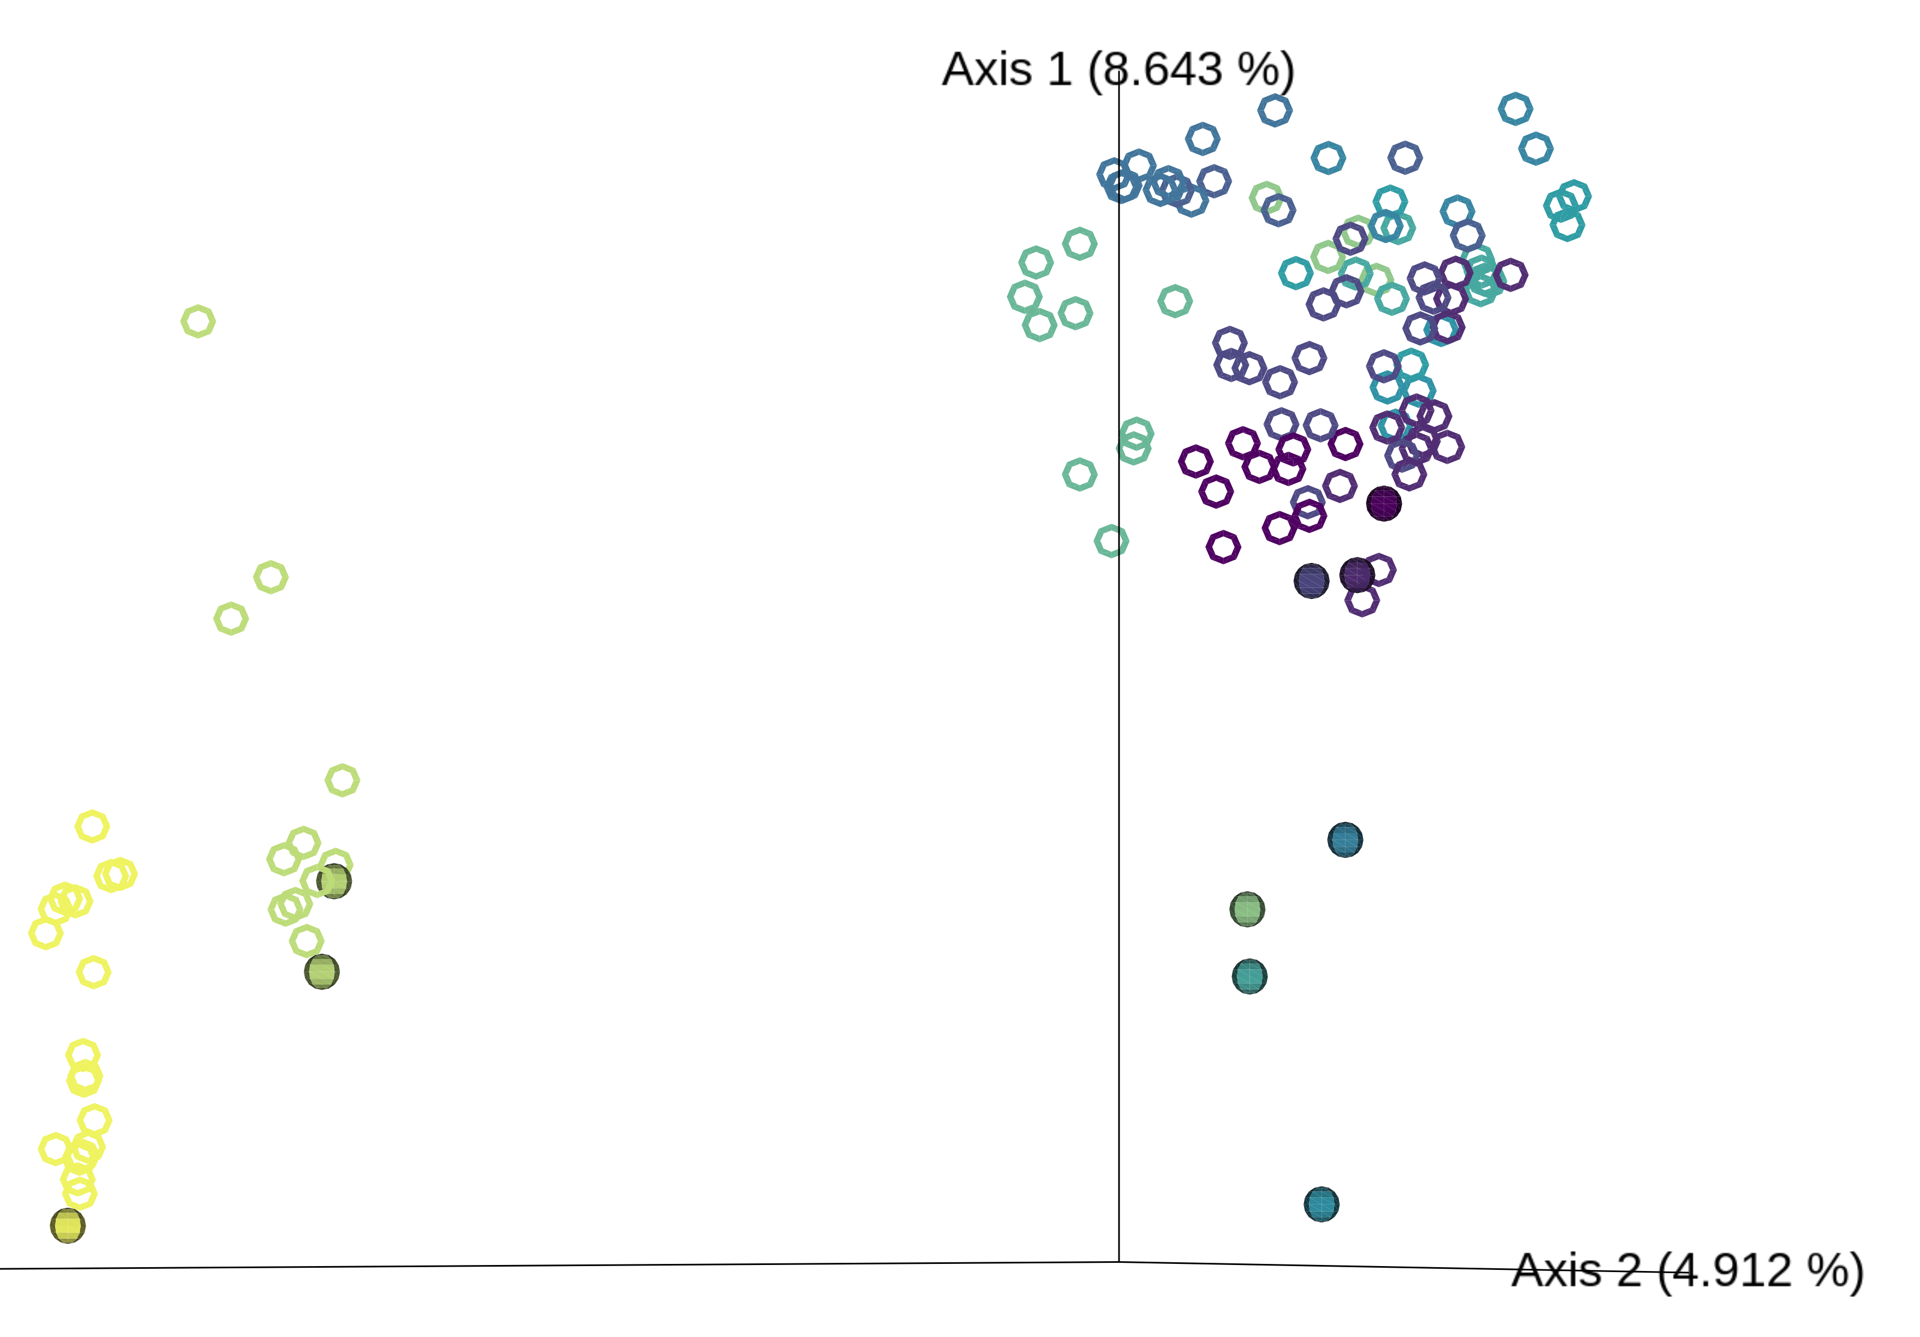
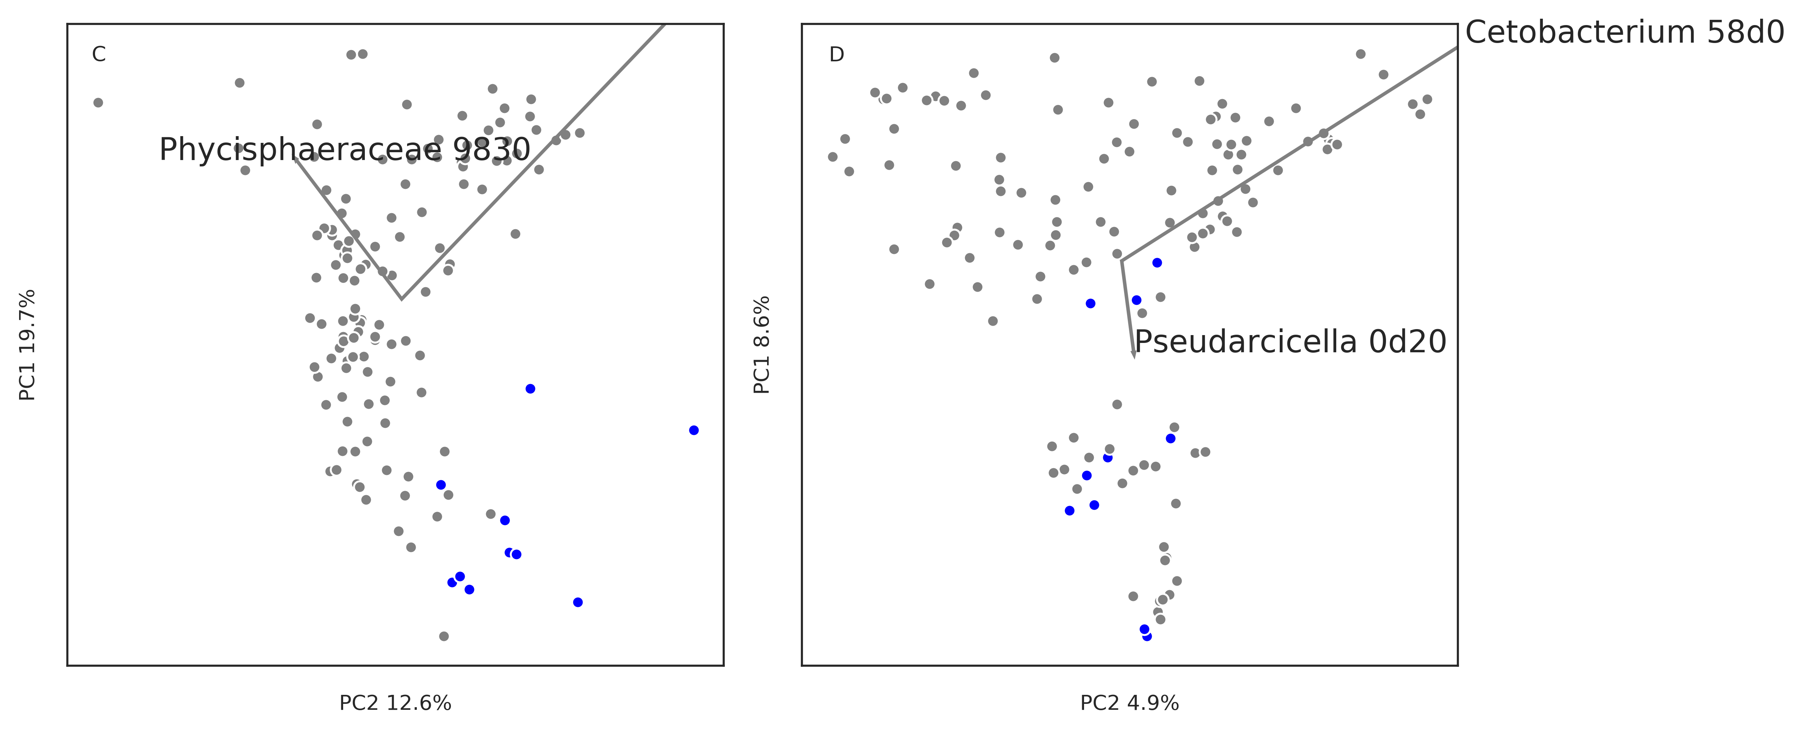
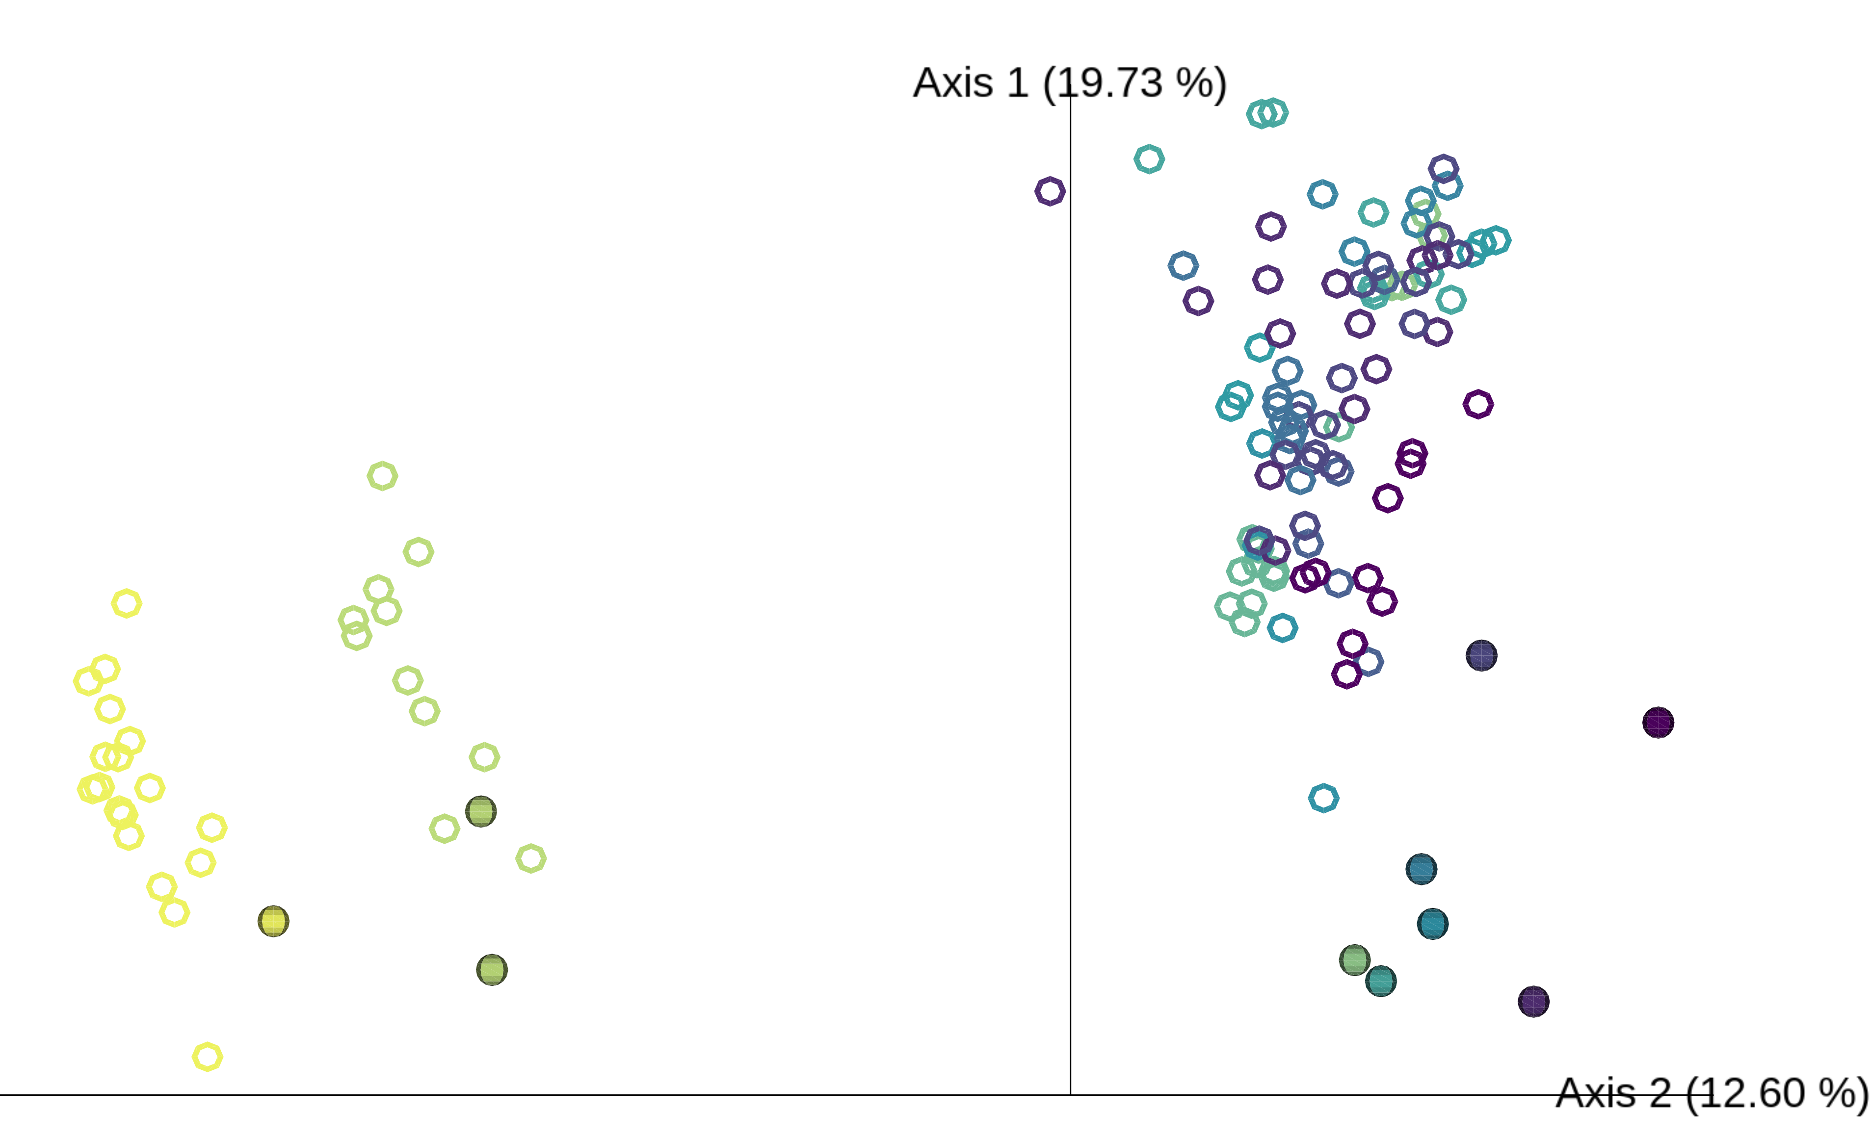
A
B
Swab
Water
Swab
Water
Conductivity
C
D
Swab
Water
3917
286
Conductivity

