Slide 1
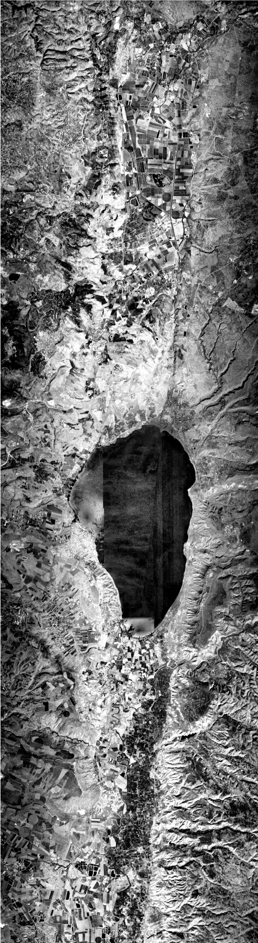
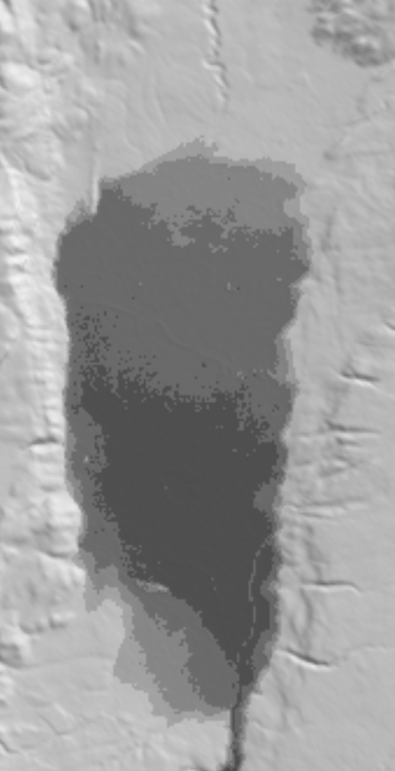
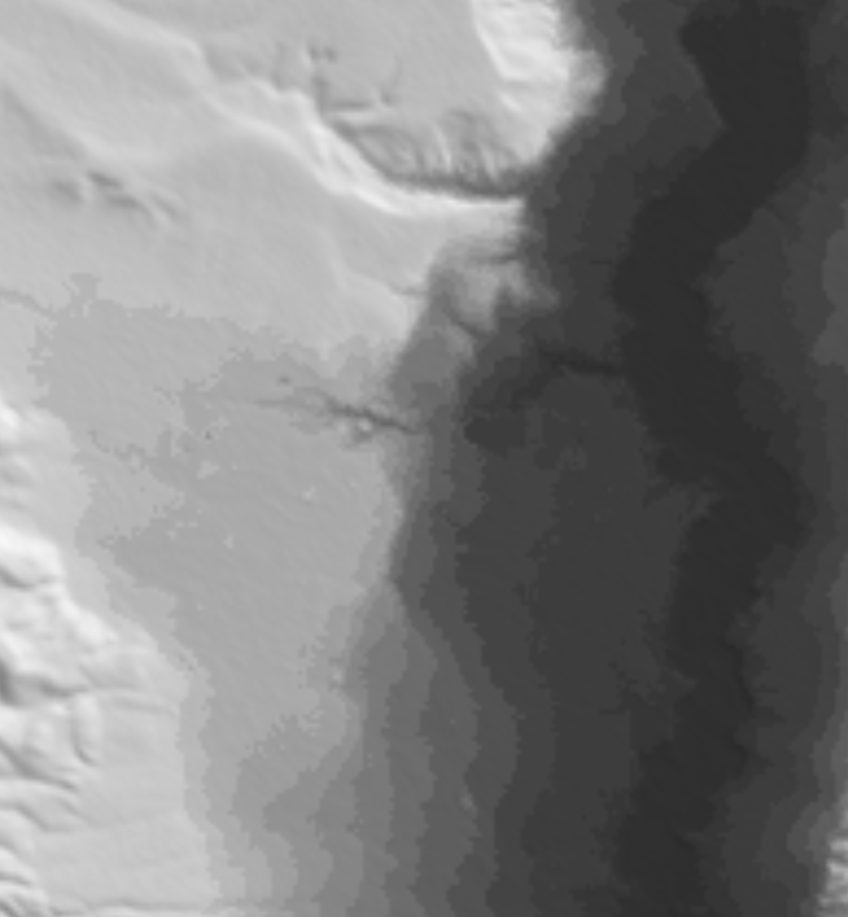
Flow
250 m
H
S
H.0.6
80 m
J.2
J.3
70 m
J.1
J.4
60 m
J.5
Flow
A
100 m
-170 m
-270 m
T
T <= 20 °C,
Salinity < 0.3 PPT
T > 30 °C,
Salinity > 1.5 PPT
H: Hermon Stream
S: Snir Stream
J: Jordan River
A: Amal Stream
T: Tel Saharon Reserve

