Slide 1
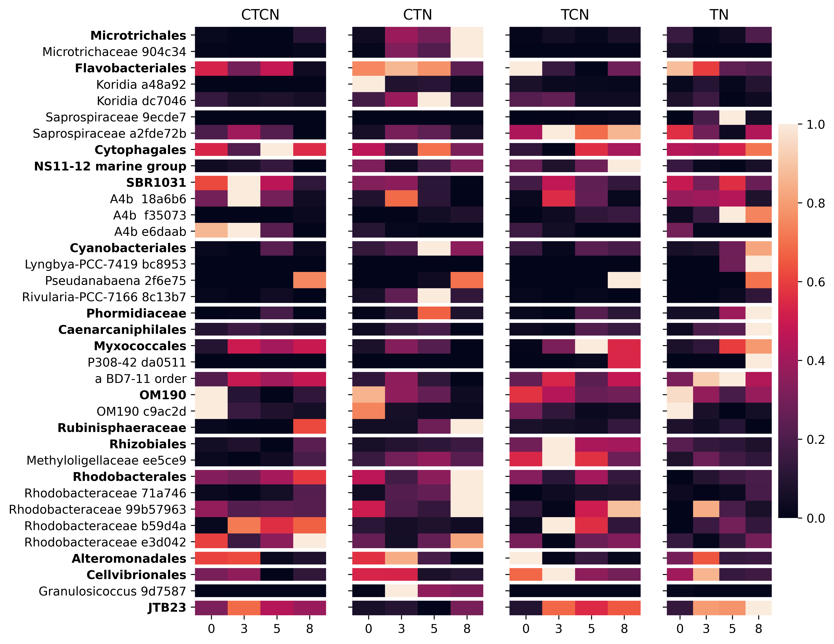
Actinobacteriota;Acidimicrobiia
Bacteroidetes;Flavobacteriia
Bacteroidetes;Saprospiria
Bacteroidetes;Bacteroidia
Chloroflexi;Anaerolineae
Cyanobacteria;Cyanobacteriia
Cyanobacteria;Oscillatoriophycideae

