Slide 1
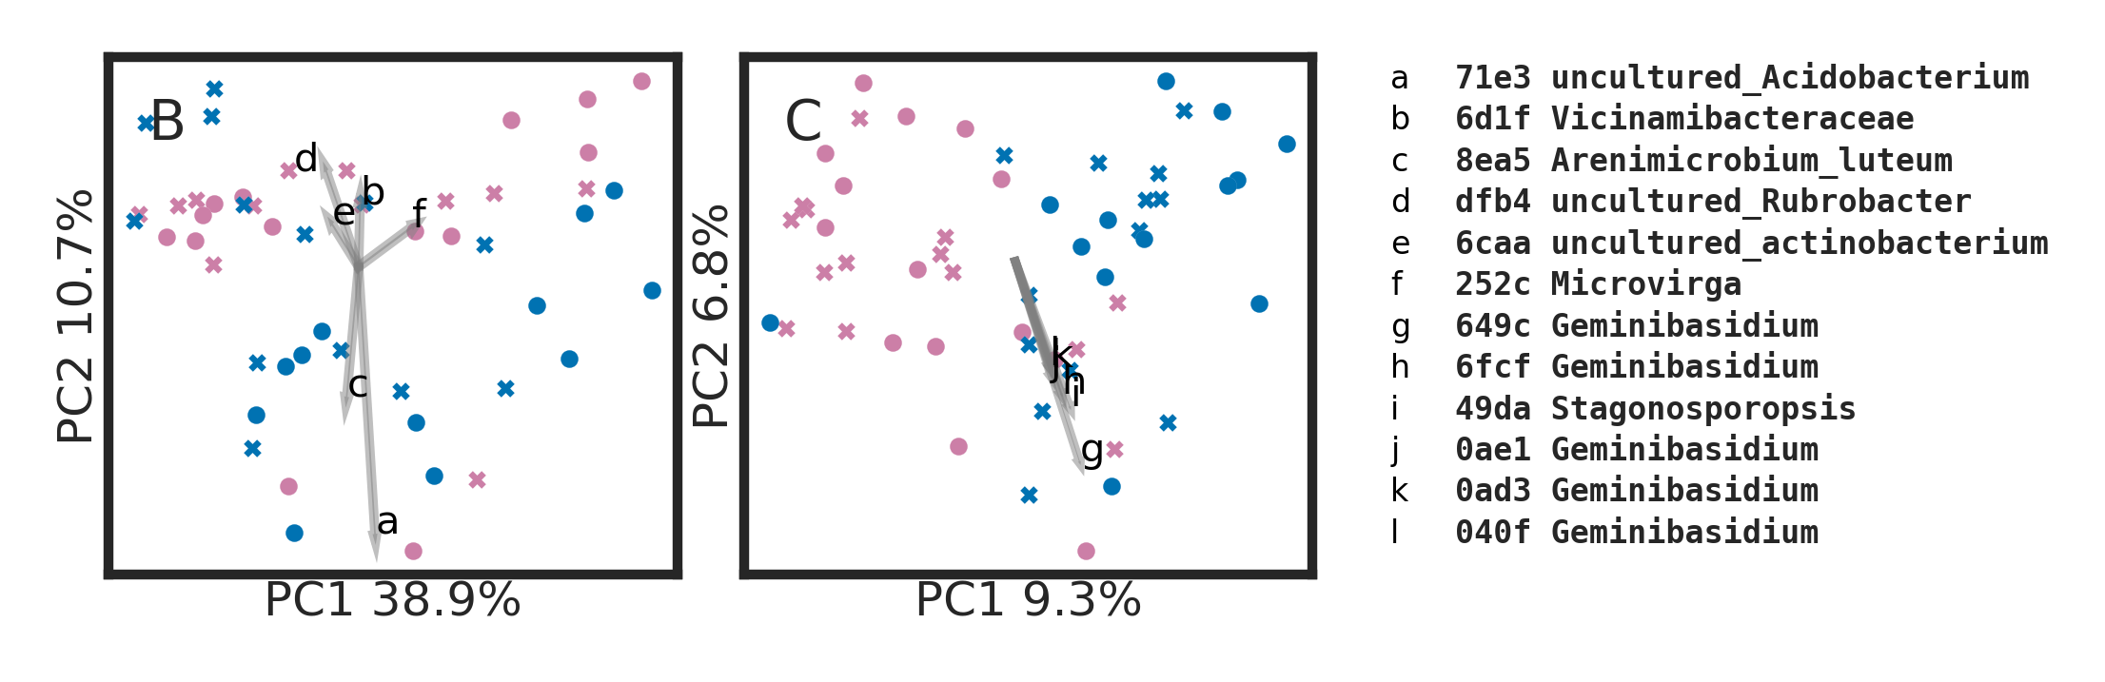
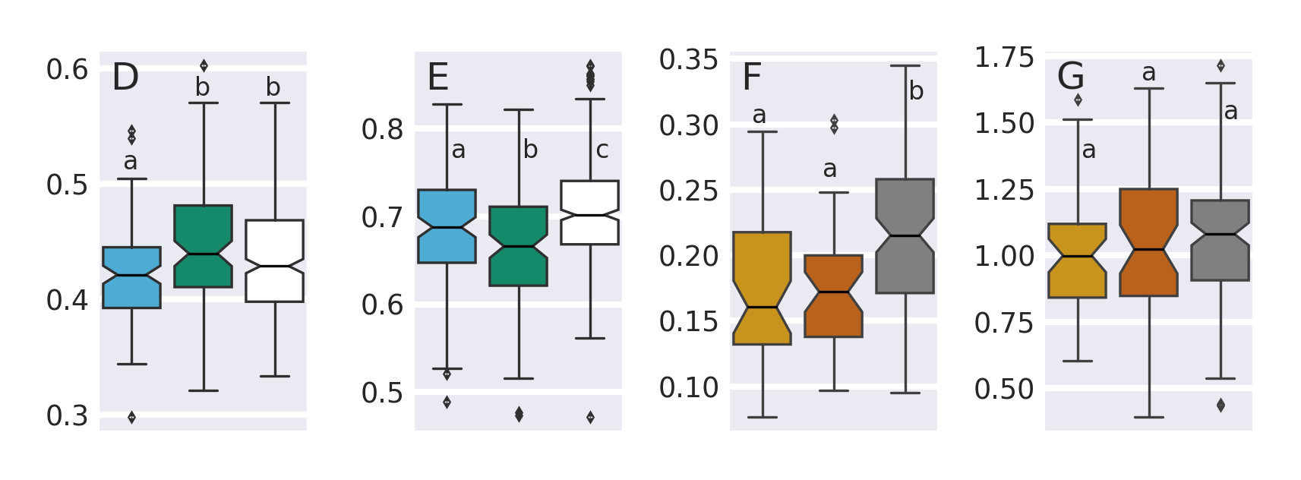
A
Sample typles
Shrubby patch - Heterogeneous
Inter patch space - Heterogeneous
Shrubby patch - Homogeneous
Inter patch space - Homogeneous
Pairwise UniFrac distances within and among niches
Within niche: shrubs (within geodiversity class, within slope)
Within niche: spaces (within geodiversity class, within slope)
Among niche (within geodiversity class, within slope)
Pairwise UniFrac distances within and among geodiversity classes
Homogeneous
slopes
Heterogeneous
slopes
Within geodiversity class: homogeneous (within niche, among slope)
Within geodiversity class: heterogeneous (within niche, among slope)
Not to scale
Among geodiversity class (within niche, among slope)
UniFrac distance

