Slide 1
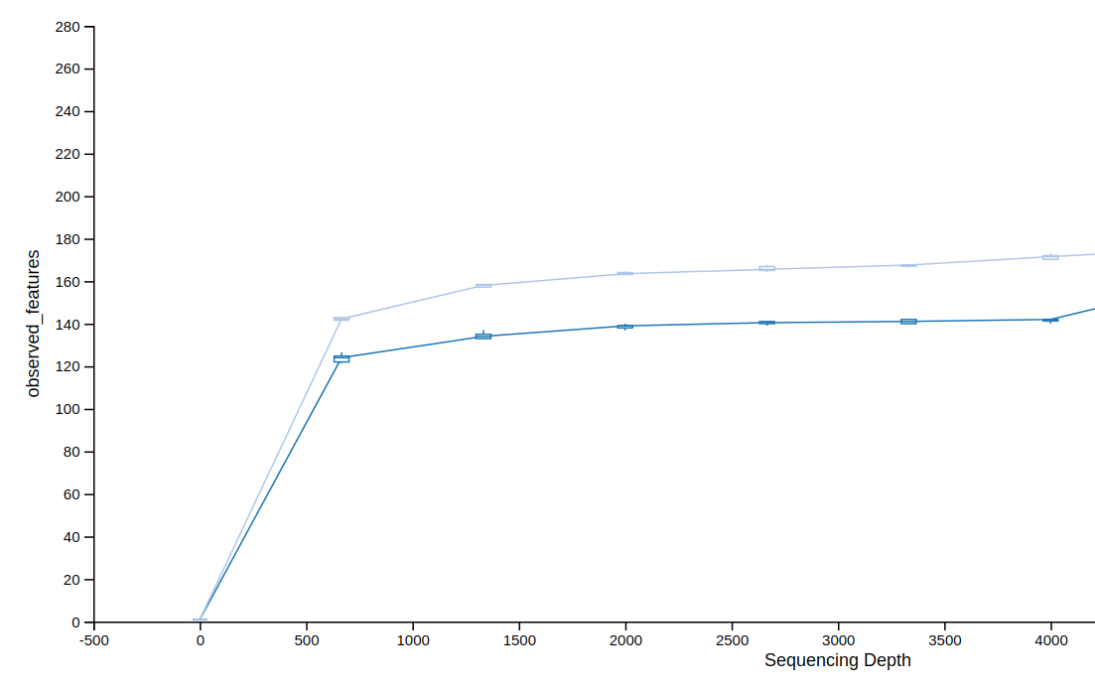
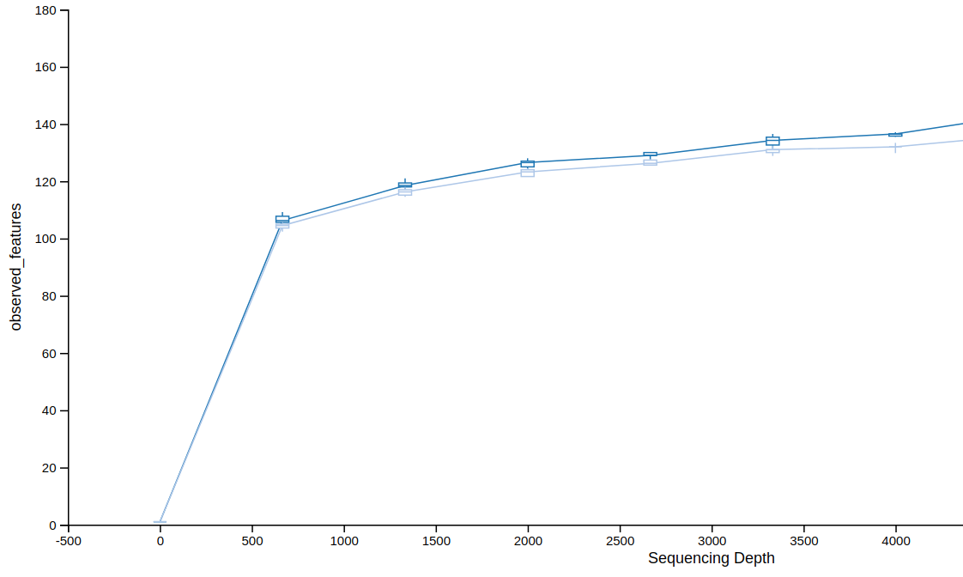
16S rRNA
Obsereved ASVs
Sequence count
ITS1
Obsereved ASVs
Sequence count

