Slide 1

Distracted Driver Image Classification with Amazon SageMaker
DSBA 6190 Final Project
May 2020
Evan Canfield ● Roma Dutta ● Shilpa Patil ● Ibrokhim Sadikov
GitHub: https://github.com/DSBA-6190-Final-Project-Team/DSBA-6190_Final-Project
Notes:
The following presentation documents our teams final project for DSBA 6190, in which we developed an image classification model, using Amazon SageMaker, which predicts distracted driver behavior

Slide 2
Project Goals
Platform as a Service (PaaS) machine learning prediction model
Image Classification Model of Distracted Driver Behavior
Scalable Platform
Amazon SageMaker
Elastic Scale-Up
Verified using Locust for load testing
Notes:
We already discussed the model we created, and the platform we used.
For Elastic Scale Up, we verified this by performing a load test of the deployed inference endpoint, using the Locust open source tool.

Slide 3
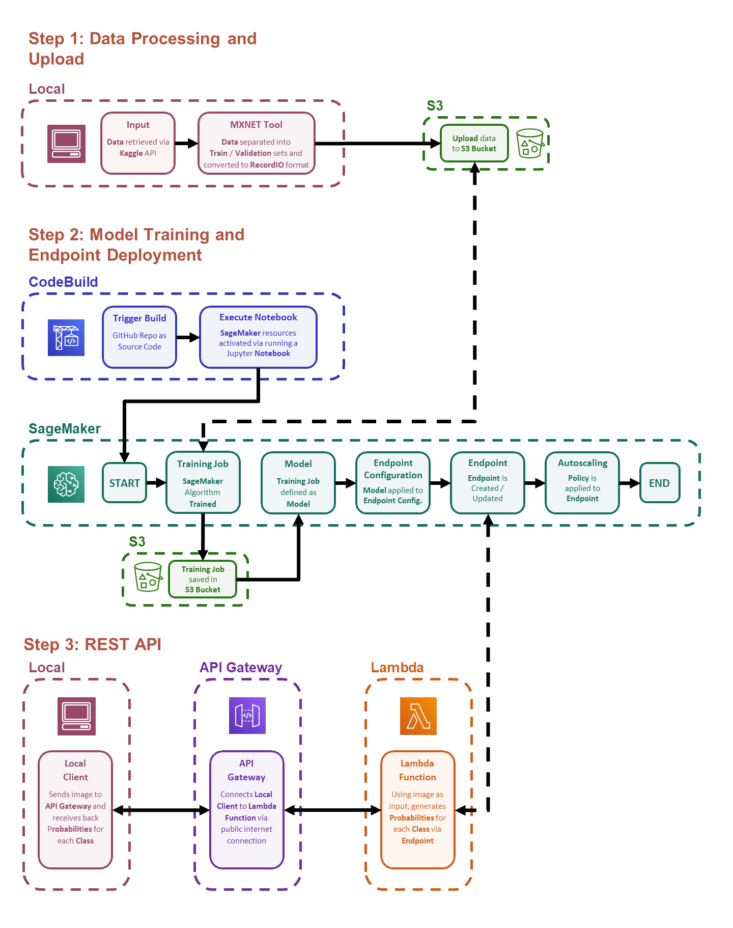

Slide 4
Steps
Data Processing and Upload
Model Training and Endpoint Deployment
REST API

Slide 5
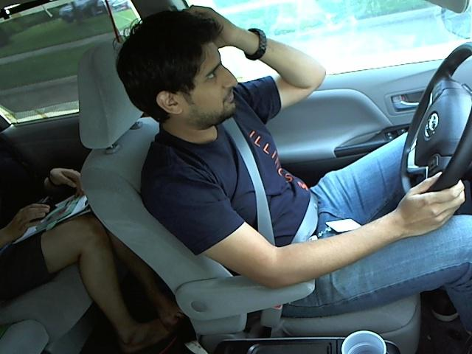
Step 1: Data Processing and Upload
Data: State Farm Distracted Driver Dataset (Kaggle)
Image Classes
c0: safe driving
c1: texting - right
c2: talking on the phone - right
c3: texting - left
c4: talking on the phone - left
c5: operating the radio
c6: drinking
c7: reaching behind
c8: hair and makeup
c9: talking to passenger
Class C8 (Hair and Makeup)

Slide 6
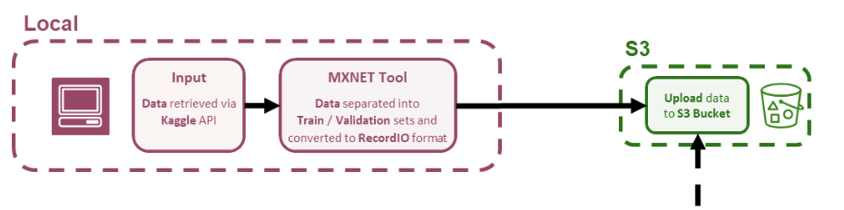
Step 1: Data Processing and Upload

Slide 7
Step 1: Data Processing and Upload

Slide 8
Step 1: Data Processing and Upload

Slide 9
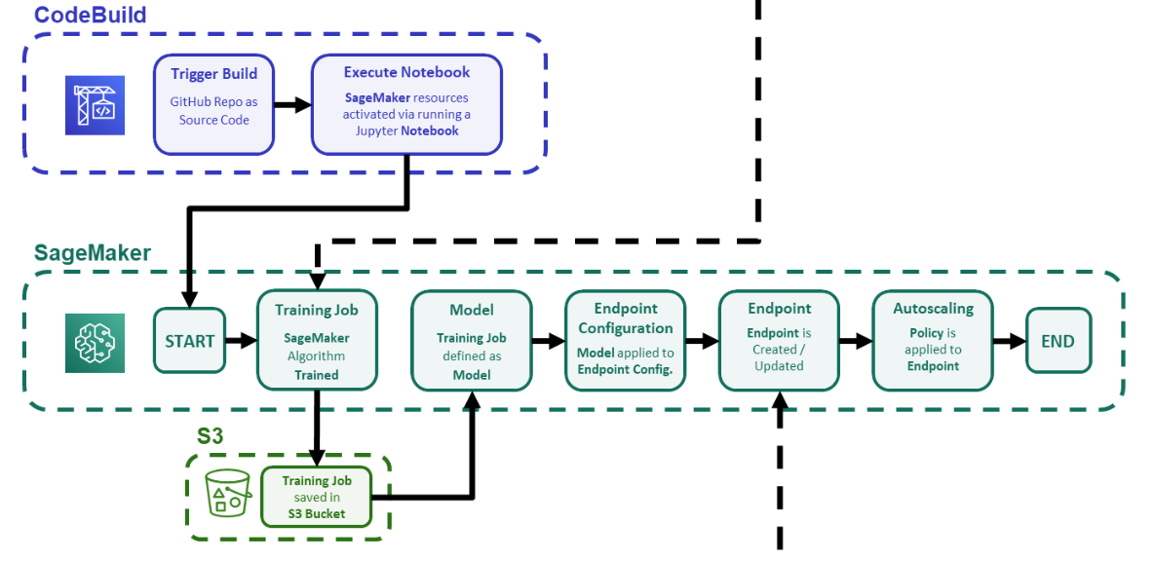

Step 2: Model Training and Endpoint Deployment
S3
Upload data
to S3 Bucket

Slide 10
Step 2: Model Training and Endpoint Deployment
S3
Upload data
to S3 Bucket

Slide 11
Step 2: Model Training and Endpoint Deployment
S3
Upload data
to S3 Bucket

Slide 12

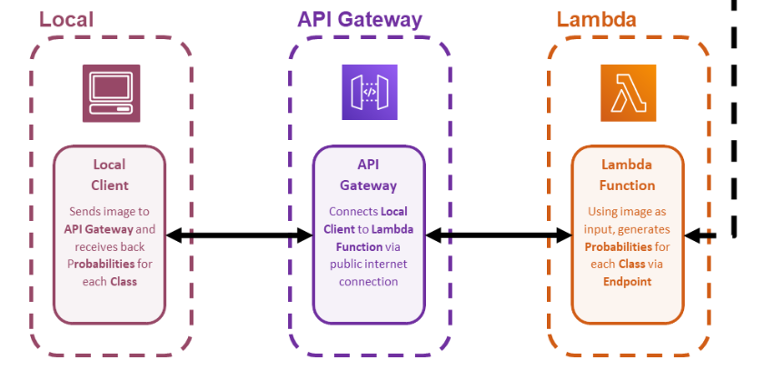
Step 3: REST API
SageMaker
Endpoint
Endpoint is Created / Updated

Slide 13
Step 3: REST API
SageMaker
Endpoint
Endpoint is Created / Updated

Slide 14
Step 3: REST API
SageMaker
Endpoint
Endpoint is Created / Updated

Slide 15
Step 3: REST API
SageMaker
Endpoint
Endpoint is Created / Updated

Slide 16
Step 3: REST API
SageMaker
Endpoint
Endpoint is Created / Updated

Slide 17
Step 3: REST API
SageMaker
Endpoint
Endpoint is Created / Updated

Slide 18
Evaluation of REST API
Input:
Class C8 (Hair and Makeup)

Slide 19
Evaluation of REST API
Input:
Output:
{
"payload": [
0.0004917857004329562,
0.0009714150219224393,
0.00037492465344257653,
0.0005540588754229248,
0.000527076655998826,
4.445736340130679e-05,
0.03505537286400795,
0.0012092252727597952,
0.960708737373352,
6.294571358012035e-05
]
}
Class C8 (Hair and Makeup)

Slide 20
Evaluation of REST API
Input:
Output:
{
"payload": [
0.0004917857004329562,
0.0009714150219224393,
0.00037492465344257653,
0.0005540588754229248,
0.000527076655998826,
4.445736340130679e-05,
0.03505537286400795,
0.0012092252727597952,
0.960708737373352,
6.294571358012035e-05
]
}
Class C8 (Hair and Makeup)

Slide 21
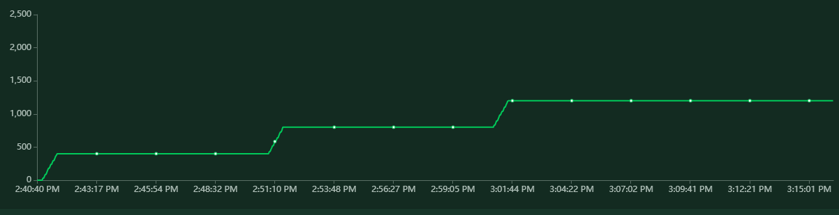
Load Test
Number of Users

Slide 22
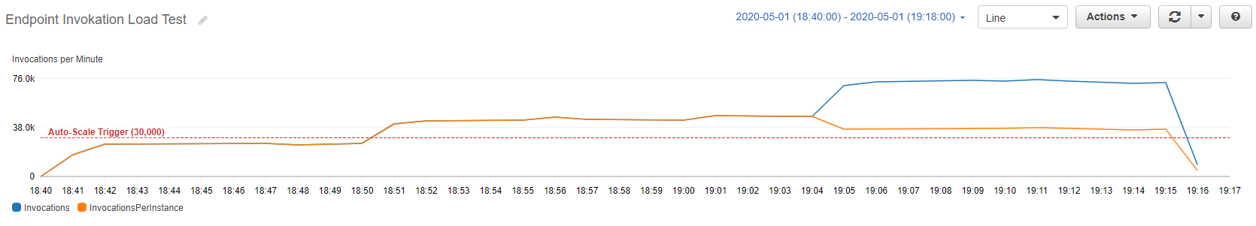
Load Test
Invocations of SageMaker Endpoint

Slide 23
Distracted Driver Image Classification with Amazon SageMaker
DSBA 6190 Final Project
May 2020
Evan Canfield ● Roma Dutta ● Shilpa Patil ● Ibrokhim Sadikov
GitHub: https://github.com/DSBA-6190-Final-Project-Team/DSBA-6190_Final-Project
Notes:
Thank you very much for listening. I hope you found this presentation interesting and informative.

