Slide 1


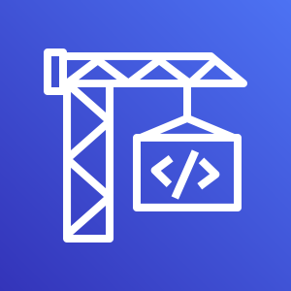

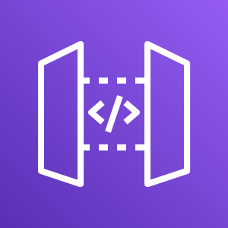

Step 1: Data Processing and
Upload
Local
S3
Input
Data retrieved via Kaggle API
MXNET Tool
Data separated into Train / Validation sets and converted to RecordIO format
Upload data
to S3 Bucket
Step 2: Model Training and Endpoint Deployment
CodeBuild
Trigger Build
GitHub Repo as Source Code
Execute Notebook
SageMaker resources activated via running a Jupyter Notebook
SageMaker
START
Training Job
SageMaker Algorithm Trained
Model
Training Job defined as
Model
Endpoint Configuration
Model applied to Endpoint Config.
Endpoint
Endpoint is Created / Updated
Autoscaling
Policy is applied to Endpoint
END
S3
Training Job saved in S3 Bucket
Step 3: REST API
Local
API Gateway
Lambda
Local Client
Sends image to API Gateway and received back the predicted probabilities for each class.
API Gateway
Gateway connects public internet to Lambda Function
Lambda Function
Function generates Class Prediction from image via deployed Endpoint

