Slide 1


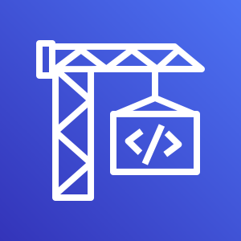

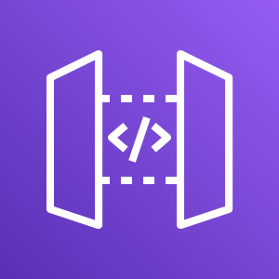

Step 1: Data Processing and
Upload
Local
S3
Input
Data retrieved via Kaggle API
MXNET Tool
Data separated into Train / Validation sets and converted to RecordIO format
Upload data
to S3 Bucket
Step 2: Model Training and Endpoint Deployment
CodeBuild
Trigger Build
GitHub Repo as Source Code
Execute Notebook
SageMaker resources activated via running a Jupyter Notebook
SageMaker
START
Training Job
SageMaker Algorithm Trained
Model
Training Job defined as
Model
Endpoint Configuration
Model applied to Endpoint Config.
Endpoint
Endpoint is Created / Updated
Autoscaling
Policy is applied to Endpoint
END
S3
Training Job saved in S3 Bucket
Step 3: REST API
Local
API Gateway
Lambda
Local Client
Sends image to API Gateway and receives back Probabilities for each Class
API Gateway
Connects Local Client to Lambda Function via public internet connection
Lambda Function
Using image as input, generates Probabilities for each Class via Endpoint

