Slide 1
Python Final Project
Weather Image Recognition using Deep Learning
Team:
Dheeraj Sannidhi
Navya Gujjarlapudi
Nishitha Reddy Boyapati
Nikhileshwar Reddy Papagiri

Slide 2
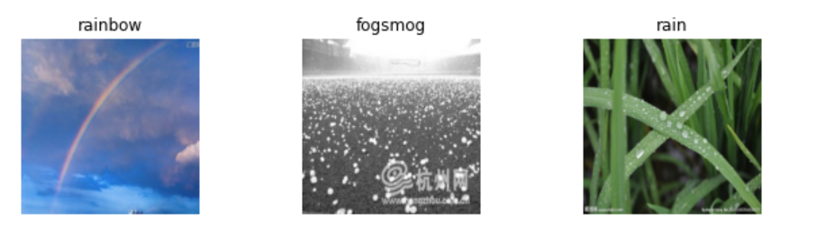
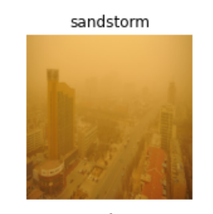
Abstract
In this project, we have built a convolutional neural network (CNN) model on a database containing 6862 images of 11 different weather conditions to classify the image into its correct weather phenomena.

Slide 3
Introduction
The process of analyzing the weather phenomena is very important for forecasting the weather and monitoring the quality of the environment.
Making an exact prediction can be of great help in agriculture and it also helps in spatial surveillance using satellites so that we can take preventive measures to avoid severe hazardous situations.
This project builds a convolutional neural network model and trains the data on the model and evaluates the model to find the accuracy. Then it predicts the data on unseen images to evaluate the results.

Slide 4
Objective
In recent days, weather forecasting has become a bigger concern all over the planet. Due to abrupt changes happening, it has been requiring a significant deal of attention since a long time. But there are many limits to better forecasts, making it difficult to accurately anticipate the weather these days. Due to the success of various data related neural network methods such as computer vision and facial recognition techniques, it has been demonstrated that the deep learning methods can efficiently analyze the spatial features from the spatial data.

Slide 5
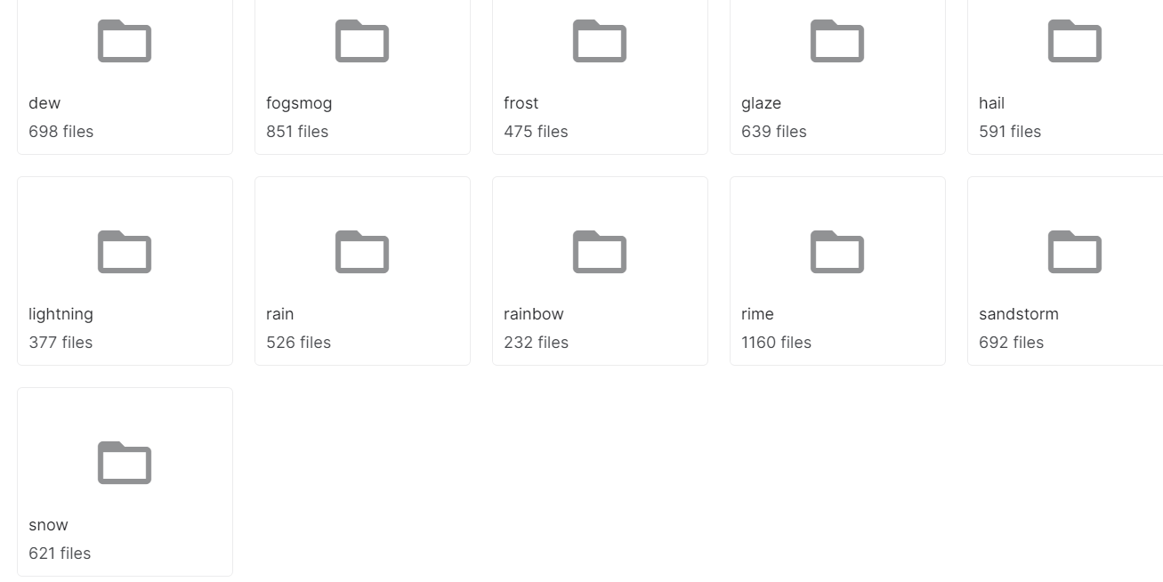
DATASET DESCRIPTION
The dataset is imported from Kaggle and it contains 6862 images belonging to 11 weather conditions out of which 75 Percent of the data is considered for training and 25 Percent of the data is considered for validation.
We have obtained the images from various weather conditions: Rain,glaze,rime,snow,fogsmog,frost,lightning,rainbow,hail,sandstorm,dew.

Slide 6
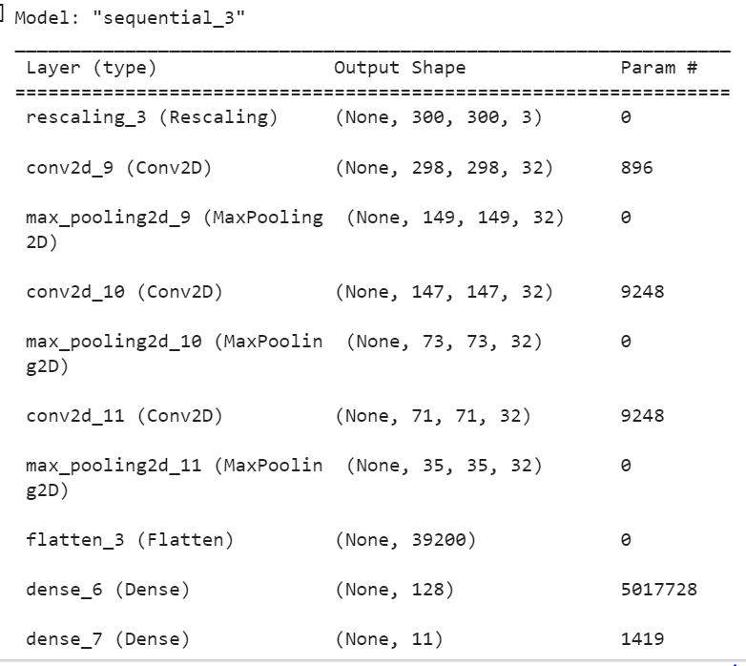
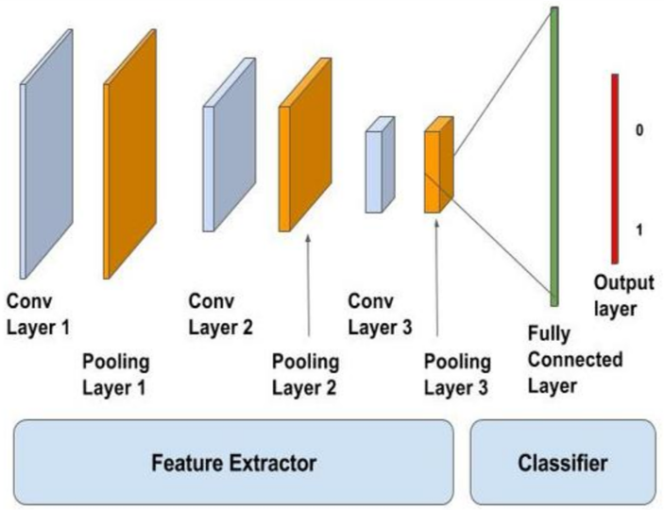
Model:
To perform predictions, we have utilized a structure with three convolutional layers, followed by max pooling and flattening out the network to fully connected layers.

Slide 7
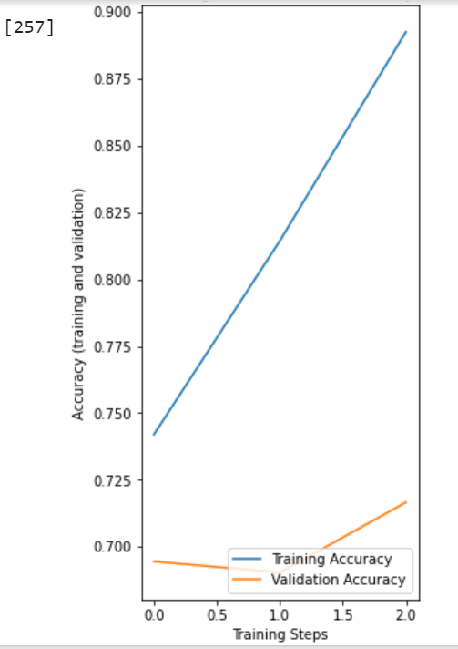
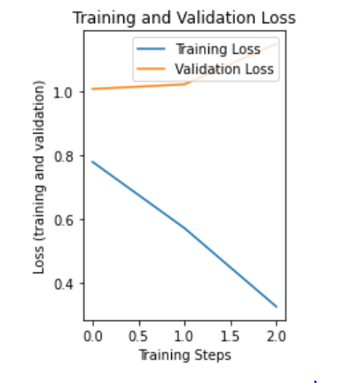
Model Performance:

Slide 8
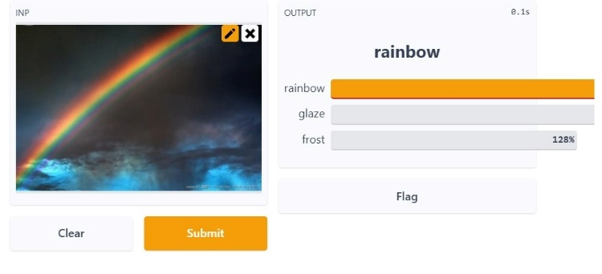
Application:
We have built a GUI using Gradio which takes any image that we upload as an input and prints the prediction
(correct class) of that image.
Below is the snapshot of the Gradio interface:

Slide 9
References
https://agupubs.onlinelibrary.wiley.com/doi/10.1029/2020EA001604?msclkid=27b9b46ccef411ecb586a7d35520a372
https://www.sciencedirect.com/science/article/abs/pii/S2214579620300460?msclkid=593dada0cf1511ecbaa91575f110644b
https://www.researchgate.net/publication/329922758_Weather_Forecast_Prediction_An_Integrated_Approach_for_Analyzing_and_Measuring_Weather_Data?msclkid=29af95e9cefb11ecb704eb9079cc91f6
https://www.kaggle.com/code/diwakargupta0/transfer-learning-with-xception-net
https://medium.com/@myalbiez/dog-breed-classifier-project-a213cf04914a
https://rexsimiloluwa.medium.com/building-a-plant-disease-classification-web-app-in-keras-and-tensorflow-js-d435829213fa

Slide 10
THANK YOU

