Slide 1
Real-Time Anomaly Prediction for IndyCar Datasets with LSTM
Yafei Wang
April 28, 2020

Slide 2
Outline
Motivation and related work
Dataset pre-processing
LSTM model architecture
Results
Discussion

Slide 3
Motivation and related work
Anomaly detection is defined as patterns in data does not match with expected behavior.
A huge majority of cases use supervised (e.g. SVM and decision trees) and unsupervised (e.g. clustering) for batch data processing.
Algorithms for real-time anomaly detection mainly include Hierarchical Temporal Memory Algorithm (HTM), Skyline, Twitter ADVec, KNN CAD, Relative Entropy, Windowed Gaussian.
However, those methods have limitation in addressing the multivariable problem due to its strong nonlinear fluctuations [1].

Slide 4
Motivation and related work
Previous work has shown that LSTM/RNN network can handle multivariate time-series data without the need for dimensionality reduction [2], which is very important for IndyCar case due to multivariate real-time metrics for each car such as speed, engine rpm, gear, lap distance and brake etc
In this project, a LSTM model is used to predict the speed with IndyCar training data, and compare the result with real value to determine if there is something anomaly happens (inspired by [3])

Slide 5
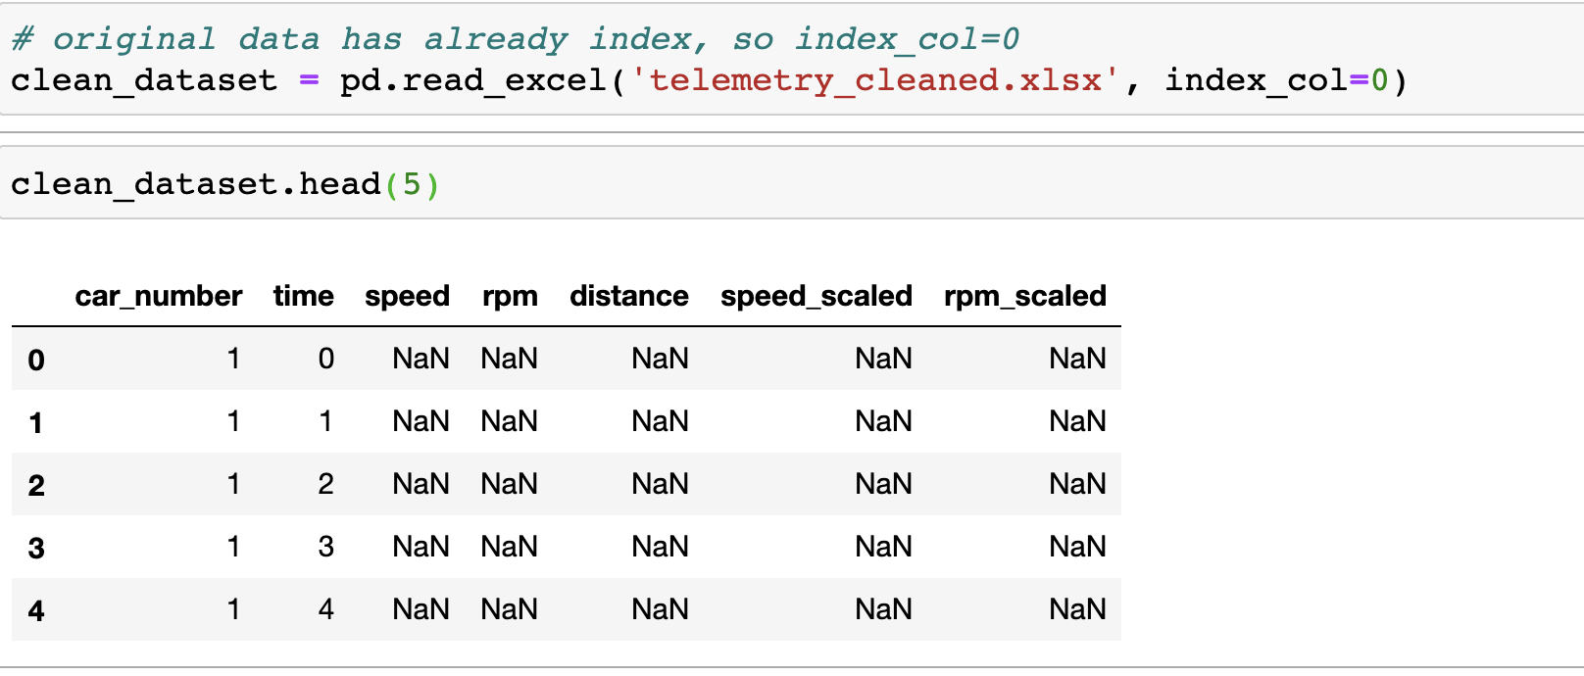
Dataset pre-processing
Raw dataset of IndyCar 2018 is used in this project
Clean the raw dataset ( acknowledge instructor Selahattin’s help )
Row length = 33*11586

Slide 6
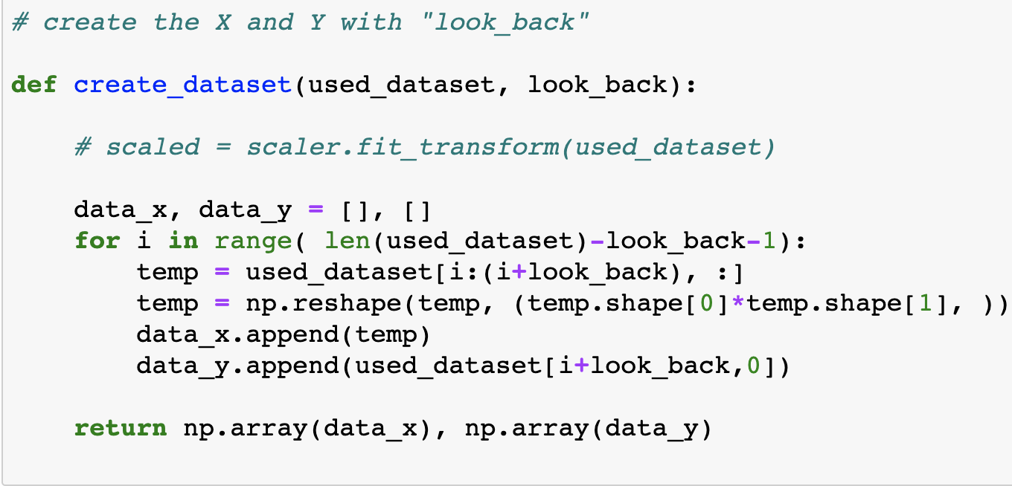
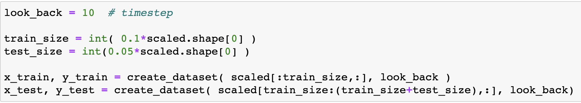
Dataset pre-processing
Select speed and lap-distance as features (each car stacked by rows)
Training and test dataset
10% of total dataset as training
5% of total dataset as test

Slide 7
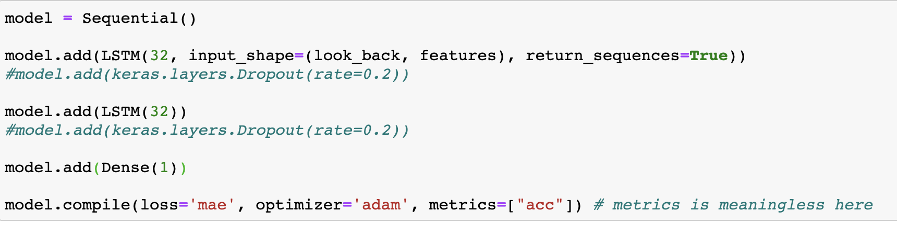
LSTM model architecture
LSTM network is used in the project
Two hidden layers, with each using 32 units
Loss function: mae
Optimizer: adam

Slide 8
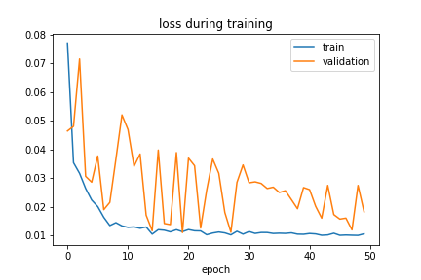
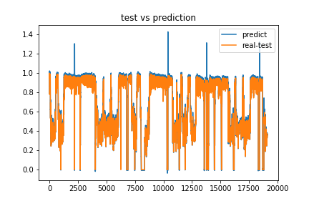
Results
Timestep =10
Train Score: 0.04 RMSE
Test Score: 0.03 RMSE

Slide 9
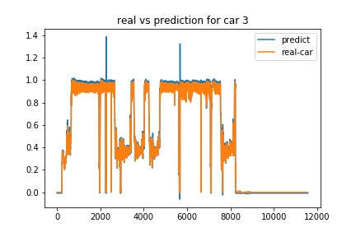
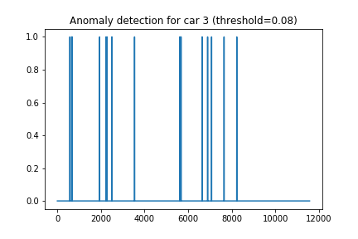
Results
Car 3 prediction
Predict Score: 0.03 RMSE
Car crash

Slide 10
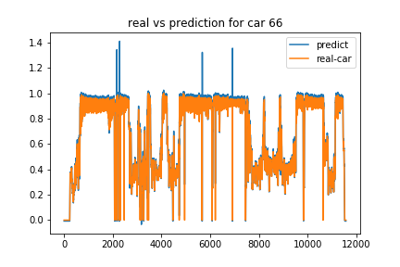
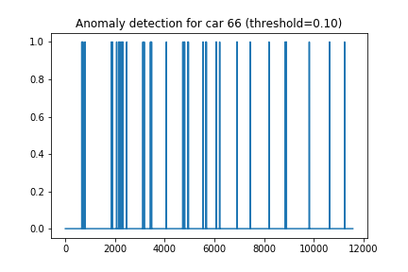
Results
Car 66 prediction
Predict Score: 0.05 RMSE

Slide 11
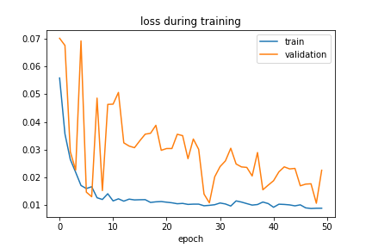
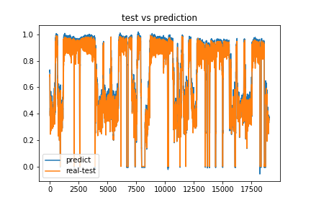
Results
Timestep =100
Train Score: 0.04 RMSE
Test Score: 0.03 RMSE

Slide 12
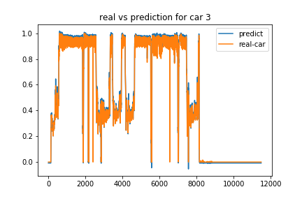
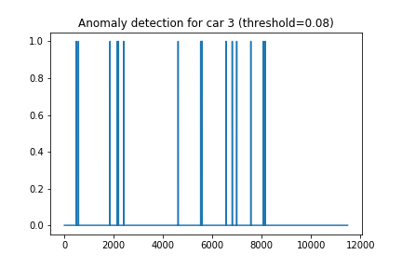
Results
Car 3 prediction
Predict Score: 0.03 RMSE
Car crash

Slide 13
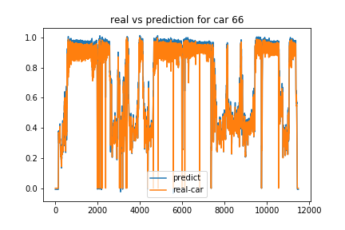
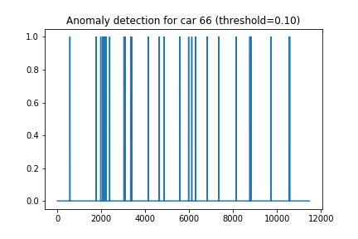
Results
Car 66 prediction
Predict Score: 0.05 RMSE

Slide 14
Discussion
From the result, the prediction speed is very closed to the ground truth
Adding a threshold would be possible to detect the anomaly event
Some possible questions
Stacked the dataset by row or column ? (there are 33 cars (objects), but every car’s speed shouldn’t depend others car by intuition. However, some car crash would definitely impact other cars)
How to use reasonable timestep ? (by simply testing two values in this project, results are different)
Other methods such as labelling car crashing should be more effective, but it’s time consuming to manually label it. What’s more, only 9 cars didn’t finish in 2018, so the crash dataset may be too small ? Possible some techniques such as GAN could be used to generate more new data ?

Slide 15
References
[1] Liu et al. An Ensemble Model Based on Adaptive Noise Reducer and Over-Fitting Prevention LSTM for Multivariate Time Series Forecasting, IEEE Access, 2019(7)
[2] Anvardh Nanduri and Lance Sherry. 2016. Anomaly detection in aircraft data using Recurrent Neural Networks (RNN). In 2016 Integrated Communications Navigation and Surveillance (ICNS). Ieee, 5C2–1.
[3] Kyle Hundman, Valentino Constantinou, Christopher Laporte, Ian Colwell, and Tom Soderstrom. 2018. Detecting spacecraft anomalies using lstms and nonparametric dynamic thresholding. In Proceedings of the 24th ACM SIGKDD International Conference on Knowledge Discovery & Data Mining. 387–39

Slide 16
Thank you!

