Slide 1
Parallel and Distributed GBT
9/18/2018
Bo Peng
IPCC@Indiana University

Slide 2
Outline
Problem
Related work
Proposal

Slide 3
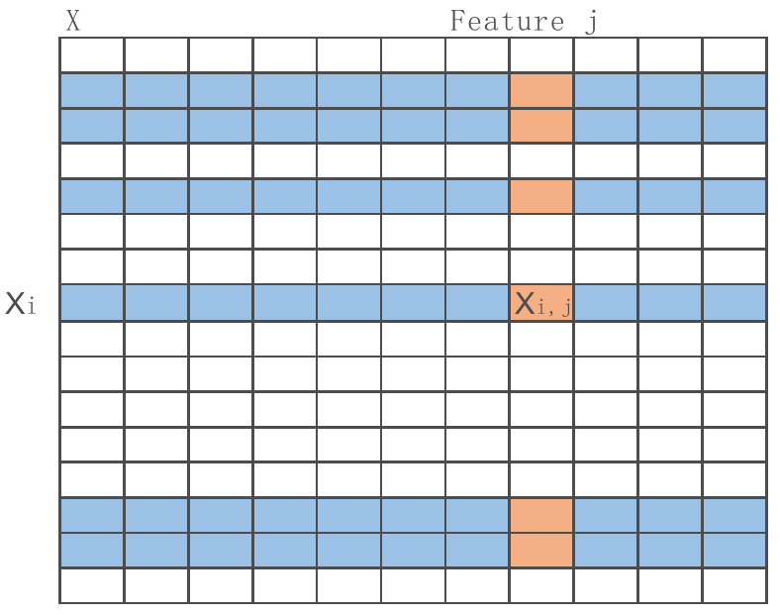
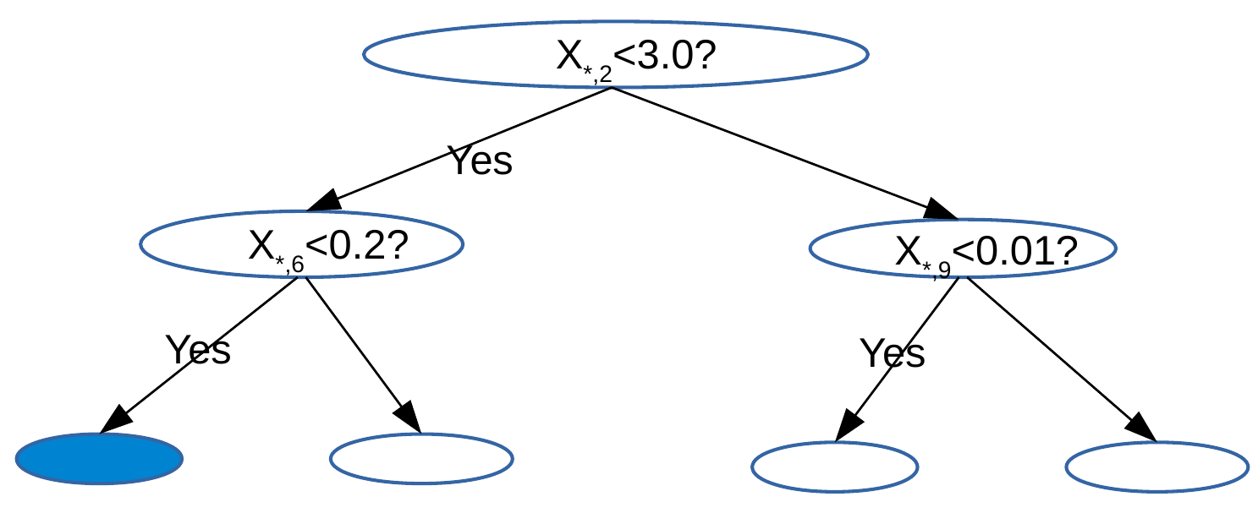
Building a Tree
findBestSplit is the bottleneck
For each node, go through all instances in the node and all features
parallelism: node level, feature level, inside single feature level

Slide 4


Single Feature j
findBestSplit is the bottleneck
GHSum is the core data structure
for each feature
bins, fixed split points
g,h summation on instances whose value fall into the bin
X_{j}
Histogram
Node Instance Set
i
Bins
b₀
b₁
①
Dynamic Memory
x_{ij}
X_{i,j}
b₂
GHSum
②
③
G₀
H₀
b₃
binID
G₁
H₁
Left
③
G₂
H₂
Split Point
④
G₃
H₃
Y
f_{t-1}
g,h
GH_{total}
G
H
y_{i}
f_{i}
g_{i}
h_{i}

Slide 5
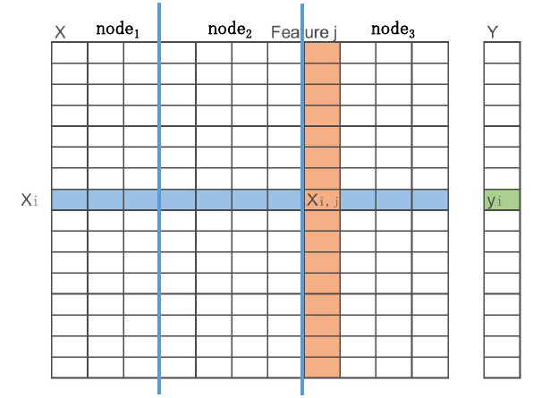
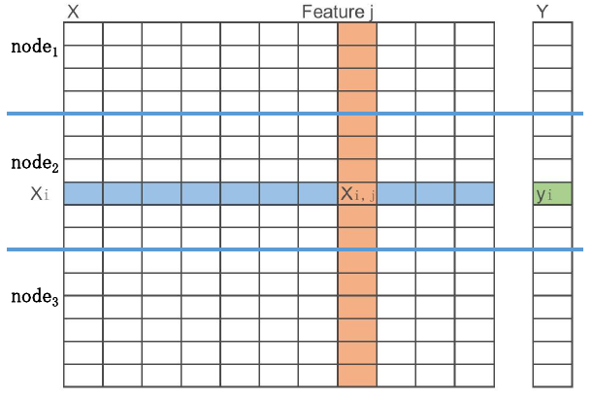
Distributed findBestSplit
Partition by rows (instances)
need gobal communication to build Bins, (build once if use global static Bins)
need gobal communication to build GHSum for each feature in findBestSplit() → allreduce(GHSum)
Partition by columns (features)
Bins and GHSum are all local, no communication
need global communication to select the best feature in findBestSplit() → allreduce(maxscore), also need to broadcast(Split Instance Set)

Slide 6
Issues
irregular memory access
instances in one tree node are dynamic set
non-continuous memory access to g,h
read/write after write dependency, GH[bin[X[i,j]]] += g[i], will stall when cache miss on access g[i]
spasity
missing values
frequent zero entries
artifacts of feature engineering such as one-hot-encoding
high dimensionality
|features| can be very large (10~50M)

Slide 7
Outline
Problem
Related work
Proposal

Slide 8
XGBoost^{[1]}
Standard baseline
Algorithm
approximate algorithm with both local and global proposal methods (Bins)*
sparsity-aware, only collect statistics of non-missing entries
System
Column Block
each block is a subset of rows
in each block, data stored in compressed column(CSC) format, with each column sorted by corresponding feature value
support feature level parallelism
linear scan to find best split
Cache-aware access
choose correct block size to get gradient statistics(g,h) fit into the CPU cache. (2¹⁶)
Notes:
*global bins need more candidates

Slide 9
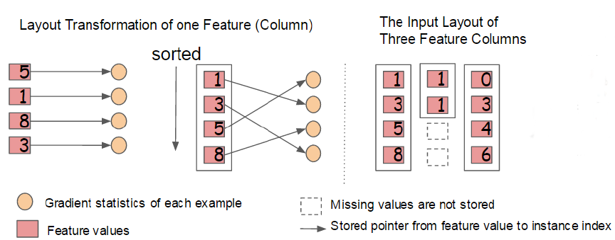
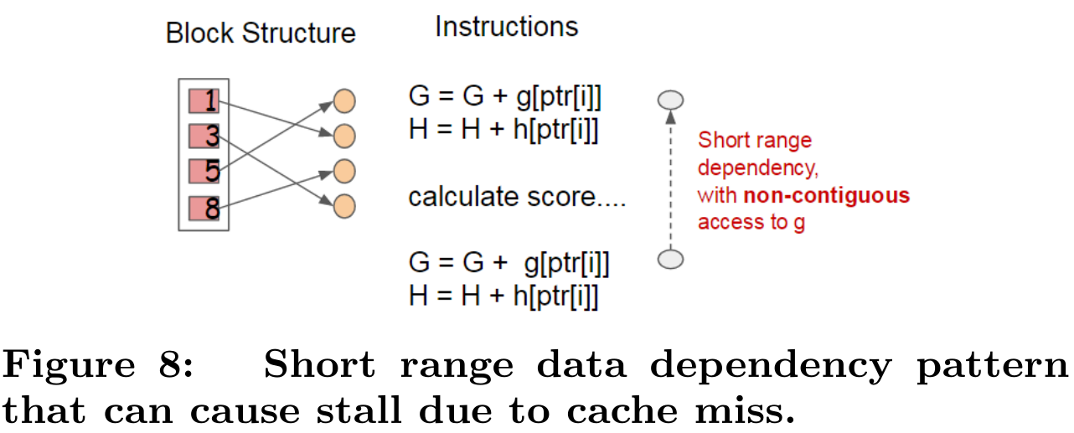

Slide 10
LightGBM^{[2][3]}
high communication costs ~O(|features|*binSize)
PV-Tree (Parallel Voting Decision Tree)
local voting: select top-k features based on local data
global voting: select top-2k features by votings from local candidates
collect full-grained histograms of the globally top-2k features, and findBestSplit
high dimensionality
Gradient-based One-side sampling
exclude a significant proportion of data instances with small gradients in estimate the score
better than SGB(Stochastic GB) with the same sampling ratio
Sparsity
Exclusive feature bundling
bundle mutually exclusive features(never nonzero values simultaneously) into a single feaure
letting exclusive features reside in different bins (adding offsets to original values)

Slide 11
DimBoost^{[4][5]}
high dimensionality (industry application with 330K features)
Optimize Communication
parameter server
claims to be one communication step and take less time (?)
two-phase-split finding
server-side split
round-robin task scheduler
schedule the splitting tasks among the workers
low-precision gradient histogram
each item q in a histogram, encode to a d-bit integer q'=floor(q/|c|*2^{d})
d=8 often enough to obtain no loss on final accuracy
Optimize Computation
parallel batch construction
divides a range into batches for the big nodes in the first few layers
spare histogram construction
only non-zero entries

Slide 12
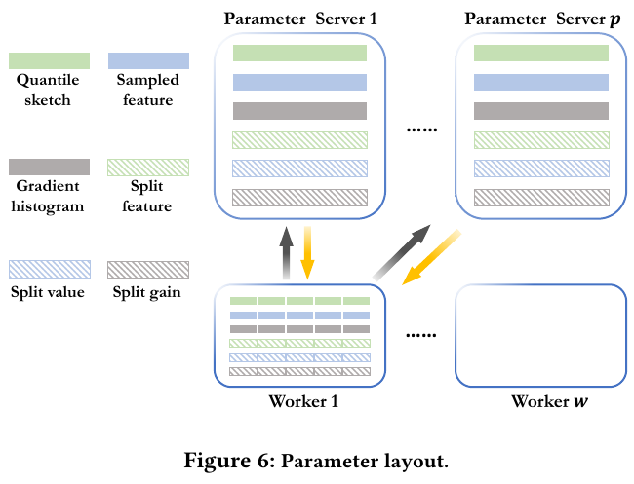
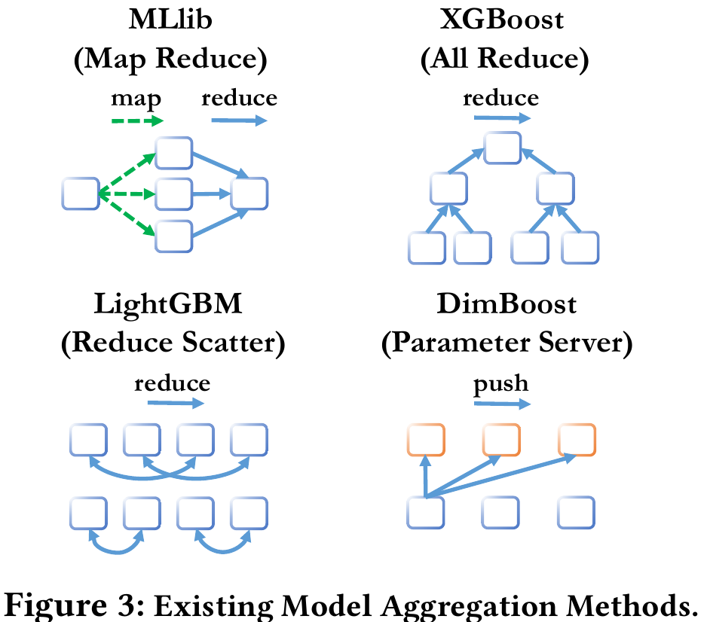
Notes:
* We first partition a vector to several ranges based on
feature indexes, then use hash partition to put each partition onto
one node.

Slide 13
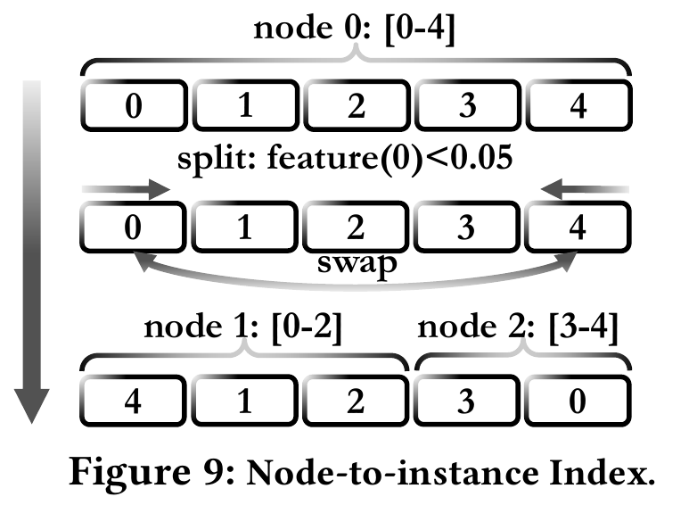
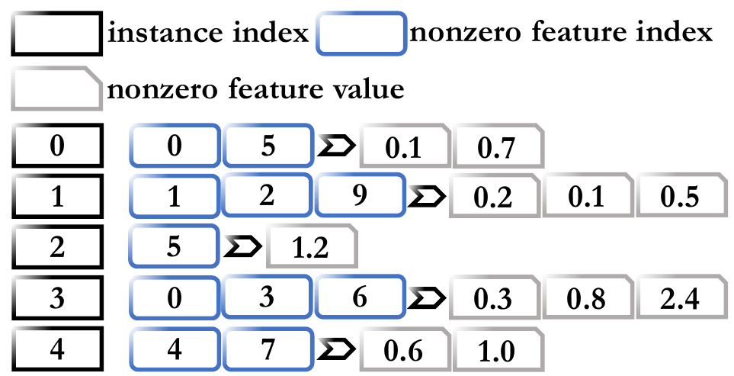

Slide 14
GPU-GBDT^{[6]}
sparse representation
similar to Column Block
fine-grain parallelism
parallelizing the score computation of each split point: segmented prefix sum --> GHSum
select best split point: semented reduction
splitting a node: maintain values of each feature in the new node in sorted order
Run-length encoding compression
sorted by feature values
repeated values can be compressed
directly splitting RLE elements
thread/block workload dynamic allocation
under a memory constrain

Slide 15
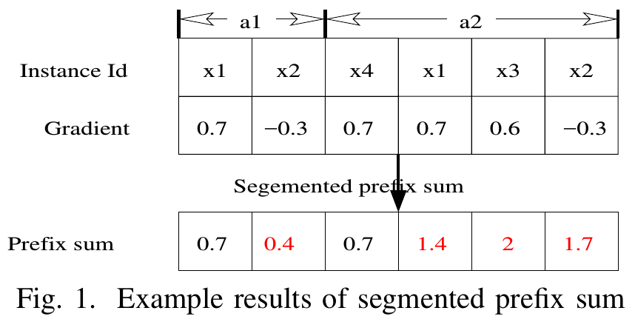
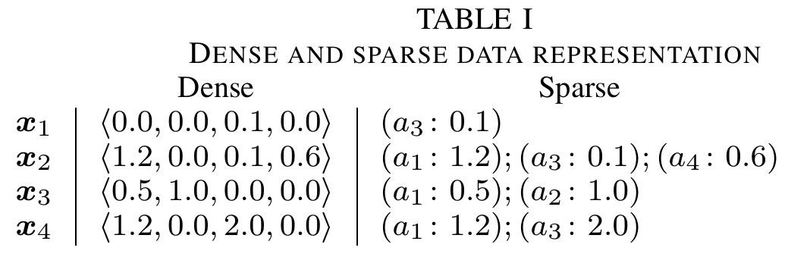
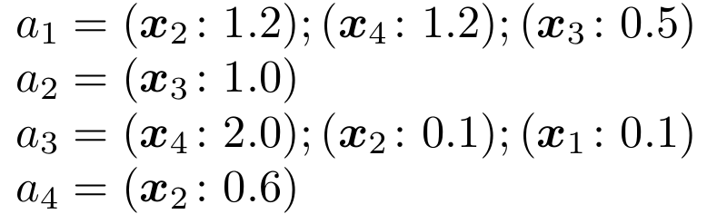

Slide 16
Outline
Problem
Related work
Proposal

Slide 17
Assumption
Assumption:
Model: GHSum, (Bins, g, h)
Model size << Training Data size
Training Data N samples, M Features, build tree with L levels
Model GHSum with bin size B
at each node, size: B*M
at each level,size: 2^{L-1}*B*M
Most cases
M <1K, L<8, B~[20,100]
high dimension can be an issue
deep tree can be an issue (GBT prefers shallow trees)

Slide 18
Dataset Statistics
example:
Higgs: N = 10m, M = 28
L = 6, B = 128; model size at level L, 32*128*28 << 10m
KDD10: N=19M, M=29M
feature enginering: expand a categorical feature into a set of binary features, combination*
Notes:
*http://ntur.lib.ntu.edu.tw/retrieve/188513/17.pdf
[1]H.-F. Yu et al., “Feature engineering and classifier ensemble for KDD cup 2010,” in KDD Cup, 2010.

Slide 19
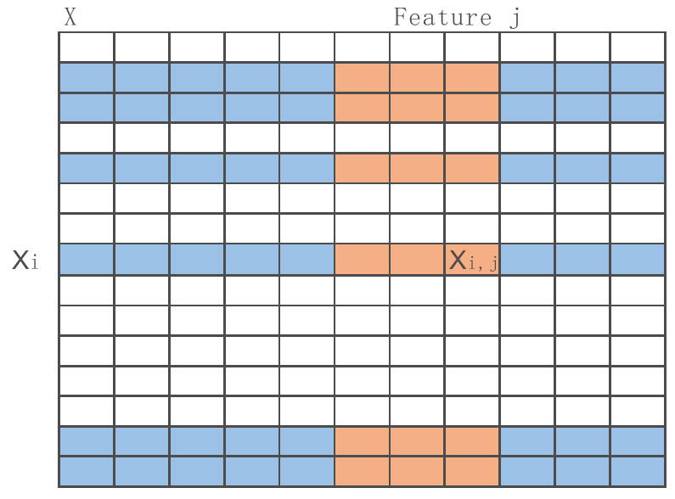
Cache Friendly Data Orgnization
Issue: non-continuous memory access in feature level parallelism
prefer column-wised data orgnization
dynamic instance set
N is large, (g,h) can not even fit into LLC cache
Ideas
multi-columns to fit one cache line
clolumn block to get a small range of (g,h) access cache friendly

Slide 20
Training data access
Issue: redundent access to training data in node level parallelism
prefer row-wised data orgnization, however, it conflicts with feaure level parallelism
Ideas
process layer-by-layer
Keep column-wised orgnization
Keep all GHSum of the same level in cache
Single pass on train data for each level. (half when reuse GHSum_{_parent})

Slide 21
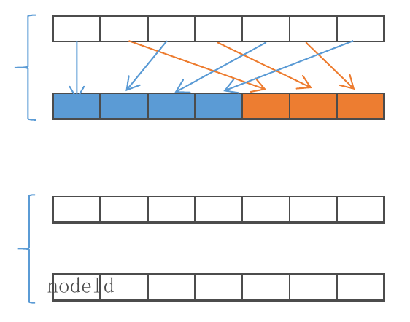
Instance Set access
Issue:Dynamic instance set
move instance id around after node split
maintain in order to process node-by-node
Ideas
encode <nodeid, level> into a uniq nodeID, (easy for binary tree)
a nodeID vector to maintain the current leaf level instance sets directly
support random access by instance id <i>
sequential scan to get <f_{i}, g_{i},h_{i}>

Slide 22

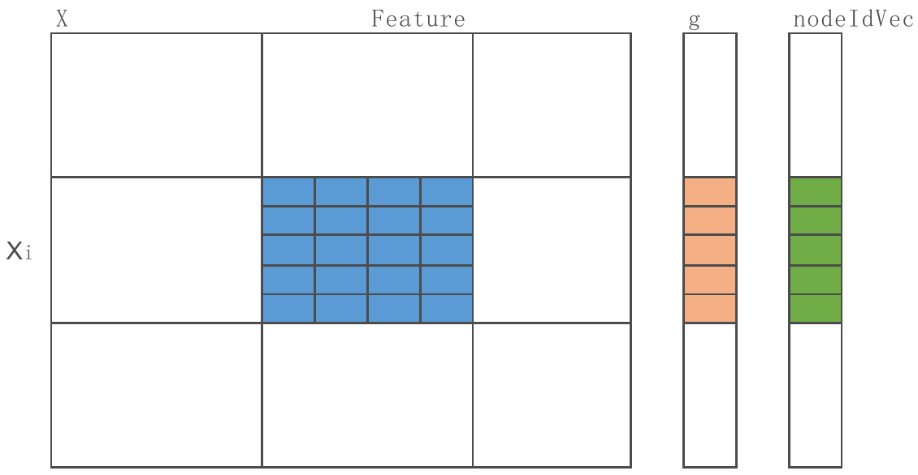
Block-based Data Orgnization and Parallelsim
Level L
Column Block
the basic unit for parallelism
column-wised data orgnization
dense/sparse support
sorted by feature values
Set the block number/size to
fit all active <g,h>,nodeIDVec blocks in LLC
fit all active GHSum blocks in L2
loop order can be optimized
nodeid=1+2^{L-1}
for j in column_block:
for each x_{i,j} in the column X_{,j}:
nodeid = nodeIDVec[i]
bindid = Bins[j][x_{i,j}]
GHSum[nodeid][j][binid] += g[i]

Slide 23
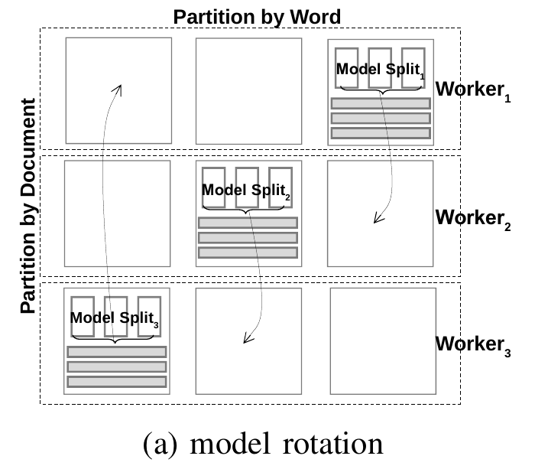
Unified Computation Model for Parallelism
Proposal
unified computation model: model rotation
Data partitioned to blocks
Data Parallelsim:
Model parallelism: GHSum split by feature columns
Scheduler to avoid update conflicts

Slide 24
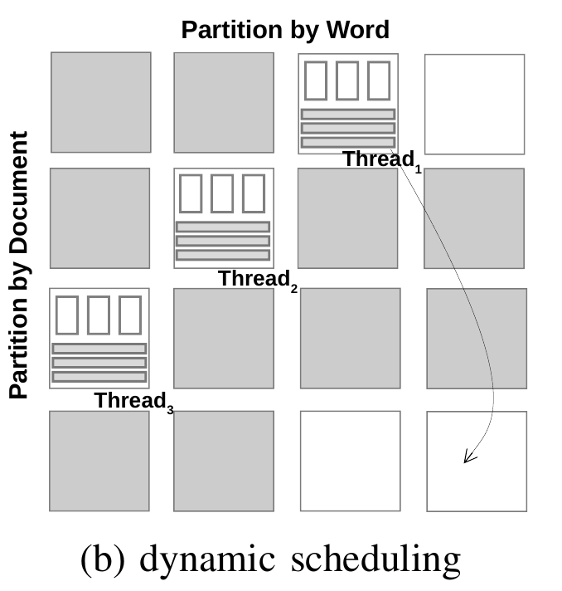
Dynamic Scheduling in Shared Memory systems
a low cost solution to remove synchronization overhead
number of partitions is larger than the number of threads,
always ‘free’ rows and columns avaliable when one thread finishes its current task.
cache-aware block size
sparse representation ready

Slide 25
Distributed Model Rotation
Training data randomly partitioned among nodes
Model partitioned among nodes
split by feature columns
Scheduler to avoid update conflicts
rotate local model partition to neighbor at each sub-step
finish after K sub-steps(K nodes)
kind of a ring-allreduce

Slide 26
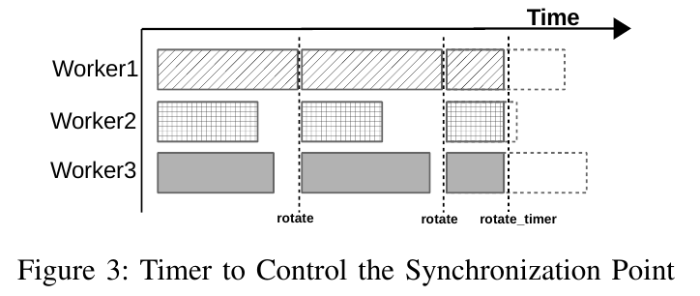
Reduce Overhead of Collective Communication
Design
Each worker only works for the same period of time and then they do synchronization all together.
They all use a timer to control the synchronization point rather than waiting until all the blocks to finish.
not ready for fault tolerance, but ready for straggler
Stochastic GBT support
This adjustment does not change the property of the uniform random selection of blocks.

Slide 27
More to consider
Feature Bundle
deal with category features
Feature Sampling
design scheduler with Gradient-based priority
Data Compression
model compression: low-precision compression
traning data compression: RLE

Slide 28
References
[1]T. Chen and C. Guestrin, “Xgboost: A scalable tree boosting system,” in Proceedings of the 22nd acm sigkdd international conference on knowledge discovery and data mining, 2016, pp. 785–794.
[2]Q. Meng et al., “A communication-efficient parallel algorithm for decision tree,” in Advances in Neural Information Processing Systems, 2016, pp. 1279–1287.
[3]G. Ke et al., “LightGBM: A Highly Efficient Gradient Boosting Decision Tree,” in Advances in Neural Information Processing Systems, 2017, pp. 3149–3157.
[4]J. Jiang, B. Cui, C. Zhang, and F. Fu, “DimBoost: Boosting Gradient Boosting Decision Tree to Higher Dimensions,” in Proceedings of the 2018 International Conference on Management of Data, 2018, pp. 1363–1376.
[5]J. Jiang, J. Jiang, B. Cui, and C. Zhang, “TencentBoost: A Gradient Boosting Tree System with Parameter Server,” in 2017 IEEE 33rd International Conference on Data Engineering (ICDE), 2017, pp. 281–284.
[6]Z. Wen, B. He, R. Kotagiri, S. Lu, and J. Shi, “Efficient Gradient Boosted Decision Tree Training on GPUs,” in 2018 IEEE International Parallel and Distributed Processing Symposium (IPDPS), 2018, pp. 234–243.

