Slide 1
Gradient Boosting Tree

Slide 2
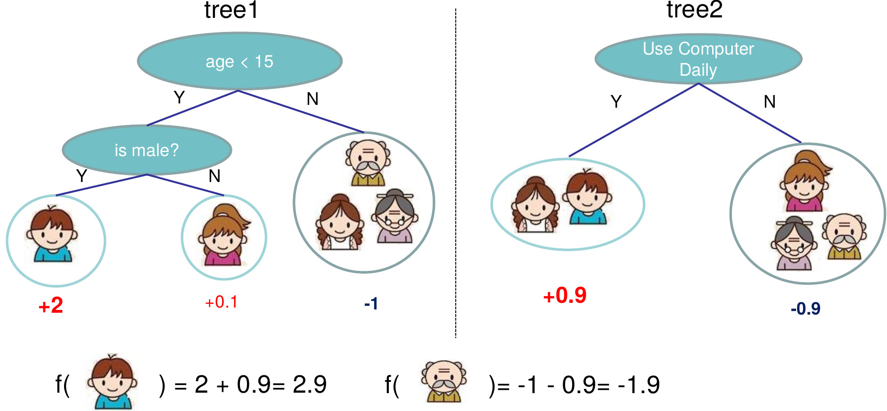

Gradient Boosting Tree Algorithm
Major Challenges of GBT training
Memory bounded
Irregular memory access pattern
Difficult to vectorize
Poor scalability if not well designed for parallelism
Our solution:
Organize data as block and use block as the basic unit for parallelism
Support data and model parallelism
Select block size and parallelism type according to the input data matrix shape to achieve optimal performance
Boosting:
Gradient Tree: learn f_{k}(x_{i}) as a tree
stage-wise and train on the previous residual at the next step
use general loss function to guide the tree split
apply second order gradient approximation on loss function to calculate the score function and optimal weight

Slide 3
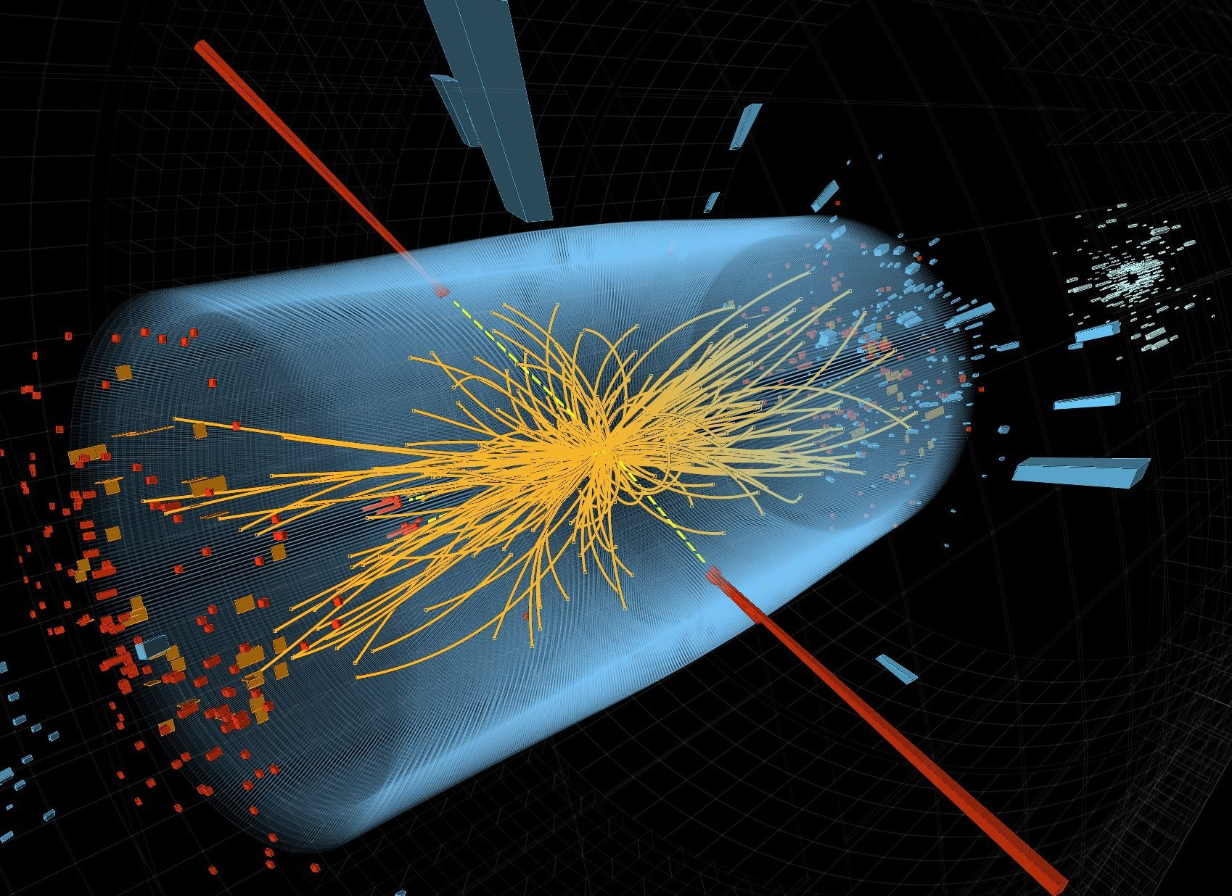

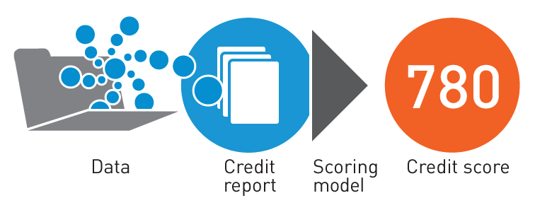
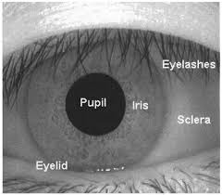
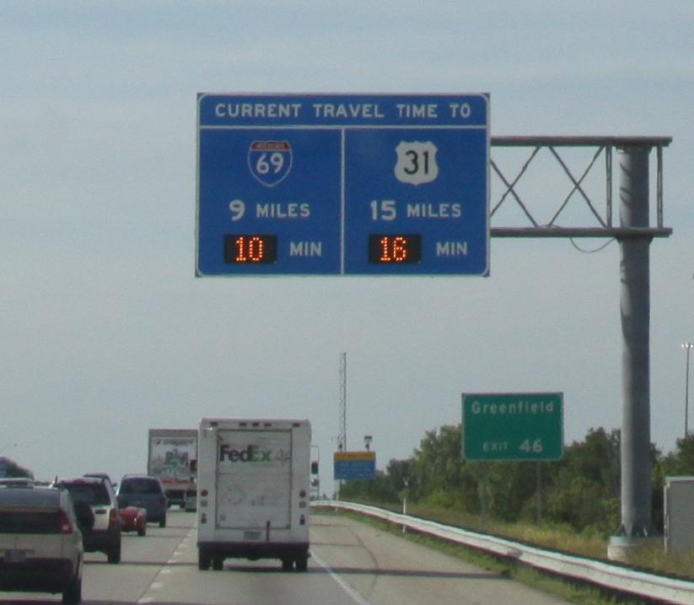
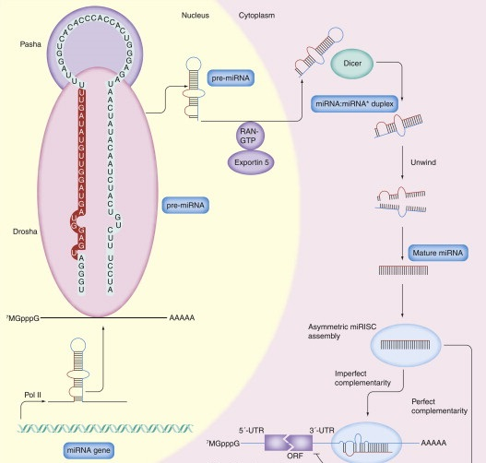
Applications
Higgs boson classification
Credit scoring
Computer-aided diagnosis of lung nodule
Eye pupil localization
Travel time prediction
MicroRNA-Disease Association prediction

Slide 4
Related Work
Application classification | Title | Year | Reference No.
particle identification | Boosted decision trees as an alternative to artificial neural networks for particle identification | 2005 | [1]
Phone duration modeling | Phone duration modeling using gradient tree boosting | 2007 | [2]
insurance loss cost modeling | Gradient boosting trees for auto insurance loss cost modeling and prediction | 2012 | [3]
Mobility management | Smart City Mobility Application—Gradient Boosting Trees for Mobility Prediction and Analysis Based on Crowdsourced Data | 2015 | [4]
Higgs boson classification | Higgs Boson Discovery with Boosted Trees | 2015 | [5]
freeway travel time prediction | A gradient boosting method to improve travel time prediction | 2015 | [6]
Quantitative structure–activity relationship models in pharmacy | Extreme Gradient Boosting as a Method for Quantitative Structure–Activity Relationships | 2016 | [7]
Eye pupil localization | An accurate eye pupil localization approach based on adaptive gradient boosting decision tree | 2016 | [8]
credit scoring | A boosted decision tree approach using Bayesian hyper-parameter optimization for credit scoring | 2017 | [9]
MiRNA-Disease Association prediction | EGBMMDA: Extreme Gradient Boosting Machine for MiRNA-Disease Association prediction | 2018 | [10]
commercial building energy consumption prediction | Gradient boosting machine for modeling the energy consumption of commercial buildings | 2018 | [11]
computer-aided diagnosis system | Computer-aided diagnosis of lung nodule using gradient tree boosting and Bayesian optimization | 2018 | [12]

Slide 5
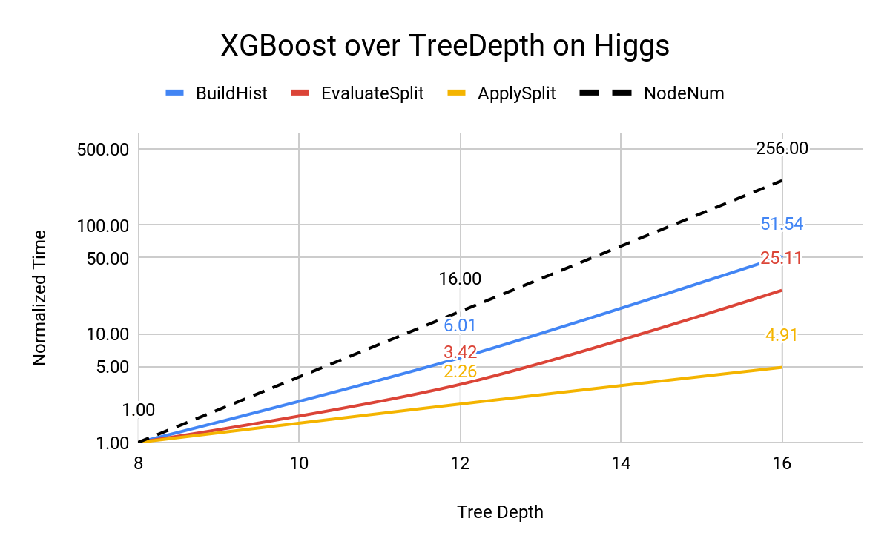
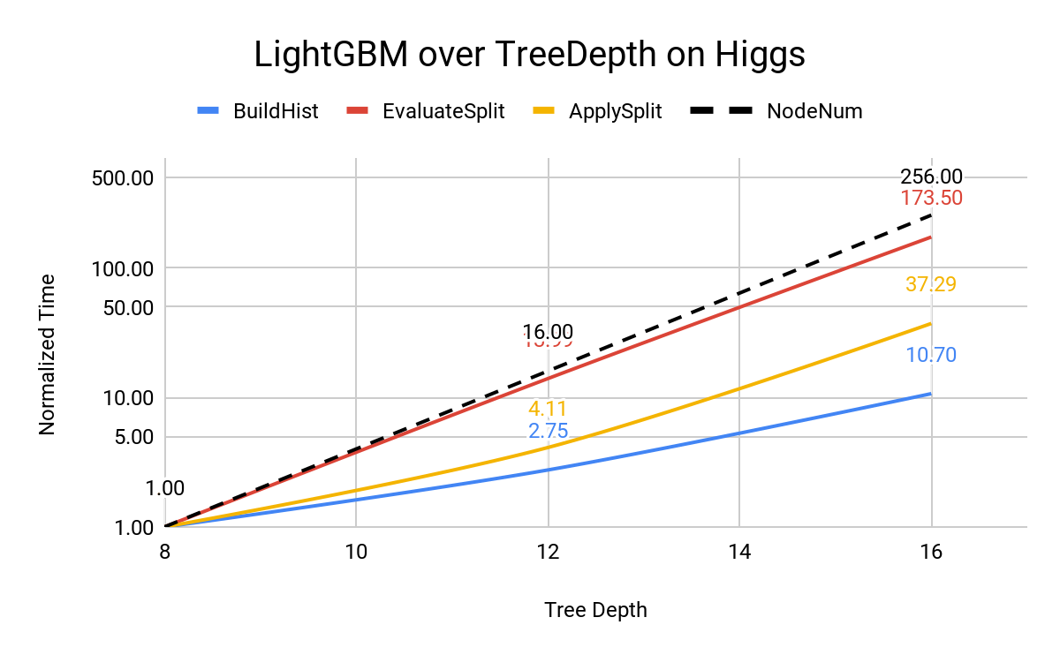
BuildHist, EvaluateSplit, ApplySplit are three core functions.
Exponential growth of execution time are all observed over the tree depth, or linear to number of leaves.
EvaluateSplit and ApplySplit should be proportional to number of leaves.
In BuildHist, the number of memory R/W is linearly proportional to the number of tree depth. The execution time should ideally keep linear over tree depth. However, both XGBoost and LightGBM have exponential growth observed.
BuildHist occupies 90% time for LightGBM, 60% time for XGBoost at tree depth 8. At depth 16, these numbers go to 60% and 70% .
Reasons:
Frequent thread synchronization. Both XGBoost and LightGBM apply OpenMP in parallelizing BuildHist inside one leaf, therefore the number of threads synchronization are proportional to the numbers of leaves.
Random access to intermediate model data, and the size of data increases proportional to the numbers of leaves.
Bottleneck Analysis

Slide 6
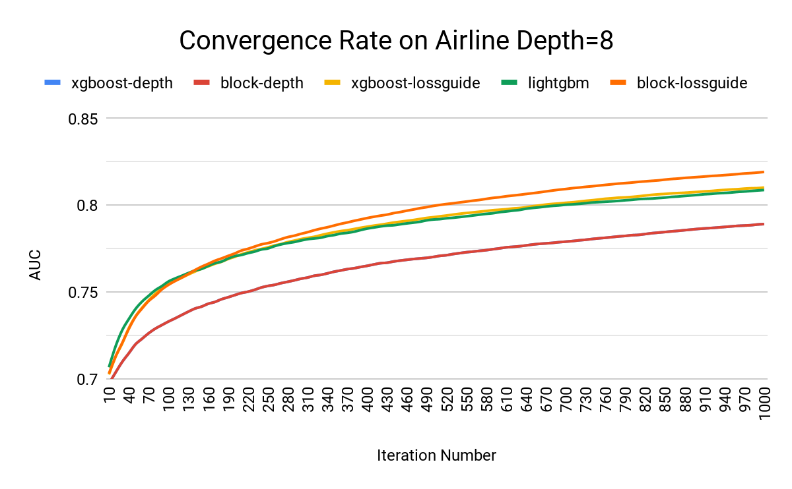
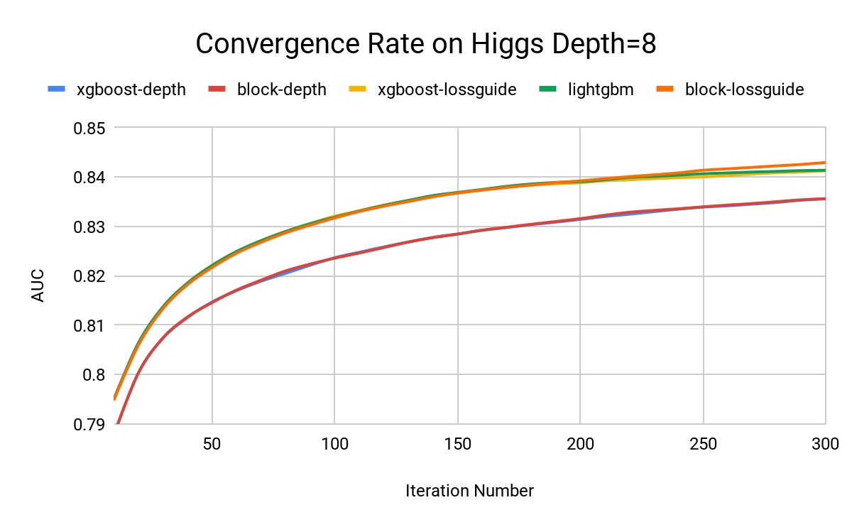
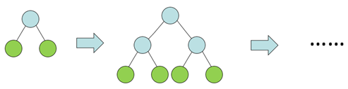
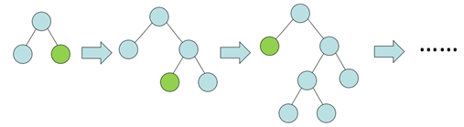
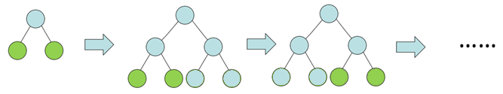

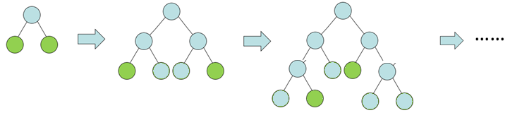
Level-wise growth
Leaf-wise growth
GBT has two tree growth methods:
1) Level-wise growth: nodes in the same level are all selected to BuildHist
2) Leaf-wise growth: only one node with the largest loss_chg is selected
Optimization:
1) Level-wise growth:
nodes in the same level can run BuildHist in parallel
control task granularity by splitting nodes into groups
2) Leaf-wise growth:
select top K nodes with largest loss_chg each time
3) Mixmode of data parallelism and model parallelism
use data parallelism with thread local model replicas when node number is small
use model parallelism when node number is larger than thread number and support to remove OpenMP loop barrier by node level scheduling
achieve the same convergence rate and even better at some dataset
Level-wise growth with NodeBlockSize=2
Leaf-wise growth with NodeBlockSize=2
Optimization: Reduce Number of Thread Synchronization

Slide 7
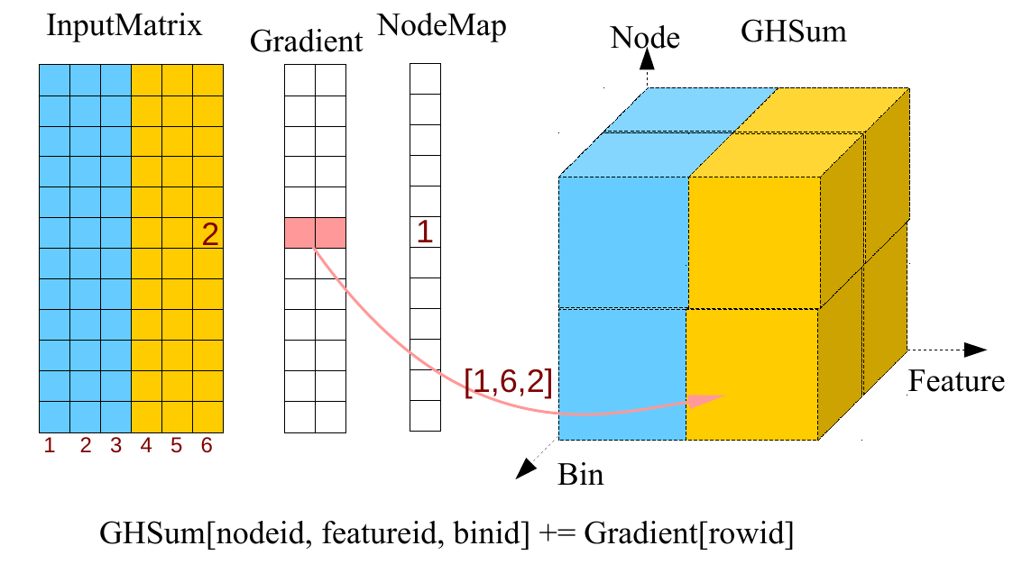
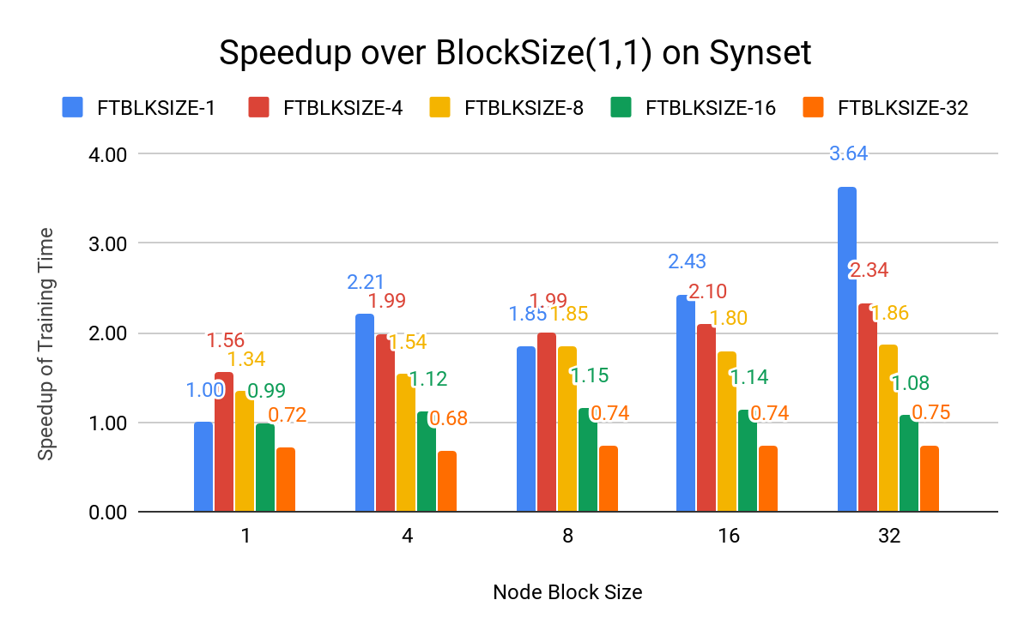
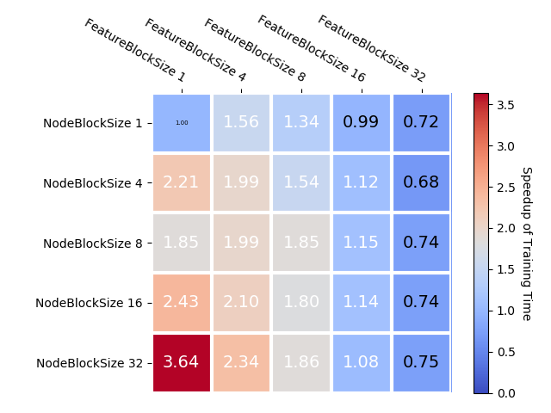
Core operation in BuildHist: Random access as the relation between nodeid and rowid dynamically changes when the tree grows.
Optimization: Block based data organization 1. GHSum is a 3-D matrix <nodeid, featureid, binid> , organized by BLOCKS, small cubes with a continuous memory layout. BLOCK size is configurable to control the size of memory region of continuous writes, to make the write cache friendly. 2. BLOCKS(cubes) in GHSum is the basic unit for parallelism, updates without conflicts.
Experiment: on synset (100 features), leaf-wise, max 256 leaves Runs with different block configurations has 0.75x-3.64x speedup over the one with (node_block_size=1, feature_block_size=1)
Optimization: Cache Friendly Random Memory Access

Slide 8
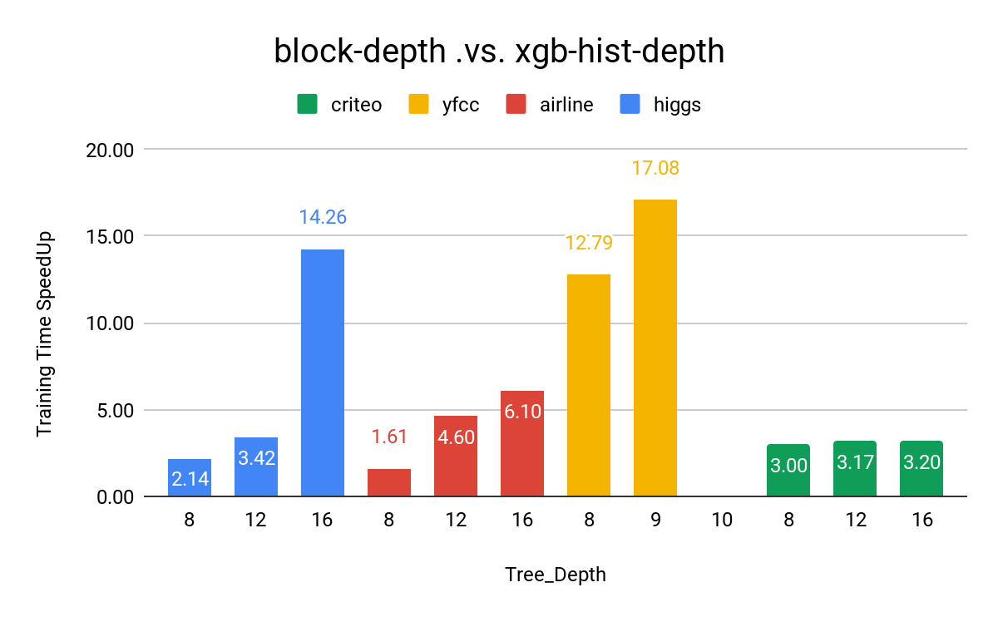
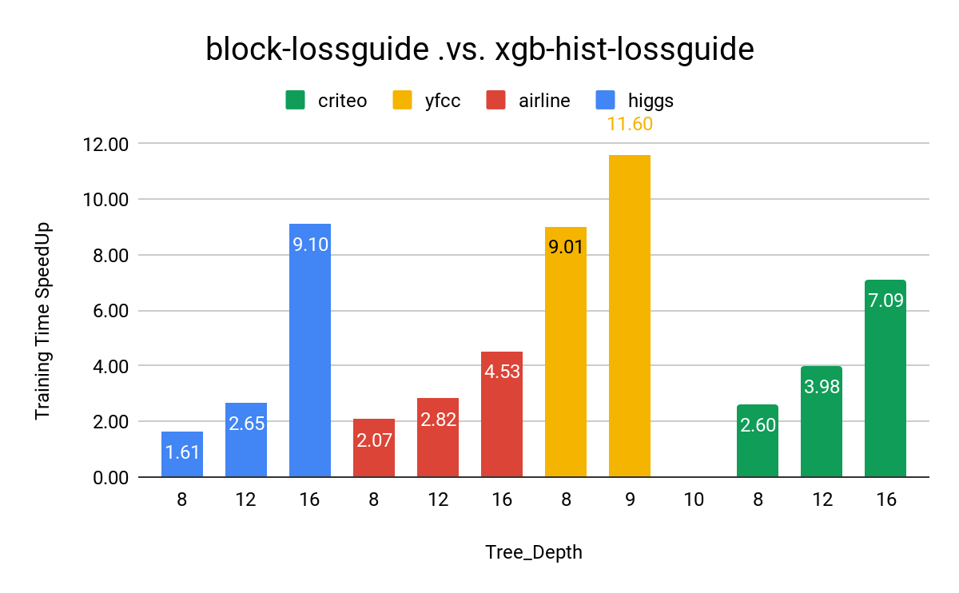
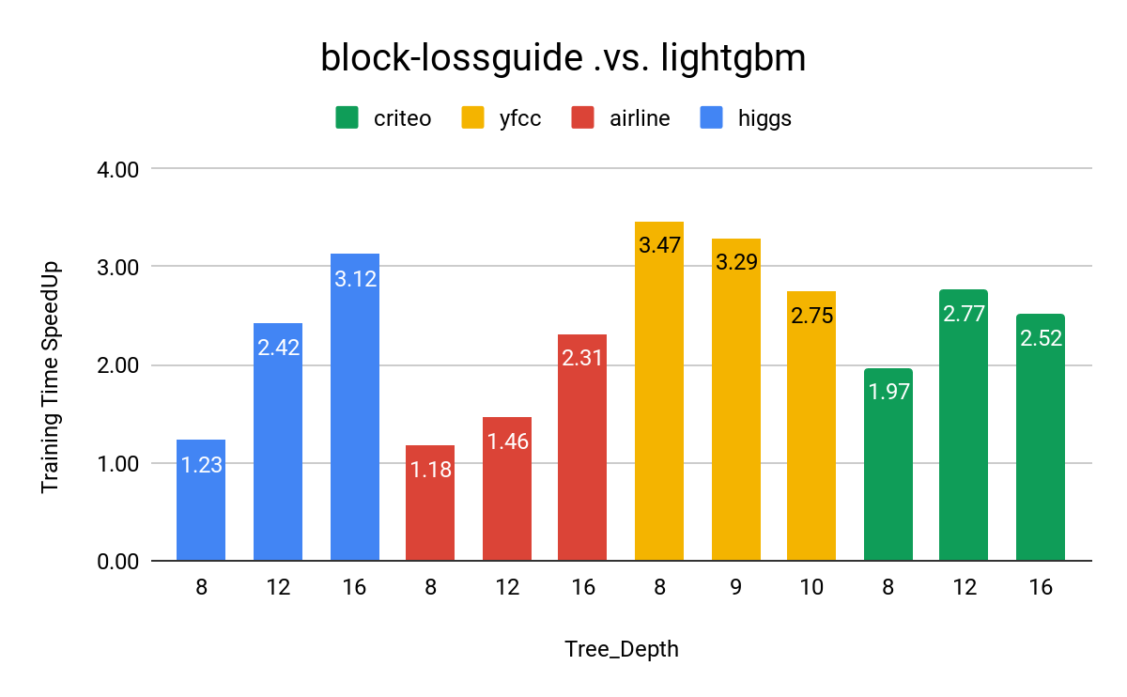
1) Level-wise growth: block .vs. xgboost-hist
achieve 1.6x~17x speedup on four different datasets,
data parallelism is faster in shallow tree depth, model parallelism wins in deep tree
2) Leaf-wise growth: block .vs. xgboost-hist .vs. lightgbm
achieve 1.6x~11x speedup over xgboost-hist,1.2x~3.4x speedup over lightgbm
mixmode with <data parallelism, asynchronized model parallelism, data parallelism> wins
notes:
yfcc: xgboost-hist run out-of-mem in depth 10, lightgbm run out-of-mem in depth 12
Performance Evaluation - Shared Memory

Slide 9
Reference
[1] Roe, B.P., Yang, H.J., Zhu, J., Liu, Y., Stancu, I. and McGregor, G., 2005. Boosted decision trees as an alternative to artificial neural networks for particle identification. Nuclear Instruments and Methods in Physics Research Section A: Accelerators, Spectrometers, Detectors and Associated Equipment, 543(2-3), pp.577-584.
[2] Yamagishi, J., Kawai, H. and Kobayashi, T., 2008. Phone duration modeling using gradient tree boosting. Speech Communication, 50(5), pp.405-415.
[3] Guelman, L., 2012. Gradient boosting trees for auto insurance loss cost modeling and prediction. Expert Systems with Applications, 39(3), pp.3659-3667.
[4] Semanjski, I. and Gautama, S., 2015. Smart city mobility application—gradient boosting trees for mobility prediction and analysis based on crowdsourced data. Sensors, 15(7), pp.15974-15987.
[5] Chen, T. and He, T., 2015, August. Higgs boson discovery with boosted trees. In NIPS 2014 Workshop on High-energy Physics and Machine Learning (pp. 69-80).
[6] Zhang, Y. and Haghani, A., 2015. A gradient boosting method to improve travel time prediction. Transportation Research Part C: Emerging Technologies, 58, pp.308-324.
[7] Sheridan, R.P., Wang, W.M., Liaw, A., Ma, J. and Gifford, E.M., 2016. Extreme gradient boosting as a method for quantitative structure–activity relationships. Journal of chemical information and modeling, 56(12), pp.2353-2360.
[8] Tian, D., He, G., Wu, J., Chen, H. and Jiang, Y., 2016, November. An accurate eye pupil localization approach based on adaptive gradient boosting decision tree. In Visual Communications and Image Processing (VCIP), 2016 (pp. 1-4). IEEE.
[9] Xia, Y., Liu, C., Li, Y. and Liu, N., 2017. A boosted decision tree approach using Bayesian hyper-parameter optimization for credit scoring. Expert Systems with Applications, 78, pp.225-241.
[10] Chen, X., Huang, L., Xie, D. and Zhao, Q., 2018. Egbmmda: extreme gradient boosting machine for mirna-disease association prediction. Cell death & disease, 9(1), p.3.
[11] Touzani, S., Granderson, J. and Fernandes, S., 2018. Gradient boosting machine for modeling the energy consumption of commercial buildings. Energy and Buildings, 158, pp.1533-1543.
[12] Nishio, M., Nishizawa, M., Sugiyama, O., Kojima, R., Yakami, M., Kuroda, T. and Togashi, K., 2018. Computer-aided diagnosis of lung nodule using gradient tree boosting and Bayesian optimization. PloS one, 13(4), p.e0195875.

