Slide 1
HarpLDA+: Optimizing Latent Dirichlet Allocation for Parallel Efficiency
Bo Peng¹ Bingjing Zhang¹ Langshi Chen¹ Mihai Avram¹ Robert Henschel² Craig Stewart²
Shaojuan Zhu³ Emily Mccallum³ Lisa Smith³ Tom Zahniser³ Jon Omer³ Judy Qiu¹
¹School of Informatics and Computing, Indiana University
²UITS, Indiana University
³Intel Corporation

Slide 2
Outline
Problem and Motivation
Large scale LDA training is challenging
Background
Parallel and distributed LDA algorithm
Our Approach
System design optimized for parallel efficiency
Experiments
Evaluation and validation
Conclusion
Contributions and insights learned

Slide 3
Latent Dirichlet Allocation (LDA)
Widely used in areas such as text mining, advertising, recommender systems, network analysis, and genetics
Use big model for exploring subtle semantics
Can be viewed as a sparse matrix decomposition technique on a word-document matrix, but roots on a probabilistic foundation

Slide 4
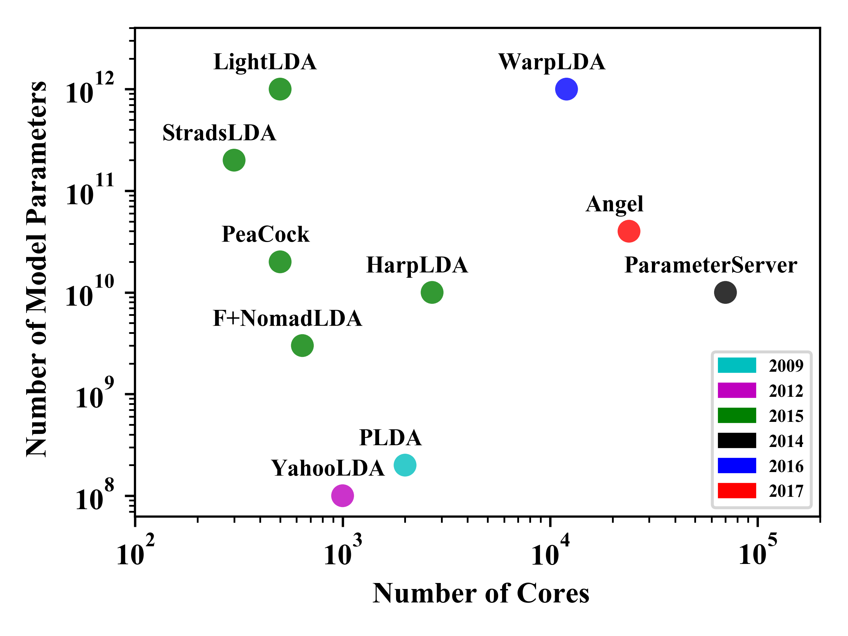
Large Scale LDA Training is Challenging
State-of-the-art LDA training systems (trainers) are implemented to handle：
billions of documents,
hundreds of billion tokens,
millions of topics,
millions of unique tokens.

Slide 5
Motivation
Why yet another LDA trainer?
many different approaches in the existing tools
however, the pros and cons of different approaches are often hard to explain
we investigate from the perspective of the system parallel design.
from our previous work, a synchronized system design shows its advantages but synchronization overhead is an issue.
Is it possible to preserve the effectiveness and at the same time improve parallel efficiency by reducing the synchronization overhead?
we search answer to this question
Notes:
1. why hard to explain?
many trade-offs between effectiveness (contributions to converge) and efficiency (computational cost) of model updates.
decrease the time complexity of the computation by introducing approximations.
reduce the synchronization overhead by using an asynchronous parallel system working on a stale model.
improve model update efficiency at the cost of the model update effectiveness for convergence.
2.

Slide 6
Outline
Problem and Motivation
Large scale LDA training is challenging
Background
Parallel and distributed LDA algorithm
Our Approach
System design optimized for parallel efficiency
Experiments
Evaluation and validation
Conclusion
Contributions and insights learned

Slide 7
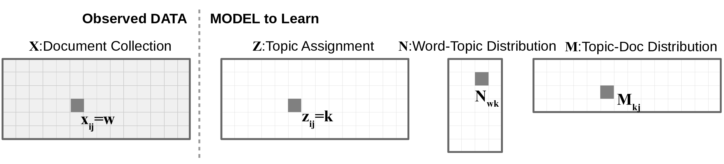
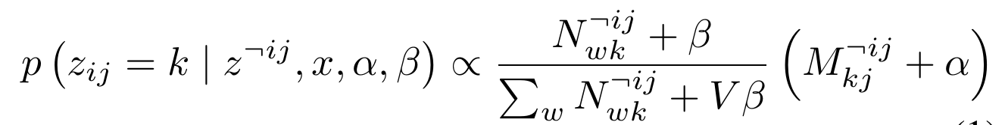
LDA Training:CGS Algorithm
Collapsed Gibbs Sampling(CGS), a Markov chain Monte Carlo (MCMC) algorithm
Initialization: each token is assigned to a random topic as Z_{ij}
Iterates until converge:
Sampling: assign new topic for token Z_{ij} from the distribution
Update: update model N_{wk}, M_{kj} accordingly
Notes:
MCMC:
MCMC framework, samples can be drawn according to
the unknown posterior distribution by a carefully designed
transition function that visits the whole parameter space.
Gibbs sampling is one such design that visits the parameter
space from one dimension to the other. For each iteration,
it fixes all the states of other dimensions and only updates
the current visiting one.

Slide 8
Features of LDA-CGS Computation
Random Memory Access
each sampling step access a row and a column of Matrices N, M
Operation on Sparse Matrix
vectorization can not be applied
Strict Sequential Process
CGS itself is a sequential algorithm

Slide 9
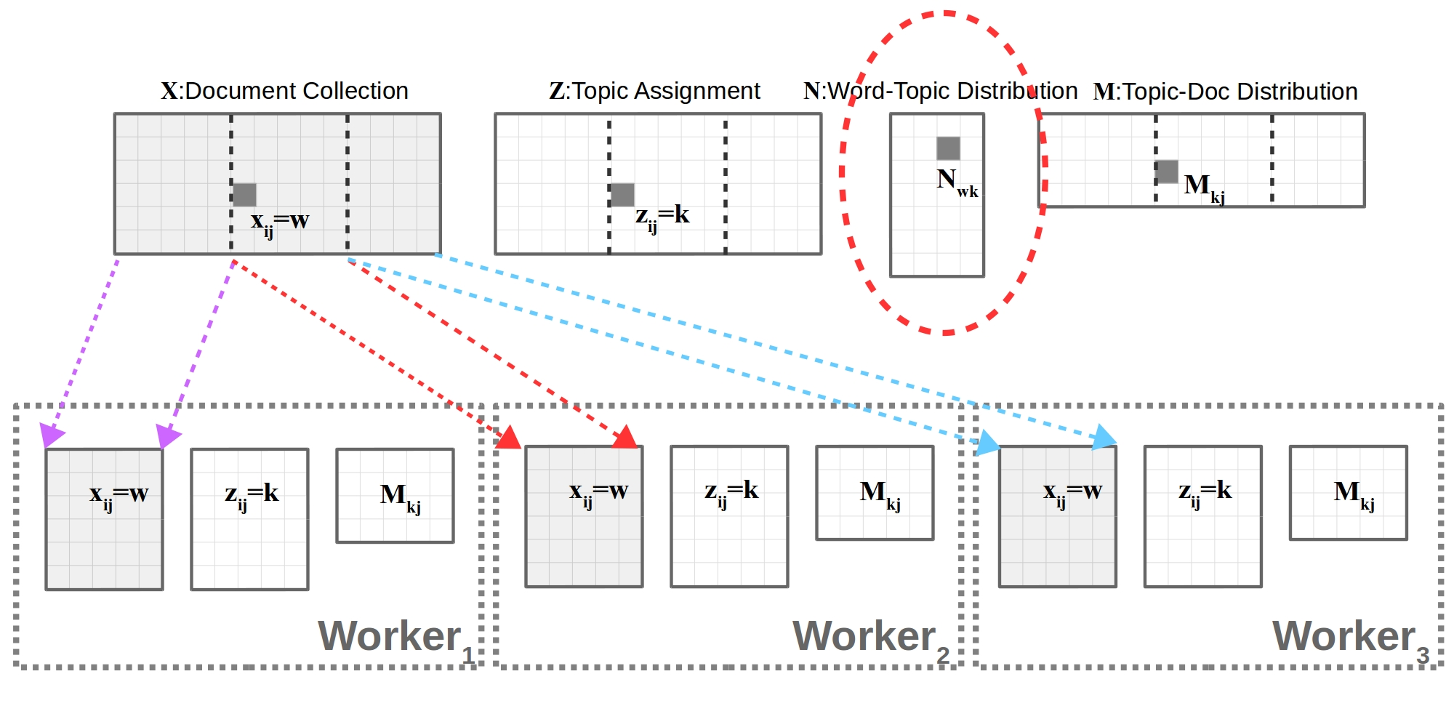
Distributed LDA-CGS
Partition by Document
X,Z,M access local only, but N is shared across all the workers

Slide 10
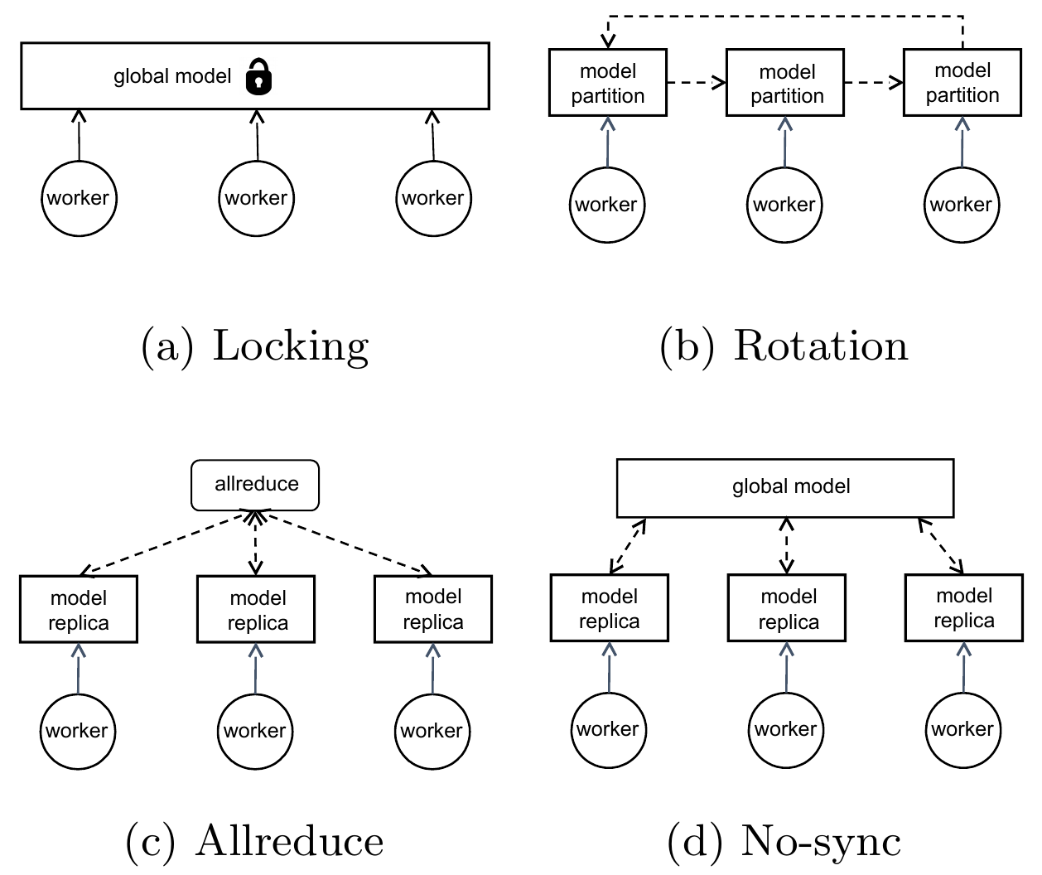
Optimizing Access to Share Model
AllReduce
works on a stale model
synchronization on model replicas.
No-sync
local replicas
synchronizes in a best effort through a group of parameter servers.
Rotation
distributed model partitions
partitions ‘rotate’ among the workers keeping model updates conflict free.
Notes:
https://dsc-spidal.github.io/harp/docs/programming/computation-models/
talk about the features of different approaches
why they use this approach
1. allreduce, easy-to implement, easy to understand
2. no-sync, no synchronization overhead, easy to scale out, but at cost of model update effectivness
3. rotation, keep model update effective, at cost of synchronization overhead

Slide 11
Optimizing Sampling Algorithm
Sampling process
first calculate the probability of each event k
generate a random number and search along the probabilities
SparseLDA
N,M is sparse, only none zero elements need in sampling
F+Tree
search with tree other than linearly
MH:
Alias Table to draw sample on fixed distribution in O(1)
Approximate by Metropolis Hasting sampling
UpdateDelay
delay all the updates

Slide 12
Outline
Problem and Motivation
Large scale LDA training is challenging
Background
Parallel and distributed LDA algorithm
Our Approach
System design optimized for parallel efficiency
Experiments
Evaluation and validation
Conclusion
Contributions and insights learned

Slide 13
Our Approach
Sampling algorithm: SparseLDA
Synchronized design: Rotation architecture
Focus on reducing the synchronization overhead

Slide 14
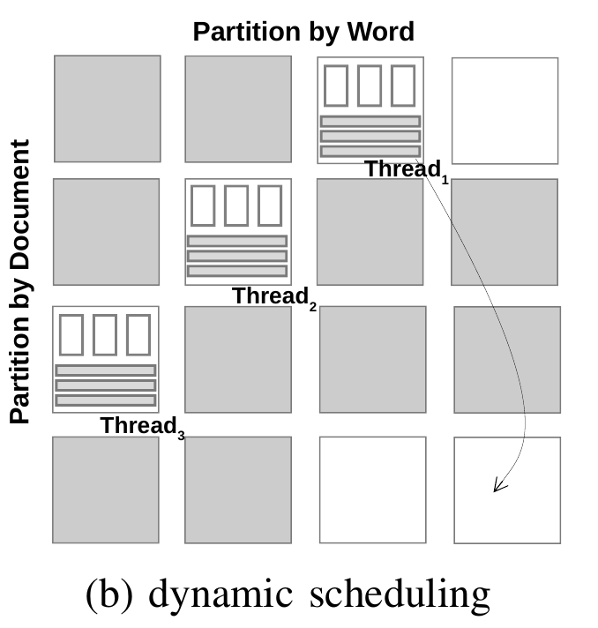
Dynamic Scheduling in Shared Memory systems
a low cost solution to remove synchronization overhead
number of partitions is larger than the number of threads,
always ‘free’ rows and columns avaliable when one thread finishes its current task.

Slide 15
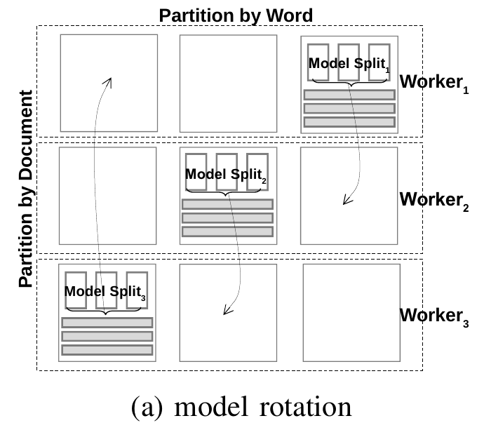
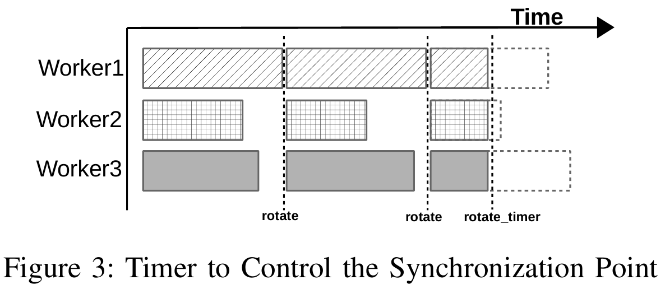
Pipelining and Timer Control in Distributed Systems
Each sampler only works for the same period of time and then the samplers do synchronization all together.
They all use a timer to control the synchronization point rather than waiting until all the blocks to finish.
This adjustment does not change the property of the uniform random selection of blocks.

Slide 16
Outline
Problem and Motivation
Large scale LDA training is challenging
Background
Parallel and distributed LDA algorithm
Our Approach
System design optimized for parallel efficiency
Experiments
Evaluation and validation
Conclusion
Contributions and insights learned

Slide 17
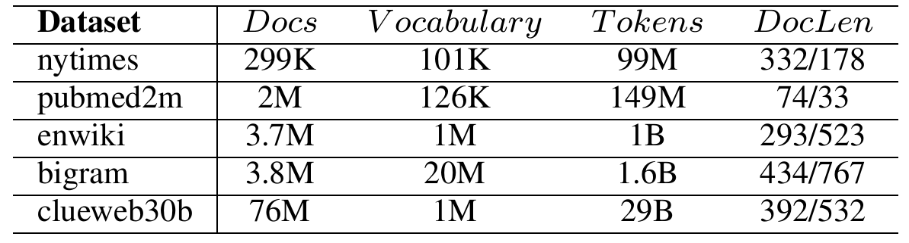
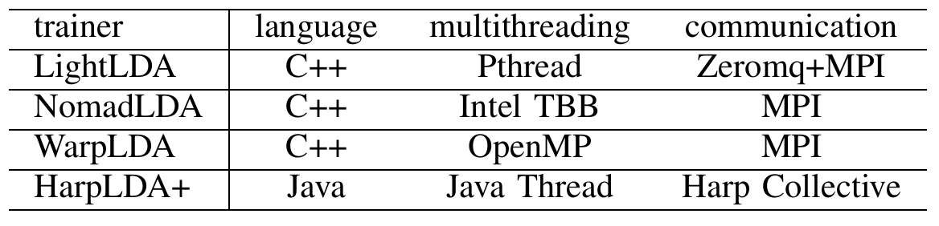
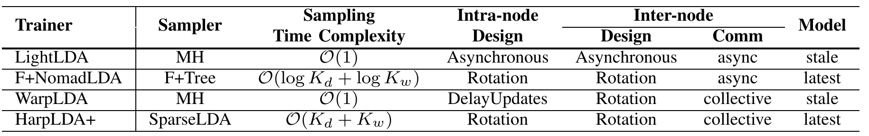
Experiment Settings
Datasets
Trainers
Cluster
128 nodes, Xeon E5-2699/70 v3 processors,128 GB DRAM, QDR InfiniBand
Parameters
hyper-parameters α = 50/K and β = 0.01
Notes:
select and evaluate on these Four trainers to show that
1. Sysstem design in perspective of parallel efficiency is important, which is overlooked in related works.
2. Rotation with optimization of reducing synchronization overhead, is proven to be a good solution.

Slide 18
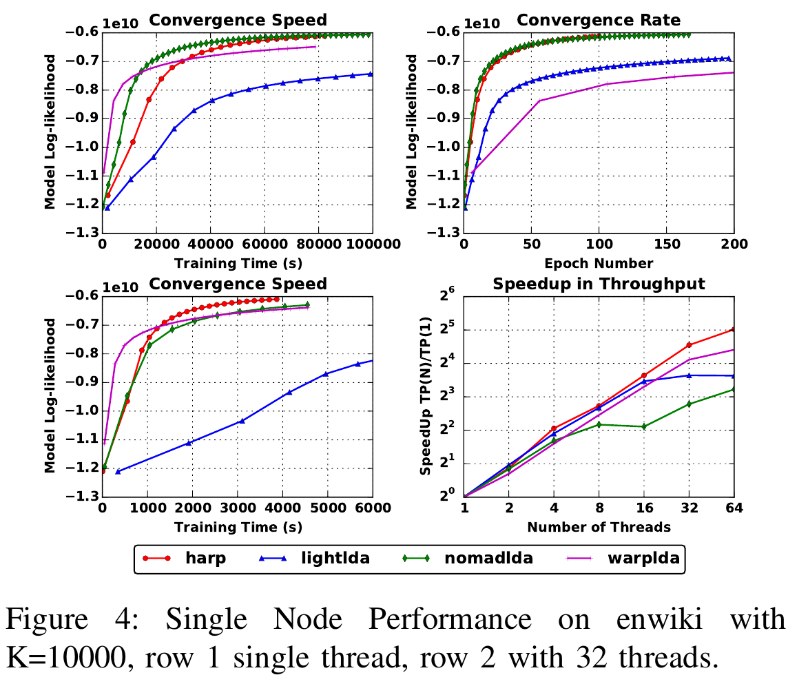
Performance of Sequential Algorithm
Sequential
WarpLDA is the fastest
F+NomadLDA, a standard SparseLDA sampler, always has the fastest converge rate
Parallel
HarpLDA+ runs as well as WarpLDA at K = 1000 and exceeds its performance for K = 10000.
HarpLDA+ demonstrates the best parallel efficiency which explains the boost of its performance froma single thread to a large number of threads.

Slide 19
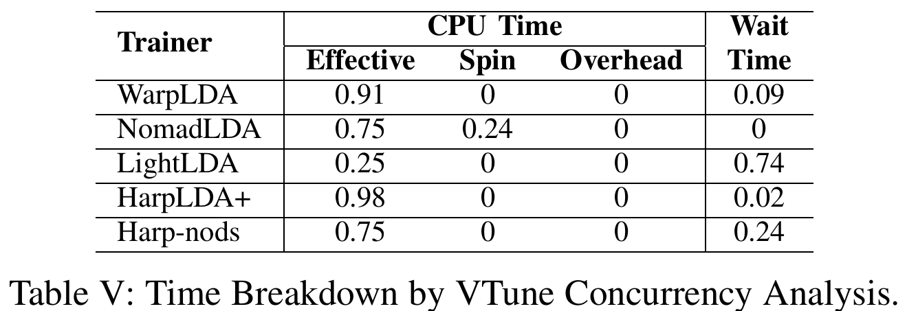
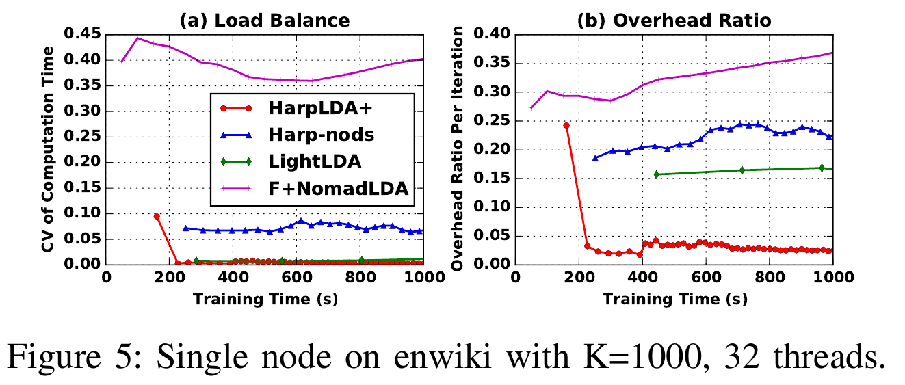
Intra-node Parallel Efficiency
HarpLDA+ performs the best with only 2% wait time, which is much less than that of Harp-nods, the trainer without dynamic scheduling.
When comparing with other trainers, the overhead in our Java dynamic scheduler is much less.

Slide 20
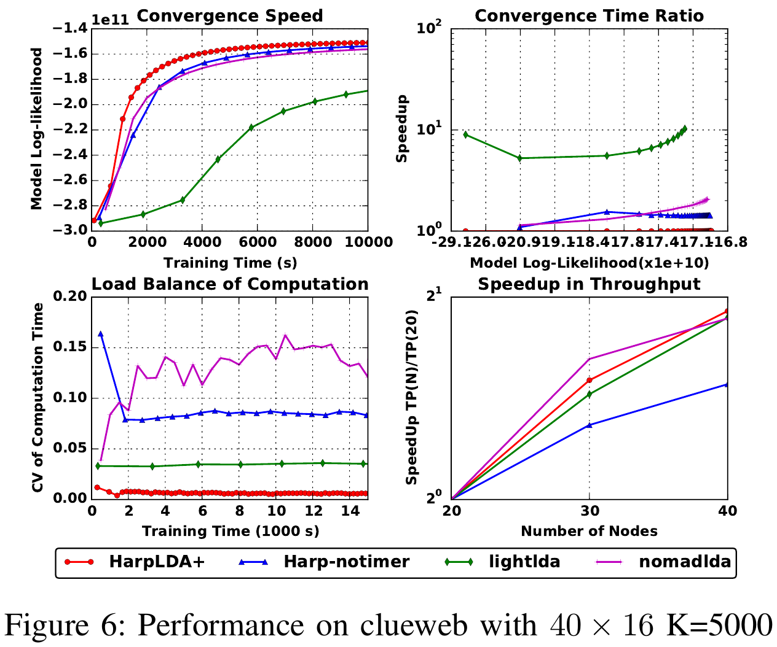
Distributed Parallel Efficiency
LightLDA, as an asynchronous approach, has less problems of load imbalance than the synchronized approaches, but a lower convergence rate.
F+NomadLDA is observed to have the most load imbalance problems and also exhibits a very high overhead ratio.
HarpLDA+ has the best overall performance,6x faster than LightLDA, 2x faster than NomadLDA

Slide 21
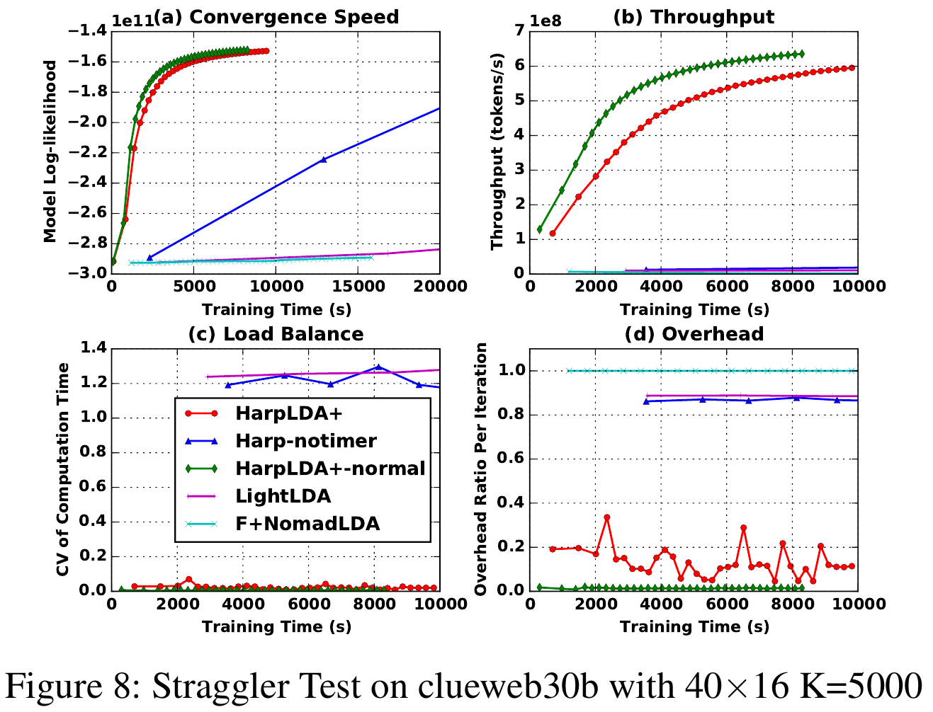
Straggler Case Study
LightLDA benefits by its SSP design to represent a stable and scaleable trainer in a cluster with minor variances, but stalls in case of straggler.
F+NomadLDA has a load balance scheduler which is designed to deal with these kinds of situations, but it does not work.
HarpLDA+ demonstrates a stable performance in the case of straggler, losing about 25% performance in the presence of a straggler.

Slide 22
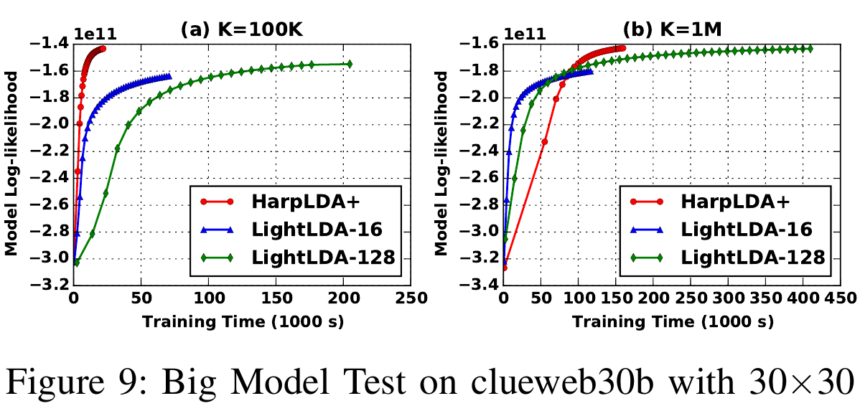
Large Model Case Study
When K increases to 1 million, LightLDA runs much faster than HarpLDA+ due to time complexity of O(1) in the MH sampling algorithm
It slows down and is surpassed by HarpLDA+ because of its ineffectiveness of computation, despite using a very large MH step parameter such as 128
HarpLDA+ demonstrates impressive performance, given that the algorithm has a time complexity of O(K_{d} + K_{w} ) while that of LightLDA is O(1)

Slide 23
Outline
Problem and Motivation
Large scale LDA training is challenging
Background
Parallel and distributed LDA algorithm
Our Approach
System design optimized for parallel efficiency
Experiments
Evaluation and validation
Conclusion
Contributions and insights learned

Slide 24
Main Contributions
Review state-of-the-art LDA training systems and summarize their design features.
Propose new mechanisms to reduce overhead in synchronized systems, dynamic scheduling for shared memory subsystems and Timer Control for distributed systems.
Implement HarpLDA+ based on Hadoop while demonstrating excellent performance and stable scalability.
Summarize our system design approach and its implications for other machine learning algorithms.

Slide 25
Insights in Designing Large Scale Machine Learning System
Choices of parallel system design are critical.
Optimization of a sequential algorithm does not necessarily lead to high performance parallel systems.
Implementation details including programming languages and high performance off-the-shelf communication libraries do not always guarantee good performance.
Synchronized parallel designs can achieve better performance on a moderate sized cluster.
Asynchronous parallel designs are favorable for scalability and robustness on large clusters.

Slide 26
Q&A

Slide 27
Backup

Slide 28
Collapsed Gibbs Sampling (CGS)
Shows high scalability in parallelization
Applied in many implementations

Slide 29
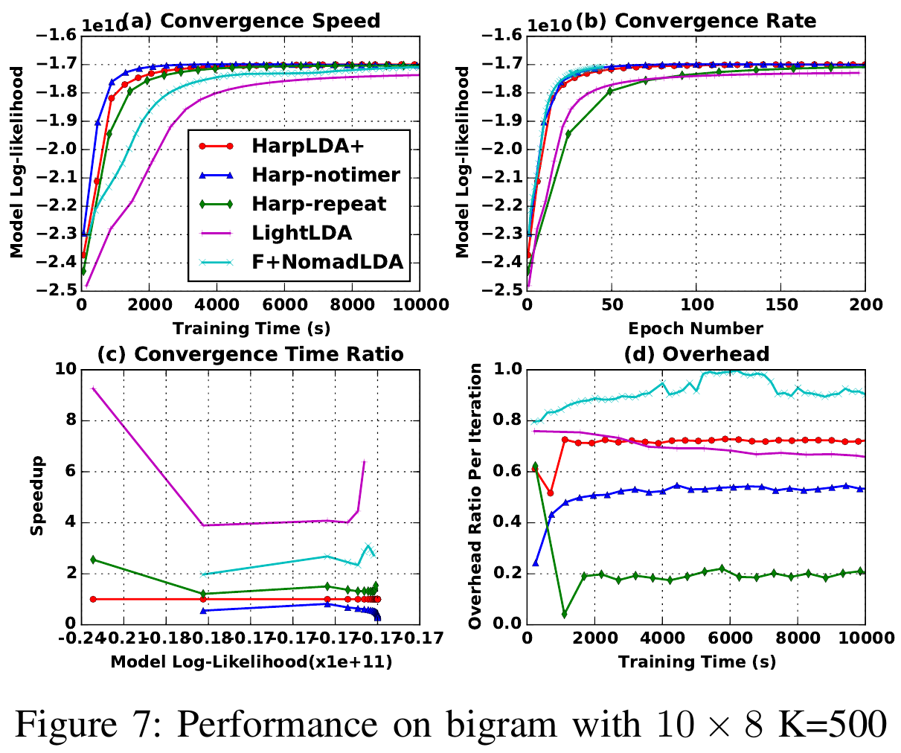
Communication Intensive Case Study
When the communication time dominates in the training process, all the trainers have a large overhead ratio
Harp-repeat significantly decreases the overhead and increases the throughput, but the effectiveness drops.
Further optimization should focus on how to decrease the size of the model that needs to be exchanged.

