Slide 1
Implementing Communication-Avoiding Algorithms
Jim Demmel
EECS & Math Departments
UC Berkeley
Notes:
1 hour including questions

Slide 2
Why avoid communication?
Communication = moving data
Between level of memory hierarchy
Between processors over a network
Running time of an algorithm is sum of 3 terms:
# flops * time_per_flop
# words moved / bandwidth
# messages * latency
communication
Time_per_flop << 1/ bandwidth << latency
Gaps growing exponentially with time [FOSC]
Avoid communication to save time
Same story for energy:
Avoid communication to save energy
Goal : reorganize algorithms to avoid communication
Between all memory hierarchy levels
L1 L2 DRAM network, etc
Very large speedups possible
Energy savings too!
Notes:
2008 DARPA Exascale report has similar prediction:
Gap between DRAM access time and flops will increase
100x over coming decade to balance power usage between
processors, DRAM
2011 NRC Report: “The Future of Computing Performance: Game Over or Next Level?”
Millett and Fuller

Slide 3
Goals
Redesign algorithms to avoid communication
Between all memory hierarchy levels
L1 L2 DRAM network, etc
Attain lower bounds if possible
Current algorithms often far from lower bounds
Large speedups and energy savings possible
Notes:
2008 DARPA Exascale report has similar prediction:
Gap between DRAM access time and flops will increase
100x over coming decade to balance power usage between
processors, DRAM

Slide 4
Outline
Review, extend communication lower bounds
Direct Linear Algebra Algorithms
Matmul
classical & Strassen-like, heterogeneous, tensors, oblivious
LU & QR (tournament pivoting)
Sparse matrices
Eigenproblems (symmetric and nonsymmetric)
Iterative Linear Algebra
Autotuning Sparse-Matrix-Vector-Multiply (SpMV)
Reorganizing Krylov methods – Conjugate Gradients
Stability challenges and approaches
What is a “sparse matrix”?
Floating-point reproducibility
Despite nondeterminism/nonassociativity

Slide 5
Outline
Review, extend communication lower bounds
Direct Linear Algebra Algorithms
Matmul
classical & Strassen-like, heterogeneous, tensors, oblivious
LU & QR (tournament pivoting)
Sparse matrices
Eigenproblems (symmetric and nonsymmetric)
Iterative Linear Algebra
Autotuning Sparse-Matrix-Vector-Multiply (SpMV)
Reorganizing Krylov methods – Conjugate Gradients
Stability challenges and approaches
What is a “sparse matrix”?
Floating-point reproducibility
Despite nondeterminism/nonassociativity

Slide 6
Lower bound for all “n³-like” linear algebra
Let M = “fast” memory size (per processor)
#words_moved (per processor) = Ω(#flops (per processor) / M^{1/2} )
#messages_sent (per processor) = Ω(#flops (per processor) / M^{3/2} )
Parallel case: assume either load or memory balanced
Holds for
Matmul, BLAS, LU, QR, eig, SVD, tensor contractions, …
Some whole programs (sequences of these operations, no matter how individual ops are interleaved, eg A^{k})
Dense and sparse matrices (where #flops << n³ )
Sequential and parallel algorithms
Some graph-theoretic algorithms (eg Floyd-Warshall)

Slide 7
Lower bound for all “n³-like” linear algebra
Let M = “fast” memory size (per processor)
#words_moved (per processor) = Ω(#flops (per processor) / M^{1/2} )
#messages_sent ≥ #words_moved / largest_message_size
Parallel case: assume either load or memory balanced
Holds for
Matmul, BLAS, LU, QR, eig, SVD, tensor contractions, …
Some whole programs (sequences of these operations, no matter how individual ops are interleaved, eg A^{k})
Dense and sparse matrices (where #flops << n³ )
Sequential and parallel algorithms
Some graph-theoretic algorithms (eg Floyd-Warshall)
Notes:
APSP talk Tuesday, session 12, Edgar Solomonik, Aydin Buluc

Slide 8
Lower bound for all “n³-like” linear algebra
Let M = “fast” memory size (per processor)
#words_moved (per processor) = Ω(#flops (per processor) / M^{1/2} )
#messages_sent (per processor) = Ω(#flops (per processor) / M^{3/2} )
Parallel case: assume either load or memory balanced
Holds for
Matmul, BLAS, LU, QR, eig, SVD, tensor contractions, …
Some whole programs (sequences of these operations, no matter how individual ops are interleaved, eg A^{k})
Dense and sparse matrices (where #flops << n³ )
Sequential and parallel algorithms
Some graph-theoretic algorithms (eg Floyd-Warshall)
SIAM SIAG/Linear Algebra Prize, 2012
Ballard, D., Holtz, Schwartz

Slide 9
Limits to parallel scaling (1/2)
Consider dense case, #flops_per_proc = n³/P
#Words = Ω(n³/(P•M^{1/2} ))
#Messages = Ω(n³/(P•M^{3/2} ))
What is M? Must be at least n²/P to hold data
#Words = Ω(n²/P^{1/2} )
#Messages = Ω(P^{1/2} )
But if M fixed, looks like perfect strong scaling in time
#Flops, #Words, #Messages all proportional to 1/P
Ditto for energy, if we count energy costs in joules …
Per flop, per word moved, per message
Per word per second for data stored in memory M
Per second, for leakage, cooling, …
How big can we make P? and M?
Notes:
Come back to this slide after 2.5D MM, fill in rest

Slide 10
Limits to parallel scaling (2/2)
Consider dense case, #flops_per_proc = n³/P
#Words = Ω(n³/(P•M^{1/2} ))
#Messages = Ω(n³/(P•M^{3/2} ))
How big can we make P? and M?
Assume we start with 1 copy of inputs A and B
Otherwise no communication may be needed
Thm: #Words= Ω(n²/P^{2/3} ), independent of M
Reached when M = n²/P^{2/3} too, or P = n³/M^{3/2} and
#Messages = Ω(1) (log P in practice)
Attained by 2.5D algorithm when c=P^{1/3} (“3D alg”)
Can keep increasing P until P = n³,
#Words = #Messages = Ω(1) (log n in practice)
Notes:
Come back to this slide after 2.5D MM, fill in rest

Slide 11
Can we attain these lower bounds?
Do conventional dense algorithms as implemented in LAPACK and ScaLAPACK attain these bounds?
Often not
If not, are there other algorithms that do?
Yes, for much of dense linear algebra
New algorithms, with new numerical properties, new ways to encode answers, new data structures
Not just loop transformations (need those too!)
Only a few sparse algorithms so far
Lots of work in progress
Algorithms, Energy, Heterogeneous Processors, …
Notes:
Sparse: depends on George, Rose, Tarjan
Algorithms: especially using extra memory

Slide 12
Outline
Review, extend communication lower bounds
Direct Linear Algebra Algorithms
Matmul
classical & Strassen-like, heterogeneous, tensors, oblivious
LU & QR (tournament pivoting)
Sparse matrices
Eigenproblems (symmetric and nonsymmetric)
Iterative Linear Algebra
Autotuning Sparse-Matrix-Vector-Multiply (SpMV)
Reorganizing Krylov methods – Conjugate Gradients
Stability challenges and approaches
What is a “sparse matrix”?
Floating-point reproducibility
Despite nondeterminism/nonassociativity

Slide 13
SUMMA– n x n matmul on P^{1/2} x P^{1/2} grid (nearly) optimal using minimum memory M=O(n²/P)
k
j
B(k,j)
k
*
=
Brow
i
C(i,j)
A(i,k)
For k=0 to n-1 … or n/b-1 where b is the block size
… = # cols in A(i,k) and # rows in B(k,j)
for all i = 1 to p_{r} … in parallel
owner of A(i,k) broadcasts it to whole processor row
for all j = 1 to p_{c} … in parallel
owner of B(k,j) broadcasts it to whole processor column
Receive A(i,k) into Acol
Receive B(k,j) into Brow
C_myproc = C_myproc + Acol * Brow
Acol
For k=0 to n/b-1
for all i = 1 to P^{1/2}
owner of A(i,k) broadcasts it to whole processor row (using binary tree)
for all j = 1 to P^{1/2}
owner of B(k,j) broadcasts it to whole processor column (using bin. tree)
Receive A(i,k) into Acol
Receive B(k,j) into Brow
C_myproc = C_myproc + Acol * Brow
Using more than the minimum memory
What if matrix small enough to fit c>1 copies, so M = cn²/P ?
#words_moved = Ω( #flops / M^{1/2} ) = Ω( n² / ( c^{1/2} P^{1/2} ))
#messages = Ω( #flops / M^{3/2} ) = Ω( P^{1/2} /c^{3/2})
Can we attain new lower bound?

Slide 14
2.5D Matrix Multiplication
Assume can fit cn²/P data per processor, c > 1
Processors form (P/c)^{1/2} x (P/c)^{1/2} x c grid
(P/c)^{1/2}
(P/c)^{1/2}
Example: P = 32, c = 2
c

Slide 15
2.5D Matrix Multiplication
Assume can fit cn²/P data per processor, c > 1
Processors form (P/c)^{1/2} x (P/c)^{1/2} x c grid
j
i
Initially P(i,j,0) owns A(i,j) and B(i,j)
each of size n(c/P)^{1/2} x n(c/P)^{1/2}
k
(1) P(i,j,0) broadcasts A(i,j) and B(i,j) to P(i,j,k)
(2) Processors at level k perform 1/c-th of SUMMA, i.e. 1/c-th of Σ_{m} A(i,m)*B(m,j)
(3) Sum-reduce partial sums Σ_{m} A(i,m)*B(m,j) along k-axis so P(i,j,0) owns C(i,j)

Slide 16
2.5D Matmul on BG/P, 16K nodes / 64K cores

Slide 17
2.5D Matmul on BG/P, 16K nodes / 64K cores
c = 16 copies
2.7x faster
12x faster
Distinguished Paper Award, EuroPar’11 (Solomonik, D.)
SC’11 paper by Solomonik, Bhatele, D.
Notes:
SC’11 paper about need to fully utilize 3D torus network on BG/P to get this to work

Slide 18
Perfect Strong Scaling – in Time and Energy (1/2)
Every time you add a processor, you should use its memory M too
Start with minimal number of procs: PM = 3n²
Increase P by a factor of c ➔ total memory increases by a factor of c
Notation for timing model:
γ_{T} , β_{T} , α_{T} = secs per flop, per word_moved, per message of size m
T(cP) = n³/(cP) [ γ_{T}+ β_{T}/M^{1/2} + α_{T}/(mM^{1/2}) ]
= T(P)/c
Notation for energy model:
γ_{E} , β_{E} , α_{E} = joules for same operations
δ_{E} = joules per word of memory used per sec
ε_{E} = joules per sec for leakage, etc.
E(cP) = cP { n³/(cP) [ γ_{E}+ β_{E}/M^{1/2} + α_{E}/(mM^{1/2}) ] + δ_{E}MT(cP) + ε_{E}T(cP) }
= E(P)
Perfect scaling extends to N-body, Strassen, …
Notes:
Can use these formulas to ask:
How to choose p and M to minimize energy needed for computation?
Given max allowed runtime T, how much energy do I need to achieve it?
Given max allowed energy E, what is the minimum runtime T I can attain?
Given target energy efficiency (Gflops/W), what architectural parameters
are needed to achieve it?
Talk by Andrew Gearhart, Session 14, today May 22

Slide 19
Perfect Strong Scaling – in Time and Energy (2/2)
T(cP) = n³/(cP) [ γ_{T}+ β_{T}/M^{1/2} + α_{T}/(mM^{1/2}) ] = T(P)/c
E(cP) = cP { n³/(cP) [ γ_{E}+ β_{E}/M^{1/2} + α_{E}/(mM^{1/2}) ] + δ_{E}MT(cP) + ε_{E}T(cP) } = E(P)
Can use these formulas to answer many questions, such as
How to choose p and M to minimize energy E needed for computation?
Given max allowed runtime T, what is minimum energy E needed to achieve it?
Given max allowed energy E, what is the minimum runtime T attainable?
Can we minimize the average power P = E/T?
Given target energy efficiency, what architectural parameters are needed to achieve it?
Can we attain 75 Gflops/Watt?
Can we attain an exaflop for 20 MWatts?
Notes:
Can use these formulas to ask:
How to choose p and M to minimize energy needed for computation?
Given max allowed runtime T, how much energy do I need to achieve it?
Given max allowed energy E, what is the minimum runtime T I can attain?
Given target energy efficiency (Gflops/W), what architectural parameters
are needed to achieve it?
Talk by Andrew Gearhart, Session 14, today May 22

Slide 20
Handling Heterogeneity
Suppose each of P processors could differ
γ_{i} = sec/flop, β_{i} = sec/word, α_{i} = sec/message, M_{i} = memory
What is optimal assignment of work F_{i} to minimize time?
T_{i} = F_{i} γ_{i} + F_{i} β_{i} /M_{i}^{1/2} + F_{i} α_{i} /M_{i}^{3/2} = F_{i} [γ_{i} + β_{i} /M_{i}^{1/2} + α_{i} /M_{i}^{3/2}] = F_{i} ξ_{i}
Choose F_{i} so Σ_{i} F_{i} = n³ and minimizing T = max_{i} T_{i}
Answer: F_{i} = n³(1/ξ_{i})/Σ_{j}(1/ξ_{j}) and T = n³/Σ_{j}(1/ξ_{j})
Optimal Algorithm for nxn matmul
Recursively divide into 8 half-sized subproblems
Assign subproblems to processor i to add up to F_{i} flops
Works for Strassen, other algorithms…

Slide 21
Application to Tensor Contractions
Ex: C(i,j,k) = Σ_{mn} A(i,j,m,n)*B(m,n,k)
Communication lower bounds apply
Complex symmetries possible
Ex: B(m,n,k) = B(k,m,n) = …
d-fold symmetry can save up to d!-fold flops/memory
Heavily used in electronic structure calculations
Ex: NWChem
CTF: Cyclops Tensor Framework
Exploits 2.5D algorithms, symmetries
Solomonik, Hammond, Matthews

Slide 22
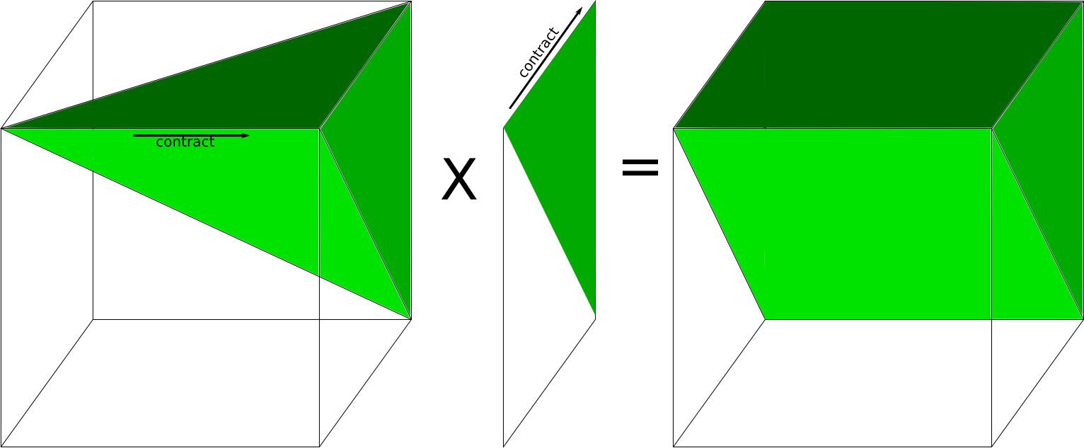
C(i,j,k) = Σ_{m} A(i,j,m)*B(m,k)
A
3-fold symm
B
2-fold symm
C
2-fold symm

Slide 23
Application to Tensor Contractions
Ex: C(i,j,k) = Σ_{mn} A(i,j,m,n)*B(m,n,k)
Communication lower bounds apply
Complex symmetries possible
Ex: B(m,n,k) = B(k,m,n) = …
d-fold symmetry can save up to d!-fold flops/memory
Heavily used in electronic structure calculations
Ex: NWChem, for coupled cluster (CC) approach to Schroedinger eqn.
CTF: Cyclops Tensor Framework
Exploits 2.5D algorithms, symmetries
Up to 3x faster running CC than NWChem on 3072 cores of Cray XE6
Solomonik, Hammond, Matthews
Notes:
128 Nodes of Hopper, w9 = water simulation

Slide 24
Communication Lower Bounds for Strassen-like matmul algorithms
Classical
O(n³) matmul:
#words_moved =
Ω (M(n/M^{1/2})³/P)
Strassen’s
O(n^{lg7}) matmul:
#words_moved =
Ω (M(n/M^{1/2})^{lg7}/P)
Strassen-like
O(n^{ω}) matmul:
#words_moved =
Ω (M(n/M^{1/2})^{ω}/P)
Proof: graph expansion (different from classical matmul)
Strassen-like: DAG must be “regular” and connected
Extends up to M = n² / p^{2/ω}
Extends to rectangular case: multiply (mxn)*(nxp) in q mults
#words_moved = Ω (#flops/M^(log_{mp}q -1))
Best Paper Prize (SPAA’11), Ballard, D., Holtz, Schwartz, also in JACM
Is the lower bound attainable?
Notes:
Rectangular case:
Bini: <3,2,2>=10
Hopcroft, Kerr: <3,2,3> = 15

Slide 25
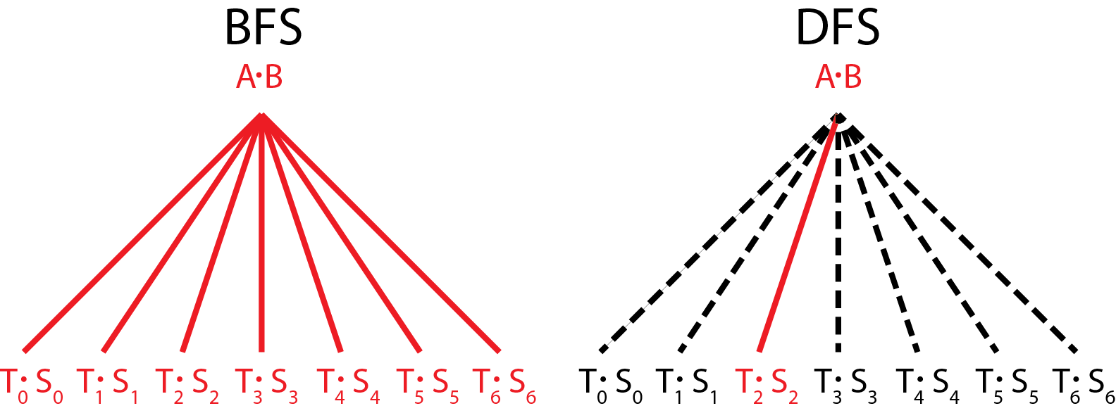
vs.
Communication Avoiding Parallel Strassen (CAPS)
Runs all 7 multiplies in parallel
Each on P/7 processors
Needs 7/4 as much memory
Runs all 7 multiplies sequentially
Each on all P processors
Needs 1/4 as much memory
CAPS
If EnoughMemory and P ≥ 7
then BFS step
else DFS step
end if
Best way to interleave
BFS and DFS is an
tuning parameter
Notes:
Say what BFS and DFS are

Slide 26
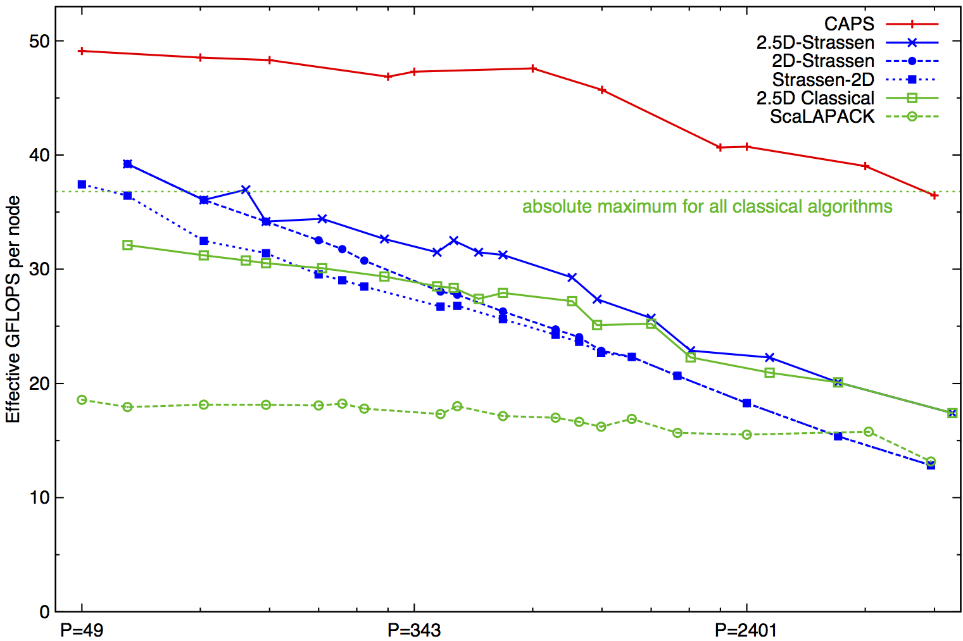
Performance Benchmarking, Strong Scaling Plot
Franklin (Cray XT4) n = 94080
Invited to appear as Research Highlight in CACM
Speedups: 24%-184% (over previous Strassen-based algorithms)
Notes:
2n^3/time 184% is at 7203 ours 7056 theirs (per node).
Strong scaling range up to about p=1000
Top on this plot: p = 7200, recent data up to 20K
2(.5)D-Strassen means 2(.5)D-outer, and Strassen-inner, on the small local matrices
Strassen-2D means x DFS Strassen steps, followed by 2D classical for the 7^x subproblems

Slide 27
Strassen-like beyond matmul
Thm (D., Dumitriu, Holtz,’07): Any Strassen-like O(n^{ω}) matmul algorithm can be used to build a numerically stable O(n^{ω+η}) algorithm, for any η>0, for Ax=b, least squares, eig, SVD, …
η>0 needed to deal with numerical stability
Strassen already stable, so η=0
Thm: For sequential versions of these algorithms
#Words_moved = O(n^{ω+η}/M^{(ω+η)/2 – 1} + n² log n)
i.e. attain expected lower bound
Ballard, D., Holtz, Schwartz

Slide 28
Cache and Network Oblivious Algorithms
Motivation: Minimizes communication at every level of a hierarchical system without tuning parameters (in theory)
Not always: 2.5D Matmul on BG/P was topology aware
CAPS: Divide-and-conquer, choose BFS or DFS to adapt to #processors, available memory
CARMA
Divide-and-conquer classical matmul: divide largest of 3 dimensions to create two subproblems
Choose BFS or DFS to adapt to #processors, available memory

Slide 29
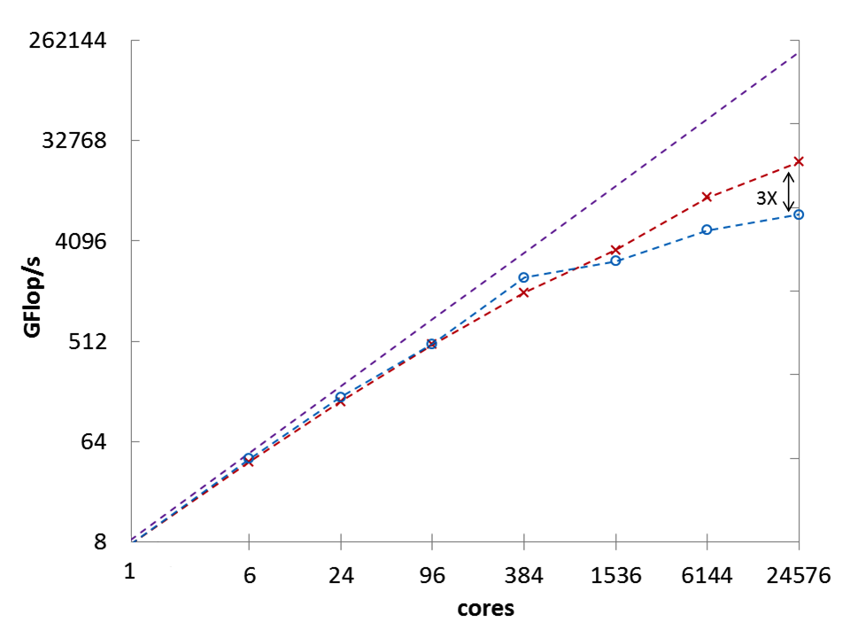
CARMA Performance: Distributed Memory
Cray XE6 (Hopper), each node 2 x 12 core, 4 x NUMA
Square: m = k = n = 6,144
(log)
Peak
CARMA
ScaLAPACK
(log)
Preliminaries Lower Bounds CARMA Benchmarking Future Work Conclusion 29

Slide 30
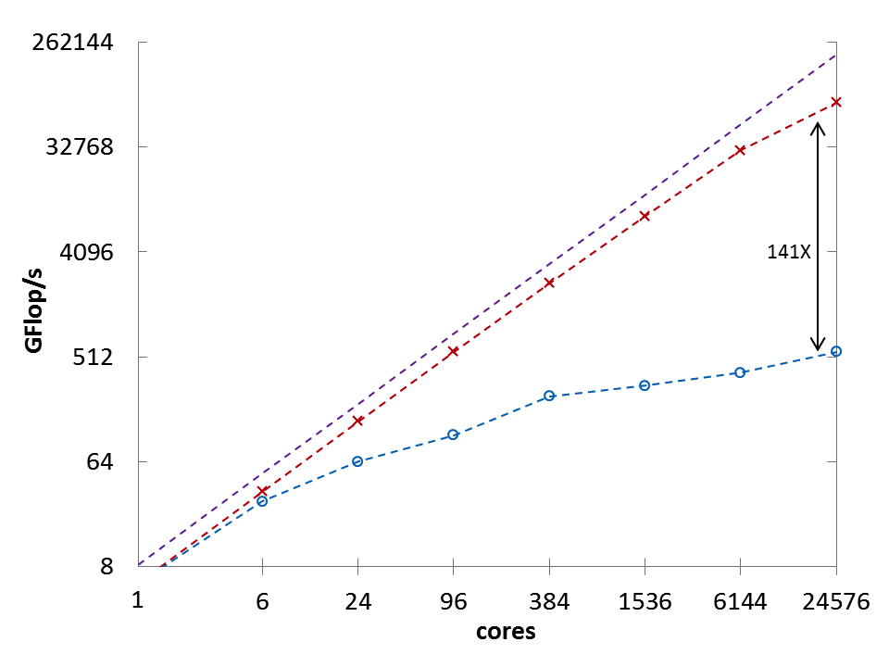
CARMA Performance: Distributed Memory
Cray XE6 (Hopper), each node 2 x 12 core, 4 x NUMA
Inner Product: m = n = 192; k = 6,291,456
(log)
Peak
CARMA
ScaLAPACK
(log)
Preliminaries Lower Bounds CARMA Benchmarking Future Work Conclusion 30
Notes:
32 GB DRAM,
Parallelism: flat MPI, 1 process per core
ScaLAPACK 1.8.0 (2D SUMMA)
Peak = double precision floating point peak

Slide 31
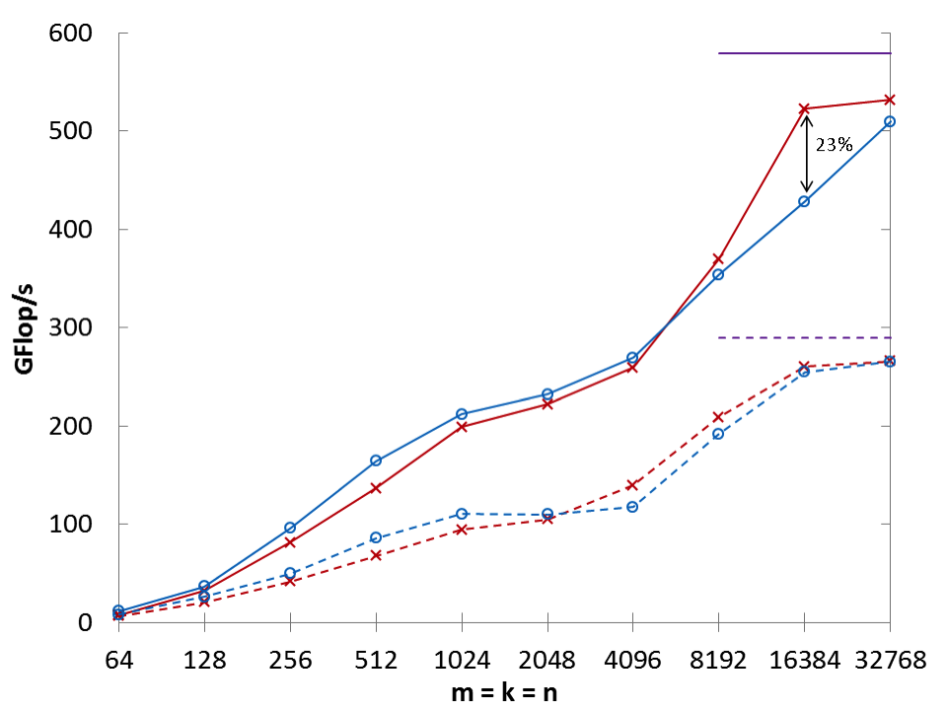
CARMA Performance: Shared Memory
Intel Emerald: 4 Intel Xeon X7560 x 8 cores, 4 x NUMA
Square: m = k = n
(linear)
Peak (single)
CARMA (single)
MKL (single)
Peak (double)
CARMA (double)
MKL (double)
(log)
Preliminaries Lower Bounds CARMA Benchmarking Future Work Conclusion 31

Slide 32
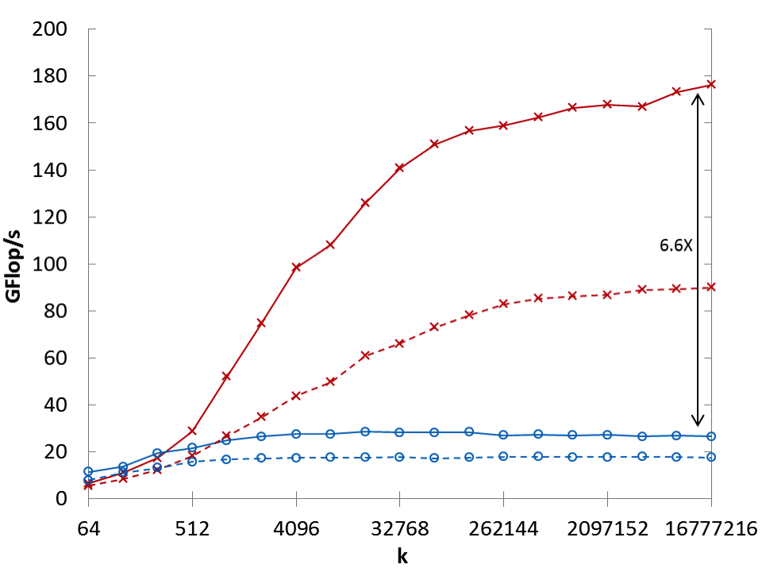
CARMA Performance: Shared Memory
Intel Emerald: 4 Intel Xeon X7560 x 8 cores, 4 x NUMA
Inner Product: m = n = 64
(linear)
CARMA (single)
CARMA (double)
MKL (single)
MKL (double)
(log)
Preliminaries Lower Bounds CARMA Benchmarking Future Work Conclusion 32
Notes:
32 cores altogether
Parallelism via Intel Cilk Plus
Intel MKL version 10.3.6
50 LOC

Slide 33
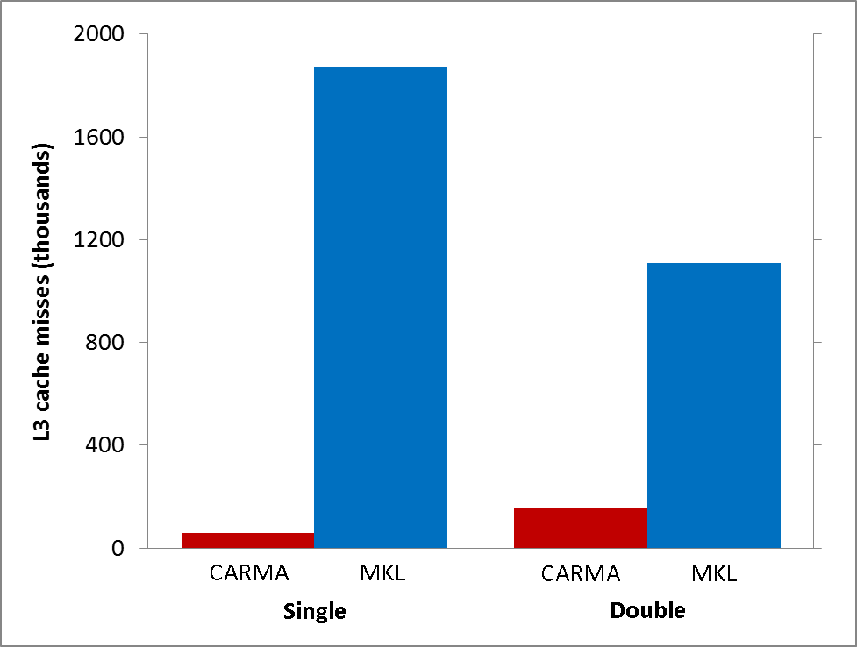
Why is CARMA Faster in Shared Memory?
L3 Cache Misses
Shared Memory Inner Product (m = n = 64; k = 524,288)
(linear)
97% Fewer Misses
86% Fewer Misses
Preliminaries Lower Bounds CARMA Benchmarking Future Work Conclusion 33

Slide 34
Outline
Review, extend communication lower bounds
Direct Linear Algebra Algorithms
Matmul
classical & Strassen-like, heterogeneous, tensors, oblivious
LU & QR (tournament pivoting)
Sparse matrices
Eigenproblems (symmetric and nonsymmetric)
Iterative Linear Algebra
Autotuning Sparse-Matrix-Vector-Multiply (SpMV)
Reorganizing Krylov methods – Conjugate Gradients
Stability challenges and approaches
What is a “sparse matrix”?
Floating-point reproducibility
Despite nondeterminism/nonassociativity

Slide 35
One-sided Factorizations (LU, QR), so far
Classical Approach
for i=1 to n
update column i
update trailing matrix
#words_moved = O(n³)
Blocked Approach (LAPACK)
for i=1 to n/b
update block i of b columns
update trailing matrix
#words moved = O(n³/M^{1/3})
Recursive Approach
func factor(A)
if A has 1 column, update it else
factor(left half of A)
update right half of A
factor(right half of A)
#words moved = O(n³/M^{1/2})
None of these approaches
minimizes #messages
Parallel case: Partial Pivoting => n reductions
Need another idea
Notes:
Recursive approach”
QR: Elmroth, Gustavson
LU: Toledo

Slide 36
TSQR: An Architecture-Dependent Algorithm
W₀
W₁
W₂
W₃
R₀₀
R₁₀
R₂₀
R₃₀
R₀₁
Parallel:
W =
R₀₂
R₁₁
W₀
W₁
W₂
W₃
R₀₀
Sequential/
Streaming:
R₀₁
W =
R₀₂
R₀₃
W₀
W₁
W₂
W₃
R₀₀
R₀₁
Dual Core:
R₀₁
W =
R₀₂
R₁₁
R₀₃
R₁₁
Multicore / Multisocket / Multirack / Multisite / Out-of-core: ?
Can choose reduction tree dynamically
Notes:
Oldest reference for idea of tree: Golub/Plemmons/Sameh 1988,
But didn’t avoid communication

Slide 37
Back to LU: Using similar idea for TSLU as TSQR: Use reduction tree, to do “Tournament Pivoting”
W₁
W₂
W₃
W₄
P₁·L₁·U₁
P₂·L₂·U₂
P₃·L₃·U₃
P₄·L₄·U₄
Choose b pivot rows of W₁, call them W₁’
Choose b pivot rows of W₂, call them W₂’
Choose b pivot rows of W₃, call them W₃’
Choose b pivot rows of W₄, call them W₄’
W^{nxb} =
=
W₁’
W₂’
W₃’
W₄’
P₁₂·L₁₂·U₁₂
P₃₄·L₃₄·U₃₄
Choose b pivot rows, call them W₁₂’
Choose b pivot rows, call them W₃₄’
=
W₁₂’
W₃₄’
= P₁₂₃₄·L₁₂₃₄·U₁₂₃₄
Choose b pivot rows
Go back to W and use these b pivot rows
(move them to top, do LU without pivoting)

Slide 38
Minimizing Communication in TSLU
W₁
W₂
W₃
W₄
LU
LU
LU
LU
LU
Parallel:
W =
LU
LU
W₁
W₂
W₃
W₄
LU
Sequential/
Streaming
LU
W =
LU
LU
W₁
W₂
W₃
W₄
LU
LU
Dual Core:
LU
W =
LU
LU
LU
LU
Can choose reduction tree dynamically, to match architecture, as before
Notes:
Do algebra on board: Eq(1) in TSQR paper
Note: Q left as implicit tree

Slide 39
Making TSLU Numerically Stable
Details matter
Going up the tree, we could do LU either on original rows of A (tournament pivoting), or computed rows of U
Only tournament pivoting stable
“Thm”: New scheme as stable as Partial Pivoting (GEPP) in following sense: Get same Schur complements as GEPP applied to different input matrix whose entries are blocks taken from input A
Why just a “Thm”?

Slide 40
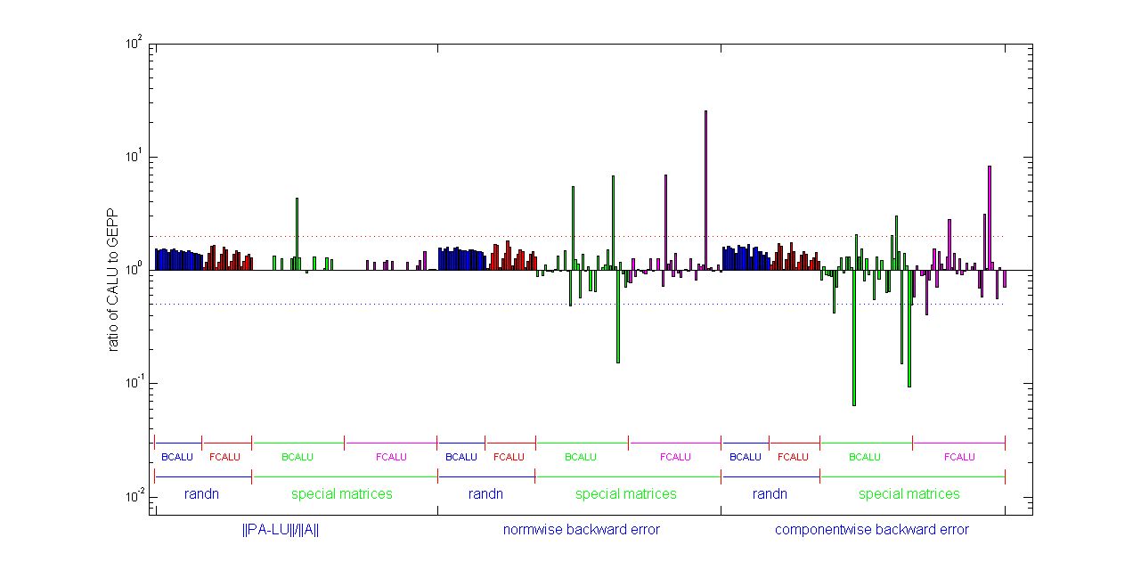
Stability of LU using TSLU: CALU
Empirical testing
Both random matrices and “special ones”
Both binary tree (BCALU) and flat-tree (FCALU)
3 metrics: ||PA-LU||/||A||, normwise and componentwise backward errors
See [D., Grigori, Xiang, 2010] for details

Slide 41
Why is stability of TSLU just a “Thm”?
Proof is correct – in exact arithmetic
Experiment
Generate 100 random 6x6, rank 3 matrices in Matlab
[L,U,P] = lu(A), do LU without pivoting on P*A, compare L factors: are they the same?
Compute || L – Lnp ||: A few 0’s, A few ∞’s, a few NaNs
Rest mostly O(1)
Why? Floating point is nonassociative, doing arithmetic in different order gives different rounding errors
Same experiment with rank 6 matrices: || L – Lnp || usually nonzero, O(macheps)
Same experiment with 20x20 rank 4 matrices:
|| L – Lnp || often O(10³)
Much harder to break TSLU, but possible
Occurred when using TSLU to factorize a low-rank subdiagonal panel in symmetric-indefinite factorization

Slide 42
Fixing TSLU
Run TSLU, quickly test for stability, fix if necessary (rare)
Test conditioning of U; if not tiny (usual case), proceed, else
Compute || L ||; if not big (usual case), proceed, else
Factor A = QR using TSQR, then
Factor Q = PLU using TSLU, then
A = P*L*(U*R), with U*R as upper triangular factor
Last topic in lecture:
how to guarantee floating point reproducibility
Notes:
Could just use GEPP, but prefer not to
Alternative fix for TSLU: LU-PRRP

Slide 43
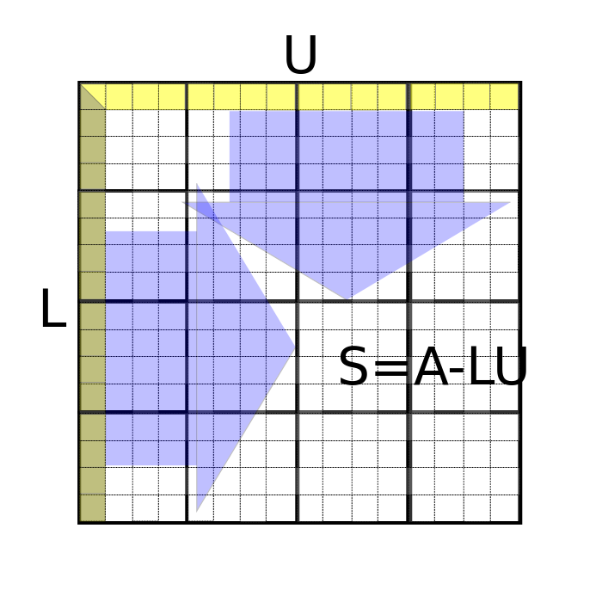
2D CALU with Tournament Pivoting

Slide 44
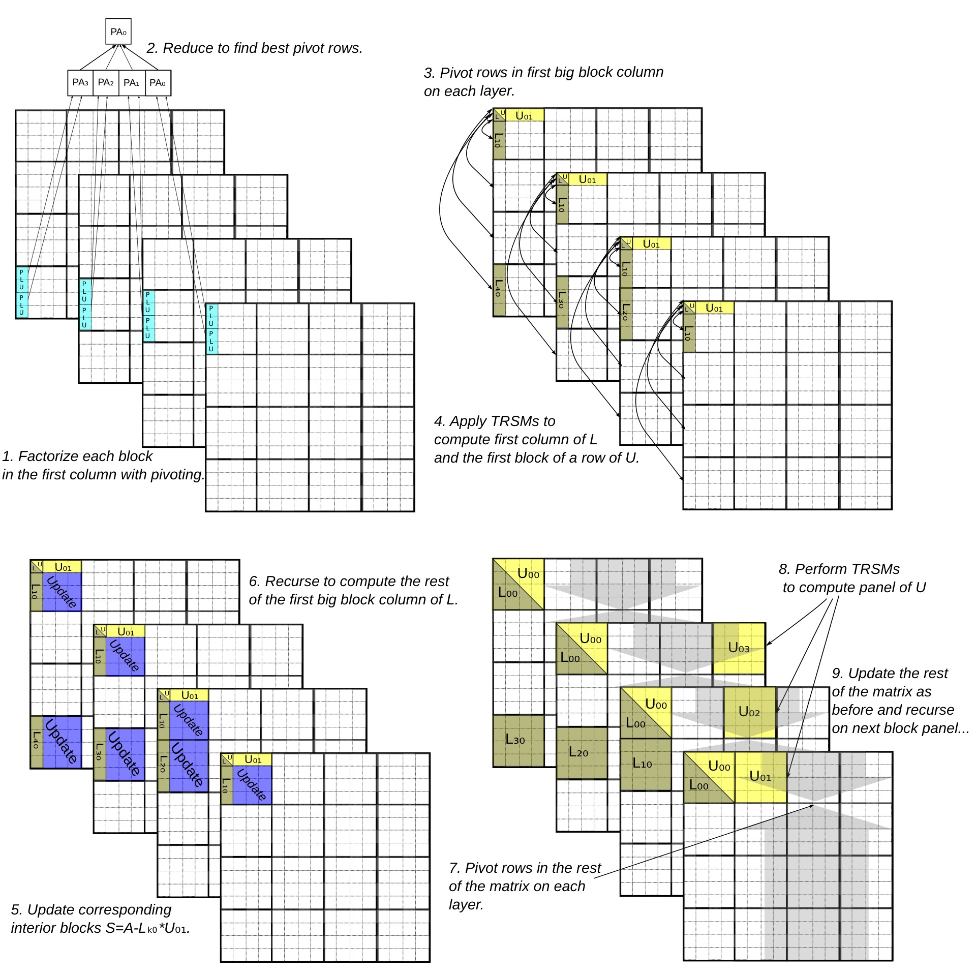
2.5D CALU with Tournament Pivoting (c=4 copies)

Slide 45
Exascale Machine Parameters Source: DOE Exascale Workshop
2^20 ≈ 1,000,000 nodes
1024 cores/node (a billion cores!)
100 GB/sec interconnect bandwidth
400 GB/sec DRAM bandwidth
1 microsec interconnect latency
50 nanosec memory latency
32 Petabytes of memory
1/2 GB total L1 on a node

Slide 46
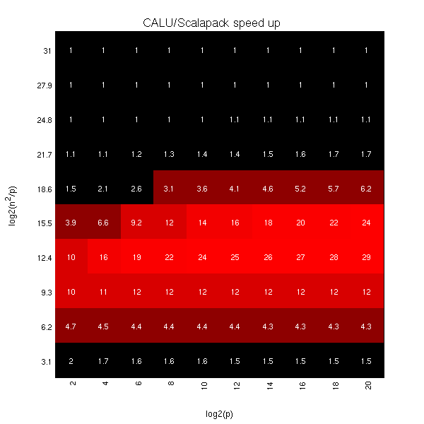
Exascale predicted speedups for Gaussian Elimination: 2D CA-LU vs ScaLAPACK-LU
log₂ (n²/p) =
log₂ (memory_per_proc)
Up to 29x
log₂ (p)
Notes:
Vertical axis log2(n^2/p) is memory per processor
Horizontal axis log2(p) is processor count

Slide 47
2.5D vs 2D LU With and Without Pivoting

Slide 48
Other CA algorithms for Ax=b, least squares(1/3)
A symmetric and indefinite
Seek factorization that retains symmetry P*A*P^{T} = L*D*L^{T}, D “simple”
Save ½ flops, preserve inertia
Usual approach: Bunch-Kaufman
D block diagonal with 1x1 and 2x2 blocks
Pivot search down column, along row (lots of communication)
Alternative: Aasen
D = tridiagonal = T
Two steps:
P*A*P^{T} = L*T*L^{T} where T is banded, using TSLU
0
0
0
…
0
0
0
0
…
Solve/factor narrow band problem with T
Up to 2.8x faster than MKL, Best Paper at IPDPS’13
Notes:
In Algorithms Track,
Grey Ballard, Dulcenia Becker, JD, Jack Dongarra, Alex Druinsky, Inon Peled, Oded Schwartz, Sivan Toledo, Ichitaro Yamazaki
“Implementing a Blocked Aasen’s Algorithm with a Dynamic Scheduler on Multicore Architectures”
A lot of care needed to update T symmetrically
Subdiagonal blocks can be low rank, have zero column etc. illustrated TSLU stability problem

Slide 49
Other CA algorithms for Ax=b, least squares (2/3)
Minimizing bandwidth and latency for sequential GEPP
So far, could not do partial pivoting and minimize #messages, just #words
Challenge:
Column layout good for choosing pivots, bad for matmul
Blocked layout good for matmul, bad for choosing pivots
Solution: use both layouts, switching between them
“Shape Morphing LU” or SMLU
func factor(A)
if A has 1 column, update it, else
factor(left half of A)
update right half of A
factor(right half of A)
#Words = O(n³/M^{1/2})
#Messages = O(n³/M)
func factor(A)
if A has 1 column, update it, else
factor(left half of A)
reshape to recursive block format
update right half of A
reshape to columnwise format
factor(right half of A)
#Words = O(n³/M^{1/2})
#Messages = O(n³/M^{3/2})
Notes:
Grey Ballard, JD, Ben Lipshitz, Oded Schwartz, Sivan Toledo
“Communication efficient Gaussian elimination with Partial Pivoting using
a Shape Morphing Data Layout”
#Message = O(n^3/M) for columnwise-only format; recursive blocked too?

Slide 50
Other CA algorithms for Ax=b, least squares (3/3)
Need for pivoting arises beyond LU, in QR
Choose permutation P so that leading columns of A*P = Q*R span column space of A – Rank Revealing QR (RRQR)
Usual approach like Partial Pivoting
Put longest column first, update rest of matrix, repeat
Hard to do using BLAS3 at all, let alone hit lower bound
Use Tournament Pivoting
Each round of tournament selects best b columns from two groups of b columns, either using usual approach or something better (Gu/Eisenstat)
Thm: This approach ``reveals the rank’’ of A in the sense that the leading rxr submatrix of R has singular values “near” the largest r singular values of A; ditto for trailing submatrix
Idea extends to other pivoting schemes
Cholesky with diagonal pivoting
LU with complete pivoting
LDL^{T} with complete pivoting
Notes:
Grey Ballard, JD, Ben Lipshitz, Oded Schwartz, Sivan Toledo
“Communication efficient Gaussian elimination with Partial Pivoting using
a Shape Morphing Data Layout”
#Message = O(n^3/M) for columnwise-only format; recursive blocked too?

Slide 51
Outline
Review, extend communication lower bounds
Direct Linear Algebra Algorithms
Matmul
classical & Strassen-like, heterogeneous, tensors, oblivious
LU & QR (tournament pivoting)
Sparse matrices
Eigenproblems (symmetric and nonsymmetric)
Iterative Linear Algebra
Autotuning Sparse-Matrix-Vector-Multiply (SpMV)
Reorganizing Krylov methods – Conjugate Gradients
Stability challenges and approaches
What is a “sparse matrix”?
Floating-point reproducibility
Despite nondeterminism/nonassociativity

Slide 52
What about sparse matrices? (1/3)
If matrix quickly becomes dense, use dense algorithm
Ex: All Pairs Shortest Path using Floyd-Warshall
Similar to matmul: Let D = A, then
But can’t reorder outer loop for 2.5D, need another idea
Abbreviate D(i,j) = min(D(i,j),min_{k}(A(i,k)+B(k,j)) by D = AB
Dependencies ok, 2.5D works, just different semiring
Kleene’s Algorithm:
for k = 1:n, for i = 1:n, for j=1:n
D(i,j) = min(D(i,j), D(i,k) + D(k,j)
D = DC-APSP(A,n)
D = A, Partition D = [[D11,D12];[D21,D22]] into n/2 x n/2 blocks
D11 = DC-APSP(D11,n/2),
D12 = D11  D12, D21 = D21  D11, D22 = D21  D12,
D22 = DC-APSP(D22,n/2),
D21 = D22  D21, D12 = D12  D22, D11 = D12  D21,

Slide 53
Performance of 2.5D APSP using Kleene
Strong Scaling on Hopper (Cray XE6 with 1024 nodes = 24576 cores)
2x
speedup
6.2x
speedup

Slide 54
What about sparse matrices? (2/3)
If parts of matrix becomes dense, optimize those
Ex: Cholesky on matrix A with good separators
Thm (Lipton,Rose,Tarjan,’79) If all balanced separators of G(A) have at least w vertices, then G(chol(A)) has clique of size w
Need to do dense Cholesky on w x w submatrix
Thm: #Words_moved = Ω(w³/M^{1/2}) etc
Thm (George,’73) Nested dissection gives optimal ordering for 2D grid, 3D grid, similar matrices
w = n for 2D n x n grid, w = n² for 3D n x n x n grid
Sequential multifrontal Cholesky attains bounds
PSPACES (Gupta, Karypis, Kumar) is a parallel sparse multifrontal Cholesky package
Attains 2D and 2.5D lower bounds (using optimal dense Cholesky on separators)

Slide 55
What about sparse matrices? (3/3)
If matrix stays very sparse, lower bound unattainable, new one?
Ex: A*B, both diagonal: no communication in parallel case
Ex: A*B, both are Erdos-Renyi: Prob(A(i,j)≠0) = d/n, d << n^{1/2},iid
Assumption: Algorithm is sparsity-independent: assignment of data and work to processors is sparsity-pattern-independent (but zero entries need not be communicated or operated on)
Thm: A parallel algorithm that is sparsity-independent and load balanced for Erdos-Renyi matmul satisfies (in expectation)
#Words_moved = Ω(min( dn/P^{1/2} , d²n/P ) )
Proof exploits fact that reuse of entries of C = A*B unlikely
Contrast general lower bound:
#Words_moved = Ω(d²n/(PM^{1/2})))
Attained by divide-and-conquer algorithm that splits matrices along dimensions most likely to minimize cost
Notes:
Sparsity-independent means that you can’t see (for free) if there is a permutation that
makes both A and B block-diagonal, so no communication necessary.

Slide 56
Outline
Review, extend communication lower bounds
Direct Linear Algebra Algorithms
Matmul
classical & Strassen-like, heterogeneous, tensors, oblivious
LU & QR (tournament pivoting)
Sparse matrices
Eigenproblems (symmetric and nonsymmetric)
Iterative Linear Algebra
Autotuning Sparse-Matrix-Vector-Multiply (SpMV)
Reorganizing Krylov methods – Conjugate Gradients
Stability challenges and approaches
What is a “sparse matrix”?
Floating-point reproducibility
Despite nondeterminism/nonassociativity

Slide 57
Symmetric Eigenproblem and SVD
Usual approach for A=A^{T} (SVD similar)
A ⇒ Q^{T}AQ = T where Q orthogonal, T tridiagonal
T ⇒ U^{T}TU = Λ where U orthogonal, Λ diagonal
QU’s columns are eigenvectors, Λ eigenvalues
Dense ⇒ Tridiagonal ⇒ Diagonal
Only half BLAS3, half BLAS2 in LAPACK’s sytrd
Communication-Avoiding Approach
A ⇒ QAQ^{T} = B, where B=B^{T} banded, of bandwidth M^{1/2}
Continue as above, starting with B
Dense ⇒ Banded ⇒ Tridiagonal ⇒ Diagonal
Dense ⇒ Banded: use TSQR to zero out M^{1/2} cols/rows at a time
Banded ⇒ Tridiagonal: need new(ish) idea

Slide 58
Successive Band Reduction (Bischof/Lang/Sun)
b+1
b+1
Notes:
Does not minimize communication by itself, but does no more communication
Than reduction to band form, so overall ok.

Slide 59
Successive Band Reduction (Bischof/Lang/Sun)
b+1
b+1
d+1
1
c
b = bandwidth
c = #columns
d = #diagonals
Constraint: c+d ≤ b
Notes:
Does not minimize communication by itself, but does no more communication
Than reduction to band form, so overall ok.

Slide 60
Successive Band Reduction (Bischof/Lang/Sun)
b+1
b+1
d+1
Q₁
1
c
b = bandwidth
c = #columns
d = #diagonals
Constraint: c+d ≤ b
Notes:
Does not minimize communication by itself, but does no more communication
Than reduction to band form, so overall ok.

Slide 61
Successive Band Reduction (Bischof/Lang/Sun)
b+1
d+c
b+1
d+1
Q₁
2
d+c
1
c
b = bandwidth
c = #columns
d = #diagonals
Constraint: c+d ≤ b
Notes:
Does not minimize communication by itself, but does no more communication
Than reduction to band form, so overall ok.

Slide 62
Successive Band Reduction (Bischof/Lang/Sun)
b+1
d+1
Q₁^{T}
1
c
d+c
b+1
d+1
Q₁
2
d+c
1
c
b = bandwidth
c = #columns
d = #diagonals
Constraint: c+d ≤ b
Notes:
Does not minimize communication by itself, but does no more communication
Than reduction to band form, so overall ok.

Slide 63
Successive Band Reduction (Bischof/Lang/Sun)
b+1
d+1
Q₁^{T}
1
c
d+c
b+1
d+1
Q₁
2
d+c
1
c
d+c
2
d+c
b = bandwidth
c = #columns
d = #diagonals
Constraint: c+d ≤ b
Notes:
Does not minimize communication by itself, but does no more communication
Than reduction to band form, so overall ok.

Slide 64
Successive Band Reduction (Bischof/Lang/Sun)
b+1
d+1
Q₁^{T}
1
c
d+c
b+1
Q₂^{T}
d+1
Q₁
2
d+c
1
c
d+c
Q₂
2
3
d+c
3
b = bandwidth
c = #columns
d = #diagonals
Constraint: c+d ≤ b
Notes:
Does not minimize communication by itself, but does no more communication
Than reduction to band form, so overall ok.

Slide 65
Successive Band Reduction (Bischof/Lang/Sun)
b+1
d+1
Q₁^{T}
1
c
d+c
b+1
Q₂^{T}
d+1
Q₁
2
d+c
1
c
Q₃^{T}
d+c
Q₂
2
3
d+c
Q₃
4
3
b = bandwidth
c = #columns
d = #diagonals
Constraint: c+d ≤ b
4
Notes:
Does not minimize communication by itself, but does no more communication
Than reduction to band form, so overall ok.

Slide 66
Successive Band Reduction (Bischof/Lang/Sun)
b+1
d+1
Q₁^{T}
1
c
d+c
b+1
Q₂^{T}
d+1
Q₁
2
d+c
1
c
Q₃^{T}
d+c
Q₂
2
3
d+c
Q₄^{T}
Q₃
4
3
5
b = bandwidth
c = #columns
d = #diagonals
Constraint: c+d ≤ b
Q₄
4
5
Notes:
Does not minimize communication by itself, but does no more communication
Than reduction to band form, so overall ok.

Slide 67
Successive Band Reduction (Bischof/Lang/Sun)
b+1
d+1
Q₁^{T}
1
c
d+c
b+1
Q₂^{T}
d+1
Q₁
2
d+c
1
c
Q₃^{T}
d+c
Q₂
2
3
d+c
Q₄^{T}
Q₃
4
3
Q₅^{T}
5
b = bandwidth
c = #columns
d = #diagonals
Constraint: c+d ≤ b
Q₄
4
Q₅
5
Notes:
Does not minimize communication by itself, but does no more communication
Than reduction to band form, so overall ok.

Slide 68
Successive Band Reduction (Bischof/Lang/Sun)
To minimize #words moved (when n > M^{1/2} )
after reducing to bandwidth b = M^{1/2} :
if n > M
Use d=b-1 and c=1
else if M^{1/2} < n ≤ M
Pass 1: Use d=b – M/(4n) and c=M/(4n)
Pass 2: Use d=M/(4n)-1 and c=1
b+1
d+1
Q₁^{T}
1
c
6
d+c
b+1
Q₂^{T}
d+1
Q₁
2
d+c
1
6
c
Q₃^{T}
d+c
Q₂
2
3
d+c
Q₄^{T}
Only need to zero out leading
parallelogram of each trapezoid:
Q₃
4
3
Q₅^{T}
5
b = bandwidth
c = #columns
d = #diagonals
Constraint: c+d ≤ b
Q₄
4
2
Q₅
5
Notes:
Does not minimize communication by itself, but does no more communication
Than reduction to band form, so overall ok.

Slide 69
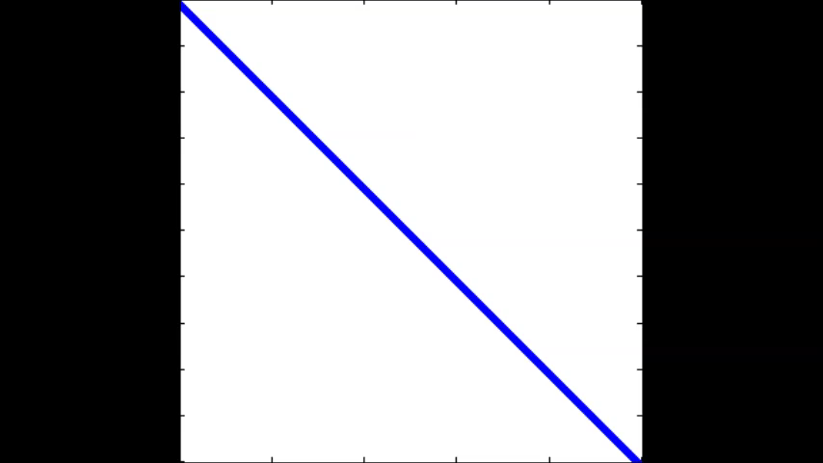

Conventional vs CA - SBR
Touch all data 4 times
Touch all data once
Conventional
Communication-Avoiding
Many tuning parameters:
Number of “sweeps”, #diagonals cleared per sweep, sizes of parallelograms
#bulges chased at one time, how far to chase each bulge
Right choices reduce #words_moved by factor M/bw, not just M^{1/2}
Notes:
Many tuning parameters:
Number of “sweeps”, #diagonals cleared per sweep, sizes of parallelograms
#bulges chased at one time, how far to chase each bulge
Right choices reduce #words_moved by factor M/bw, not just M^{1/2}

Slide 70
Speedups of Sym. Band Reduction vs DSBTRD
Up to 17x on Intel Gainestown, vs MKL 10.0
n=12000, b=500, 8 threads
Up to 12x on Intel Westmere, vs MKL 10.3
n=12000, b=200, 10 threads
Up to 25x on AMD Budapest, vs ACML 4.4
n=9000, b=500, 4 threads
Up to 30x on AMD Magny-Cours, vs ACML 4.4
n=12000, b=500, 6 threads
Neither MKL nor ACML benefits from multithreading in DSBTRD
Best sequential speedup vs MKL: 1.9x
Best sequential speedup vs ACML: 8.5x

Slide 71
Nonsymmetric Eigenproblem
No apparent way to modify standard algorithm
Instead: Spectral Divide-and-Conquer
Find orthogonal matrix Q whose leading columns span an invariant subspace of A
Q^{T}AQ will be block upper triangular:
Apply recursively to A₁₁ , A₂₂
Depends on randomization
Randomized Rank Revealing QR decomposition
Randomized location to try splitting spectrum
A₁₁ A₁₂
ε A₂₂

Slide 72
Attaining the Lower bounds: Sequential
Legend [Existing][Ours] [Math-Lib][Random] | Two Levels |  | Memory Hierarchy
 | Words | Messages | Words | Messages
BLAS-3 | [FLPR’99][BDLST’13][MKL, etc.] |  | [FLPR’99][BDLST’13][MKL, etc.]
Cholesky | [G’97][AP’00] [LAPACK] [BDHS’09] | [G’97][AP’00] [BDHS’09] | [G’97][AP’00][BDHS’09]
Sym. Indefinite | [BBDDDPSTY’13] |  | [BBDDDPSTY’13]
LU | [G’97][T’97] [GDX’11] [BDLST’13] | [GDX’11] [BDLST’13] | [G’97][T’97] [BDLST’13] | [BDLST’13]
QR | [EG’98][FW’03] [DGHL’12] [BDLST’13] | [FW’03] [DGHL’12] [BDLST’13] | [EG’98][FW’03] [BDLST’13] | [FW’03] [BDLST’13]
Rank Revealing QR | [BDD’11][DGGX’13] |  | ? | ?
Sym Eig & SVD | [BDD’11][BDK’13] |  | [BDD’11]
Non Sym Eig | [BDD’11] |  | [BDD’11]
Notes:
[AP’00] N. Ahmed and K. Pingali. Euro-Par 2000.
[BDHS’09] Ballard, Demmel, Holtz, Schwartz. (Cholesky) SPAA '09
[BDLST’13] Ballard, Demmel, Lipshitz, Schwartz, Toledo. (SMLU). SPAA'13
[BBDDDPSTY’13] Ballard, Becker, Demmel, Dongarra, Druinsky, Peled, Schwartz, Toledo, Yamazak, (Aasen) IPDPS'13 (best paper)
[DGHL’12] Demmel, Grigori, Hoemmen, Langou (CALU,CAQR) SISC'12
[BDD’11] Ballard, Demmel, Dumitriu. (RR-QR) Techreport 2013
[BDK’13] Ballard, Demmel, Knight (CA SBR) PPoPP'12
[DGGX’13] Demmel, James, Grigori, Gu, Xiang, (CA RR QR with Column Pivoting) Techreport 2013,
[EG’98] Elmroth, Gustavson. (Recursive QR), '98
[FW’03] Frens, Wise. (QR with Morton-ordered...) SIGPLAN'03
[FLPR’99] Frigo, Leiserson, Prokop, Ramachandran. (Cache-Oblivious Algorithms) FOCS'99.
[GDX’11] Grigori, Demmel, Xiang. (CALU) SIMAX'11
[G’97] Gustavson. 1997
[T’97] Toledo. (RLU) SIMAX'97

Slide 73
Attaining the Lower bounds, Parallel 2D:M=Θ(n²/P), (Ignoring poly-log(P) factors, #words = Ω( n²/ P^{1/2}) , #messages = Ω(P^{1/2})
Legend [Existing][Ours] [Math-Lib][Random] | Words (BW) | Messages (L) |  | Saving factor
BLAS-3: | [AGZ’94][MT’99][ScaLAPACK] [C’69][vGW’97][SD’11] |  |  | L: n/P^{1/2}
Cholesky | [ScaLAPACK][T’99][SD’11] |  |  | L: n/P^{1/2}
Sym. Indefinite | [BBDDDPSTY’13] [ScaLAPACK] |  | [BBDDDPSTY’13] | L: n/P^{1/2}
LU | [ScaLAPACK] [GDX’11][T’99][SD’11] |  | [GDX’11][T’99][SD’11] | L: n/P^{1/2}
QR | [ScaLAPACK] [DGHL’12] [T’99] |  | [DGHL’12][T’99] | L: n/P^{1/2}
Rank Revealing QR | [BDD’11][DGGX’13] |  | ?
Sym Eig & SVD | [BDD’11][BDK’13] [ScaLAPACK] |  | [BDD’11][BDK’13] | L: n/P^{1/2}
Non-Sym Eig | [BDD’11] |  | [BDD’11] | BW: P^{1/2}, L: n
✓
✓
✓
✓
✓
✓
✓
?
✓
?
✓
?
✓
?
Attaining with extra memory: 2.5D M=Θ(c⋅n²/P)?
Notes:
[AGZ’94] Agarwal, Gustavson, Zubair. 1994
[BBDDDPSTY’13] Ballard, Becker, Demmel, Dongarra, Druinsky, Peled, Schwartz, Toledo, Yamazak, (Aasen) IPDPS'13 (best paper)
[BDD’11] Ballard, Demmel, Dumitriu. (RR-QR) Techreport 2013
[BDK’13] Ballard, Demmel, Knight (CA SBR) PPoPP'12
[C’69] Cannon, 1969
[vGW’97] van de Geijn, Watts (SUMMA) 1997
[GDX’11] Grigori, Demmel, Xiang. (CALU) SIMAX'11
[DGHL’12] Demmel, Grigori, Hoemmen, Langou (CALU,CAQR) SISC'12
[DGGX’13] Demmel, James, Grigori, Gu, Xiang, (CA RR QR with Column Pivoting) Techreport 2013,
[MT’99] McColl, A. Tiskin A. 1999, Memory-Efficient Matrix Multiplication in the BSP Model
[T’99] Tiskin, 1999, (BSP), 1999
[SD’11] Solomonik Demmel. (2.5D) Euro-Par'11 (distinguished paper)

Slide 74
Outline
Review, extend communication lower bounds
Direct Linear Algebra Algorithms
Matmul
classical & Strassen-like, heterogeneous, tensors, oblivious
LU & QR (tournament pivoting)
Sparse matrices
Eigenproblems (symmetric and nonsymmetric)
Iterative Linear Algebra
Autotuning Sparse-Matrix-Vector-Multiply (SpMV)
Reorganizing Krylov methods – Conjugate Gradients
Stability challenges and approaches
What is a “sparse matrix”?
Floating-point reproducibility
Despite nondeterminism/nonassociativity

Slide 75
Avoiding Communication in Iterative Linear Algebra
k-steps of iterative solver for sparse Ax=b or Ax=λx
Does k SpMVs with A and starting vector
Many such “Krylov Subspace Methods”
Conjugate Gradients (CG), GMRES, Lanczos, Arnoldi, …
Goal: minimize communication
Assume matrix “well-partitioned”
Serial implementation
Conventional: O(k) moves of data from slow to fast memory
New: O(1) moves of data – optimal
Parallel implementation on p processors
Conventional: O(k log p) messages (k SpMV calls, dot prods)
New: O(log p) messages - optimal
Lots of speed up possible (modeled and measured)
Price: some redundant computation
Challenges: Poor partitioning, Preconditioning, Num. Stability
75
Notes:
Well – partitioned = modest surface-to-volume ratio
See bebop.cs.berkeley.edu
CG: [van Rosendale, 83], [Chronopoulos and Gear, 89]
GMRES: [Walker, 88], [Joubert and Carey, 92], [Bai et al., 94]

Slide 76
Outline
Review, extend communication lower bounds
Direct Linear Algebra Algorithms
Matmul
classical & Strassen-like, heterogeneous, tensors, oblivious
LU & QR (tournament pivoting)
Sparse matrices
Eigenproblems (symmetric and nonsymmetric)
Iterative Linear Algebra
Autotuning Sparse-Matrix-Vector-Multiply (SpMV)
Reorganizing Krylov methods – Conjugate Gradients
Stability challenges and approaches
What is a “sparse matrix”?
Floating-point reproducibility
Despite nondeterminism/nonassociativity

Slide 77
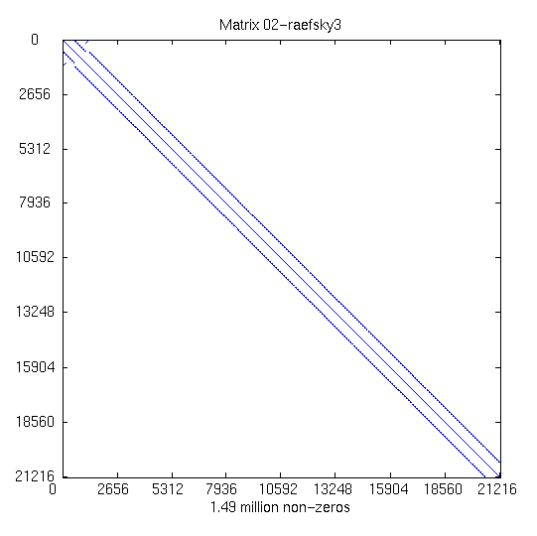
Example: The Difficulty of Tuning SpMV
n = 21200
nnz = 1.5 M
Source: NASA structural analysis problem (raefsky)
77
Notes:
FEM discretization from a structural analysis problem.
Source: Matrix “raefsky”, provided by NASA via the University of Florida Sparse Matrix Collection
http://www.cise.ufl.edu/research/sparse/matrices/Simon/raefsky3.html

Slide 78
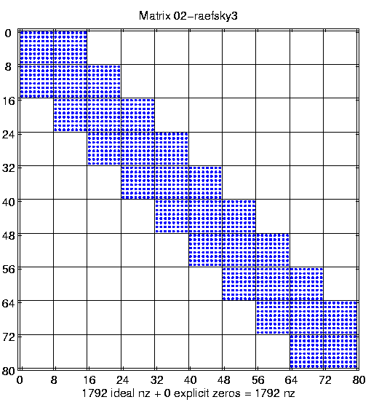
Example: The Difficulty of Tuning
n = 21200
nnz = 1.5 M
Source: NASA structural analysis problem (raefsky)
8x8 dense substructure: exploit this to limit #mem_refs
78
Notes:
discretization from a structural analysis problem.
Source: Matrix “raefsky”, provided by NASA via the University of Florida Sparse Matrix Collection
http://www.cise.ufl.edu/research/sparse/matrices/Simon/raefsky3.html

Slide 79
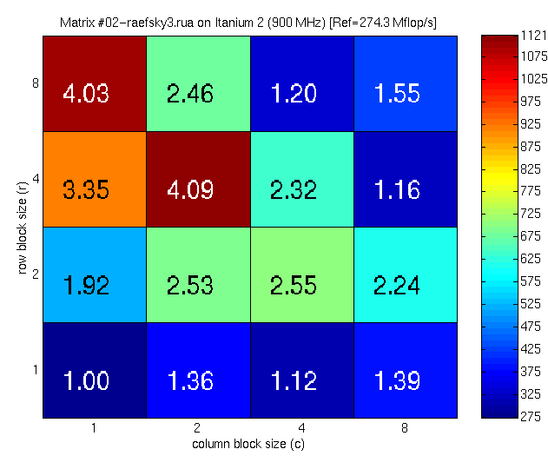
Speedups on Itanium 2: The Need for Search
Mflop/s
Best: 4x2
Reference
Mflop/s
79
Notes:
[NOTE: This slide has some animation in it.]
Experiment: Try all block sizes that divide 8x8—16 implementations in all.
Platform: 900 MHz Itanium-2, 3.6 Gflop/s peak speed. Intel v7.0 compiler.
Good speedups (4x) but at an unexpected block size (4x2).
Figure taken from Im, Yelick, Vuduc, IJHPCA paper, to appear.

Slide 80
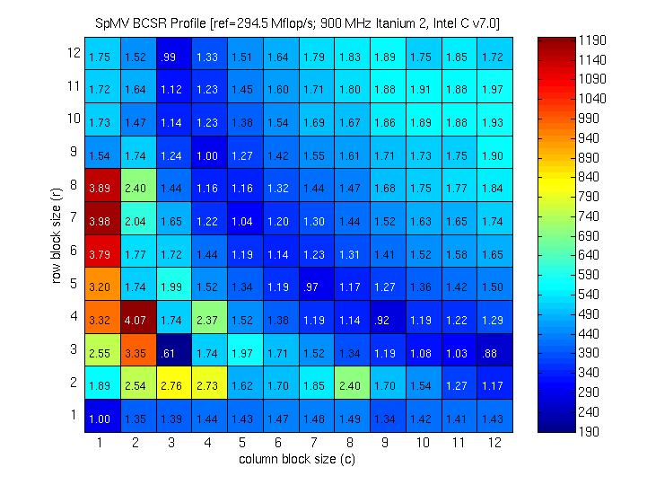
Register Profile: Itanium 2
1190 Mflop/s
190 Mflop/s
80

Slide 81
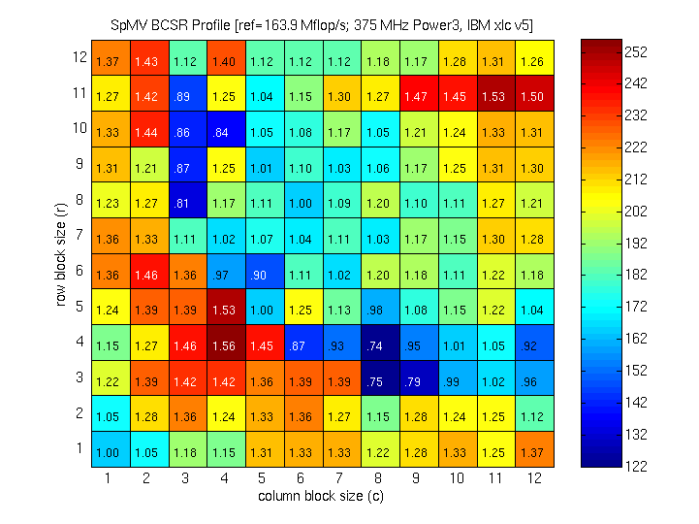
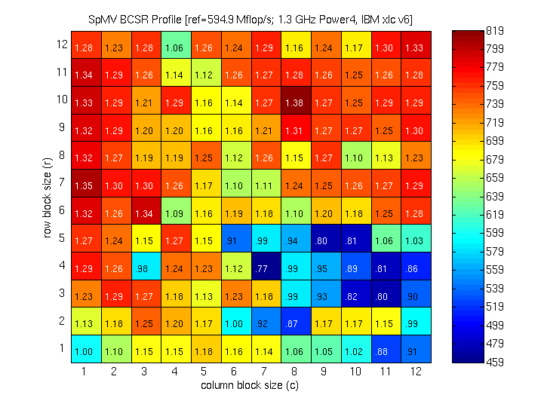
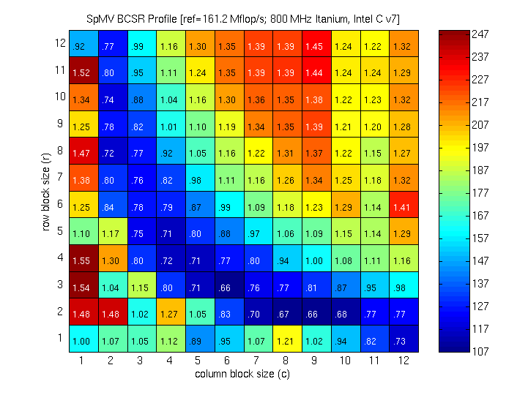
Register Profiles: IBM and Intel IA-64
Power3 - 17%
252 Mflop/s
Power4 - 16%
820 Mflop/s
122 Mflop/s
459 Mflop/s
Itanium 1 - 8%
247 Mflop/s
Itanium 2 - 33%
1.2 Gflop/s
107 Mflop/s
190 Mflop/s

Slide 82
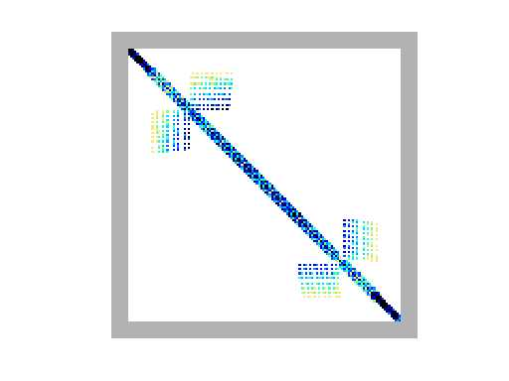
Another example of tuning challenges for SpMV
Ex11 matrix (fluid flow)
More complicated non-zero structure in general
N = 16614
NNZ = 1.1M
82
Notes:
An enlarged submatrix for “ex11”, from an FEM fluid flow application.
Original matrix: n = 16614, nnz = 1.1M
Source: UF Sparse Matrix Collection
http://www.cise.ufl.edu/~davis/sparse/FIDAP/ex11.rua.html

Slide 83
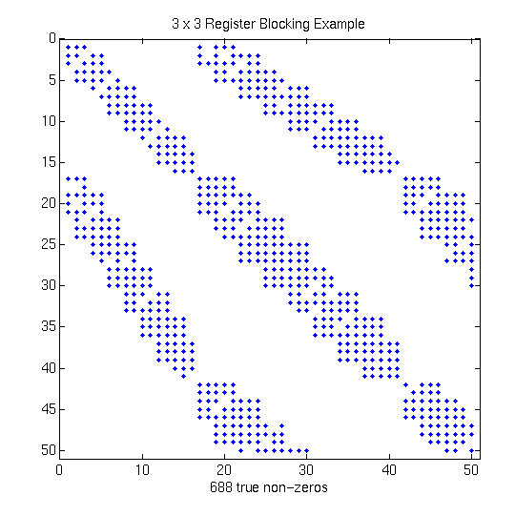
Zoom in to top corner
More complicated non-zero structure in general
N = 16614
NNZ = 1.1M
83
Notes:
An enlarged submatrix for “ex11”, from an FEM fluid flow application.
Original matrix: n = 16614, nnz = 1.1M
Source: UF Sparse Matrix Collection
http://www.cise.ufl.edu/~davis/sparse/FIDAP/ex11.rua.html

Slide 84
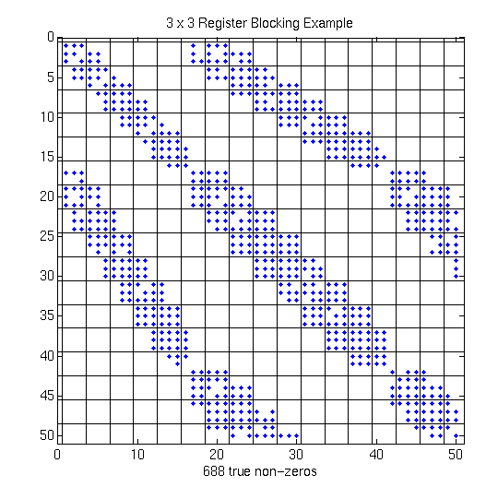
3x3 blocks look natural, but…
Example: 3x3 blocking
Logical grid of 3x3 cells
But would lead to lots of “fill-in”
84
Notes:
Suppose we know we want to use 3x3 blocking.
SPARSITY lays a logical 3x3 grid on the matrix…

Slide 85
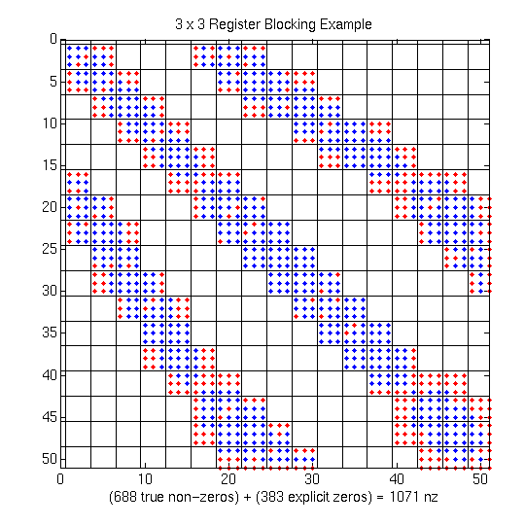
Extra Work Can Improve Efficiency!
Example: 3x3 blocking
Logical grid of 3x3 cells
Fill-in explicit zeros
Unroll 3x3 block multiplies
“Fill ratio” = 1.5
On Pentium III: 1.5x speedup!
Actual mflop rate 1.5² = 2.25 higher
85
Notes:
The main point is that there can be a considerable pay-off for judicious choice of “fill” (r x c), but that allowing for fill makes the implementation space even more complicated.
For this matrix on a Pentium III, we observed a 1.5x speedup, even after filling in an additional 50% explicit zeros. Two effects:
Filling in zeros, but eliminating integer indices (overhead)
(2) Quality of r x c code produced by compiler may be much better for particular r’s and c’s.
In this particular example, overall data structure size stays the same, but 3x3 code is 2x faster than 1x1 code for a dense matrix stored in sparse format.

Slide 86
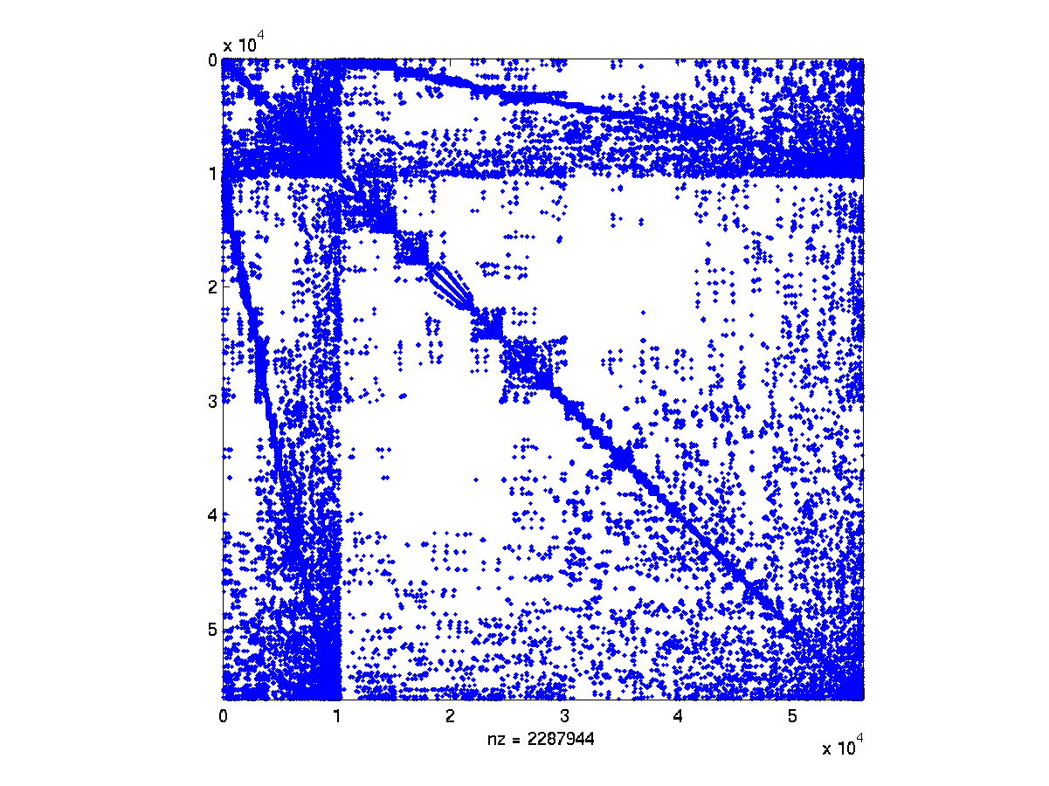
Source: Accelerator Cavity Design Problem (Ko via Husbands)
86

Slide 87
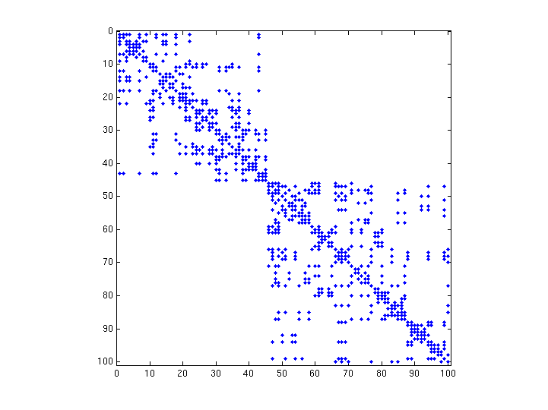
100x100 Submatrix Along Diagonal
87
Summer School Lecture 7

Slide 88
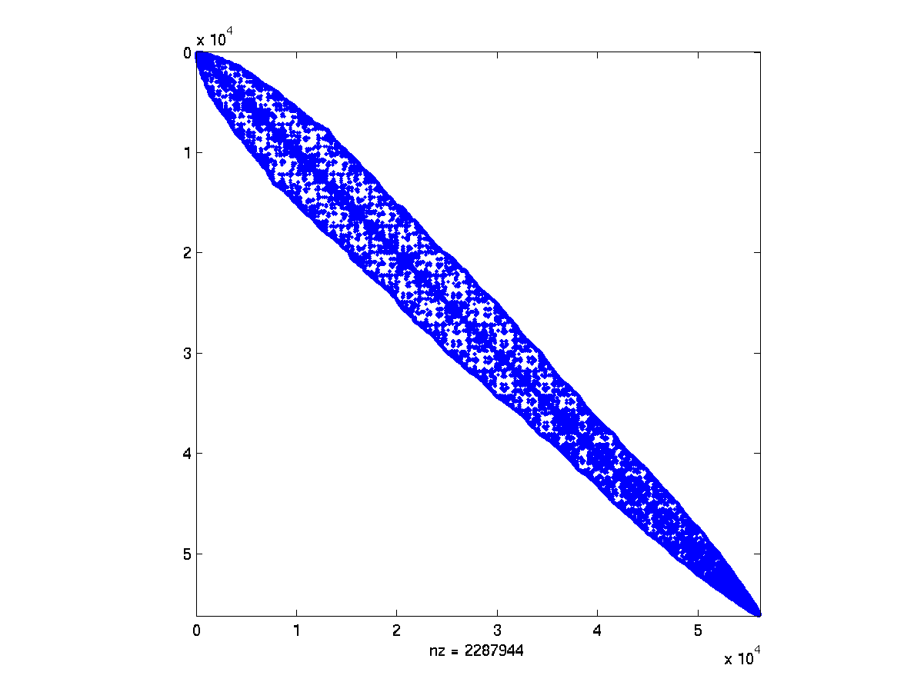
Post-RCM Reordering
88

Slide 89
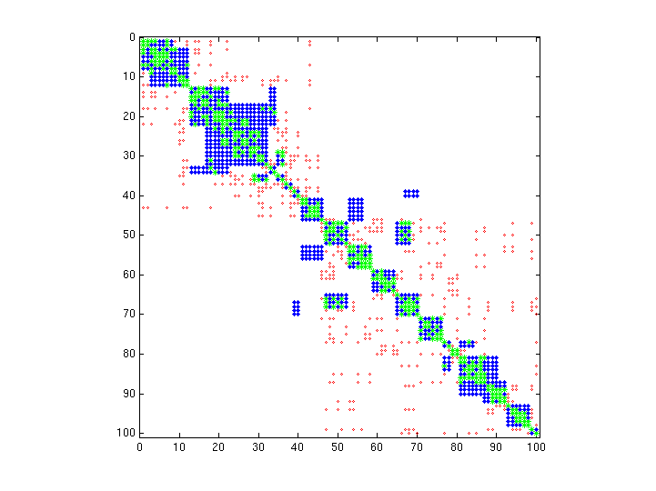
Effect of Combined RCM+TSP Reordering
Before: Green + Red
After: Green + Blue
2x speedups on Pentium 4, Power 4, …
89
Summer School Lecture 7

Slide 90
Summary of Other Performance Optimizations
Optimizations for SpMV
Register blocking (RB): up to 4x over CSR
Reordering to create dense structure : 2x over CSR
Variable block splitting: 2.1x over CSR, 1.8x over RB
Diagonals: 2x over CSR
Symmetry: 2.8x over CSR, 2.6x over RB
Cache blocking: 2.8x over CSR
Multiple vectors (SpMM): 7x over CSR
And combinations…
Sparse triangular solve
Hybrid sparse/dense data structure: 1.8x over CSR
Higher-level kernels
A·A^{T}·x, A^{T}·A·x: 4x over CSR, 1.8x over RB
More general kernels later …
90
Notes:
Items in bold: see Vuduc’s 455 page dissertation
Other items: see collaborations with BeBOPpers
2.1x for variable block splitting is just for the FEM matrices with 2 block sizes

Slide 91

Optimized Sparse Kernel Interface - OSKI
Provides sparse kernels automatically tuned for user’s matrix & machine
BLAS-style functionality: SpMV, Ax & A^{T}y, TrSV
Does both off-line and run-time tuning
Hides complexity of run-time tuning
For “advanced” users & solver library writers
Available as stand-alone library
Available as PETSc extension
bebop.cs.berkeley.edu/oski
pOSKI
Extension to multicore architectures
OSKI + thread blocking, cache blocking, matrix compression, software prefetching, NUMA, SIMD, …
bebop.cs.berkeley.edu/poski
91
Notes:
Library interface defines low-level primitives in the style of the Sparse BLAS: sparse matrix-vector multiply, sparse triangular solve.
Matrix-vector multiply touches each matrix element only once, whereas our locality-aware kernels can reuse these elements. The BeBOP library includes these kernels:
(1) simultaneous computation of A*x, A^{T}*z
(2) A^{T}*A*x
(3) A^{k}*x, k is non-negative integer
Unlike tuning in the dense case, sparse tuning must occur at run-time since the matrix is unknown until then.
Here, the “standard implementation” stores the matrix in compressed sparse row (CSR) format with the kernel coded in C or Fortran compiled with full optimizations.
To maximize the impact of our software, we are implementing a new “automatically tuned” matrix type in PETSc. Most PETSc users will be able to use our library with little or no modifications to their source code. The stand-alone version of our library is C and Fortran-callable.
“Advanced users” means users willing to program at the level of the BLAS.

Slide 92
Outline
Review, extend communication lower bounds
Direct Linear Algebra Algorithms
Matmul
classical & Strassen-like, heterogeneous, tensors, oblivious
LU & QR (tournament pivoting)
Sparse matrices
Eigenproblems (symmetric and nonsymmetric)
Iterative Linear Algebra
Autotuning Sparse-Matrix-Vector-Multiply (SpMV)
Reorganizing Krylov methods – Conjugate Gradients
Stability challenges and approaches
What is a “sparse matrix”?
Floating-point reproducibility
Despite nondeterminism/nonassociativity

Slide 93
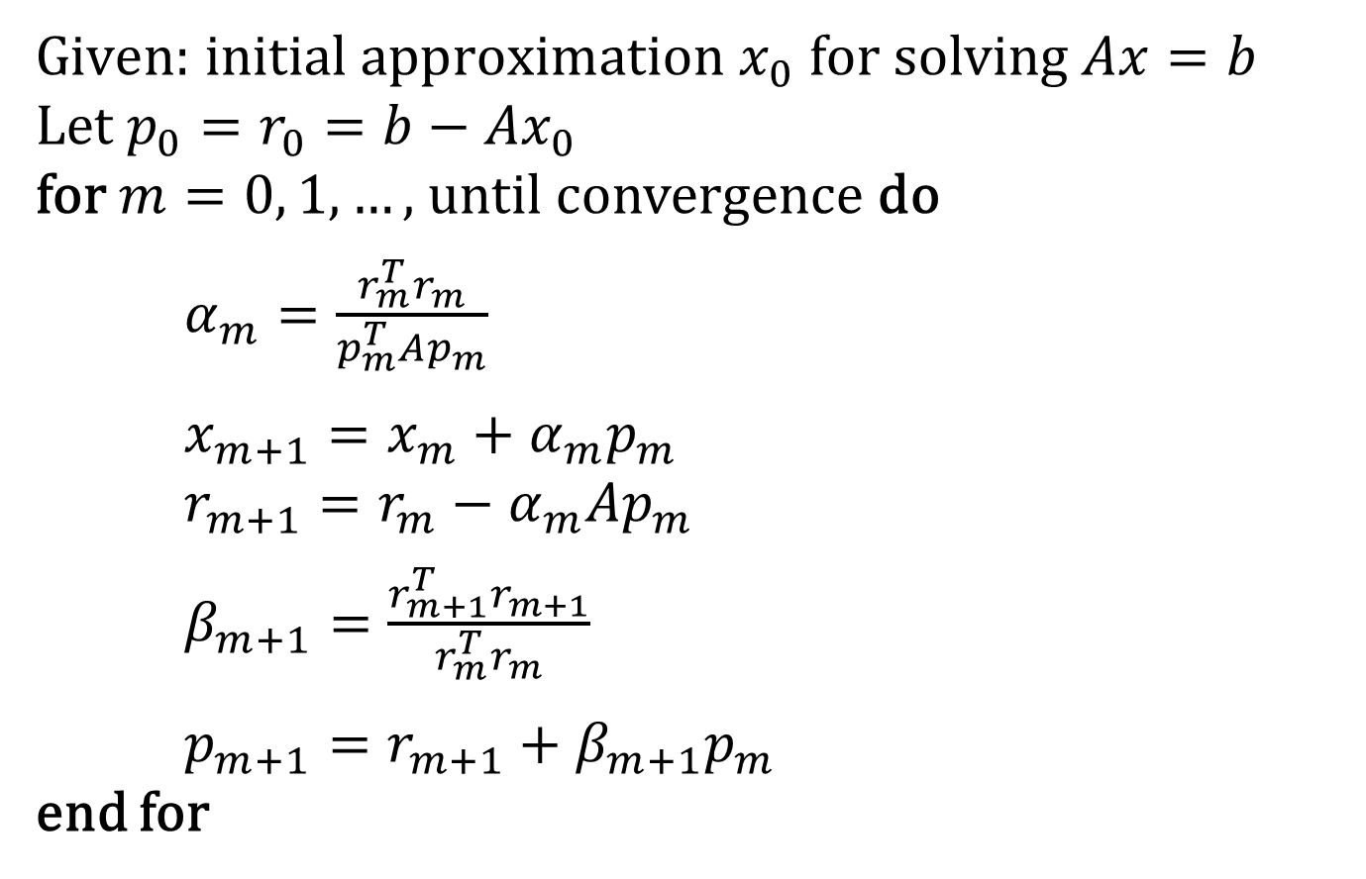
Example: Classical Conjugate Gradient (CG)
SpMVs and dot products require communication in each iteration

Slide 94
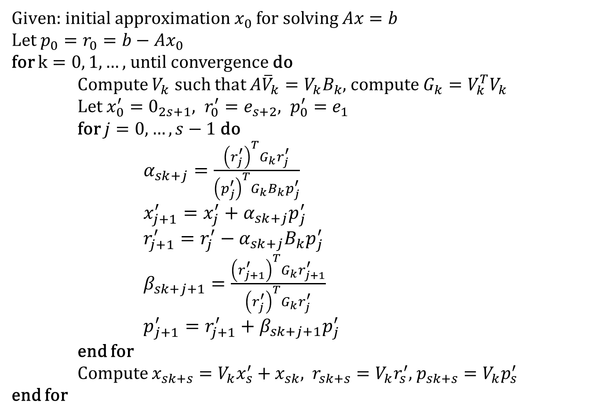
Example: CA-Conjugate Gradient
via CA Matrix Powers Kernel
Global reduction to compute G
Local computations within inner loop require no communication!

Slide 95
Outline
Review, extend communication lower bounds
Direct Linear Algebra Algorithms
Matmul
classical & Strassen-like, heterogeneous, tensors, oblivious
LU & QR (tournament pivoting)
Sparse matrices
Eigenproblems (symmetric and nonsymmetric)
Iterative Linear Algebra
Autotuing Sparse-Matrix-Vector-Multiply (SpMV)
Reorganizing Krylov methods – Conjugate Gradients
Stability challenges and approaches
What is a “sparse matrix”?
Floating-point reproducibility
Despite nondeterminism/nonassociativity

Slide 96
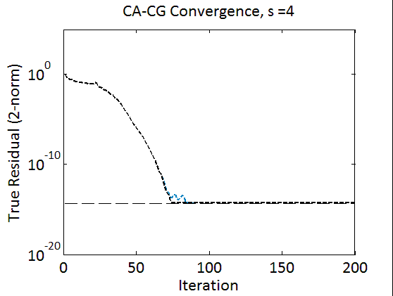
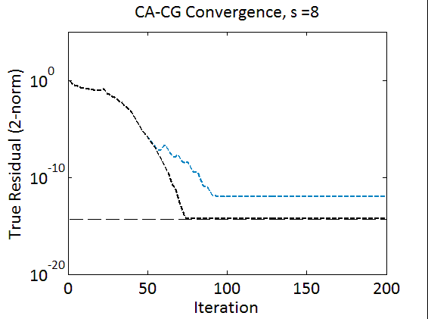
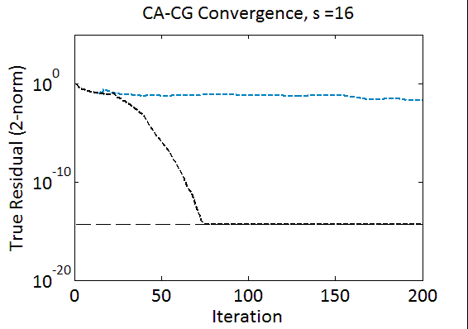
Slower convergence due to roundoff
Loss of accuracy due to roundoff
CG
CA-CG (monomial)
machine precision
Model problem:
2D Poisson, 5 point stencil
30x30 grid
Cond(A)~400
At s = 16, monomial basis is rank deficient! Method breaks down!

Slide 97
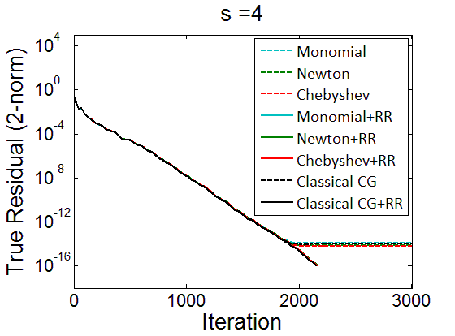
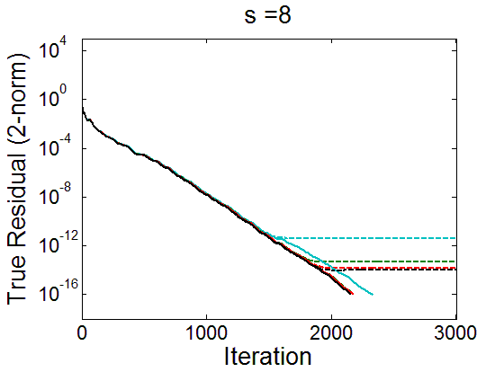
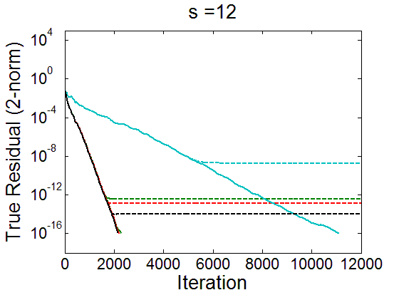
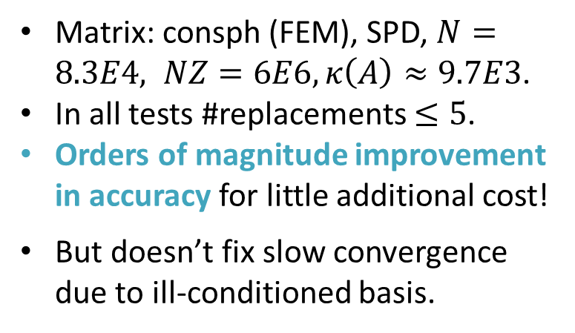
Notes:
Extra cost is additional bandwidth of computing |V|^T|V| in addition to V^TV, as well as extra cost of 1 SpMV per replacement
Residual Replacement based on Van der Vorst and Ye

Slide 98
Outline
Review, extend communication lower bounds
Direct Linear Algebra Algorithms
Matmul
classical & Strassen-like, heterogeneous, tensors, oblivious
LU & QR (tournament pivoting)
Sparse matrices
Eigenproblems (symmetric and nonsymmetric)
Iterative Linear Algebra
Autotuning Sparse-Matrix-Vector-Multiply (SpMV)
Reorganizing Krylov methods – Conjugate Gradients
Stability challenges and approaches
What is a “sparse matrix”?
Floating-point reproducibility
Despite nondeterminism/nonassociativity

Slide 99
What is a “sparse matrix”?
Requires o(n²) data/indices to store
Nonzero entries and indices could be explicit or implicit
Matrix could be sum of “sparse” matrices
Ex: A = sparse + low rank = S + UDV^{T}, D small & square
Semiseparable matrices, arise as preconditioners
Need to write A^{k} = (S + UDV^{T})^{k} as sum of S^{k} and low rank matrices
Indices
 | Explicit (O(nnz)) | Implicit (o(nnz))
Explicit (O(nnz)) | CSR and variations | Vision, climate, AMR,…
Implicit (o(nnz)) | Graph Laplacian | Stencils
Nonzero
entries

Slide 100
Outline
Review, extend communication lower bounds
Direct Linear Algebra Algorithms
Matmul
classical & Strassen-like, heterogeneous, tensors, oblivious
LU & QR (tournament pivoting)
Sparse matrices
Eigenproblems (symmetric and nonsymmetric)
Iterative Linear Algebra
Autotuning Sparse-Matrix-Vector-Multiply (SpMV)
Reorganizing Krylov methods – Conjugate Gradients
Stability challenges and approaches
What is a “sparse matrix”?
Floating-point reproducibility
Despite nondeterminism/nonassociativity

Slide 101
Reproducible Floating Point Computation
Get bit-wise identical answer when you type a.out again
NA-Digest submission on 8 Sep 2010
From Kai Diethelm, at GNS-MBH
Sought reproducible parallel sparse linear equation solver, demanded by customers (construction engineers), otherwise they don’t believe results
Willing to sacrifice 40% - 50% of performance for it
Email to ~110 Berkeley CSE faculty, asking about it
Most: “What?! How will I debug without reproducibility?”
Few: “I know better, and do careful error analysis”
S. Govindjee: needs it for fracture simulations
S. Russell: needs it for nuclear blast detection
Notes:
GNS = Gesellschaft fuer Numerische Simulation

Slide 102
Intel MKL non-reproducibility
Vector size: 1e6. Data aligned to 16-byte boundaries. For each input vector:
Dot products are computed using 1, 2, 3 or 4 threads
Absolute error = maximum – minimum
Relative error = Absolute error / maximum absolute value
Sign not
reproducible
Absolute Error for Random Vectors
Relative Error for Orthogonal vectors
Same magnitude opposite signs

Slide 103
Goals/Approaches for Reproducibility
Consider summation or dot product
Goals
Same answer, independent of layout, #processors, order of summands
Good performance (scales well)
Portable (assume IEEE 754 only)
User can choose accuracy
Approaches
Guarantee fixed reduction tree (not 2. or 3.)
Use (very) high precision to get exact answer (not 2.)
Prerounding technique (Nguyen, D.)

Slide 104
Performance results on 1024 proc Cray XC30 1.2x to 3.2x slowdown vs fastest code, for n=1M

Slide 105
Collaborators and Supporters
James Demmel, Kathy Yelick, Michael Anderson, Grey Ballard, Erin Carson, Aditya Devarakonda, Michael Driscoll, David Eliahu, Andrew Gearhart, Evangelos Georganas, Nicholas Knight, Penporn Koanantakool, Ben Lipshitz, Diep Nguyen, Oded Schwartz, Edgar Solomonik, Omer Spillinger
Austin Benson, Maryam Dehnavi, Mark Hoemmen, Shoaib Kamil, Marghoob Mohiyuddin
Abhinav Bhatele, Aydin Buluc, Michael Christ, Ioana Dumitriu, Armando Fox, David Gleich, Ming Gu, Jeff Hammond, Mike Heroux, Olga Holtz, Kurt Keutzer, Julien Langou, Devin Matthews, Tom Scanlon, Michelle Strout, Sam Williams, Hua Xiang
Jack Dongarra, Dulceneia Becker, Ichitaro Yamazaki
Sivan Toledo, Alex Druinsky, Inon Peled
Laura Grigori, Sebastien Cayrols, Simplice Donfack, Mathias Jacquelin, Amal Khabou, Sophie Moufawad, Mikolaj Szydlarski
Members of ParLab, ASPIRE, BEBOP, CACHE, EASI, FASTMath, MAGMA, PLASMA
Thanks to DOE, NSF, UC Discovery, INRIA, Intel, Microsoft, Mathworks, National Instruments, NEC, Nokia, NVIDIA, Samsung, Oracle
bebop.cs.berkeley.edu
Notes:
Underlined named visited other site, Mathias and Sophie in Summer 2012
New INRIA Postdoc: Soleiman Yousef

Slide 106
Summary
Time to redesign all linear algebra, n-body, …
algorithms and software
(and compilers)
Don’t Communic…

