Slide 1
Communication-Avoiding Algorithms for Linear Algebra and Beyond
Jim Demmel
EECS & Math Departments
UC Berkeley

Slide 2
Why avoid communication? (1/3)
Algorithms have two costs (measured in time or energy):
Arithmetic (FLOPS)
Communication: moving data between
levels of a memory hierarchy (sequential case)
processors over a network (parallel case).
CPU
Cache
CPU
DRAM
CPU
DRAM
DRAM
CPU
DRAM
CPU
DRAM

Slide 3
Why avoid communication? (2/3)
Running time of an algorithm is sum of 3 terms:
# flops * time_per_flop
# words moved / bandwidth
# messages * latency
communication
Time_per_flop << 1/ bandwidth << latency
Gaps growing exponentially with time [FOSC]
Avoid communication to save time
Annual improvements
Time_per_flop |  | Bandwidth | Latency
 | Network | 26% | 15%
 | DRAM | 23% | 5%
59%
Goal : reorganize algorithms to avoid communication
Between all memory hierarchy levels
L1 L2 DRAM network, etc
Very large speedups possible
Energy savings too!
Notes:
2008 DARPA Exascale report has similar prediction:
Gap between DRAM access time and flops will increase
100x over coming decade to balance power usage between
processors, DRAM
2011 NRC Report: “The Future of Computing Performance: Game Over or Next Level?”
Millett and Fuller

Slide 4
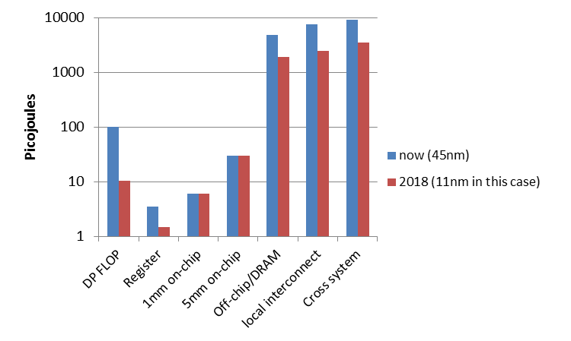
Why Minimize Communication? (3/3)
Source: John Shalf, LBL

Slide 5
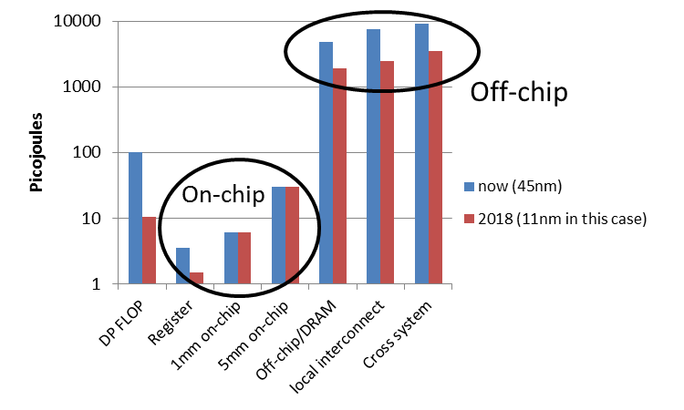
Why Minimize Communication? (3/3)
Minimize communication to save energy
Source: John Shalf, LBL

Slide 6
Goals
Redesign algorithms to avoid communication
Between all memory hierarchy levels
L1 L2 DRAM network, etc
Attain lower bounds if possible
Current algorithms often far from lower bounds
Large speedups and energy savings possible
Notes:
2008 DARPA Exascale report has similar prediction:
Gap between DRAM access time and flops will increase
100x over coming decade to balance power usage between
processors, DRAM

Slide 7
President Obama cites Communication-Avoiding Algorithms in the FY 2012 Department of Energy Budget Request to Congress:
“New Algorithm Improves Performance and Accuracy on Extreme-Scale Computing Systems. On modern computer architectures, communication between processors takes longer than the performance of a floating point arithmetic operation by a given processor. ASCR researchers have developed a new method, derived from commonly used linear algebra methods, to minimize communications between processors and the memory hierarchy, by reformulating the communication patterns specified within the algorithm. This method has been implemented in the TRILINOS framework, a highly-regarded suite of software, which provides functionality for researchers around the world to solve large scale, complex multi-physics problems.”
FY 2010 Congressional Budget, Volume 4, FY2010 Accomplishments, Advanced Scientific Computing Research (ASCR), pages 65-67.
CA-GMRES (Hoemmen, Mohiyuddin, Yelick, JD)
“Tall-Skinny” QR (Grigori, Hoemmen, Langou, JD)

Slide 8
Outline
Survey state of the art of CA (Comm-Avoiding) algorithms
TSQR: Tall-Skinny QR
CA O(n³) 2.5D Matmul
CA Strassen Matmul
Beyond linear algebra
Extending lower bounds to any algorithm with arrays
Communication-optimal N-body algorithm
CA-Krylov methods

Slide 9
Outline
Survey state of the art of CA (Comm-Avoiding) algorithms
TSQR: Tall-Skinny QR
CA O(n³) 2.5D Matmul
CA Strassen Matmul
Beyond linear algebra
Extending lower bounds to any algorithm with arrays
Communication-optimal N-body algorithm
CA-Krylov methods

Slide 10
Summary of CA Linear Algebra
“Direct” Linear Algebra
Lower bounds on communication for linear algebra problems like Ax=b, least squares, Ax = λx, SVD, etc
Mostly not attained by algorithms in standard libraries
New algorithms that attain these lower bounds
Being added to libraries: Sca/LAPACK, PLASMA, MAGMA
Large speed-ups possible
Autotuning to find optimal implementation
Ditto for “Iterative” Linear Algebra

Slide 11
Lower bound for all “n³-like” linear algebra
Let M = “fast” memory size (per processor)
#words_moved (per processor) = Ω(#flops (per processor) / M^{1/2} )
#messages_sent (per processor) = Ω(#flops (per processor) / M^{3/2} )
Parallel case: assume either load or memory balanced
Holds for
Matmul, BLAS, LU, QR, eig, SVD, tensor contractions, …
Some whole programs (sequences of these operations, no matter how individual ops are interleaved, eg A^{k})
Dense and sparse matrices (where #flops << n³ )
Sequential and parallel algorithms
Some graph-theoretic algorithms (eg Floyd-Warshall)

Slide 12
Lower bound for all “n³-like” linear algebra
Let M = “fast” memory size (per processor)
#words_moved (per processor) = Ω(#flops (per processor) / M^{1/2} )
#messages_sent ≥ #words_moved / largest_message_size
Parallel case: assume either load or memory balanced
Holds for
Matmul, BLAS, LU, QR, eig, SVD, tensor contractions, …
Some whole programs (sequences of these operations, no matter how individual ops are interleaved, eg A^{k})
Dense and sparse matrices (where #flops << n³ )
Sequential and parallel algorithms
Some graph-theoretic algorithms (eg Floyd-Warshall)
Notes:
APSP talk Tuesday, session 12, Edgar Solomonik, Aydin Buluc

Slide 13
Lower bound for all “n³-like” linear algebra
Let M = “fast” memory size (per processor)
#words_moved (per processor) = Ω(#flops (per processor) / M^{1/2} )
#messages_sent (per processor) = Ω(#flops (per processor) / M^{3/2} )
Parallel case: assume either load or memory balanced
Holds for
Matmul, BLAS, LU, QR, eig, SVD, tensor contractions, …
Some whole programs (sequences of these operations, no matter how individual ops are interleaved, eg A^{k})
Dense and sparse matrices (where #flops << n³ )
Sequential and parallel algorithms
Some graph-theoretic algorithms (eg Floyd-Warshall)
SIAM SIAG/Linear Algebra Prize, 2012
Ballard, D., Holtz, Schwartz

Slide 14
Can we attain these lower bounds?
Do conventional dense algorithms as implemented in LAPACK and ScaLAPACK attain these bounds?
Often not
If not, are there other algorithms that do?
Yes, for much of dense linear algebra
New algorithms, with new numerical properties, new ways to encode answers, new data structures
Not just loop transformations (need those too!)
Only a few sparse algorithms so far
Lots of work in progress
Notes:
Sparse: depends on George, Rose, Tarjan

Slide 15
Outline
Survey state of the art of CA (Comm-Avoiding) algorithms
TSQR: Tall-Skinny QR
CA O(n³) 2.5D Matmul
CA Strassen Matmul
Beyond linear algebra
Extending lower bounds to any algorithm with arrays
Communication-optimal N-body algorithm
CA-Krylov methods

Slide 16
TSQR: QR of a Tall, Skinny matrix
W₀
W₁
W₂
W₃
Q₀₀ R₀₀
Q₁₀ R₁₀
Q₂₀ R₂₀
Q₃₀ R₃₀
Q₀₀
Q₁₀
Q₂₀
Q₃₀
R₀₀
R₁₀
R₂₀
R₃₀
W =
=
=
.
R₀₀
R₁₀
R₂₀
R₃₀
Q₀₁ R₀₁
Q₁₁ R₁₁
Q₀₁
Q₁₁
R₀₁
R₁₁
=
=
.
R₀₁
R₁₁
=
Q₀₂ R₀₂

Slide 17
TSQR: QR of a Tall, Skinny matrix
W₀
W₁
W₂
W₃
Q₀₀ R₀₀
Q₁₀ R₁₀
Q₂₀ R₂₀
Q₃₀ R₃₀
Q₀₀
Q₁₀
Q₂₀
Q₃₀
R₀₀
R₁₀
R₂₀
R₃₀
W =
=
=
.
R₀₀
R₁₀
R₂₀
R₃₀
Q₀₁ R₀₁
Q₁₁ R₁₁
Q₀₁
Q₁₁
R₀₁
R₁₁
=
=
.
R₀₁
R₁₁
=
Q₀₂ R₀₂
Output = { Q₀₀, Q₁₀, Q₂₀, Q₃₀, Q₀₁, Q₁₁, Q₀₂, R₀₂ }

Slide 18
TSQR: An Architecture-Dependent Algorithm
W₀
W₁
W₂
W₃
R₀₀
R₁₀
R₂₀
R₃₀
R₀₁
Parallel:
W =
R₀₂
R₁₁
W₀
W₁
W₂
W₃
R₀₀
Sequential:
R₀₁
W =
R₀₂
R₀₃
W₀
W₁
W₂
W₃
R₀₀
R₀₁
Dual Core:
R₀₁
W =
R₀₂
R₁₁
R₀₃
R₁₁
Multicore / Multisocket / Multirack / Multisite / Out-of-core: ?
Can choose reduction tree dynamically
Notes:
Oldest reference for idea of tree: Golub/Plemmons/Sameh 1988,
But didn’t avoid communication

Slide 19
TSQR Performance Results
Parallel
Intel Clovertown
Up to 8x speedup (8 core, dual socket, 10M x 10)
Pentium III cluster, Dolphin Interconnect, MPICH
Up to 6.7x speedup (16 procs, 100K x 200)
BlueGene/L
Up to 4x speedup (32 procs, 1M x 50)
Tesla C 2050 / Fermi
Up to 13x (110,592 x 100)
Grid – 4x on 4 cities vs 1 city (Dongarra, Langou et al)
Cloud – 1.6x slower than accessing data twice (Gleich and Benson)
Sequential
“Infinite speedup” for out-of-core on PowerPC laptop
As little as 2x slowdown vs (predicted) infinite DRAM
LAPACK with virtual memory never finished
SVD costs about the same
Joint work with Grigori, Hoemmen, Langou, Anderson, Ballard, Keutzer, others
Data from Grey Ballard, Mark Hoemmen, Laura Grigori, Julien Langou, Jack Dongarra, Michael Anderson
Notes:
Transition: TSQR -> CAQR
Cloud: Hadoop and Python based Dumbo MapReduce interface on 40-core mapreduce cluster at Stanford

Slide 20
Summary of dense parallel algorithms attaining communication lower bounds
Assume nxn matrices on P processors
Minimum Memory per processor = M = O(n² / P)
Recall lower bounds:
#words_moved = Ω( (n³/ P) / M^{1/2} ) = Ω( n² / P^{1/2} )
#messages = Ω( (n³/ P) / M^{3/2} ) = Ω( P^{1/2} )
Does ScaLAPACK attain these bounds?
For #words_moved: mostly, except nonsym. Eigenproblem
For #messages: asymptotically worse, except Cholesky
New algorithms attain all bounds, up to polylog(P) factors
Cholesky, LU, QR, Sym. and Nonsym eigenproblems, SVD
Can we do Better?
Notes:
ScaLAPACK assumes best block size chosen
Many references, blue are ours
LU: uses tournament pivoting, different stability, speedup up to 29X predicted on exascale
QR uses TSQR, speedup up to 8x on Intel Clovertown, 13x on Tesla, up on cloud
Symeig uses variant of SBR, speedup up to 30x on AMD Magny-Cours, vs ACML 4.4
n=12000, b=500, 6 threads
Nonsymeig, uses randomization in two ways

Slide 21
Can we do better?
Aren’t we already optimal?
Why assume M = O(n²/p), i.e. minimal?
Lower bound still true if more memory
Can we attain it?

Slide 22
Outline
Survey state of the art of CA (Comm-Avoiding) algorithms
TSQR: Tall-Skinny QR
CA O(n³) 2.5D Matmul
CA Strassen Matmul
Beyond linear algebra
Extending lower bounds to any algorithm with arrays
Communication-optimal N-body algorithm
CA-Krylov methods

Slide 23
2.5D Matrix Multiplication
Assume can fit cn²/P data per processor, c > 1
Processors form (P/c)^{1/2} x (P/c)^{1/2} x c grid
j
i
Initially P(i,j,0) owns A(i,j) and B(i,j)
each of size n(c/P)^{1/2} x n(c/P)^{1/2}
k
(1) P(i,j,0) broadcasts A(i,j) and B(i,j) to P(i,j,k)
(2) Processors at level k perform 1/c-th of SUMMA, i.e. 1/c-th of Σ_{m} A(i,m)*B(m,j)
(3) Sum-reduce partial sums Σ_{m} A(i,m)*B(m,j) along k-axis so P(i,j,0) owns C(i,j)

Slide 24
2.5D Matmul on BG/P, 16K nodes / 64K cores

Slide 25
2.5D Matmul on BG/P, 16K nodes / 64K cores
c = 16 copies
2.7x faster
12x faster
Distinguished Paper Award, EuroPar’11 (Solomonik, D.)
SC’11 paper by Solomonik, Bhatele, D.
Notes:
SC’11 paper about need to fully utilize 3D torus network on BG/P to get this to work

Slide 26
Perfect Strong Scaling – in Time and Energy
Every time you add a processor, you should use its memory M too
Start with minimal number of procs: PM = 3n²
Increase P by a factor of c ➔ total memory increases by a factor of c
Notation for timing model:
γ_{T} , β_{T} , α_{T} = secs per flop, per word_moved, per message of size m
T(cP) = n³/(cP) [ γ_{T}+ β_{T}/M^{1/2} + α_{T}/(mM^{1/2}) ]
= T(P)/c
Notation for energy model:
γ_{E} , β_{E} , α_{E} = joules for same operations
δ_{E} = joules per word of memory used per sec
ε_{E} = joules per sec for leakage, etc.
E(cP) = cP { n³/(cP) [ γ_{E}+ β_{E}/M^{1/2} + α_{E}/(mM^{1/2}) ] + δ_{E}MT(cP) + ε_{E}T(cP) }
= E(P)
Perfect scaling extends to N-body, Strassen, …
Notes:
Can use these formulas to ask:
How to choose p and M to minimize energy needed for computation?
Given max allowed runtime T, how much energy do I need to achieve it?
Given max allowed energy E, what is the minimum runtime T I can attain?
Given target energy efficiency (Gflops/W), what architectural parameters
are needed to achieve it?
Talk by Andrew Gearhart, Session 14, today May 22

Slide 27
Ongoing Work
Lots more work on
Algorithms:
BLAS, LDL^{T}, QR with pivoting, other pivoting schemes, eigenproblems, …
All-pairs-shortest-path, …
Both 2D (c=1) and 2.5D (c>1)
But only bandwidth may decrease with c>1, not latency
Platforms:
Multicore, cluster, GPU, cloud, heterogeneous, low-energy, …
Software:
Integration into Sca/LAPACK, PLASMA, MAGMA,…
Integration into applications (on IBM BG/Q)
CTF (with ANL): symmetric tensor contractions
Notes:
Rectangular matmul, talk yesterday by David Eliahu, Session 6
LDLT – best paper talk by Ichitiaro Yamazaki, May 23,tomorrow Thursday, plenary session
APSP – talk yesterday by Edgar Solomonik, session 12
CTF – talk by Edgar Solomonik, today Session 17
Qbox code – Francois Gygi @ UC Davis, also LLNL, first principle molecular dynamics,
uses Density Functional Theory to solve Kohn Sham equations, won Gordon Bell Prize in 2006
CTF – Cyclops Tensor Framework,
faster symmetric tensor contractions for “coupled cluster” electronic structure calculations

Slide 28
Outline
Survey state of the art of CA (Comm-Avoiding) algorithms
TSQR: Tall-Skinny QR
CA O(n³) 2.5D Matmul
CA Strassen Matmul
Beyond linear algebra
Extending lower bounds to any algorithm with arrays
Communication-optimal N-body algorithm
CA-Krylov methods

Slide 29
Communication Lower Bounds for Strassen-like matmul algorithms
Classical
O(n³) matmul:
#words_moved =
Ω (M(n/M^{1/2})³/P)
Strassen’s
O(n^{lg7}) matmul:
#words_moved =
Ω (M(n/M^{1/2})^{lg7}/P)
Strassen-like
O(n^{ω}) matmul:
#words_moved =
Ω (M(n/M^{1/2})^{ω}/P)
Proof: graph expansion (different from classical matmul)
Strassen-like: DAG must be “regular” and connected
Extends up to M = n² / p^{2/ω}
Best Paper Prize (SPAA’11), Ballard, D., Holtz, Schwartz,
also in JACM
Is the lower bound attainable?

Slide 30
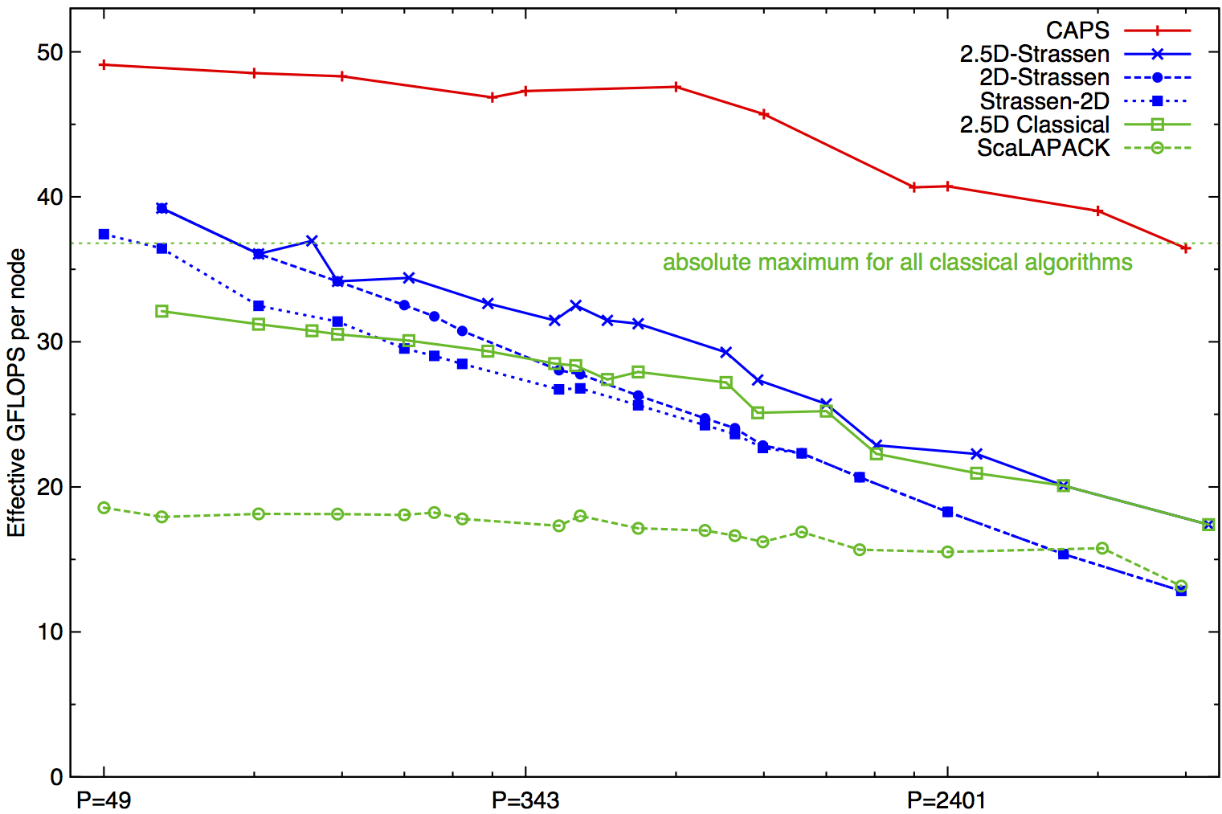
Performance Benchmarking, Strong Scaling Plot
Franklin (Cray XT4) n = 94080
Invited to appear as Research Highlight in CACM
Speedups: 24%-184% (over previous Strassen-based algorithms)
Notes:
2n^3/time 184% is at 7203 ours 7056 theirs (per node).
Strong scaling range up to about p=1000
Top on this plot: p = 7200, recent data up to 20K
2(.5)D-Strassen means 2(.5)D-outer, and Strassen-inner, on the small local matrices
Strassen-2D means x DFS Strassen steps, followed by 2D classical for the 7^x subproblems

Slide 31
Outline
Survey state of the art of CA (Comm-Avoiding) algorithms
TSQR: Tall-Skinny QR
CA O(n³) 2.5D Matmul
CA Strassen Matmul
Beyond linear algebra
Extending lower bounds to any algorithm with arrays
Communication-optimal N-body algorithm
CA-Krylov methods

Slide 32
Recall optimal sequential Matmul
Naïve code
for i=1:n, for j=1:n, for k=1:n, C(i,j)+=A(i,k)*B(k,j)
“Blocked” code
for i1 = 1:b:n, for j1 = 1:b:n, for k1 = 1:b:n
for i2 = 0:b-1, for j2 = 0:b-1, for k2 = 0:b-1
i=i1+i2, j = j1+j2, k = k1+k2
C(i,j)+=A(i,k)*B(k,j)
Thm: Picking b = M^{1/2} attains lower bound:
#words_moved = Ω(n³/M^{1/2})
Where does 1/2 come from?
b x b matmul

Slide 33
New Thm applied to Matmul
for i=1:n, for j=1:n, for k=1:n, C(i,j) += A(i,k)*B(k,j)
Record array indices in matrix Δ
Solve LP for x = [xi,xj,xk]^{T}: max 1^{T}x s.t. Δ x ≤ 1
Result: x = [1/2, 1/2, 1/2]^{T}, 1^{T}x = 3/2 = s_{HBL}
Thm: #words_moved = Ω(n³/M^{SHBL-1})= Ω(n³/M^{1/2})
Attained by block sizes M^{xi},M^{xj},M^{xk} = M^{1/2},M^{1/2},M^{1/2}
 | i | j | k
 | 1 | 0 | 1 | A
Δ = | 0 | 1 | 1 | B
 | 1 | 1 | 0 | C

Slide 34
New Thm applied to Direct N-Body
for i=1:n, for j=1:n, F(i) += force( P(i) , P(j) )
Record array indices in matrix Δ
Solve LP for x = [xi,xj]^{T}: max 1^{T}x s.t. Δ x ≤ 1
Result: x = [1,1], 1^{T}x = 2 = s_{HBL}
Thm: #words_moved = Ω(n²/M^{SHBL-1})= Ω(n²/M¹)
Attained by block sizes M^{xi},M^{xj} = M¹,M¹
 | i | j
 | 1 | 0 | F
Δ = | 1 | 0 | P(i)
 | 0 | 1 | P(j)

Slide 35
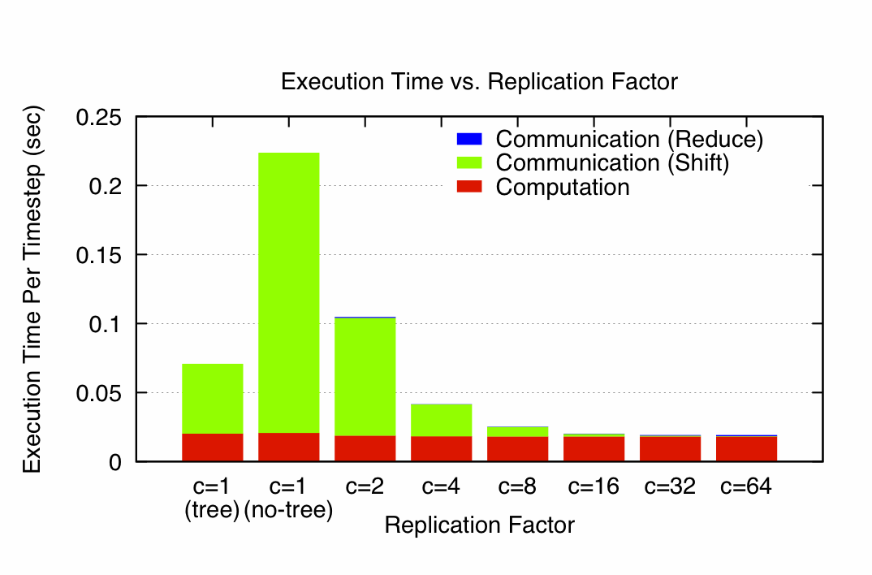
N-Body Speedups on IBM-BG/P (Intrepid) 8K cores, 32K particles
K. Yelick, E. Georganas, M. Driscoll, P. Koanantakool, E. Solomonik
11.8x speedup
Notes:
Talk by M. Driscoll, tomorrow, May 23, session 21
Intrepid: 163,480 core IBM BG/P at Argonne NL (ALCF)
Each node is one quad-core in a 3D torus
C=1(tree) uses special HW collective network, (no tree) just used regular network

Slide 36
New Thm applied to Random Code
for i1=1:n, for i2=1:n, … , for i6=1:n
A1(i1,i3,i6) += func1(A2(i1,i2,i4),A3(i2,i3,i5),A4(i3,i4,i6))
A5(i2,i6) += func2(A6(i1,i4,i5),A3(i3,i4,i6))
Record array indices
in matrix Δ
Solve LP for x = [x1,…,x7]^{T}: max 1^{T}x s.t. Δ x ≤ 1
Result: x = [2/7,3/7,1/7,2/7,3/7,4/7], 1^{T}x = 15/7 = s_{HBL}
Thm: #words_moved = Ω(n⁶/M^{SHBL-1})= Ω(n⁶/M^{8/7})
Attained by block sizes M^{2/7},M^{3/7},M^{1/7},M^{2/7},M^{3/7},M^{4/7}
 | i1 | i2 | i3 | i4 | i5 | i6
 | 1 | 0 | 1 | 0 | 0 | 1 | A1
 | 1 | 1 | 0 | 1 | 0 | 0 | A2
Δ = | 0 | 1 | 1 | 0 | 1 | 0 | A3
 | 0 | 0 | 1 | 1 | 0 | 1 | A3,A4
 | 0 | 0 | 1 | 1 | 0 | 1 | A5
 | 1 | 0 | 0 | 1 | 1 | 0 | A6

Slide 37
Where do lower and matching upper bounds on communication come from? (1/3)
Originally for C = A*B by Irony/Tiskin/Toledo (2004)
Proof idea
Suppose we can bound #useful_operations ≤ G doable with data in fast memory of size M
So to do F = #total_operations, need to fill fast memory F/G times, and so #words_moved ≥ MF/G
Hard part: finding G
Attaining lower bound
Need to “block” all operations to perform ~G operations on every chunk of M words of data

Slide 38
Proof of communication lower bound (2/3)
k
C = A * B
(Irony/Tiskin/Toledo
2004)
“C face”
Cube representing
C(1,1) += A(1,3)·B(3,1)
C(2,3)
C(1,1)
B(3,1)
A(1,3)
A(1,2)
B(2,1)
j
B(1,3)
B(1,1)
A(2,1)
A(1,1)
“B face”
i
If we have at most M “A squares”, M “B squares”, and M “C squares”, how many cubes G can we have?
“A face”

Slide 39
Proof of communication lower bound (3/3)
k
x
“C shadow”
y
z
y
j
z
x
“B shadow”
“A shadow”
#words_moved = Ω(M(n³/P)/M^{3/2}) = Ω(n³/(PM^{1/2}))
i
(i,k) is in “A shadow” if (i,j,k) in 3D set
(j,k) is in “B shadow” if (i,j,k) in 3D set
(i,j) is in “C shadow” if (i,j,k) in 3D set
Thm (Loomis & Whitney, 1949)
G = # cubes in 3D set = Volume of 3D set
≤ (area(A shadow) · area(B shadow) ·
area(C shadow)) ^{1/2}
≤ M ^{3/2}
G = # cubes in black box with
side lengths x, y and z
= Volume of black box
= x·y·z
= ( xz · zy · yx)^{1/2}
= (#A□s · #B□s · #C□s )^{1/2}
≤ M ^{3/2}
Notes:
This is the original matmul proof:
But it has nothing to do with doing mul/add in the inner loop,
Or A, B and C being disjoint matrices, or with them being dense

Slide 40
Approach to generalizing lower bounds
Matmul
for i=1:n, for j=1:n, for k=1:n,
C(i,j)+=A(i,k)*B(k,j)
=> for (i,j,k) in S = subset of Z³
Access locations indexed by (i,j), (i,k), (k,j)
General case
for i1=1:n, for i2 = i1:m, … for ik = i3:i4
C(i1+2*i3-i7) = func(A(i2+3*i4,i1,i2,i1+i2,…),B(pnt(3*i4)),…)
D(something else) = func(something else), …
=> for (i1,i2,…,ik) in S = subset of Z^{k}
Access locations indexed by group homomorphisms, eg
φ_{C} (i1,i2,…,ik) = (i1+2*i3-i7)
φ_{A} (i1,i2,…,ik) = (i2+3*i4,i1,i2,i1+i2,…), …
Can we bound #loop_iterations (= |S|)
given bounds on #points in its images, i.e. bounds on |φ_{C} (S)|, |φ_{A} (S)|, … ?

Slide 41
General Communication Bound
Given S subset of Z^{k}, group homomorphisms φ₁, φ₂, …, bound |S| in terms of |φ₁(S)|, |φ₂(S)|, … , |φ_{m}(S)|
Def: Hölder-Brascamp-Lieb LP (HBL-LP) for s₁,…,s_{m}:
for all subgroups H < Z^{k}, rank(H) ≤ Σ_{j} s_{j}*rank(φ_{j}(H))
Thm (Christ/Tao/Carbery/Bennett): Given s₁,…,s_{m}
|S| ≤ Π_{j} |φ_{j}(S)|^{sj}
Thm: Given a program with array refs given by φ_{j}, choose s_{j} to minimize s_{HBL} = Σ_{j} s_{j} subject to HBL-LP. Then
#words_moved = Ω (#iterations/M^{sHBL-1})
Notes:
Note: there are infinitely many subgroups H, but only finitely many possible constraints
Michael Chris (UCB), Terry Tao (UCLA), Anthony Carbery (Edinburgh), Jonathan Bennett (Birmingham),
Published in Geometric Functional Analysis, 2008

Slide 42
Is this bound attainable (1/2)?
But first: Can we write it down?
Thm: (bad news) HBL-LP reduces to Hilbert’s 10th problem over Q (conjectured to be undecidable)
Thm: (good news) Another LP with same solution is decidable (but expensive, so far)
Thm: (better news) Easy to write down LP explicitly in many cases of interest (eg all φ_{j} = {subset of indices})
Thm: (good news) Easy to approximate, i.e. get upper or lower bounds on s_{HBL}
If you miss a constraint, the lower bound may be too large (i.e. s_{HBL} too small) but still worth trying to attain
Tarski-decidable to get superset of constraints (may get s_{HBL} too large)
Notes:
Note: real “relaxation” is Tarski decidable.

Slide 43
Is this bound attainable (2/2)?
Depends on loop dependencies
Best case: none, or reductions (matmul)
Thm: When all φ_{j} = {subset of indices}, dual of HBL-LP gives optimal tile sizes:
HBL-LP: minimize 1^{T}*s s.t. s^{T}*Δ ≥ 1^{T}
Dual-HBL-LP: maximize 1^{T}*x s.t. Δ*x ≤ 1
Then for sequential algorithm, tile i_{j} by M^{xj}
Ex: Matmul: s = [ 1/2 , 1/2 , 1/2 ]^{T} = x
Extends to unimodular transforms of indices

Slide 44
Ongoing Work
Accelerate decision procedure for lower bounds
Ex: At most 3 arrays, or 4 loop nests
Have yet to find a case where we cannot attain lower bound – can we prove this?
Extend “perfect scaling” results for time and energy by using extra memory
Incorporate into compilers
Notes:
Qbox code – Francois Gygi @ UC Davis, also LLNL, first principle molecular dynamics,
uses Density Functional Theory to solve Kohn Sham equations, won Gordon Bell Prize in 2006
CTF – Cyclops Tensor Framework,
faster symmetric tensor contractions for “coupled cluster” electronic structure calculations

Slide 45
Outline
Survey state of the art of CA (Comm-Avoiding) algorithms
TSQR: Tall-Skinny QR
CA O(n³) 2.5D Matmul
CA Strassen Matmul
Beyond linear algebra
Extending lower bounds to any algorithm with arrays
Communication-optimal N-body algorithm
CA-Krylov methods

Slide 46
Avoiding Communication in Iterative Linear Algebra
k-steps of iterative solver for sparse Ax=b or Ax=λx
Does k SpMVs with A and starting vector
Many such “Krylov Subspace Methods”
Conjugate Gradients (CG), GMRES, Lanczos, Arnoldi, …
Goal: minimize communication
Assume matrix “well-partitioned”
Serial implementation
Conventional: O(k) moves of data from slow to fast memory
New: O(1) moves of data – optimal
Parallel implementation on p processors
Conventional: O(k log p) messages (k SpMV calls, dot prods)
New: O(log p) messages - optimal
Lots of speed up possible (modeled and measured)
Price: some redundant computation
Challenges: Poor partitioning, Preconditioning, Num. Stability
46
Notes:
Well – partitioned = modest surface-to-volume ratio
See bebop.cs.berkeley.edu
CG: [van Rosendale, 83], [Chronopoulos and Gear, 89]
GMRES: [Walker, 88], [Joubert and Carey, 92], [Bai et al., 94]

Slide 47
Communication Avoiding Kernels: The Matrix Powers Kernel : [Ax, A²x, …, A^{k}x]
Replace k iterations of y = A⋅x with [Ax, A²x, …, A^{k}x]
Example: A tridiagonal, n=32, k=3
Works for any “well-partitioned” A
A³·x
A²·x
A·x
x
1 2 3 4 …
… 32
Notes:
C. J. Pfeifer, Data flow and storage allocation for the PDQ-5 program on the Philco-2000, Comm. ACM 6, No. 7 (1963), 365366.
Referred to in paper by Leiserson/Rao/Toledo/ in 1993 paper on blocking covers

Slide 48
Communication Avoiding Kernels: The Matrix Powers Kernel : [Ax, A²x, …, A^{k}x]
Replace k iterations of y = A⋅x with [Ax, A²x, …, A^{k}x]
Example: A tridiagonal, n=32, k=3
A³·x
A²·x
A·x
x
1 2 3 4 …
… 32

Slide 49
Communication Avoiding Kernels: The Matrix Powers Kernel : [Ax, A²x, …, A^{k}x]
Replace k iterations of y = A⋅x with [Ax, A²x, …, A^{k}x]
Example: A tridiagonal, n=32, k=3
A³·x
A²·x
A·x
x
1 2 3 4 …
… 32

Slide 50
Communication Avoiding Kernels: The Matrix Powers Kernel : [Ax, A²x, …, A^{k}x]
Replace k iterations of y = A⋅x with [Ax, A²x, …, A^{k}x]
Example: A tridiagonal, n=32, k=3
A³·x
A²·x
A·x
x
1 2 3 4 …
… 32

Slide 51
Communication Avoiding Kernels: The Matrix Powers Kernel : [Ax, A²x, …, A^{k}x]
Replace k iterations of y = A⋅x with [Ax, A²x, …, A^{k}x]
Example: A tridiagonal, n=32, k=3
A³·x
A²·x
A·x
x
1 2 3 4 …
… 32

Slide 52
Communication Avoiding Kernels: The Matrix Powers Kernel : [Ax, A²x, …, A^{k}x]
Replace k iterations of y = A⋅x with [Ax, A²x, …, A^{k}x]
Example: A tridiagonal, n=32, k=3
A³·x
A²·x
A·x
x
1 2 3 4 …
… 32

Slide 53
Communication Avoiding Kernels: The Matrix Powers Kernel : [Ax, A²x, …, A^{k}x]
Replace k iterations of y = A⋅x with [Ax, A²x, …, A^{k}x]
Sequential Algorithm
Example: A tridiagonal, n=32, k=3
Step 1
A³·x
A²·x
A·x
x
1 2 3 4 …
… 32

Slide 54
Communication Avoiding Kernels: The Matrix Powers Kernel : [Ax, A²x, …, A^{k}x]
Replace k iterations of y = A⋅x with [Ax, A²x, …, A^{k}x]
Sequential Algorithm
Example: A tridiagonal, n=32, k=3
Step 1
Step 2
A³·x
A²·x
A·x
x
1 2 3 4 …
… 32

Slide 55
Communication Avoiding Kernels: The Matrix Powers Kernel : [Ax, A²x, …, A^{k}x]
Replace k iterations of y = A⋅x with [Ax, A²x, …, A^{k}x]
Sequential Algorithm
Example: A tridiagonal, n=32, k=3
Step 1
Step 2
Step 3
A³·x
A²·x
A·x
x
1 2 3 4 …
… 32

Slide 56
Communication Avoiding Kernels: The Matrix Powers Kernel : [Ax, A²x, …, A^{k}x]
Replace k iterations of y = A⋅x with [Ax, A²x, …, A^{k}x]
Sequential Algorithm
Example: A tridiagonal, n=32, k=3
Step 1
Step 2
Step 3
Step 4
A³·x
A²·x
A·x
x
1 2 3 4 …
… 32

Slide 57
Communication Avoiding Kernels: The Matrix Powers Kernel : [Ax, A²x, …, A^{k}x]
Replace k iterations of y = A⋅x with [Ax, A²x, …, A^{k}x]
Parallel Algorithm
Example: A tridiagonal, n=32, k=3
Each processor communicates once with neighbors
Proc 1
Proc 2
Proc 3
Proc 4
A³·x
A²·x
A·x
x
1 2 3 4 …
… 32

Slide 58
Communication Avoiding Kernels: The Matrix Powers Kernel : [Ax, A²x, …, A^{k}x]
Replace k iterations of y = A⋅x with [Ax, A²x, …, A^{k}x]
Parallel Algorithm
Example: A tridiagonal, n=32, k=3
Each processor works on (overlapping) trapezoid
Proc 1
Proc 2
Proc 3
Proc 4
A³·x
A²·x
A·x
x
1 2 3 4 …
… 32

Slide 59
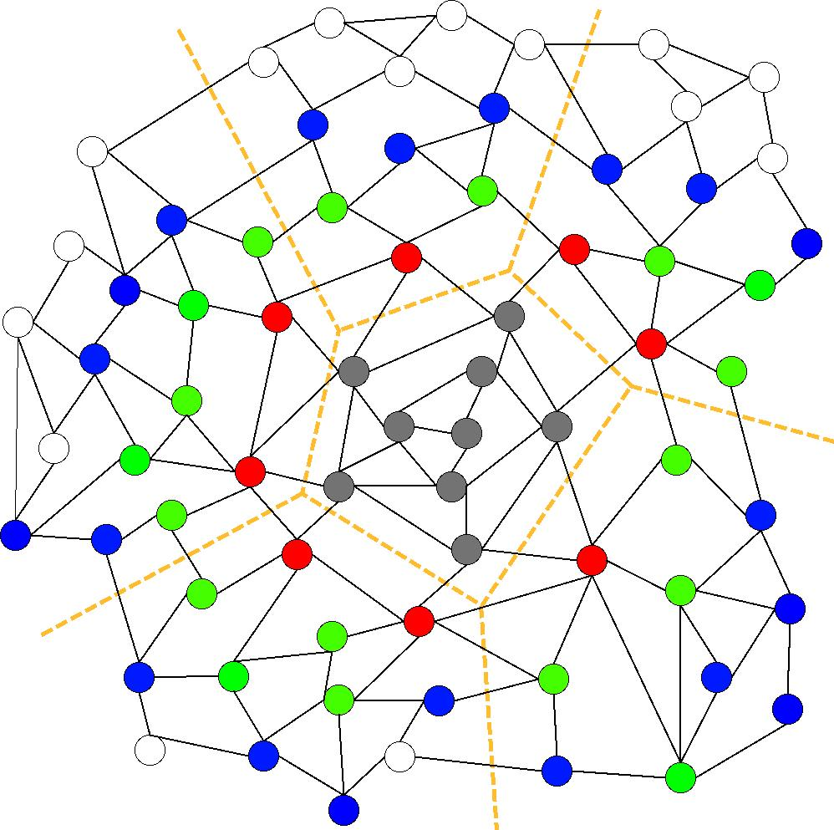
Communication Avoiding Kernels: The Matrix Powers Kernel : [Ax, A²x, …, A^{k}x]
Same idea works for general sparse matrices
Simple block-row partitioning ➔
(hyper)graph partitioning
Top-to-bottom processing ➔
Traveling Salesman Problem
Notes:
Red needed for k=1
Green also needed for k=2
Blue also needed for k=3

Slide 60
Minimizing Communication of GMRES to solve Ax=b
GMRES: find x in span{b,Ab,…,A^{k}b} minimizing || Ax-b ||₂
Standard GMRES
for i=1 to k
w = A · v(i-1) … SpMV
MGS(w, v(0),…,v(i-1))
update v(i), H
endfor
solve LSQ problem with H
Communication-avoiding GMRES
W = [ v, Av, A²v, … , A^{k}v ]
[Q,R] = TSQR(W)
… “Tall Skinny QR”
build H from R
solve LSQ problem with H
Sequential case: #words moved decreases by a factor of k
Parallel case: #messages decreases by a factor of k
Oops – W from power method, precision lost!
60

Slide 61
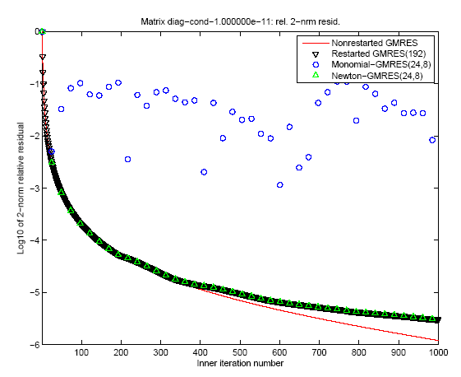
“Monomial” basis [Ax,…,A^{k}x]
fails to converge
Different polynomial basis [p₁(A)x,…,p_{k}(A)x]
does converge
61

Slide 62
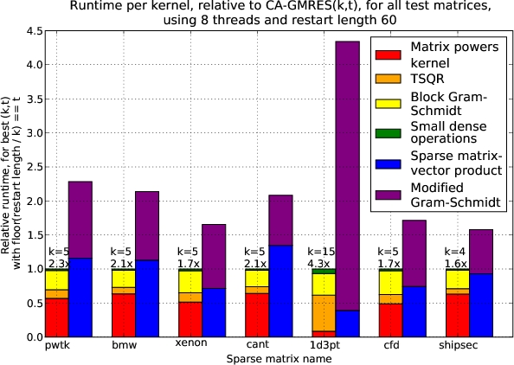
Speed ups of GMRES on 8-core Intel Clovertown
Requires Co-tuning Kernels
[MHDY09]
62

Slide 63
Summary of Iterative Linear Algebra
New lower bounds, optimal algorithms, big speedups in theory and practice
Lots of other progress, open problems
Many different algorithms reorganized
More underway, more to be done
Need to recognize stable variants more easily
Preconditioning
Hierarchically Semiseparable Matrices
Autotuning and synthesis
Different kinds of “sparse matrices”

Slide 64
For more details
Bebop.cs.berkeley.edu
CS267 – Berkeley’s Parallel Computing Course
Live broadcast in Spring 2013
www.cs.berkeley.edu/~demmel
All slides, video available
Prerecorded version broadcast in Spring 2013
www.xsede.org
Free supercomputer accounts to do homework
Free autograding of homework

Slide 65
Related IPDPS’13 Talks, Tuesday
Communication-Optimal Parallel Recursive Rectangular Matrix Multiplication
JD, D. Eliahu, A. Fox, S. Kamil, B. Lipshitz, O. Schwartz, O. Spillinger
1:30-3:30pm, Session 6
Minimizing comunication in all-pairs shortest paths
E. Solomonik, A. Buluc, JD
4:00-6:00pm, Session 12

Slide 66
Related IPDPS’13 Talks, Wednesday
Perfect Strong Scaling Using No Additional Energy
JD, A. Gearhart, B. Lipshitz, O. Schwartz
10:00am – 12:00pm, Session 14
Cyclops Tensor Framework: Reducing communication and eliminating load imbalance in massively parallel contractions
E. Solomonik, D. Matthews, J. Hammond, JD
1:30 – 3:30pm, Session 17

Slide 67
Related IPDPS’13 Talks, Thursday
Implementing a blocked Aasen’s algorithm with a dynamic scheduler on multicore architectures
I. Yamazaki, G. Ballard, D. Becker, JD, J. Dongarra, A. Druinsky, I. Peled, O. Schwartz, S. Toledo
10:00am – 12:00pm, Plenary Session: Best Papers
A Communication-Optimal N-body Algorithm for Direct Interactions
M. Driscoll, E. Georganas, P. Koanantokool, E. Solomonik, K. Yelick
1:30pm – 3:30pm, Session 21

Slide 68
Collaborators and Supporters
James Demmel, Kathy Yelick, Michael Anderson, Grey Ballard, Erin Carson, Aditya Devarakonda, Michael Driscoll, David Eliahu, Andrew Gearhart, Evangelos Georganas, Nicholas Knight, Penporn Koanantakool, Ben Lipshitz, Oded Schwartz, Edgar Solomonik, Omer Spillinger
Austin Benson, Maryam Dehnavi, Mark Hoemmen, Shoaib Kamil, Marghoob Mohiyuddin
Abhinav Bhatele, Aydin Buluc, Michael Christ, Ioana Dumitriu, Armando Fox, David Gleich, Ming Gu, Jeff Hammond, Mike Heroux, Olga Holtz, Kurt Keutzer, Julien Langou, Devin Matthews, Tom Scanlon, Michelle Strout, Sam Williams, Hua Xiang
Jack Dongarra, Dulceneia Becker, Ichitaro Yamazaki
Sivan Toledo, Alex Druinsky, Inon Peled
Laura Grigori, Sebastien Cayrols, Simplice Donfack, Mathias Jacquelin, Amal Khabou, Sophie Moufawad, Mikolaj Szydlarski
Members of ParLab, ASPIRE, BEBOP, CACHE, EASI, FASTMath, MAGMA, PLASMA
Thanks to DOE, NSF, UC Discovery, INRIA, Intel, Microsoft, Mathworks, National Instruments, NEC, Nokia, NVIDIA, Samsung, Oracle
bebop.cs.berkeley.edu
Notes:
Underlined named visited other site, Mathias and Sophie in Summer 2012
New INRIA Postdoc: Soleiman Yousef

Slide 69
Summary
Time to redesign all linear algebra, n-body, …
algorithms and software
(and compilers)
Don’t Communic…

