Slide 1
Basic GBT Benchmark
10/17/2018
Bo Peng
IPCC@Indiana University

Slide 2
Outline
Progress
basic performance evaluation
hotspot analysis
optimzation test
Discussion
categorical features
interface to support distributed version

Slide 3
Performance Evaluatioin
GBT Implementations
xgboost 0.80, https://github.com/dmlc/xgboost
daal DAAL 2019. Revision: 30360, https://github.com/intel/daal
Experiment setup
benchm-ml, https://github.com/szilard/benchm-ml
A minimal benchmark for scalability, speed and accuracy of commonly used open source implementations (R packages, Python scikit-learn, H2O, xgboost, Spark MLlib etc.) of the top machine learning algorithms for binary classification (random forests, gradient boosted trees, deep neural networks etc.).
Binary Classification: airline dataset
Experiment B: learn_rate = 0.1 max_depth = 6 n_trees = 300.
Accuracy is measured by AUC.

Slide 4
Machine
CPU: Intel(R) Xeon(R) CPU E5-2670 v3 @ 2.30GHz
Cores: 24 Cores (thread# set to 24)
RAM: 128 GB

Slide 5
Dataset
dataset | train# | test# | features# | sparsity | size
synset | 750K | 250K | 50 | dense | 420 MB
 | x5,x10 |  | x2,x4 |  | 17 GB ~40 times
airline | 1m | 100K | 690 | dense(one-hot encoding) | 2.6 GB/63 MB
higgs | 10m | 1m | 28 | dense | 4.8 GB

Slide 6
synset
sklearn.datasets.make_classification
Generate a random n-class classification problem. This initially creates clusters of points normally distributed (std=1) about vertices of an 2-dimensional hypercube with sides of length 2 and assigns an equal number of clusters to each class. It introduces interdependence between these features and adds various types of further noise to the data.

Slide 7
Airline
The Airline data set consists of flight arrival and departure details for all commercial flights from 1987 to 2008. The approximately 120MM records (CSV format), occupy 120GB space.
Training datasets of sizes 1M, 10M are generated using years 2005 and 2006. A test set of size 100K is generated from the same (using year 2007).
Categorical features
One-hot encoding for categorical features
Month | DayofMonth | DayOfWeek | DepTime | UniqueCarrier | Origin | Dest | Distance | dep_delayed_15min
c-4 | c-26 | c-2 | 1828 | XE | LEX | IAH | 828 | N
c-12 | c-11 | c-1 | 1212 | UA | DEN | MCI | 533 | N
c-10 | c-1 | c-6 | 935 | OH | HSV | CVG | 325 | N
c-11 | c-26 | c-6 | 930 | OH | JFK | PNS | 1028 | N
c-12 | c-6 | c-2 | 1350 | MQ | DFW | LBB | 282 | Y
0 | 6:1.0 | 30:1.0 | 44:1.0 | 50:1828.0 | 72:1.0 | 238:1.0 | 520:1.0 | 689:828.0
0 | 3:1.0 | 14:1.0 | 43:1.0 | 50:1212.0 | 69:1.0 | 155:1.0 | 560:1.0 | 689:533.0
0 | 1:1.0 | 12:1.0 | 48:1.0 | 50:935.0 | 66:1.0 | 209:1.0 | 455:1.0 | 689:325.0
0 | 2:1.0 | 30:1.0 | 48:1.0 | 50:930.0 | 66:1.0 | 228:1.0 | 611:1.0 | 689:1028.0
1 | 3:1.0 | 39:1.0 | 44:1.0 | 50:1350.0 | 64:1.0 | 156:1.0 | 543:1.0 | 689:282.0

Slide 8
Higgs
https://archive.ics.uci.edu/ml/datasets/HIGGS#
This is a classification problem to distinguish between a signal process which produces Higgs bosons and a background process which does not.
The data has been produced using Monte Carlo simulations. The first 21 features (columns 2-22) are kinematic properties measured by the particle detectors in the accelerator. The last seven features are functions of the first 21 features; these are high-level features derived by physicists to help discriminate between the two classes.
Example:
0.87 | -0.64 | 0.23 | 0.33 | -0.69 | 0.75 | -0.25 | -1.09 | 0.00 | 1.37 | -0.65 | 0.93 | 1.11 | 1.14 | -1.58 | -1.05 | 0.00 | 0.66 | -0.01 | -0.05 | 3.10 | 1.35 | 0.98 | 0.98 | 0.92 | 0.72 | 0.99 | 0.88 | 1.00
0.91 | 0.33 | 0.36 | 1.50 | -0.31 | 1.10 | -0.56 | -1.59 | 2.17 | 0.81 | -0.21 | 1.27 | 2.21 | 0.50 | -1.26 | 0.73 | 0.00 | 0.40 | -1.14 | 0.00 | 0.00 | 0.30 | 0.83 | 0.99 | 0.98 | 0.78 | 0.99 | 0.80 | 1.00

Slide 9
Feature Value Distribution
the distribution of unique values determines the computation complexity of findBestSplit()
uniq values for each feature
feature id | synset | higgs | airline
0 | 746182 | 27642 | 2
1 | 746047 | 5001 | 2
2 | 746073 | 6284 | 2
3 | 746066 | 1228758 | 2
4 | 746047 | 2138808 | 2
5 | 746098 | 45068 | 2
6 | 746099 | 5999 | 2
7 | 746055 | 6284 | 2
8 | 746126 | 3 | 2
9 | 745976 | 37341 | 2
10 | 746103 | 5999 | 2

Slide 10
Parameters
Parameter | xgboost | daalgbt
learning rate | eta | shrinkage
histogram algorithm | tree_method exact: Exact greedy algorithm. approx: quantile sketch and gradient histogram. hist: Fast histogram with bins caching. | SplitMethod Exact greedy method Inexact method for splits finding: bucket continuous features to discrete bins
bin size | max_bin by default 256 for hist | maxBins by default 256
global or local histogram |  | memorySavingMode true: build histogram on fly false: build once in initialization

Slide 11
Feature Value Distribution using Histogram
daalgbt
IndexedFeatures().numIndices(size_t iCol)
xgboost tree_method = hist
GHistIndexMatrix
updater_fast_hist
feature id | synset | higgs | airline
0 | 257 | 253 | 2
1 | 257 | 248 | 2
2 | 257 | 252 | 2
3 | 257 | 256 | 2
4 | 257 | 256 | 2
5 | 257 | 254 | 2
6 | 257 | 248 | 2
7 | 257 | 251 | 2
8 | 257 | 3 | 2
9 | 257 | 254 | 2
10 | 257 | 248 | 2
feature id | synset | higgs | airline
0 | 254 | 254 | 1
1 | 254 | 254 | 1
2 | 254 | 254 | 1
3 | 254 | 254 | 1
4 | 254 | 254 | 1
5 | 254 | 254 | 1
6 | 254 | 254 | 1
7 | 254 | 254 | 1
8 | 254 | 2 | 1
9 | 254 | 254 | 1
10 | 254 | 254 | 1

Slide 12
Synset Results
trainer | train# 1m |  |  | train# 5m |  |  | train# 10m
 | f# 50 | f# 100 | f# 200 | f# 50 | f# 100 | f# 200 | f# 50 | f# 100 | f# 200
xgb-hist | 25.38 | 82.18 | 144.41 | 46.42 | 132.28 | 243.63 | 87.68 | 221.05 | 407.13
xgb-exact | 121.88 | 783.57 | 2406.4 | 206.58 | 1280.8 | 3518.46 | 358.52 | 2504.71 | 7462.44
daal-gnu-inexact | 36.56 | 193.9 | 386.5 | 64.70 | 350.8 | 686.0 | 124.0 | 635.2 | 1343.3
daal-gnu-exact | 250.51 | 1323.9 | 2576.58 | 432.50 | 2571.73 | 4597.02 | 789.95 | 3708.14 | 7838.2
daal-icc-inexact | 27.96 | 170.79 | 359.72 | 51.88 | 373.56 | 607.47 | 109.18 | 696.58 | 1447.43
daal-icc-exact | 211.47 | 1054.67 | 2128.24 | 366.36 | 2252.4 | 4248.7 | 596.03 | 2964.5 | 5952.8

Slide 13
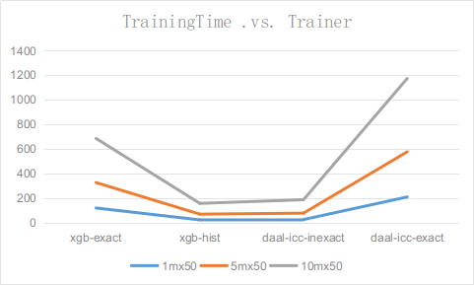
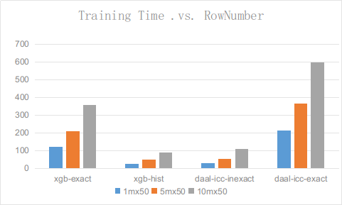

Slide 14
Higgs Results
dataset | trainer | Parameter | training time(s) | AUC
higgs | xgb | Exact | 1387.3 | 0.742
 |  | Approx | 1354.1 | 0.742
 |  | Hist | 229.7 | 0.742
 | daal-gnu | Exact | 776.5 | 0.742
 |  | Inexact | 494.6 | 0.742
 |  | Exact + memSave | 3686.3 | 0.710
 |  | Inexact + memSave | 3669.1 | 0.712
 | daal-icc | Exact | 653.0 | 0.742
 |  | Inexact | 402.7 | 0.742
 |  | Exact + memSave | 3550.0 | 0.715
 |  | Inexact + memSave | 3564.8 | 0.712

Slide 15
Airline Results
dataset | trainer | Parameter | training time(s) | AUC
Airline-Sparse | xgb | Exact | 43.1 | 0.557
 |  | Hist | 18.7 | 0.559
Airline-Dense | xgb | Exact | 391.9 | 0.557
 |  | Hist | 47.6 | 0.556
 | daal-gnu | Exact | 383.8 | 0.555
 |  | Inexact | 362.9 | 0.555
 | daal-icc | Exact | 319.79 | 0.556
 |  | Inexact | 309.71 | 0.555

Slide 16
Hotspot Analysis
Intel(R) VTune(TM) Amplifier 2019 (build 570779) Command Line Tool
higgs 50 iterations
hotspots
memory-access

Slide 17
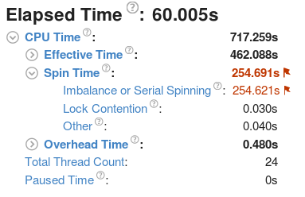
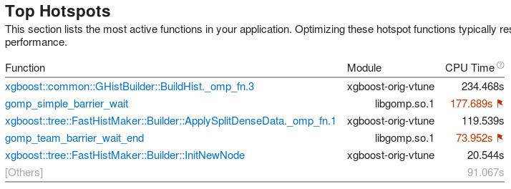
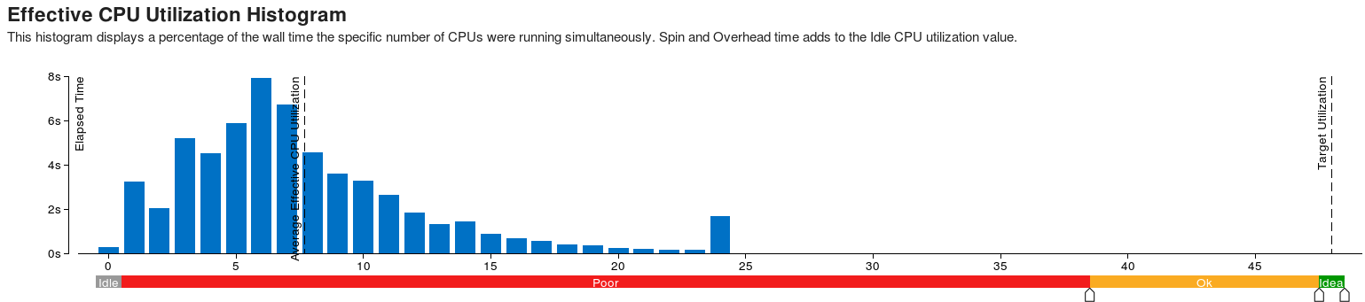
xgboost + Higgs + hist

Slide 18
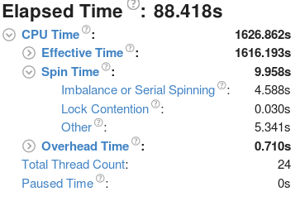
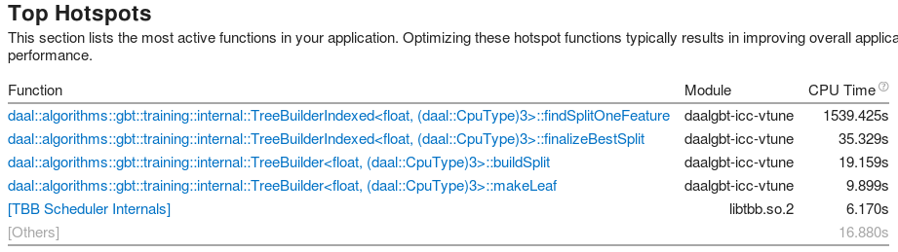
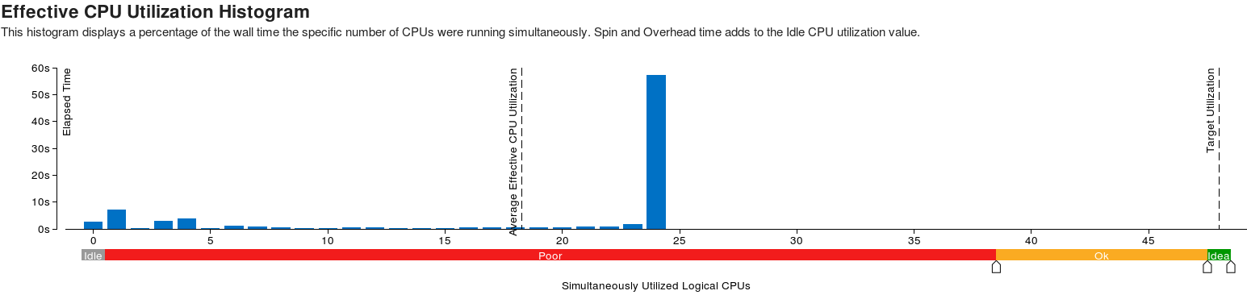
daalgbt-icc + Higgs + inexact

Slide 19
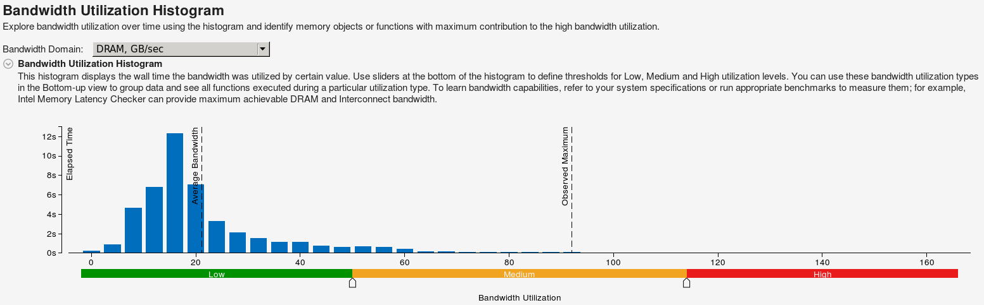
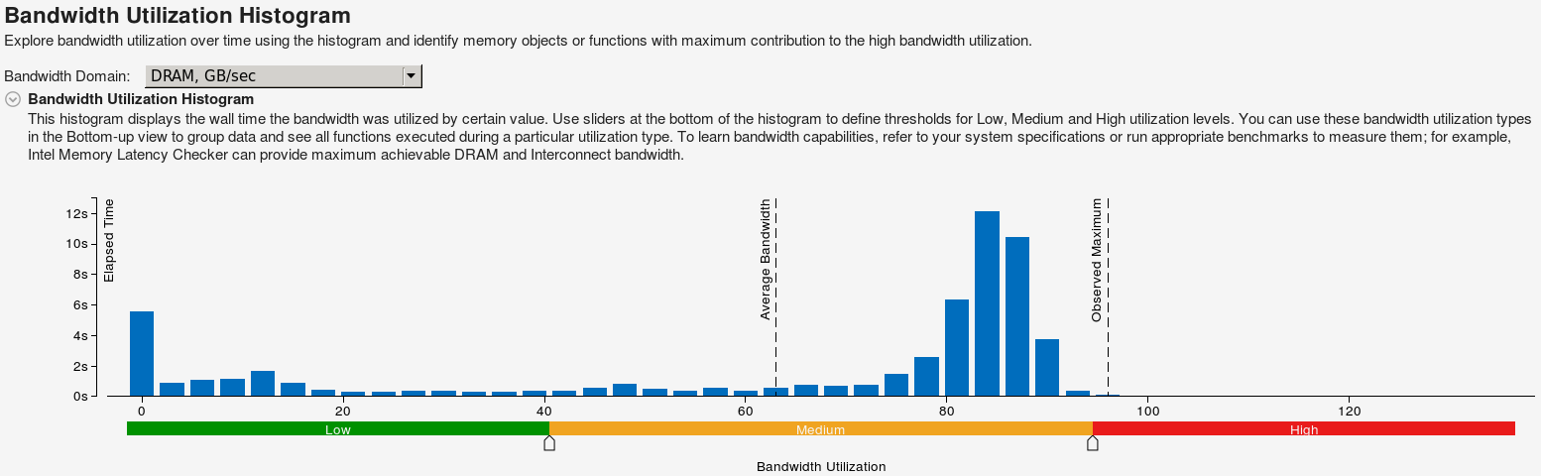
Higgs + Hist
xgboost
daal

Slide 20
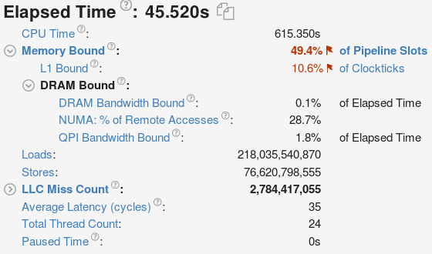

Higgs + Hist
xgboost+ hist
daal + inexact

Slide 21
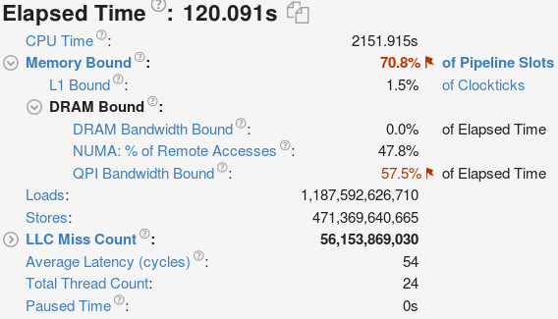
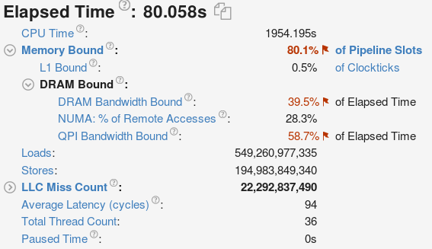
Higgs + Exact
xgboost
daal-icc

Slide 22
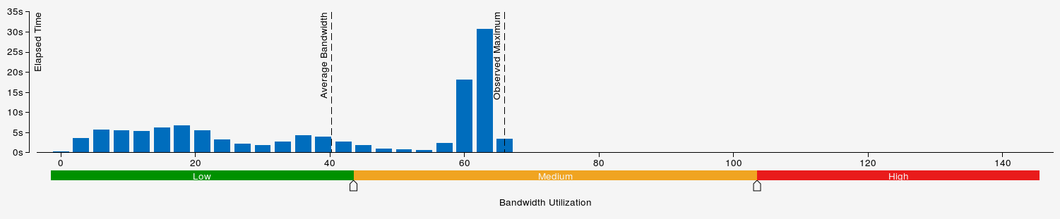
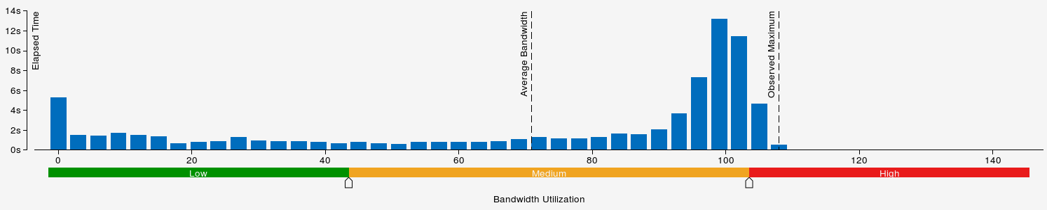
Higgs + Exact

Slide 23
benmark results
daalgbt provides very good cpu and memory utilization, leading to better performance in exact mode for normal dense dataset
xgboost support sparse dataset by default, and it has an improved histogram algorithm, leading to better performance on sparse dataset and in fast_hist mode

Slide 24
Discussion & Questions
Categorical features
feature bundle is a useful feature for sparse dataset, (xgboost supports in 0.80)
Q: how tree split is done on an unordered categorical feature in daalgbt?
Interface to support distributed version
need allreduce in the processes of
build histogram (feature index)
findBestSplit(local GHSum)
currently tree expands supports feature level and node level parallelism
Q: Is it possible to reduce the number of communication by aggregating to single allreduce for all the nodes in the same tree level?

Slide 25
End
“All benchmarks are wrong, but some are useful”

