Slide 1
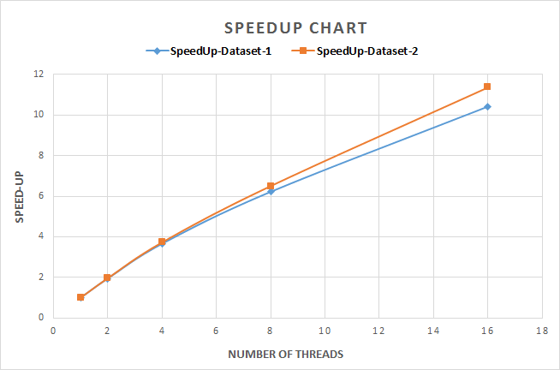
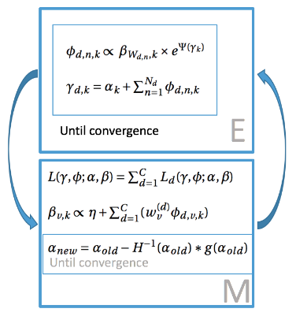
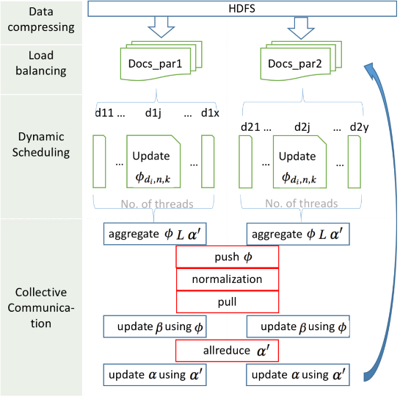
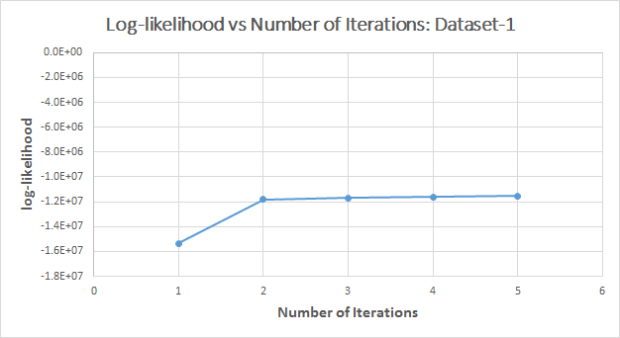
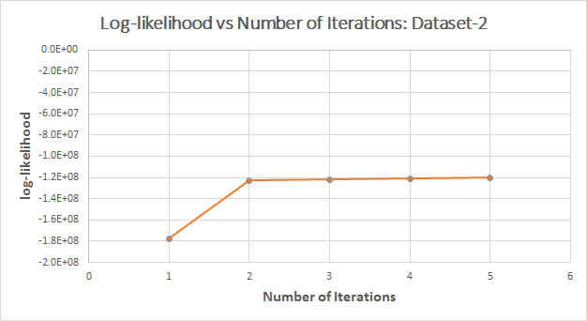
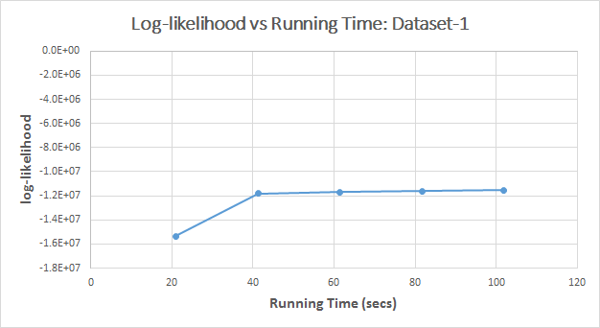
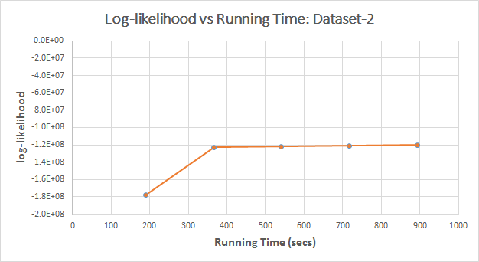
Distributed LDA on Harp
Ethan Li, Rohit Patil
ABSTRACT
ALGORITHM
MATERIALS AND METHODS
Harp LDA is a distributed variational bayes inference (VB) algorithm for LDA model which would be able to model a large and continuously expanding dataset using Harp collective communication library. We demonstrate how variational bayes inference converges within Map-Collective jobs provided by Harp. We provide results of the experiments conducted on a corpus of Wikipedia Dataset.
Harp[2] is a collective communication library plugged in Hadoop plug-in to accelerate machine learning algorithms.
LDA[3] is a popular topic modeling algorithm. We follow the Mr.LDA[4] to implement distributed variational inference LDA on Harp with it’s dynamic schedueler, allreduce and push-pull communication models.
WORK FLOW
DATASETS
 | Dataset-1 | Dataset-2
docsize | 744 | 7698
numOfWords | 89907 | 435840
numOfTokenS | 535156 | 5308848
CONCLUSIONS
Harp-LDA is proposed to provide high scalability achieve better performance with shorter time and memory requirements. A clear evidence of convergence of likelihood after a certain number of iterations is depicted. The results from the speed up chart illustrate high scalability.
EXPERIMENTS
REFERENCE
[1] B. Zhang, Y. Ruan, J. Qiu, Harp: Collective Communication on Hadoop, in the proceedings of IEEE International Conference on Cloud Engineering (IC2E2015), March 9-13, 2015.
[2] Harp project https://github.iu.edu/IU-Big-Data-Lab/Harp
[3] Blei, David M., Andrew Y. Ng, and Michael I. Jordan. "Latent dirichlet allocation." Journal of machine Learning research 3.Jan (2003): 993-1022.
[4] Zhai, Ke, et al. "Mr. LDA: A flexible large scale topic modeling package using variational inference in mapreduce." Proceedings of the 21st international conference on World Wide Web. ACM, 2012.

