Slide 1
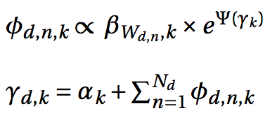
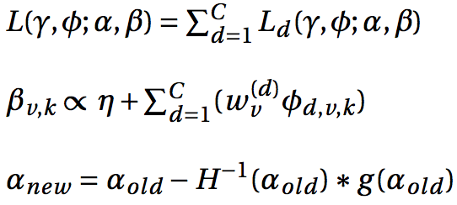
E
Until convergence
Until convergence
M

Slide 2





Data compressing
Load balancing
Dynamic Scheduling
Collective Communica-tion
HDFS
Docs_par1
Docs_par2
d11 … d1j … d1x
d21 … d2j … d2y
Update
Update
…
…
…
…
No. of threads
No. of threads
aggregate
aggregate
push
normalization
pull
update using
update using
allreduce
update using
update using

