Slide 1
Building Histograms in GBDT
A Survey from an implementation perspective
Miao Jiang

Slide 2
Papers and Codes:
A Survey from an implementation perspective
[1] Parallel Boosted Regression Tress for Web Search Ranking (pGBRT)
[2] A Streaming Parallel Decision Tree Algorithm
[3] DimBoost: Boosting Gradient Boosting Decision Tree to Higher Dimensions
[4] TencentBoost: A Gradient Boosting Tree System with Parameter Server
[5] LightGBM: A Highly Efficient Gradient Boosting Decision Tree
[6] XGBoost: A Scalable Tree Boosting System
[7] A fast algorithm for approximate quantiles in high speed data streams
[8] Codebase (Scikit-Learn, XGBoost…)

Slide 3
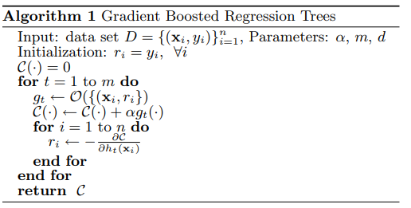
GBDT algorithm
A Survey from an implementation perspective

Slide 4
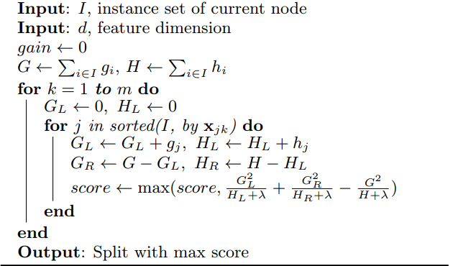
Exact Split Algorithm
A Survey from an implementation perspective

Slide 5
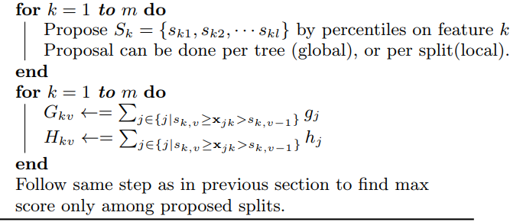
An approximation split
A Survey from an implementation perspective
Build histograms to make the approximation

Slide 6

Core operations on GBDT
A Survey from an implementation perspective
Data Partitioning
Gradient Histogram Construction
Histogram Aggregation and Split finding
Tree Splitting and update the histogram
“The traditional GBRT algorithm spends the majority of its computation time evaluating split points during the creation of regression trees. We can speed up and parallelize this process by summarizing label and feature-value distributions using histograms. ”

Slide 7
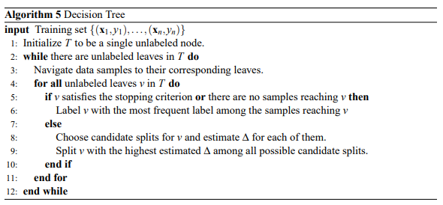
Build the Tree
A Survey from an implementation perspective
Distributed!

Slide 8
A Streaming Parallel Decision Tree Algorithm
A Survey from an implementation perspective
Update (Algorithm 1)
  The update procedure, which adds a new point to a set that is already represented by a given histogram
Merge (Algorithm 2)
  The merge procedure creates a histogram that represents
  the union S1 ∪ S2 of the sets S1,S2, whose representing histograms are given.
Sum (Algorithm 3)
  The sum procedure estimates the number of points in a given interval [a,b], that belong to a set whose histogram is given
Uniform (Algorithm 4)
  Make sure the elements are uniformly distrubuted

Slide 9
GBT System
A Survey from an implementation perspective
PGBRT
XGBoost
LightGBM
DimBoost and Tencent Boost

Slide 10
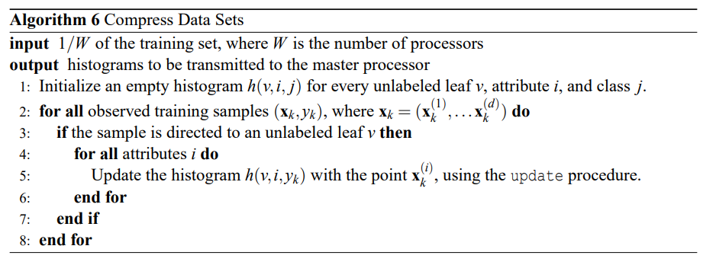
Distribute and Parallel Process
A Survey from an implementation perspective

Slide 11

How to make it distrubuted?
A Survey from an implementation perspective
Divide the dataset with N worker-processors (node)
Each worker node do update work
Master node exchange histogram with worker node
Histogram information are managed by master node and make calculations

Slide 12
Histogram in pGBRT
A Survey from an implementation perspective
Each worker compresses its share of the data feature-wise using histograms and sends to master node
Master nodes merges histograms and use them to approximate the best splits and generate a new layer
Master nodes sends layer data to workers and then workers constructs new histograms.

Slide 13
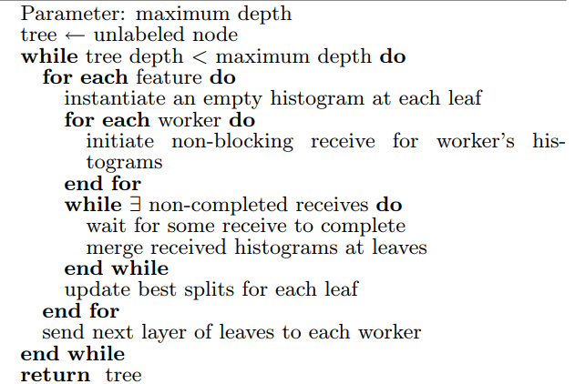
Histogram in pGBRT
A Survey from an implementation perspective
Parallel Cart Master

Slide 14
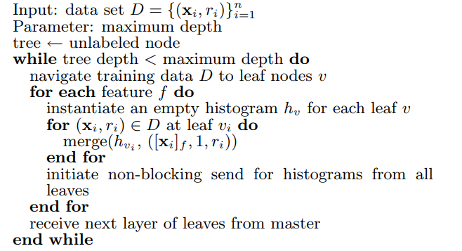
Histogram in pGBRT
A Survey from an implementation perspective
Parallel CART worker

Slide 15
Quantile Approximation in XGBoost
A Survey from an implementation perspective
Weighted sketch quantile sketch algorithm
Implemented with GK algorithm and GK frame work. [8]
Supports prune and merge operations.

Slide 16
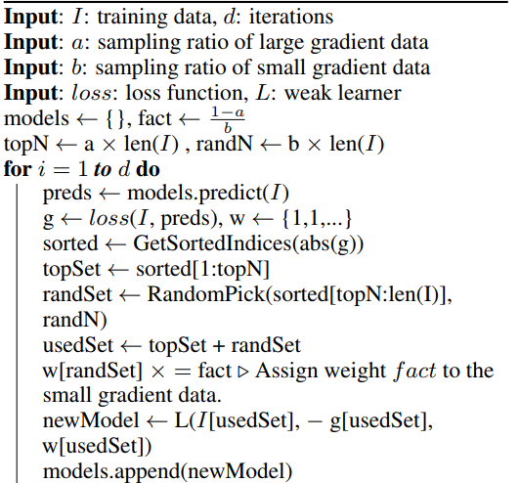
LightGBD
A Survey from an implementation perspective
Gradient-based one-side sampling

Slide 17
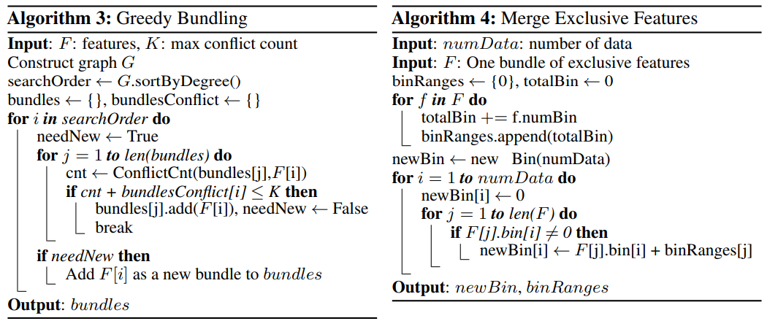
Exclusive Feature Bundling
A Survey from an implementation perspective

Slide 18
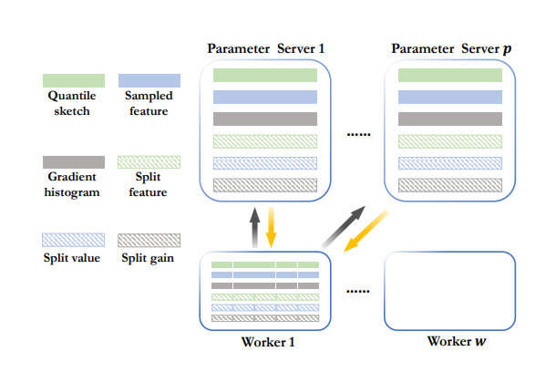
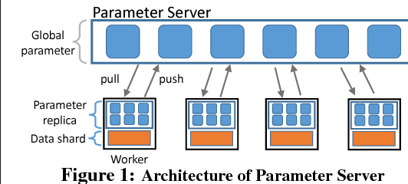
Tencent Boost and DimBoost
A Survey from an implementation perspective
Parameter Server architecture

Slide 19
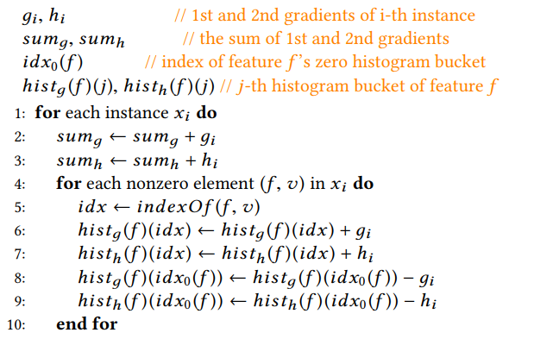
DimBoost
A Survey from an implementation perspective
Sparsity-aware histogram construction

Slide 20
DimBoost
A Survey from an implementation perspective
Parallel Batch Construction
  During the histogram construction, two tree nodes can be processed in parallel if they have no parent-child relationship. Since we train GBDT in a layer-wise manner, we can concurrently process the tree nodes within a layer.
Node-to-instance Index.
Parallel Batch Construction.

