Slide 1
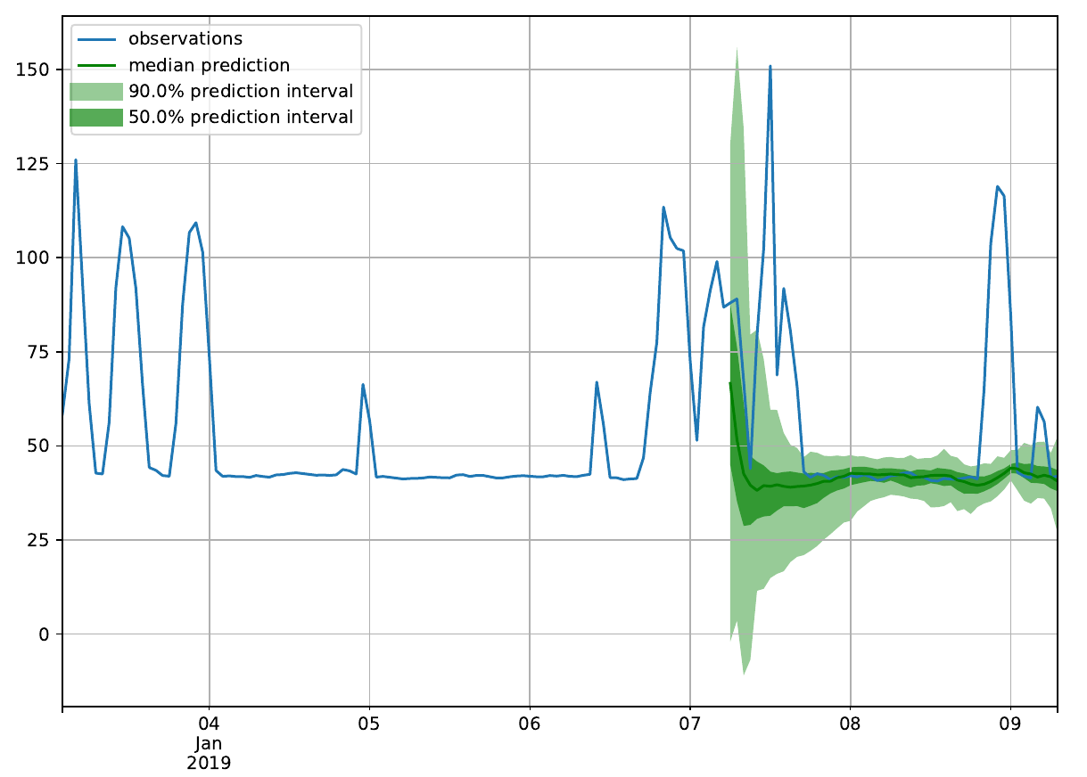
Indy Dataset
Predict final 50 laps laptime
model: DeepAR
Epochs: 2000

Slide 2
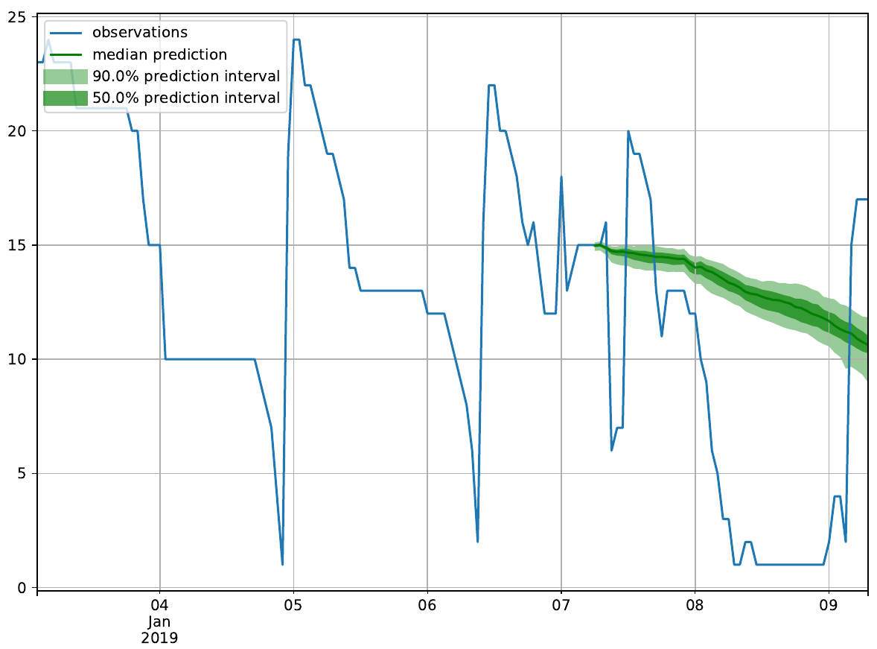
Indy Dataset
Predict final 50 laps rank
model: DeepAR
Epochs: 2000

Slide 3
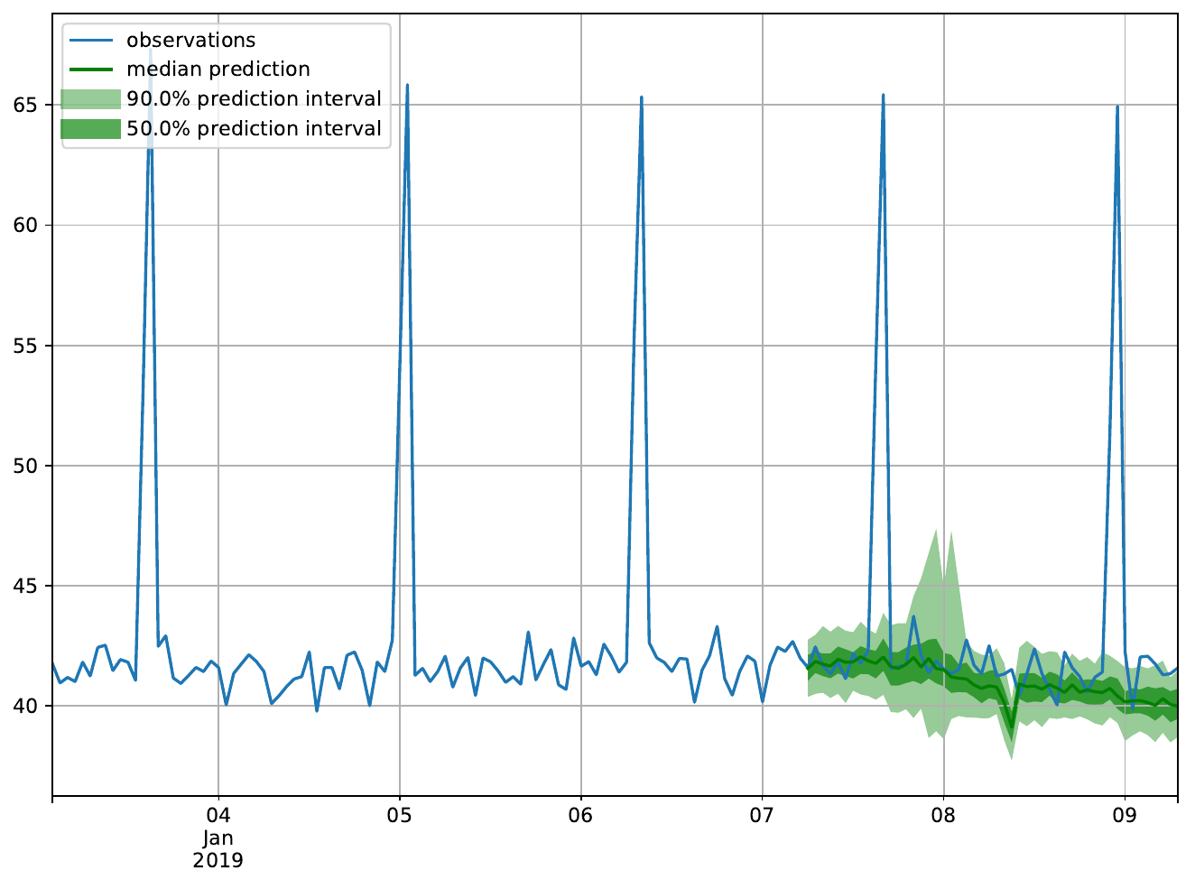
Simulation Dataset
200 laps, 120 runs
Predict final 50 laps rank
model: DeepAR
Epochs: 500

Slide 4
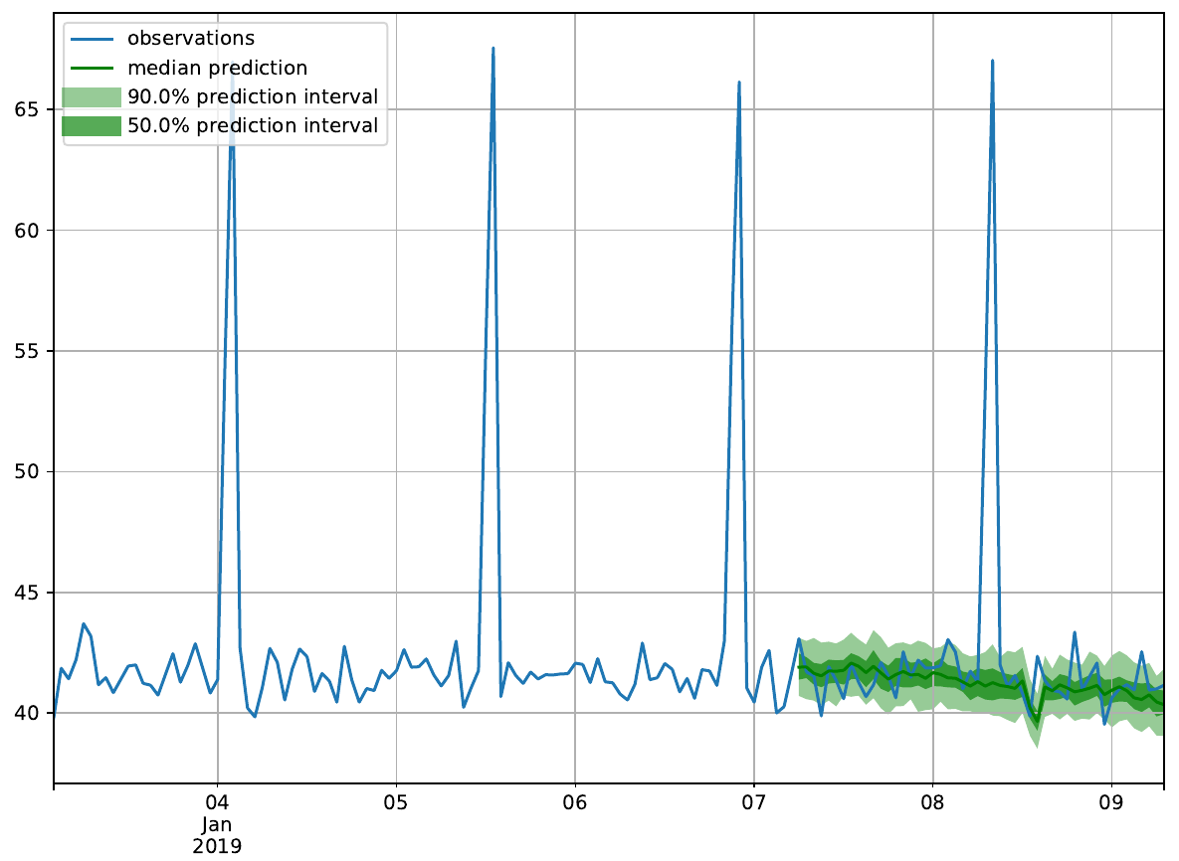
Simulation Dataset
200 laps, 360 runs
Predict final 50 laps rank
model: DeepAR
Epochs: 500

Slide 5
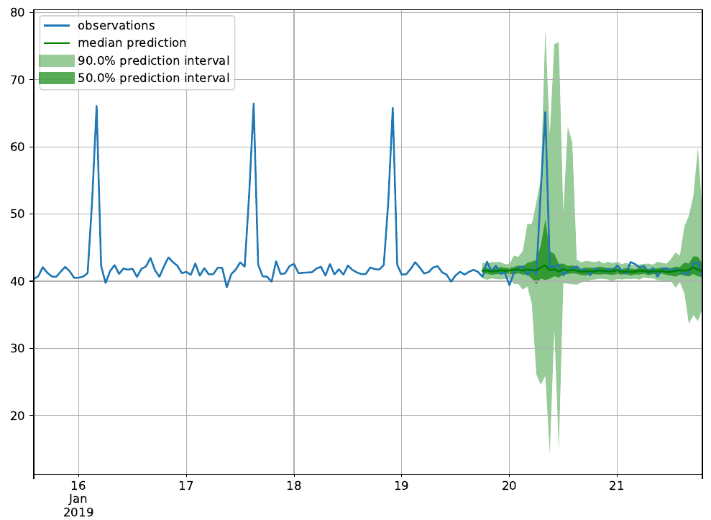
Simulation Dataset
500 laps, 120 runs
Predict final 50 laps rank
model: DeepAR
Epochs: 500

