Slide 1
Dataset
events = ['Phoenix','Indy500','Texas','Iowa','Pocono','Gateway']
Preprocessing
start prediction time as 80% of the longest time series
remove ts if it is too short
remove ts if missing data longer than 10%
Laptime (1 lap ts)
total 116 time series left as training data
VSpeed (1 second ts)
Pocono all removed (because of 2 hrs halt in the beginning of the race)
total 96 time series left as training data

Slide 2
Laptime
laptime-gluonts-all-2018, non-interpolate, train 80%, prediction length=5 laps
Model | RMSE | NRMSE | P50-Risk | P90-Risk | Avg-Risk
Arima | 12.21 | 0.37 | 0.19 | 0.15 | 0.14
ETS | 13.26 | 0.40 | 0.17 | 0.14 | 0.15
Prophet | 14.01 | 0.42 | 0.27 | 0.19 | 0.18
DeepAR | 11.69 | 0.35 | 0.15 | 0.14 | 0.11

Slide 3
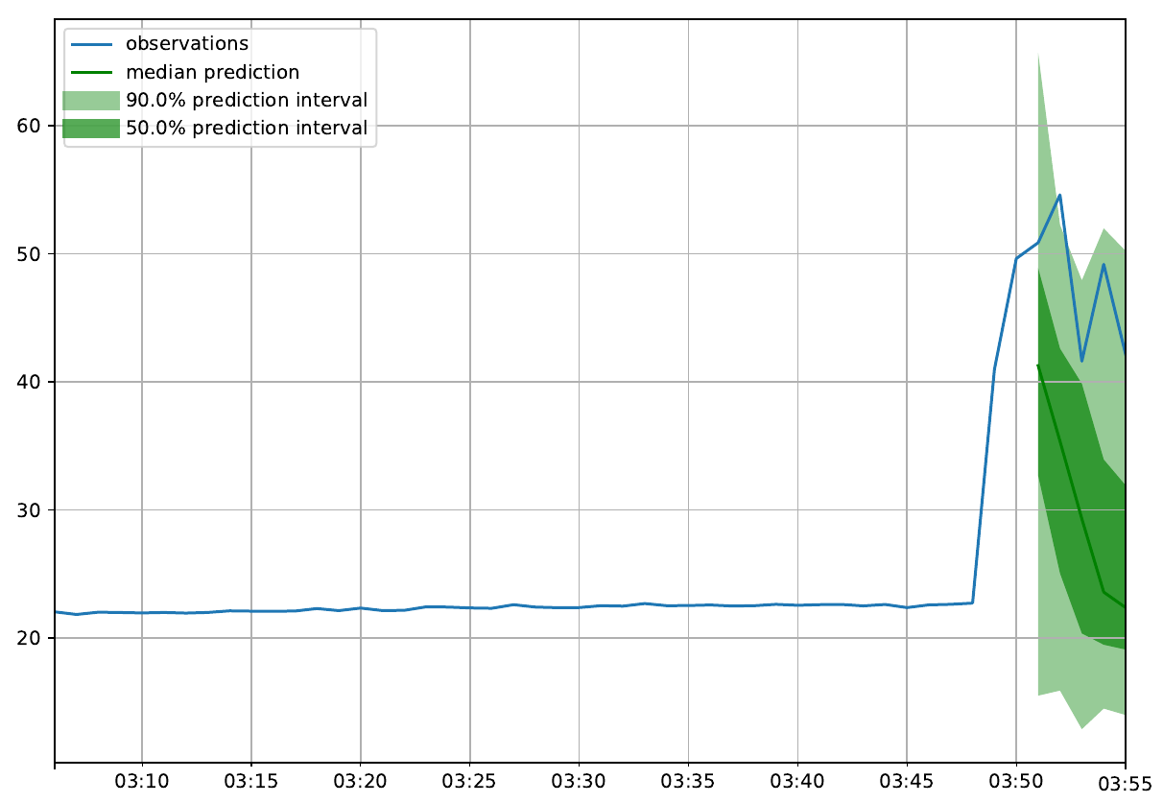
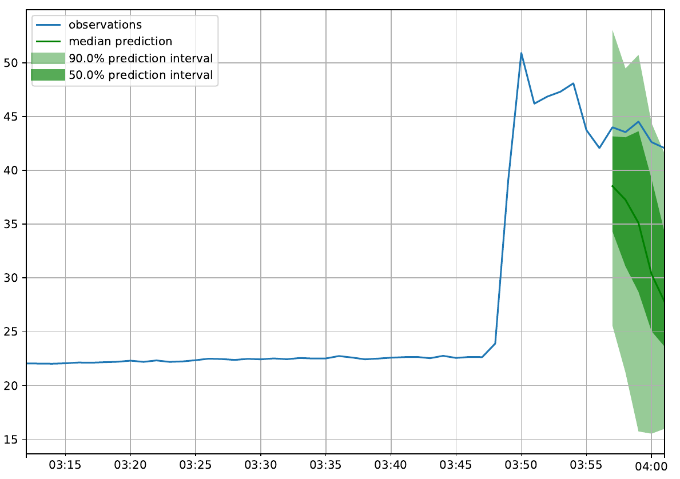
DeepAR
Laptime(s)

Slide 4
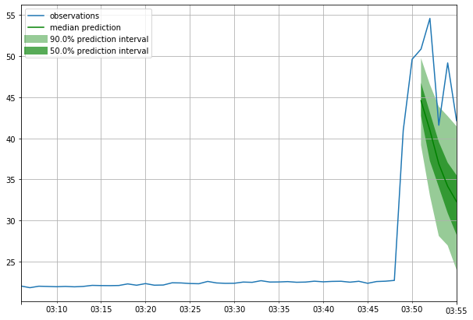
ARIMA
Laptime(s)

Slide 5
vspeed
telemetry-gluonts-all-2018, interpolate, train 80%, prediction length=200s
Model | RMSE | NRMSE | P50-Risk | P90-Risk | Avg-Risk
Arima | 43.83 | 0.28 | 0.17 | 0.1 | 0.13
ETS | 56.01 | 0.35 | 0.26 | 0.31 | 0.3
Prophet | 60.74 | 0.38 | 0.28 | 0.12 | 0.2
DeepAR | 42.48 | 0.27 | 0.19 | 0.11 | 0.14

Slide 6
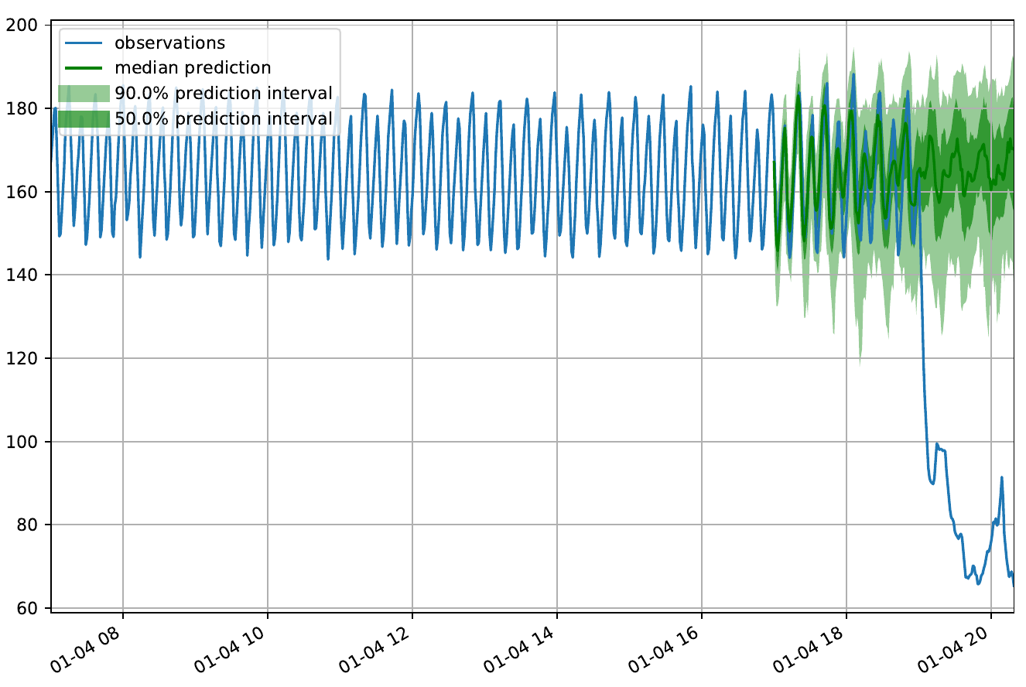
DeepAR
vspeed(RPM)

Slide 7
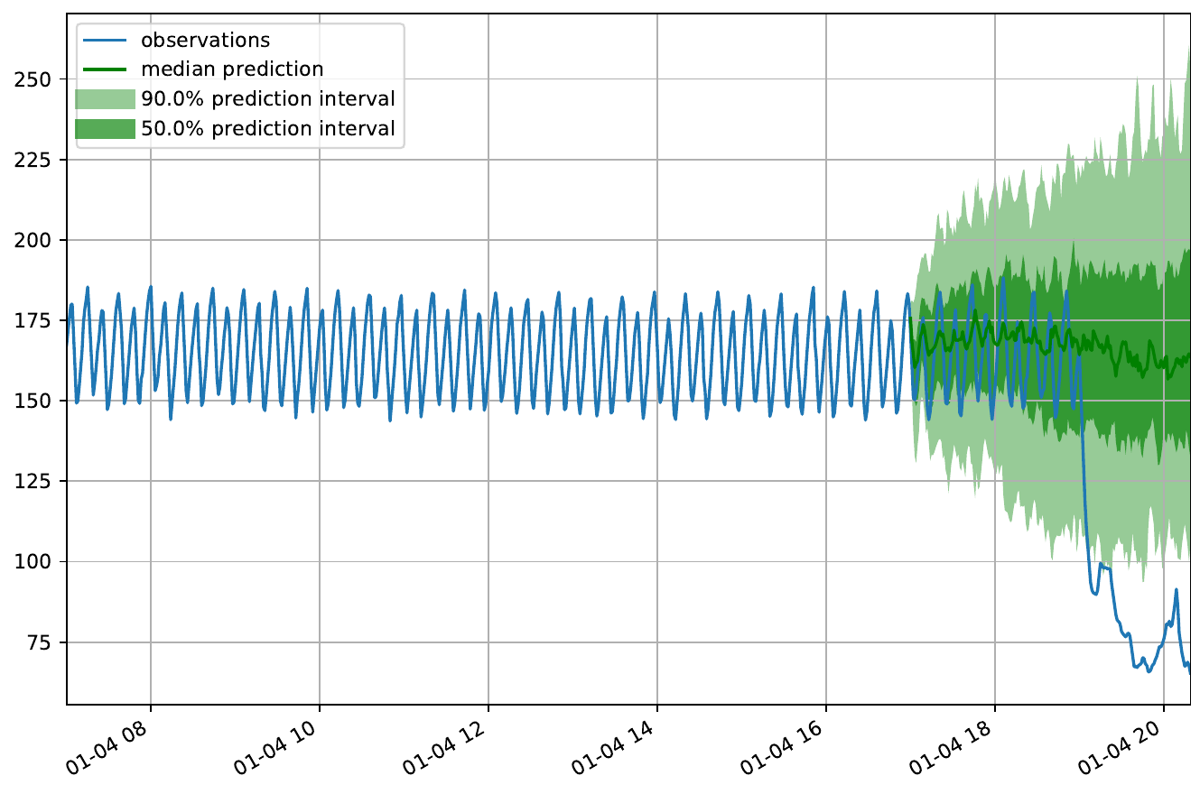
ARIMA
vspeed(RPM)

Slide 8
TODO
no interpolation test
remove interpolation in vspeed dataset
Oracle test
deepar + pitstop and yellow flag as input features
the space of possible improvement on deepar

