Slide 1
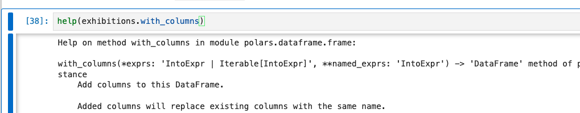
Argument Format →
varargs
kwargs
Python type →
Column expression
Column expression
Sequence of Column expressions
Returns
dataframe

Slide 2
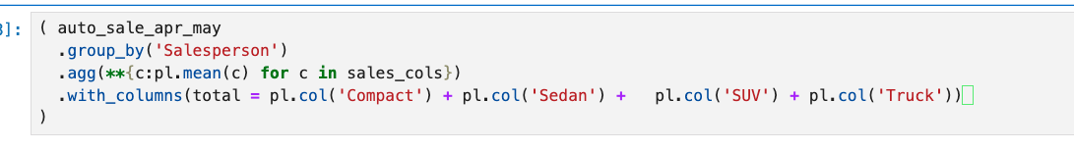
Update Step
Initial
Value
Update Step
Update Step

