Slide 1
Hard Drive
RAM
Read into RAM
Select columns
Filter rows
Eager DataFrame reads the whole data into RAM, which causes memory pressure for larger data sets

Slide 2
Hard Drive
RAM
Read into RAM
Projection Pushdown
(Select columns)
Predicate Pushdown
(Filter rows)
Lazy DataFrame applies filter & select as part of scanning the CSV, reducing the RAM footprint

Slide 3
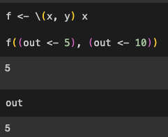
x and y are passed to body
as unevaluated expressions
2) Only x gets evaluated
Only first assignment statement gets processed
Only first assignment expression gets processed

Slide 4
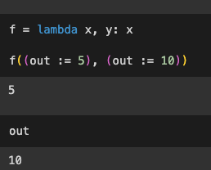
x and y are both evaluated and
and passed as values
2) The value of x is
substituted in the body
Both assignment expressions gets processed in order and out gets overwritten with the second assignment
Both assignment expressions gets processed in order and out gets overwritten with the second assignment
Both assignment expressions gets processed in order and out gets overwritten with the second assignment

