Slide 1
Recession Prediction

Slide 2
MEET OUR TEAM
Waseema Begum
Team Lead/Data Scientist
Likhita Yakanuru
Data Engineer
Ajay Kumar Reddy Vemapati
Data Visualization

Slide 3
THE Problem
The job market is extremely competitive and aggressive right now, especially for individuals who are just starting out in their professions and lack experience.
Graduate students in 2024 should comprehend the causes of events of this nature since we experienced significant layoffs in 2023 and prepare for the following year accordingly.
So, knowing whether or not a recession is imminent will be helpful in this aspect.

Slide 4
Implementation
The project focuses on training the model with past years data and concluding if there will be any recession happening soon in future based on analysis.
Data was collected from https://fred.stlouisfed.org and preprocessed to convert it into quarter intervals. Logistic regression is a powerful and interpretable model that produces a probability score for each observation, it is simple to implement and computationally efficient. Model is trained by splitting the complete dataset into 70% of training set and 30% of testing set. Its accuracy is tested, and maximum likelihood is estimated.
The model can be used to envision the recession by assuming the features considered for deciding the outcome.

Slide 5
Implementation continued…
A recession is an economic situation that arrives when the circulation of money in the economy is low for two consecutive quarters. Recession is calculated and analyzed according to the growth in GDP, the growth in the unemployment rate or Layoffs, and the growth in Personal Consumption Expenditures.
For above factors, following values has been taken as cut off to decide whether the economy was in recession or not:
GDP: percentage change in two consecutive quarters decreased.
Unemployment Rate: Greater than 7.5%
Layoffs: More than 5000 per quarte
Personal Consumption Expenditures: percentage change in two consecutive quarters got decreases.
The final decision is then made by combining all the above factors.

Slide 6
Methodology
The methodology used for this solution is CRISP-DM (Cross Industry Standard Process for Data Mining):
Business Understanding:
Examine the information on the indicators (Layoffs, GDP, unemployment, and consumer spending) to determine whether a recession is likely to occur.
Data Understanding:
Gather information and carry out exploratory analysis to learn about the properties and structure of the data.
Used data sets such as Layoffs Dataset, Unemployment as per US state, Personal Consumption Expenditures and USA GDP dataset from Fred site.

Slide 7
methodology continued…
Data Preparation:
Cleaned the data, did feature engineering, and updated the data into a quarterly format for modeling. Taking care of missing values, eliminating outliers, and adding new features.
Modeling:
The Logistic Regression model is constructed based on the available data using methods like clustering, classification and analyzing the previous recession patterns.
Evaluation:
Utilized relevant measures to assess the performance of the models, such as accuracy, precision, and recall. Depending on the findings of the evaluation, concluded the future outcomes.
Deployment:
Deploy the models in a production setting and monitor their performance.

Slide 8
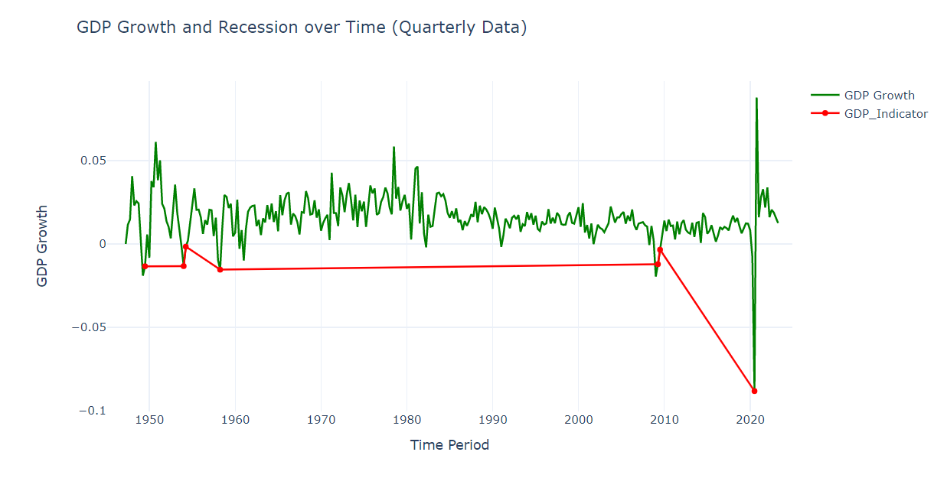
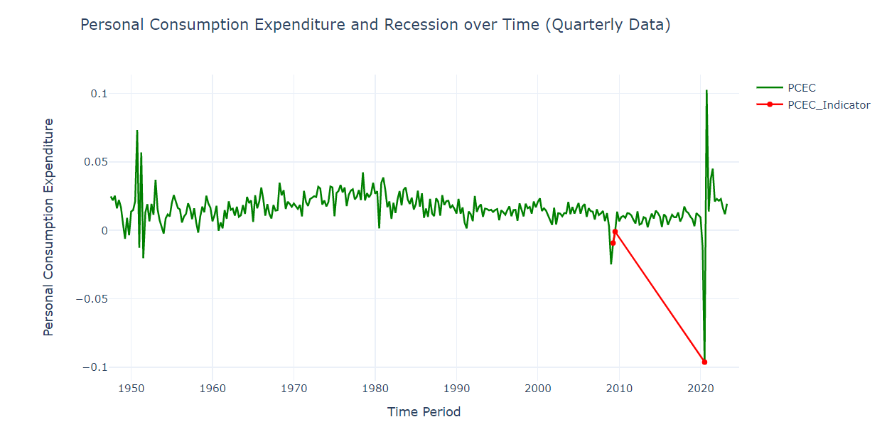
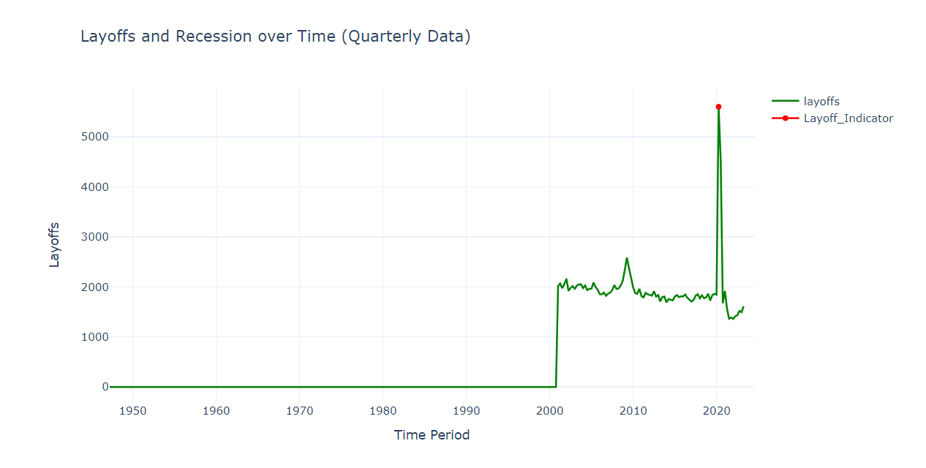
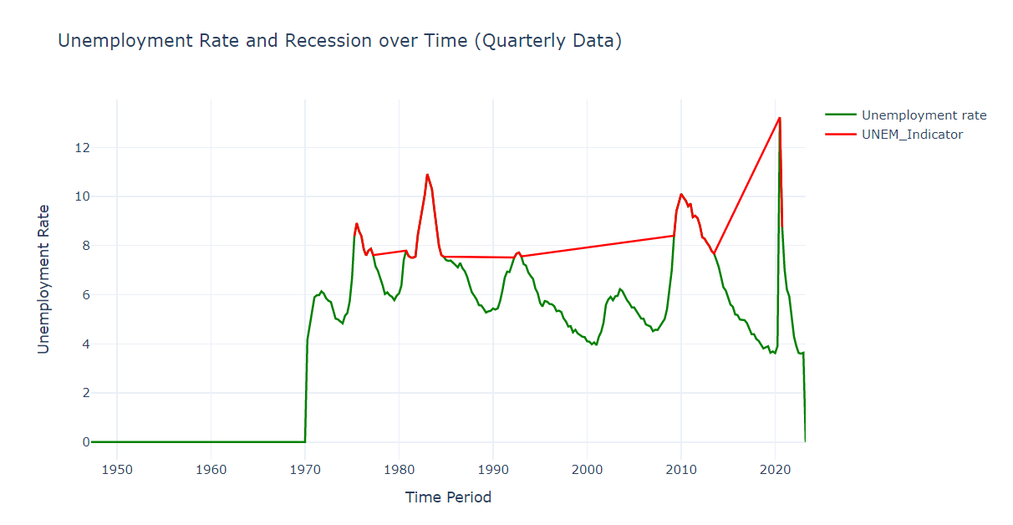
Results:
The generated graphs make it clear that after 2020, all the decisive factors will be steadily improving, and despite recent swings, they won't go below the cutoff point anytime soon. Therefore, even with frequent changes in economic factors, we can draw the conclusion that there won't be a recession anytime soon.

Slide 9
Conclusion
In conclusion, based on the percentage change in GDP, consumer spending, and the typical number of layoffs over the prior quarters, we constructed a logistic regression model to forecast the likelihood of a recession.
We used the test data to determine the model's accuracy as well. Additional adjustments can be made to this to accommodate particular needs and information.
Also, it is important to note that no single indicator is sufficient to determine whether an economy is in a recession. A combination of these indicators should be analyzed to get a clearer picture of the overall economic situation.

Slide 10
References:
Gross Domestic Product (GDP) | FRED | St. Louis Fed (stlouisfed.org)
Unemployment Rate: Aged 15-64: All Persons for the United States (LRUN64TTUSQ156S) | FRED | St. Louis Fed (stlouisfed.org)
Layoffs and Discharges: Total Nonfarm (JTSLDL) | FRED | St. Louis Fed (stlouisfed.org)
Personal Consumption Expenditures (PCE) | FRED | St. Louis Fed (stlouisfed.org)
Recession Analysis using Python | Aman Kharwal (thecleverprogrammer.com)

Slide 11

THANK YOU

