Slide 1

YOUTUBE DATA ANALYSIS
FINAL FROJECT: TEAM 09
Distributed and Scalable Data Engineering

Slide 2
OUR TEAM
Lohith kumar Bollampally
Jefrina Jahangir
Jahnavi Garikapati
Damodar reddy Chirapureddy
Data Engineer ML Engineer Data Analyst Research And
Documentation

Slide 3
INTRODUCTION
YouTube is the world's largest video-sharing platform, it is not only a hub for entertainment but also a goldmine of data waiting to be explored.
Analyzing YouTube data offers invaluable insights into audience behavior, content performance, and trends shaping digital media consumption.
Data analysis can help identify potential risks, such as copyright infringements or community guideline violations, allowing for proactive measures to mitigate them.
Understanding viewer behavior and preferences can lead to more effective monetization strategies, such as sponsored content, merchandise sales, or Patreon support.

Slide 4
Business Question Overview
Content Optimization:
Question: What specific elements in video content significantly impact rapid trendiness and sustained engagement?
Geographic Tailoring:
Question: How can content creators tailor their videos based on geographic variations to maximize audience appeal in different regions?
Optimal Timing and Length:
Question: What are the optimal times, days, and video lengths for publishing content to ensure higher visibility and trendiness?

Slide 5
The Solutions
Content Optimization
Data Analysis:
Engaging titles, relevant tags.
Sentiment Analysis:
Understand audience reactions.
Geographic Tailoring:
Analyze Regional Data:
Identify preferences.
Tailor Content:
Cultural references, trending topics.
Optimal Timing and Length:
Time-Series Analysis:
Peak hours and days.
Length Trends:
Optimal duration for engagement.

Slide 6
Project Goals
Data Ingestion — Build a mechanism to ingest data from different sources
ETL System — We are getting data in raw format, transforming this data into the proper format.
3. Data lake — We will be getting data from multiple sources so we need centralized repo to store them
4. Scalability — As the size of our data increases, we need to make sure our system scales with it
5. Cloud — We can’t process vast amounts of data on our local computer so we need to use the cloud, in this case, we will use AWS.
6. Reporting — Build a dashboard to get answers to the question we asked earlier

Slide 7
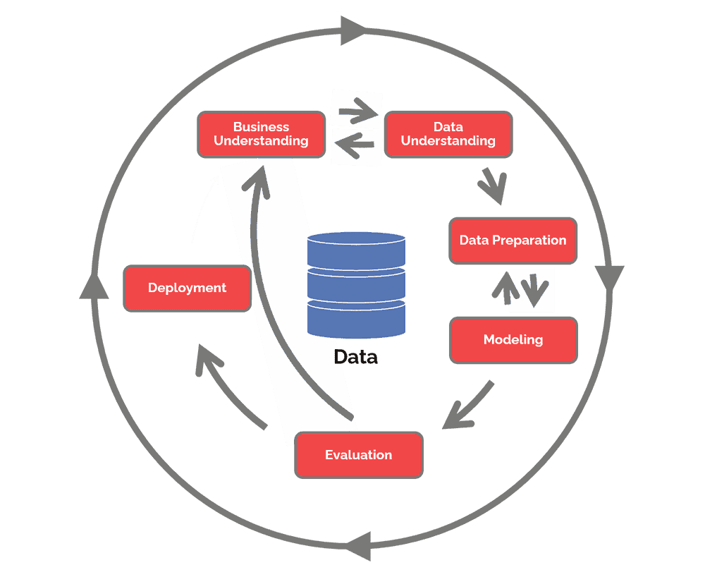
Methodology CRISP-DM
GAIN BUSINESS UNDERSTANDING
DATA COLLECTION AND INTEGRATION
DATA CLEANING AND PREPARATION
DATA MODELING AND ANALYSIS

Slide 8
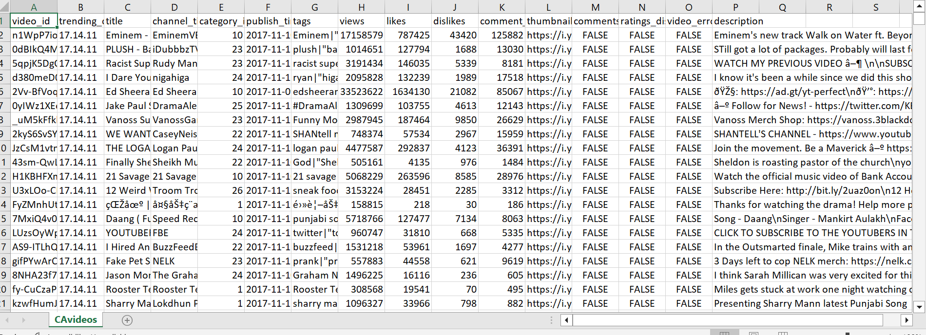
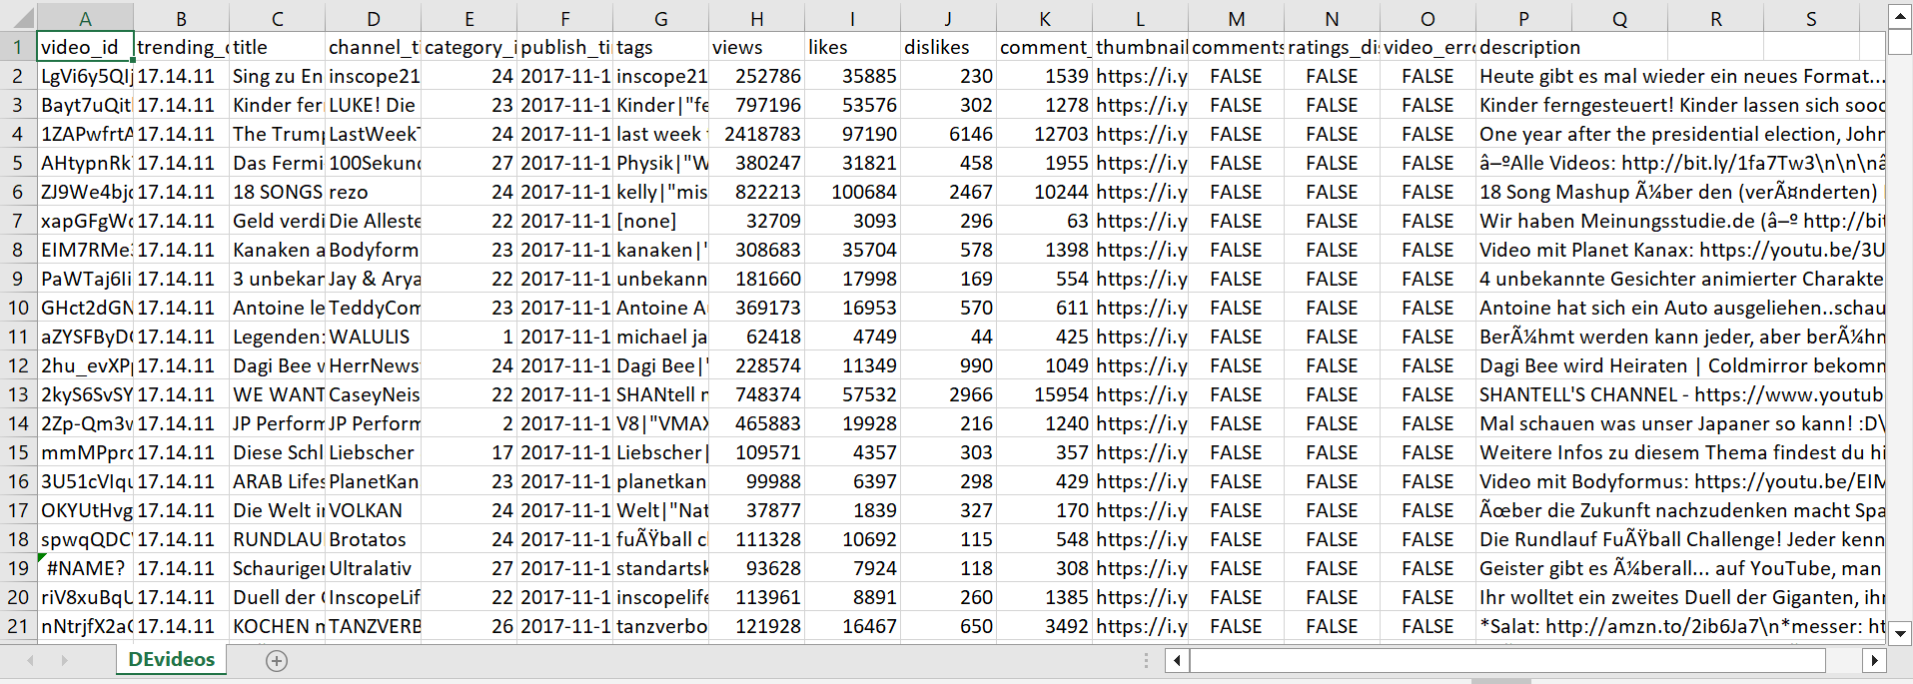
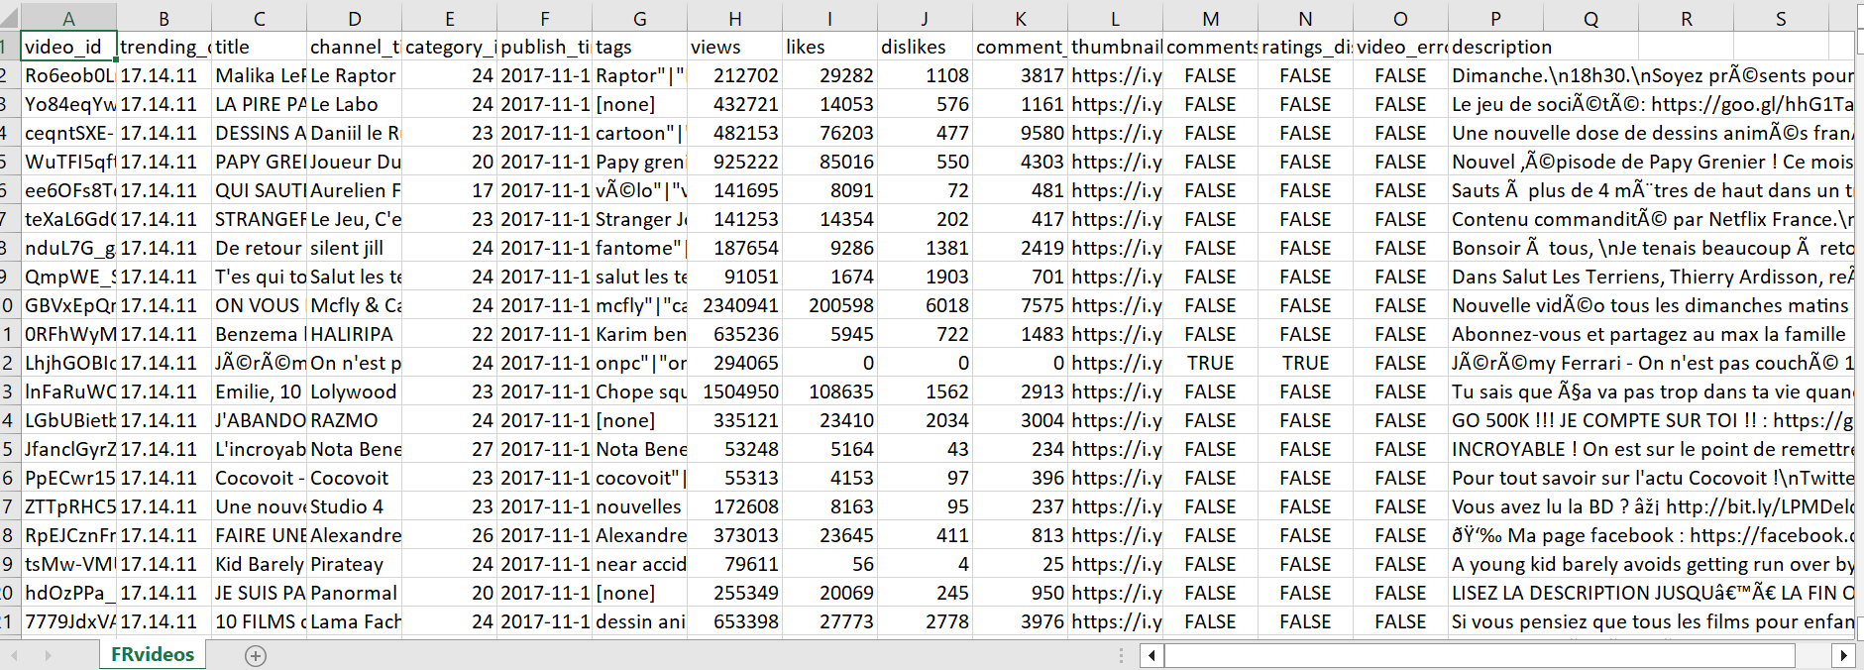
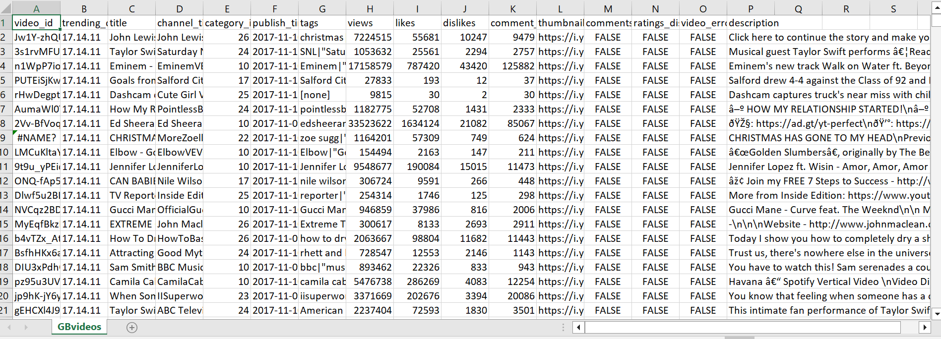
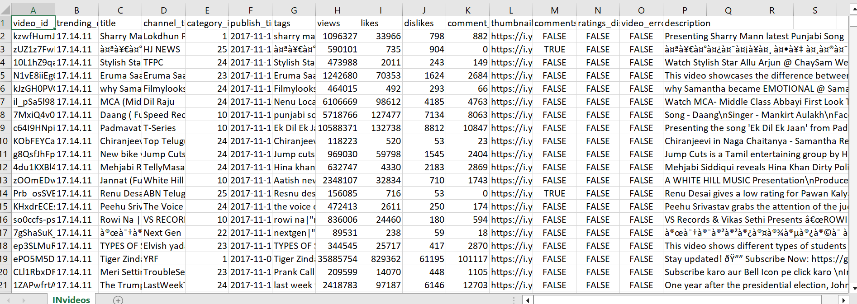
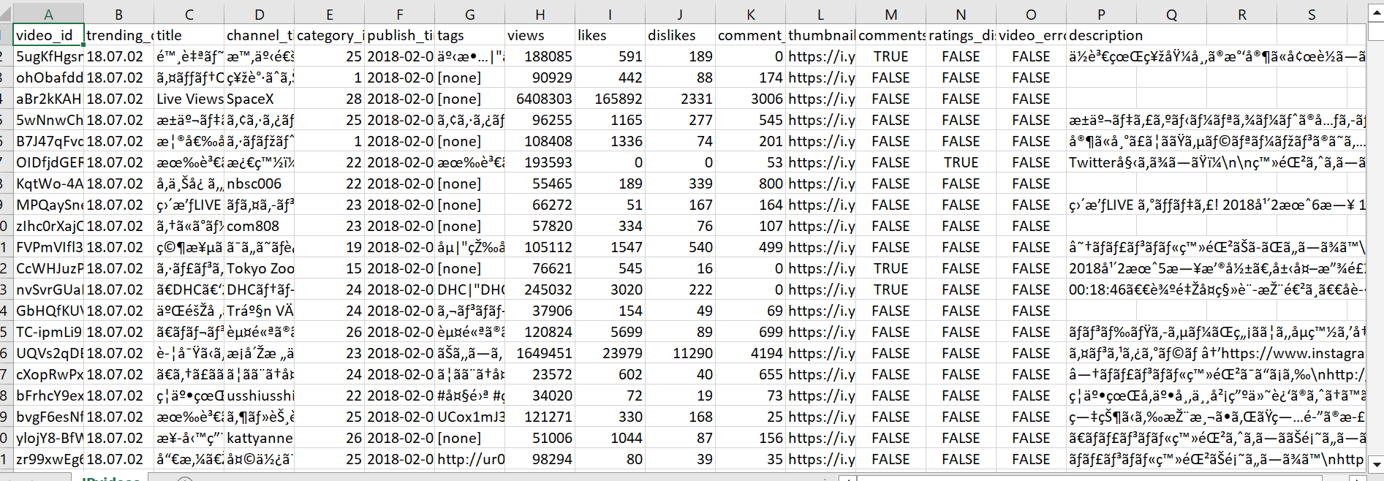
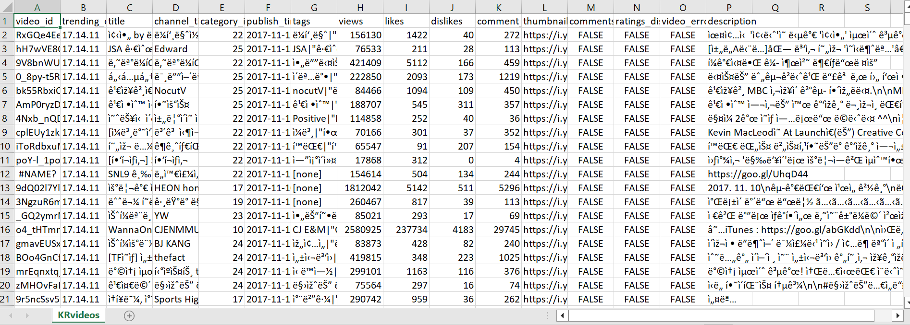
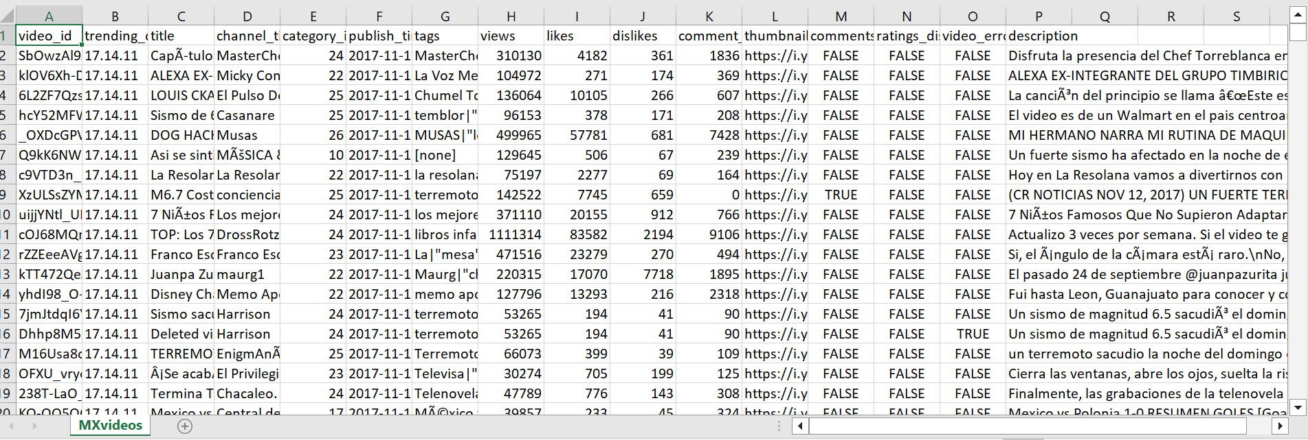
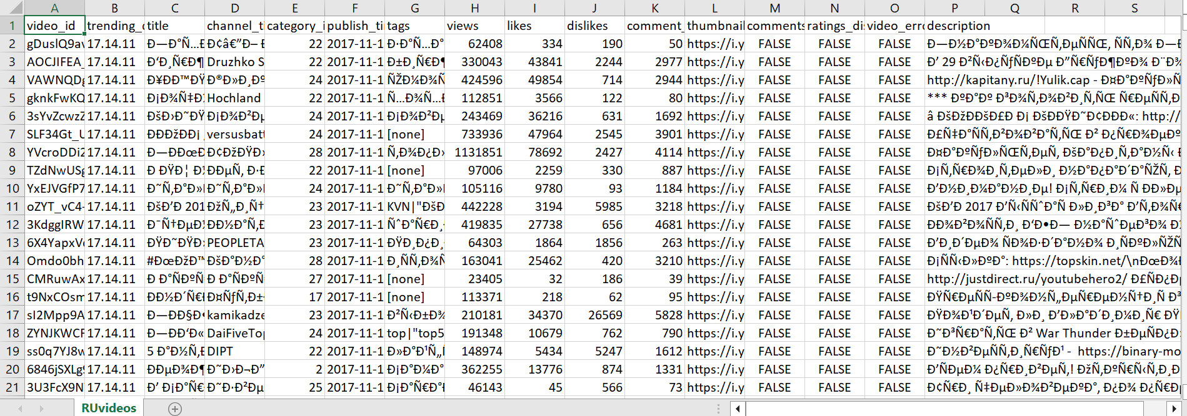
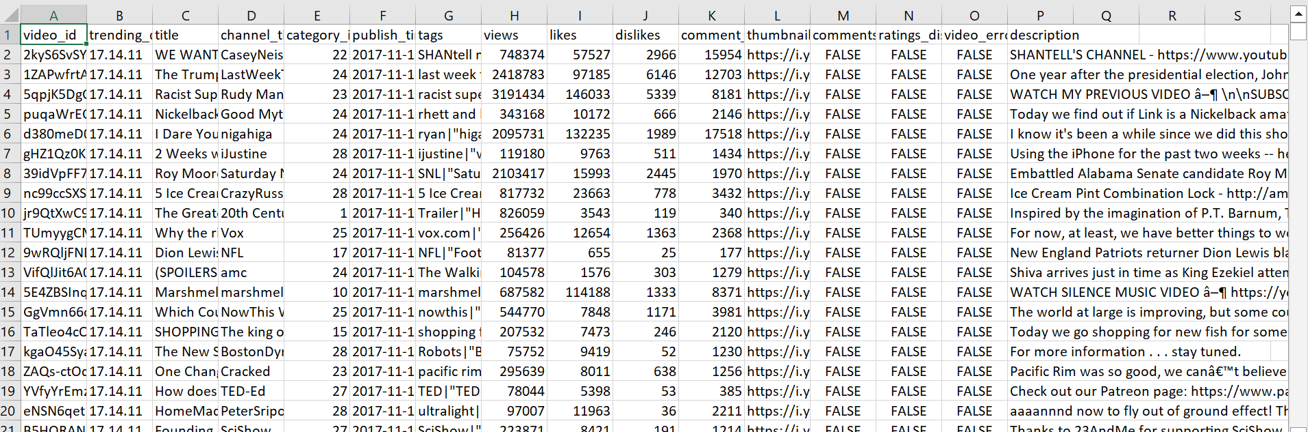
Dataset
CA Videos.csv
DE Videos.csv
FR Videos.csv
We Had 10 individual Datasets
Dataset: https://www.kaggle.com/datasets/datasnaek/youtube-new?resource=download
GB Videos.csv
IN Videos.csv
JP Videos.csv
KR Videos.csv
MX Videos.csv
RU Videos.csv
US Videos.csv

Slide 9
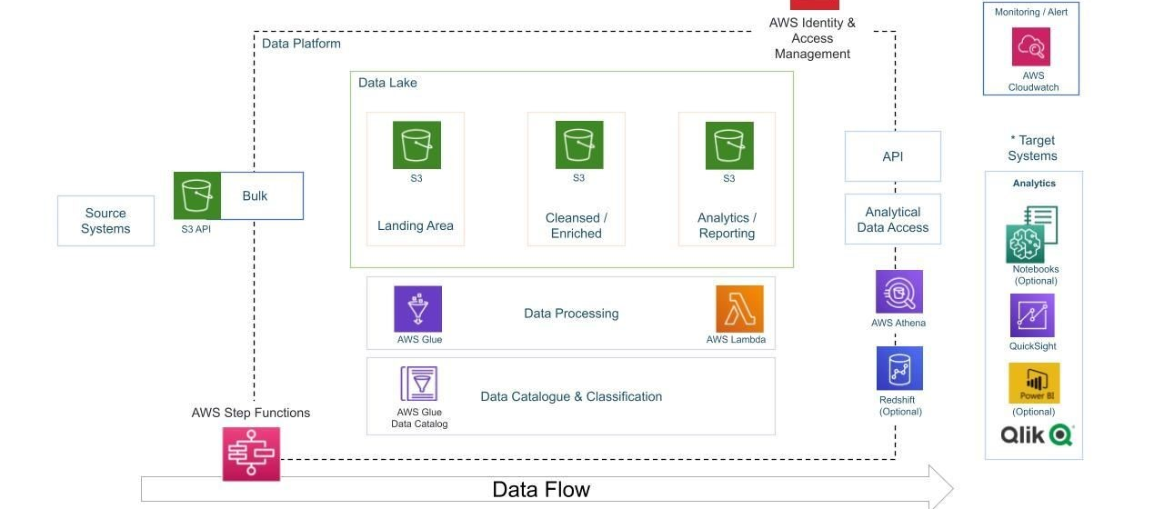
Architecture diagram of the solution

Slide 10
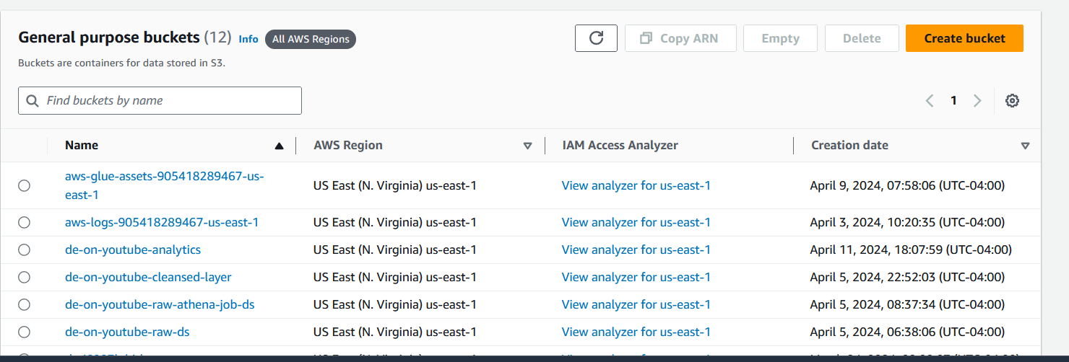
S3 BUCKET
We utilize an S3 bucket as the primary repository for raw data.

Slide 11

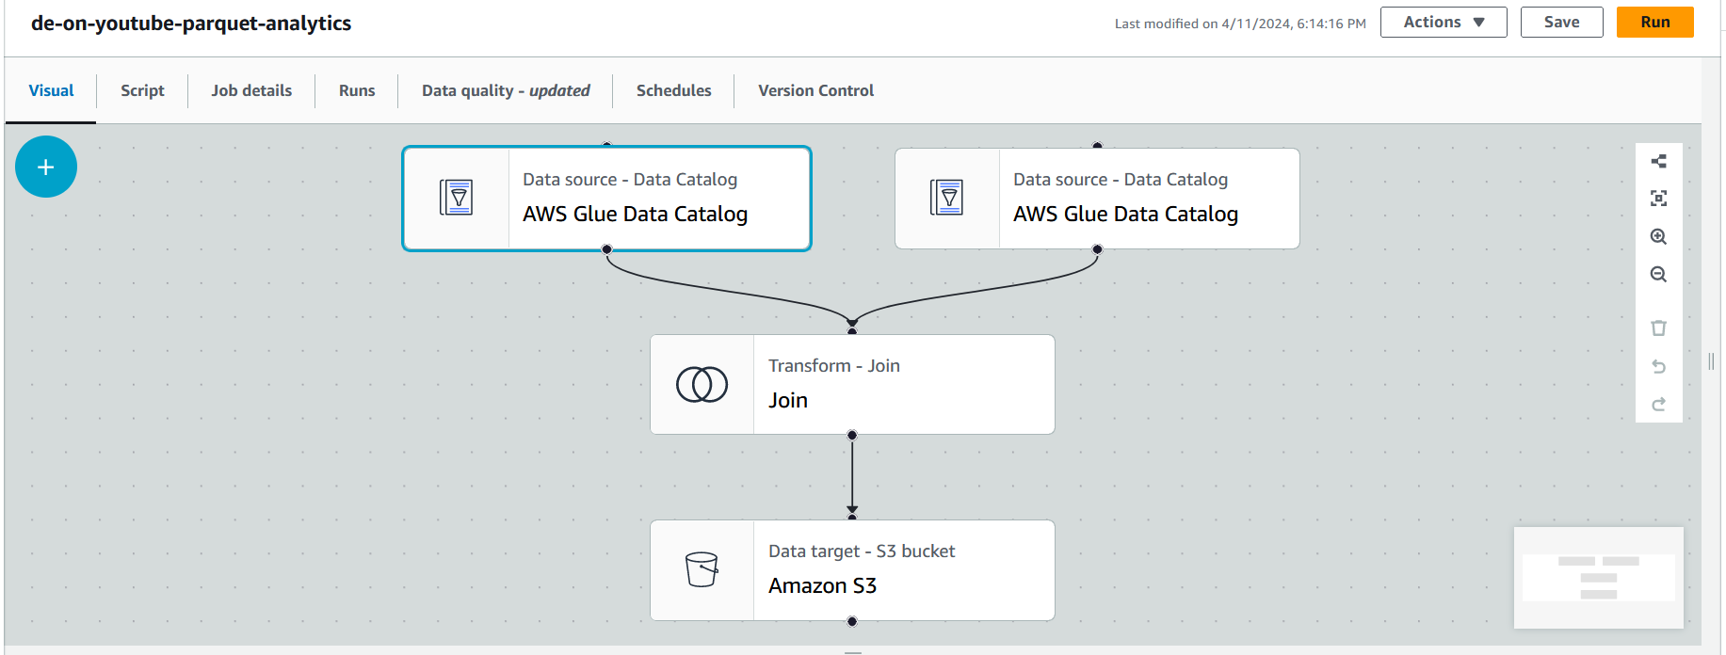
Data Cleaning and Integration
We utilize AWS Glue to construct our ETL pipeline. This pipeline efficiently retrieves data from the S3 bucket, performs essential transformations like cleaning and joining, ensuring the accuracy and uniformity of the data. These steps are crucial for improving the dataset and preparing it for more in-depth analysis.

Slide 12

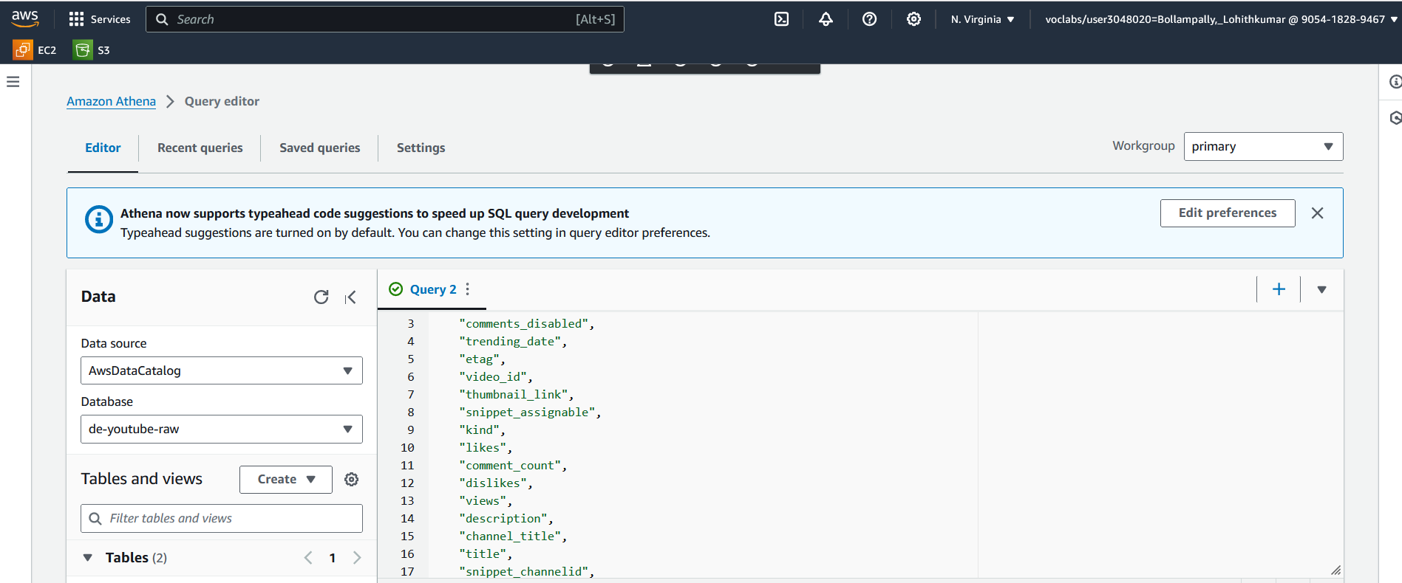
AWS ATHENA:
To enable easy querying, we depend on AWS Athena, utilizing its features to effortlessly examine and analyze the data housed within our database tables. This enables us to extract valuable insights and make well-informed decisions through our data analysis efforts, as detailed below:
Query1: Selecting disabled rating videos:

Slide 13
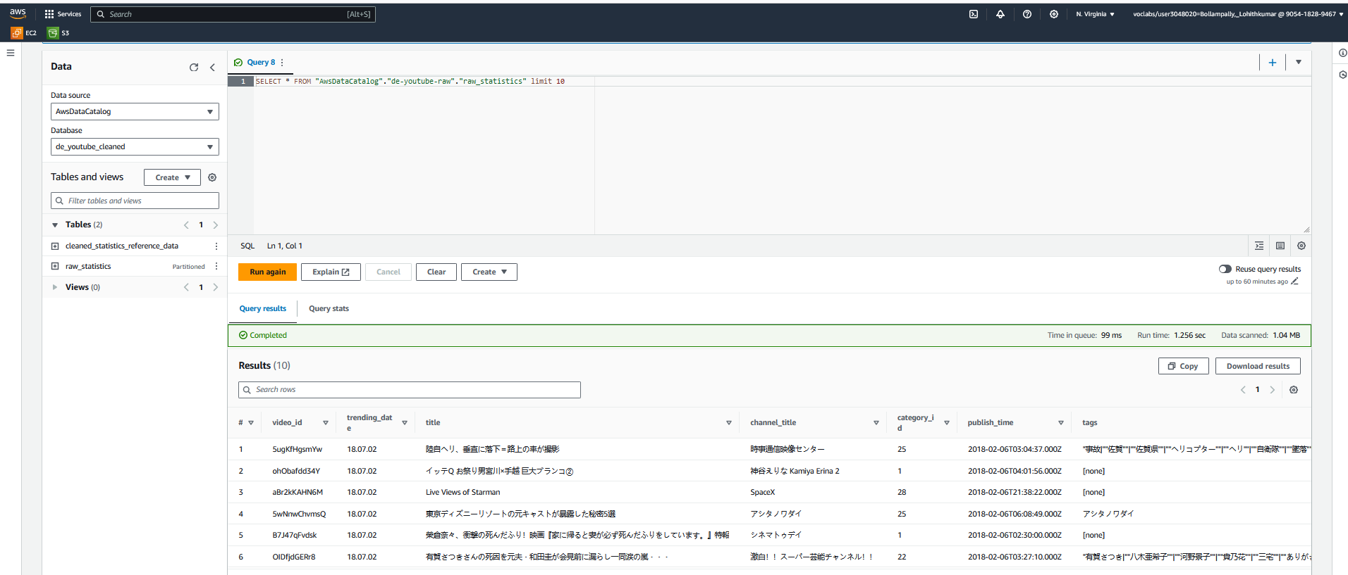
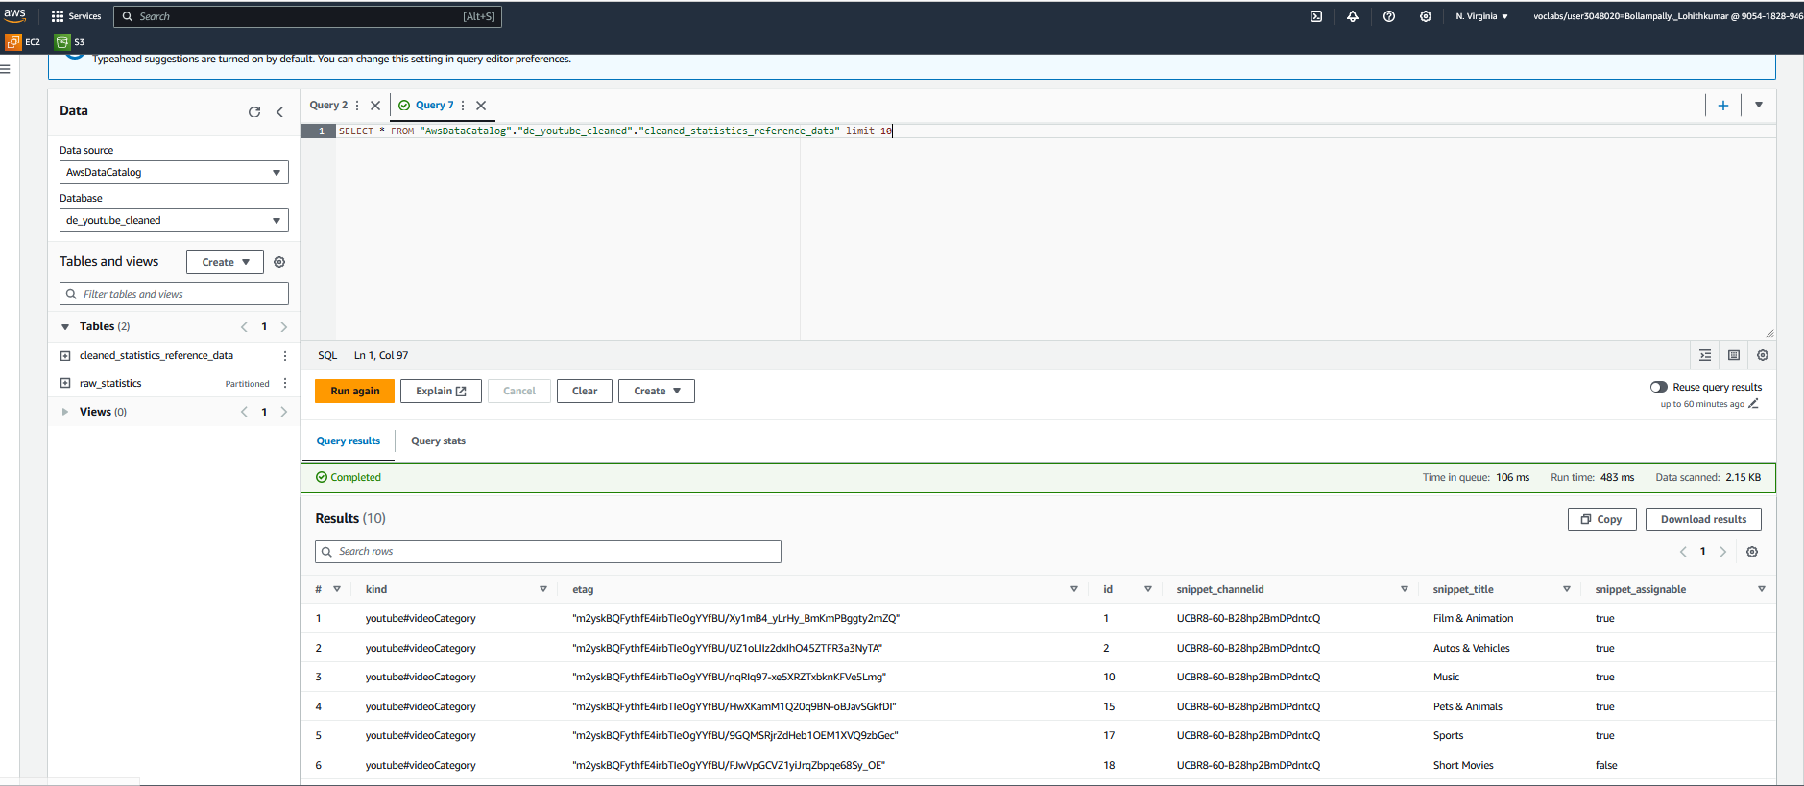
Query2:- Finding the raw statastics reference data:
Query3:- Finding the cleaned statastics reference data:

Slide 14
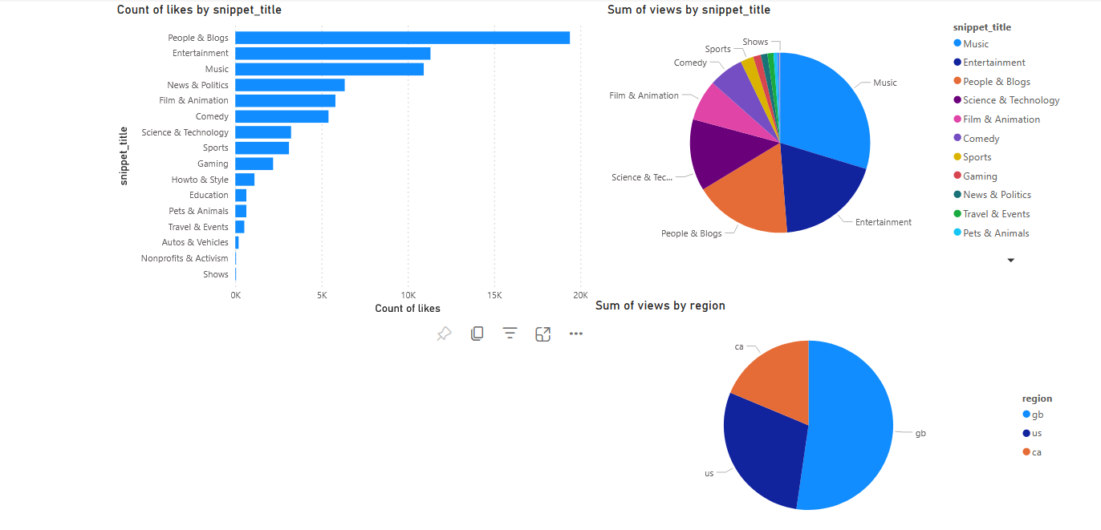
Power BI Visualization

Slide 15
Lessons learned
Challenges Overcame: During the project, we faced obstacles such as data preprocessing complexities and model evaluation.
Helpful Resources: We got AWS documentation, linkdn learning, and experienced people support to overcoming challenges and gaining insights.
New Skills: We developed proficiency in AWS services, data preprocessing techniques, and machine learning model evaluation.
Next Steps: In the future, we aim to improve our models, delve into more advanced analytics methods, and bolster scalability to accommodate larger datasets.

Slide 16
DEMO
Github
Power BI Reports

Slide 17
Thank You

