Slide 1
YOUTUBE DATA ANALYSIS

Slide 2
Team - 09
Jahnavi Garikapati Lohith kumar Bollampally Damodar reddy Chirapureddy Jefrina Jahangir

Slide 3
BUSINESS PROBLEM
Content creators lack clear insights into what makes YouTube videos trend quickly and engage audiences. This gap in understanding leads to suboptimal content strategies, impacting overall video performance on the platform. A systematic, data-driven solution is needed to empower creators in optimizing their content effectively.

Slide 4
PROPOSED SOLUTION
Implement a data-driven solution leveraging AWS services to analyze YouTube video data. Provide content creators with actionable insights, visualizations, and optimization recommendations, empowering them to enhance their video strategies for improved trendiness and sustained engagement.

Slide 5
Business Question
Content Optimization:
Question: What specific elements in video content significantly impact rapid trendiness and sustained engagement?
Geographic Tailoring:
Question: How can content creators tailor their videos based on geographic variations to maximize audience appeal in different regions?
Optimal Timing and Length:
Question: What are the optimal times, days, and video lengths for publishing content to ensure higher visibility and trendiness?

Slide 6
The Solutions
Content Optimization
Data Analysis:
Engaging titles, relevant tags.
Sentiment Analysis:
Understand audience reactions.
Geographic Tailoring:
Analyze Regional Data:
Identify preferences.
Tailor Content:
Cultural references, trending topics.
Optimal Timing and Length:
Time-Series Analysis:
Peak hours and days.
Length Trends:
Optimal duration for engagement.
01
02
03

Slide 7
Data Overview
Source: https://www.kaggle.com/datasets/datasnaek/youtube-new
Attributes: In-depth details include video title, channel information, publication time, tags, views, likes, dislikes, description, and comment count.
Categories: Videos categorized with a unique identifier (category_id) that varies across different regions.
Storage: Centralized in Amazon S3, ensuring scalable, secure, and efficient access to the dataset.
Objective: Facilitate detailed analysis to uncover patterns and trends, understanding the factors influencing video trendiness and engagement on the YouTube platform.

Slide 8
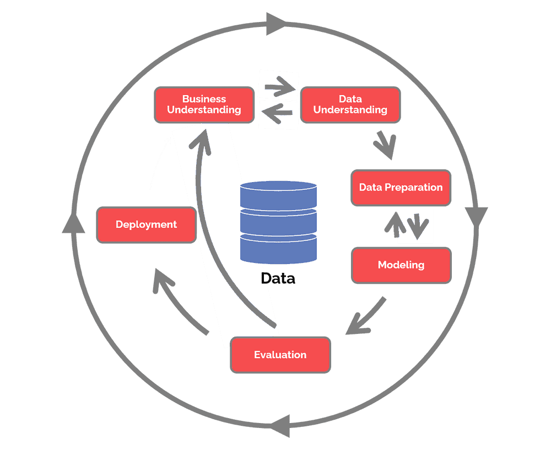
METHODOLOGY CRISP-DM

Slide 9
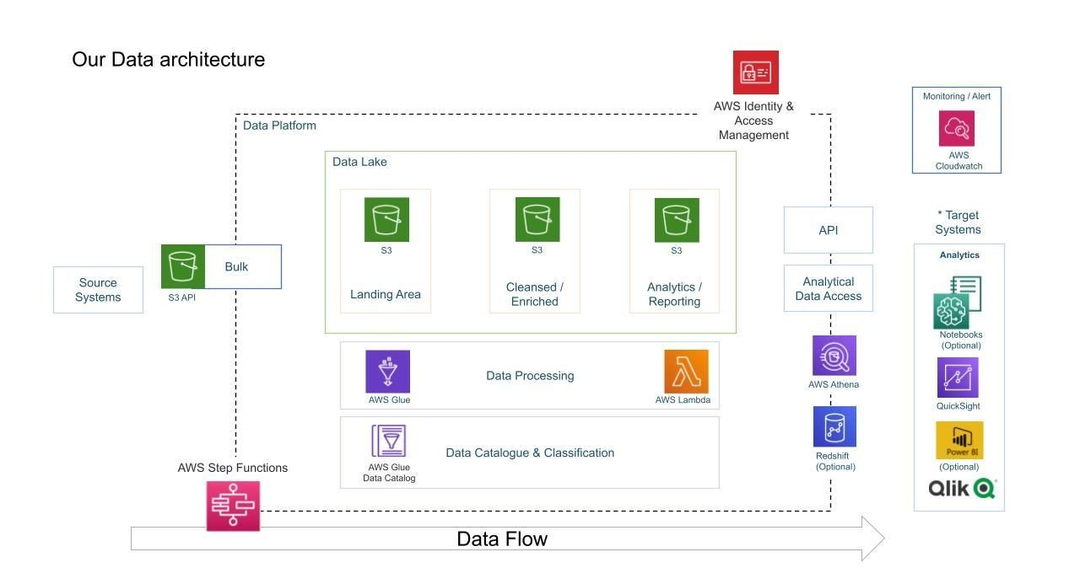

Technologies

Slide 10
Road Map
Data Setup and Transformation:
Acquire Kaggle dataset for YouTube videos.
Employ AWS Glue for data transformation.
Establish a centralized data lake on Amazon S3 for efficient storage.
AWS Integration and Analysis:
Ensure scalability with AWS services.
Implement serverless processing using Lambda.
Utilize Athena for interactive querying and apply machine learning techniques for insightful analysis.
Integrate Amazon Quick Sight for creating interactive dashboards and visualizations.
Documentation, Training, and Feedback:
Document the data processing pipeline for reference.
Conduct training sessions for stakeholders to interpret insights.
Establish a continuous feedback loop for content creators, adapting analyses based on emerging trends.
Evaluate project outcomes, refining processes for future optimization.

Slide 11
Why Are We Better?
Informed Decision-Making with Data:
This project empowers content creators through detailed data analysis and machine learning insights. By delving into video attributes, sentiment, and trends, creators can make informed decisions, aligning their content with what resonates most with their audience.
Comprehensive Understanding of Success Factors:
The project takes a holistic approach, offering insights into content optimization, geographic preferences, and optimal timing. This comprehensive understanding enables creators to strategically tailor their content for maximum impact and engagement.
Efficiency, Scalability, and Continuous Improvement:
Leveraging AWS services ensures scalability, security, and efficient processing of vast datasets. The establishment of a user feedback loop allows for continuous improvement, adapting analyses based on real-time feedback and evolving trends, creating a dynamic and efficient content optimization strategy.

Slide 12
GitHub link
https://github.com/DSCI-6007-03-Team09/DSCI-6007-03-Team09?tab=readme-ov-file

Slide 13
THANK YOU

