Slide 1


Tagliatela College of Engineering
Exploratory Data Analysis: Doctors by Country Over Time Dataset
Understanding Global Healthcare Distribution

Slide 2

Presented to:
Project Manager: Mr. Div Pithadia
Project Sponsor: University of New HavenTime Dataset

Slide 3
01
Introduction
02
Dataset Overview
03
Data Cleaning & Preparation
04
Relationship between columns
Table of Contents
05
Data Visualization
06
Limitations
07
Conclusions

Slide 4
Our Team
Manis Chaudhary
Team Member
Sapna Baniya
Team Member
Rohit Kumar Sah
Team Member
Timilehin Oluwole
Team Member

Slide 5








Data Exploration & Collaboration Tools​
Matplotlib
2. Pandas​
3. Seaborn
4. Numpy
5. Jupyter Notebook
6. Microsoft Excel
7. Microsoft PowerPoint
8. Github​

Slide 6
Introduction to Dataset
Objective:
Analyze the distribution of doctors across countries using available dataset.
Identifying disparities in healthcare access and guiding policy decisions.
This dataset is from the WHO Global Health Observatory (GHO).
This dataset provides information on the number of medical doctors (physicians) per 10,000 population, reported by country and year.
It covers a wide range of countries and territories, with data spanning multiple years.

Slide 7
Dataset Overview
Objectives:
WHO dataset containing information from 3603 entries across multiple countries and years.
This dataset is from the WHO Global Health Observatory (GHO)
This dataset provides information on the number of medical doctors (physicians) per 10,000 population, reported by country and year.
It covers a wide range of countries and territories, with data spanning multiple years

Slide 8
Fields Information:
Country/Area: This is country or territory from which the data is reported
Year: The reference year for the data point
Number of medical doctors (per 10,000 population): The main indicator, representing the density of medical doctors.
Generalist medical practitioners (number): The number of medical doctors who do not limit their practice to certain disease categories or methods of treatment.
Specialist medical practitioners (number) : The number of doctors who have completed advanced education and training in a specific area of medicine.
Medical doctors not further defined (number): The number of medical doctors who cannot be clearly classified as either generalists or specialists due to lack of information in the original data source.

Slide 9
Data Cleaning & Preparation
Missing Values:
We found that there are a lot of missing values.
There are:
Medical doctors (per 10 000 population) 700
Medical doctors (number) 160
Generalist medical practitioners (number) 2270
Specialist medical practitioners (number) 2351
Medical doctors not further defined (number) 822
There is no any values missing in Country and Year column.
Since Medical doctors(number) has 160 null values, we are replace it with 0
Duplicated Values:
We have 0 duplicate values.

Slide 10
Relationship Between Columns
Relationship between Medical doctors(number), Generalist medical practitioners (number), Specialist medical practitioners (number), and Medical doctors not further defined (number) ​
​
Medical doctors(number) = Generalist medical practitioners (number) + Specialist medical practitioners (number) + Medical doctors not further defined (number)
Missing values in column medical doctors(per 10000 population) - basically, the column medical doctors (per 10000 population ) has missing values from Year 1952.​
​
Since we are not given the population of the country in that year, we will drop the records with missing value in medical doctors(per 10000 population) column​

Slide 11
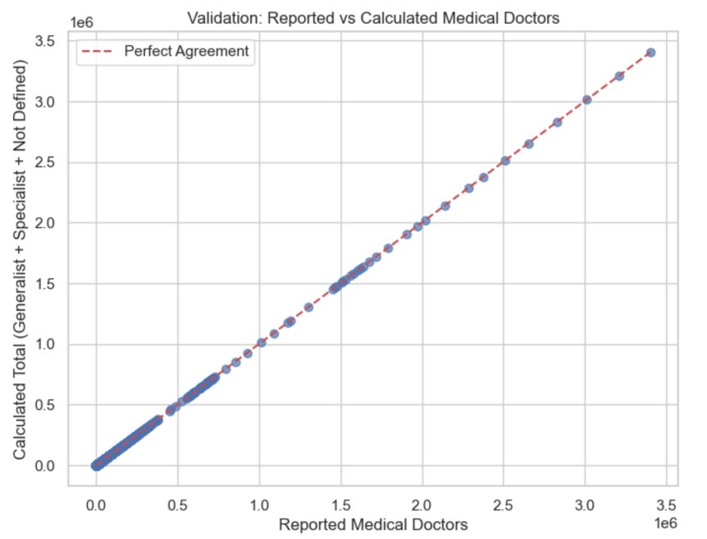
Data Visualization

Slide 12
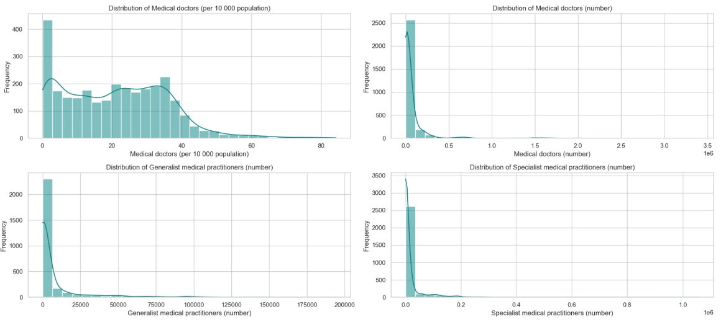

Slide 13
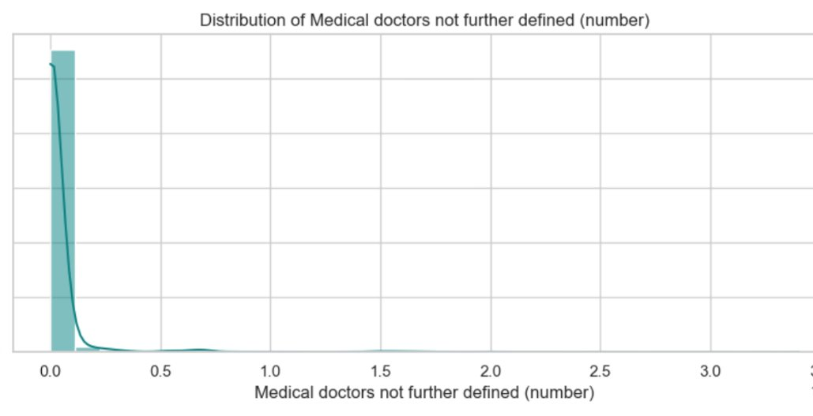

Slide 14
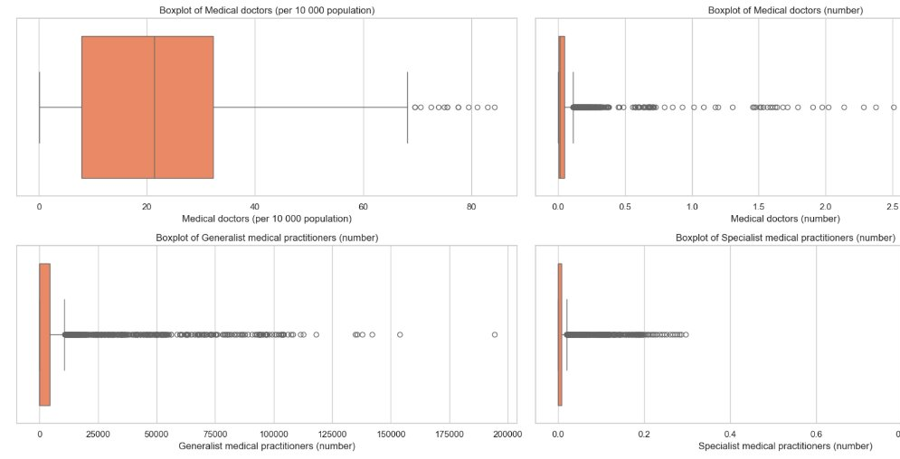

Slide 15
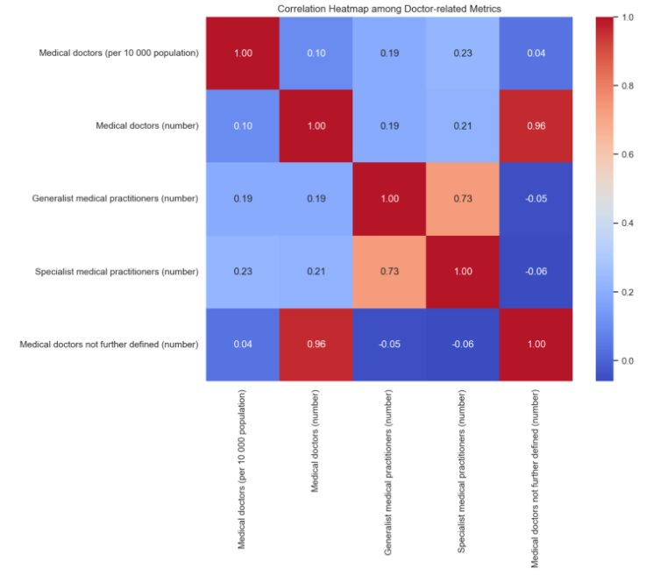

Slide 16
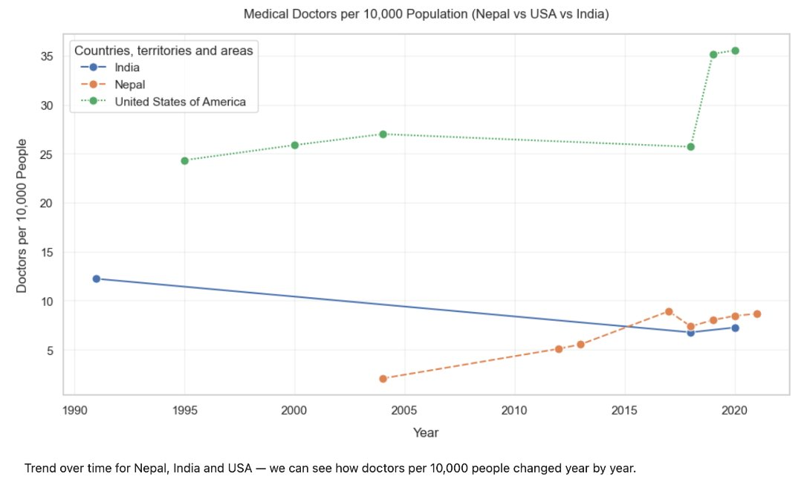

Slide 17
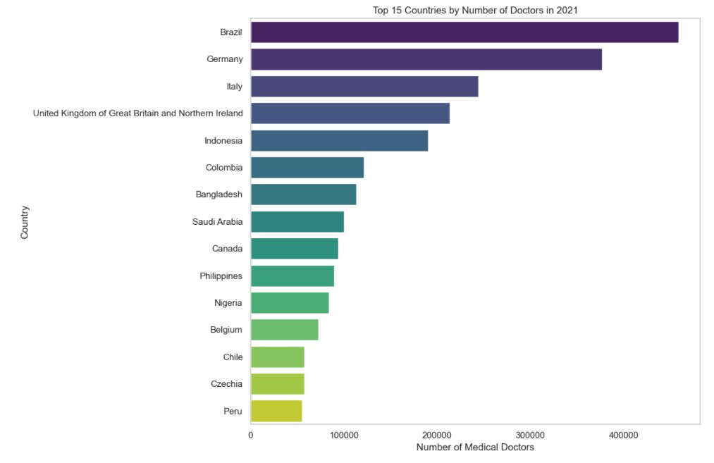

Slide 18
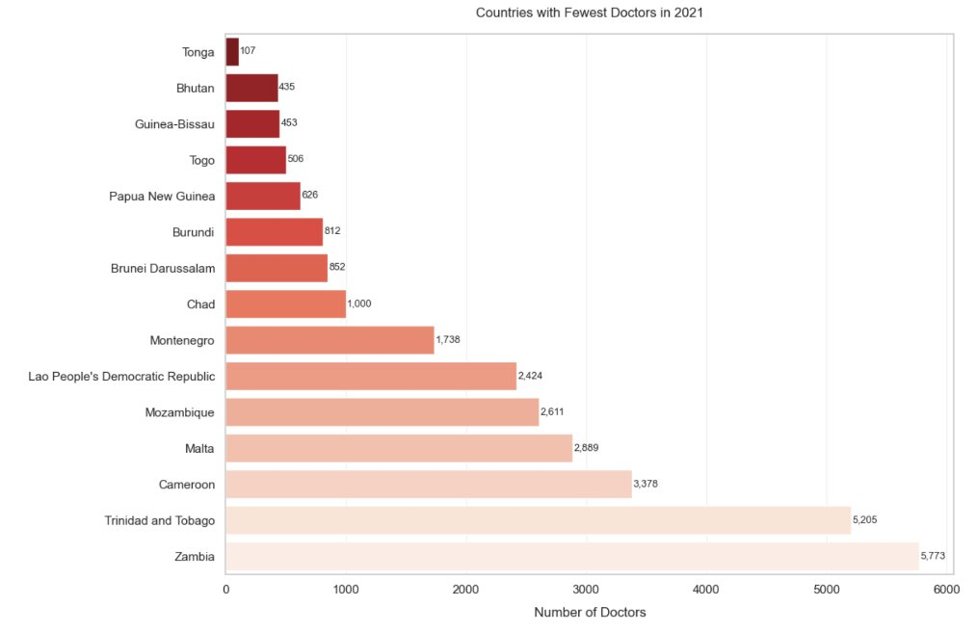

Slide 19
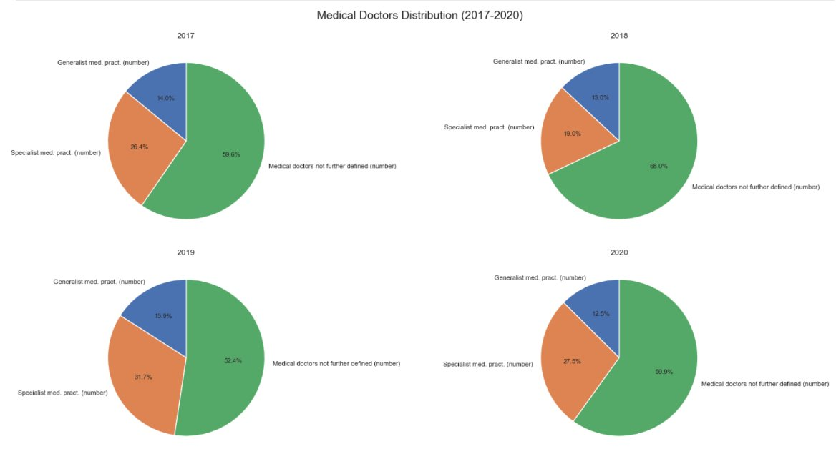

Slide 20
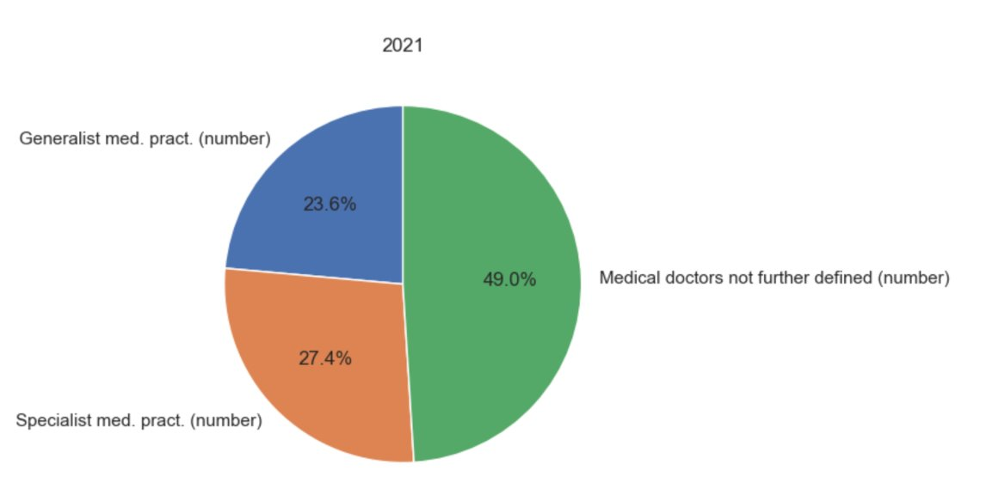

Slide 21
Limitations:

Slide 22
Conclusions:

Slide 23

Thank You
Any Questions?

