Slide 1
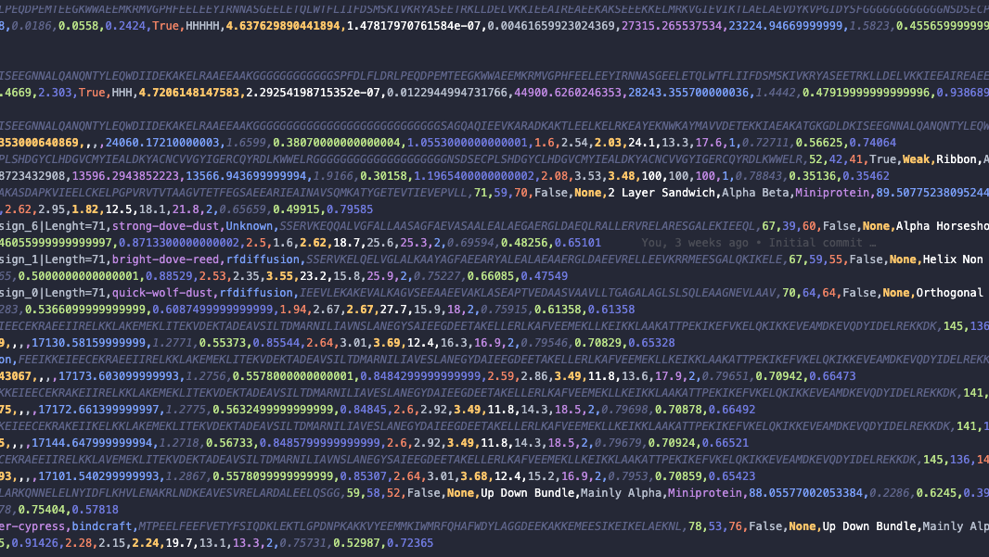
March 2026, group meeting presentation
Elliott Taguchi Dickinson, Master Student

Slide 2
A quick reminder of my project
My title: Assessing AI Scoring Accuracy for De Novo Proteins
Using 8 AI models to predict structures of 400 experimentally validated de novo protein designs (peptides, mini proteins, antibodies, scFv and “others”) targeting EGFR
The Epidermal Growth Factor Receptor is a trans-membrane protein that regulates cell growth, survival and differentiation. Drives cancer progression, specially in lung and head cancers
Benchmarking these AI models against each other through comparative analysis of metrics – both provided by the models itself and calculated
Notes:
scFv = Single-chain variable fragment. Is a recombinant antibody fragment (smaller than an actual antibody) consisting of the heavy and light chains, and connected by a short, flexible peptide linker.
Have the title focus more on consensus and the after math.
Look into protenix, cherry pick.
Probably switched around the jaccard values.
Do not split interface analysis into binder and target.
Cherry pick some specific ones and do screen shots and also do visual inspections, also do correlation plot of Protenix.

Slide 3
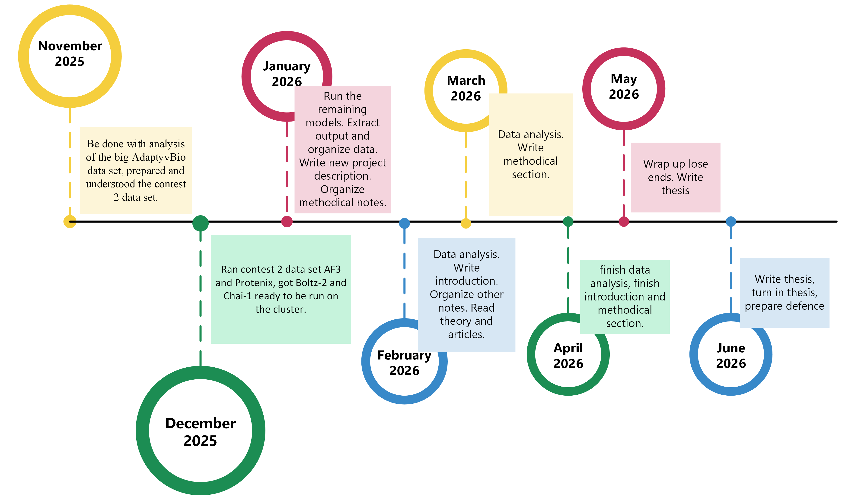
Where am I right now?
Notes:
Did not write introduction yet but have the outline and the titles. Already have some of my methodical section written. Data analysis is moving forward.

Slide 4
What does my data analysis consist of?
Calculating the RMSD of the binder between the models when: 1. I super impose on the target 2. I super impose on the binder
Do it for each model as the reference point and do it between each model.
Investigate the contact interface between the models (Cut off 4.5 Å) 1. Jaccard coefficient 2. Binder/target interface size
Jaccard Binder value: Agreement between two models on which binder residues are binding to the target
Jaccard target value: Agreement between two models on which target residues are binding to the binder
Notes:
The Jaccard index is a statistic used to compare the similarity and diversity of two sets of data. How much agreement do we have between these two models in terms of where the binder interacts with the target.
Binder and target interface size is the number of binder residues that a given model predicts are in contact with the target. For example, if value is 18 AF3 predicts that 18 binder residues participate in binding (or target residues that it predicts are contacted).

Slide 5
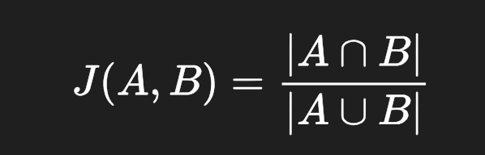
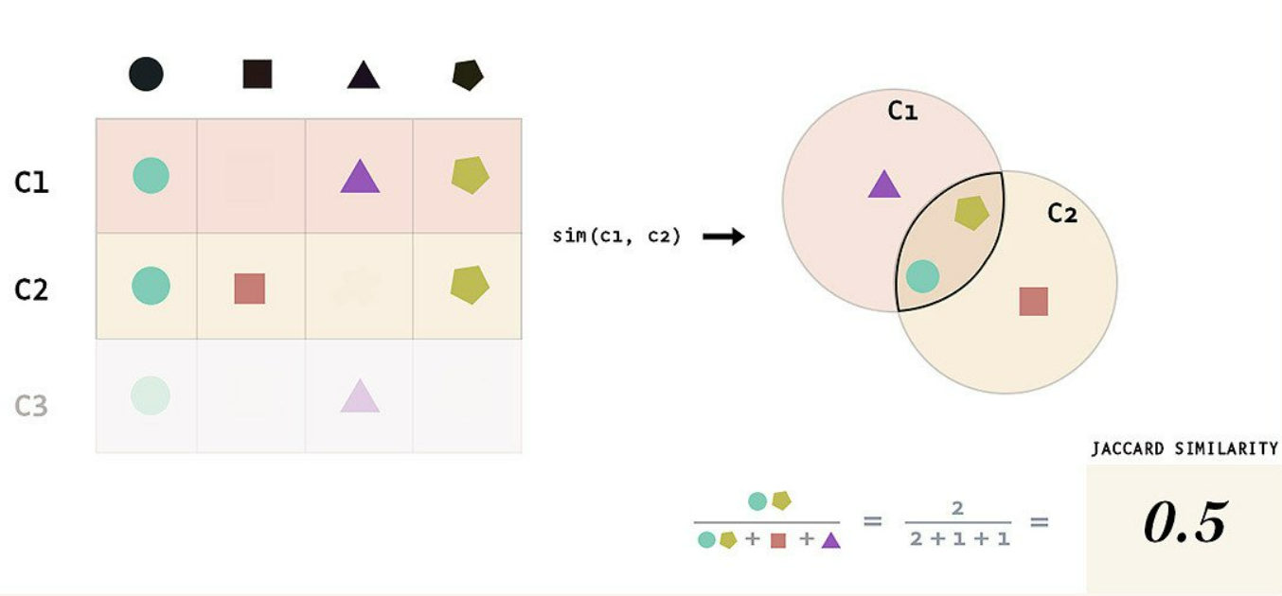
Jaccard calculation
Value | Meaning
1.0 | Perfect agreement
0.7–0.9 | Very strong agreement
0.4–0.6 | Moderate agreement
0.1–0.3 | Weak agreement
0.0 | No shared predicted residues
Jaccard Similarity = (number of observations in both sets) / (number in either set)
Source: https://mayurdhvajsinhjadeja.medium.com/jaccard-similarity-34e2c15fb524
Notes:
The Jaccard index is a statistic used to compare the similarity and diversity of two sets of data. How much agreement do we have between these two models in terms of where the binder interacts with the target.
And also do the models agree on which residues of the target is bound.
A and B are the two sets (C1 and C2 in the picture).
Top one is overlapping observations.
Bottom is total observations.
Simple, but a good start. Let’s say that AF3 perdicts 20 residues are binding in this complex, and Boltz predicts 25. Then if they share 15 residues it would also give a value of 0.5 so there’s a 50% overlap of total predicted interface.
Basically a way to figure out how much the two models agree in terms of contact interface and binding.

Slide 6
What else does my data analysis consist of?
A correlational analysis of the other metrics provided by the models itself
If time allows it, run on another data set
Consensus analysis in the end
Notes:
Consensus scoring: Generating a result superior to the individual screens of each model. Combining all the results from all the AI models which would be superior than to look at each model individually. See how the models are in agreement

Slide 7
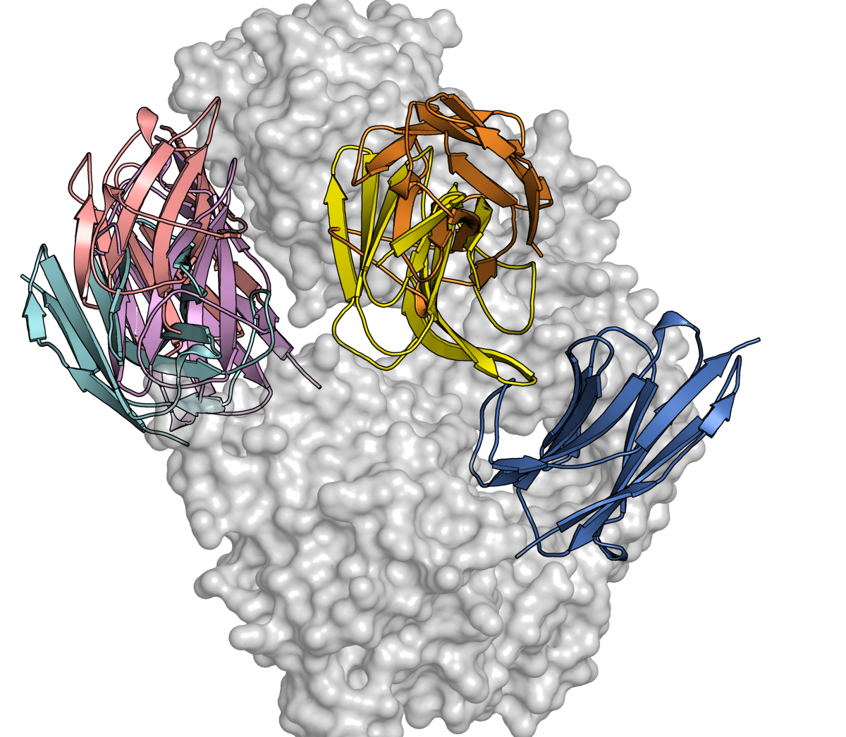
Example of model structure predictions (nanobody, noble-otter-pearl)
AlphaFold3
Boltz-2
Chai-1
HelixFold3
Protenix
AlphaFold2
This binder has strong binding
Notes:
Knowledge based assessment.

Slide 8
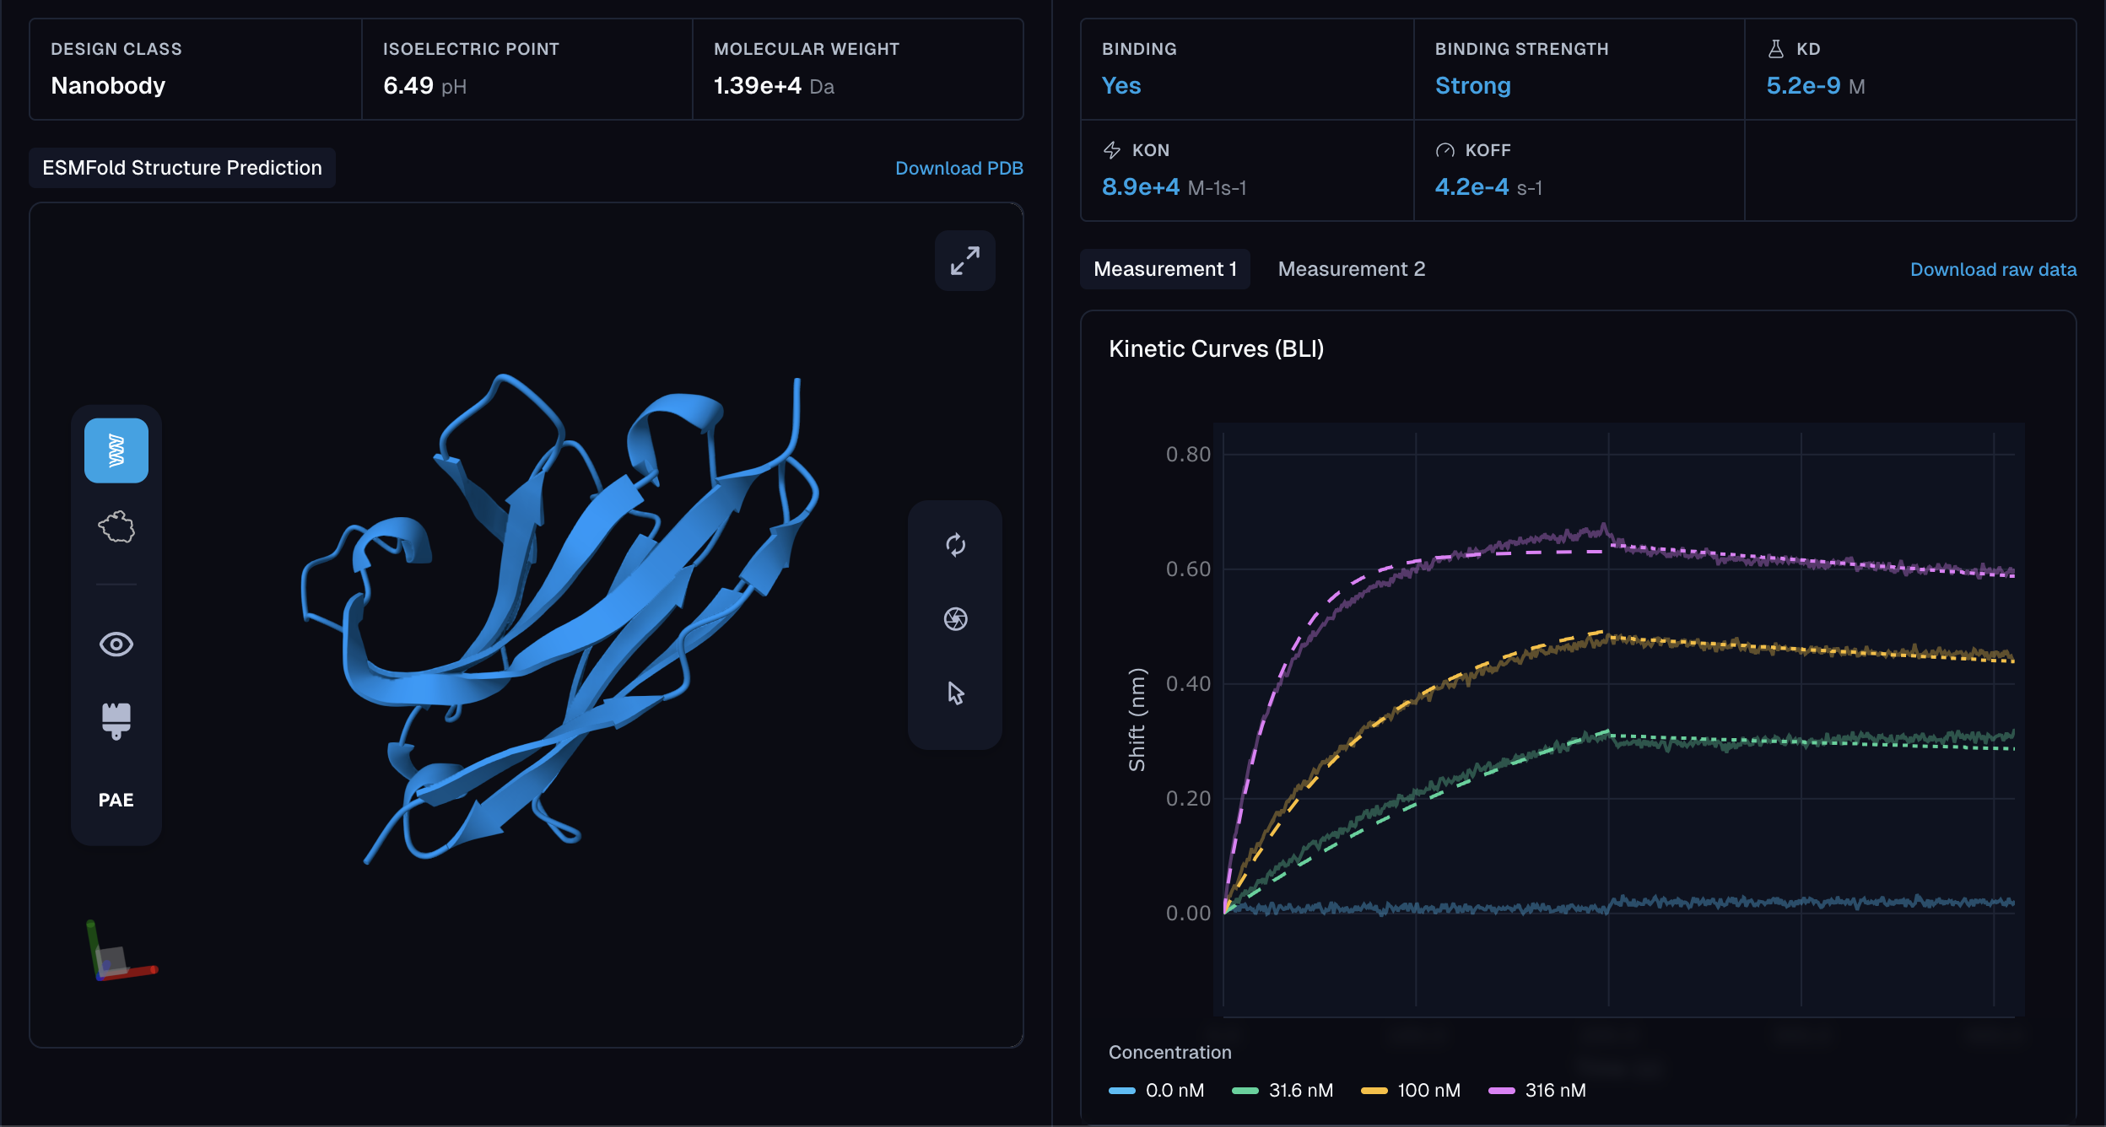

Slide 9
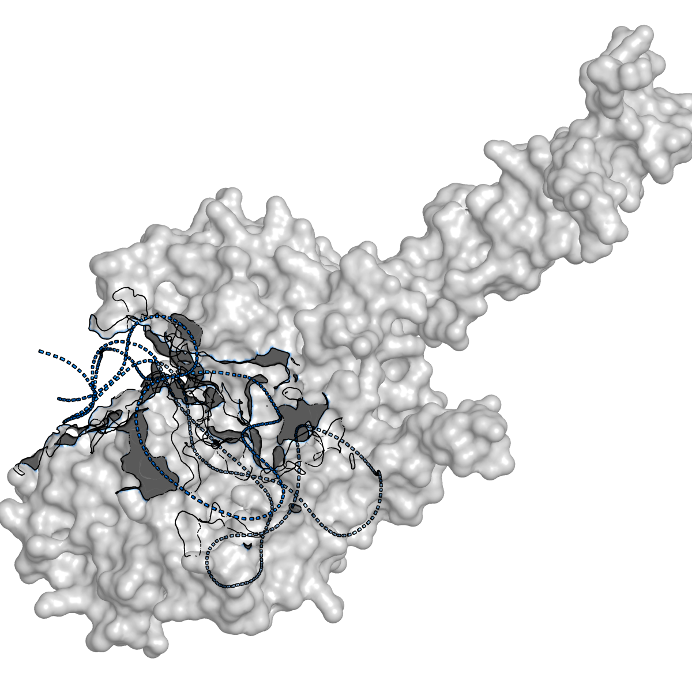
What about OF2 and OF3?

Slide 10
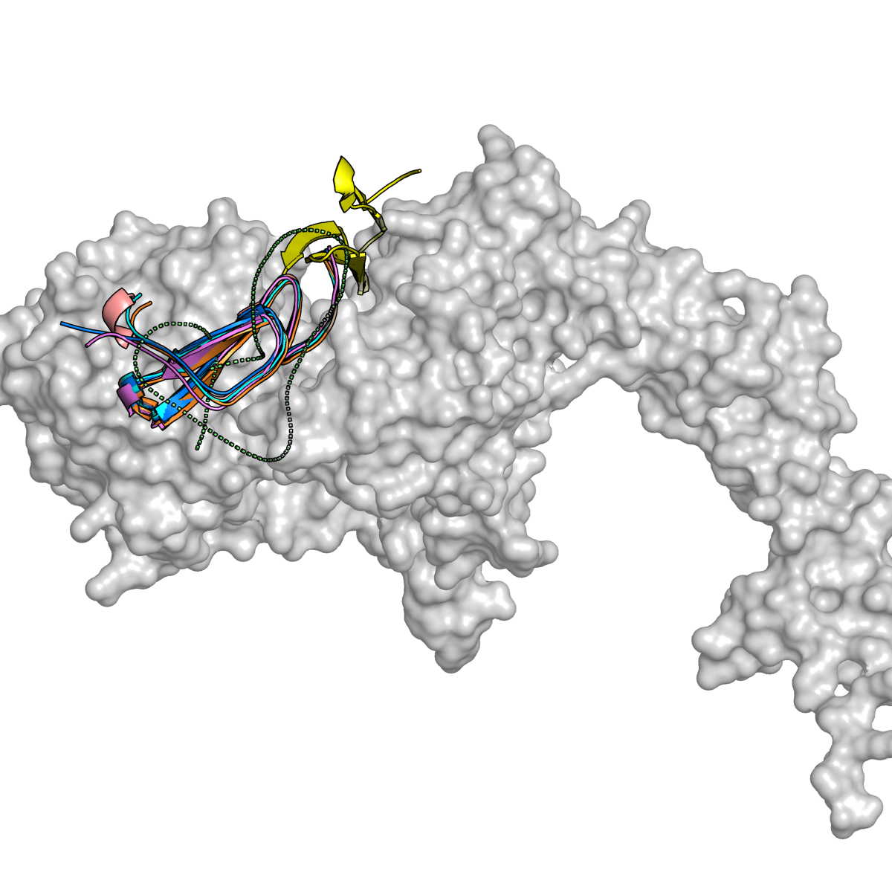
Example of model structure predictions (Peptide, scarlet-crane-moss)
AlphaFold3
Boltz-2
Chai-1
HelixFold3
Protenix
AlphaFold2
This binder has strong binding

Slide 11
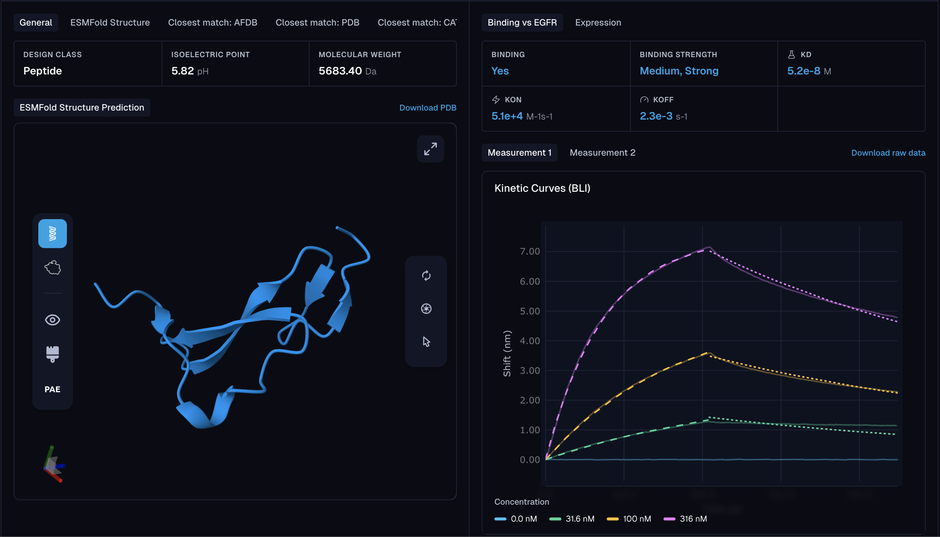

Slide 12
Example of model structure predictions
So just from two ”strong” examples there’s variance – nanobody having the higher variance which is expected.

Slide 13
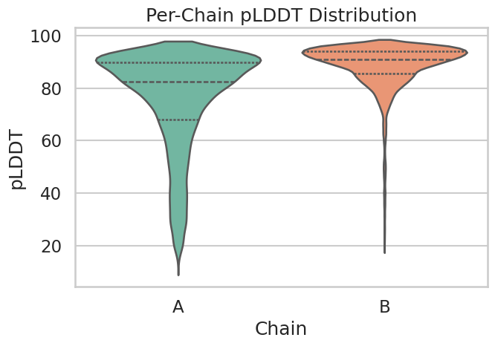
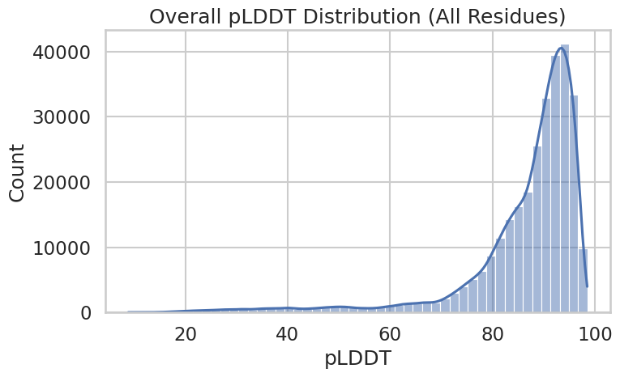
What I started with in terms of metrics: AF3 as the reference
Notes:
I started with a quick look into AF3’s own scoring of how well the model performed. Most importantly I wanted to make sure that AF3 predicted the target correctly, as to verify that I could use the data.

Slide 14
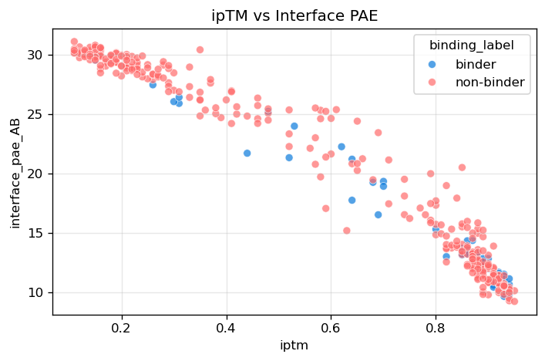
What I started with in terms of metrics: AF3 as the reference
PAE =Predicted Aligned Error (Å) How confident is AF3 about the relative positioning of the two chains (not if they are folded correctly)
ipTM = Interface Predicted TM-Score How well does AF3 predict relative positions and contacts between chains
Notes:
I want to do something similar with all the models, to verify and confirm that the predicted structures are confident and that the structures are usable (the validity). When reading through other articles, several compared these two metrics which was my reasoning to look at them over others.
Low PAE (0–5 Å): AF3 is very confident the two chains dock in a specific orientation, strong signal of real binding Medium PAE (5–15 Å): Interface may be flexible or weak, could be real or transient High PAE (>20 Å): AF3 is NOT confident about docking, usually means no reliable binding interface
If interface PAE is low, AF3 thing the proteins ”snap together”, while if it’s high AF3 is a bit confused ipTM: Only focus on interchain residue pairs. Flexible regions fx common in peptides can artificially reduce ipTM. > 0.8: High-confidence interface; interaction likely correct 0.6–0.8: Grey zone; could be correct or wrong. < 0.6: Likely an incorrect interaction/interface
Wanted to look at this comparison to see if AF3 was confident about both the relative position and contacts between binder + target but from two different metrics. And it seems like the higher the ipTM the lower the interface PAE, so at least we see some agreement between these metrics on the positioning of the chains and contact between them.

Slide 15
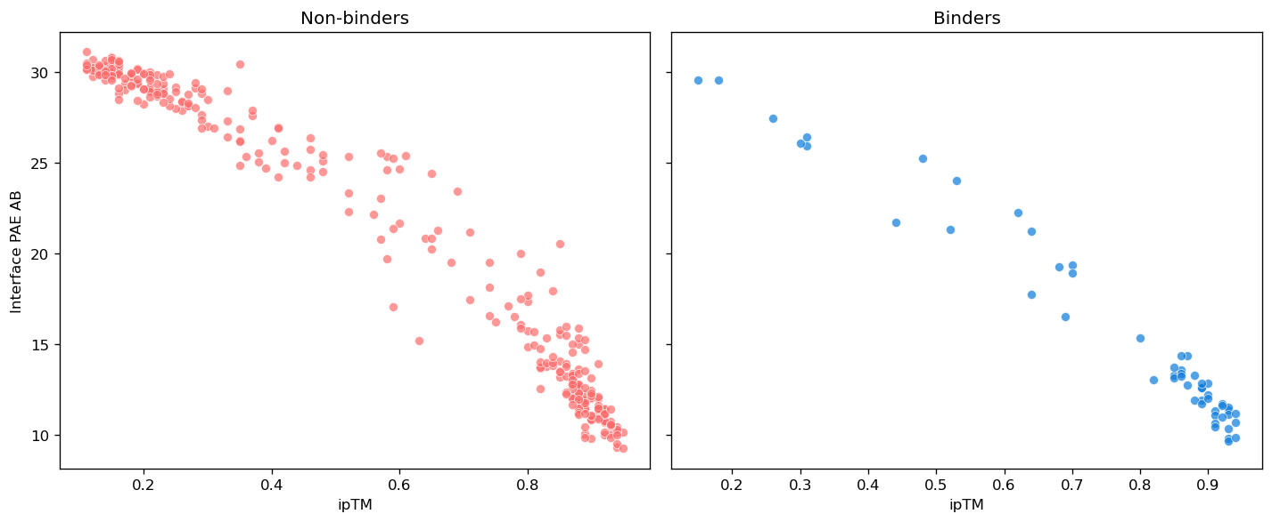
What I started with in terms of metrics: AF3 as the reference
Notes:
This should also be done after categorising into nanobodies and proteins.

Slide 16
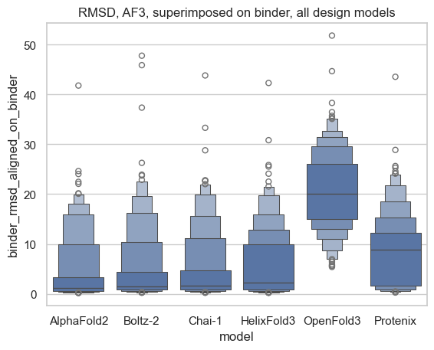
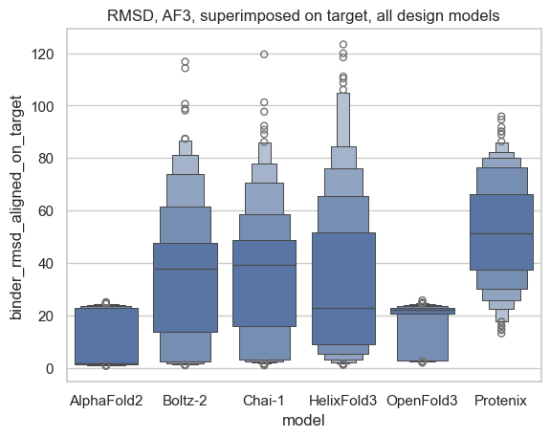
Next step: RMSD results with AF3 as reference model
Notes:
RMSD of the binder when aligned on the binder: The overall fold of the binder
RMSD of the binder when aligned on the target: Orientation of the binder with respect to the target
In general to see how agreeable the models are in regards to the overall fold of the binder and the orientation of the binder in respect to target.

Slide 17
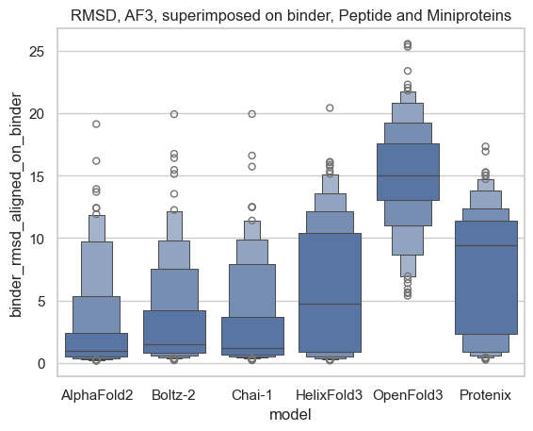
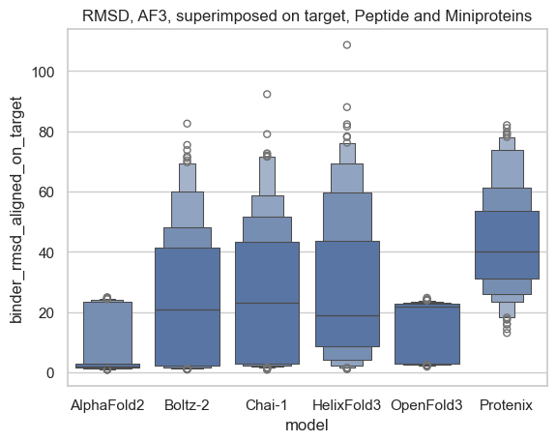
RMSD results with AF3 as reference model
Notes:
Biggest difference is seen on the overall fold of the binder, which also was to be expected as we know these models can have a hard time with antibodies.

Slide 18
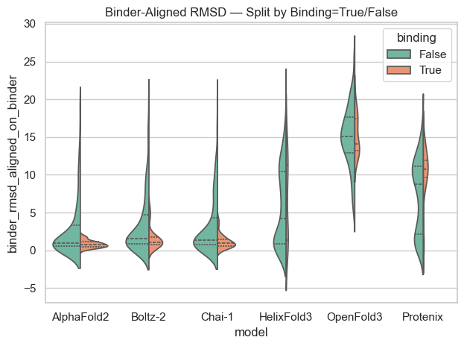
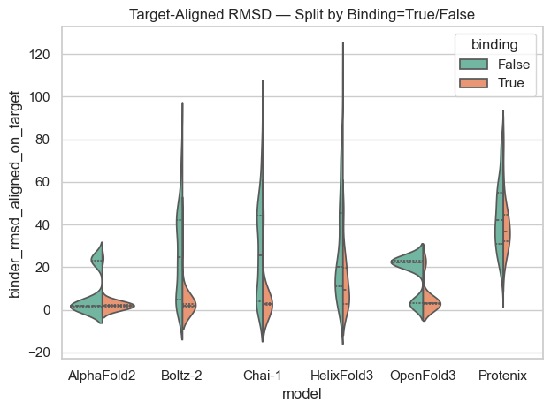
RMSD results with AF3 as reference model (only mini proteins and peptides)
Notes:
RMSD of the binder when aligned on the binder: The overall fold of the binder
RMSD of the binder when aligned on the target: Orientation of the binder with respect to the target
In general to see how agreeable the models are in regards to the overall fold of the binder and the orientation of the binder in respect to target but this time also divided into experimentally validated binders and non binders.
Spread is way larger for non binders at least for AF2, Boltz and chai.

Slide 19
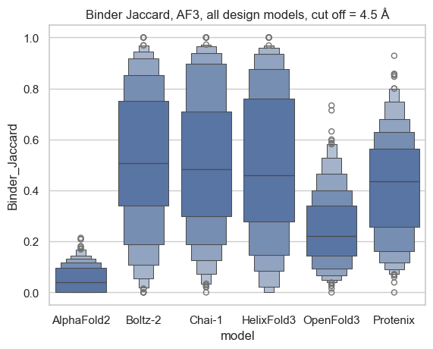
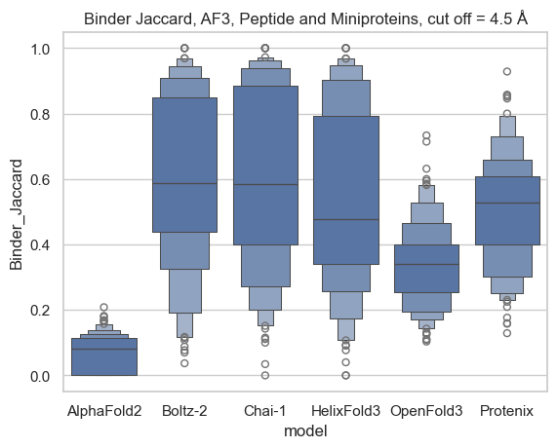
Jaccard results (mean) with AF3 as reference model
Notes:
Binder Jaccard: Measures agreement between AF3 and model X on which binder residues are binding.
Thinking back to interpretation, the higher the mean value, the more general agreement there is between the models on the residues which are in contact.

Slide 20
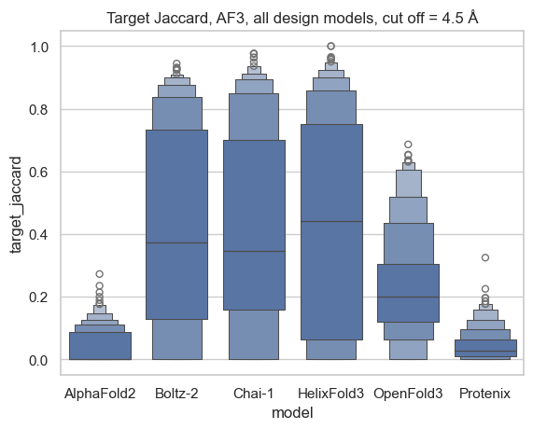
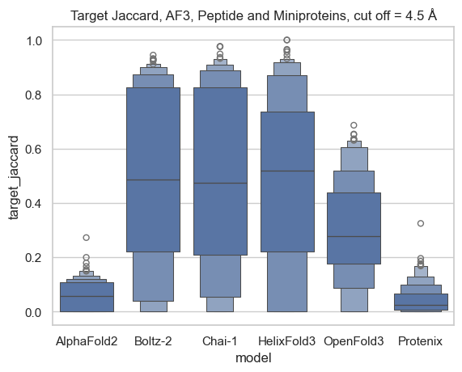
Jaccard results (mean) with AF3 as reference model
Notes:
Target Jaccard: Measure agreement between AF3 and model X on which target residues are binding.
Thinking back to interpretation, the higher the mean value, the more general agreement there is between the models on the residues which are in contact.

Slide 21
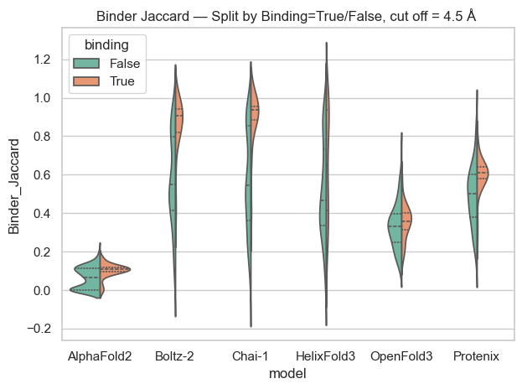
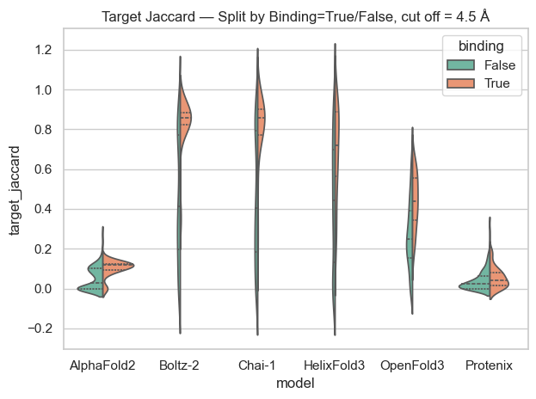
Jaccard results (mean) with AF3 as reference model
Notes:
Binder Jaccard: Measures agreement between AF3 and model X on which binder residues are binding.
Target Jaccard: Measure agreement between AF3 and model X on which target residues are binding.
Thinking back to interpretation, the higher the mean value, the more general agreement there is between the models on the residues which are in contact.

