Slide 1
Catch up talk with Albert
Elliott Taguchi Dickinson
January 8th, 2026

Slide 2
Agenda
How far I’ve come, and whether it’s on time
What the next step is
What else should my project contain (Building the AI filter). Also, What’s expected from me for the rest of the project
Will I have time for more?
Am I on, behind or ahead of schedule?
Project description

Slide 3
How far I’ve come
Ran AF3, Boltz-2, (Almost OpenFold) and Protenix
Chai-1 ready to be sent to the cluster / another GPU (Memory issues)
HelixFold3 almost ready, just need a way to solve precomputed MSA issue
For each model except OpenFold (and maybe HelixFold3), I’ve used the same MSA calculation done by AF3 for the target.
Done that to receive consistency and lower computational cost (only had to do one run of calculating MSA).
Only OpenFold showing issues with using the precomp MSA (and maybe HelixFold3)
Notes:
I want to use the same MSA for OF as well so I don’t want to run a monomer run.

Slide 4
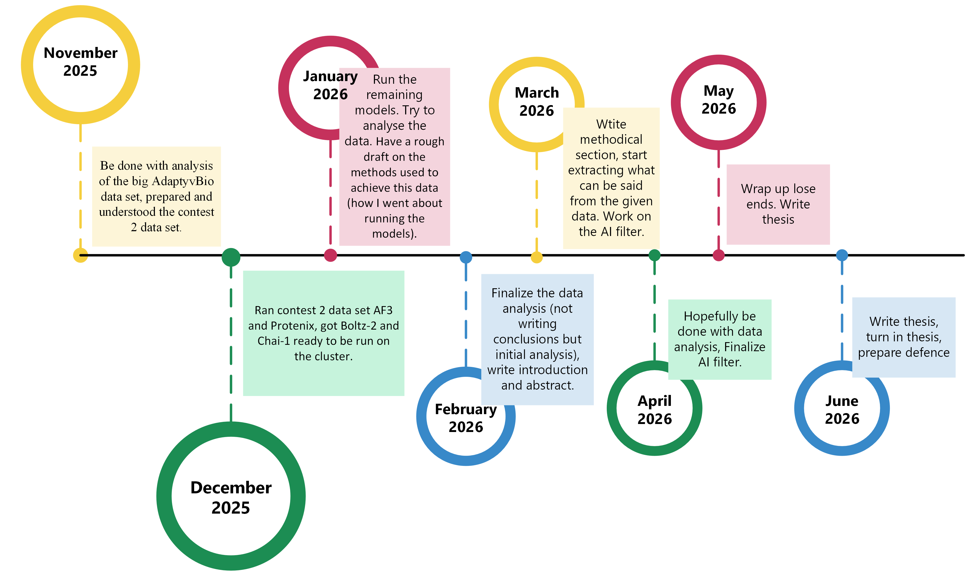
How far I’ve come
Notes:
Adjust timeplan: Feb-April focus on data analysis and at the same time try to start already in feb with writing my introduction. Describe background, what is known, what I look at and what is the challenges. What do I want to figure out with all this work.

Slide 5
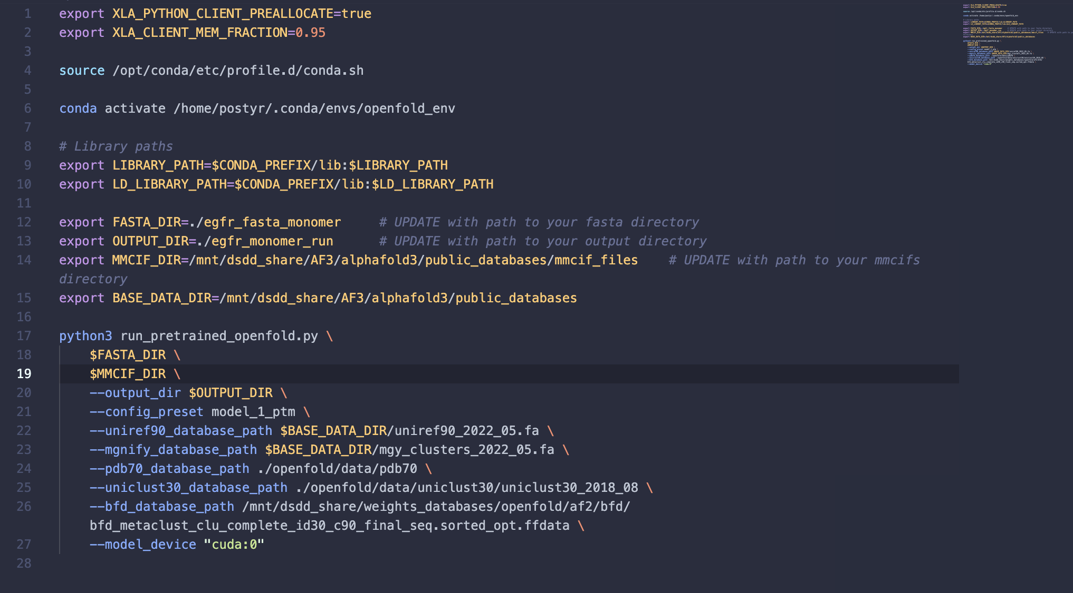
OpenFold

Slide 6
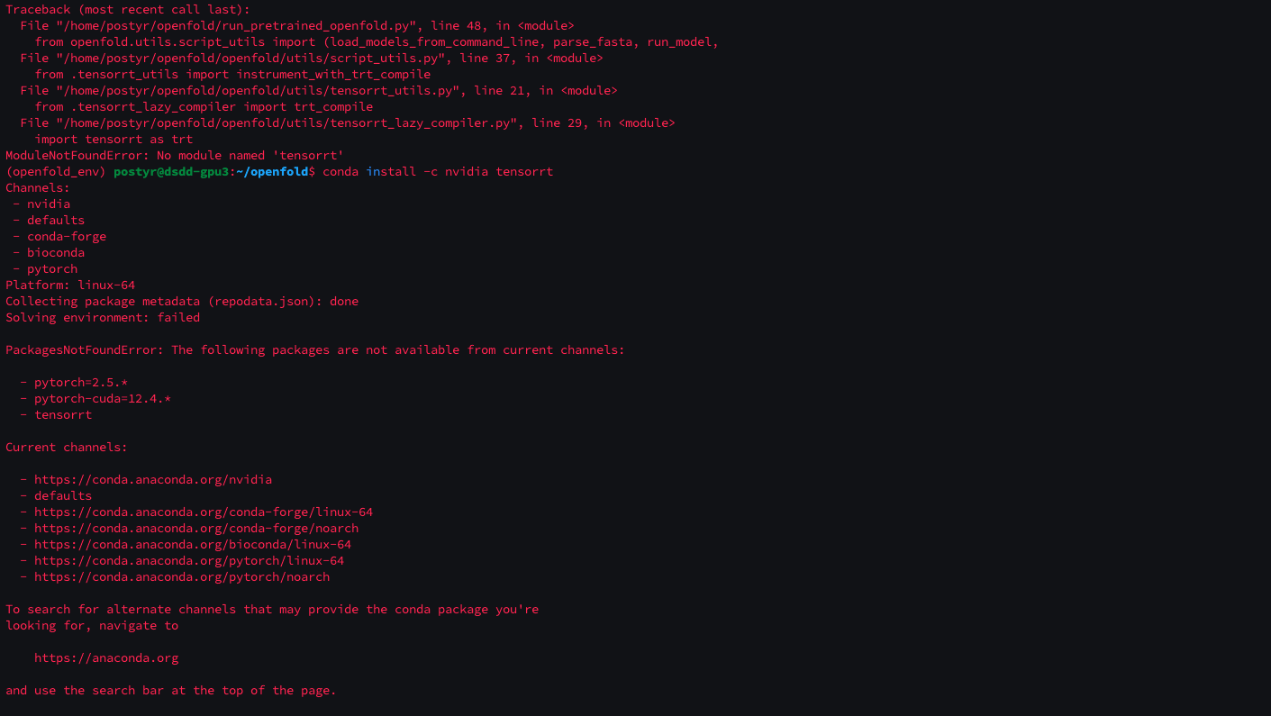
OpenFold

Slide 7
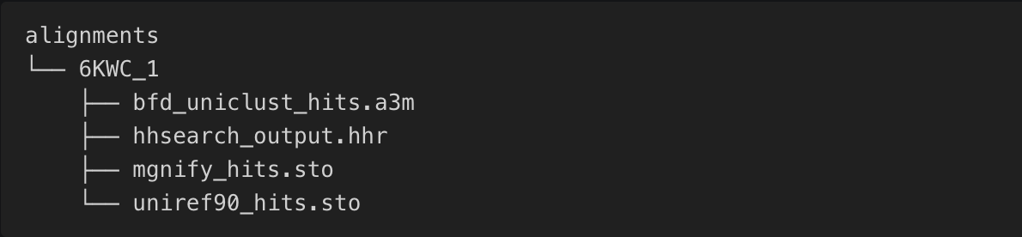
OpenFold
Want to do one monomer run on the target (EGFR) to get the necessary alignment files.
This means that it’s not the same as for the other 4 models (excluding HF3, didn’t run it yet).
Just need to explain this in my thesis. This of course lowers the consistency but might also add
A valuable comparison, since if there’s a huge difference between the signals from OpenFold and the other models, it might be because of the MSA calculation – but we will see.
Also for binders we try to ”trick it”, by just giving the sequence in an .a3m file format. Also did this with Protenix This is still under way.

Slide 8
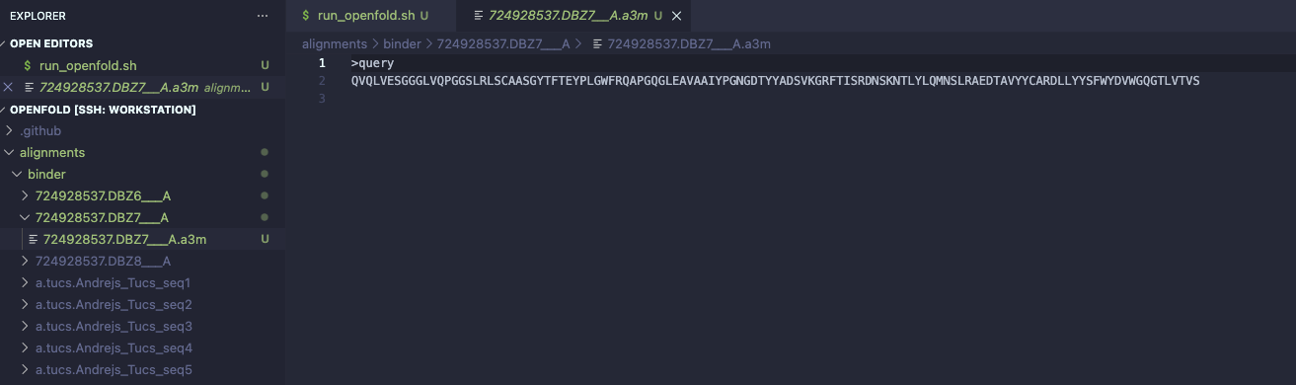
OpenFold

Slide 9
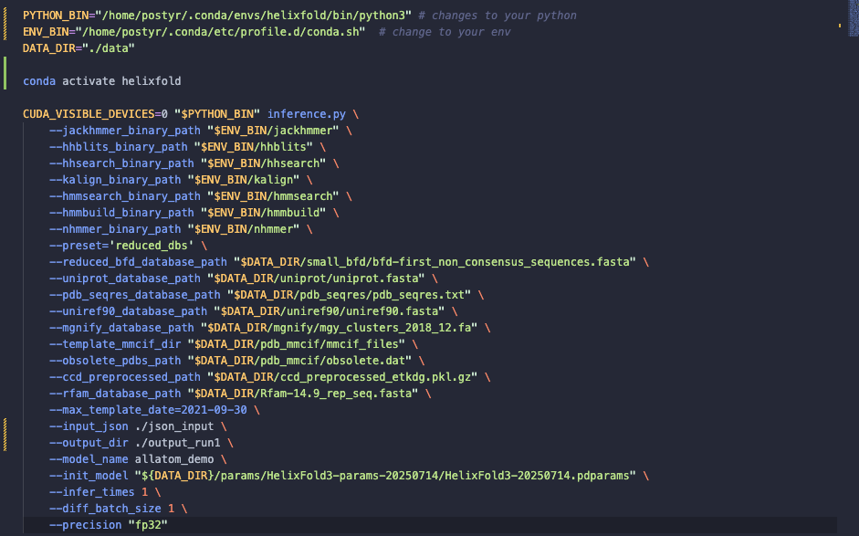
HelixFold3

Slide 10
HelixFold3
How do I use the already precomputed MSA file from AF3 that I also used for every other model? (the .a3m file, which can be converted to the desired file format). Current challenge.
Decide what to do.

Slide 11
What’s next?
Need to do something with all the output I received.
What to do? Not sure yet, but will try to analyse and look for signals / correlations.
Need to compare the scores from the 6 models with AdaptyvBio results.
→ Then use that somehow to build the AI filter?

Slide 12
What else should my project contain? What is expected?
Building the AI filter seems like the end goal for this project, and it makes sense that I start doing that farely soon (March the latest).
Should the project contain anything else that I forgot or overlooked? Is this an acceptable amount of work / data put into the thesis and the 52,5 ECTS points.
Is there expected more from me? Or does it all sound plausible and realistic.
Am I on schedule or perhaps a bit behind?
Notes:
Focus on the alignment between the methods, focus solely on the data analysis part of the outputs of the models. Don’t focus on AI filter but solely on the models and the outputs and what I can gather from them. Compare them. Maybe also run OF3 and AF2.
First focus on getting all the data, then do comparisons, meanwhile do the follow up.
Also install AF2 and OF3.
I need to do customisation for AF2, HF3, OF2 in terms of MSA, since I want to use the same MSA calculation for each model (the AF3 generated MSA). The AF MSA’s are a bit more extensive than the other models (they use ColabFold), also top of the line model (AF3 is). OF3, boltz, chai and protenix uses Mmseqs servers (colab fold). AF3 is a slightly simplified compared to AF2.
First step is to extract all scores. (native scores from the models). How well does the metrics correlate. And how does the models correlate between each other in terms of end results (binders/non binders). RMSD fx.
Also super position AF3 conformation on top of Boltz-2 conformation – do they align in the space? Are the folds close to each other? Which residues are interacting? What do the scores represent? How are they calculated? What do they mean?
Post scoring, scores that you calculate afterwards based on the models you got (LIIS, energy-based scores RF).
Consensus scoring. DockM8 paper to read about it.
Are the models complimentary.

Slide 13
My project description
A quick look at a new project description that I made, and if it’s good and precise enough.

Slide 14
Questions & comments?

