Slide 1
November presentation
Elliott Taguchi Dickinson
Master student

Slide 2
New project description – hallucination of de novo proteins.
Now I’m focusing on the hallucination of de novo proteins, and more specifically the in silico validation scores used for scoring the results, that the various design methods generate.
We want to make an AI filter that tells us if the generated protein is a hit (a binder).
One of my jobs is to gather, download and organize the training data on which the AI model will be trained on.
Goal: To program a new AI model that will make the scoring / filter part of hallucinating de novo proteins better, less costly and more precise
Notes:
These in silico validation scores, like pLDDT, IPAE, and RosettaEnergy, have historically not been very good nor accurate, and we need to find a better way of validating the results that these design models make.
These scoring functions (also called filters) are what tells us if the proteins generated are good binders and if they are possible hits.
We want to make an AI model that does the job of the filters, a so called AI filter. We give this AI filter an input (sequences, structures, pocket properties etc. - also what will be our weights) and train it so that it can determine whether the generated protein is a binder (a hit) or not a hit.
One of my jobs is to gather, download and organize the training data on which the AI model will be trained on. This is done by gathering all the raw data we have from different papers and experiments, on the hallucination of de novo proteins.

Slide 3
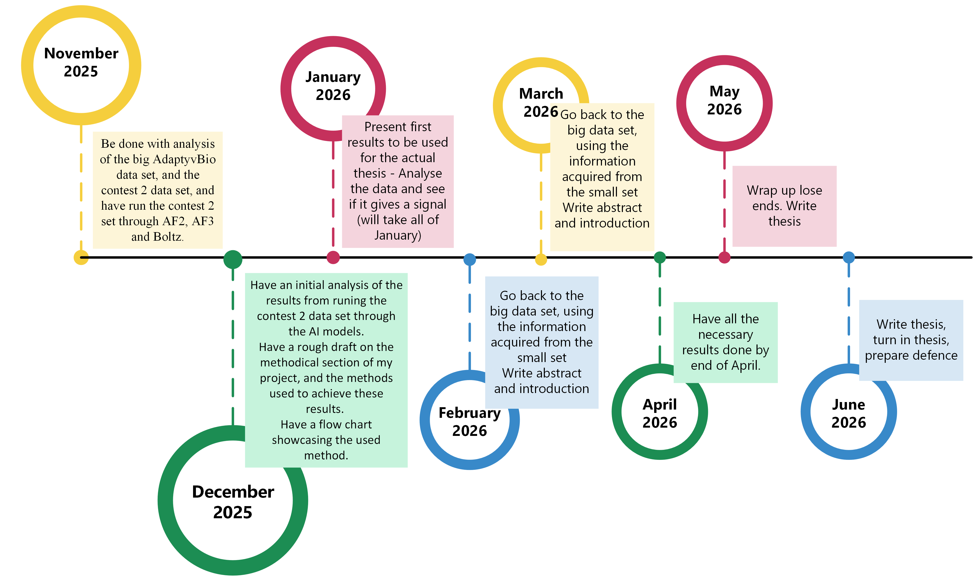
Current project outline
Notes:
For the methods and theoretical section of the thesis I need to narrow it down on what I need to focus on.
I will at least focus on the design methods and then I’ll find out how deep into AI architecture I’ll go later.
Check up on all the rules about handing in.

Slide 4
Current project outline
Notes:
For the methods and theoretical section of the thesis I need to narrow it down on what I need to focus on.
I will at least focus on the design methods and then I’ll find out how deep into AI architecture I’ll go later.
Check up on all the rules about handing in.

Slide 5
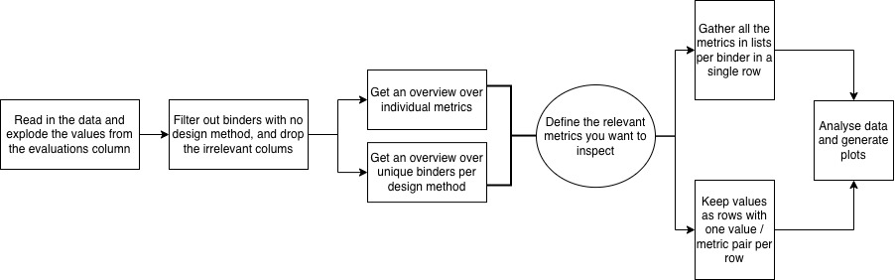
How I went about the initial filtering and analysis of the AdaptyvBio data set
Flowchart over the filtering and plotting of the AdaptyvBio proteinbase set.
Notes:
Metrics = in silico validation scores that we look at.

Slide 6
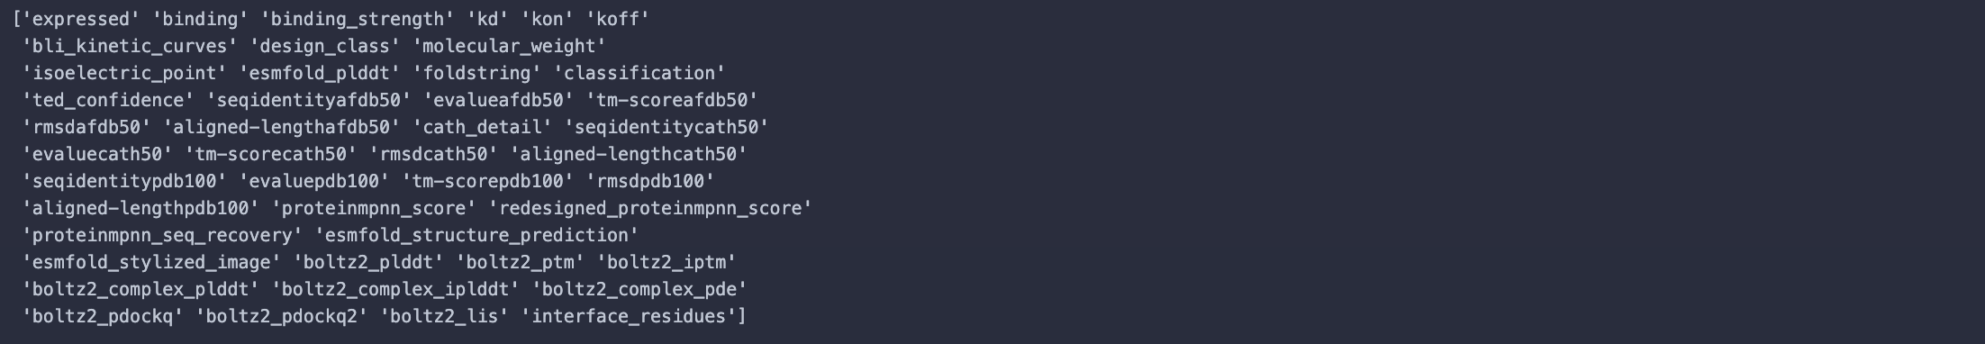
How I went about the initial filtering and analysis of the AdaptyvBio data set
What metrics did I focus on?

Slide 7
How I went about the initial filtering and analysis of the AdaptyvBio data set
Flowchart over the filtering and plotting of the AdaptyvBio proteinbase set.

Slide 8
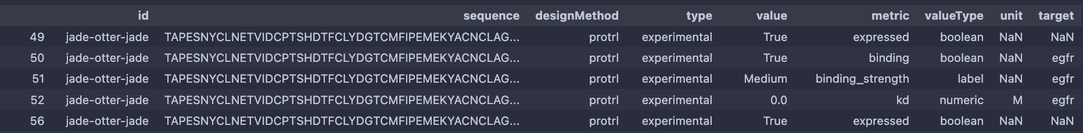
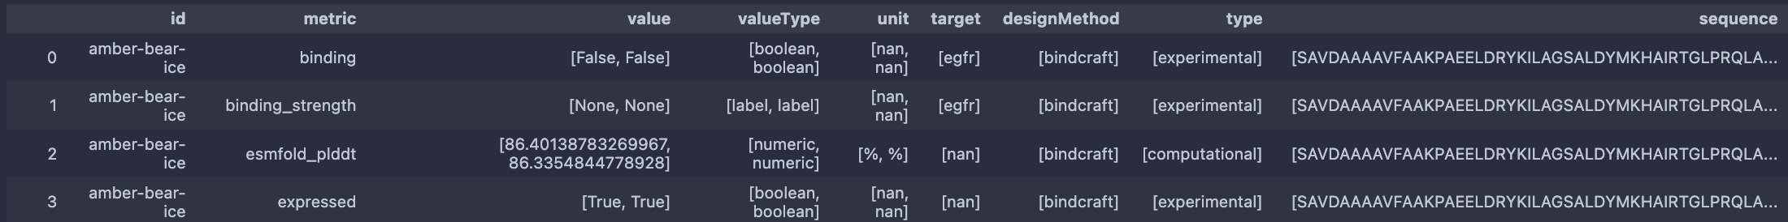
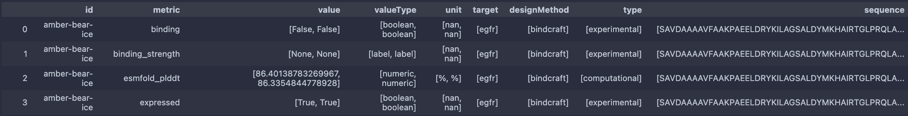
How I went about the initial filtering and analysis (Code cleaning)

Slide 9
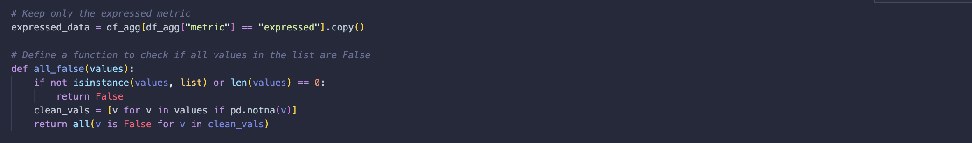
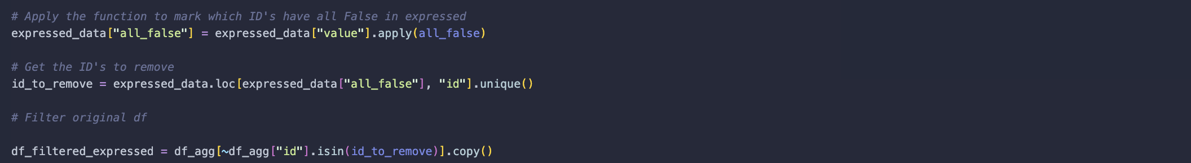
How I went about the initial filtering and analysis (Code cleaning)
Next, excluding non expressed binders:

Slide 10
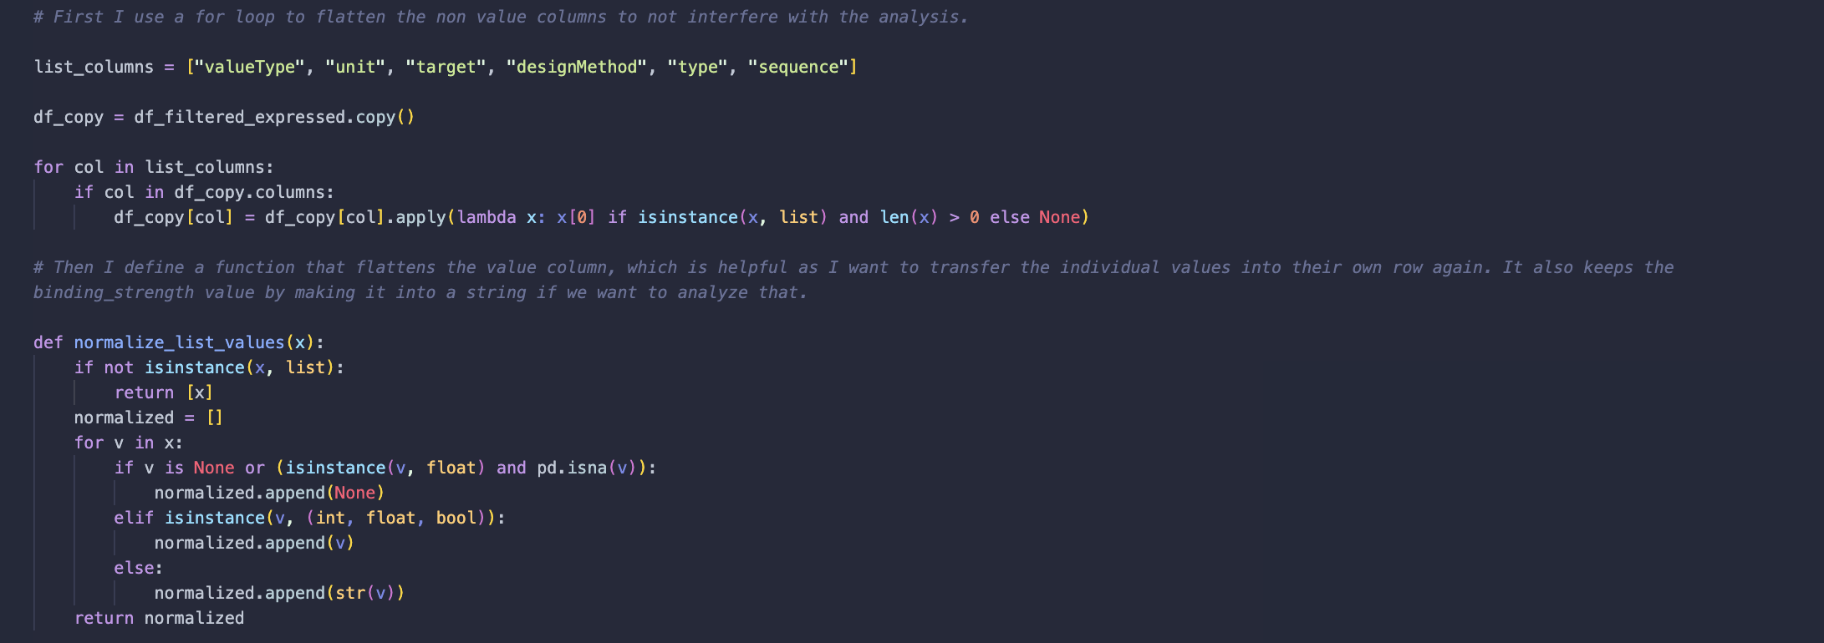
How I went about the initial filtering and analysis (Code cleaning)
After, I then do more coding to turn my dataframe values back into objects on individual rows so seaborn and matplotlib can work with it.
Reversing but with target filled out and non expressed binders excluded.
Is this just unnecesary?
Turning it into lists to then fill out target column and to exclude non expressed binders and then back.
Is it worth to spend time to completely skip the “list step” and make it even cleaner?

Slide 11
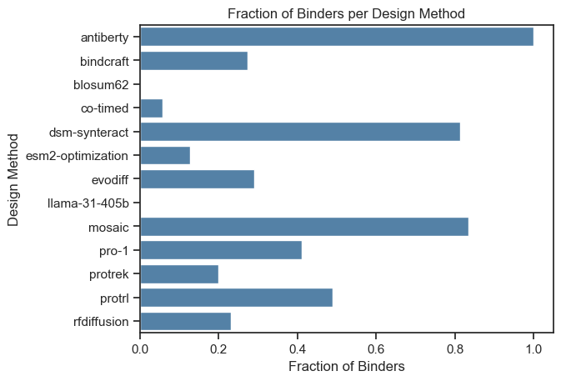
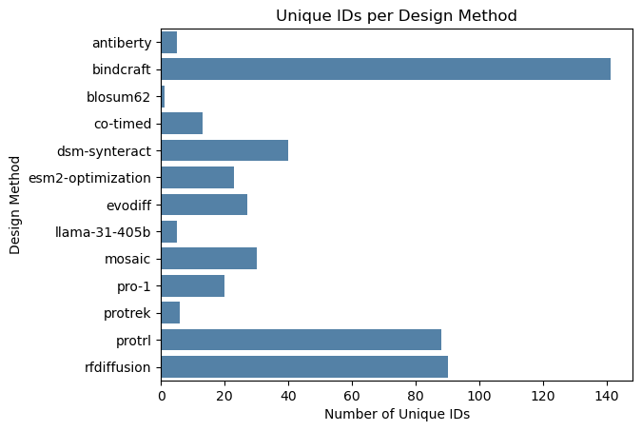
Data that lays out the ground understanding of the dataset
Note: I also have the raw numbers of unique ID’s per design method
Notes:
Try to drop the duplicate boolean rows.

Slide 12
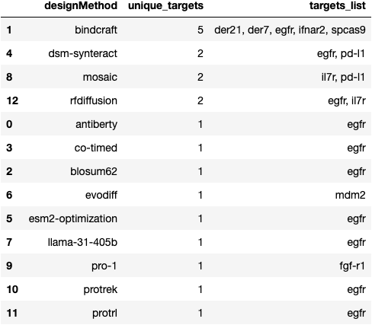
Data that lays out the ground understanding of the dataset
What can I conclude from this information? To be determined..

Slide 13
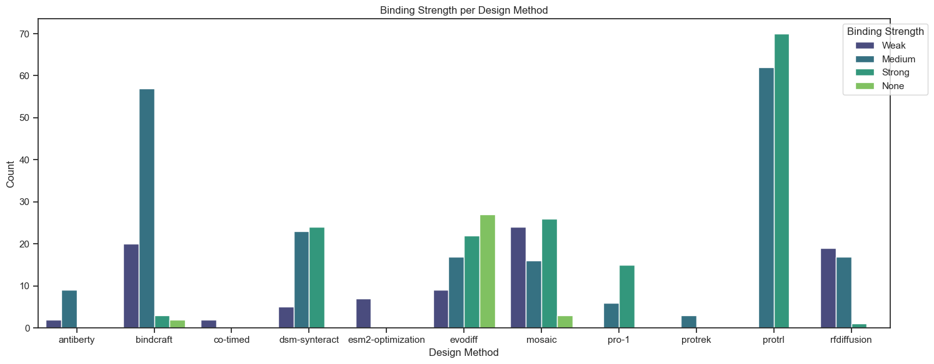
More data to get a bigger picture of what the data set contains
This also shows which design methods have mixed results on whether the generated binder binds (when sorting as being a ”True” binder: bindcraft, evodiff and mosaic (seen as "None" here).
This means that individual binders generated with a specific method has been reported both as a binder and as a non binder by different projects.
Notes:
Put the numeric values and boolean values in different data frames and plot.
Maybe define a threshold for numeric values in order.
How much does a certain score give a percent of binders.

Slide 14
The further analysis
I wanted to make horizontal box plots of the metrics of interest that I chose earlier, in relation to each design method.
Want to see how each design method performs.
Also put in relation to binding fraction.
→ Each design method on the y-axis and one metric on the x-axis.

Slide 15
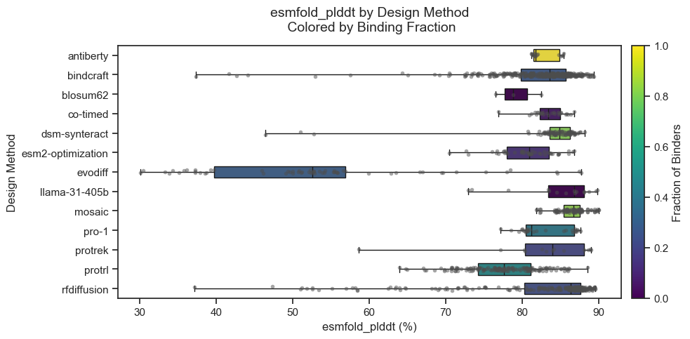
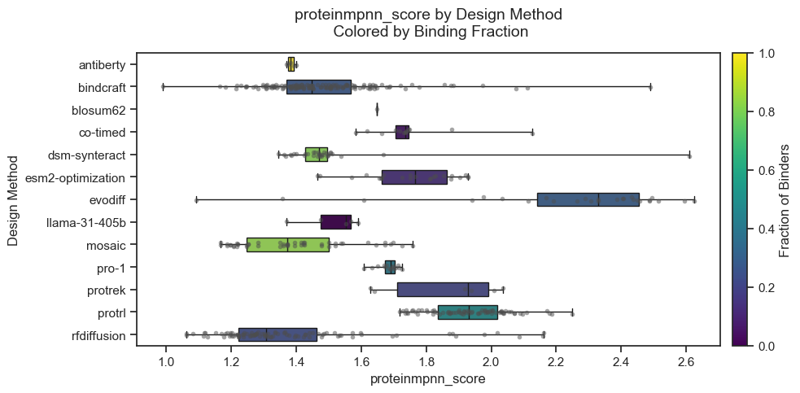
Horizontal box plots showing different metrics per design method (binders & non-binders)

Slide 16
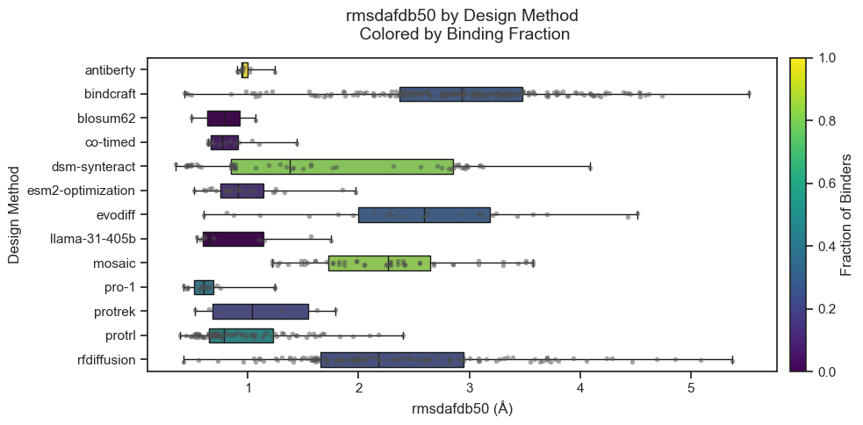
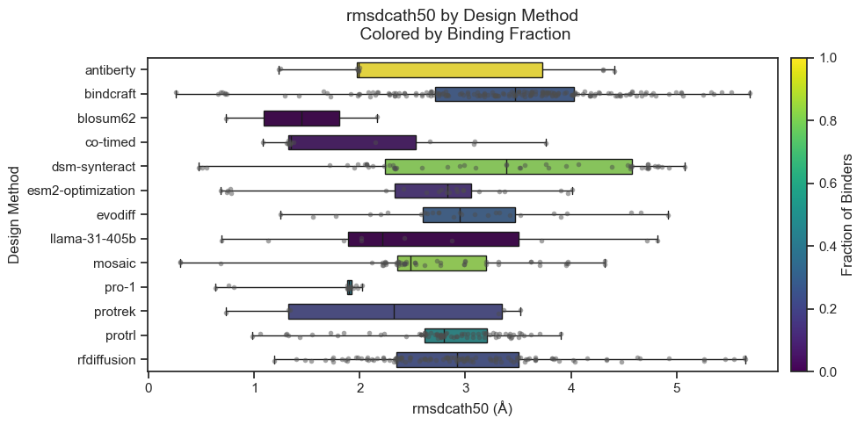
Horizontal box plots showing different metrics per design method (binders & non-binders)

Slide 17
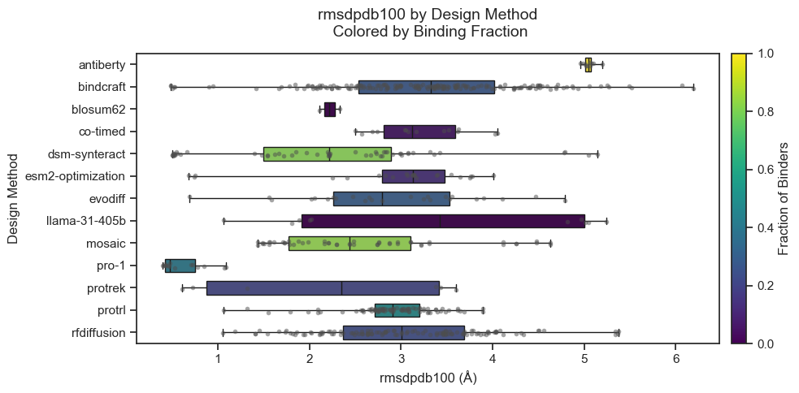
Horizontal box plots showing different metrics per design method (binders & non-binders)

Slide 18
The further analysis pt. 2
Looking at the Pearson correlation coefficient between the metrics, for each individual design method.
→ Melika helped me and made a heat map

Slide 19
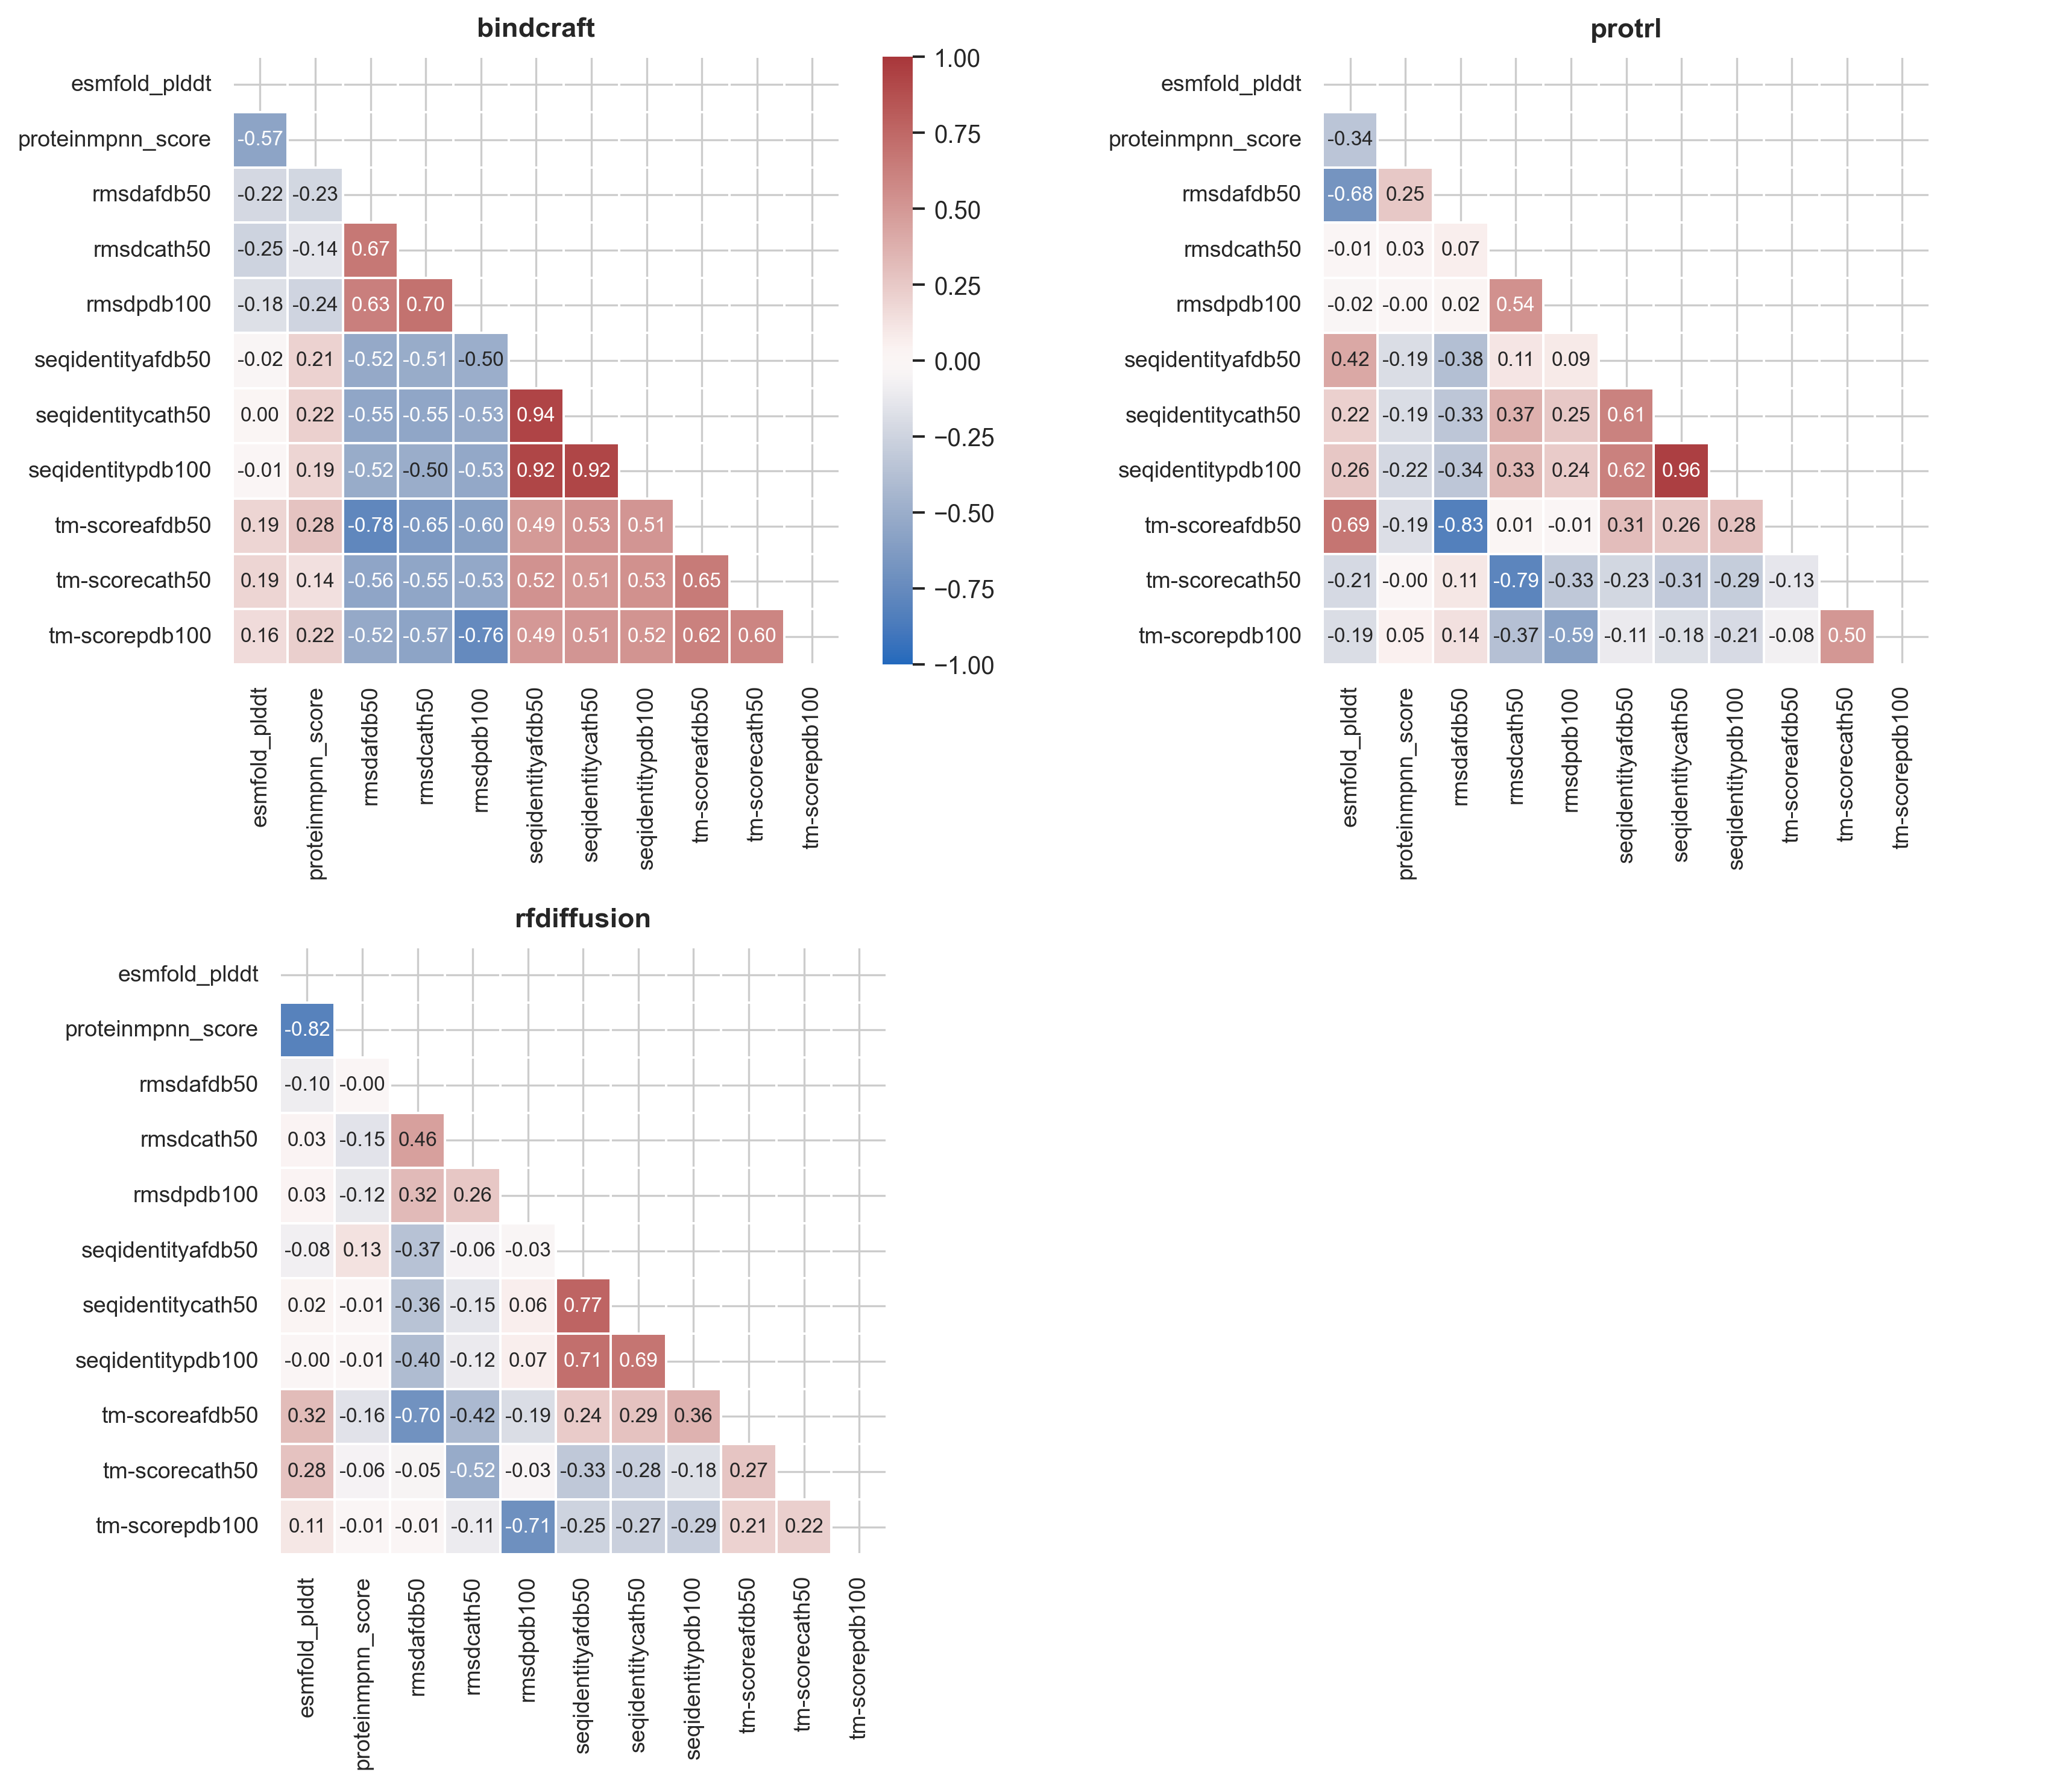
Heatmap of Pearson correlations for 3 methods (binders & non-binders)
Also will be made for binders only!

Slide 20
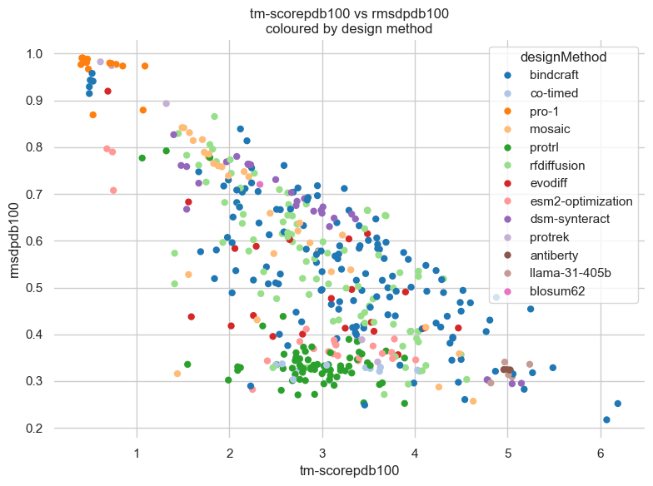
Zooming in on one specific correlation
We then wanted to zoom in on one specific correlation, that showed a response in the heatmap.
Didn’t get to do too much but quickly made one for rmsdpdb100 and tm-scorepdb100
Blue dots are bindcraft (P-coeff = -0.76) and dark green is protrl (P-coeff = -0.59)

Slide 21
Zooming in on one specific correlation
Then one question for my self is: What can I use all these numbers and plots for, in terms of answering my project and my (not yet specified) research questions?
Also to be determined. Hopefully, it can be used train the upcoming AI model being worked on by Melika – or at least take us in the right direction.

Slide 22
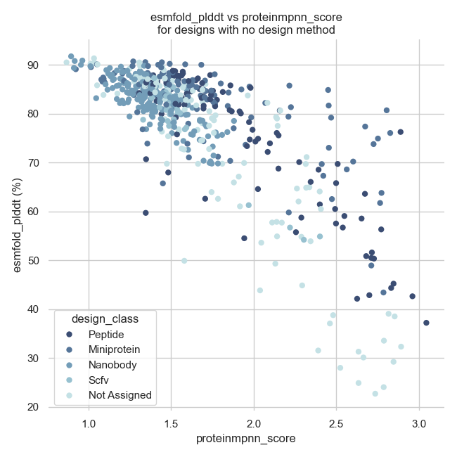
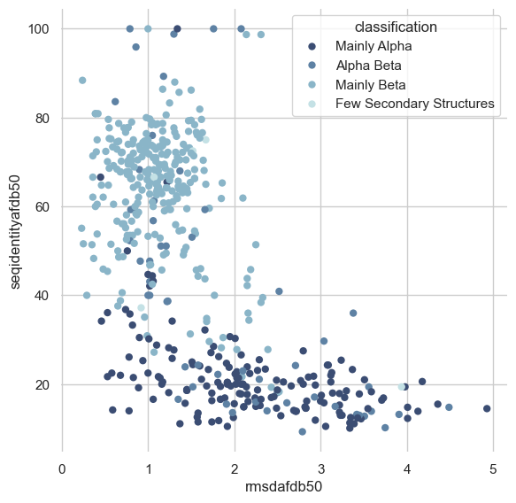
What did the binders without a design method show? Are these binders in any way usable?
Not quite sure. But I have a notebook and a .csv file with them.
Notes:
Change the colour palette to a rainbow colour.

Slide 23
Questions & comments?

