Slide 1
Segmentation with ENet on PYNQ
2023/04

Slide 2
Workflow
Environment Setup
Install Vitis-AI docker
Download a model from model-zoo
Try a model on GPU
Try a model on DPU
Python code mapping GPU -> DPU

Slide 3
1. Environment Setup
PC
Ubuntu 18.04 / 20.04 / 22.04
NVIDIA GPU
Vitis-AI v2.5
Board:
Any PYNQ-capable boards: ZCU104, PYNQ-ZU, KV260, …
PYNQ image v3.0 / v3.0.1

Slide 4
2. Install Vitis-AI docker (1)
Install NVIDIA driver
$ sudo apt install nvidia-driver-520 nvidia-utils-520
2. Install Docker: https://docs.docker.com/engine/install/ubuntu/
Perform Post-Installation: https://docs.docker.com/engine/install/linux-postinstall/
Reboot system
3. Install NVIDIA Docker Runtime
$ curl -s -L https://nvidia.github.io/nvidia-container-runtime/gpgkey | \
sudo apt-key add -
$ distribution=$(. /etc/os-release;echo $ID$VERSION_ID)
$ curl -s -L https://nvidia.github.io/nvidia-container-runtime/$distribution/nvidia-container-runtime.list | \
sudo tee /etc/apt/sources.list.d/nvidia-container-runtime.list
$ sudo apt-get update
$ sudo apt-get install nvidia-container-toolkit nvidia-container-runtime

Slide 5
2. Install Vitis-AI docker (2)
4. On PC, open Terminal and run:
$ cd ~
$ git clone -b 2.5 https://github.com/Xilinx/Vitis-AI
$ cd Vitis-AI/docker
$ ./docker_build_gpu.sh
5. Run Vitis-AI docker
$ cd ~/Vitis-AI
$ ./docker_run.sh xilinx/vitis-ai-gpu:latest

Slide 6
3. Download a model from model-zoo
After opening Vitis-AI GPU docker, run:
Vitis-AI /workspace > cd model_zoo/
Vitis-AI /workspace/model_zoo > python downloader.py
…
tf:tensorflow1.x tf2:tensorflow2.x cf:caffe dk:darknet pt:pytorch all: list all model
input:pt
chose model
…
15 : pt_face-mask-detection_512_512_0.59G_2.5
16 : pt_ENet_cityscapes_512_1024_8.6G_2.5
17 : pt_BCC_shanghaitech_800_1000_268.9G_2.5
…
input num:16
chose model type
0: all
1 : GPU
2 : zcu102 & zcu104 & kv260
…
input num:1
pt_ENet_cityscapes_512_1024_8.6G_2.5.zip
100.0%|100%
done

Slide 7
4. Try a model on GPU
After downloading model, extract and examine it
Vitis-AI /workspace/model_zoo > unzip pt_ENet_cityscapes_512_1024_8.6G_2.5.zip
Vitis-AI /workspace/model_zoo > cd pt_ENet_cityscapes_512_1024_8.6G_2.5
Review README
$ cat readme.md
Activate pytorch environment
$ conda activate vitis-ai-pytorch
Install dependencies
$ pip install --user -r requirements.txt
Dataset
Download leftImg8bit_trainvaltest.zip [11GB] from https://www.cityscapes-dataset.com/downloads.
Put it in data/cityscapes (review in README)
Run Demo
$ bash run_demo.sh # The result will be put in data/demo_results.

Slide 8
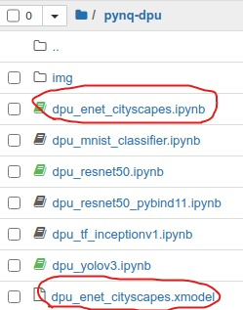
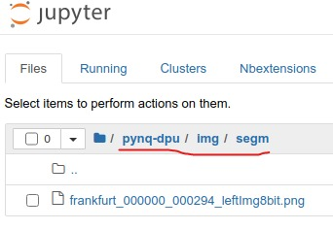
5. Try a model on DPU
https://github.com/haipnh/DPU-PYNQ/blob/enet_cityscapes/pynq_dpu/notebooks/dpu_enet_cityscapes.ipynb
Download pre-trained & quantized model
review 3. Download a model from model-zoo
choose 2 : zcu102 & zcu104 & kv260
Upload xmodel to PYNQ
Extract downloaded file and upload ENet_cityscapes_pt.xmodel to PYNQ board.
(Optional) Rename it to dpu_enet_cityscapes.xmodel.
Upload sample image to PYNQ
Upload example notebook to PYNQ

Slide 9
6. Python code mapping GPU -> DPU (1)
Main of the work was retrieved from
pt_ENet_cityscapes_512_1024_8.6G_2.5/code/test/test.py
Processing Flow:
GPU:
Input: 2048x1024 -> Resize to 1024x512 -> Model -> 1024x512x19 tensor -> max() -> 1024x512 -> convert to uint8 -> interpolate to 2048x1024 output -> putpalette() -> Output: 2048x1024
DPU:
Input: 2048x1024 -> Resize to 1024x512 -> Model -> 1024x512x19 tensor -> max() -> 1024x512 -> convert to uint8 -> interpolate to 2048x1024 output -> putpalette() -> Output: 1024x512

Slide 10
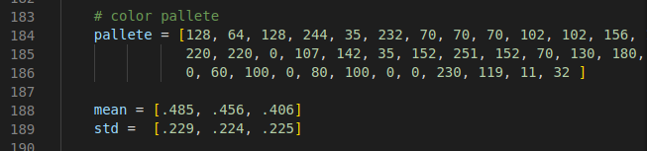
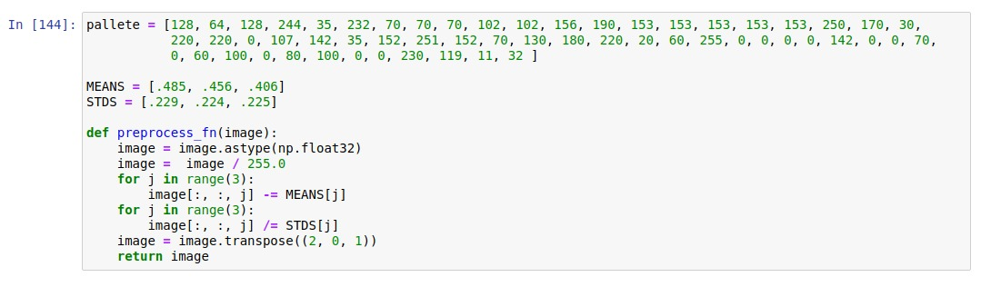
6. Python code mapping GPU -> DPU (2)
Main of the work was retrieved from
pt_ENet_cityscapes_512_1024_8.6G_2.5/code/test/test.py
Pre-process
GPU:
DPU:

Slide 11
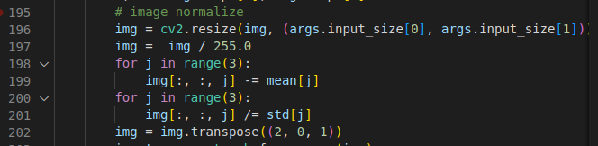
6. Python code mapping GPU -> DPU (3)
Main of the work was retrieved from
pt_ENet_cityscapes_512_1024_8.6G_2.5/code/test/test.py
Pre-process
GPU:
DPU:

Slide 12
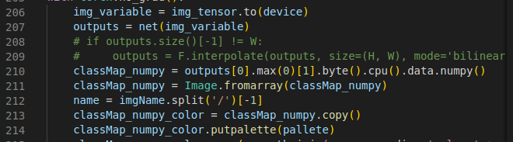
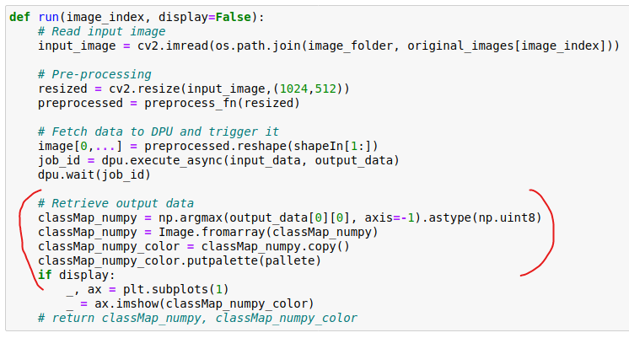
6. Python code mapping GPU -> DPU (4)
Main of the work was retrieved from
pt_ENet_cityscapes_512_1024_8.6G_2.5/code/test/test.py
Post-process
GPU:
DPU:

