Slide 1
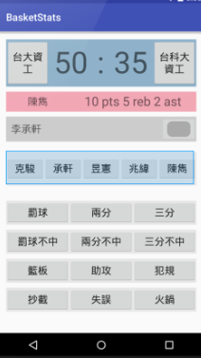
Home page
Choose team
New match
OK
back
Ok/back
Load match
New
Load
back
back
New team
saved
New Match
Player1
Date
OK
Match Box
Player2
New team
Opp.
Choose match
Team
Saved
New
OK
back
back
Ok/back
back
back
ok
back
ok
back
ok
save

