Slide 1
Chicago Crime Analysis per District/Region

Slide 2
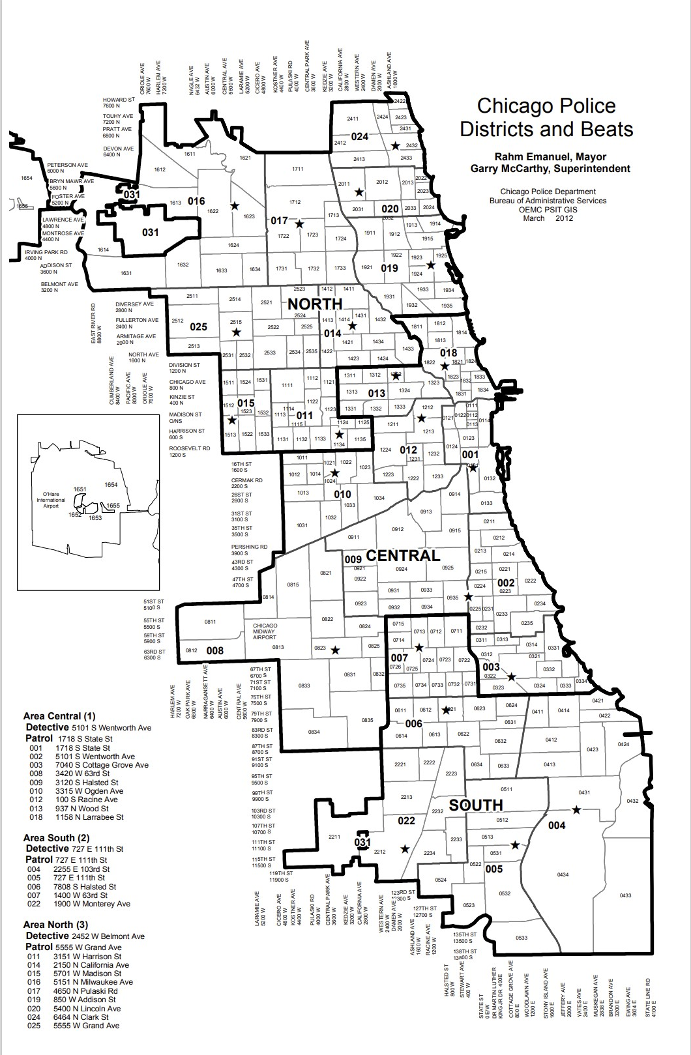
Key Information
Utilized features:
Primary types (crimes)
District (22 district)
Area (Centra, North and South)
Map of Chicago Police Districts and Beats.pdf (wttw.com)

Slide 3
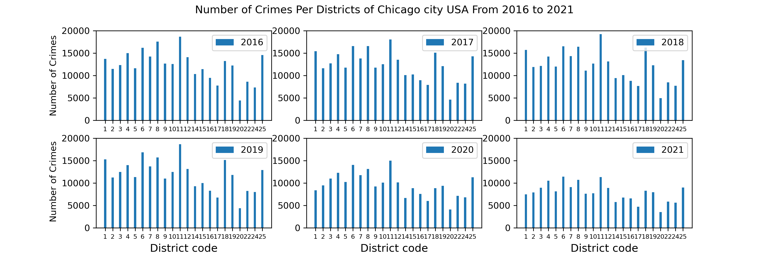
Crimes per District
Through the years 2016, 2017,2018 and 2019, the trend of crimes in most of districts have not faced a big change. Unlikely, the other figures (for years 2020 and 2021) show a noticeable decrease in the level of crimes in all districts, particularly in the areas coded 1, 8, 11 and 18 with the largest-scale of criminal activities that are dropped to about 10000 crimes or less in 2021.

Slide 4
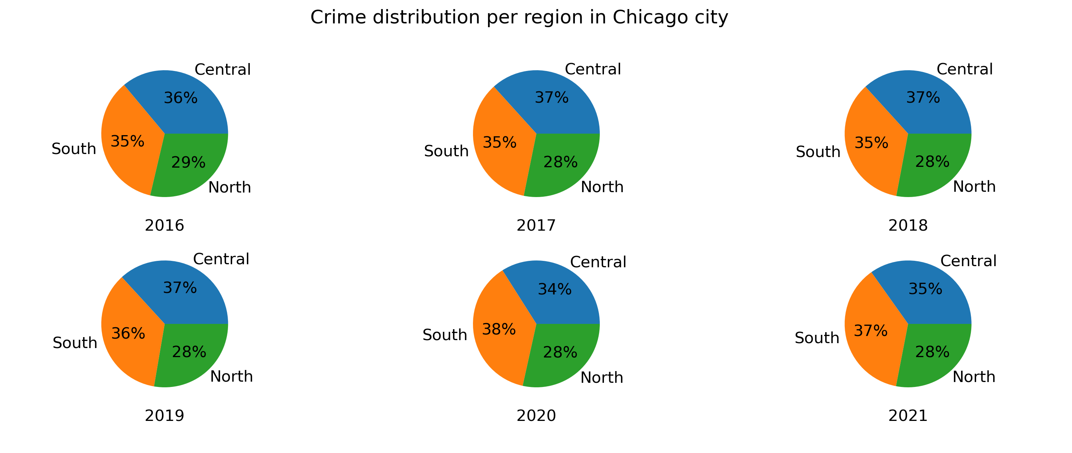
Crimes per Area
There is no change in the crime trend distribution before covid19 pandemic with the central Chicago region with the highest crime. However, The south region of Chicago becomes the highest crime rate during the Covid19.

Slide 5
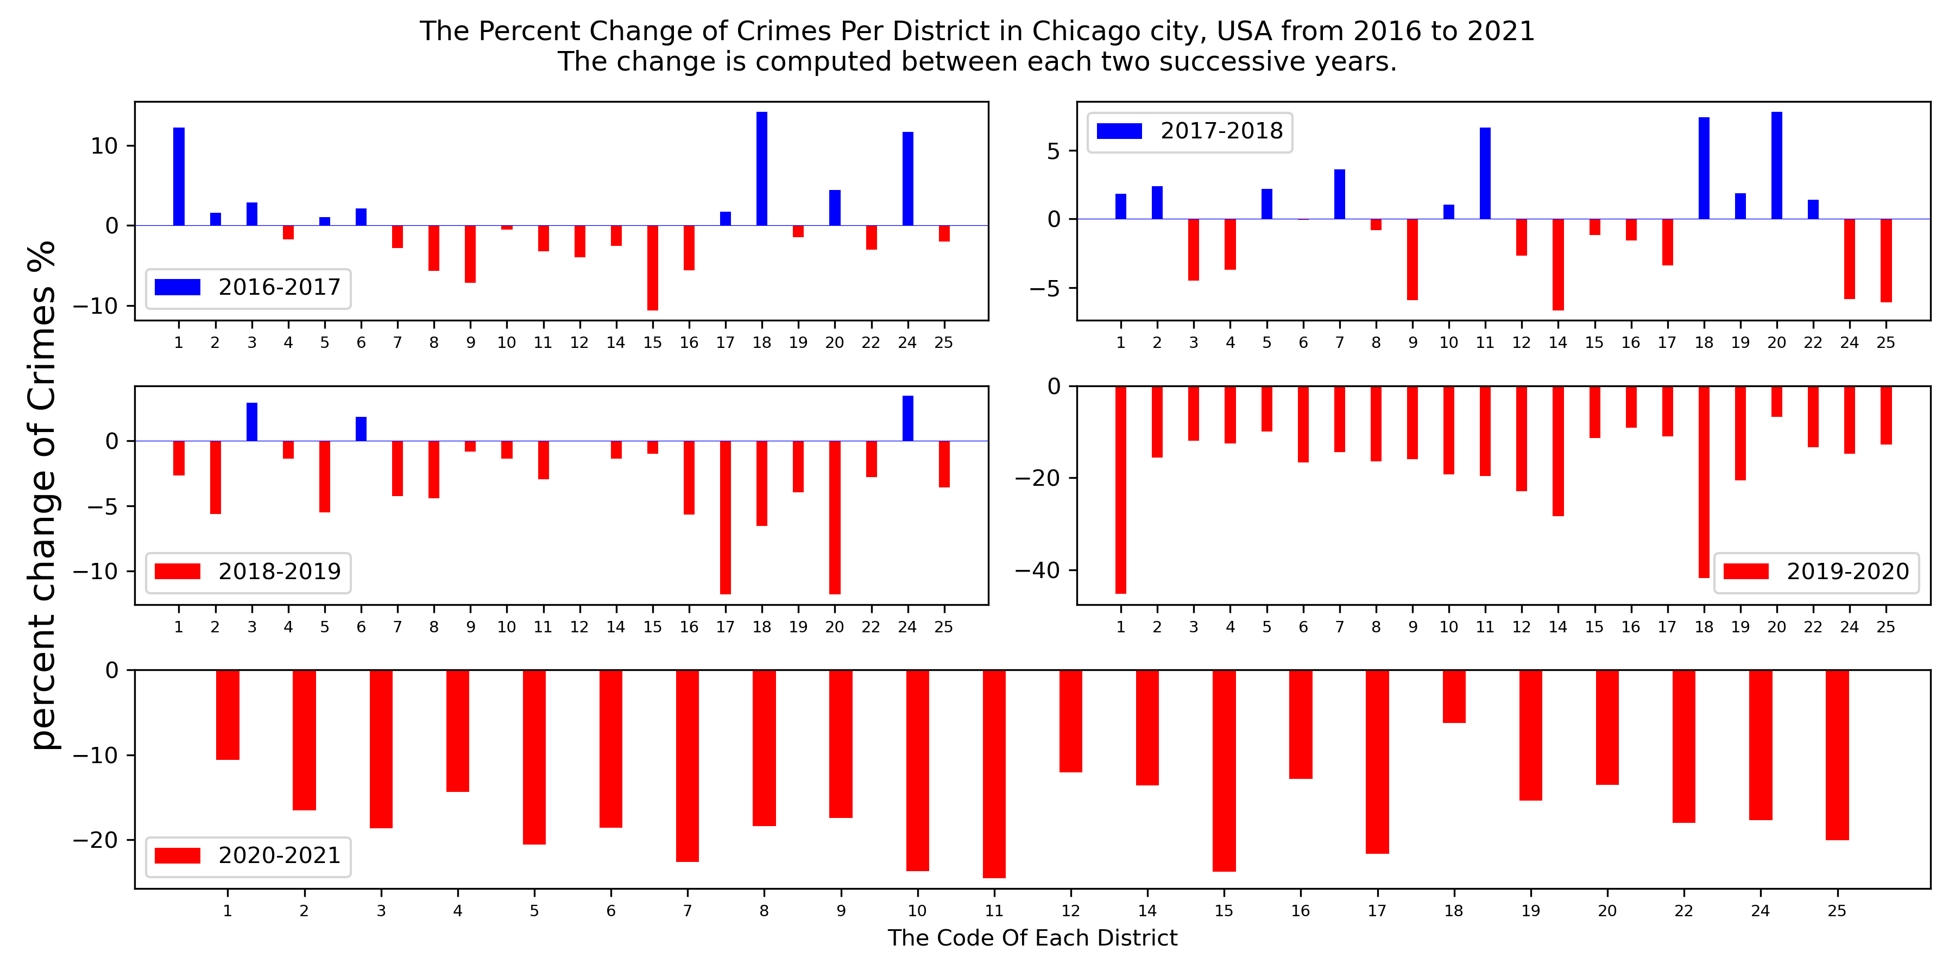

Crime percent change per district
$${Percent Change}^{∗}=\frac{x_{i}−x_{i−1}}{x_{i−1}}∗100$$
The first three figures, which represent the duration almost before Covid19, show a crime percent change range (about 10% to -10%). However, we observe a noticeable decrease in crime percent change during Covid19,which reach down to 40% decrease in 2020.
* https://www.percentage-change-calculator.com/calculate.php

Slide 6
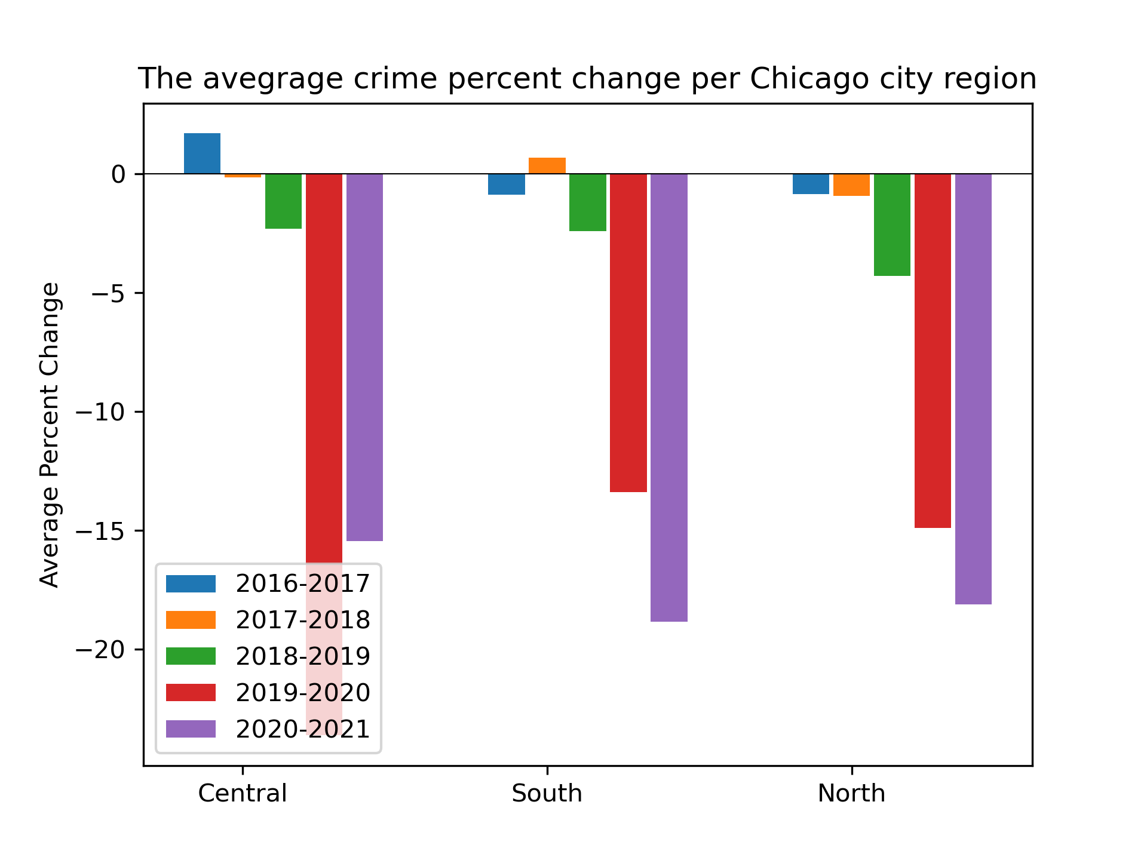
Average percent crime change per region
The crime percent change, computed per regions in Chicago, has massively decreased during the pandemic, particulary for the Central Chicago region for the 2019-2020 (about 25%). For the 2020-2021 period, the South and North regions have the highest crime percent decrease with about 18% each.

Slide 7
Conclusion
From the conducted analytics on Chicago districts, we figure out that the crime activities have been noticeably decreased in the Covid19 pandemic.

