Slide 1

Traffic Accident Prediction with Machine Learning
DSE511 Final Project
EonYeon Jo, Russ Limber, and Sanjeev Singh

Slide 2
Problem Introduction
“Vehicular accidents make up approximately 38,000 deaths in the United States each year and cause about 4.4 million hospitalizations.” (ASIRT, 2021).
Model Accident Severity
Handling a highly skewed dataset

Slide 3
Data Description
The base dataset that we picked carried around 1.5 Million observations. Each record represents an accident in the USA between 2016 and 2020.
We downsampled the data to ~90K samples to make the problem more manageable. To filter, we considered six major US cities: New York City, Los Angeles, Chicago, Houston, Phoenix, and Philadelphia.
Finally, the target variable, Severity, had four levels, one to four.

Slide 4
Features
Event Log (6) | Location (14) | Weather Conditions (14) | Road Infrastructure (13)
Description | Side | Precipitation | Bump
Distance(mi) | Start_Lng | Visibility(mi) | Crossing
Start_Time | Start_Lat | Pressure(in) | Junction
End_Time | City | Humidity(%) | Stop
ID | County | Temperature(F) | Roundabout
 | Timezone | Wind_Chill(F) | Railway
 | ... | ... | ...

Slide 5
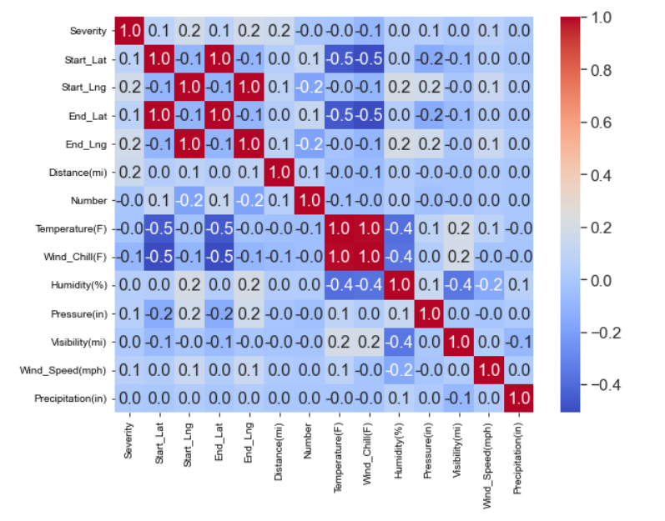
Preprocessing: Imputation
Removed Unnecessary Columns
OLS Interpolation - To impute Wind Chill
KNN Imputation - On Weather Conditions
Simple Imputation - What remained (categorical variables) were imputed using the mode.
Checked for Multicollinearity
Standardized the 12 numeric variables

Slide 6
Preprocessing: Extraction and Encoding
We made the problem a binary classification problem by transforming Severity.
1 & 2 0 and 3 & 4 1
Extracted the following features:
Duration (Using Start_Time and End_Time).
Month, Day of Week, and Hour (Using Start_Time).
Cartesian Coordinates X, Y, Z (Using Start_Lat & Start_Lng).
Encoding:
Performed binary encoding on 14 categorical variables.
Performed one-hot encoding on remaining 8 categorical variables.

Slide 7
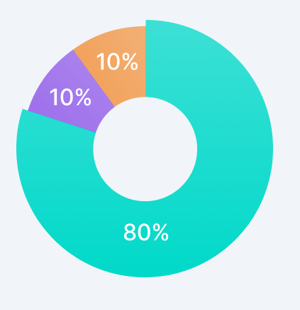
Preprocessing: Split, Standardize, and Reduction
Next, performed a stratified random train (80%)/validation (10%)/test (10%) split based on severity.
Lastly, we performed PCA, preserving 95% of the information.
Finally for model building, we prepared two datasets:
Full data, carrying 141 features.
PCA reduced dataset carrying 47 features.

Slide 8
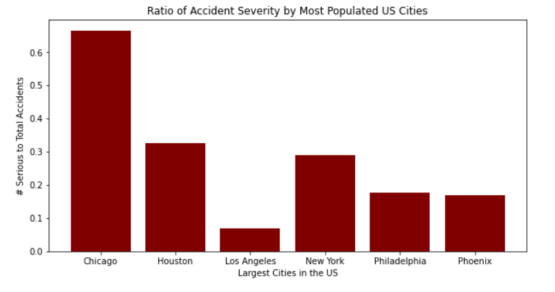
Exploratory Data Analysis (EDA)
Chi Square Test for Homogeneity
P-value almost equal to 0

Slide 9
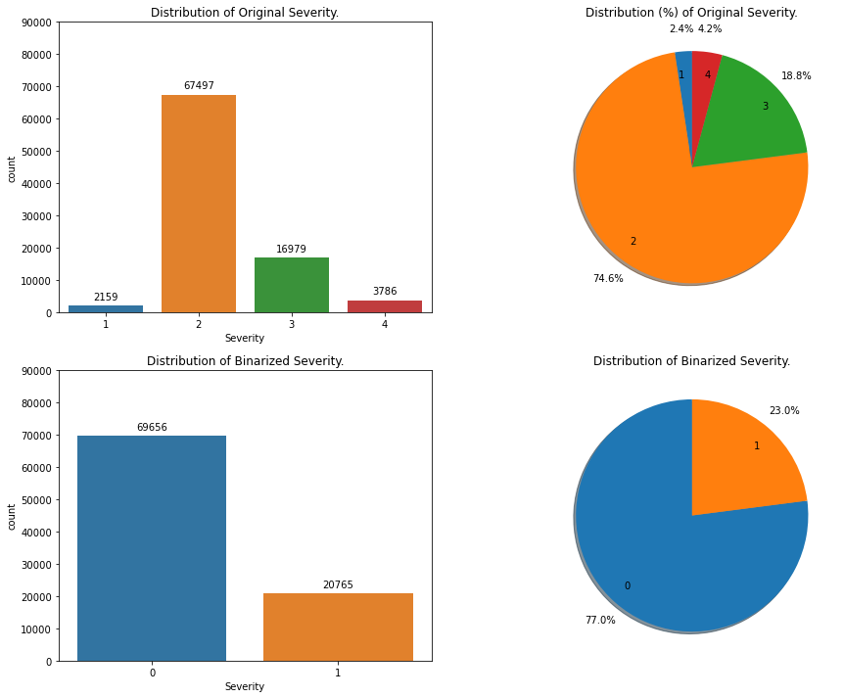
EDA: Accident Distribution by Severity

Slide 10
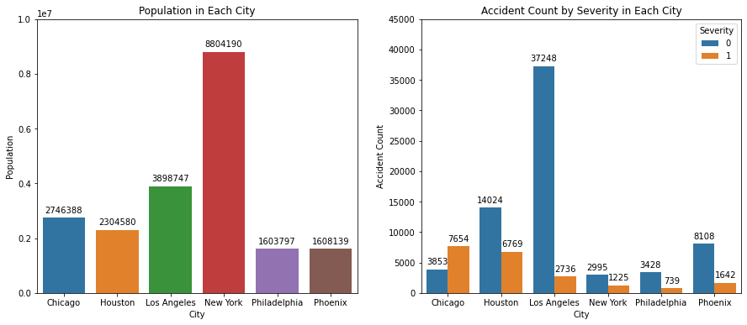
EDA: Accident Distribution by Cities

Slide 11
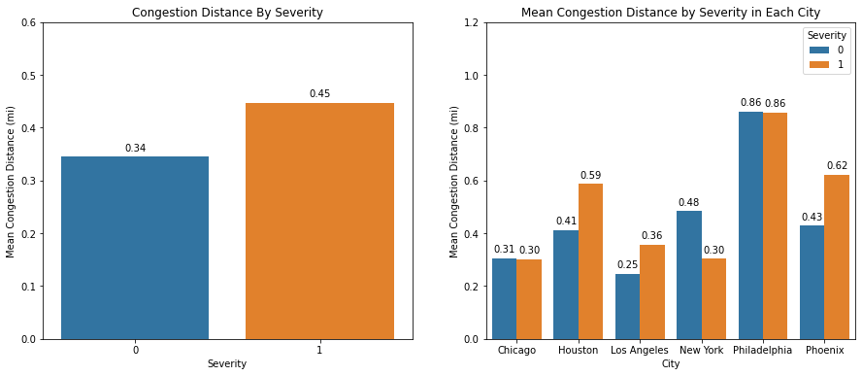
EDA: Traffic Congestion by City & Severity

Slide 12
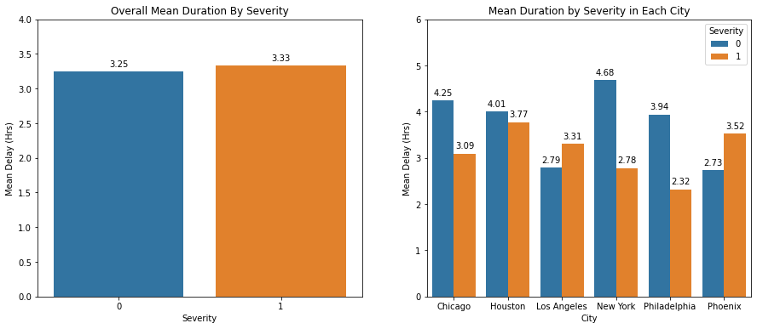
EDA: Delay Duration by Severity & City

Slide 13
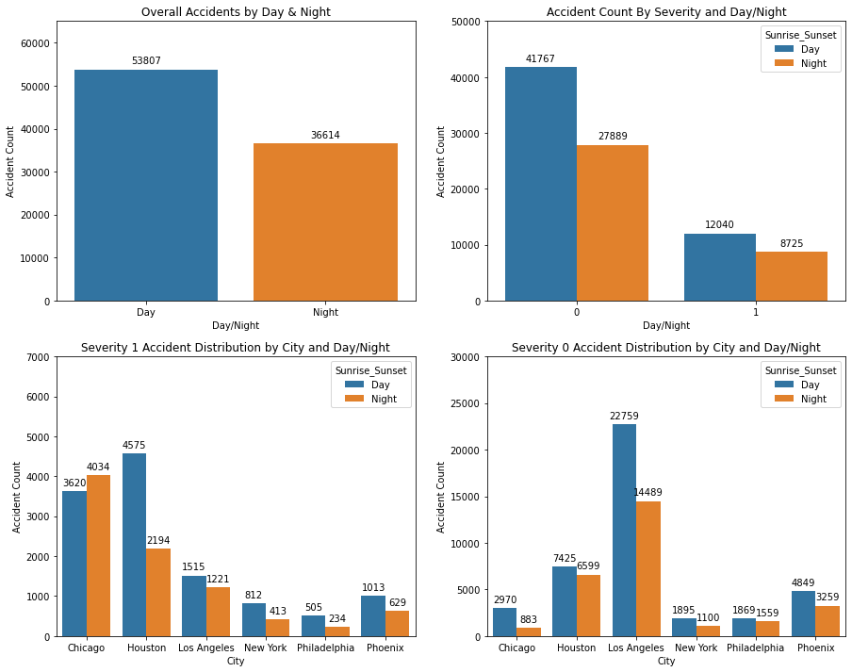
EDA: Accident Distribution by Day/Night

Slide 14
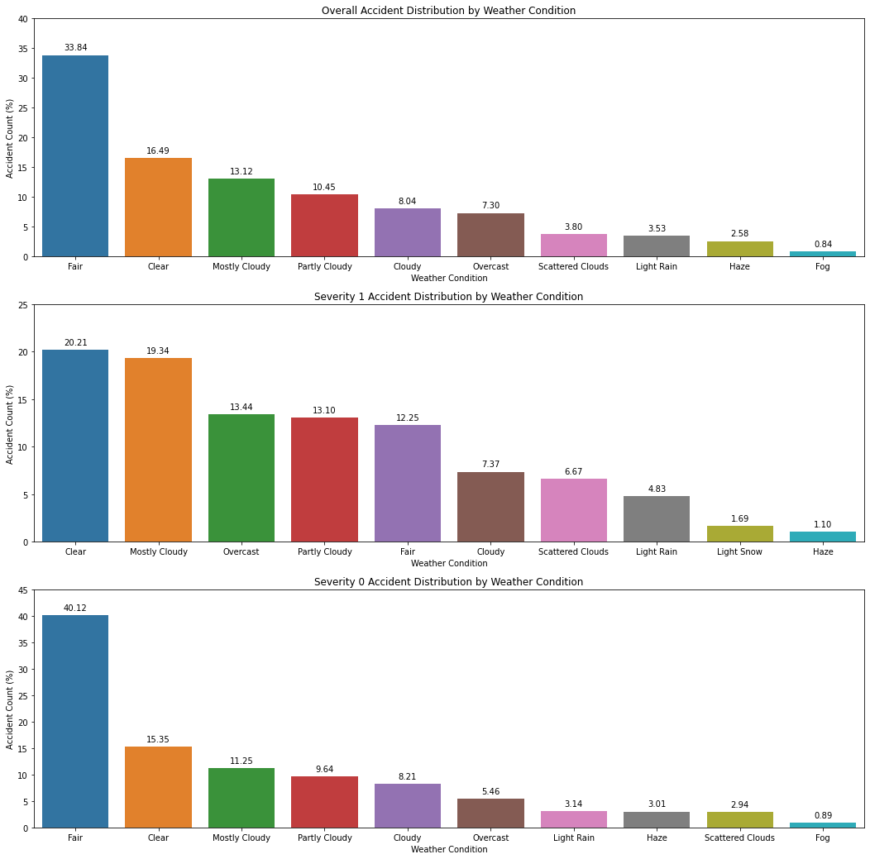
EDA: Accident Distribution by Weather Condition

Slide 15
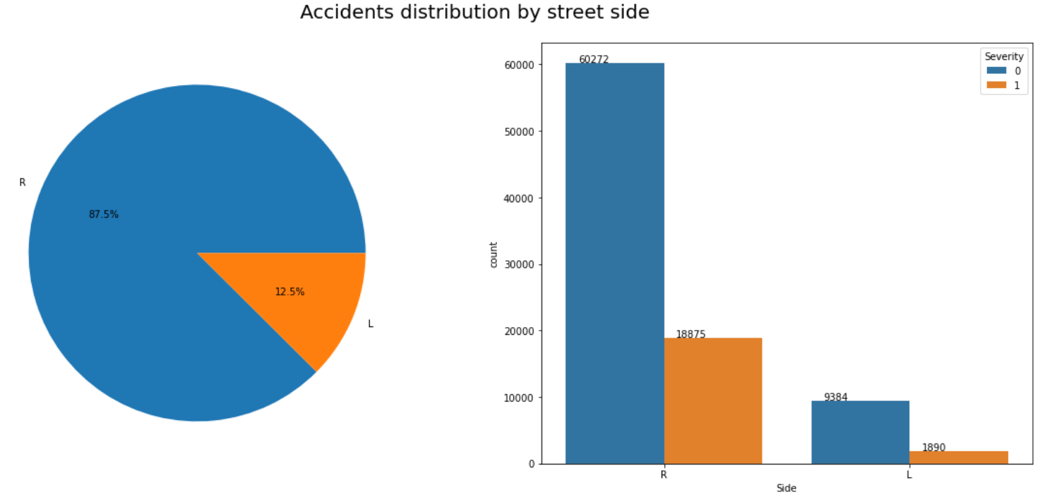
EDA: Accident Distribution by street side

Slide 16
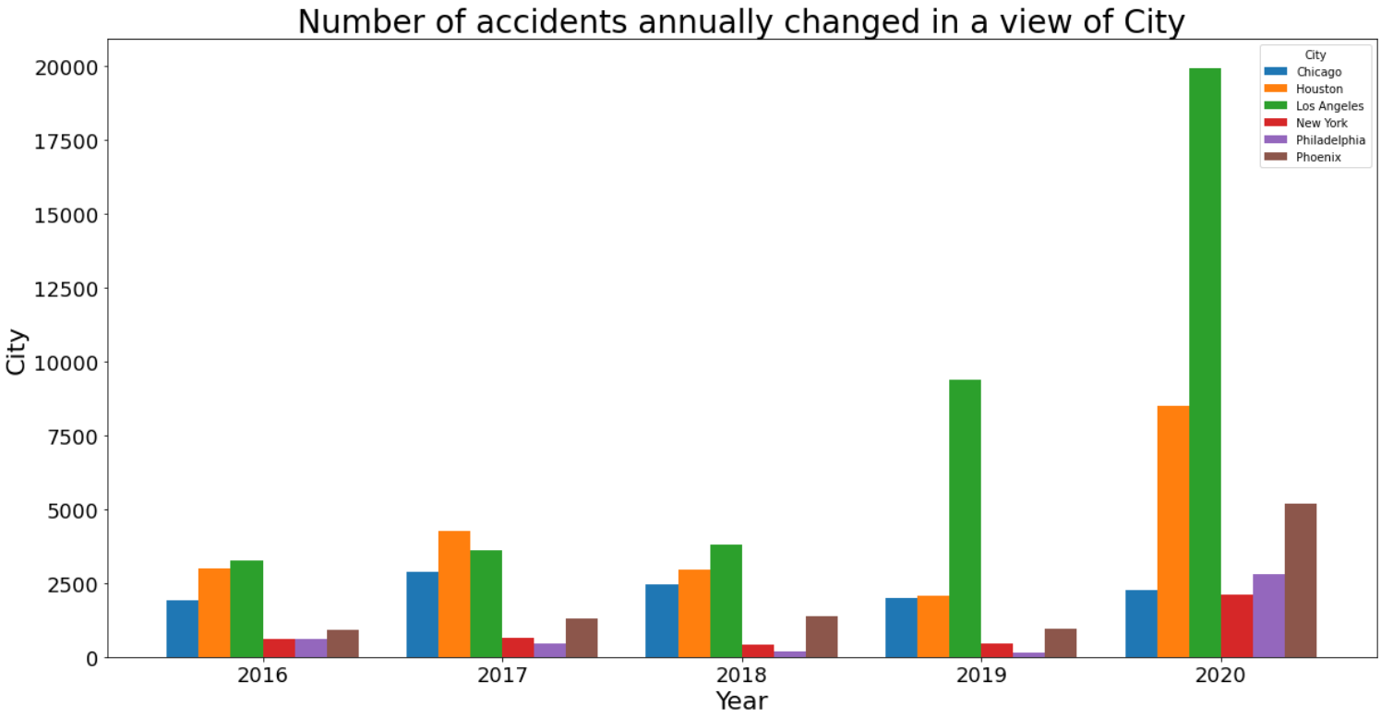
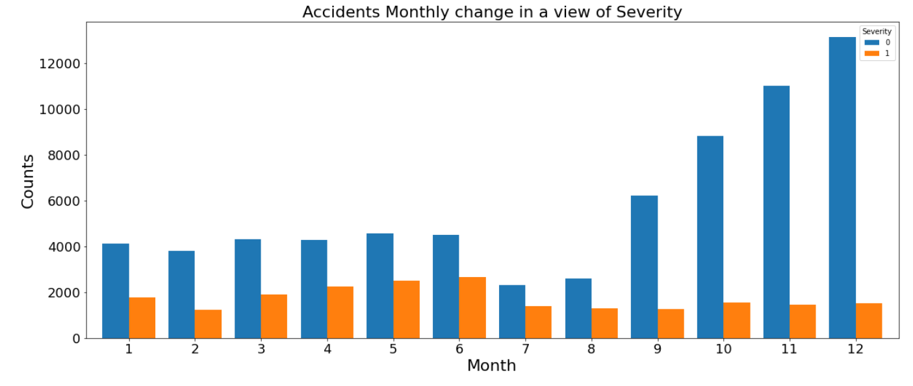
EDA: Accidents Annually & Monthly change

Slide 17
Methods Used
Logistic Regression (Baseline)
Random Forest (Ensemble)
AdaBoost (Ensemble)
XGBoost (Ensemble)
Naive Bayes
Gradient Boosting (Ensemble)
For model building, we used two datasets and compared:
Full data, carrying 141 features.
PCA reduced dataset carrying 47 features.

Slide 18
Hyperparameter Tuning
Optimized all of our models based on Macro F1 Score. To break ties we used overall accuracy.
AdaBoost and XGBoost - used just the initial training/validation split. All other models were trained using cross validation.
RandomGridCV: to create a reasonable number of parameter combinations to Tune against.
Notes:
RandomGridCV: In contrast to GridSearchCV, not all parameter values are tried out, but rather a fixed number of parameter settings is sampled from the specified distributions.

Slide 19
Tuning Parameters
Classifiers | Tuning Parameters
Logistic Regression | warm_start, solver, penalty, multi_class, fit_intercept, dual, and C
Random Forest | n_estimators, min_samples_split, min_samples_leaf, max_features, max_depth, and criterion
Naive Bayes | fit_prior, and alpha
AdaBoost | n_estimators, learning_rate
XGBoost | n_estimators, learning_rate, scale_pos_weight, max_depth, reg_alpha, reg_lambda
Gradient Boosting | n_estimators, learning_rate, max_depth

Slide 20
Tuning Time (PCA)
Classifier | Tune Time (mins) | Combinations | Time / Fit (s)
Naive Bayes* | 3.87 | 16,000 | 0.02*
Logistic Regression | 2.48 | 375 | 0.4
Random Forest | 59.67 | 300 | 11.93
XGBoost | 20.95 | 96 | 13.09
AdaBoost | 138.10 | 28 | 295.94
Gradient Boosting | NA | 10 | 630.44

Slide 21
Tuning Time (Full)
Classifier | Tune Time (mins) | Combinations | Time / Fit (s)
Naive Bayes* | 10.06 | 16,000 | 0.04*
Logistic Regression | 8.35 | 375 | 1.34
XGBoost | 56.28 | 116 | 29.11
Random Forest | 222.10 (3.7 Hr) | 300 | 44.42
AdaBoost | 30.18 | 28 | 64.68
Gradient Boosting | NA | 10 | 128.05

Slide 22
Model Evaluation (PCA)
Classifier | Accuracy | Recall | Specificity | Precision | F1-Score (Macro)
Logistic Regression | 0.81 | 0.36 | 0.94 | 0.65 | 0.67
Random Forest | 0.85* | 0.49 | 0.96* | 0.78* | 0.75
AdaBoost | 0.82 | 0.43 | 0.94 | 0.67 | 0.7
XGBoost | 0.83 | 0.7 | 0.87 | 0.61 | 0.77*
Naive Bayes | 0.74 | 0.73* | 0.75 | 0.46 | 0.69
Gradient Boosting* | 0.85* | 0.56 | 0.94 | 0.74 | 0.77*

Slide 23
Model Evaluation (Full Data)
Classifier | Accuracy | Recall | Specificity | Precision | F1-Score (Macro)
Logistic Regression | 0.82 | 0.41 | 0.94 | 0.67 | 0.7
Random Forest | 0.87 | 0.58 | 0.95* | 0.79* | 0.79
AdaBoost | 0.84 | 0.55 | 0.93 | 0.69 | 0.76
XGBoost* | 0.88* | 0.66 | 0.94 | 0.78 | 0.82*
Naive Bayes | 0.77 | 0.67* | 0.8 | 0.5 | 0.71
Gradient Boosting | 0.87 | 0.66 | 0.94 | 0.76 | 0.81

Slide 24
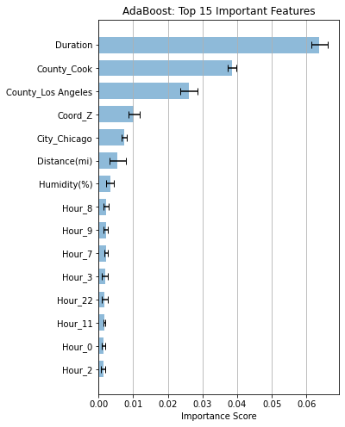
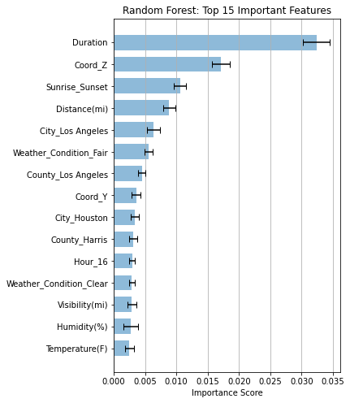
Feature Importance

Slide 25
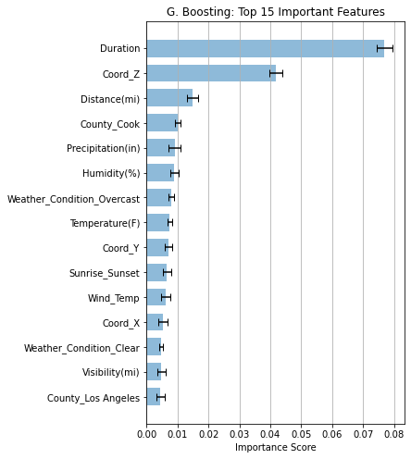
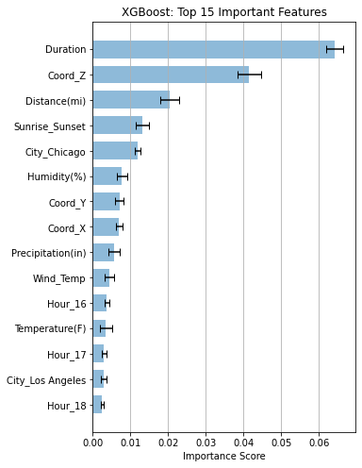
Feature Importance

Slide 26
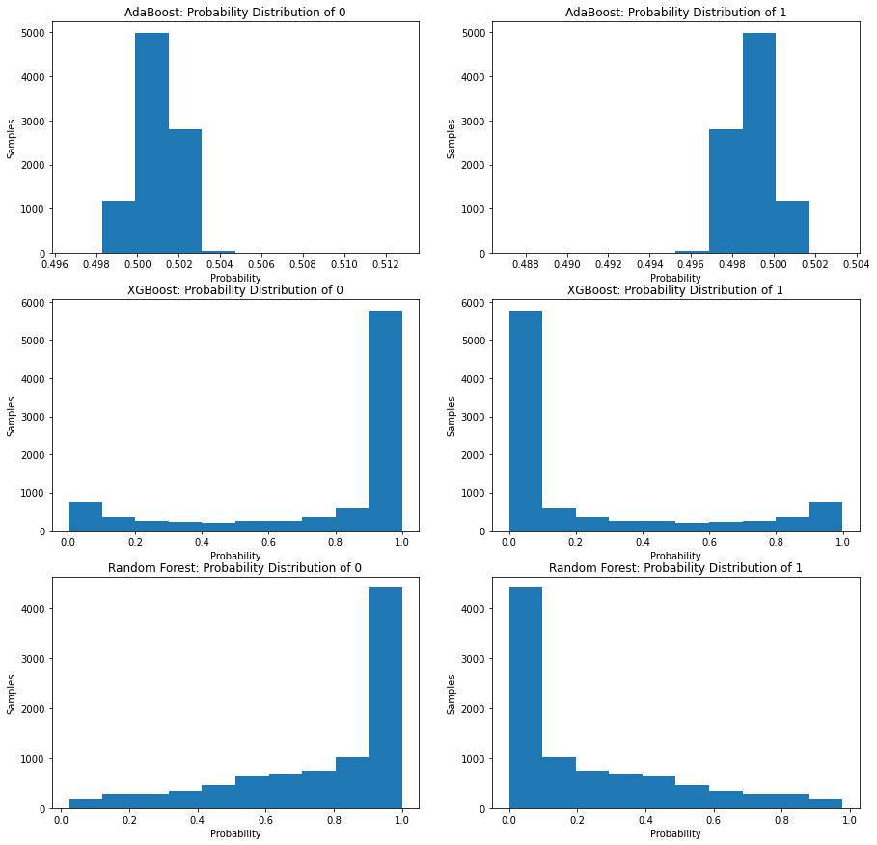
Prediction Probability Distribution
The AdaBoost model had probability score almost near 0.5. Cause, decision stumps.
Random Forest & XGBoost, had almost similar pattern; However, XGBoost had more concentration towards the end.
Explains why Severity-1 is better predicted by XGBoost.

Slide 27
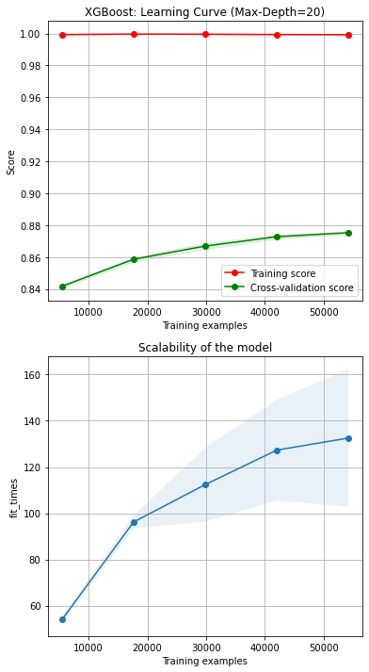
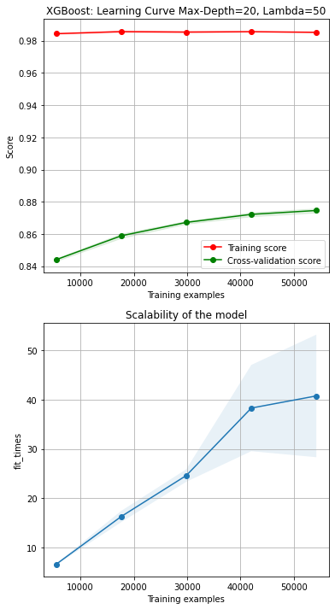
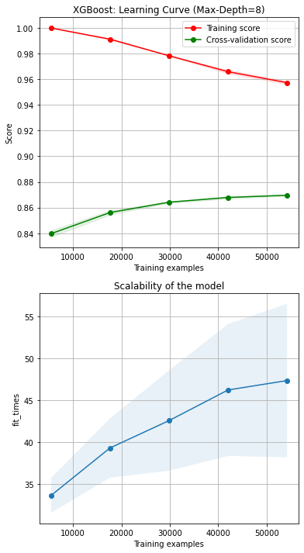
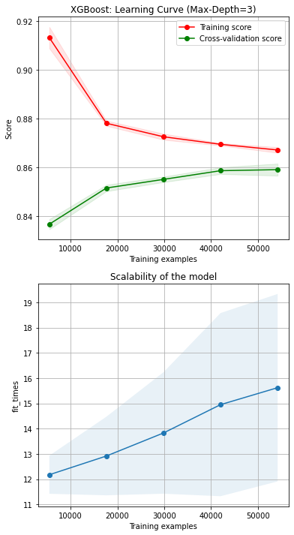
Learning Curves & Scalability

Slide 28
Findings/Conclusion
Accident severity varies by city (pretty obvious).
Chicago had more severe accidents compared to other cities.
Los Angeles was the place with the most accidents. Given, the population size, New York had proportionately lower number of accidents.
Parameters selected during hyperparameter tuning for each model were almost identical for PCA vs. Full dataset.
Duration, Coord_Z, Distance, Day/Night, and Chicago Area were the top predictors for severity.
In relation to our best model, the learning curve suggested there is a diminishing return in improving the validation accuracy if we increase the training size.

Slide 29
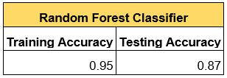
Future Work
Attempt to cover a larger region (with the help of more computing power)
Handle the skewness in the severity, by using sampling techniques like SMOTE.
Make our tree models more generalizable and reduce overfitting. For Example:
Improve Recall at the expense of Specificity!!

Slide 30
Questions?

