Slide 1

Report on: ERCOT PNNL Contract 401882: Start Date 3/19/2018 Development of an Integrated Transmission and Distribution Test System to Evaluate Transactive Energy Systems
Department of Economics, Department of Electrical & Computer Engineering
Department of Electrical and Computer Engineering
ISU Project Team:
PI Leigh Tesfatsion & Co-PI Zhaoyu Wang
Grad Research Assistant: Swathi Battula
PNNL/ISU Web Conference, 10 May 2019

Slide 2
ERCOT Contract: Presentation Outline
Original Task/Milestone Schedule: M1-M3
Updated Task/Milestone Schedule: M1-M3
Latest AMES V5.0 Work for ERCOT Test Cases (i.e., for M3.2)
Two options now available for inputing DAM and RTM Load Profiles
Input file modified so users can easily set how frequently RTM runs
Answer to Mitch’s MIPGap question
The ECA Model -- used to model the ISO-managed Day-Ahead Market SCUC/SCED Optimization in AMES V5.0 -- has been extended to permit Load-Serving Entities (LSEs) to submit price-sensitive demand bids.
NOTE: LSEs do not participate as bidders in the Real-Time Market (RTM) either in AMES V5.0 or in any real-world U.S. RTMs. Instead, the ISO itself submits load forecasts into the RTM.
2

Slide 3
Original Task & Milestone Schedule
Milestone | Date Due | Original Description
M1 | May 31, 2018 | 5-zone model of the old ERCOT system, posted to a web repository.
M2 | Sep 30, 2018 | Nodal model of the new ERCOT system, posted to a web repository.
M3 | Sep 30, 2018 | Submitted conference or journal paper on this work.
3

Slide 4
Updated Task & Milestone Schedule
Milestone | Date Due | Date Delivered | Fuller Descriptions of Actual Work
M1* DONE | May 31, 2018 | June 5, 2018 | Development of 8-Bus ERCOT model (with nodal locational marginal pricing); grid/load/gen data posted at PNNL repository
M2.1 DONE | Sept 30, 2018 | August 1, 2018 | Basic 8-Bus ERCOT Test System, implemented via AMES V3.1, posted at https://github.com/ITDProject/ERCOTTestSystem
M2.2 DONE | Sept 30, 2018 | August 24, 2018 | 8-Bus ERCOT Test System (with wind power), implemented via AMES V3.2, posted at https://github.com/ITDProject/ERCOTTestSystem
M3.1 DONE | Sept 30, 2018 | August 31, 2018 | 200-Bus ERCOT Test System (with wind power), implemented via AMES V3.2, posted at https://github.com/ITDProject/ERCOTTestSystem/tree/master/ERCOT_Test_Systems/The_200Bus_ERCOT_Test_System
M3.2** | July 31, 2019 |  | 200-Bus ERCOT Test System (with wind power), implemented via AMES V5.0, to be posted at PNNL/ISU repositories.
M3.3** | July 31, 2019 |  | Paper to be submitted that focuses on the development of the ERCOT Test Systems
* M1 Modification (Ok’d by PNNL): For M1 we have skipped the modeling of the old (zonal) ERCOT system and instead directly worked to develop an 8-bus model of the new (nodal) ERCOT system.
** M3 Modification: Contract extension through July 31, 2019 received from PNNL on March 4, 2019, for completion of task M3

Slide 5
Latest Work on AMES V5.0
Choices for DAM and RTM Load Profiles for AMES V5.0
Case1: Load profile given in the input ‘.dat’ file can be used for running both the Day-Ahead Market (DAM) and the Real-Time Market (RTM) for consecutive days.
Case2:
Up-to-date forecast of DAM load profile of each LSE can be sent to ‘LSEAgent.java’ using ‘loadforecast.py’ for every day ‘D’ for ‘D+1’ operation.
To switch from ‘Case1.java’ to ‘Case2.java’,
line 150 of method ‘submitLoadProfile()’ of LSEAgent.java needs to be changed from ‘return loadProfile’ to ‘return loadForecast’
Similarly, up-to-date forecast of RTM load profile can be sent to ‘ISO.java’ for all LSEs using ‘loadforecast.py’ for every day ‘D’ for ‘D+1’ operation
To switch from ‘Case1.java’ to ‘Case2.java’,
lines 307-313 of method ‘getRealTimeLoad()’ of ISO.java need to be commented.
5

Slide 6
Latest Work on AMES V5.0 … Continued
Input file modified to give users an easy way to set RTM frequency
User can set ‘RTMInterval’ in the input data file to specify how frequently the real-time market runs.
6

Slide 7
Latest Work on AMES V5.0 … Continued
Answer to Mitch’s Question: “What is ‘MIPGap’?”
From Pyomo documentation: MIPGap for a Mixed Integer Programming (MIP) problem indicates a termination threshold based on the difference in current lower and upper bounds.
The MIP solver will terminate (with an approximately optimal result) when the gap between the lower and upper objective bound is less than MIPGap times the absolute value of the upper bound.
7

Slide 8
Latest Work on AMES V5.0 …Continued
Modeling of LSE Price-Sensitive Demand Bids
Suppose a DAM SCUC/SCED optimization is being conducted for a future operating period T divided into NK time-steps k, where each k has length ∆t (e.g., 1h, 5min, M minutes)
Suppose a Load-Serving Entity (LSE) participates in this DAM SCUC/SCED optimization in order to buy power on behalf of a collection of retail customers.
A price-sensitive demand bid for this LSE is a demand for power usage p (MW) during each time-step k that is accompanied by price (valuation) information indicating the LSE’s maximum willingness to pay for this power usage.

Slide 9
Latest Work on AMES V5.0…Continued
ECA Model Extension: Inclusion of Price-Sensitive Demand Bids
See Section 6 of the following report:
http://www2.econ.iastate.edu/tesfatsi/ECAModelAndPyomoCodeDoc.LTesfatsion.pdf
Demand bids with time-of-use pricing
A specified price submitted for each time-step k
Demand bids with step-function pricing
A step-function demand schedule submitted for each time-step k
Demand bids directly expressed as benefit functions
A benefit function submitted for each time-step k

Slide 10
Latest Work on AMES V5.0…Continued
ECA Model Extension: LSEs can submit three types of price-sensitive demand bids. See Section 6 of the following report:
http://www2.econ.iastate.edu/tesfatsi/ECAModelAndPyomoCodeDoc.LTesfatsion.pdf
Demand bids with time-of-use pricing
A specified price submitted for each time-step k
Demand bids with step-function pricing
A step-function demand schedule submitted for each time-step k
Demand bids directly expressed as benefit functions
A benefit function submitted for each time-step k

Slide 11
Price-Responsive Demand Bids … Continued
Option 1: Time-of-Use Pricing
Recall that the future operating period T is divided into NK time-steps, where each time-step k has length ∆t
Suppose LSE j submits a separate price π_{j}(k) ($/MW) for each time-step k.
The maximum amount ($) that LSE j is willing to pay for a power-usage level p_{j}(k) (MW) maintained during time-step k is then given by π_{j}(k)p_{j}(k).

Slide 12
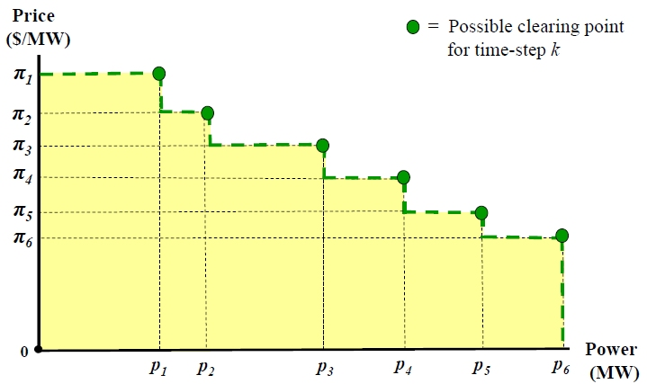
Price-Responsive Demand Bid … Continued
Option 2: A demand schedule for each time-step k
A power-price combination (p_{n}(k),π_{n}(k)) for time-step k has the following interpretation:
π_{n}(k) p_{n}(k) = Maximum amount ($) that LSE j is willing to pay for a power-usage level
p_{n}(k) maintained during time-step k

Slide 13
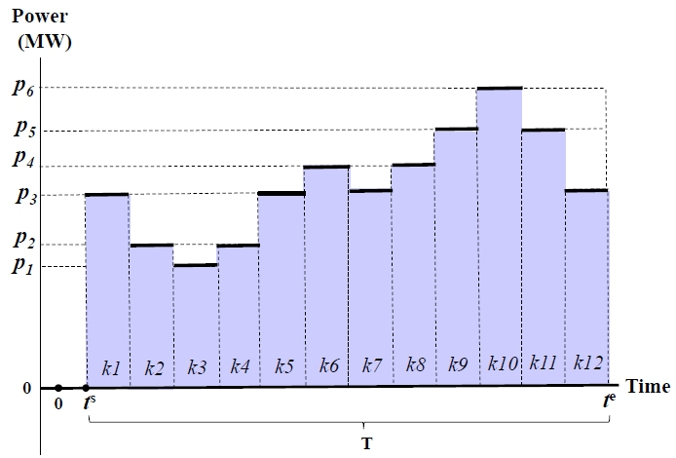
Price-Responsive Demand Bid … Continued
Option 2: Demand schedule for each time-step k…Cont’d
Illustration: Physical aspects of a price-sensitive demand bid submitted by an LSE for an operating period T consisting of 12 time-steps k. The demand schedule for each k is as depicted on the previous slide. The shaded region denotes one possible load profile the ISO could clear for operating period T.

Slide 14
Price-Responsive Demand Bids … Continued
Option 3: Submit a benefit function for each time-step k
More generally, suppose LSE j directly assigns a benefit ($) to each possible power-usage level p for time-step k by means of a non-decreasing concave benefit function B_{j,k}(p).
Quadratic Example:
B_{j,k}(p) = d_{j}(k) + e_{j}(k) p + f_{j}(k) p²
The max amount ($) that LSE j is willing to pay for a power-usage level p maintained during time-step k is then given by Bj,k(p).
The price πj,k(p) ($/MW) that LSE j is willing to pay for incremental power at the power-usage level p for time-step k can be expressed by the marginal benefit function:

Slide 15
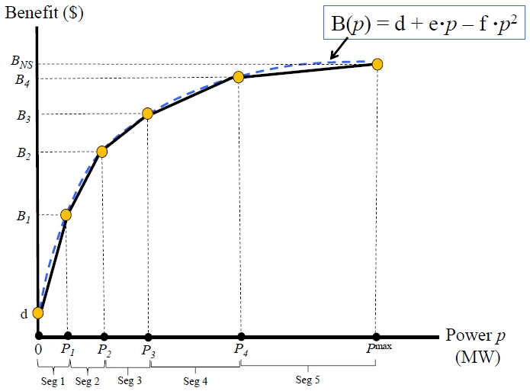
Submission of a benefit function…Cont’d
A MILP (Mixed Integer Linear Programming) tractable approximation for a general concave non-decreasing benefit function, here shown for a quadratic benefit function B(p).

