Slide 1

June Cho Enterprise Mobile App Dev App Innovation | Global Black Belt

Slide 2
Why Test on Real Devices?
Verify App Integrity
UI loads as expected on different sized screen
App performs as expected on different CPUs
Accessible UI
Features work as per User Flows
Useable Functionality
Testing as part of CI
Reliable Development Cycle

Slide 3



Mobile Center: Test
Release faster
Shrink release times significantly and push new apps out faster
Ship high quality apps Ensure the highest quality user experience that keeps users continuously engaged
Engage a broad audience
Test on a broad range of devices to make sure apps work on your users’ devices
Create new features Spend less time fixing bugs, and more time creating value

Slide 4
Supported Testing Platforms
Xamarin.UITest
Tests written in C#
Supports Xamarin apps, Native (Android, iOS) Apps, React Native Apps, Hybrid Apps
XCUITest
Tests written in Swift
Supports native iOS apps
Espresso
Tests written in Java
Supports native Android apps
Appium
Tests written in Java
Supports native (Android and iOS) apps , Xamarin Apps, React Native Apps, Hybrid Apps

Slide 5
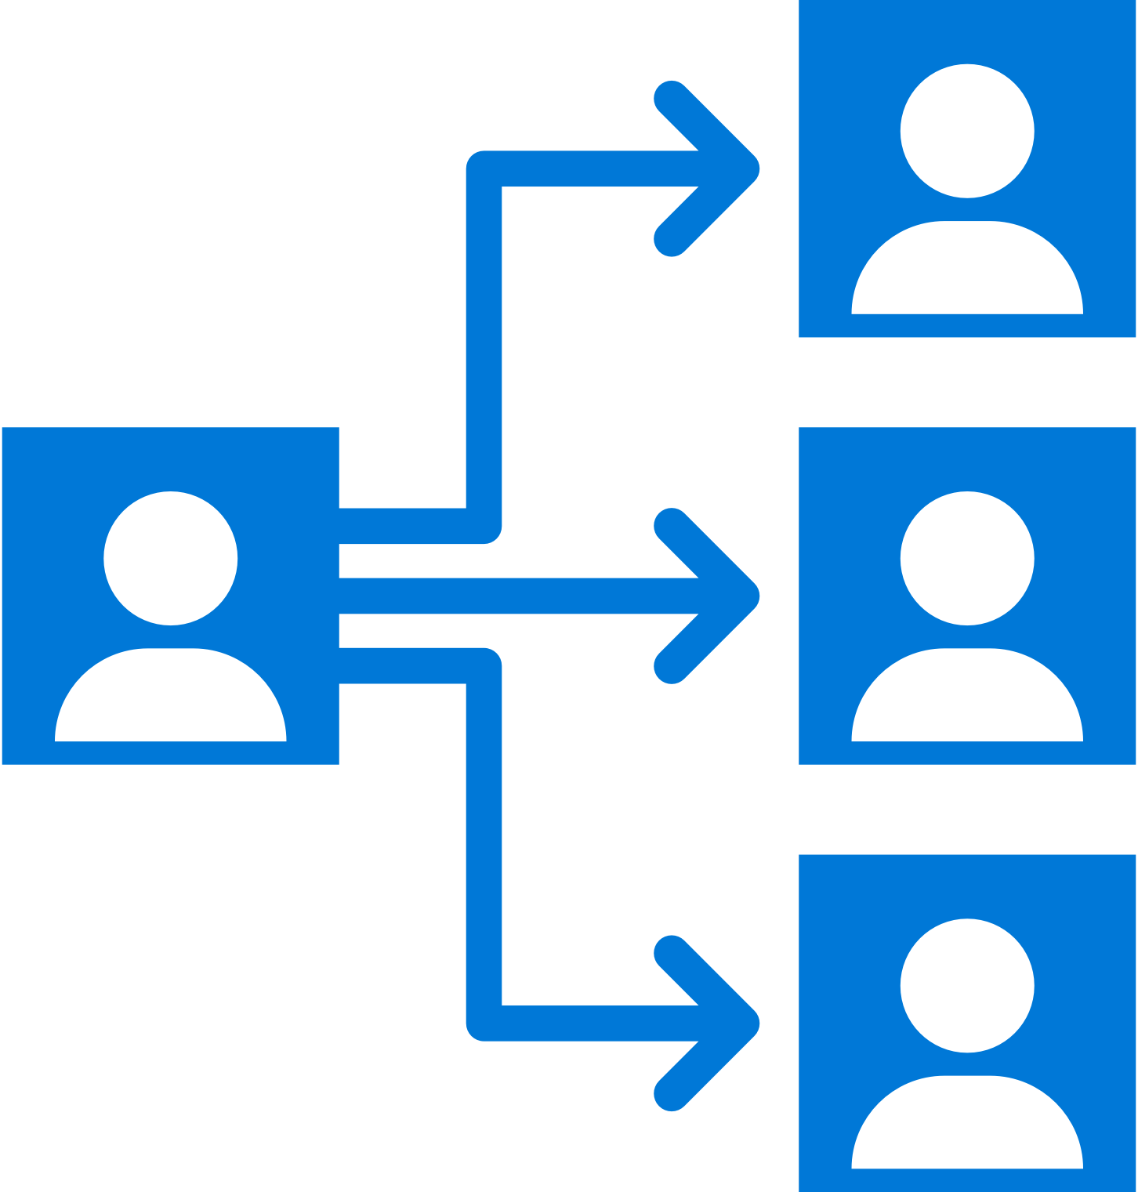

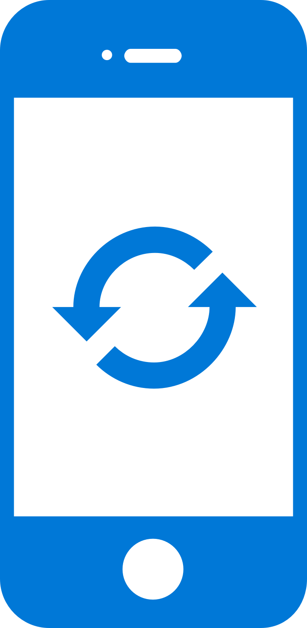
Mobile Center: Distribute
Instantly distribute apps
Quickly get apps in the hands of your beta testers on multiple device platforms
Create targeted distribution groups
With categorized groups of users, send specific builds to specific groups and devices
Send in-app updates
Notify beta testers as soon as a new build is available, right inside the app

Slide 6
Getting Started
Distributing with Mobile Center is easy, and only requires a few steps:
Add users to grant access to all releases.
Create Distribution Groups to manage access.
Upload a new application release.
Install the release onto your device by clicking on the link in the email.
Enable In-App Updates to help your users stay always on the latest release.

Slide 7
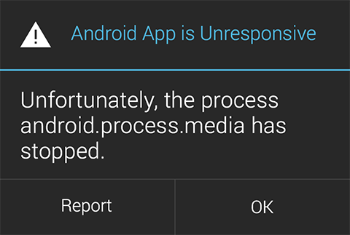
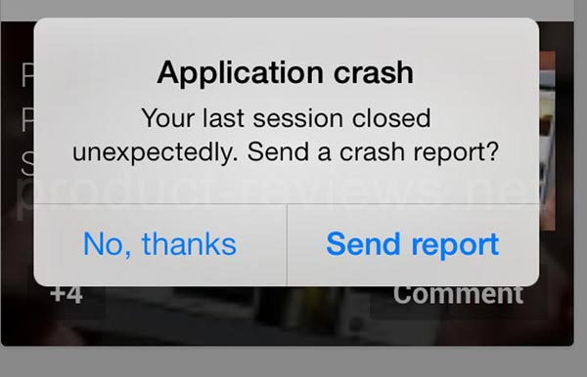

Slide 8
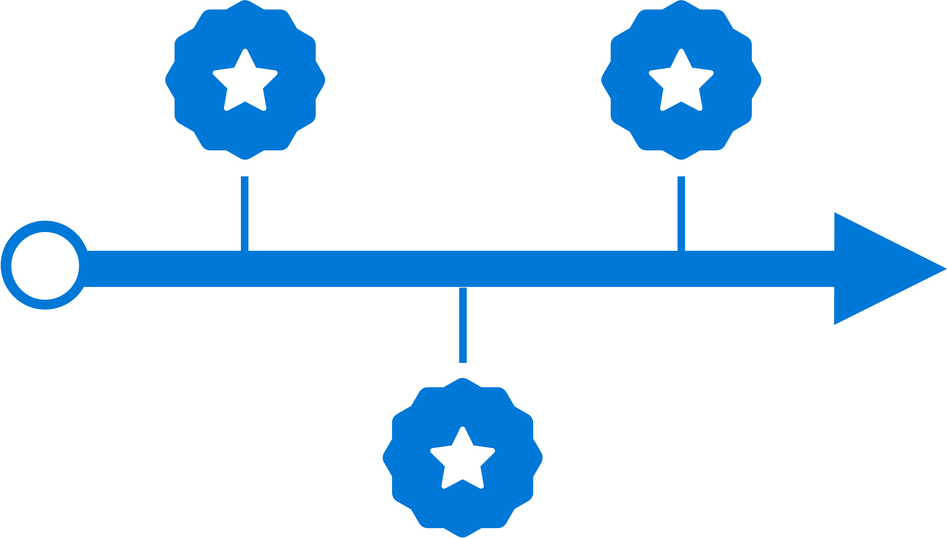



Mobile Center: Crashes
Ship consistent quality
Diagnose crashes fast for maximum uptime and maintain high quality
Get real-time insights
Monitor your app health with real-time crash reports to diagnose and fix problems quickly
Do smart troubleshooting
Crashes are grouped together by similarities to focus on the most critical groups
Easily analyze data
Get detailed, easy-to-read stack traces and logs to quickly understand issues

Slide 9

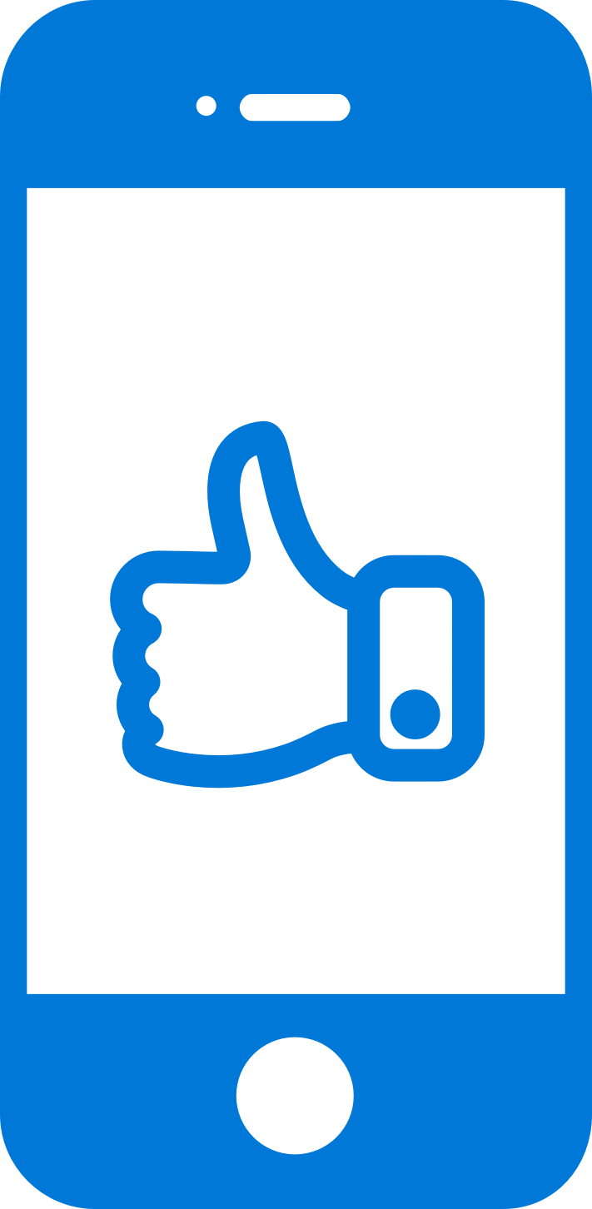


Mobile Center: Analytics
Access instant data
Integrate the analytics SDK in just two steps to start instantaneously seeing data from your app
Understand your customers
Real-time app usage data about your core audience—devices, locations, session info, and more
Build what users want
Analyze the data to see how customers use your app and accordingly prioritize and build new features
Learn more faster
Use custom events to follow users’ actions through your app to analyze their likes and dislikes

Slide 10
Key Features
Overview
Custom Events
Log Flow
Export to Azure

Slide 11
Sign up free today: mobile.azure.com

