Slide 1
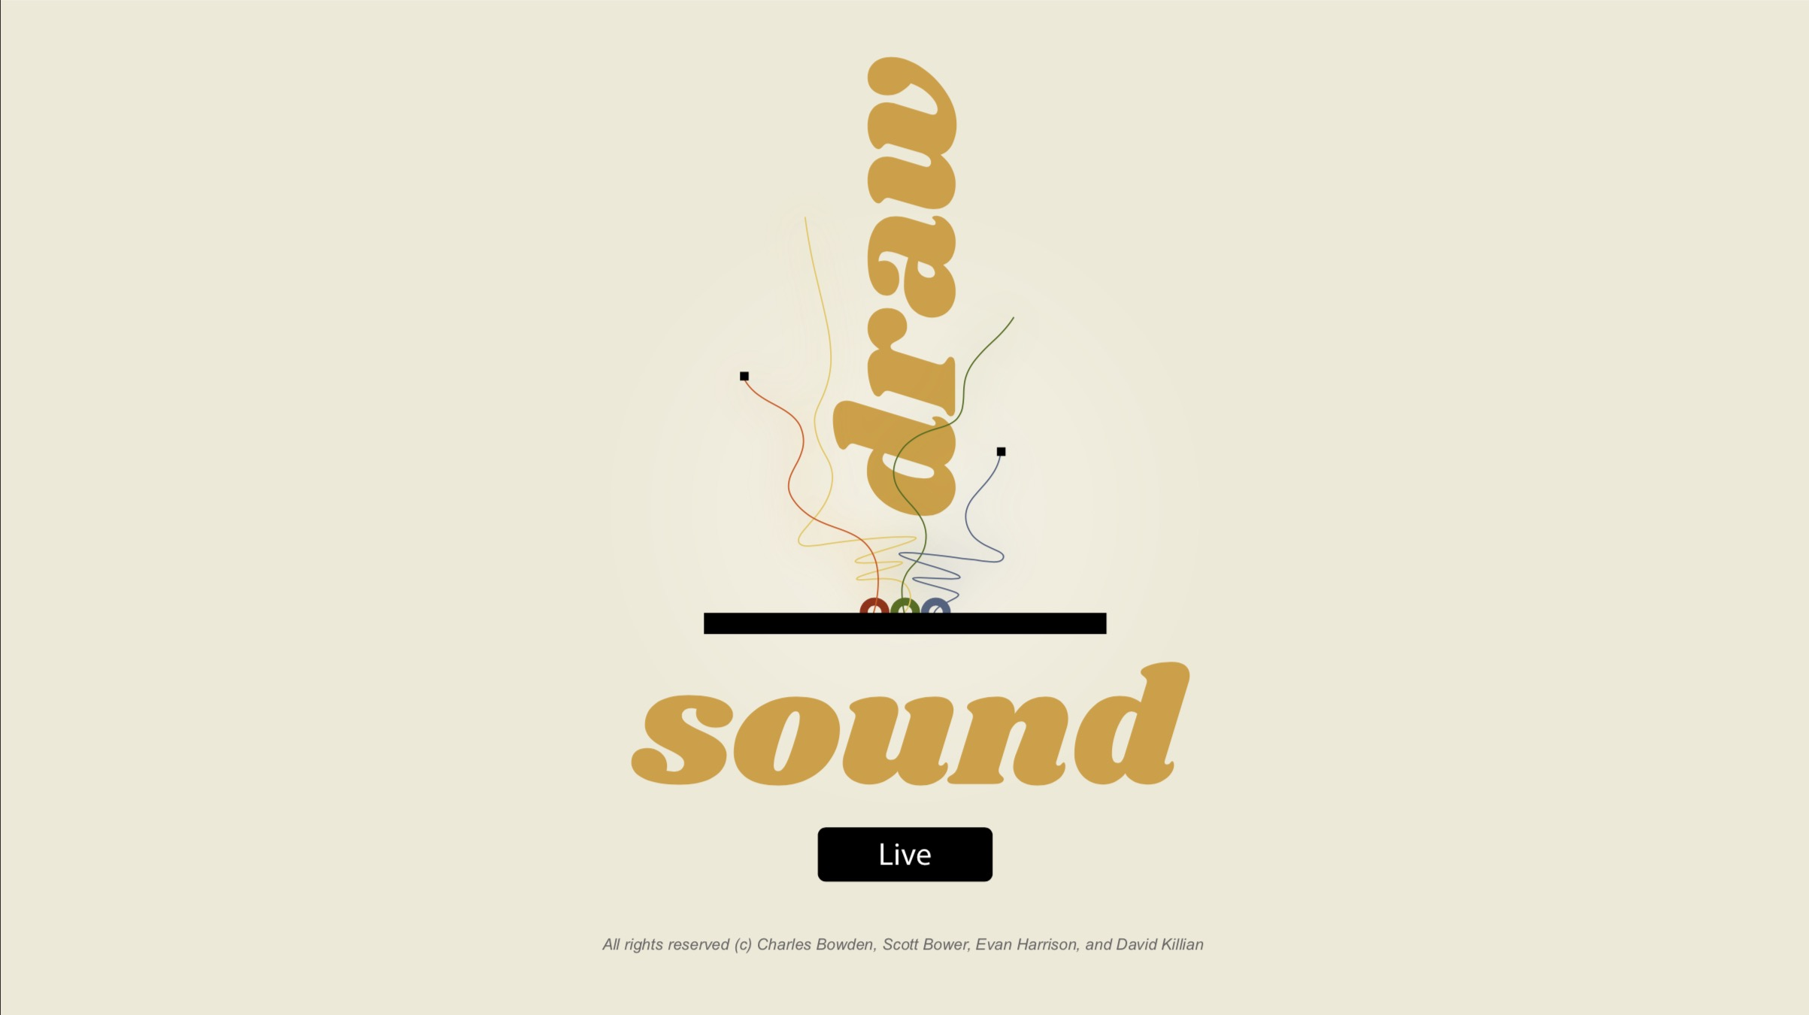
Evan Harrison
Scott Bower
David Killian
Charles Bowden
Notes:
Architectural Win // Technical Case Study
Framework for our discussion
- Customer Engagement
-Technology
- Problem Solving

Slide 2
Draw < -- > Sound < -- > Live Motivation
How can creatively coding visual and audio instruments be brought together in interesting, fun, and unexpected ways?
Notes:
Start with background to provide context
- Local/Raleigh
- Breakout growth in past 5 years
- Still has small mom/pop shop
-Derive much of their business indirectly through National Infrastructure Spending (Highway Bill)
- Began our engagement in 2016
- 2 day discovery meeting

Slide 3
Draw < -- > Sound < -- > Live Motivation
Draw - Sound - Live is a live performance space that enables users to draw music for an audience.
Notes:
Start with background to provide context
- Local/Raleigh
- Breakout growth in past 5 years
- Still has small mom/pop shop
-Derive much of their business indirectly through National Infrastructure Spending (Highway Bill)
- Began our engagement in 2016
- 2 day discovery meeting

Slide 4
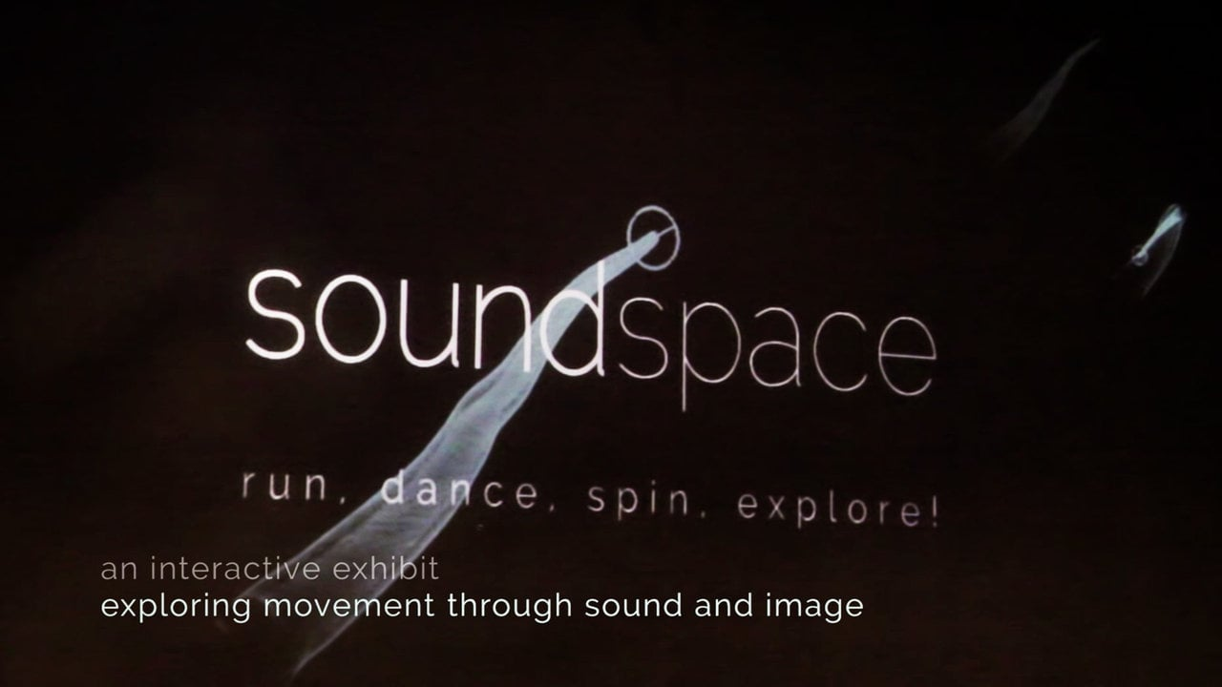
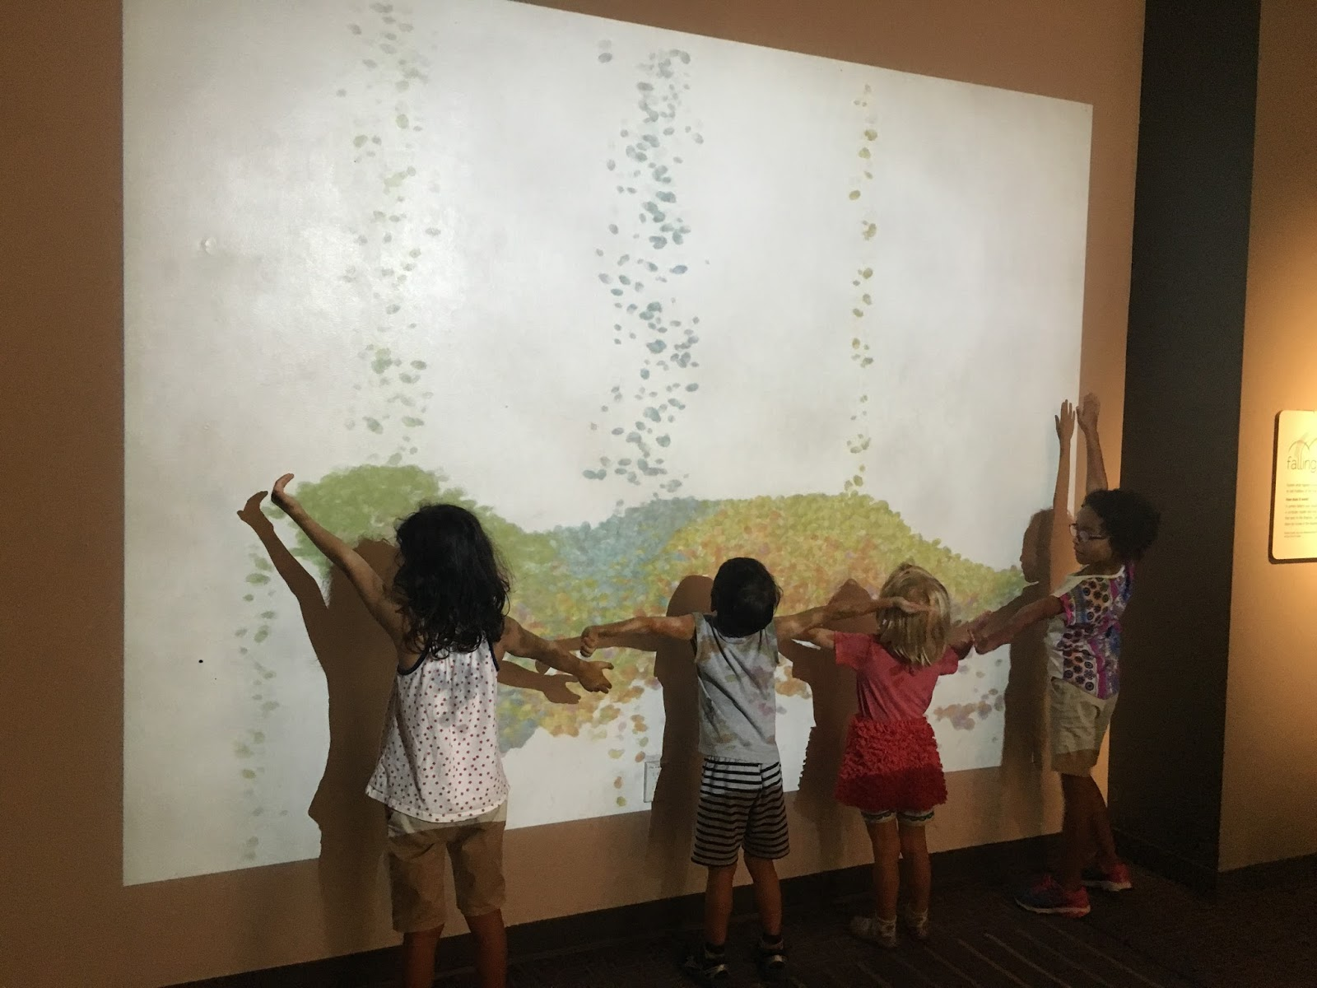
Draw < -- > Sound < -- > Live Motivation
Inspired by Soundspace at Durham Science Museum, which merges movement, sound, and visual art
Notes:
Start with background to provide context
- Local/Raleigh
- Breakout growth in past 5 years
- Still has small mom/pop shop
-Derive much of their business indirectly through National Infrastructure Spending (Highway Bill)
- Began our engagement in 2016
- 2 day discovery meeting

Slide 5
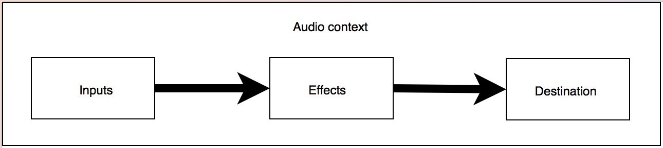
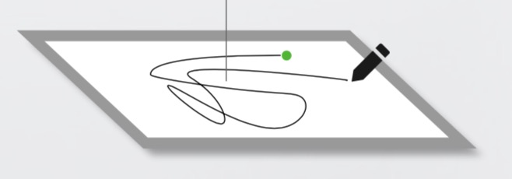
Draw < -- > Sound < -- > Live Design Goals
Render cutting-edge audio {sound effects}
Visualize performance {canvas}
Mimic live venue {chat, applause, boo}
Encourage whimsy {instrument}
Notes:
Start with background to provide context
- Local/Raleigh
- Breakout growth in past 5 years
- Still has small mom/pop shop
-Derive much of their business indirectly through National Infrastructure Spending (Highway Bill)
- Began our engagement in 2016
- 2 day discovery meeting

Slide 6
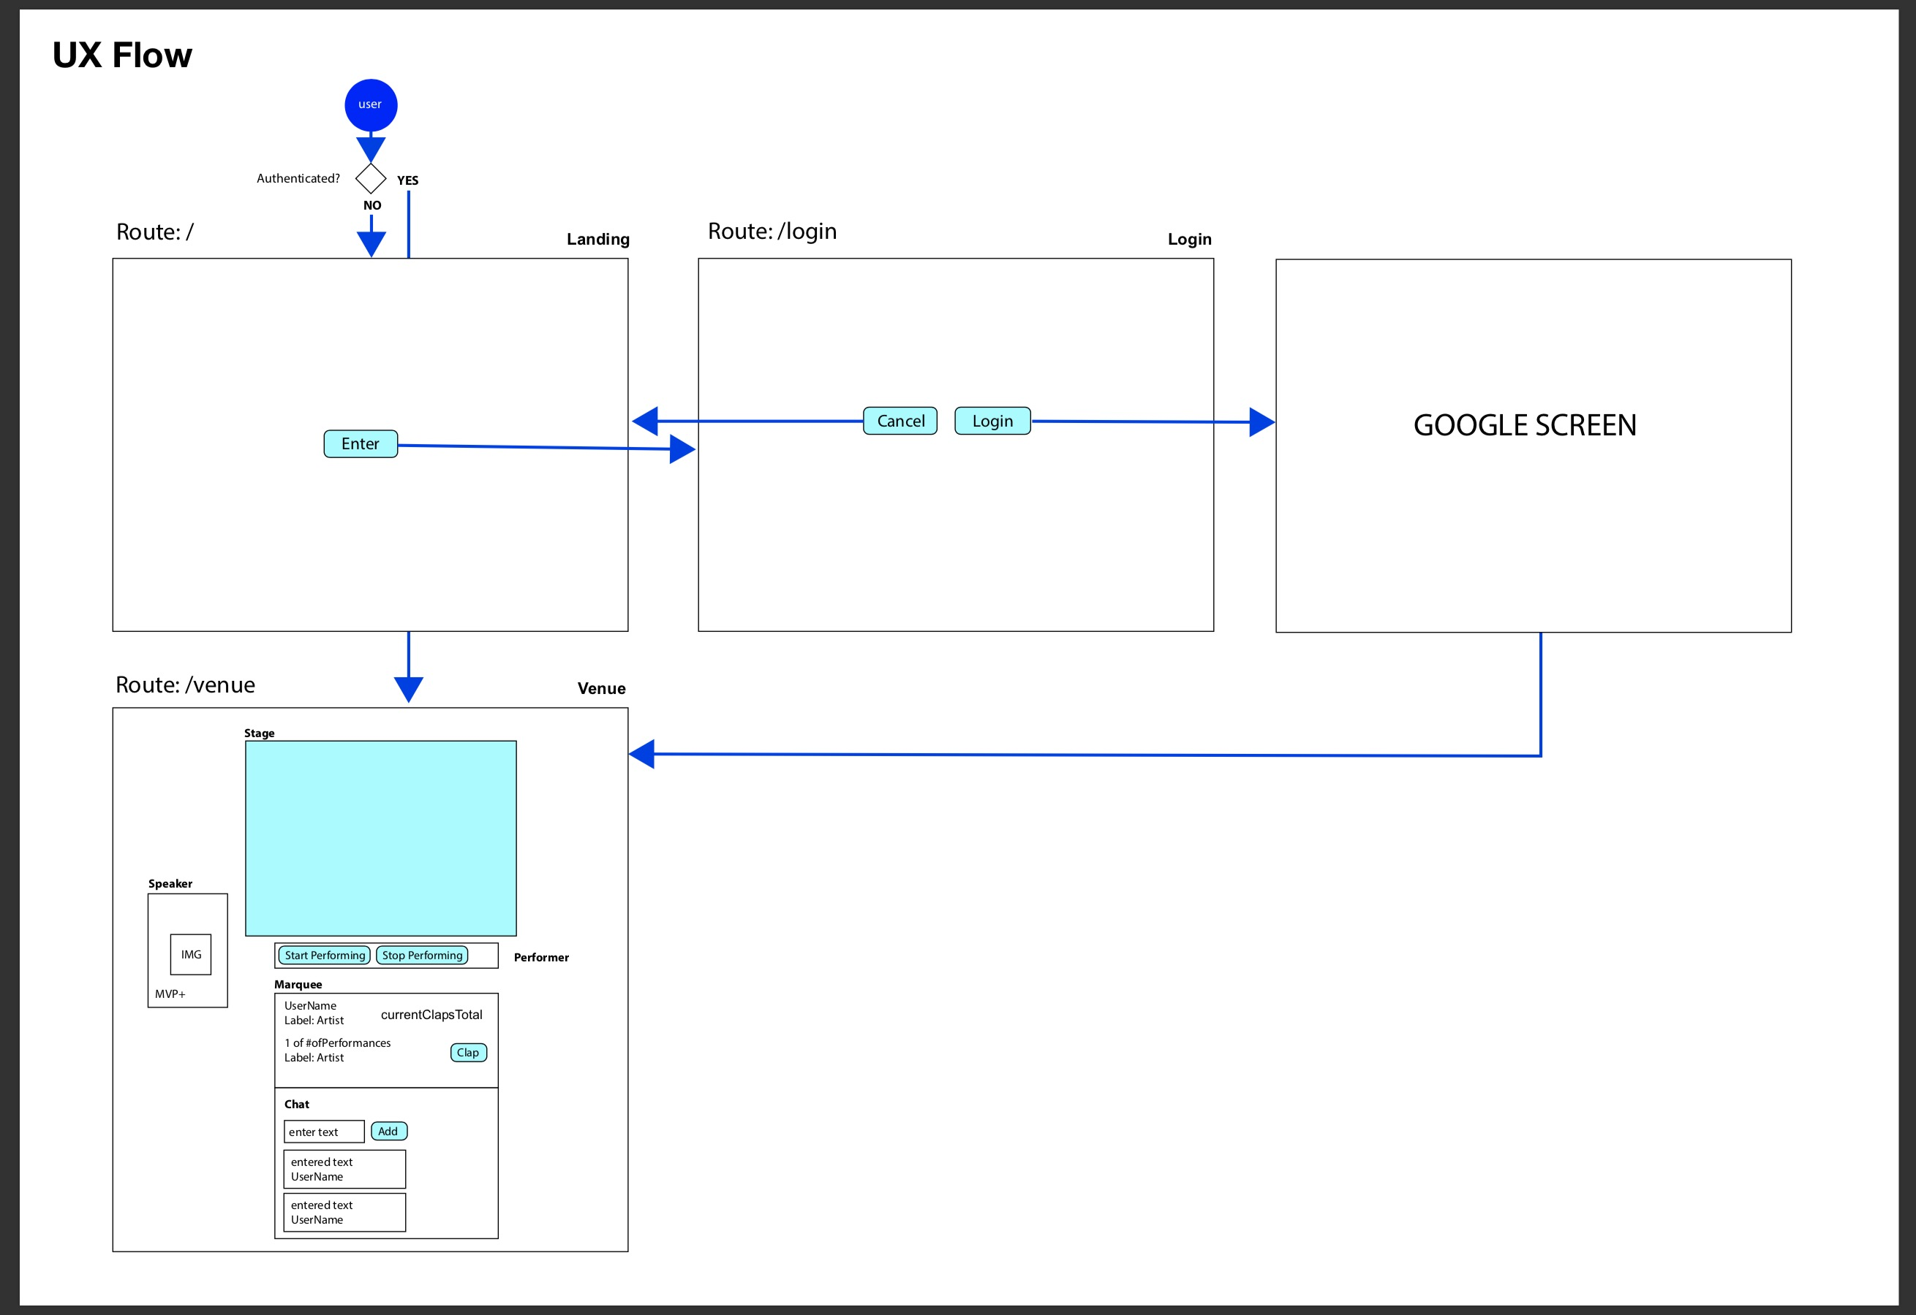
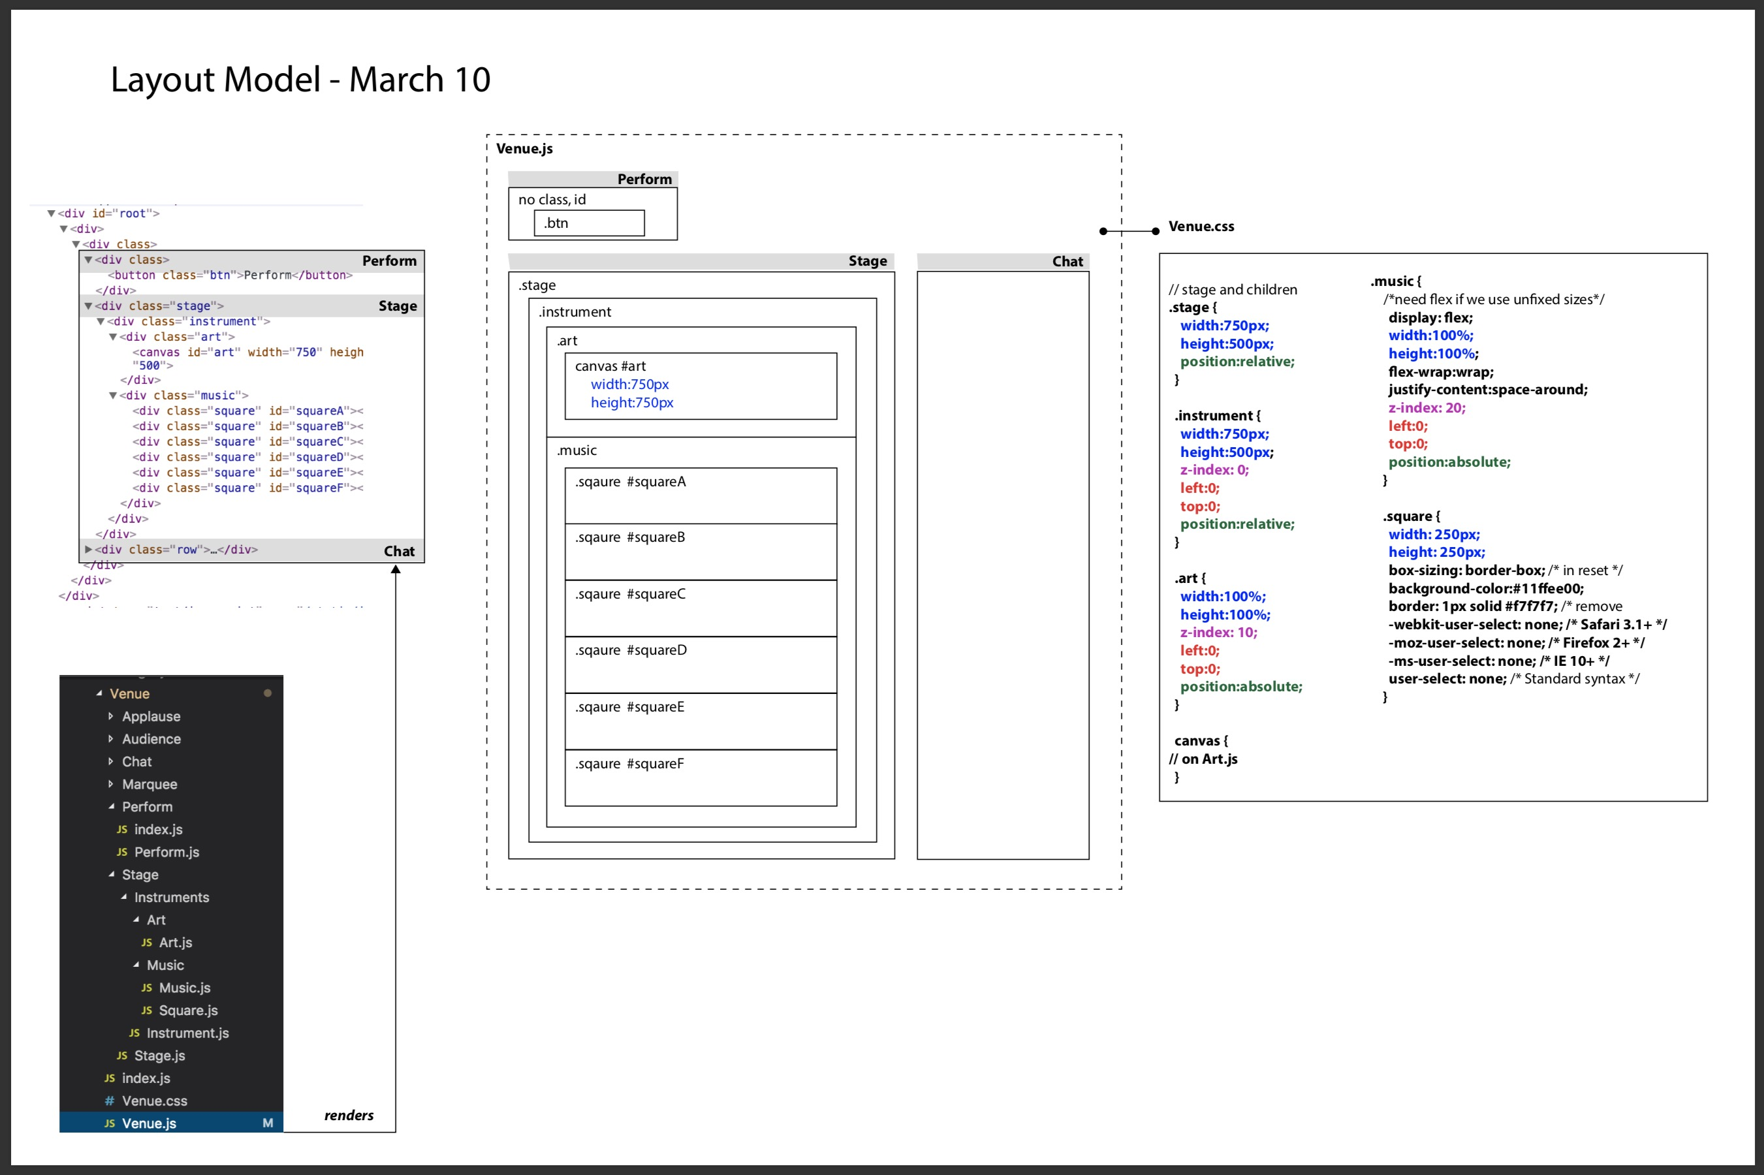
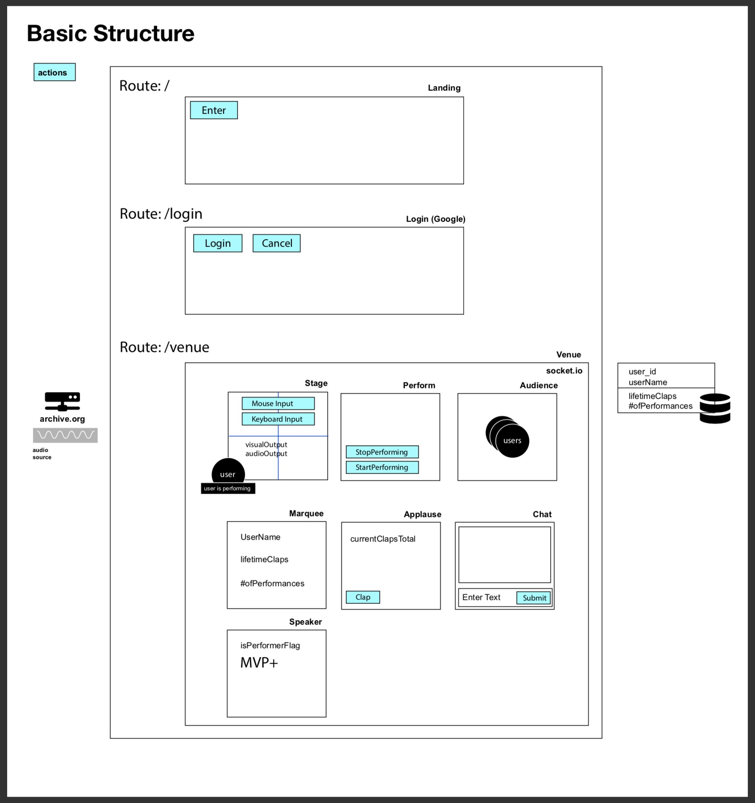
Draw < -- > Sound < -- > Live Process
Research Web Audio & Visualization
Vet proof-of-concept
Wire frames, components, routes, state
Notes:
Start with background to provide context
- Local/Raleigh
- Breakout growth in past 5 years
- Still has small mom/pop shop
-Derive much of their business indirectly through National Infrastructure Spending (Highway Bill)
- Began our engagement in 2016
- 2 day discovery meeting

Slide 7
Draw < -- > Sound < -- > Live Components
Component hierarchy mirrors conceptual hierarchy
State everywhere
Component Hierarchy
App
State: id, name
Props
Login
Landing
Venue
State: performer,
isPerformer
Perform
Chat
Stage
Audience
State: clientCount
Instrument
State: x, y, active,
mouseDn, keys
Art
Music
Notes:
Start with background to provide context
- Local/Raleigh
- Breakout growth in past 5 years
- Still has small mom/pop shop
-Derive much of their business indirectly through National Infrastructure Spending (Highway Bill)
- Began our engagement in 2016
- 2 day discovery meeting

Slide 8
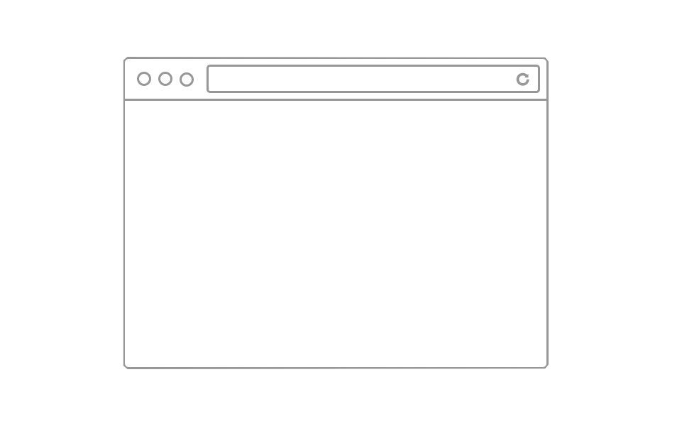

Draw < -- > Sound < -- > Live Socket
Socket used to broadcast Performer actions
Socket Dataflow
Server
x, y, mouseDn
Music (archive.org)
isPerformer
Client (Performer)
song (stream)
chat
x, y
clientCount
Cool..
16 X Humans Here
x, y, mouseDn
song (stream)
isPerformer
Client (Audience)
chat
clientCount
Cool..
16 X Humans Here
Notes:
Start with background to provide context
- Local/Raleigh
- Breakout growth in past 5 years
- Still has small mom/pop shop
-Derive much of their business indirectly through National Infrastructure Spending (Highway Bill)
- Began our engagement in 2016
- 2 day discovery meeting

Slide 9
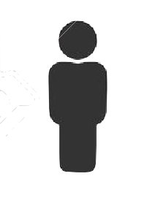

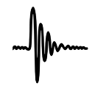


Draw < -- > Sound < -- > Live Venue
Venue
Boo
Yay!!
Chat
Audience
This is cool!
Performer
Canvas
Stage
Effects
Music
Music ->
Music ->
Effects
Notes:
Start with background to provide context
- Local/Raleigh
- Breakout growth in past 5 years
- Still has small mom/pop shop
-Derive much of their business indirectly through National Infrastructure Spending (Highway Bill)
- Began our engagement in 2016
- 2 day discovery meeting

Slide 10
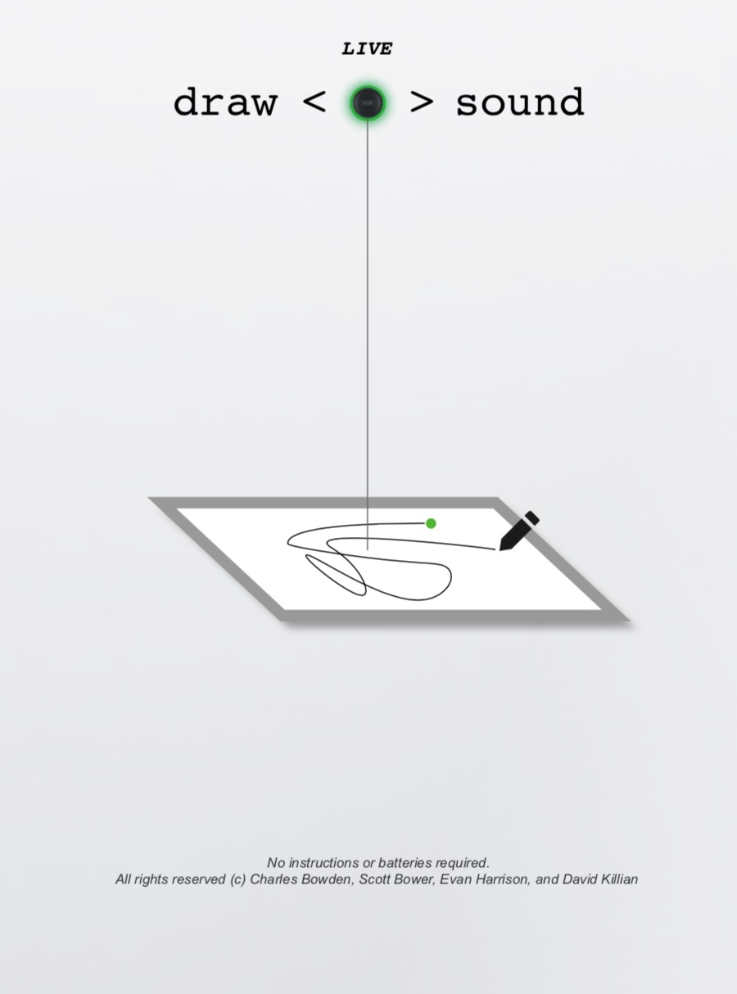
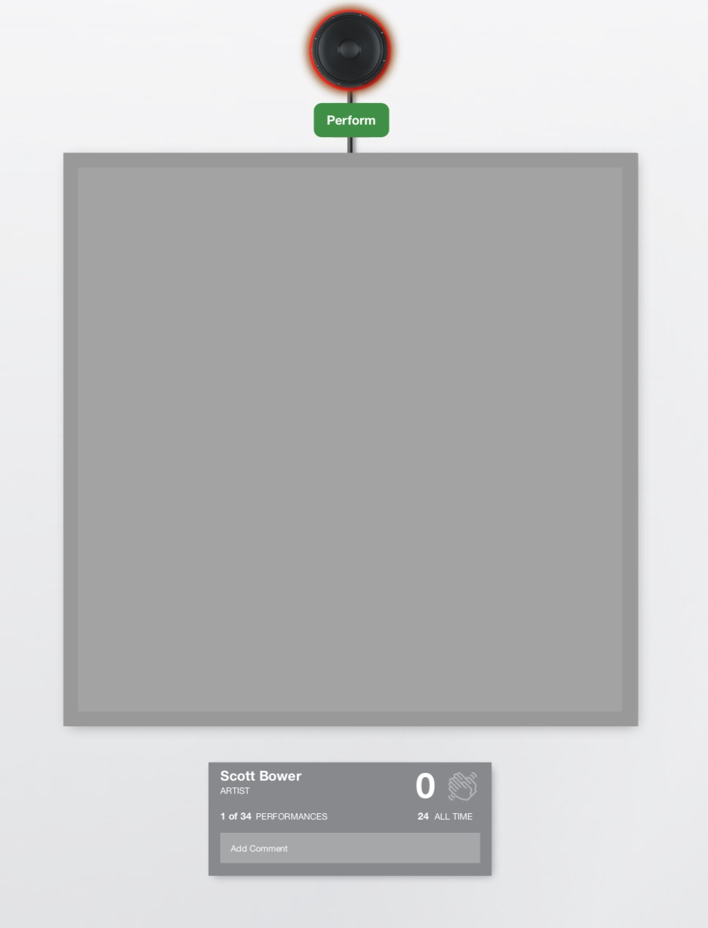
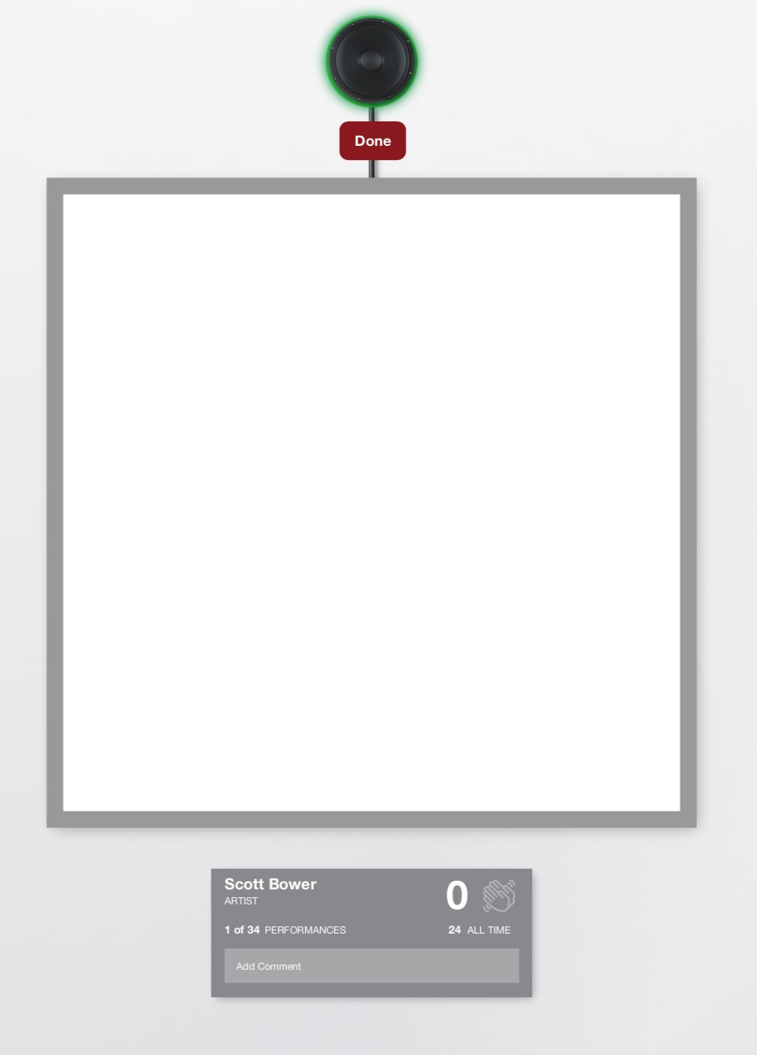
Draw < -- > Sound < -- > Live Process
UX Mock-ups
Iterate
Notes:
Start with background to provide context
- Local/Raleigh
- Breakout growth in past 5 years
- Still has small mom/pop shop
-Derive much of their business indirectly through National Infrastructure Spending (Highway Bill)
- Began our engagement in 2016
- 2 day discovery meeting

Slide 11
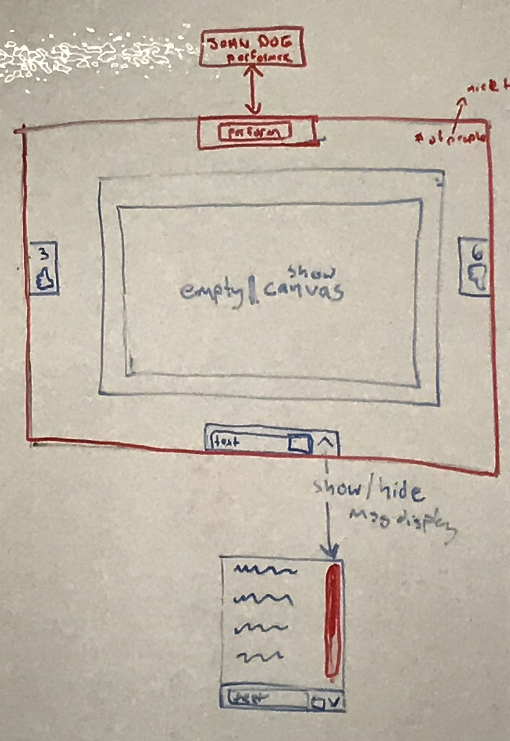
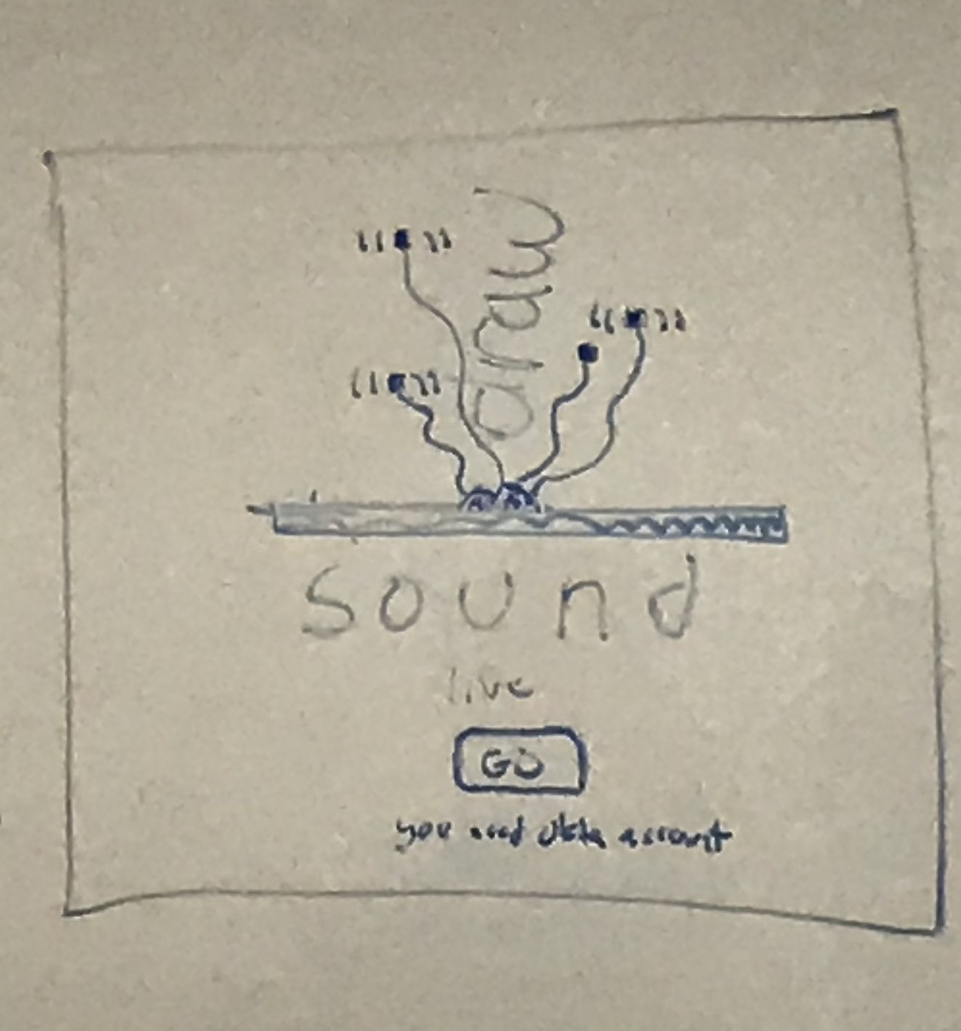
Draw < -- > Sound < -- > Live Process
UX Mock-ups
Iterate
Notes:
Start with background to provide context
- Local/Raleigh
- Breakout growth in past 5 years
- Still has small mom/pop shop
-Derive much of their business indirectly through National Infrastructure Spending (Highway Bill)
- Began our engagement in 2016
- 2 day discovery meeting

Slide 12
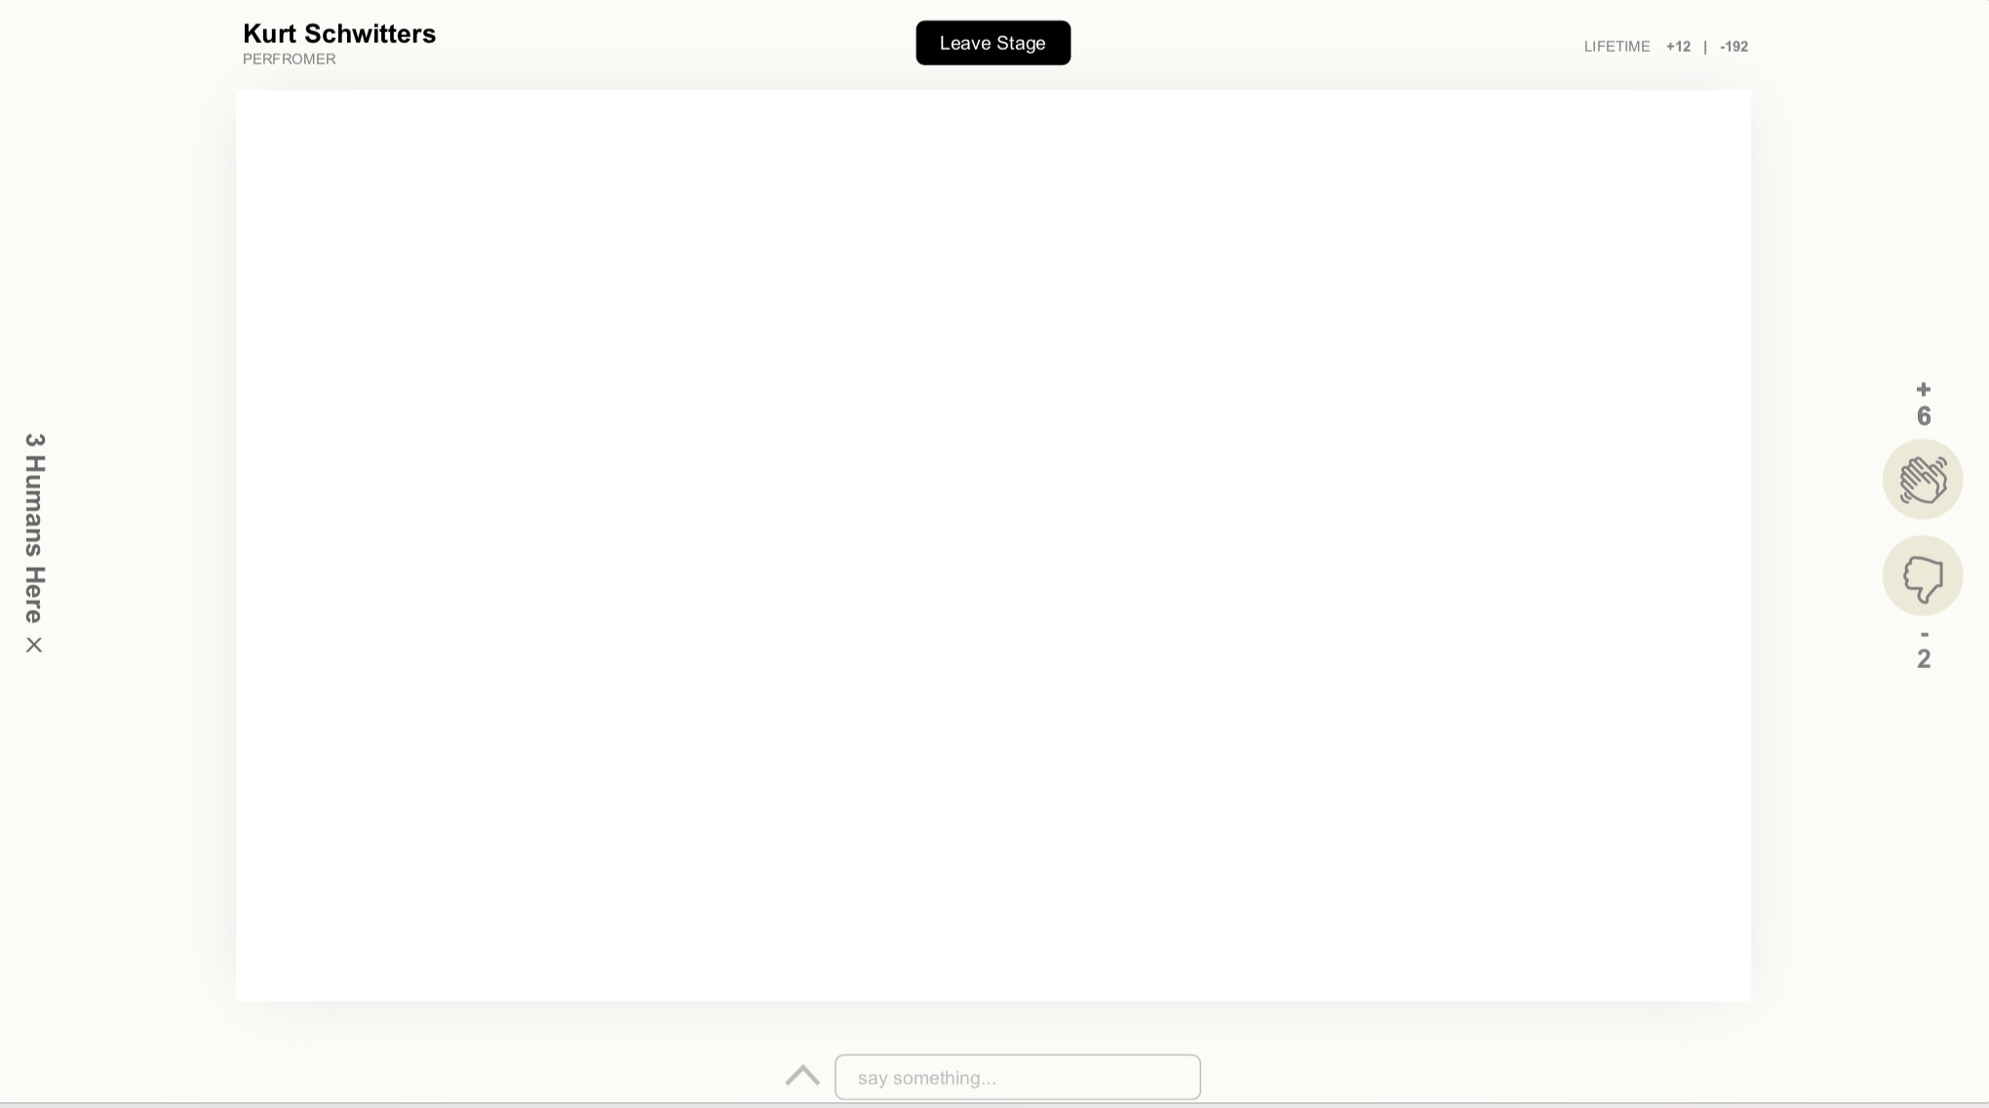
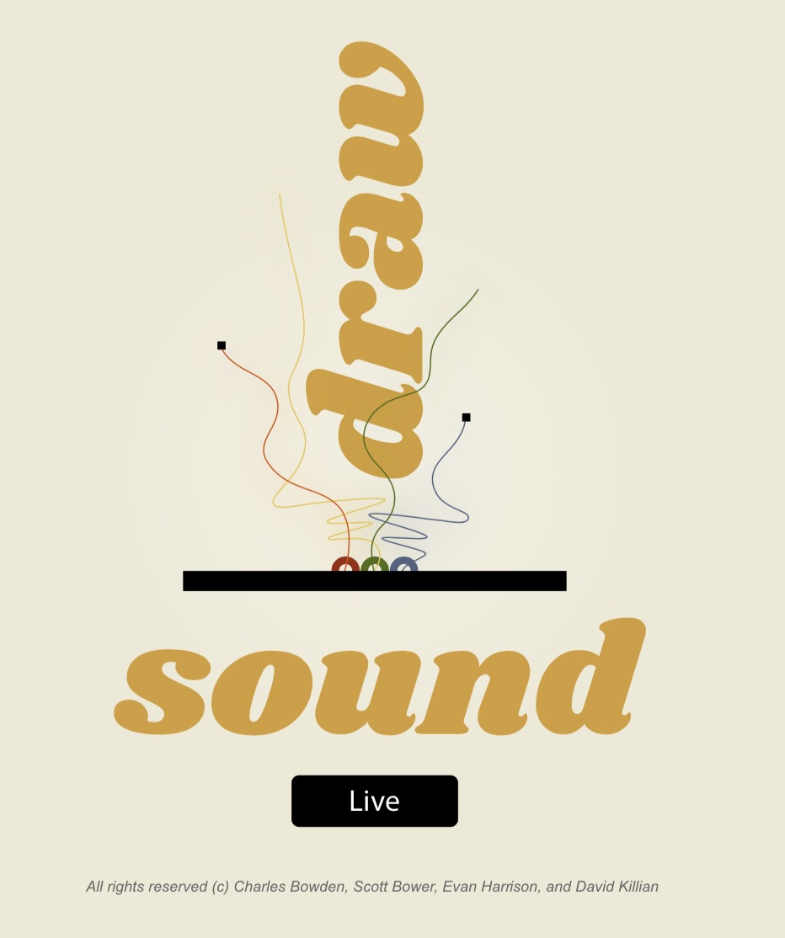
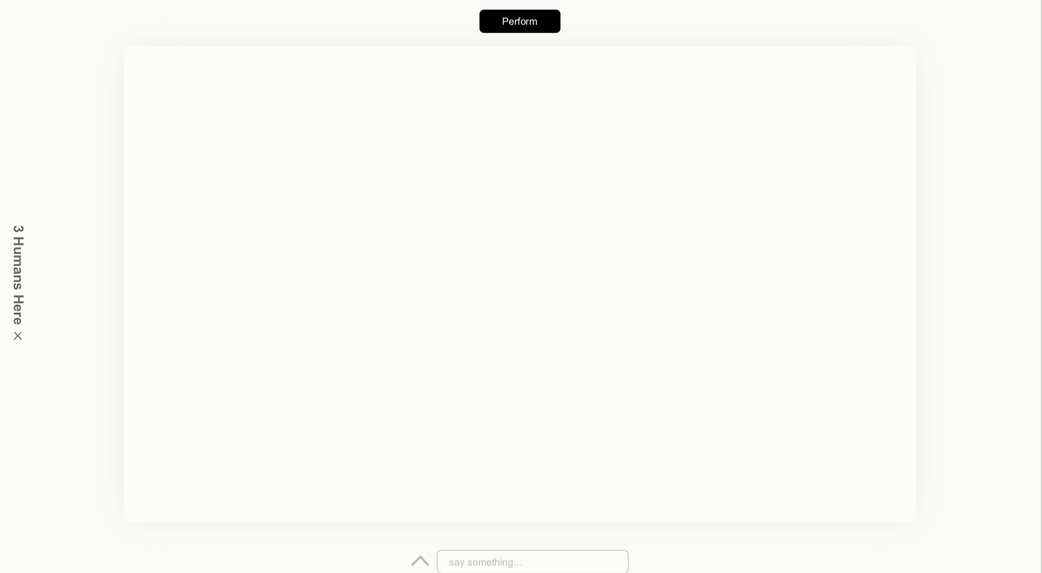
Draw < -- > Sound < -- > Live Process
UX Mock-ups
Iterate
Notes:
Start with background to provide context
- Local/Raleigh
- Breakout growth in past 5 years
- Still has small mom/pop shop
-Derive much of their business indirectly through National Infrastructure Spending (Highway Bill)
- Began our engagement in 2016
- 2 day discovery meeting

Slide 13






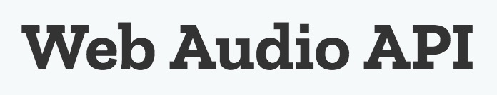
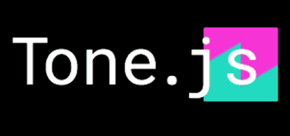
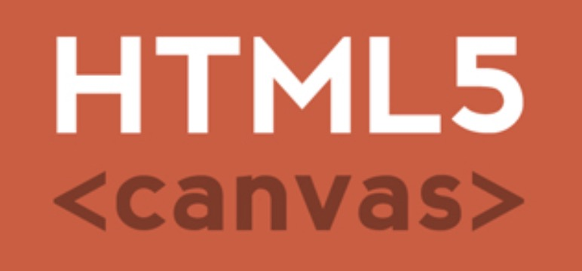







Draw < -- > Sound < -- > Live Stats
14 technologies
21 days
20 branches
100+ commits
4 devs❕
Collaboration
Front End
Back End
Notes:
Start with background to provide context
- Local/Raleigh
- Breakout growth in past 5 years
- Still has small mom/pop shop
-Derive much of their business indirectly through National Infrastructure Spending (Highway Bill)
- Began our engagement in 2016
- 2 day discovery meeting

