Slide 1
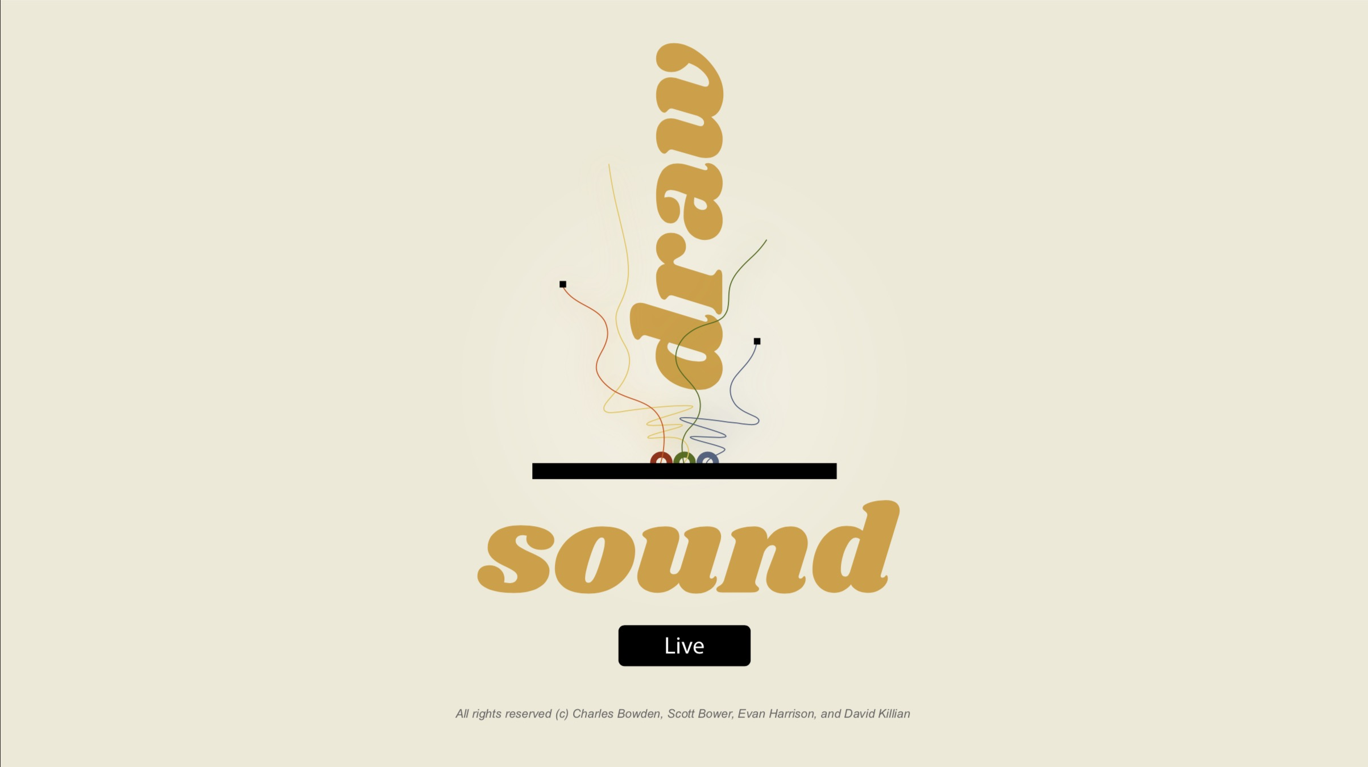
Evan Harrison
Scott Bower
David Killian
Charles Bowden
Notes:
Architectural Win // Technical Case Study
Framework for our discussion
- Customer Engagement
-Technology
- Problem Solving

Slide 2
Draw < -- > Sound < -- > Live Motivation
Explore the intersection of performance art and coding
Inspired by by Soundspace at Durham Science Museum, which merges movement, sound, and visual art
Incorporate cutting-edge web audio
Notes:
Start with background to provide context
- Local/Raleigh
- Breakout growth in past 5 years
- Still has small mom/pop shop
-Derive much of their business indirectly through National Infrastructure Spending (Highway Bill)
- Began our engagement in 2016
- 2 day discovery meeting

Slide 3
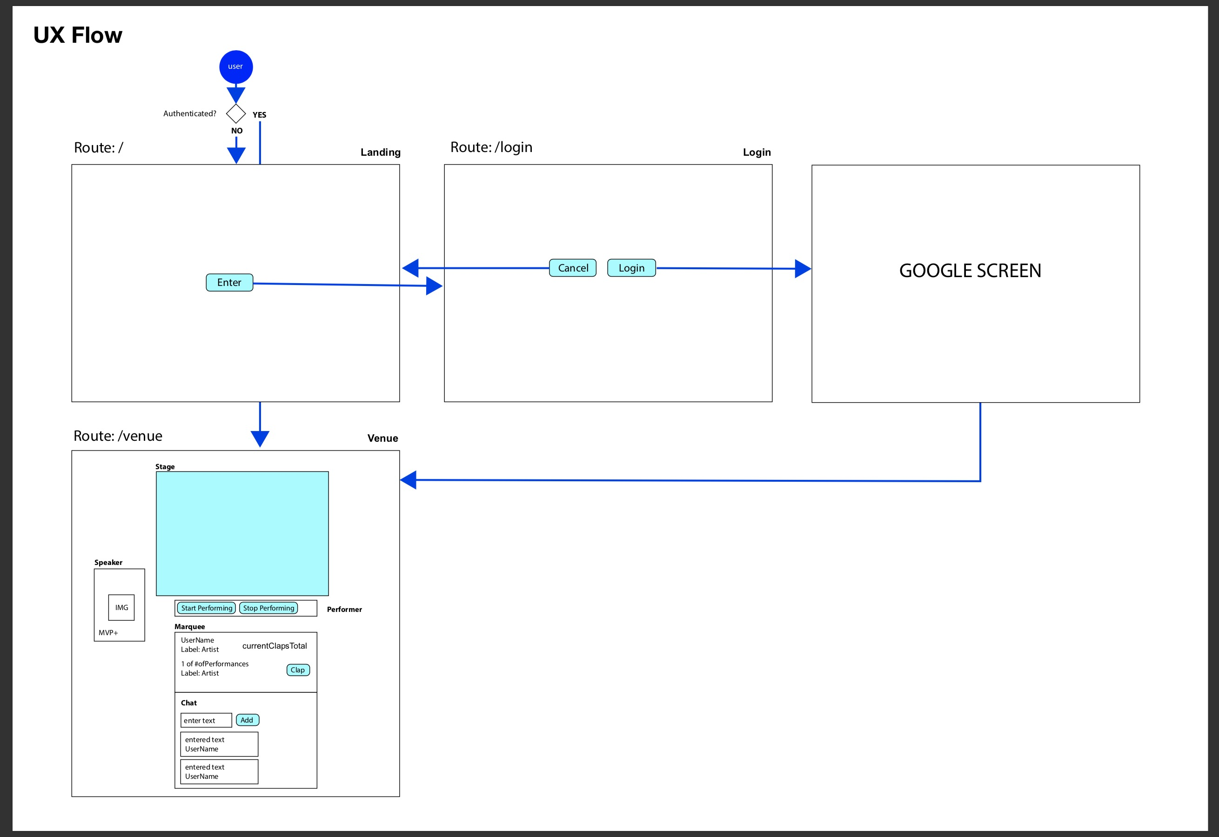
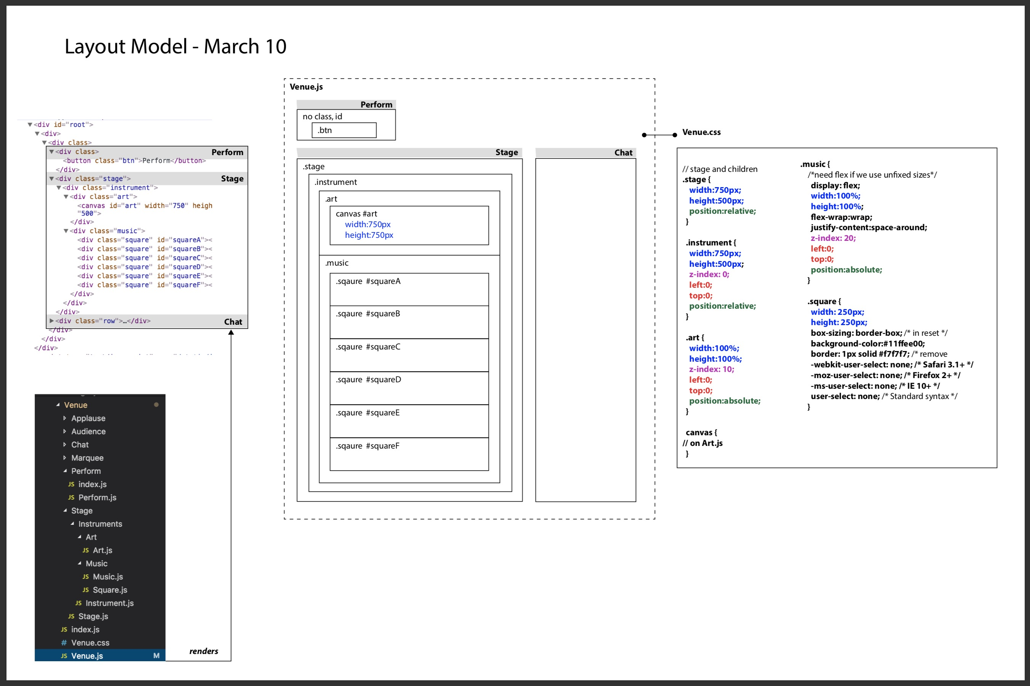
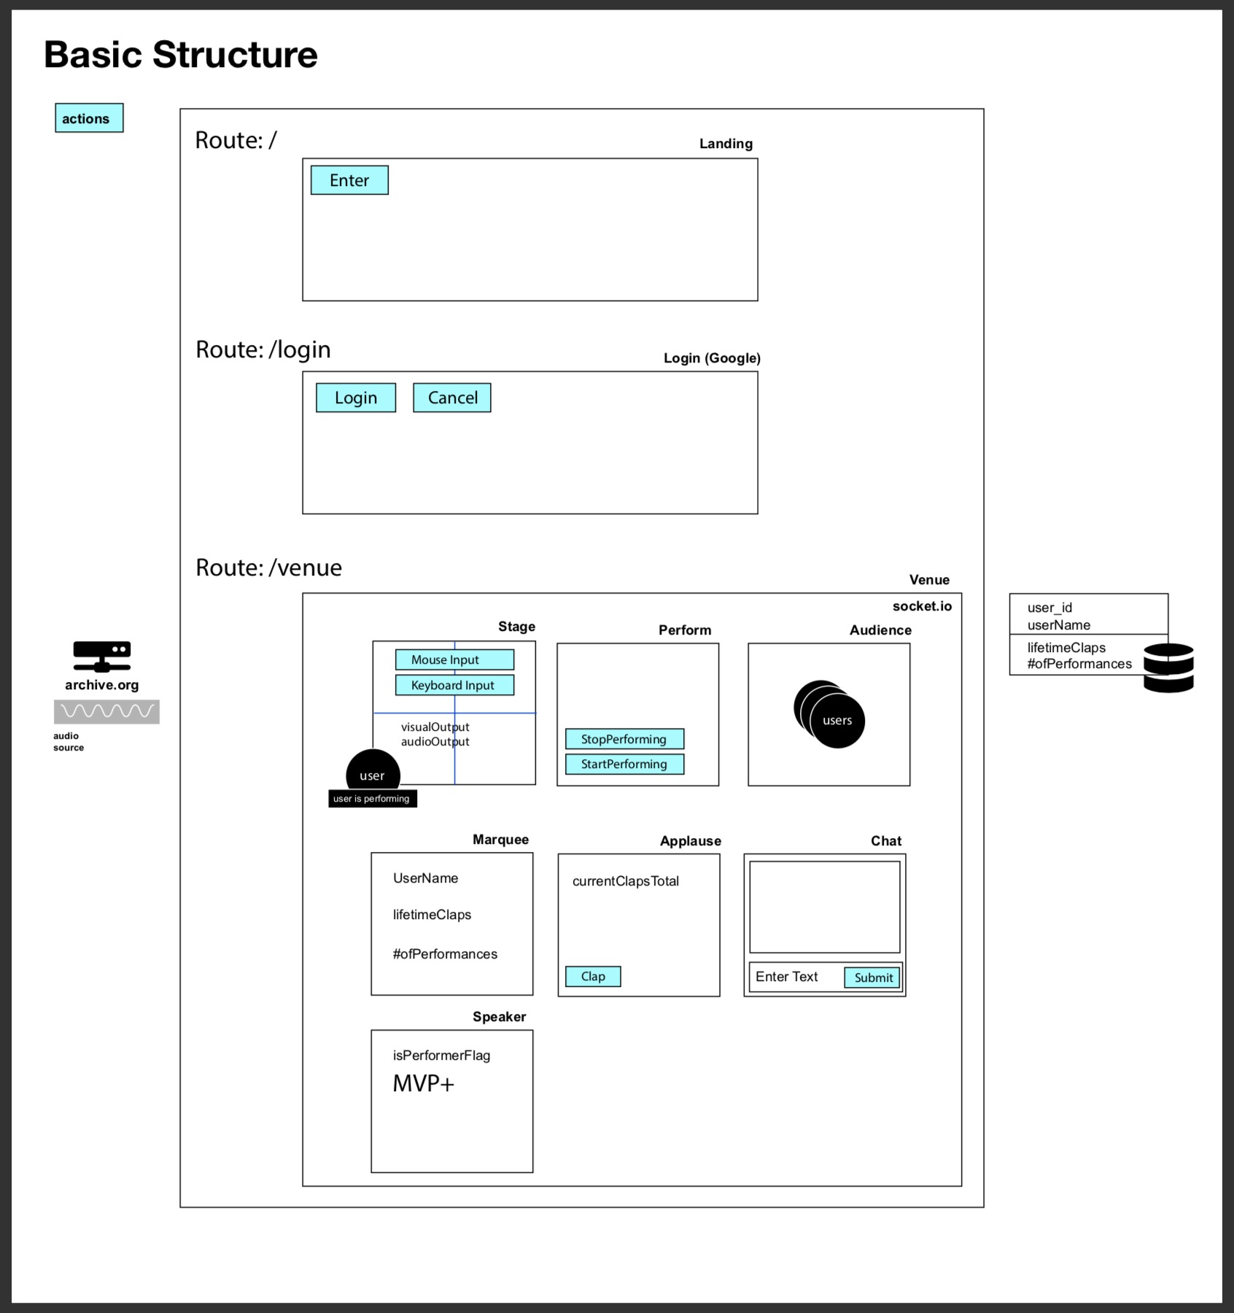
Draw < -- > Sound < -- > Live Process
Research
Notes:
Start with background to provide context
- Local/Raleigh
- Breakout growth in past 5 years
- Still has small mom/pop shop
-Derive much of their business indirectly through National Infrastructure Spending (Highway Bill)
- Began our engagement in 2016
- 2 day discovery meeting

Slide 4
Draw < -- > Sound < -- > Live Design
Epic: make dumb things smart
Mobile-first philosophy
Custom CSS
Multi-user
Authenticated
Relational data model
MVC: efficient code re-use, parallel dev
Notes:
Start with background to provide context
- Local/Raleigh
- Breakout growth in past 5 years
- Still has small mom/pop shop
-Derive much of their business indirectly through National Infrastructure Spending (Highway Bill)
- Began our engagement in 2016
- 2 day discovery meeting

Slide 5














Draw < -- > Sound < -- > Live Stats
14 technologies
21 days
20 branches
100+ commits
4 devs❕
Collaboration
Front End
Back End
Notes:
Start with background to provide context
- Local/Raleigh
- Breakout growth in past 5 years
- Still has small mom/pop shop
-Derive much of their business indirectly through National Infrastructure Spending (Highway Bill)
- Began our engagement in 2016
- 2 day discovery meeting

Slide 6
Draw < -- > Sound < -- > Live Roadmap
Simple and intuitive layout
Basic List of items and tasks
Reminders and status
Quick update
”Sticky note” records
User authentication
Updated layout
Comprehensive list
Granular editing
Auto fill dates
Integration with Google Calendar
Text and email notification
PWA
Manufacturer integration
Product inventory
Advertising services
Service company referrals
Trend & Demographic analytics
Release 1.0
Release 2.0
Release 3+
Notes:
Start with background to provide context
- Local/Raleigh
- Breakout growth in past 5 years
- Still has small mom/pop shop
-Derive much of their business indirectly through National Infrastructure Spending (Highway Bill)
- Began our engagement in 2016
- 2 day discovery meeting

Slide 7
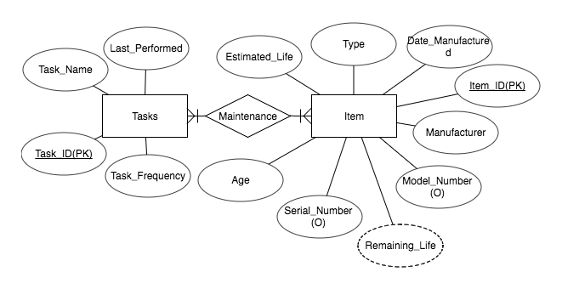
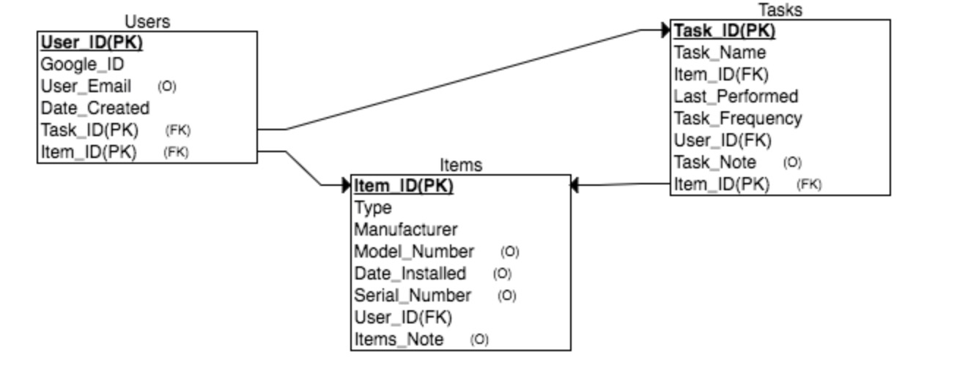
Artifacts
Notes:
Start with background to provide context
- Local/Raleigh
- Breakout growth in past 5 years
- Still has small mom/pop shop
-Derive much of their business indirectly through National Infrastructure Spending (Highway Bill)
- Began our engagement in 2016
- 2 day discovery meeting

