Slide 1
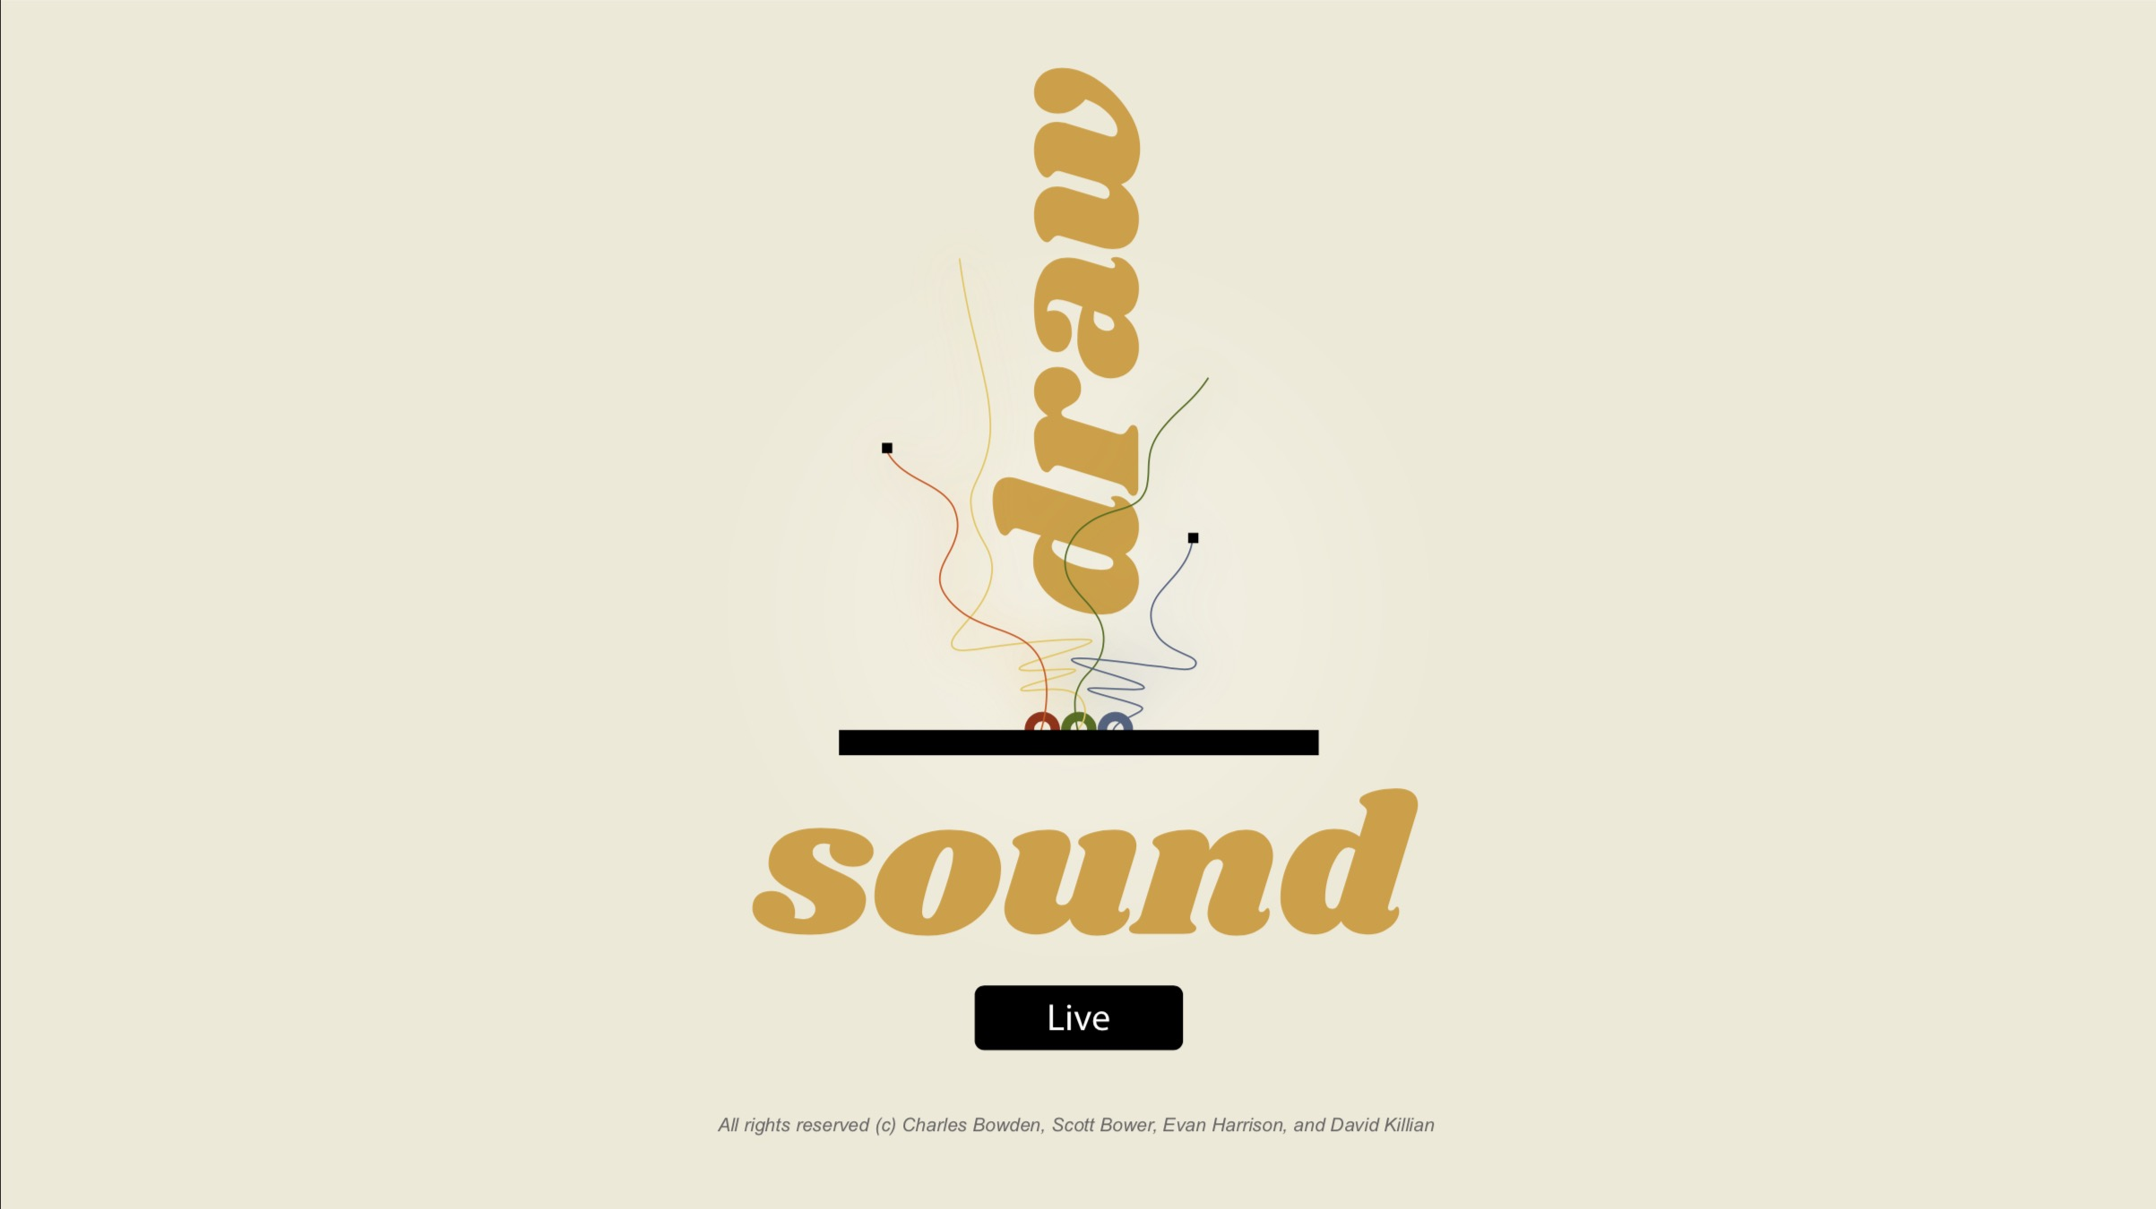
Evan Harrison
Scott Bower
David Killian
Charles Bowden
Notes:
Architectural Win // Technical Case Study
Framework for our discussion
- Customer Engagement
-Technology
- Problem Solving

Slide 2
Draw < -- > Sound < -- > Live Motivation
How can creatively coding visual and audio instruments be brought together in interesting, fun, and unexpected ways?
Notes:
Start with background to provide context
- Local/Raleigh
- Breakout growth in past 5 years
- Still has small mom/pop shop
-Derive much of their business indirectly through National Infrastructure Spending (Highway Bill)
- Began our engagement in 2016
- 2 day discovery meeting

Slide 3
Draw < -- > Sound < -- > Live Motivation
Draw - Sound - Live is a live performance space that enables users to draw music for an audience.
Beneath the covers, an input controller captures and transmits user interactions to the audience
A canvas interprets and renders user performances both visually and by transforming sound
Its up to the performer to determine the composition of the input controller AND the rules of expression - will the art and music work together in enabling the performer to understand?
Inspired by by Soundspace at Durham Science Museum, which merges movement, sound, and visual art
Notes:
Start with background to provide context
- Local/Raleigh
- Breakout growth in past 5 years
- Still has small mom/pop shop
-Derive much of their business indirectly through National Infrastructure Spending (Highway Bill)
- Began our engagement in 2016
- 2 day discovery meeting

Slide 4
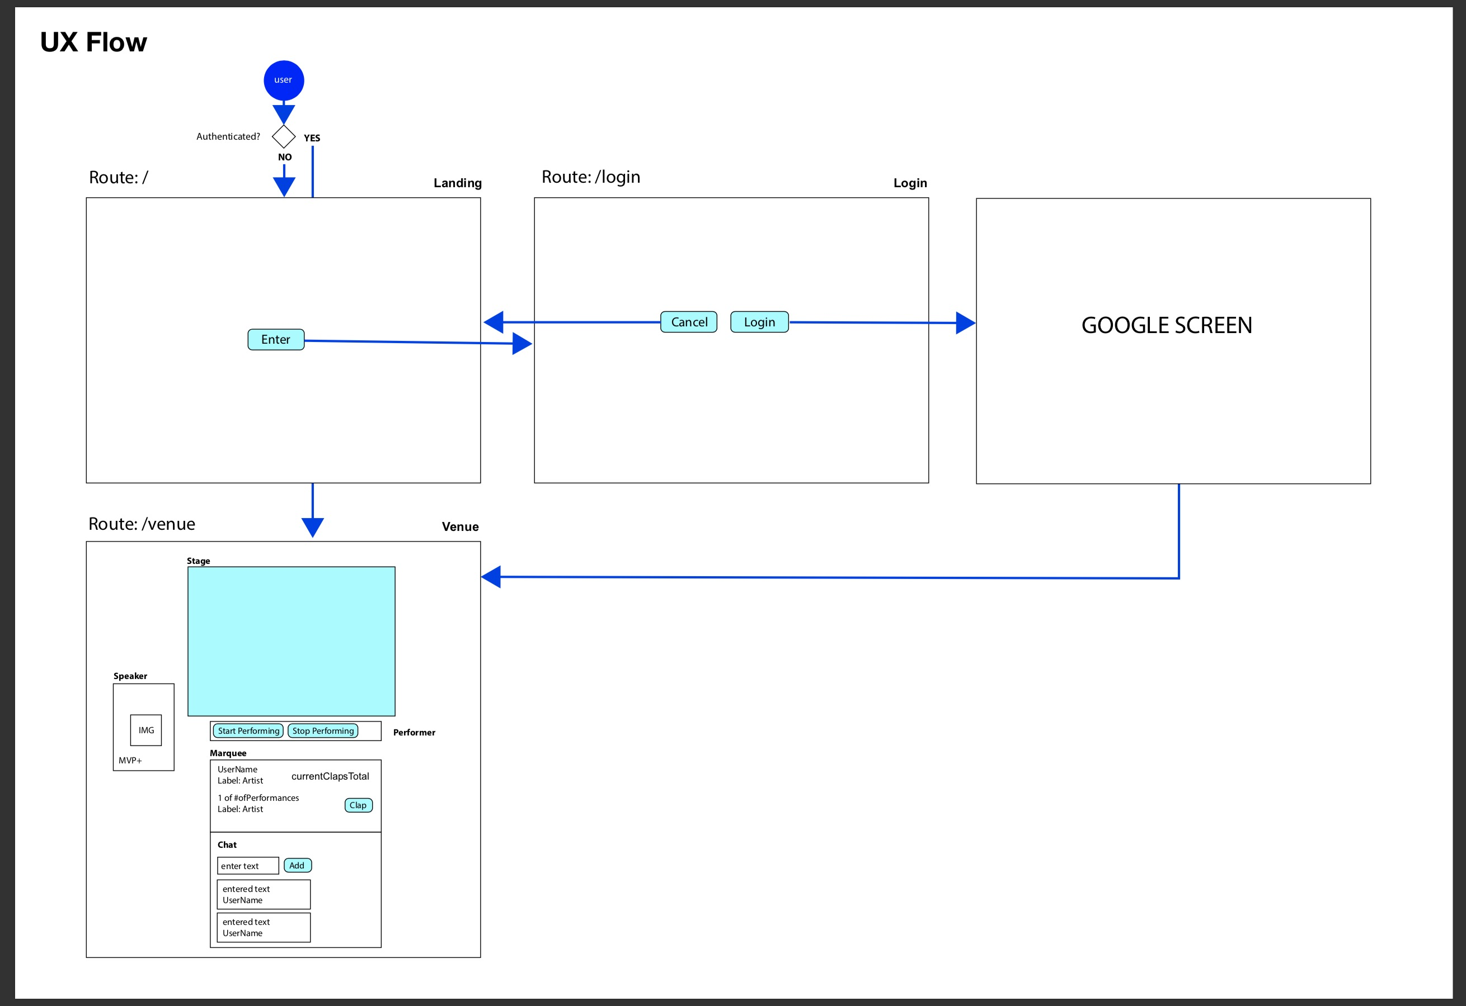
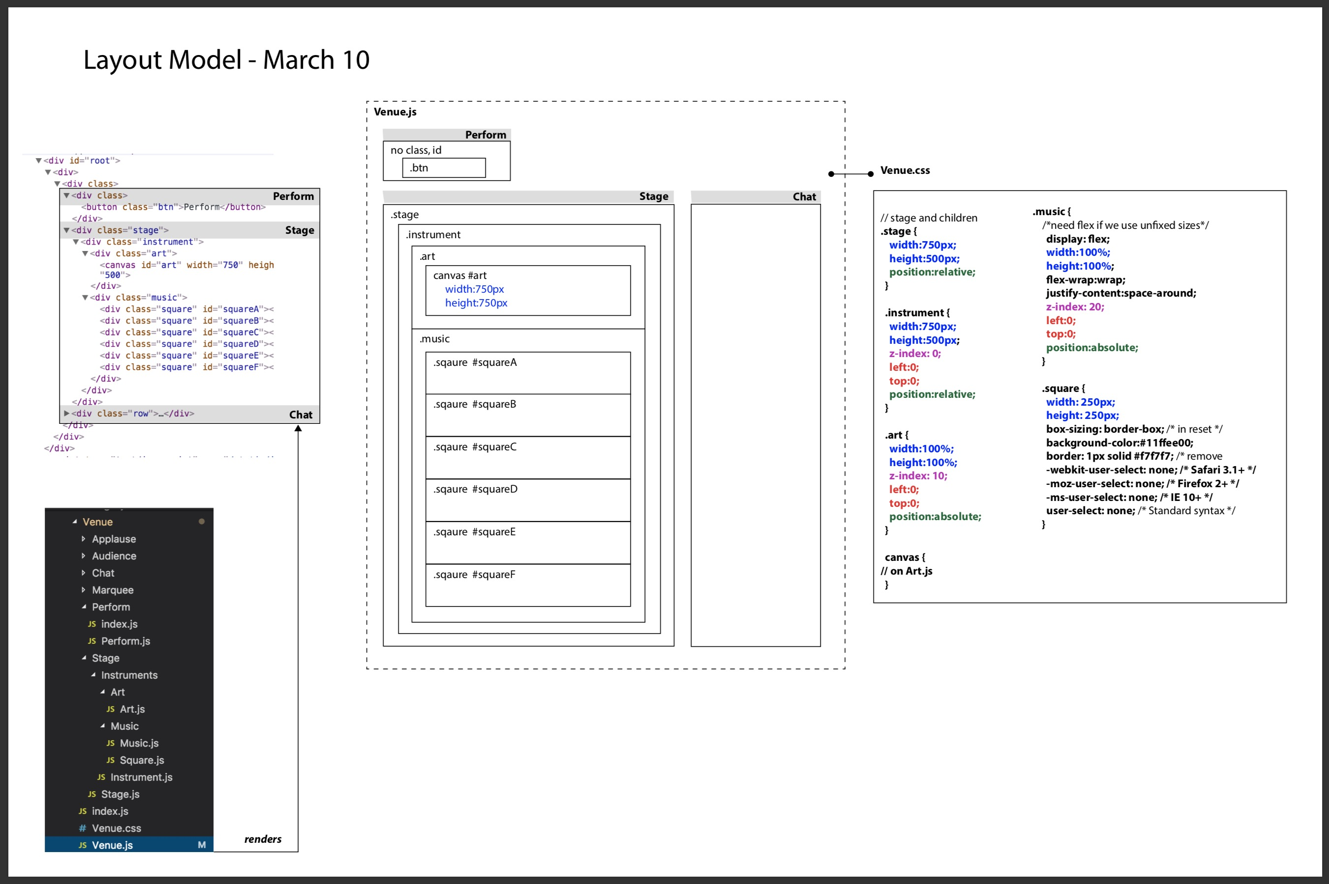
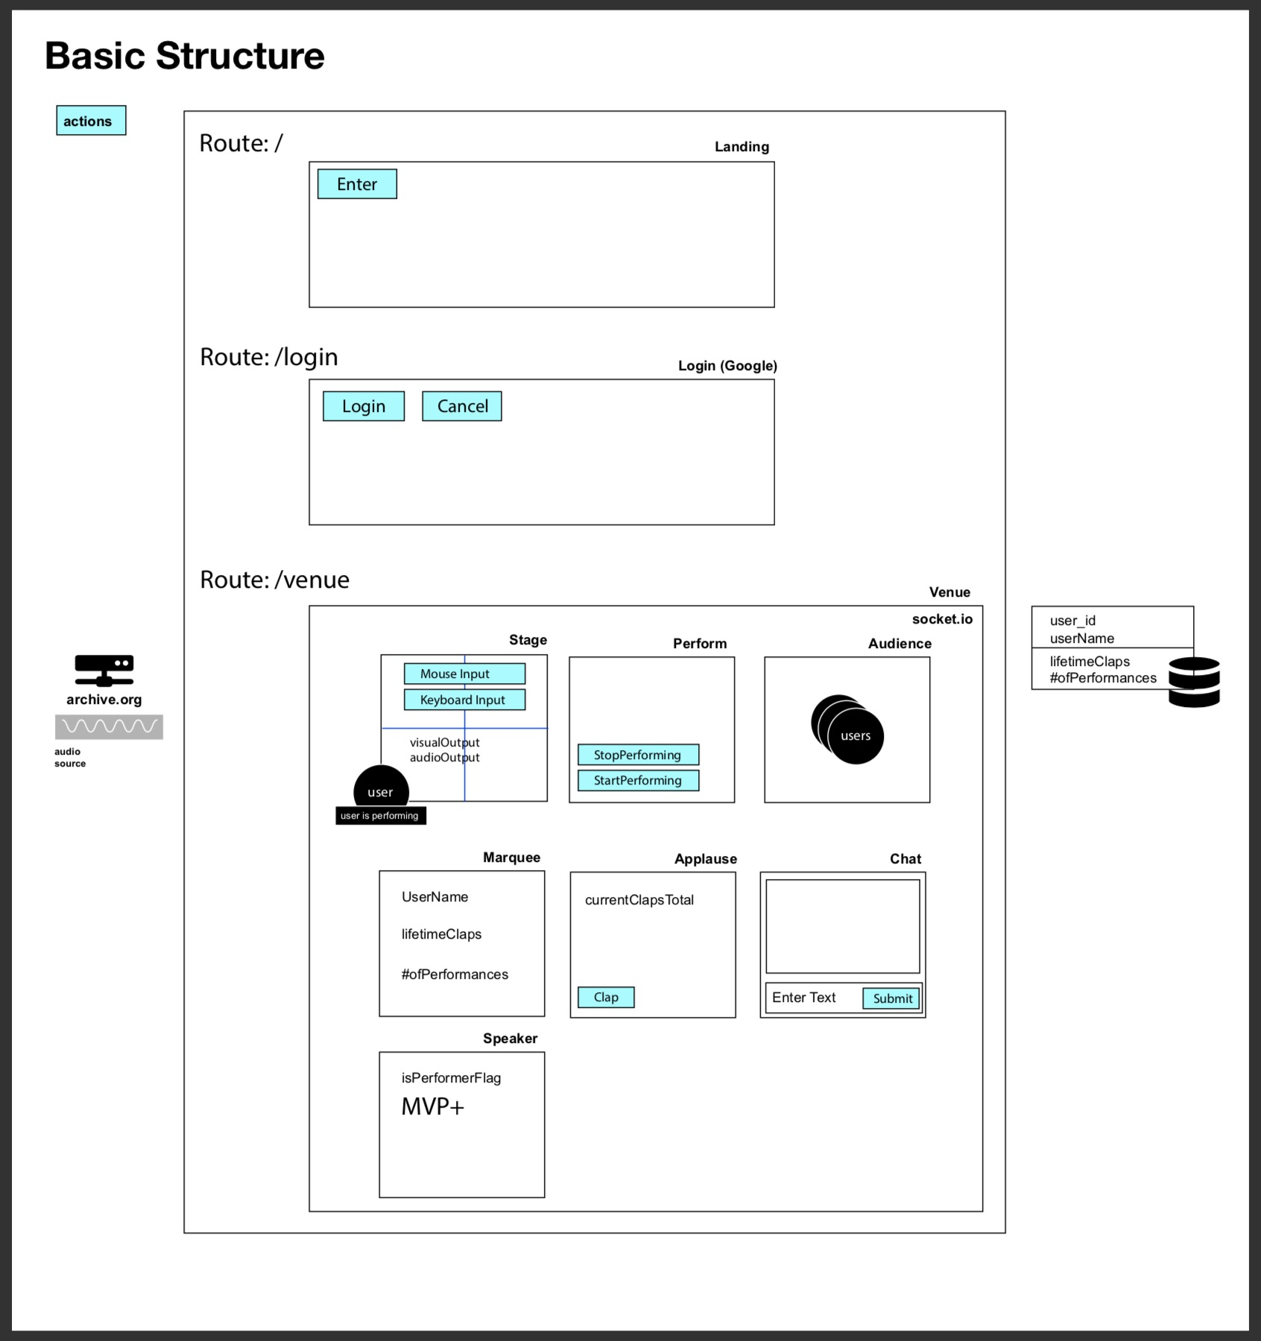
Draw < -- > Sound < -- > Live Process
Research
Wire frame
Notes:
Start with background to provide context
- Local/Raleigh
- Breakout growth in past 5 years
- Still has small mom/pop shop
-Derive much of their business indirectly through National Infrastructure Spending (Highway Bill)
- Began our engagement in 2016
- 2 day discovery meeting

Slide 5
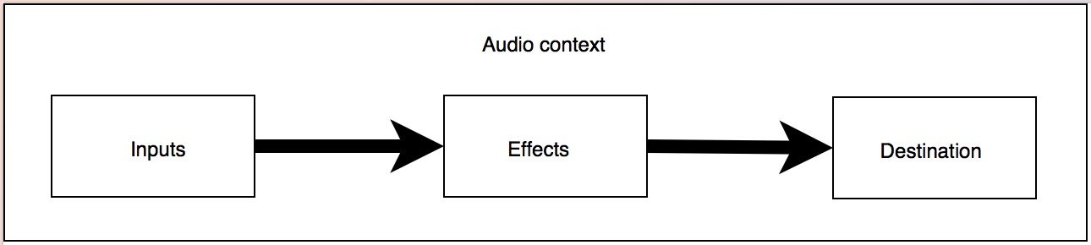
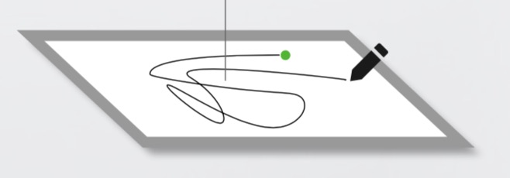
Draw < -- > Sound < -- > Live Design
Render cutting-edge audio {sound effects}
Visualize performance {canvas}
Mimic live venue {chat, clapping, booing}
Encourage whimsy {instrument}
Notes:
Start with background to provide context
- Local/Raleigh
- Breakout growth in past 5 years
- Still has small mom/pop shop
-Derive much of their business indirectly through National Infrastructure Spending (Highway Bill)
- Began our engagement in 2016
- 2 day discovery meeting

Slide 6


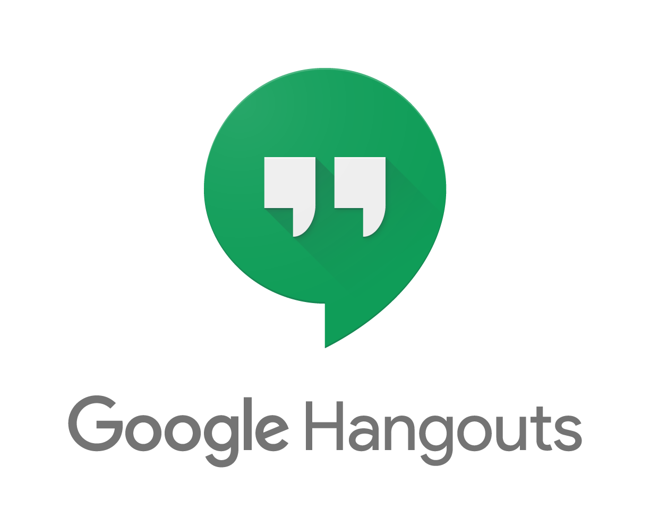













Draw < -- > Sound < -- > Live Stats
14 technologies
21 days
20 branches
100+ commits
4 devs❕
Collaboration
Front End
Back End
Notes:
Start with background to provide context
- Local/Raleigh
- Breakout growth in past 5 years
- Still has small mom/pop shop
-Derive much of their business indirectly through National Infrastructure Spending (Highway Bill)
- Began our engagement in 2016
- 2 day discovery meeting

