Slide 1
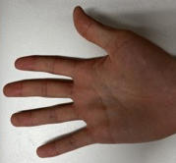
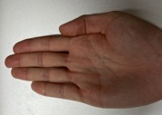
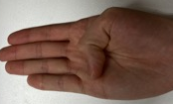
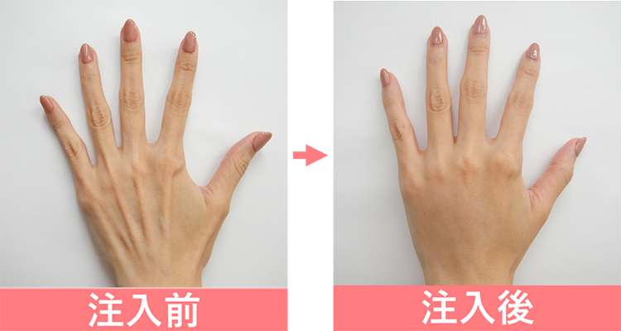
Ratio1_2 = resisntace(pose2) / resistance (pose1)
Ratio1_3 = resisntace(pose3) / resistance (pose1)
Output = |ratio1_3 - ratio1_2|/sqrt(|ratio1_2 - 1|)
Output become bigger as the ratio1_2 reach 1, and ratio1_3 bigger or smaller than ratio1_2
Pose1
Pose2
Pose3
Width(3)
Start (4)
End (3)
Angle (4)
Offset (3)

