Slide 2
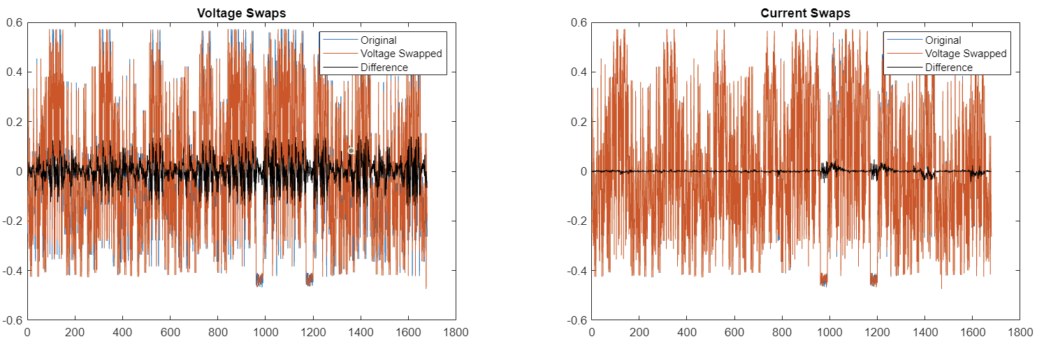
From a single frame of data – these black lines would be zero in an ideal system

Slide 3
The shape of this black line is surprisingly repeatable.
Why?

Slide 4
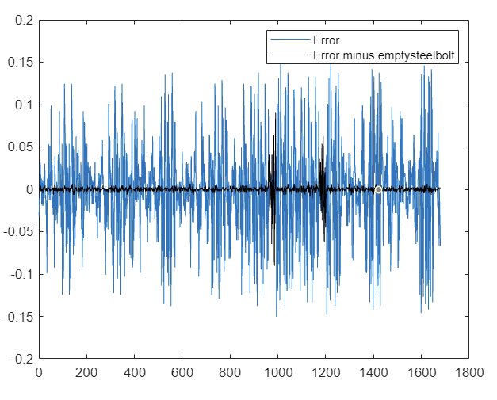
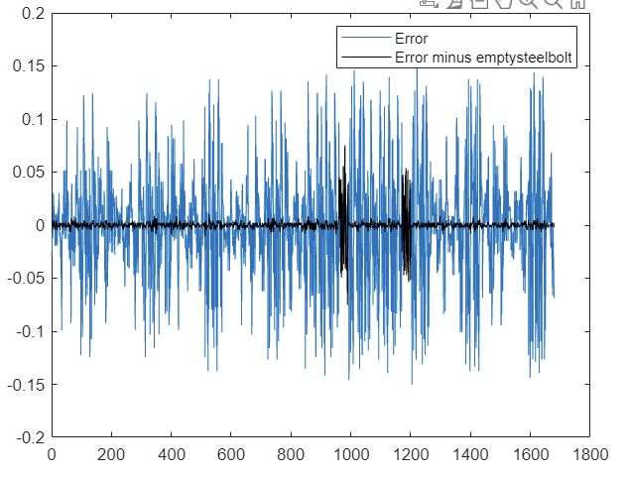
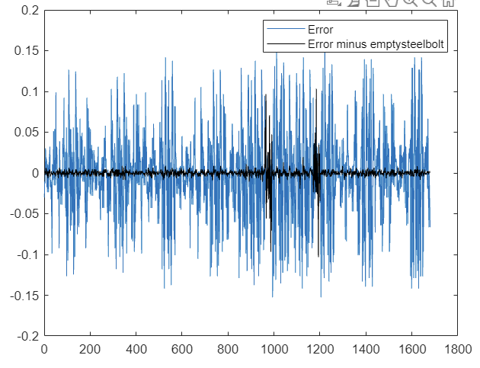
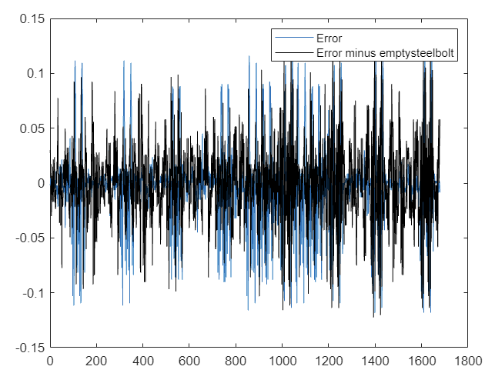
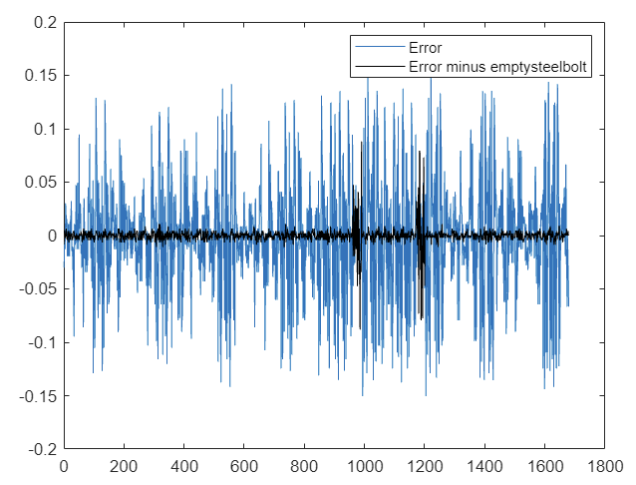
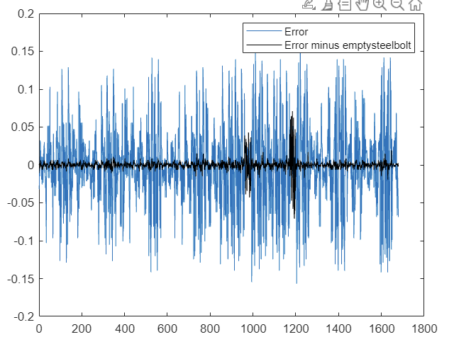
Subtract empty steelbolts errors from other modality errors…
Steelbolts with stimuli
Presshuman
Damages (start)
Damages (end)
Melting
Hemisphere (error shape changes with setup)

Slide 5
Remaining error is comparable to the smallest measured signals: pressrobot.
(Which was already close to background noise: error of same magnitude).
For stronger modalities, can likely not perform repeated measurements (Reducing by 75%).

Slide 6
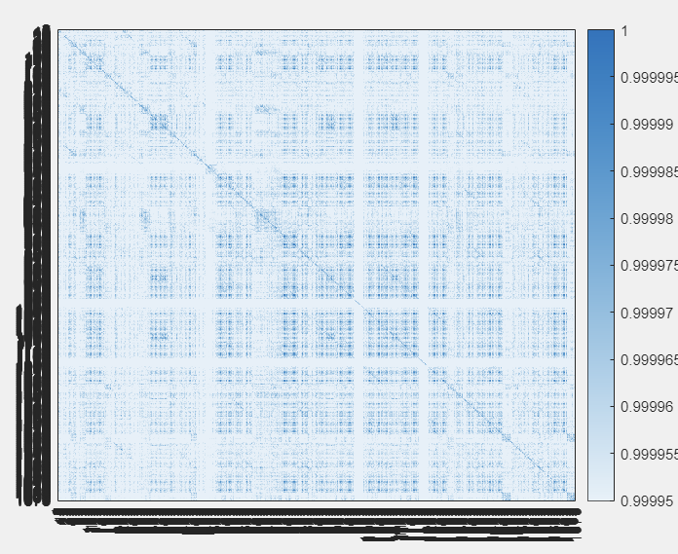
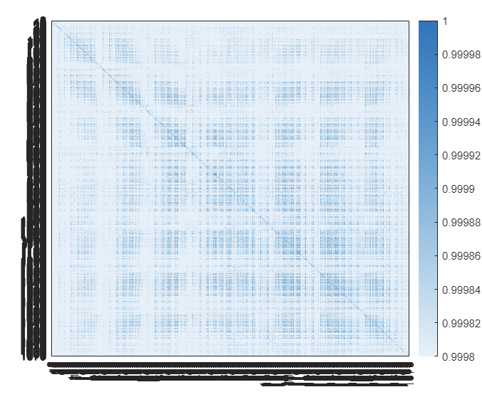
Typical Homogeneous membrane
Membrane with channels
Correlations of all electrode combinations – not much variation between membrane tests

Slide 7
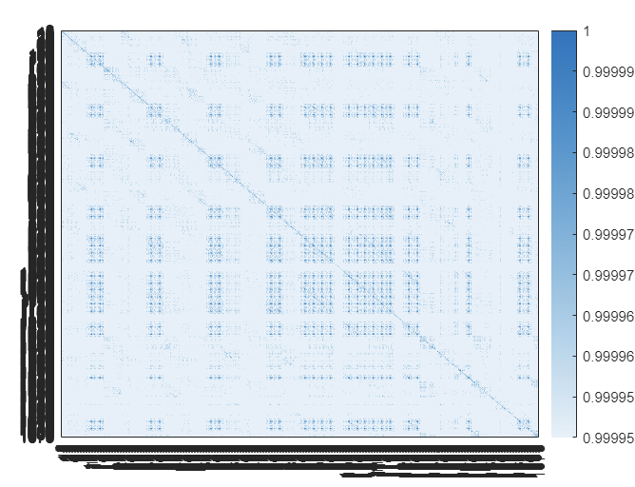
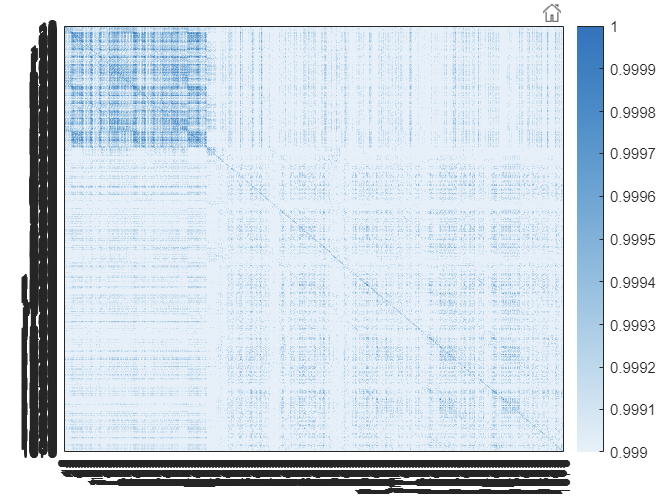
Typical Hemisphere pattern
Typical Membrane pattern
(Salted hemisphere – experimental data needs validating)

Slide 8
TODO: How many more channels could be removed without affecting results?

Slide 9
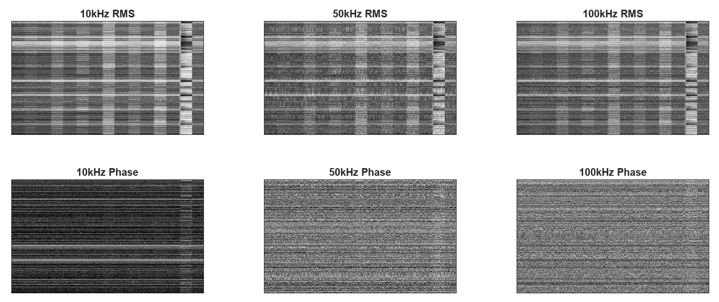
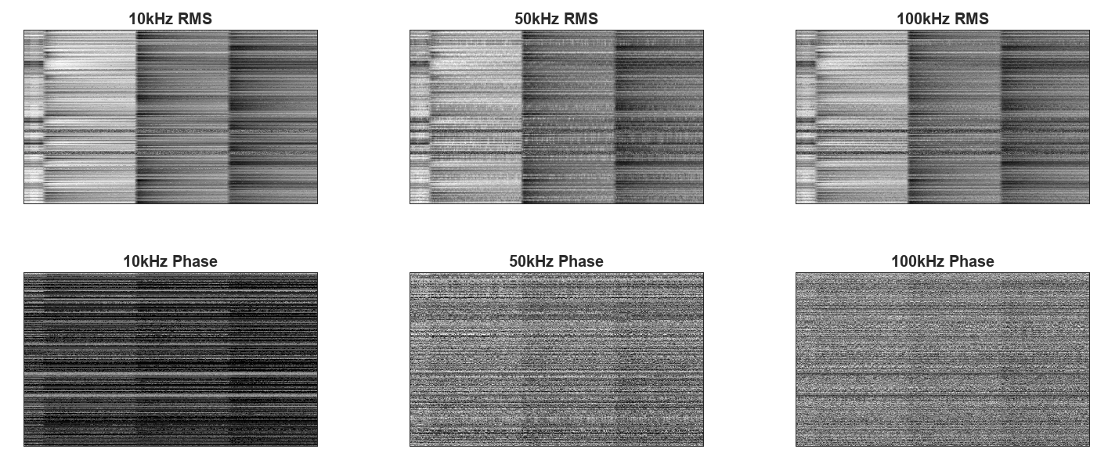
PressRobot
Melting

Slide 10
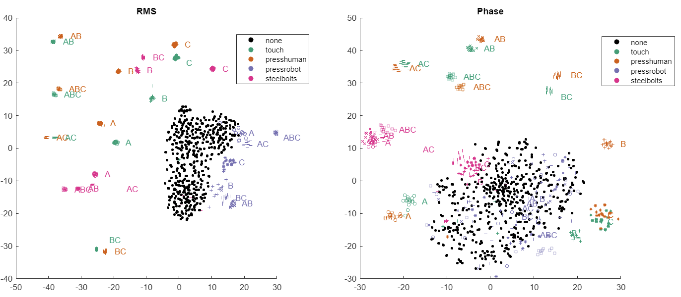
TSNE Clustering – all with events overlaid. 10krms from here unless otherwise specified.

Slide 11
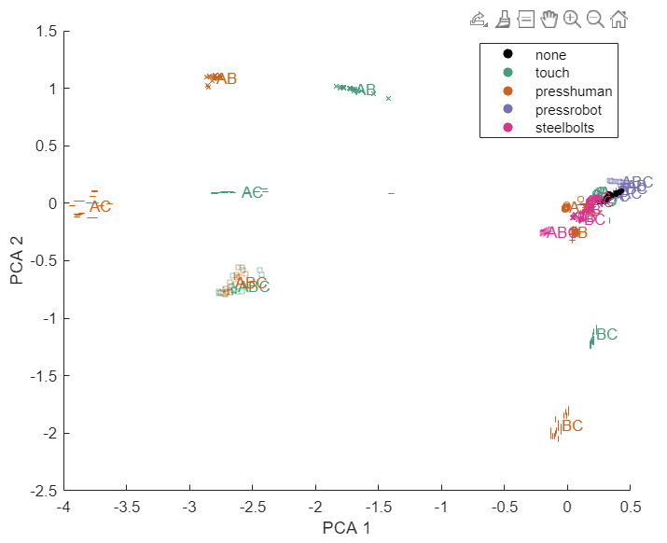
PCA 2D with all. Multi-tactile dominate, and presshuman very similar to pure touching.

Slide 12
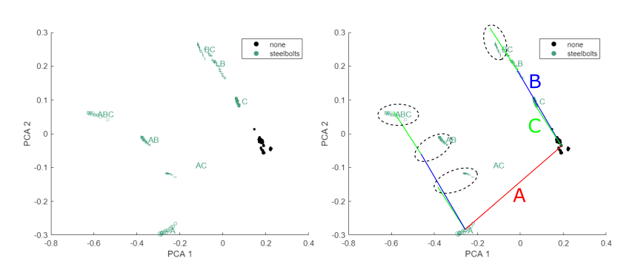
Each can be PCA-ed individually – steel bolts can be superposed

Slide 13
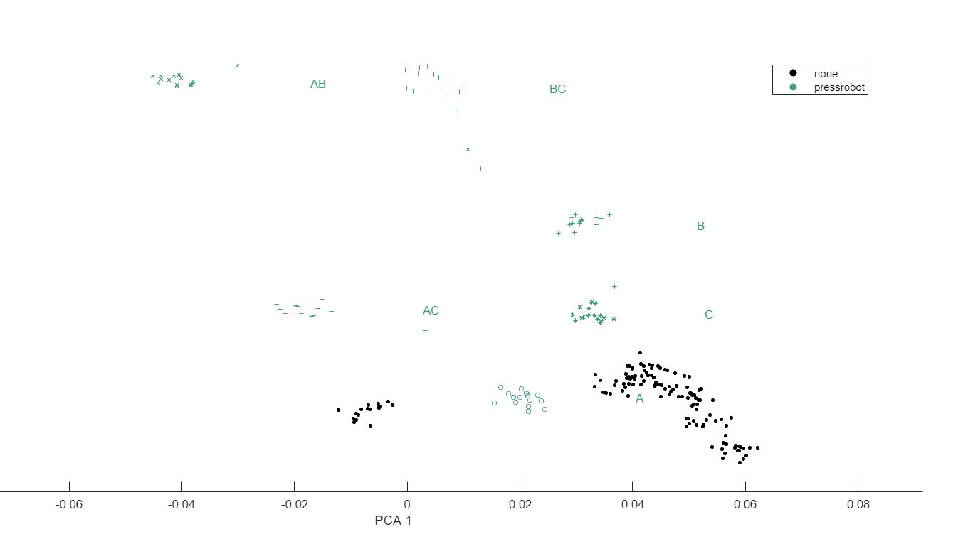

Slide 14
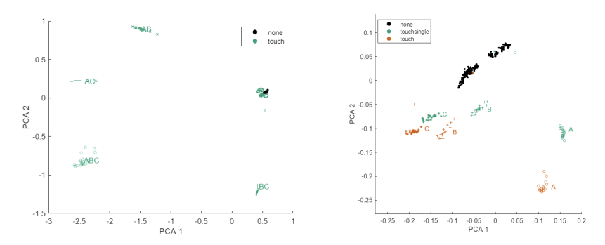
Each can be PCA-ed individually – multi-tactile dominate clustering

Slide 15
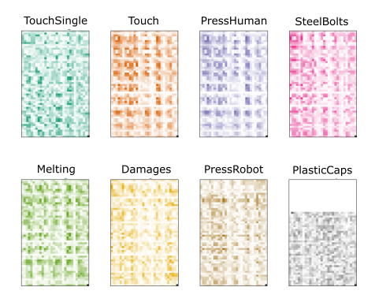
Visualise most important electrode combinations in fingerprint for each – visualization of principal PCA direction

Slide 16
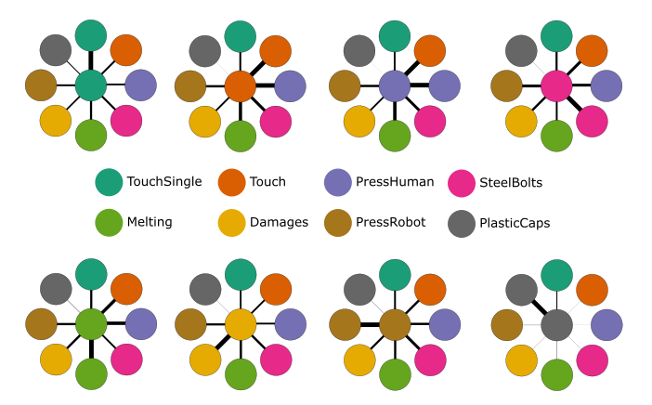
Dot product of fingerprints gives most similar modalities

Slide 17
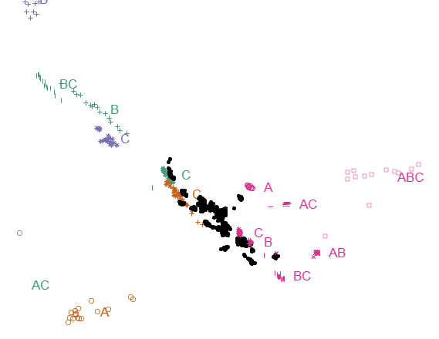
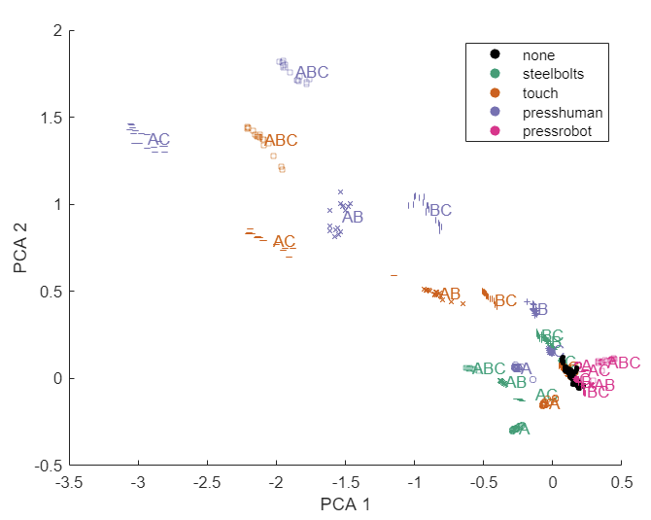
Using only coeffs from steelbolts is surprisingly effective

Slide 18
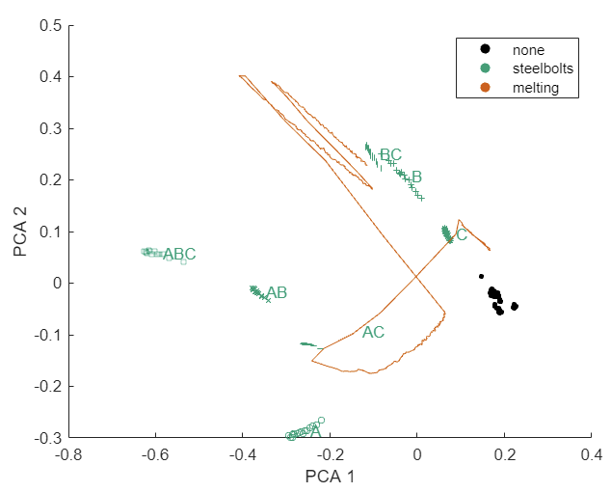
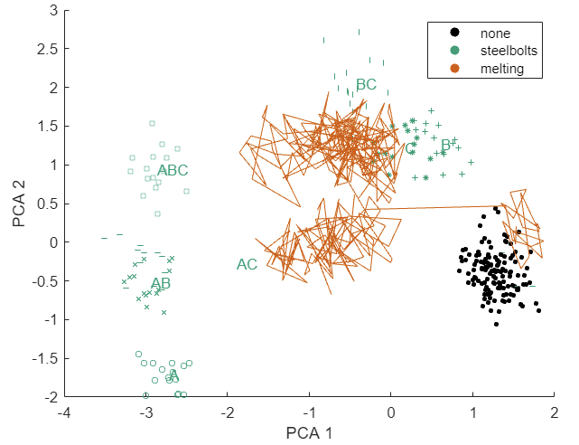
RMS
Phase
Can track melting path from steelbolt axes – though much noisier in phase space

Slide 19
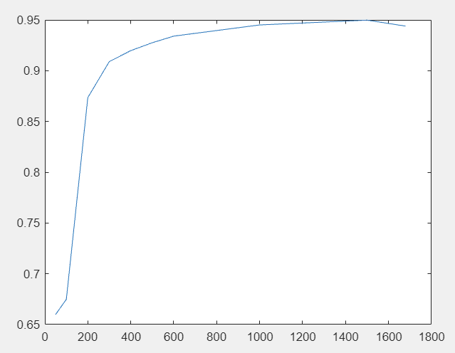
Follow up: PCAElectrodeSubsets.m

