Slide 2
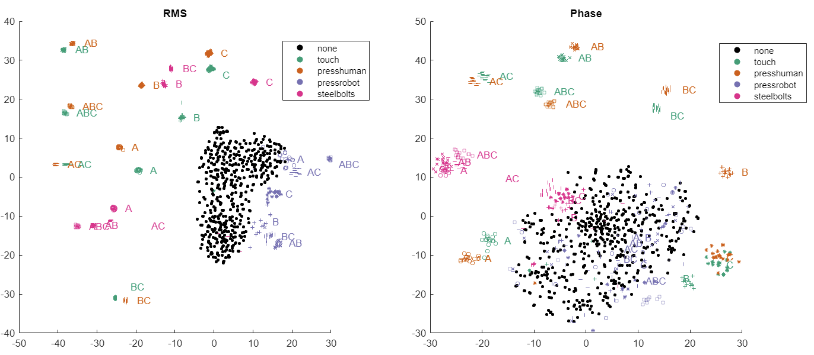
TSNE Clustering – all with events overlaid. 10krms from here unless otherwise specified.

Slide 3
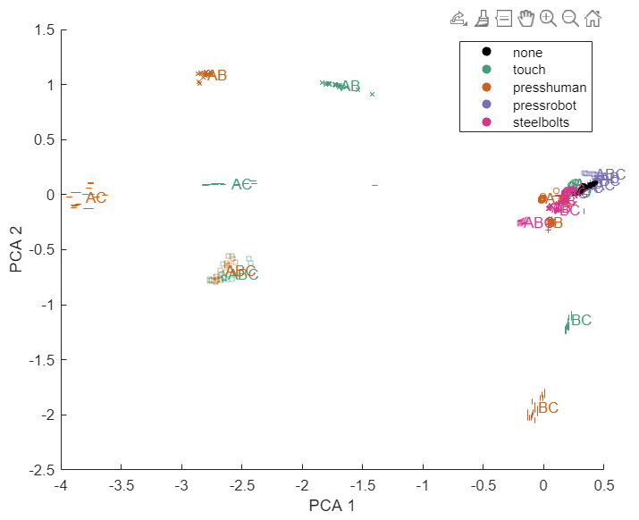
PCA 2D with all. Multi-tactile dominate, and presshuman very similar to pure touching.

Slide 4
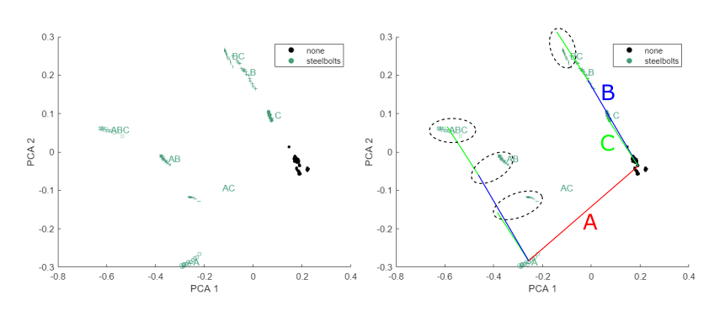
Each can be PCA-ed individually – steel bolts can be superposed

Slide 5
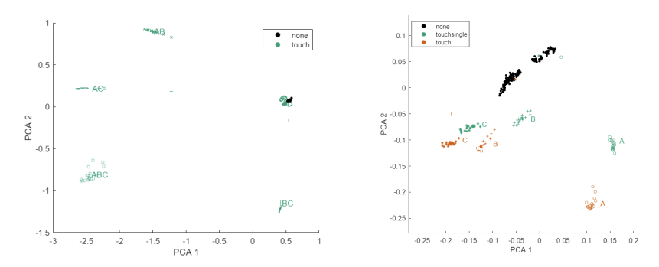
Each can be PCA-ed individually – multi-tactile dominate clustering

Slide 6
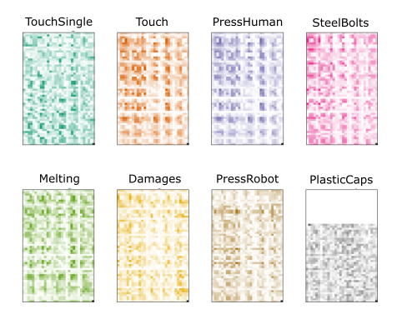
Visualise most important electrode combinations in fingerprint for each – visualization of principal PCA direction

Slide 7
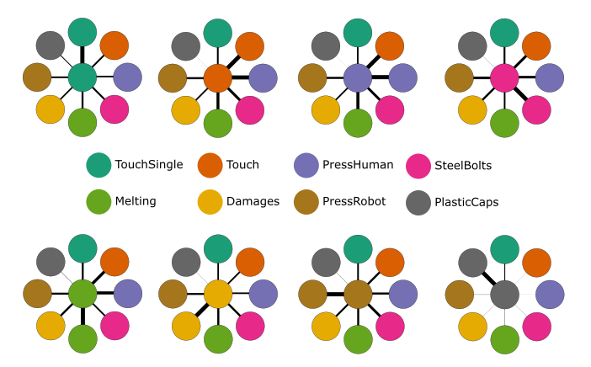
Dot product of fingerprints gives most similar modalities

Slide 8
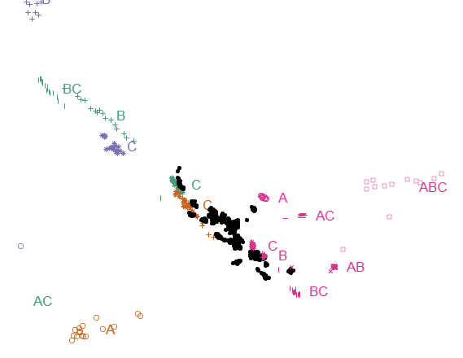
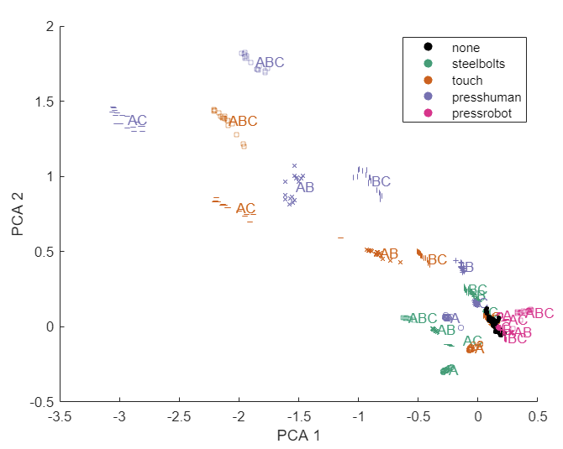
Using only coeffs from steelbolts is surprisingly effective

Slide 9
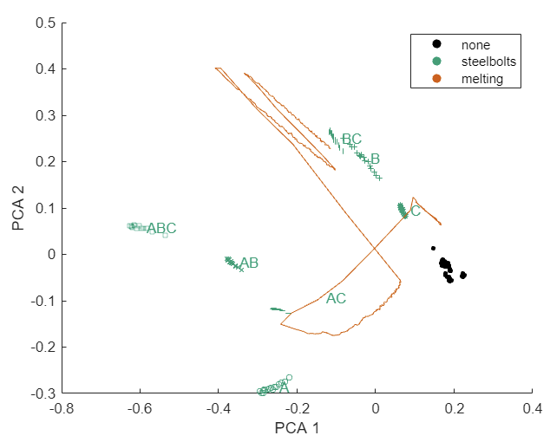
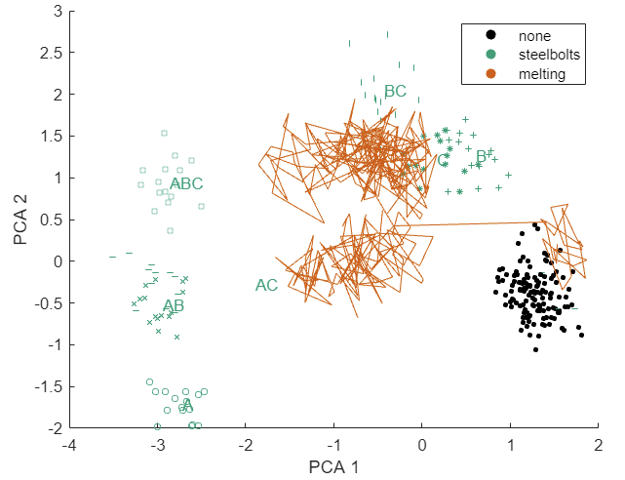
RMS
Phase
Can track melting path from steelbolt axes – though much noisier in phase space

Slide 10
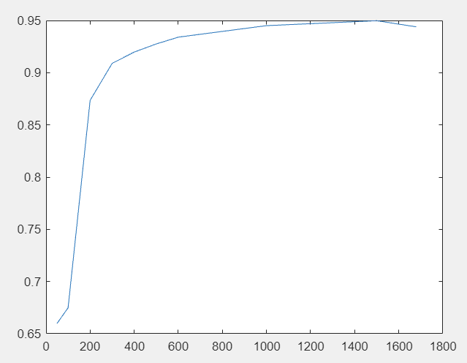
Follow up: PCAElectrodeSubsets.m

