Slide 1
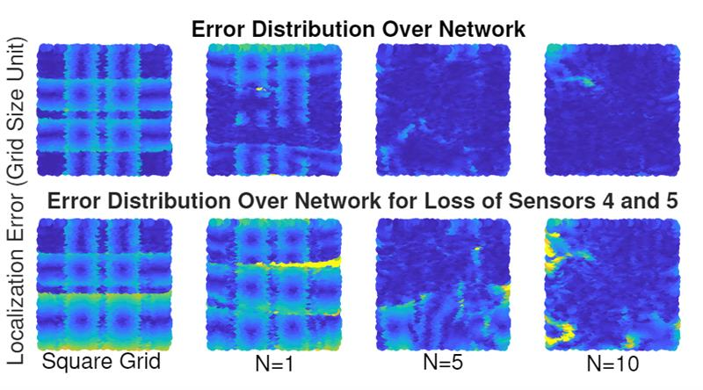
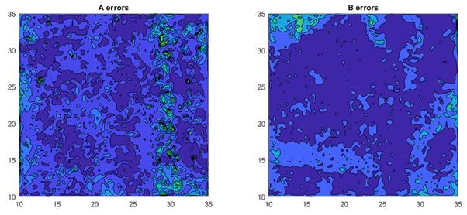

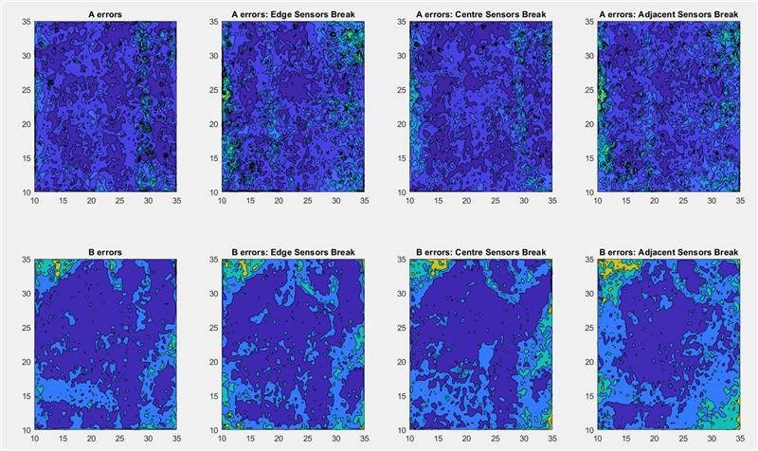
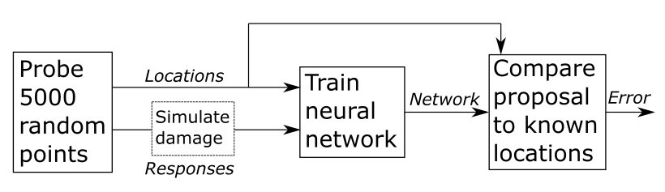
Error Distribution
3D Printed Sensor Networks
Simulated
Measured
Square Grid
Damaged
Square Grid
Complex Grid
Damaged
Complex Grid

