Slide 1
120hrs
24hrs
Dataset A
4000 tests
X & y 0→33.5mm
Depth = 1mm
Dataset B
5000 tests
X & y 0→33.5mm
Depth ∈ [0.5, 1.0, 1.5]mm
Dataset C
5000 tests
X & y 0→33.5mm
Depth ∈ [0.5, 1.0, 1.5]mm

Slide 2
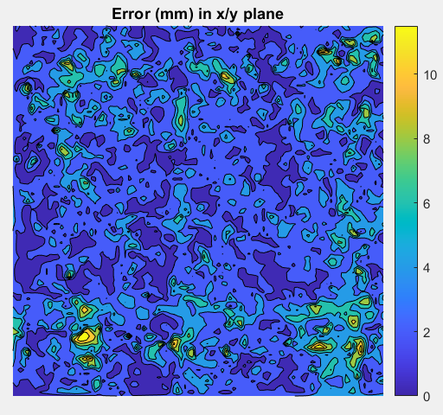
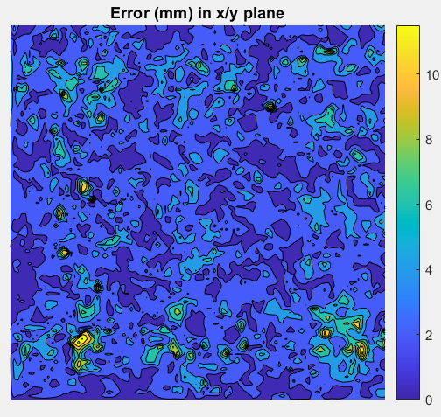
Trained on A
Tested on A
40 Neuron Hidden Layer
(N=40)
50 Neuron Hidden Layer
(N=50)
3.33mm mean
3.04mm mean
Potential for overfitting to noise

Slide 3
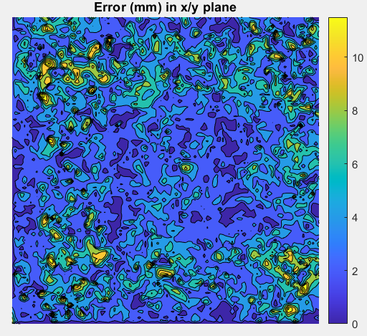
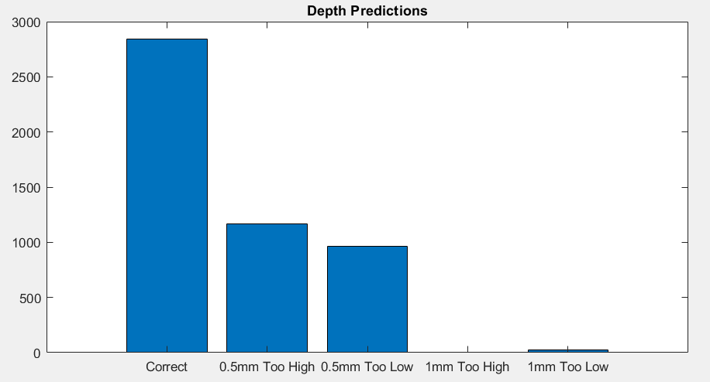
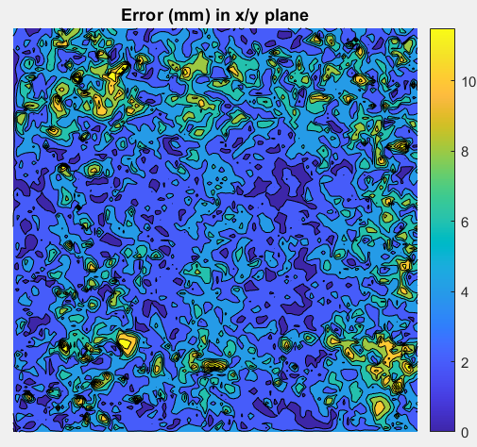
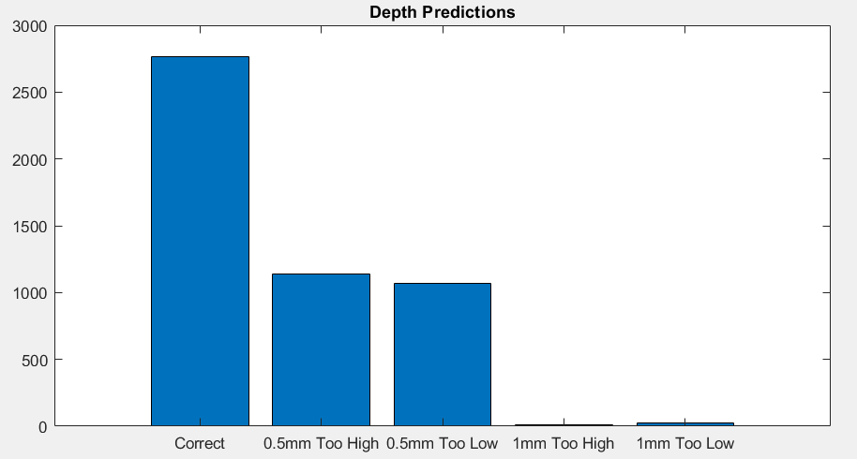
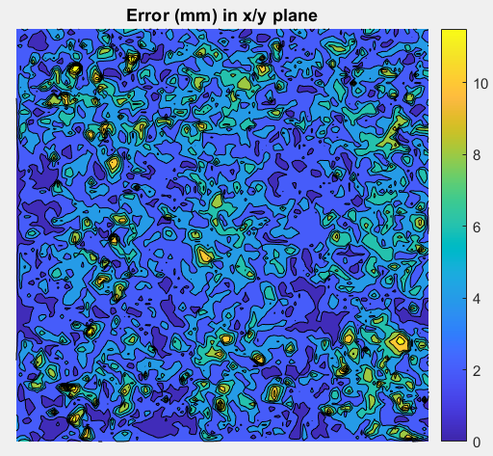
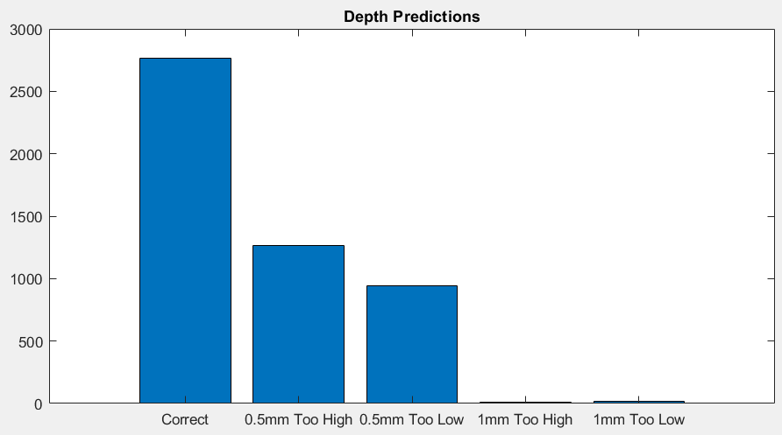
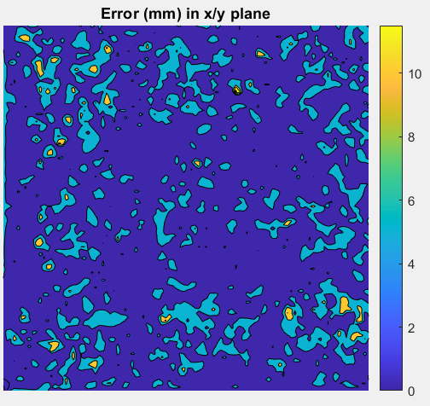
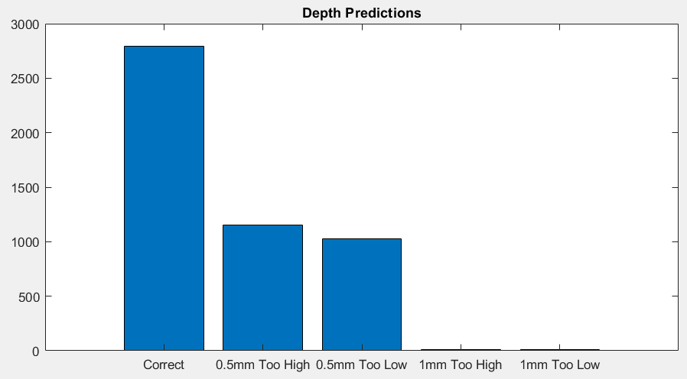
Trained on B
Tested on B
N=50
N=60
4.29mm mean
4.45mm mean
Trained on C
Tested on C
4.17mm mean
3.90mm mean
Potential for overfitting to noise

Slide 4
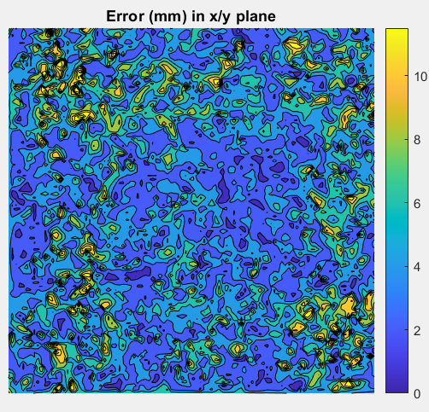

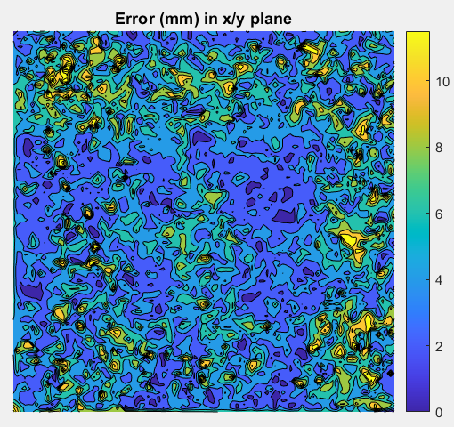
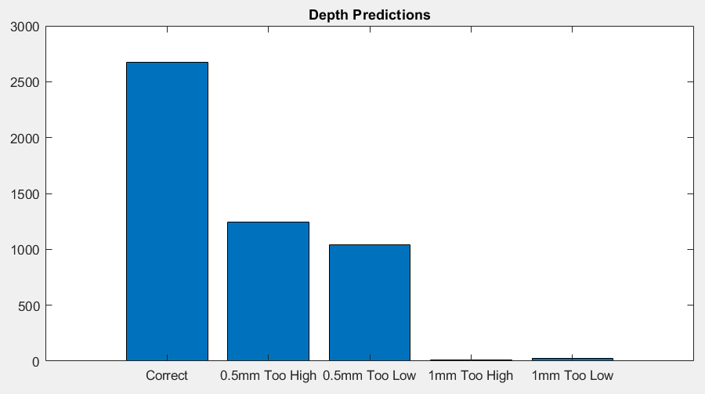
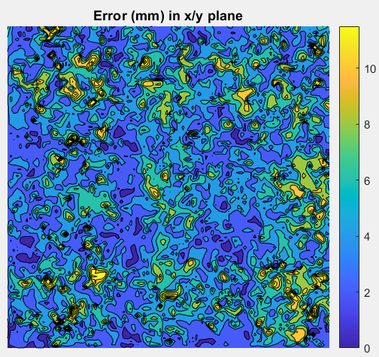
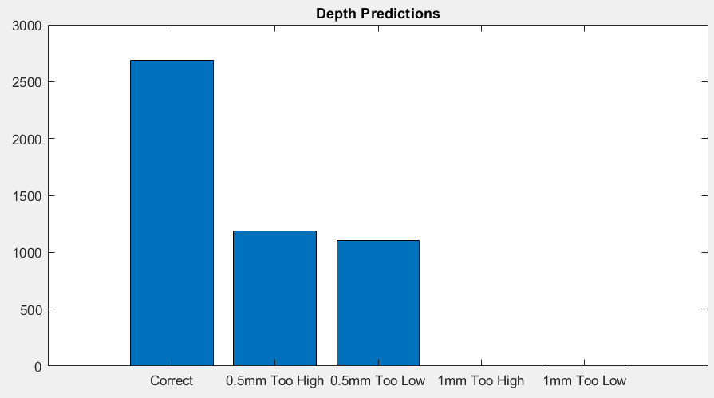
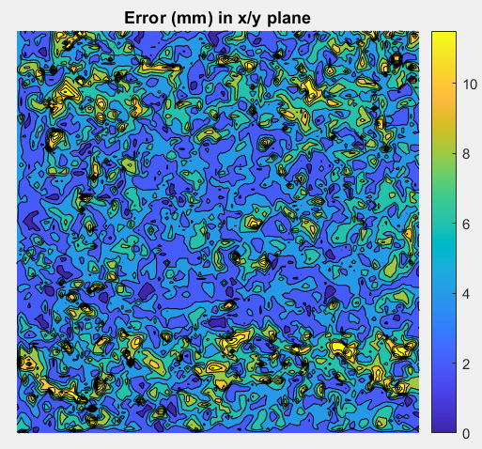
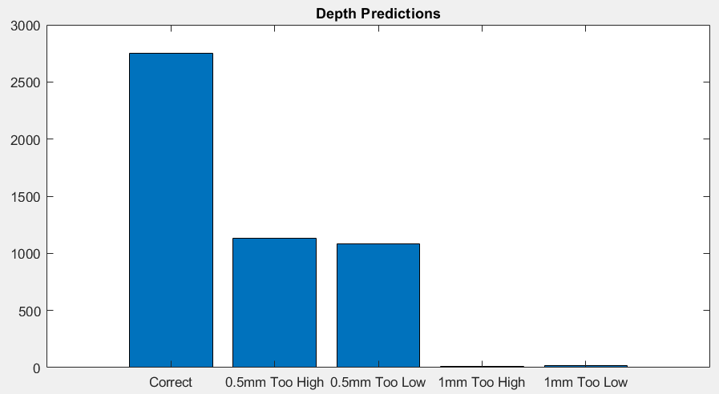
Trained on B
Tested on C
N=50
N=60
5.05mm mean
5.19mm mean
Trained on C
Tested on B
4.50mm mean
4.65mm mean

Slide 5
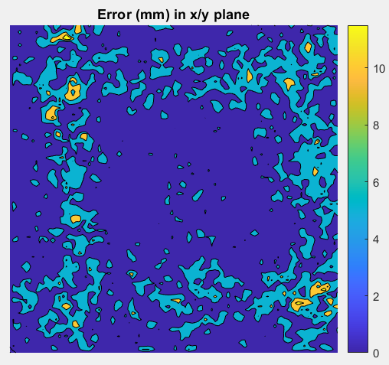
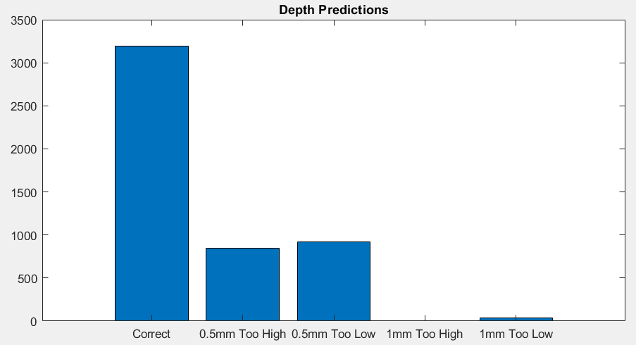
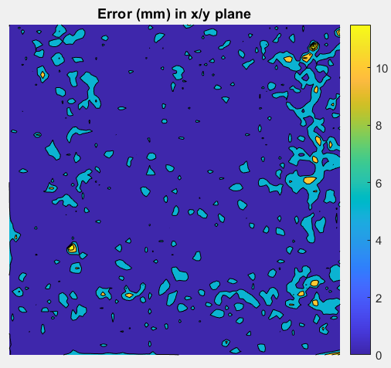
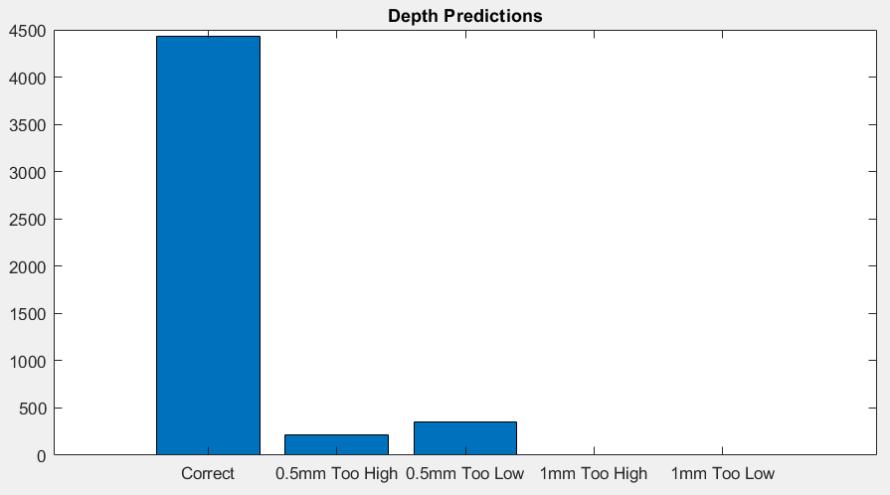
Trained on B
Tested on B
N=100
4.11mm mean
These 2 slides use 80 points from the raw data without TVD
Trained on C
Tested on C
3.25mm mean
Potential for overfitting to noise

Slide 6
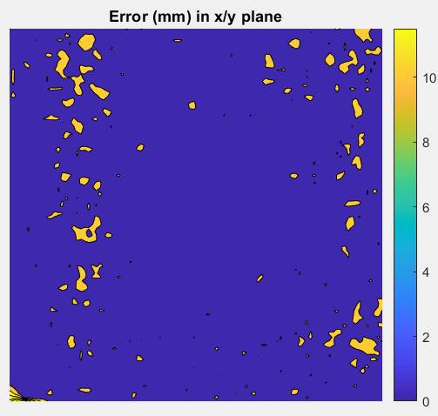
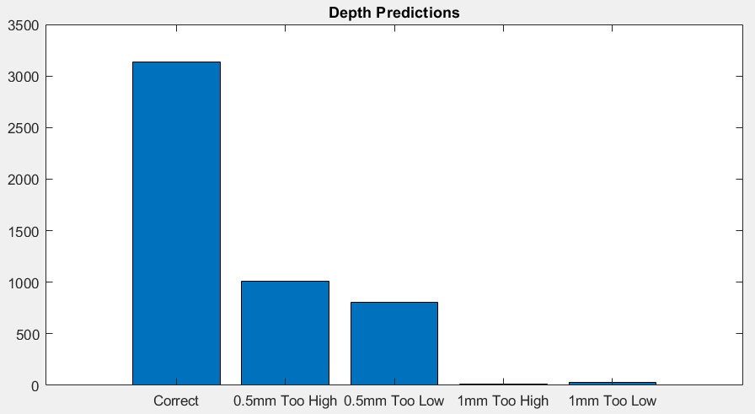
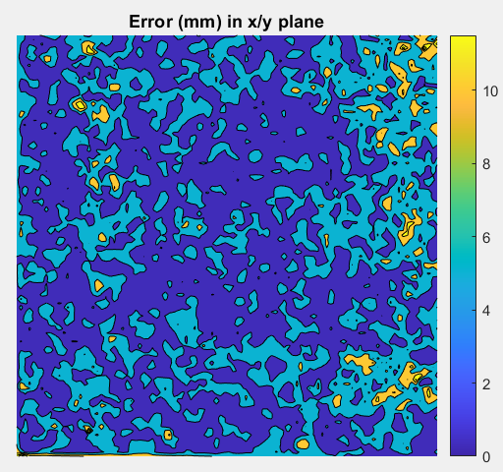
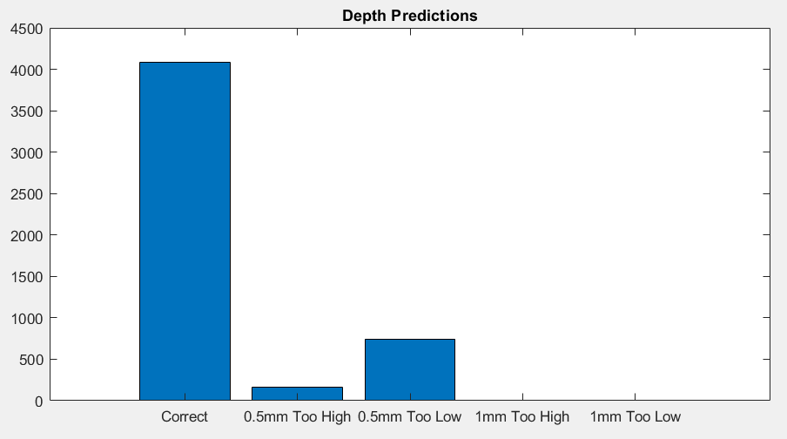
Trained on B
Tested on C
N=100
These 2 slides use 80 points from the raw data without TVD
5.42mm mean
Trained on C
Tested on B
4.40mm mean

