Slide 1
Driver Assistant
Dr. Akbari

Slide 2
Goals
Face Recognition
Driver Monitoring
Drowsiness Detection

Slide 3
Face Recognition
Performed only once
It requires some pictures from legitimate drivers
Many trained models are available
Same model can accomplish extra tasks, like age estimation, mood detection, etc.

Slide 4
Driver Monitoring
Monitor driver actions in real-time
Actions include speaking, texting, drinking, etc.
The model warns the driver if it detects distraction
Fuzzy logic can be used for inference

Slide 5
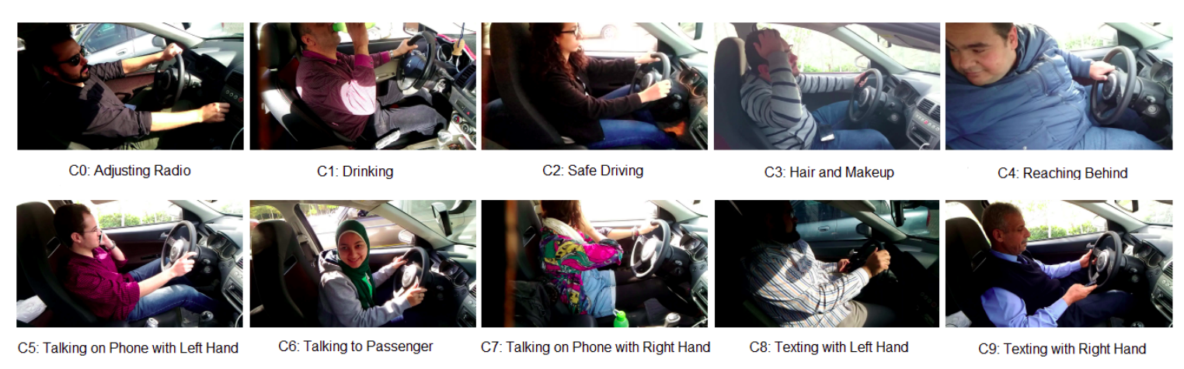
Driver Monitoring

Slide 6
Drowsiness Detection
Detect drowsiness in driver
Facial landmarks might improve accuracy

Slide 7
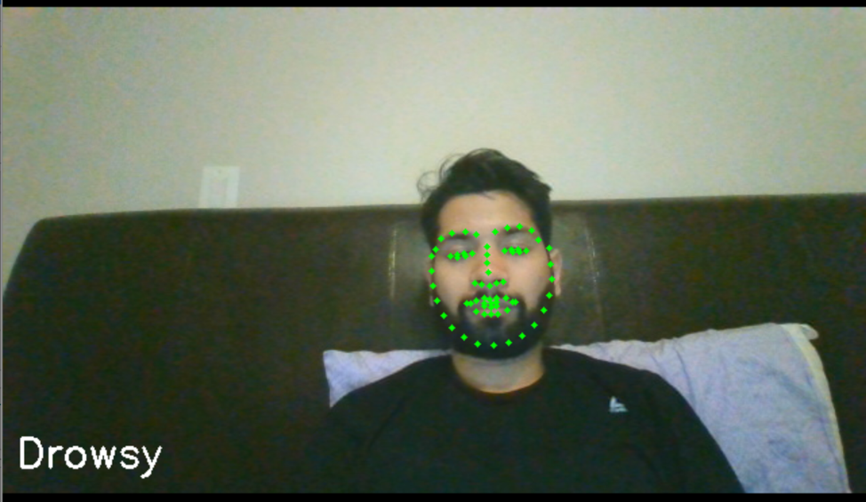
Drowsiness Detection

Slide 8
Datasets
State Farm Distracted Driver Detection
RobeSafe Driver Monitoring Video Dataset
DMD – Driving Monitoring Dataset
Driver Drowsiness Detection Dataset - National Tsuing Hua University

Slide 9
State Farm Dataset
Side view
Pictures only
RGB
Labeled with 9 classes
https://www.kaggle.com/c/state-farm-distracted-driver-detection/data

Slide 10
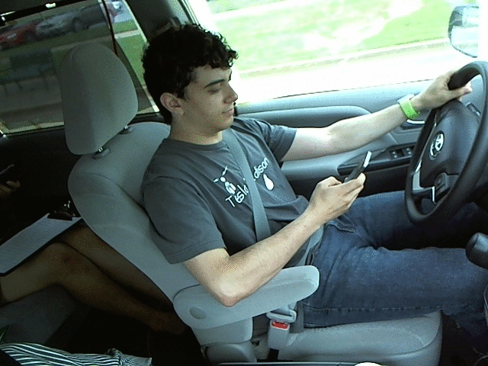
State Farm Dataset

Slide 11
RobeSafe Dataset
Dashboard view
Grayscale videos in 30 fps
Faces have been marked with 20 points
Distributed via hardware! (not available on web)
http://www.robesafe.com/personal/jnuevo/Datasets.html

Slide 12
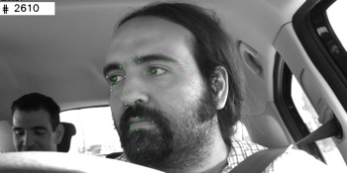
RobeSafe Dataset

Slide 13
DMD
40 hours of video
RGB, infrared and depth data
Recored from three angles
Includes annotation in VCD format
https://dmd.vicomtech.org (distributed via Box)

Slide 14
DMD

Slide 15
Driver Drowsiness Dataset
Relatively low resolution videos in 15 and 30 fps
18 subjects with 5 different scenarios
active infrared (IR) illumination is used to acquire IR videos
Only drowsiness-related labels

Slide 16
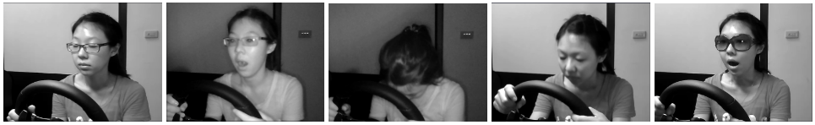
Driver Drowsiness Dataset

