Slide 1
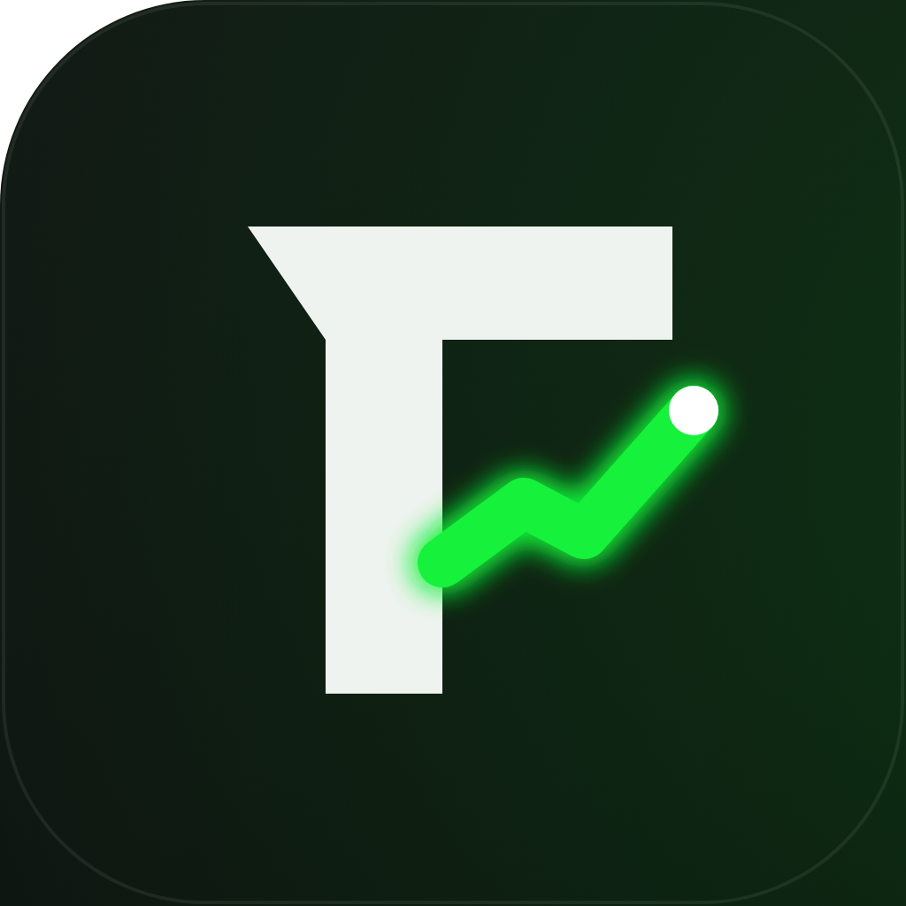

Finandex
Global Financial Market Indexing Insights
27 data-grounded chatbots for markets, economics, and law — including financial law and help for scam victims
by Dea Saka Kurnia Putra
October 2026 · finandex-beta.vercel.app

Slide 2
PROBLEM
Data is everywhere, trust is not
Scattered
Not traceable
Scam victims
Prices, macro, startup, and social data live in many sources with different formats, quality, and dates.
General chatbots answer fluently but rarely show where a number came from, its date, or how it was computed.
Financial fraud keeps rising; victims need immediate steps, official channels, and a clear legal basis.
© 2026 Dea Saka Kurnia Putra · Finandex
2

Slide 3
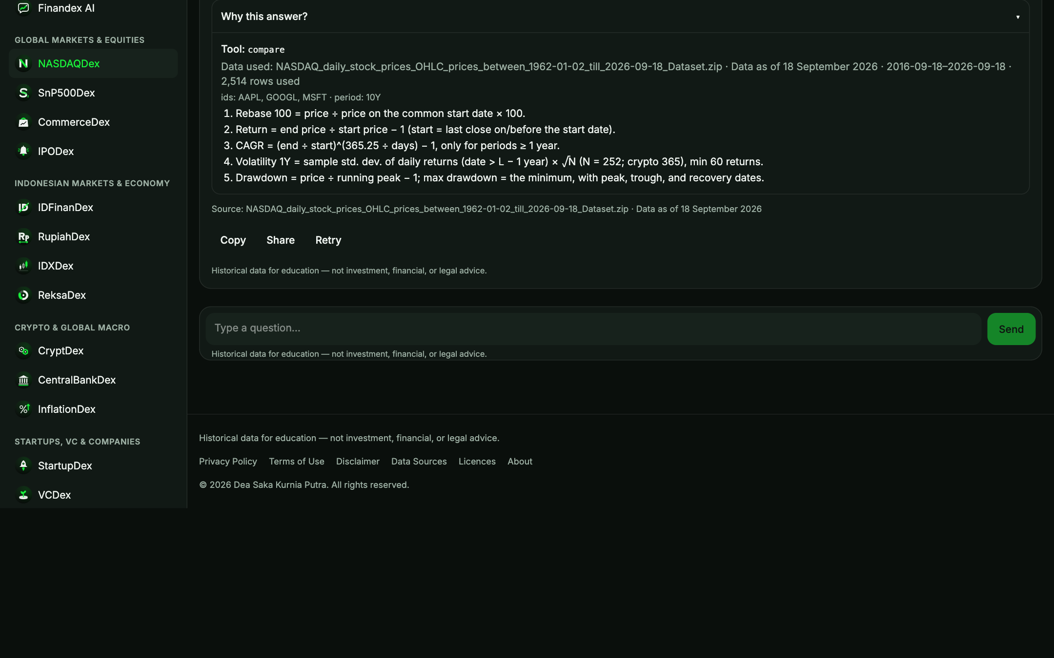
SOLUTION
Every answer traces back to its data
■ Numbers only from SHA-256-verified datasets
■ Chart, source, as-of date, and formula in every answer
■ One computation path: chat = feature tabs (same tools)
■ Legal quotes from official regulation texts
■ No accounts, no tracking, offline, two languages
© 2026 Dea Saka Kurnia Putra · Finandex
3

Slide 4
AT A GLANCE
The platform in numbers
27
42
19
362
Dex
verified datasets
official financial-law texts
read-only analytics tools
793
128/128
59/59
180
automated tests passing
chatbot evaluation (mock)
Python ↔ TypeScript parity
interactive feature panels
© 2026 Dea Saka Kurnia Putra · Finandex
4

Slide 5
PRODUCT
27 Dex in 8 categories
Global Markets & Equities
Indonesian Markets & Economy
Crypto & Global Macro
Startups, VC & Companies
Finandex AI
NASDAQDex
SnP500Dex
CommerceDex
IPODex
IDFinanDex
RupiahDex
IDXDex
ReksaDex
CryptDex
CentralBankDex
InflationDex
StartupDex
VCDex
VCNetworkDex
OpenCompanyDex
Cost of Living, Work & Household
Social & Development
Sentiment & Personal Finance
Law
SalaryDex
CostLivingDex
IDHousingDex
IDFoodDeliveryDex
PovertyDex
PopulationDex
HomelessnessDex
HousingDex
FintechDex
PersonalFinanDex
My LAIwyer
© 2026 Dea Saka Kurnia Putra · Finandex
5

Slide 6
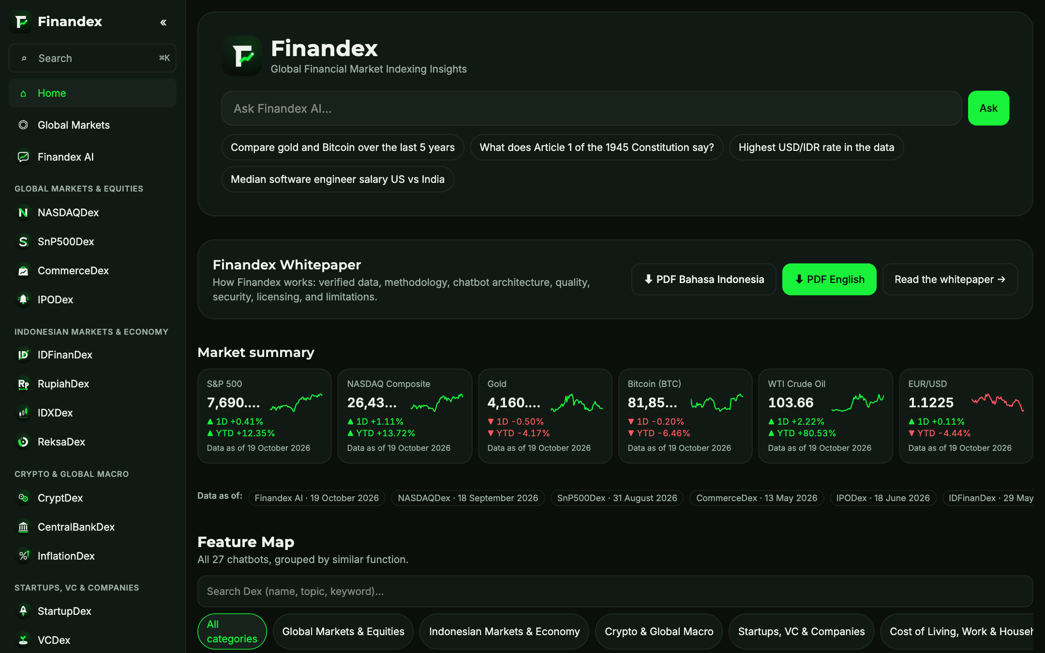
USER EXPERIENCE
Home: a map of every feature
■ "Ask Finandex AI" box + cross-category suggestions
■ 6-asset summary with sparklines
■ Whitepaper: download PDF ID / EN
■ Feature map: search, categories, Indonesia filter
■ "As of" strip for every Dex
© 2026 Dea Saka Kurnia Putra · Finandex
6

Slide 7
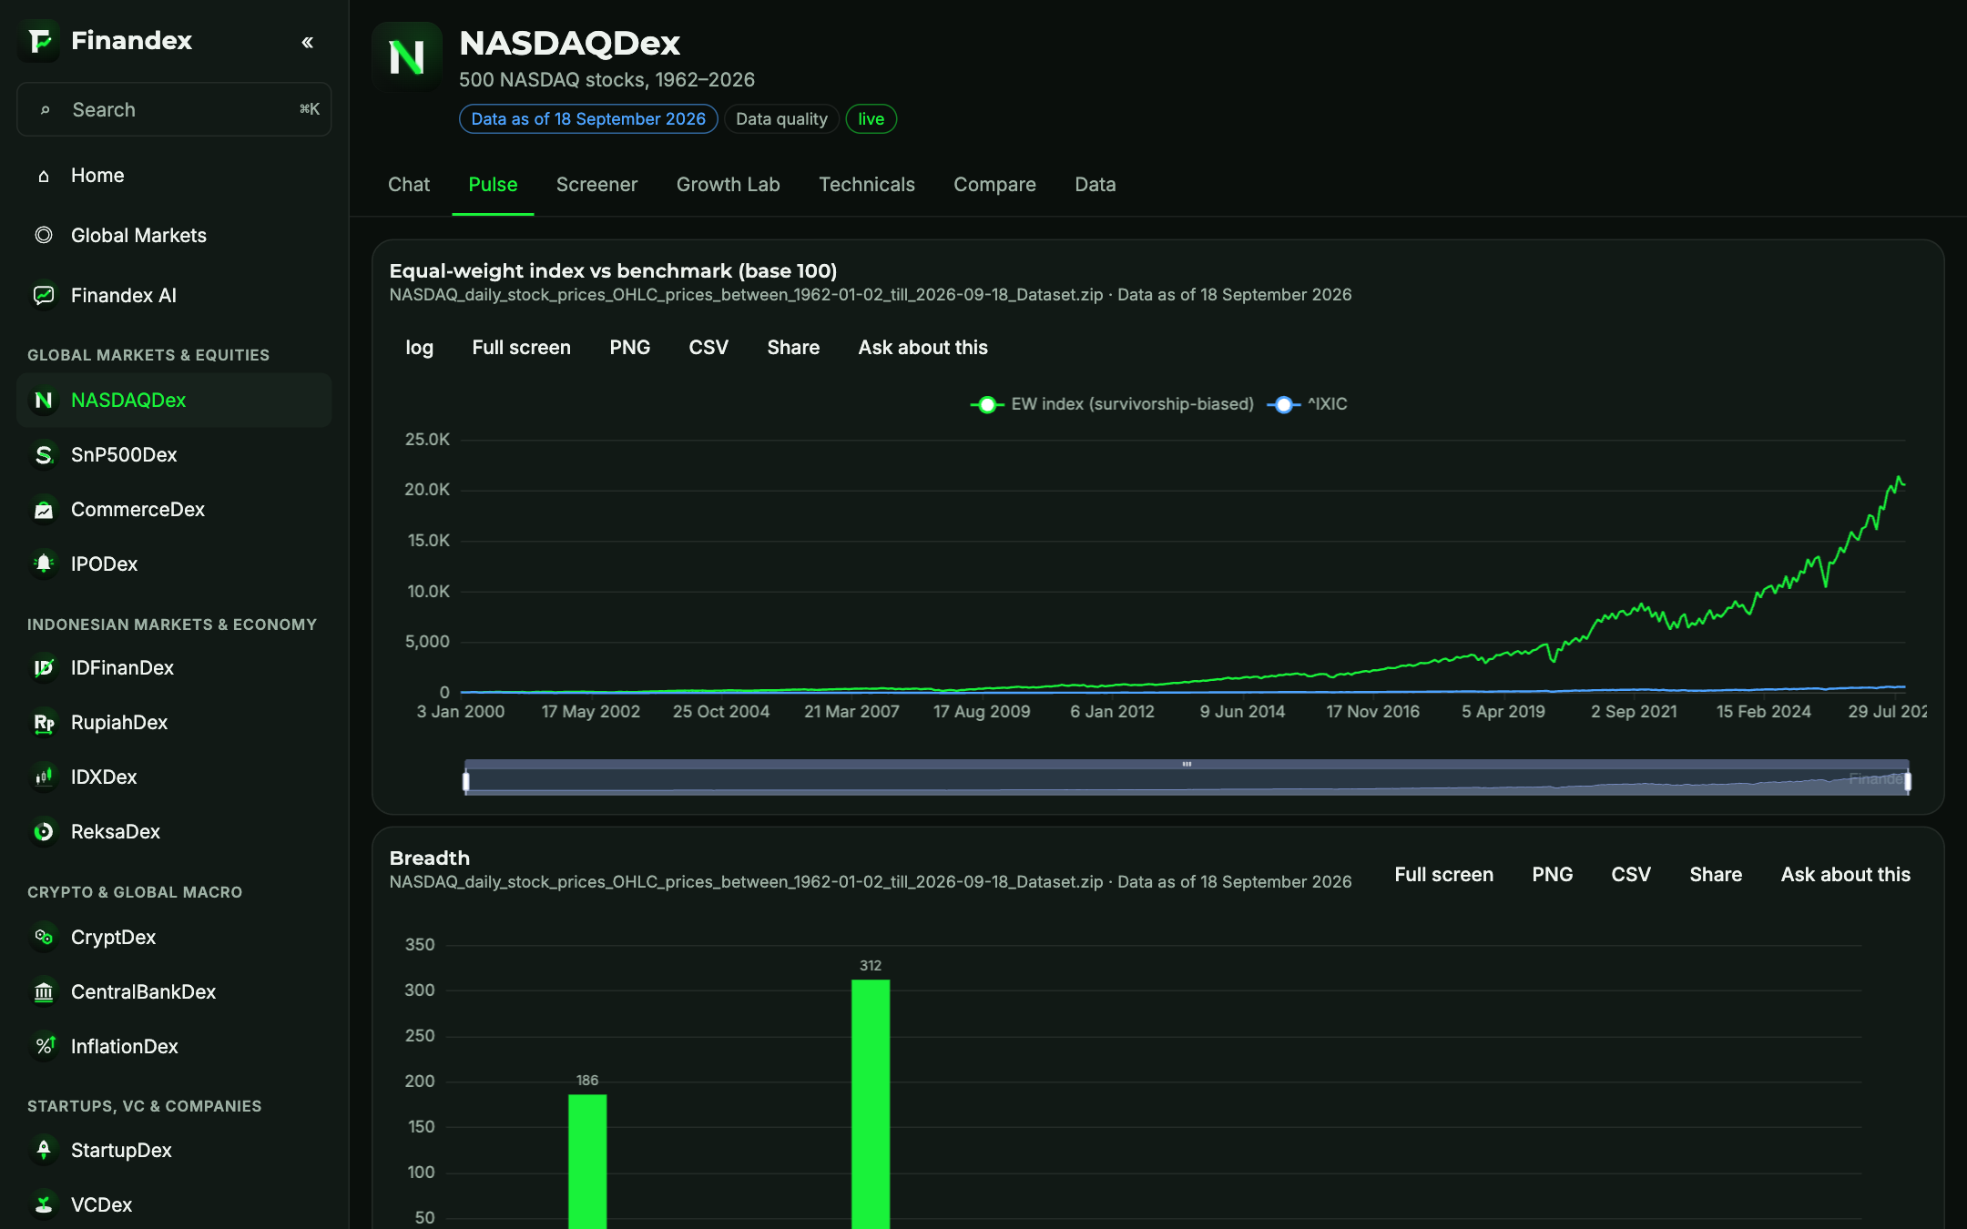
DEX PAGE & CHAT
Feature tabs and self-explaining answer cards
Feature tabs run the same tools as the chatbot, right in the browser.
"Why this answer?" panel: data, period, rows, formulas.
© 2026 Dea Saka Kurnia Putra · Finandex
7

Slide 8
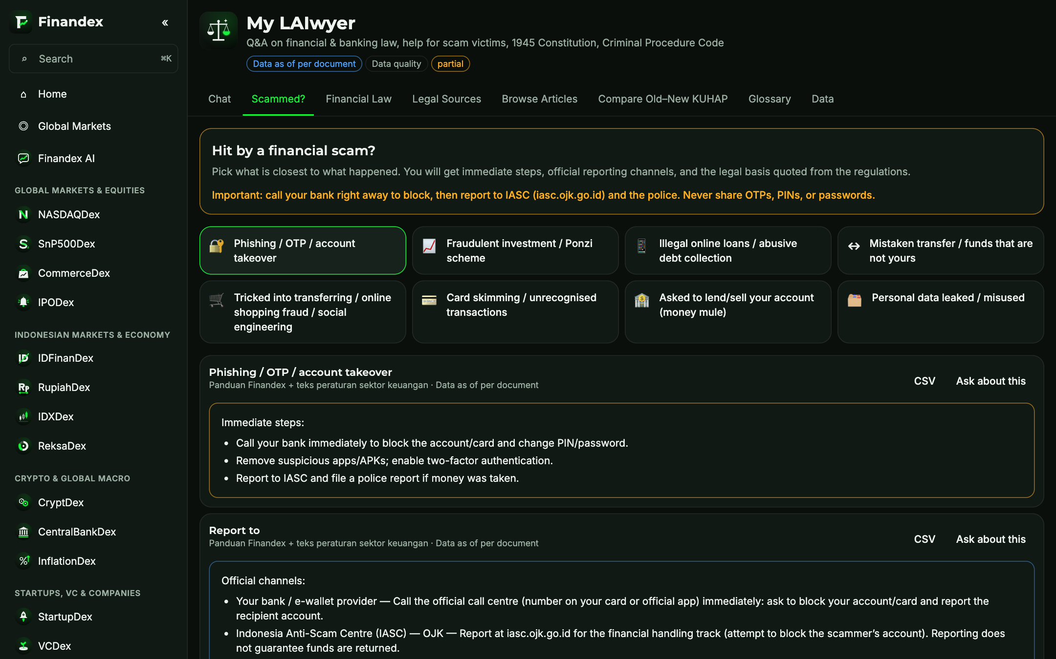
MY LAIWYER
Help for financial-scam victims
■ 8 scenarios: OTP/phishing, fraudulent investment, illegal loans, mistaken transfer, tricked transfer, skimming, money mule, data leak
■ Immediate steps + official channels
■ Legal basis quoted from the regulations
Your bank → block
IASC · iasc.ojk.go.id
OJK Contact 157 · PASTI Task Force
Police · BI Bicara 131 · Emergency 112
© 2026 Dea Saka Kurnia Putra · Finandex
8

Slide 9
MY LAIWYER
Financial-sector law corpus: 19 official texts
Document | Pp.
Law 4/2023 (Financial Sector Development) | 819
Law 4/2026 (P2SK amendment) | 207
Law 21/2011 (OJK) | 36
Law 7/1992 (Banking) | 68
Law 10/1998 (Banking amendment) | 63
Law 23/1999 (Bank Indonesia) | 55
Law 24/2004 (Deposit Insurance) | 30
Law 8/1999 (Consumer Protection) | 54
Law 3/2011 (Fund Transfer) | 45
Law 8/2010 (Anti-Money Laundering) | 41
Document | Pp.
Law 11/2008 (EIT) | 38
Law 19/2016 (EIT amendment) | 22
Law 1/2024 (2nd EIT amendment) | 39
Law 27/2022 (Personal Data Protection) | 50
Law 1/2023 (new Criminal Code) | 345
OJK Reg. 22/2023 (Consumer Protection) | 131
OJK Reg. 12/2024 (Anti-Fraud) | 67
OJK Reg. 40/2024 (P2P Lending) | 217
BI Reg. 3/2023 (Consumer Protection) | 40
Sources: peraturan.go.id · ojk.go.id · JDIH BPK — pinned SHA-256; statutory texts are not copyrighted (Law 28/2014 Art. 42).
© 2026 Dea Saka Kurnia Putra · Finandex
9

Slide 10
DATA
A verified data pipeline
Verify
Extract
Clean
Validate
Serve
42 datasets + 19 legal PDFs: size, SHA-256, archive contents.
Streaming ZIP/CSV/Parquet/PDF; third-party content = data.
Spikes, FX bad prints, carry-forward, dedupe, privacy.
Zod schemas, ≤ 10 digits, no NaN; golden 62/62.
core (offline) + heavy; SHA-256 manifest.
Analytics are ported 1:1 from the Python reference and tested against golden values (relative tolerance 1e-6). The same formulas appear in the explanation panel.
© 2026 Dea Saka Kurnia Putra · Finandex
10

Slide 11
ARCHITECTURE
One codebase, one number path
ETL
Static data
Tools
Server
Client
TypeScript, tsx: data/inputs → public/data
CDN + CORS; service-worker cache
362 read-only tools, strict zod schemas
/api/chat: validation, rate limit, orchestrator, SSE
React PWA + Capacitor; feature tabs run tools in the browser
Mode | How it works
AI (Claude) | The model picks tools with strict schemas and writes analysis only from tool results (≤ 8 turns, ≤ 12 tools).
Data (no model) | Deterministic router: entities, periods, rankings, options, countries, scam scenarios, legal topics; answers assembled from tool results.
© 2026 Dea Saka Kurnia Putra · Finandex
11

Slide 12
TECH STACK
Technology used
Layer | Technology
Language & runtime | TypeScript 6.0 (strict) · Node.js 24 LTS
Interface | React 19.3 · React Router 8.5 · Vite 8.3 · Tailwind CSS 4.3 · Radix UI
Charts & documents | Apache ECharts 6.1 · pdf.js 6.4 (WASM CCITT/JBIG2)
Client data | TanStack Query 5 · Zustand 5 · IndexedDB (idb-keyval) · TanStack Virtual
Schemas & search | Zod 4.6 · MiniSearch 7.2 (BM25)
ETL | tsx · PapaParse · hyparquet · fflate · pdf.js
Server & AI | Vercel/Netlify Functions (Web Fetch API) · esbuild · Anthropic Claude SDK 1.0
PWA & native | vite-plugin-pwa 2.0 · Workbox 7.4 · Capacitor 8.5 (Android, iOS)
Quality | Vitest 5 · Playwright 1.64 · axe-core · ESLint 9 · size-limit · Lighthouse CI
Infrastructure | GitHub (repo, Actions, Releases) · Vercel · Netlify
© 2026 Dea Saka Kurnia Putra · Finandex
12

Slide 13
QUALITY
"Zero-defect" quality gates
0
793
62/62
128/128
lint & typecheck errors
tests passing · 96% coverage
golden tests
chatbot eval · safety 100%
324
0
≥ 90
0
suggested questions answered from data
serious axe violations
Lighthouse gate (CI)
npm audit vulnerabilities
© 2026 Dea Saka Kurnia Putra · Finandex
13

Slide 14
SECURITY & PRIVACY
Secure by design
■ No accounts, no third-party analytics
■ History & preferences stay on the device
■ Blocks seed phrases, private keys, cards, IDs
■ The server does not store message contents
■ Strict CSP, HSTS, CORS allowlist, rate limits
■ Prompt-injection defence: data ≠ instructions
■ gitleaks, npm audit, licence checker
■ Privacy policy refers to PDP Law 27/2022
© 2026 Dea Saka Kurnia Putra · Finandex
14

Slide 15
DEPLOYMENT
From repository to web and apps
Component | Status
GitHub | github.com/DSKPutra/finandex_beta · releases data-inputs-v1, law-docs-v1
Vercel | finandex-beta.vercel.app — production (web + API)
Netlify | Configuration ready; site finandex-beta awaiting account credits
GitHub Actions | ci · parity · promote · android · ios · deploy-fallback · eval-live
Android / iOS | Capacitor 8 — APK/AAB & IPA built in CI
© 2026 Dea Saka Kurnia Putra · Finandex
15

Slide 16
ROADMAP
Next steps
AI mode
Law
Licensing
App stores
Data
Enable Claude in production; live eval ≥ 95%.
Amended Constitution, Civil Code, HIR/RBg, implementing rules.
Confirm dataset licences for distribution.
Release Android & iOS.
Periodic updates with golden tests.
© 2026 Dea Saka Kurnia Putra · Finandex
16

Slide 17
Thank you
finandex-beta.vercel.app
finandex-beta.vercel.app/whitepaper — PDF ID / EN
github.com/DSKPutra/finandex_beta
Finandex is designed and developed by Dea Saka Kurnia Putra — A BRIGHTER TOMORROW THROUGH MEANINGFUL WORK.
Historical data for information and education — not investment, financial, or legal advice. Data is not real-time.
© 2026 Dea Saka Kurnia Putra. All rights reserved.

