Slide 1

29.10.2013
Simplifying complex Embedded
Development processes with mbeddr
Stefan Schmierer
Markus Völter, Bernd Kolb

Slide 2
Notes:
Using mbbedr in the automotive domain ➔ AUTOSAR as a main requirement

Slide 3
Context.
What is mbeddr?
An extensible set of integrated languages
for embedded software engineering.
Notes:
Using mbbedr in the automotive domain ➔ AUTOSAR as a main requirement

Slide 4
Context.
What is mbeddr?
An extensible set of integrated languages
for embedded software engineering.
Notes:
Using mbbedr in the automotive domain ➔ AUTOSAR as a main requirement

Slide 5
Context.
What is mbeddr?
An extensible set of integrated languages
for embedded software engineering.
Notes:
Using mbbedr in the automotive domain ➔ AUTOSAR as a main requirement

Slide 6
Context.
What is mbeddr?
An extensible set of integrated languages
for embedded software engineering.
Notes:
Using mbbedr in the automotive domain ➔ AUTOSAR as a main requirement

Slide 7
Context.
What is mbeddr?
An extensible set of integrated languages
for embedded software engineering.
Notes:
Using mbbedr in the automotive domain ➔ AUTOSAR as a main requirement

Slide 8
Context.
What is mbeddr?
An extensible set of integrated languages
for embedded software engineering.
Notes:
Using mbbedr in the automotive domain ➔ AUTOSAR as a main requirement

Slide 9
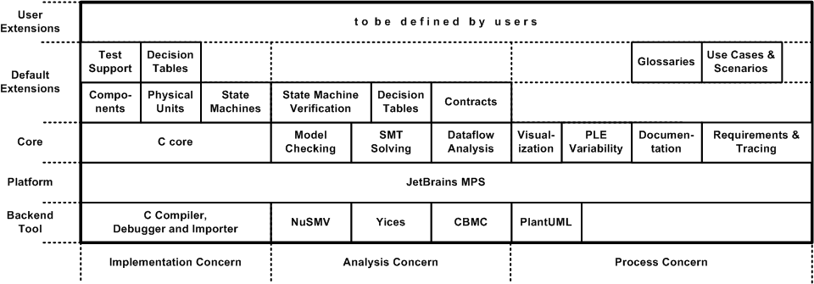
Context.
What is mbeddr?
An extensible set of integrated languages
for embedded software engineering.
Notes:
Using mbbedr in the automotive domain ➔ AUTOSAR as a main requirement

Slide 10
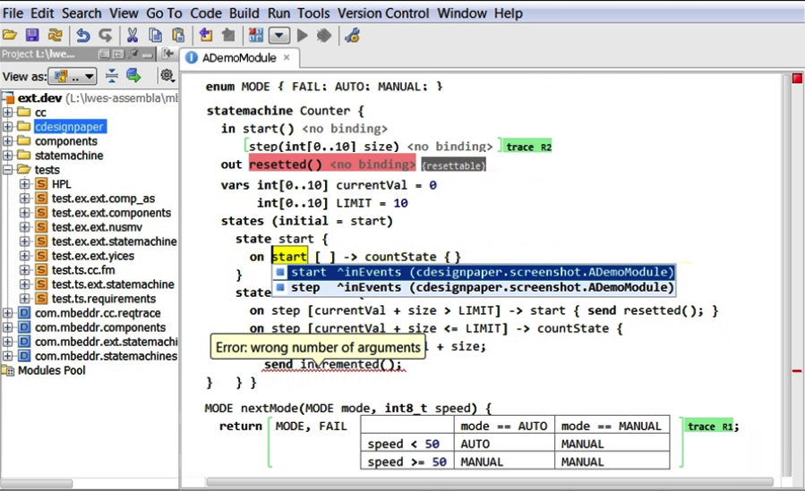
Context.
What is mbeddr?
And an IDE for everything.

Slide 11




Context.
What is mbeddr?
Open Source
Eclipse Public License
http://mbeddr.com

Slide 12
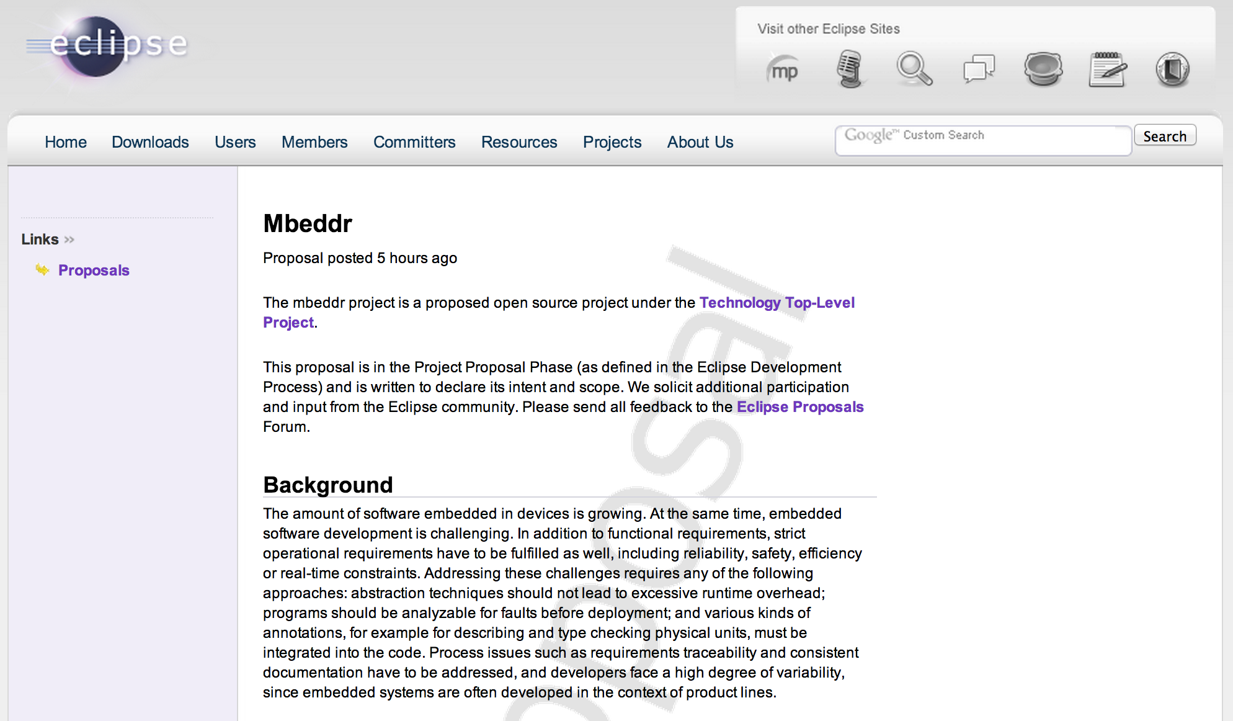
Context.
What is mbeddr?

Slide 13
Notes:
Using mbbedr in the automotive domain ➔ AUTOSAR as a main requirement

Slide 14
Context.
What is mPS?
Language Workbench.
Projectional Editing
Textual/Symbolic/Tabular/(soon Graphical)
Multiple projections for the same language
Modular language development, extension and embedding

Slide 15
Context.
What is mPS?
Support for language aspects such as type system, scopes, code completion, find usages, dataflow
Template-based approach for transformation and code generation with IDE support for target language in templates
Support for building extensible debuggers

Slide 16


Context.
What is mPS?
Open Source
Apache 2.0
http://jetbrains.com/mps

Slide 17
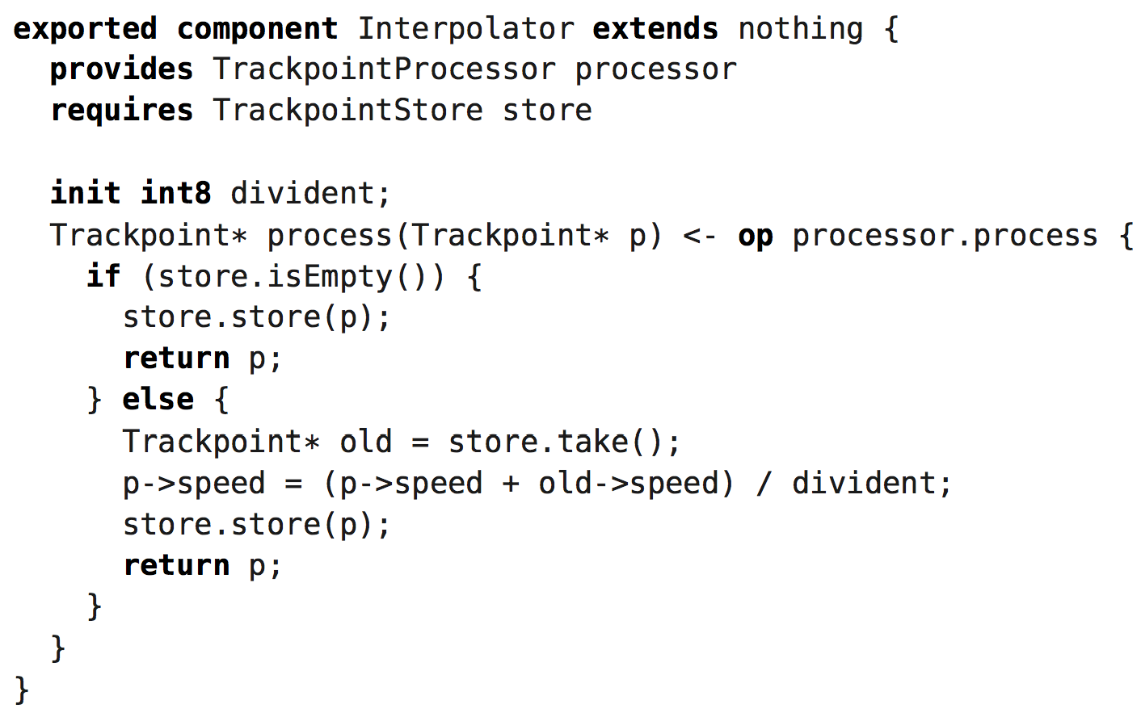
MPS.
Supported notations: text

Slide 18
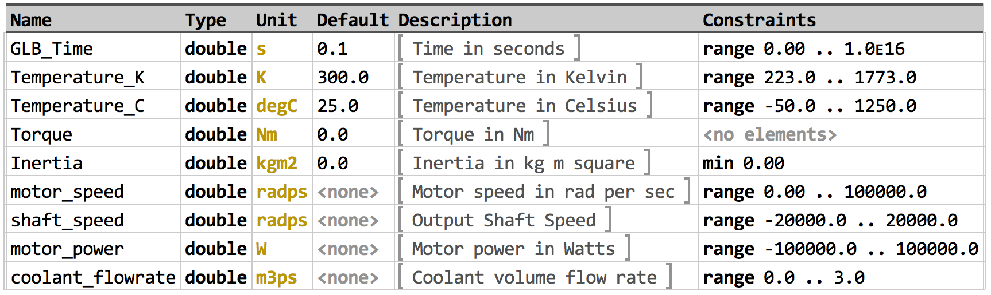
MPS.
SUPported notations: tables

Slide 19
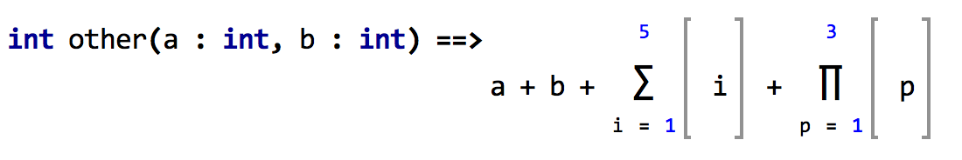
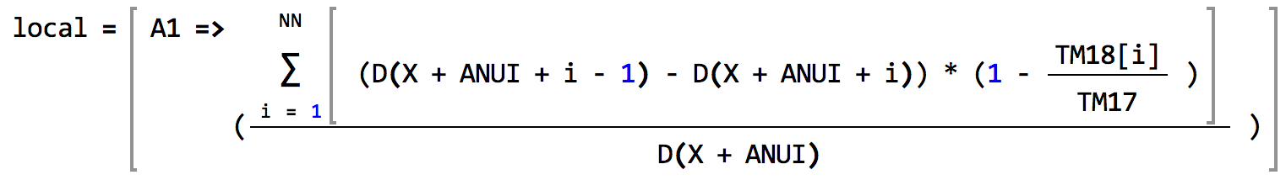
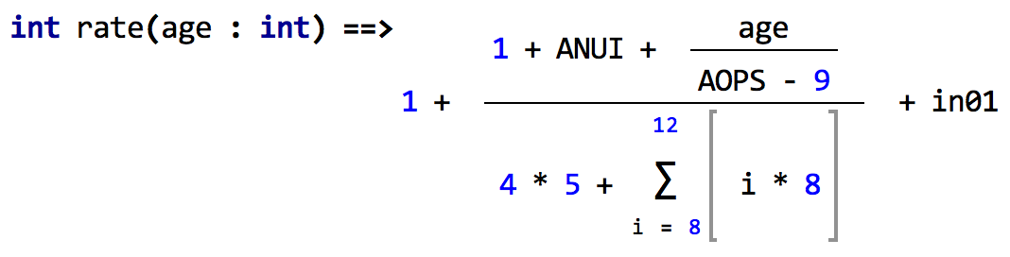
MPS.
SUPported notations: Math

Slide 20
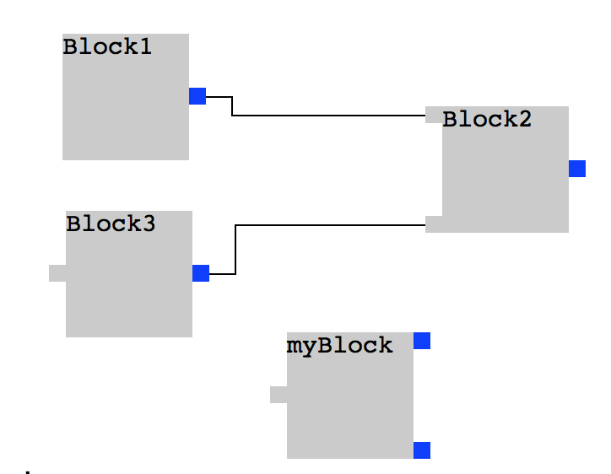
MPS.
SUPported notations: diagrams

Slide 21
MPS.
Let’s see how it works.
DEMO

Slide 22
Notes:
Using mbbedr in the automotive domain ➔ AUTOSAR as a main requirement

Slide 23

Motivation.
Automotive specific extensions.
Notes:
Using mbbedr in the automotive domain ➔ AUTOSAR as a main requirement

Slide 24
AUTOSAR.
A Brief introduction.
Software
Component 1
Software
Component 2
Software
Component 3
Virtual Function Bus (VFB)
ECU 1
ECU 2
Software
Component 1
Software
Component 2
Software
Component 3
RTE
RTE
Basic Software
Basic Software
Notes:
AUTOSAR VFB View and AUTOSAR System View

Slide 25
AUTOSAR.
A Brief introduction.
Software
Component 1
Software
Component 2
AUTOSAR
Software
Software
Component n
AUTOSAR
Interface
AUTOSAR
Interface
AUTOSAR
Interface
AUTOSAR Runtime Environment (RTE)
Basic Software
ECU Hardware
Notes:
AUTOSAR ECU View: RTE as VFB implementation

Slide 26



AUTOSAR in mbeddr?
The Challenge.
Components
Runnable Entities
Interfaces:
- Sender / Receiver
- Client / Server
- Mode Switch
Parameter
Data Types:
Modes
- Mode Groups
Event Trigger:
Timing
Server Call
Mode Switch
Notes:
Which language concepts were missing in the mbeddr core language and what was already covered?

Slide 27

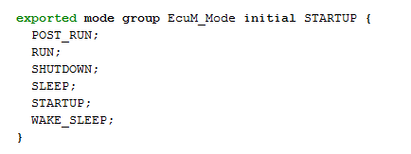

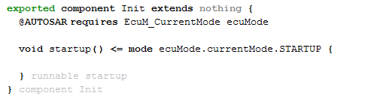
AUTOSAR in mbeddr.
The solution.
Introduction of AUTOSAR specific language extensions:
Parameter Interface
Mode Groups
Mode Switch Interfaces
Mode Triggers for Runnables
Notes:
- AUTOSAR specific language concepts added by extending the existing component language
1st step is done: component language is powerful enough to user necessary concepts from the software component template
Next step: closer look on the AUTOSAR methodology

Slide 28
Mbeddr.
Language Extension.
DEMO

Slide 29
AUTOSAR.
Methodology.
Functional Specification
Software Component description (XML)
Software Component description (XML)
Rte_Swc.h
Rte_Type.h
Rte.h
SWC.c
Rte_Swc.h
Rte_Type.h
Rte.h
Specify Software Component
Generate Component Header
Implement Software Component
Compile Software Component
Software Component description (XML)
Rte_Swc.h
Rte_Type.h
Rte.h
SWC.c
SWC.o
Notes:
Focus on software component implementation (not integration):
Each step requires a different tool
subsequent steps depend on artifacts from previous steps
artifacts are mainly „handmade“ and only partly generated
very long feedback loops

Slide 30
AUTOSAR.
Methodology.
Specify Software Component
Generate Component Header
Implement Software Component
Compile Software Component
Notes:
very long feedback loops

Slide 31
AUTOSAR methodology.
Simplification.
1. Simplify
Software Component Specification

Slide 32
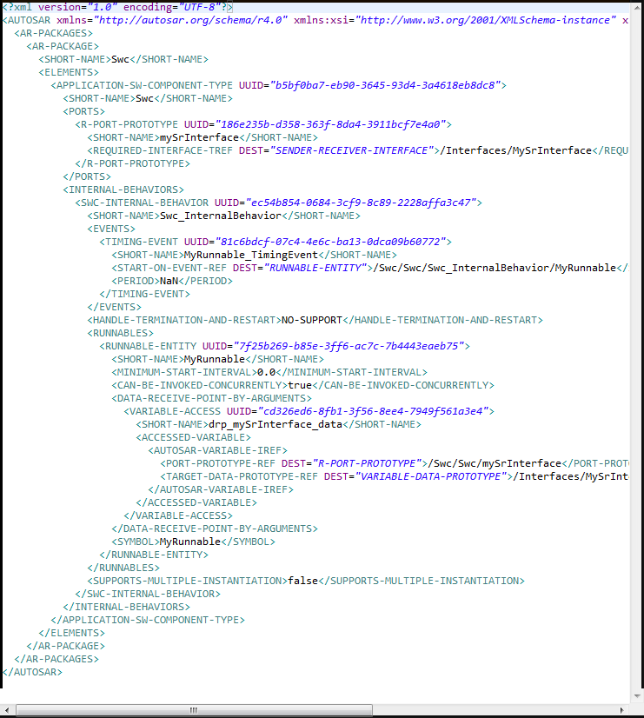
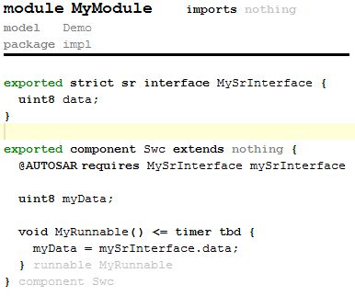
AUTOSAR methodology.
Software component Specification.
VS.
Notes:
Component specification in AUTOSAR XML vs. Using the component language in mbeddr:
Ugly XML
Special authoring tool is needed
BUT: AUTOSAR XML is needed as an exchange format
➔ Why shouldn‘t we use just the mbeddr component language?

Slide 33

AUTOSAR methodology.
SWC Description with mbeddr.
Model Transformation
(http://www.artop.org)
AUTOSAR XML Description
Notes:
Tool extension: Using Artop for AUTOSAR serialization

Slide 34
AUTOSAR methodology.
Simplification.
2. Simplify
Software Component Implementation

Slide 35
AUTOSAR methodology.
Simplification.
Do we really need to know which middleware is used?
Notes:
Focus on platform independent implementation
Generator should take care about underlying platform
➔ Solution: Extend the mbeddr generator

Slide 36
AUTOSAR IMPLEMENTATION.
State of the ART.
Swc
S/R Interface
uint8 State
MyRunnable
Swc.c
#include "Rte_Swc.h"
void MyRunnable()
{
uint8 state;
Rte_Read_RPort_State(&state);
}
Notes:
Simple example of a component accessing a data element of a s/r interface: plain C
AUTOSAR Specific function call
RTE specification must be well known by software developer

Slide 37
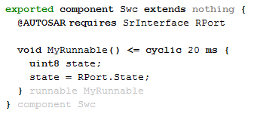
AUTOSAR IMPLEMENTATION.
The mbeddr way.
Swc
S/R Interface
uint8 State
MyRunnable
Notes:
Simple example of a component accessing a data element of a s/r interface: mbeddr C
The only platform specific information needed is the @AUTOSAR port annotation
No special AUTOSAR knowledge needed
BUT: We still need the RTE header files to compile the generated code

Slide 38
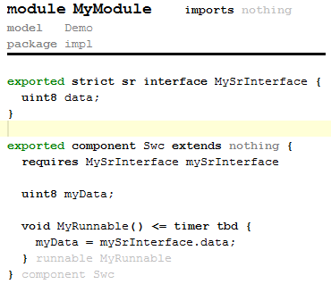
AUTOSAR methodology.
Software component Header Generation.
MBEDDR CORE
MyModule.h
generate
MyModule.c
MBEDDR CORE +
AUTOSAR
EXTENSIONS
MyModule.h
AUTOSAR
RELATED
Rte_Swc.h
Rte_Swc_Type.h
generate
MyModule.c
Rte_Type.h
Notes:
With an AUTOSAR specific extension of the mbeddr generator the necessary header files are generated from the mbeddr implementation

Slide 39
MPS.
Mbeddr + autosar
DEMO

Slide 40
AUTOSAR methodology.
Using mbeddr.
Functional Specification
Implement Software Component
Software Component description (XML)
Rte_Swc.h
Rte_Type.h
Rte.h
SWC.c
SWC.o
Notes:
The software developer can focus on implementation (taking into account the external = AUTOSAR interfaces)
all artifacts are generated in one step and with one tool
Maybe some comments, that the described scenario is very idealistic (one person doing all steps, mbeddr is the master, …)

Slide 41
Thank you!

